Slide 1



Plastic Life Simulation
Storyboard Presentation
A Design Thinking Approach to Plastic Waste Awareness
DESIGN
THINKING
© Design Thinking Class | Plastic Awareness Project

Slide 2




THE PROBLEM
380M+
Plastic waste has become a critical environmental issue. Most students and citizens are unaware of plastic categories or proper recycling methods. Incorrect disposal causes severe pollution.
Tons of plastic
produced yearly
Lack of Awareness
Improper Recycling
91%
Most people cannot identify plastic types by resin codes
Plastics end up in wrong bins, harming recycling rates
Plastic never
recycled
Environmental Pollution
Need for Education
Mismanaged plastic degrades ecosystems and oceans
Engaging educational tools are scarce and outdated

Slide 3

1
1
EMPATHIZE
TARGET USERS
PAIN POINTS
School Students
1
Difficult to identify plastic types by codes
Primary audience for plastic education
Young Learners
2
Confusing recycling symbols
Ages 10–18 seeking interactive content
3
Recycling education feels boring
Citizens
General public lacking recycling knowledge
4
Low environmental awareness overall
"Understanding the user is the foundation of every great design."

Slide 4



2
DEFINE
HOW MIGHT WE...
"Create an engaging and interactive way for students to learn plastic types and proper recycling methods?"
PROJECT GOAL
Easy
Fun
Interactive
Educational
Simple interface for all age groups
Gamified learning experience
Hands-on simulation approach
Builds lasting environmental habits

Slide 5



3
IDEATE
IDEAS CONSIDERED
WHY INTERACTIVE SIMULATION?
Traditional Posters
Fun learning experience
Awareness Sessions
Better engagement
Text-Heavy Content
Easy understanding
Interactive Simulation ✓
Gamified learning
LEARNING JOURNEY
Learn Plastic
Understand Uses
Check Recyclability
Play Challenge
Learn Better

Slide 6
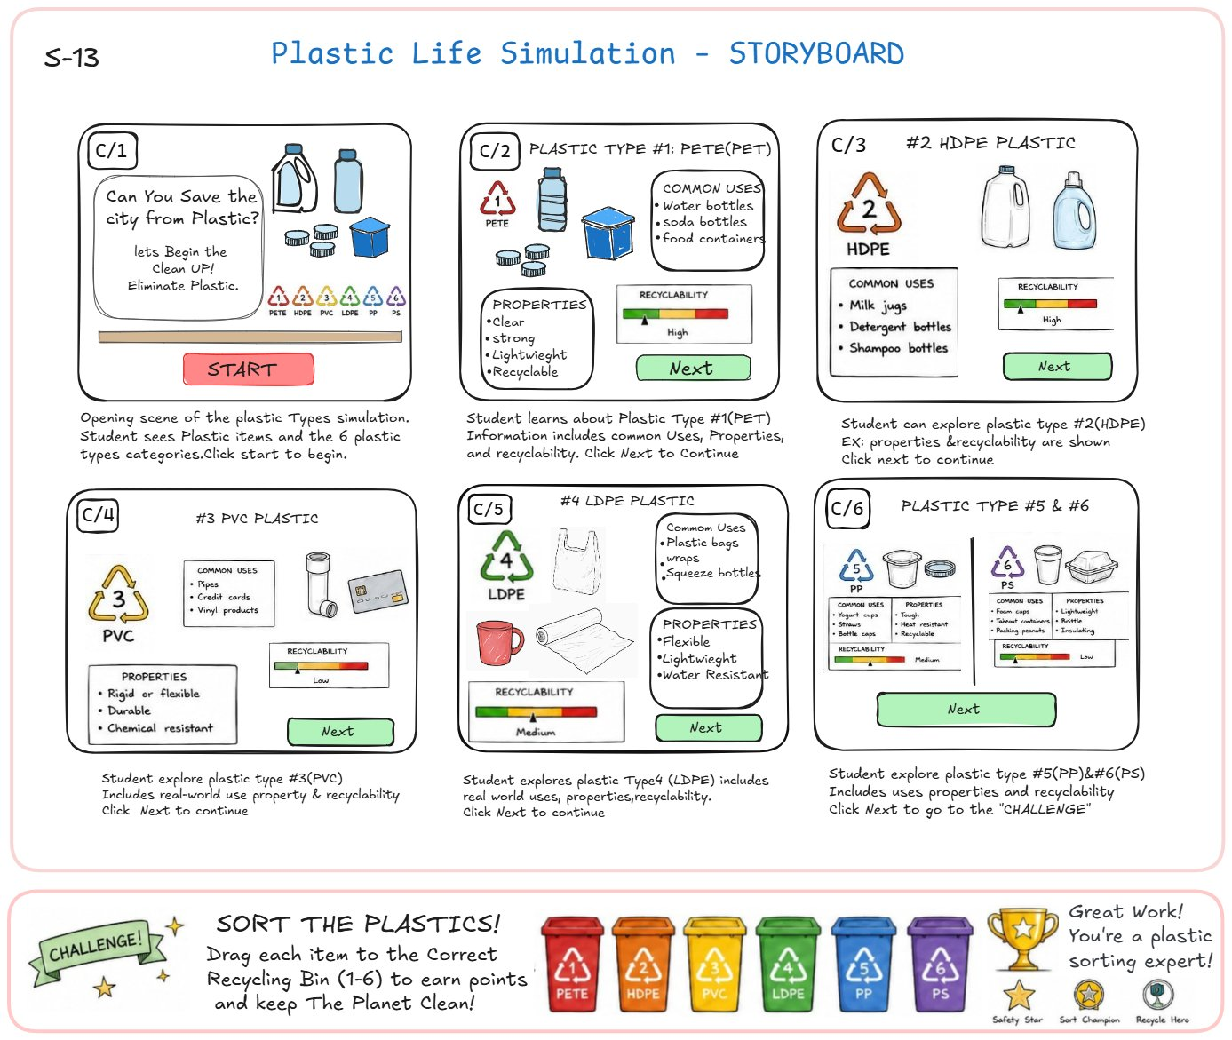
STORYBOARD OVERVIEW
The storyboard maps the user journey through the simulation — from introduction to the final plastic sorting challenge.

Slide 7

4
PROTOTYPE – Interface Screens
C/1
Introduction
C/2
PET (Type 1)
C/3
HDPE (Type 2)
Intro page shows all 6 plastic types (PET, HDPE, PVC, LDPE, PP, PS) and a START button to begin the simulation.
Displays uses (water bottles, soda bottles, food containers), properties (clear, strong, lightweight, recyclable) and HIGH recyclability.
Shows uses (milk jugs, detergent & shampoo bottles), properties, and HIGH recyclability rating with Next button.
C/4
PVC (Type 3)
C/5
LDPE (Type 4)
C/6
PP & PS (5 & 6)
Covers uses (pipes, credit cards, vinyl products) and properties (rigid/flexible, durable, chemical resistant). LOW recyclability.
Explores uses (plastic bags, wraps, squeeze bottles), properties (flexible, lightweight, water resistant). MEDIUM recyclability.
Combined screen: PP (yogurt cups, straws, bottle caps — tough, recyclable) and PS (foam cups, takeout containers — lightweight, insulating). LOW recyclability.
⭐ FINAL CHALLENGE: Drag and sort plastic items into correct recycling bins (1-6) to earn points and complete the simulation!

Slide 8
KEY FEATURES
Interactive Learning
Plastic Identification
Real-time simulation where users explore each plastic type through engaging screens
Visual guides with resin codes, properties, and real-world product examples
Recyclability Awareness
Challenge-Based Learning
Color-coded recyclability meter for quick and intuitive comparison
Drag-and-drop sorting game reinforces knowledge through active participation
User-Friendly Interface
Educational Gamification
Simple, clean UI designed for school students and young learners
Points, badges and achievements motivate learners to complete all modules

Slide 9



5
TEST
USER FEEDBACK
SUGGESTED IMPROVEMENTS
Easy to understand and navigate
Score System
Add points and leaderboard for motivation
Fun and highly engaging gameplay
Sound Effects
Audio feedback for correct/incorrect sorting
Visuals improve memory retention
More Categories
Include plastic types 7+ (other/mixed)
Better awareness about recycling
Mobile-Friendly
Responsive design for smartphones and tablets
OVERALL USER RATING
4.2 / 5 – Based on pilot test with 25 students

Slide 10
EXPECTED IMPACT
By making plastic education fun and accessible, this simulation creates lasting behavioral change and promotes environmental responsibility among the next generation.
Increased Awareness
Better Recycling Habits
Students accurately identify all 6 plastic types after completing the simulation
Correct disposal behavior improves up to 60% among tested users
Cleaner Environment
Fun Education
Reduced plastic contamination in recycling streams and landfills
Engaging, game-based learning that students actually want to repeat

Slide 11
CONCLUSION
DESIGN THINKING PROCESS
Empathize
Define
Ideate
Prototype
Test
Understood user pain points
Crafted the HMW statement
Chose interactive simulation
Built storyboard & screens
Gathered user feedback
By rigorously following the Design Thinking process, this Plastic Life Simulation project delivers a meaningful and engaging solution to a real-world environmental challenge. From empathizing with students struggling to identify plastic types, to building an interactive gamified simulation — every stage was driven by user needs.
Outcome: A fun, educational simulation that builds plastic awareness and promotes responsible recycling habits.

Slide 12

Thank You!
Any Questions?
Plastic Life Simulation | Design Thinking Class | Building a Greener Future

