Slide 1
Detecting Music Notes with the C6713 DSK
Final Project
Embedded Systems ECEG 721
Andrew Ippoliti

Slide 2
Requirements
Detect 4 different notes per second
Allowed notes: C4, D4, E4, F4, G4, A4, B4, C5
Output data on LEDs or to host computer

Slide 3
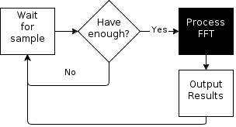
Failed Fourier Transform
Processes data in large chunks
Requires large amount of memory
Hard to schedule
Waste time waiting

Slide 4
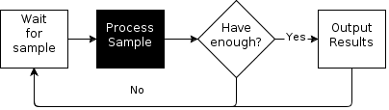
Geortzel Algorithm
Less memory requirements
Better frequency resolution
Easy to schedule
Process sample while waiting for next

Slide 5
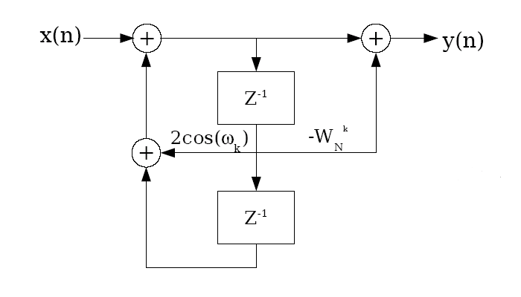
Geortzel Algorithm

Slide 6
Goertzel Code
/* Run Goertzel Algorithm */
for(i=0; i<BLOCK_SIZE; i++){
//read one channel
while(!DSK6713_AIC23_read(hCodec, &sampleRead)){}
sampleDbl = ((double)sampleRead)/16383.0;
for(f=0; f<NOTE_COUNT; f++){
S[f] = sampleDbl + RW[f]*Z1[f] - Z2[f];
Z2[f] = Z1[f];
Z1[f] = S[f];
}
//read other channel & ignore it
while(!DSK6713_AIC23_read(hCodec, &sampleRead)){}
}

Slide 7
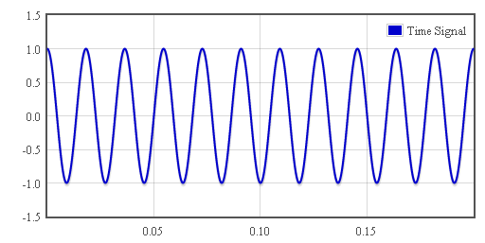
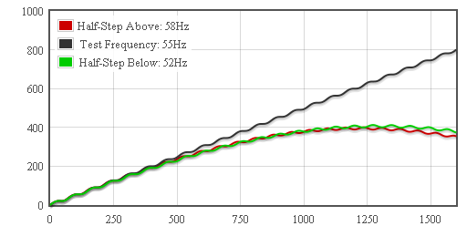
Geortzel Progression (A1)
Input: cos(2π55t)
Sampling Rate: 8000Hz

Slide 8
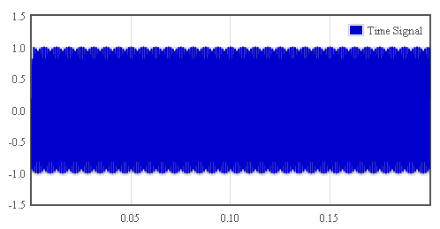
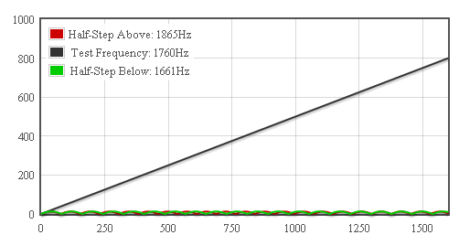
Geortzel Progression (A6)
Input: cos(2π1760t)
Sampling Rate: 8000Hz

Slide 9
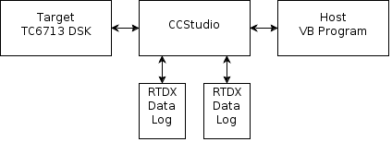
Real Time Data eXchange

Slide 10
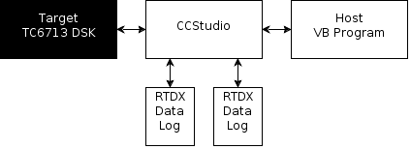
RTDX Target Code
#include <rtdx.h> /* For RTDX communication*/
#include "target.h" /* RTDX setup */
/* Declare an output channel called "ochan" */
RTDX_CreateOutputChannel(ochan);
/* RTDX Setup in Main() */
TARGET_INITIALIZE();
RTDX_enableOutput(&ochan);
/* Write to RTDX */
RTDX_write( &ochan, &data, sizeof(data) )

Slide 11
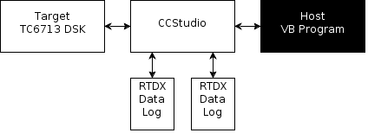
RTDX Host VB Code
Dim status As Long
Dim ReadValue As Long
Set rtdx = CreateObject("RTDX")
status = rtdx.SetProcessor(Board, Processor)
status = rtdx.Open("ochan", "R")
status = rtdx.ReadI4(ReadValue)
status = rtdx.Close()

Slide 12
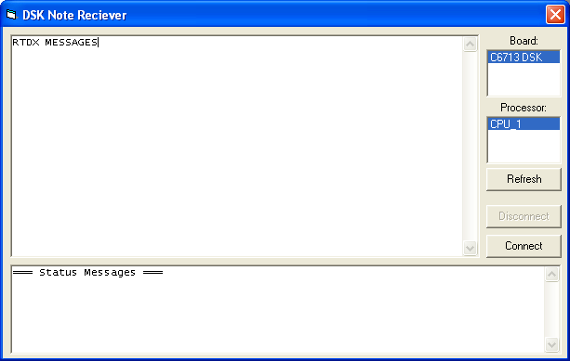
Note Receiver User Interface

Slide 13
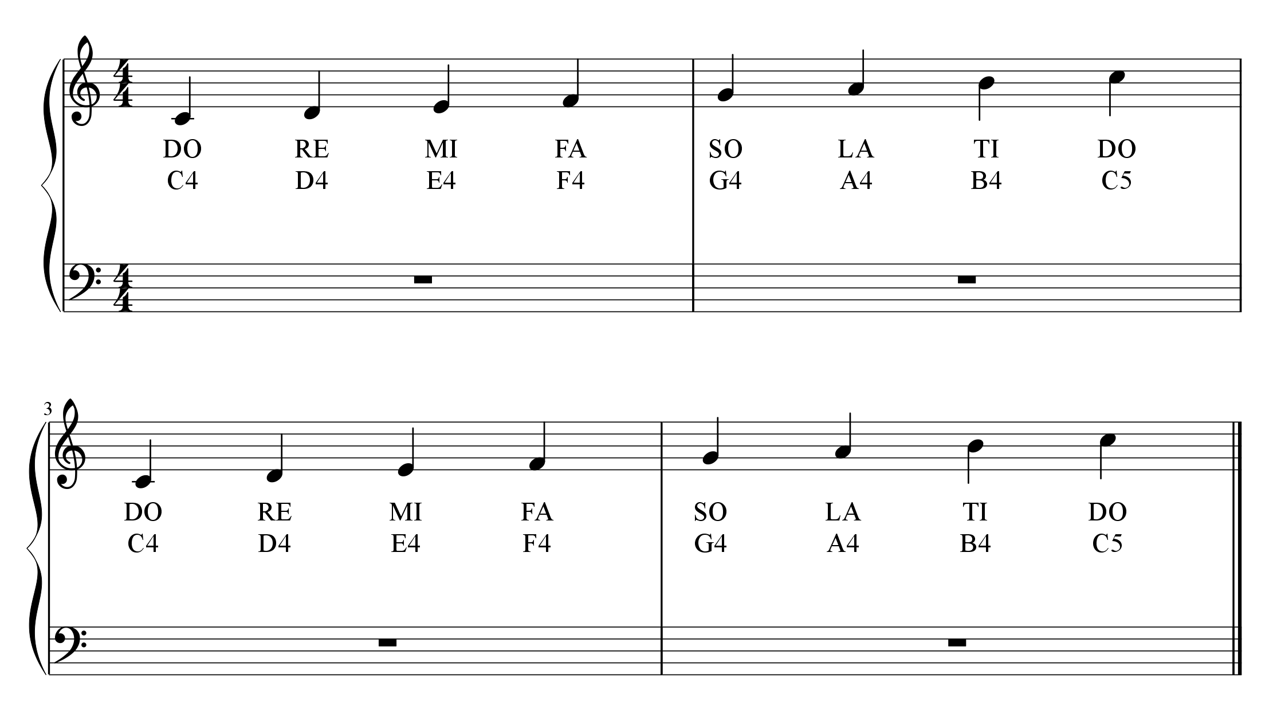
Notes Sent to DSK
Program Output:
DO,DO,DO,RE,RE,MI,MI,MI,FA,FA,SO,SO,SO,LA,LA,TI,TI,TI,DOH,DOH,
DO,DO,DO,RE,RE,MI,MI,MI,FA,FA,SO,SO,SO,LA,LA,TI,TI,TI,DOH,DOH,DOH,

Slide 14
Other Instruments
Piano – 63% Correct
Guitar – 0% Correct
Horn – 44% Correct
Viola – 0% Correct
Syn. Voice – 0% Correct

Slide 15
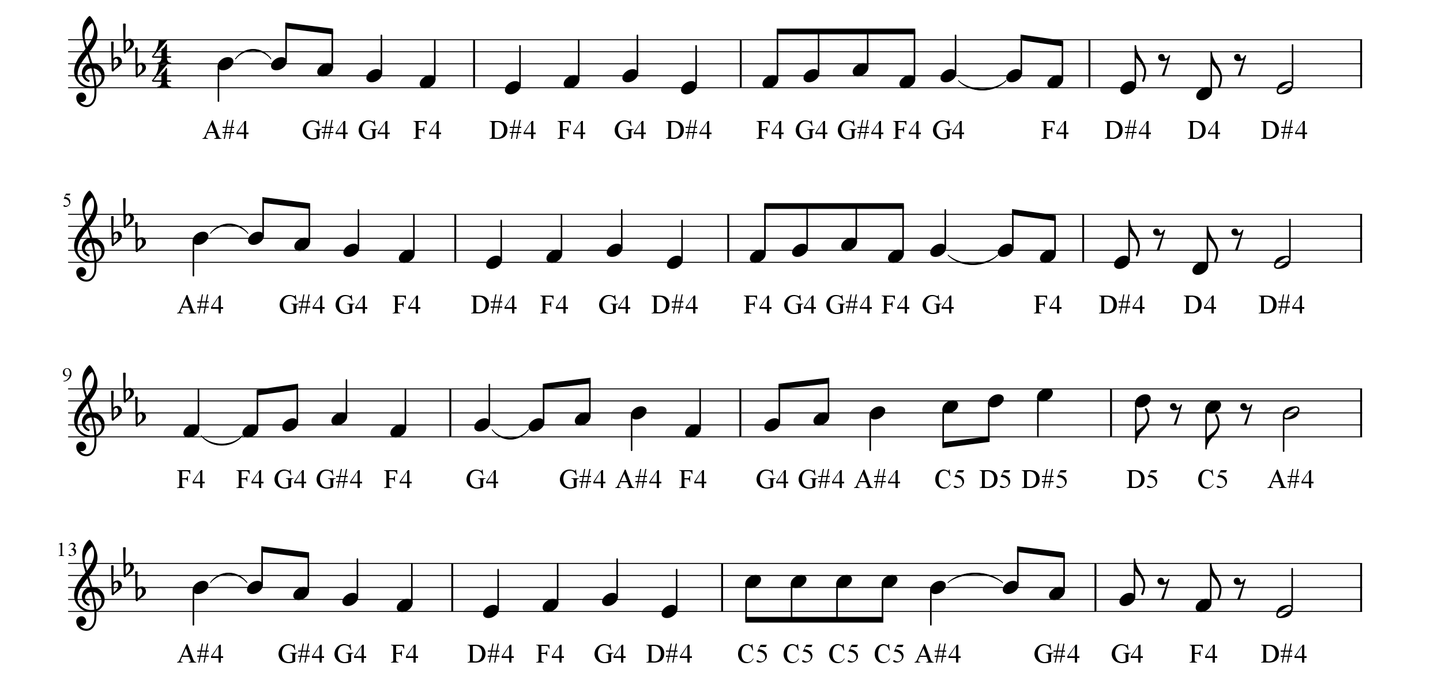


Deck the Halls – 73% Correct
Original:
Heard By DSK:

Slide 16
Improvements
Different algorithms for different instruments
Outputting all possible notes (ie chords) instead of just the dominant
Use interrupts

Slide 17
Questions?

