Slide 1
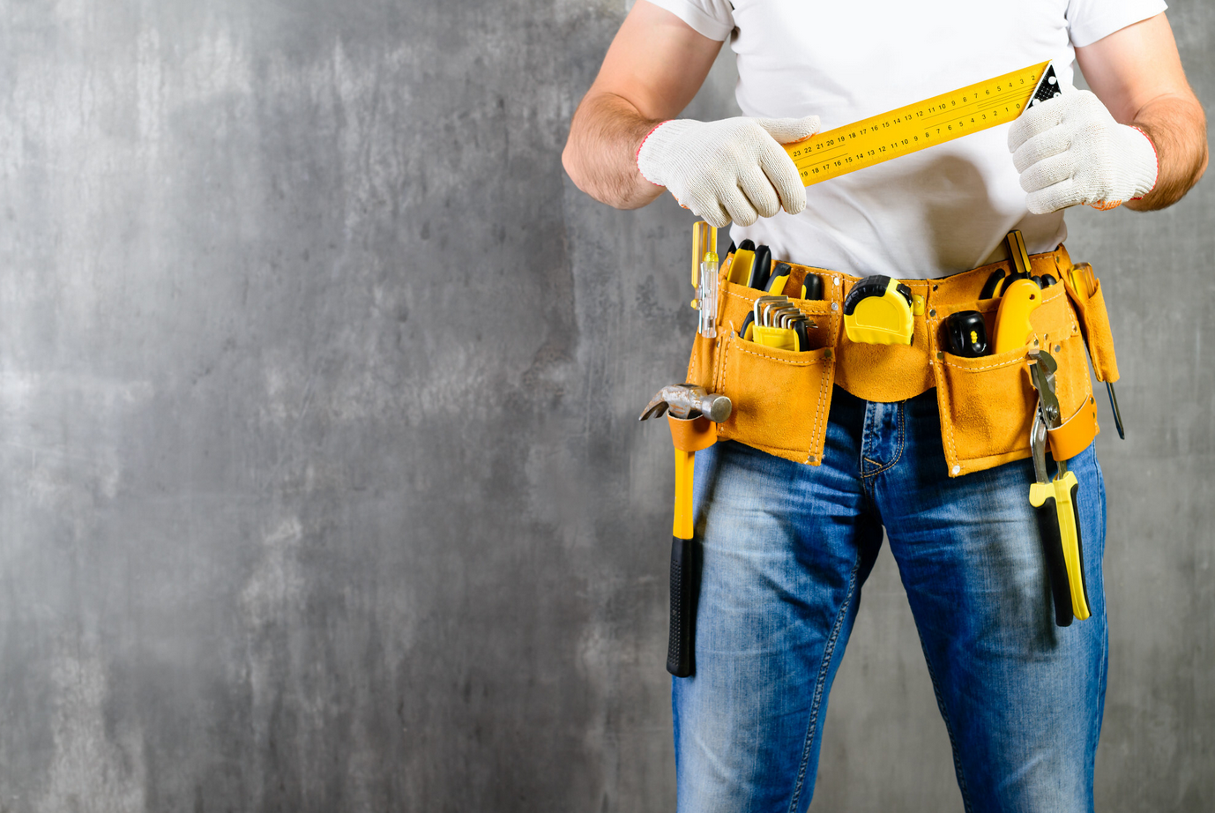
A GOOD
HANDYMAN IS
HANDY
TO HAVE AROUND

