Slide 1
Continuous Training and Deployment of Deep Learning Models
Ioannis Prapas, Behrouz Derakhshan, Alireza Rezaei Mahdiraji, Volker Markl
LWDA 2021

Slide 2
Motivation
Continuous input streams
Gather Data
Train Model
Deploy model
Slow
more data - more training time
Wasteful
previous model is discarded
DL training resource-hungry
Stale models
data continuously arrive
new models not fresh
DL Model Lifecycle
Periodical Deployment
Periodical Retraining
GOAL
Make everything continuous

Slide 3
Training - Observations
Two extremes for updating Machine Learning models
Full Retraining - Train until convergence on a batch dataset. Retrain from scratch when enough new data arrive
Slow
Wasteful
Stale models
Online Training - Train only on new data as soon as they arrive
Fast
Fresh models
BUT, typically lower model quality than full retraining
Proposal: Proactive Training [1] - a solution for Continuous Training between these two extremes
[1] Derakhshan, Behrouz, et al. "Continuous Deployment of Machine Learning Pipelines." EDBT. 2019.

Slide 4
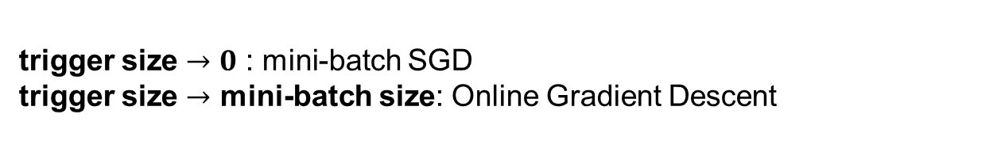
Proactive Training
Combines streaming data with samples of historical data to form batches for mini-batch Stochastic Gradient Descent (SGD)
Proactive Training Iteration
Fetch trigger size new training examples from the stream
Combine with a sample of historical data in a mini-batch
Calculate gradients (Like SGD)
Update model parameters (Like SGD)
Update historical data
Offers a balance between full retraining and online training
trigger size $→0$ : mini-batch SGD
trigger size $→$ mini-batch size: Online Gradient Descent

Slide 5
Deployment - Observations
Gather Data
Train Model
Deploy model
Continuous
Continuous Training implies
Continuous Deployment
Modern DL models can have billions of parameters – Communication bottleneck
Proposal: Sparse training – sparsify gradients [2,3] per iteration to reduce the deployment cost for Continuous Deployment
?
Continuous
[2] Lin, Yujun, et al. "Deep gradient compression: Reducing the communication bandwidth for distributed training. 2017
[3] Stich, Sebastian U., Jean-Baptiste Cordonnier, and Martin Jaggi. "Sparsified SGD with memory." Advances in Neural Information Processing Systems. 2018.
Notes:
Different requirements between training and inference
Throughput vs Latency
Dedicated HW vs Commodity HW
Forward-Backward pass vs Forward-only pass

Slide 6
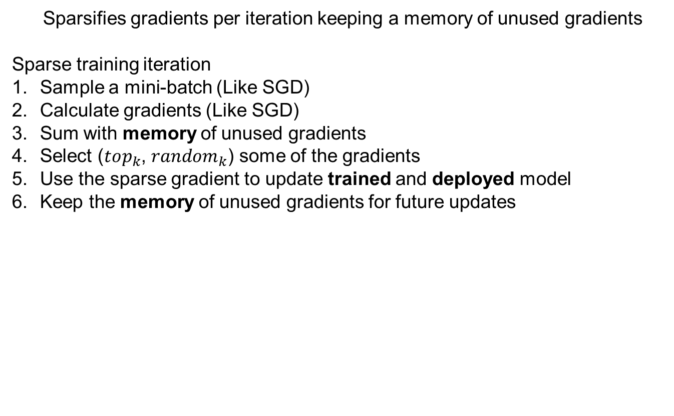
Sparse training
Sparsifies gradients per iteration keeping a memory of unused gradients
Sparse training iteration
Sample a mini-batch (Like SGD)
Calculate gradients (Like SGD)
Sum with memory of unused gradients
Select ($top_{k}$, $random_{k}$) some of the gradients
Use the sparse gradient to update trained and deployed model
Keep the memory of unused gradients for future updates
Reduces deployment cost by reducing the communication cost per iteration

Slide 7
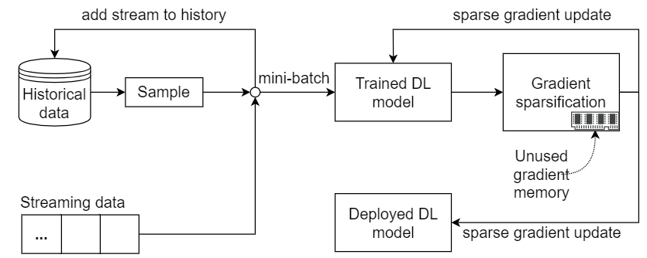
Solution overview

Slide 8
Experiments - Questions
How do full retraining, online training and proactive training compare?
model quality
training time
Does sparse training converge at the same rate as non-sparse?
How far can we sparsify gradients without sacrifices in model quality?
What is the overhead of sparse training?

Slide 9
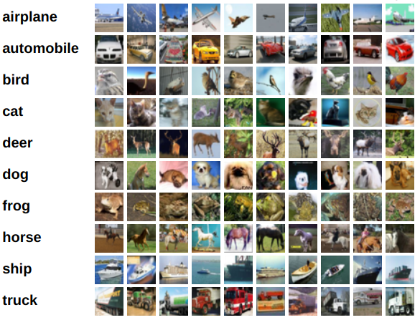
Experiments – CIFAR dataset
CIFAR10 32x32 RGB images in 10 classes
50,000 training examples
10,000 test examples
Common dataset for DL models in computer vision
Αrrival of data in a streaming fashion
Figure: CIFAR10 class examples Source: https://www.cs.toronto.edu/~kriz/cifar.html

Slide 10
Experiments - Setup
Hardware
Intel Xeon E7, 128 GB Memory
Nvidia Tesla GPU K40, 12GB GDDR5 Memory
Software
Pytorch 1.2.0 (GPU enabled)

Slide 11
Experiments - Setting
Hyperparameters: Batch Size 128, ADAM optimizer default params
Initial Training
first 10,000 training examples, 25 epochs
Prequential evaluation to compare full retraining, online training and (sparse) proactive training
Incoming Data
Evaluate model
Update model
Every new data point is first used to test and then to train a model
Notes:
Start with the dataset. No full sentences. Not so much text. Be consistent with bullet points, font size, dots

Slide 12
Experiments - Setting
Full retraining
every 10,000 new examples, train for 25 epochs from scratch and replace model
Online training
Warm-start from initial training
Online SGD iteration when a mini-batch of new elements arrives
(Sparse) Proactive training
Model is warm started from initial training.
Proactive SGD iteration when trigger size number of new elements arrive
𝑏𝑎𝑡𝑐ℎ 𝑠𝑖𝑧𝑒/𝑡𝑟𝑖𝑔𝑔𝑒𝑟 𝑠𝑖𝑧𝑒 more times than online training
Notes:
Start with the dataset. No full sentences. Not so much text. Be consistent with bullet points, font size, dots

Slide 13
Experiments - Models
DNN Architecture | Trainable Params | Depth
Mobilenet_v2 | 2,236,682 | 53
Resnet18 | 11,181,642 | 18
Resnet50 | 23,528,522 | 50
Densenet161 | 26,494,090 | 161
Notes:
Mention the extremes

Slide 14
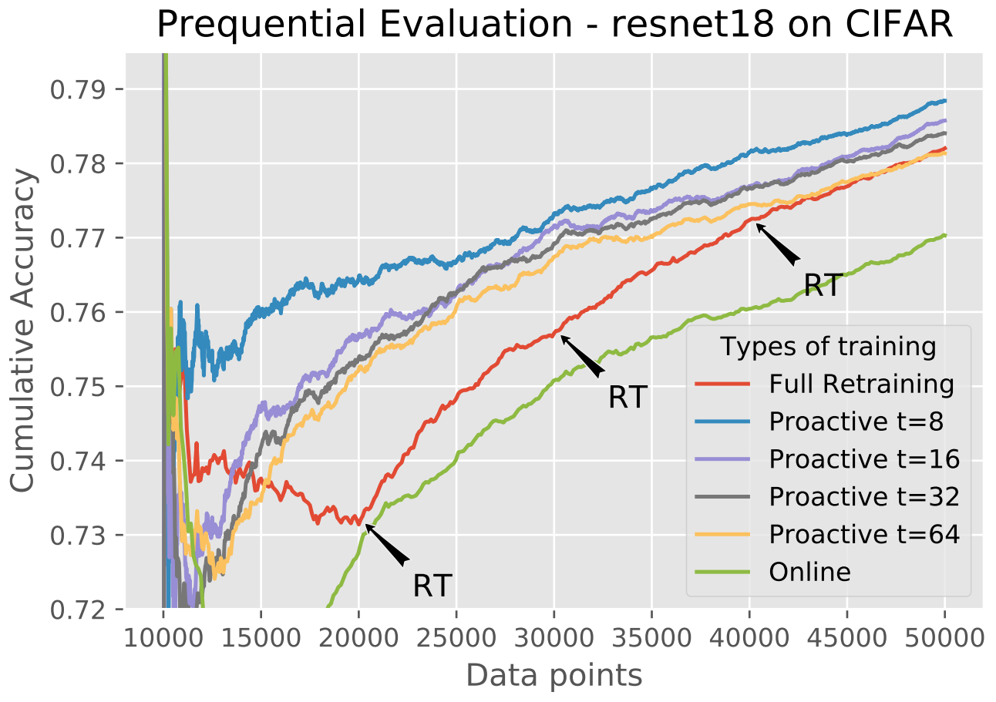
Full Retraining vs Online vs Proactive
Online training (green) achieves the worst performance
Notes:
One page. Questions of experiments. Mention color of lines

Slide 15
Full Retraining vs Online vs Proactive
Proactive with trigger size 64 (yellow) comparable with
full retraining (red)

Slide 16
Full Retraining vs Online vs Proactive
Proactive with smaller trigger size (grey, purple, blue) increasingly better performance

Slide 17
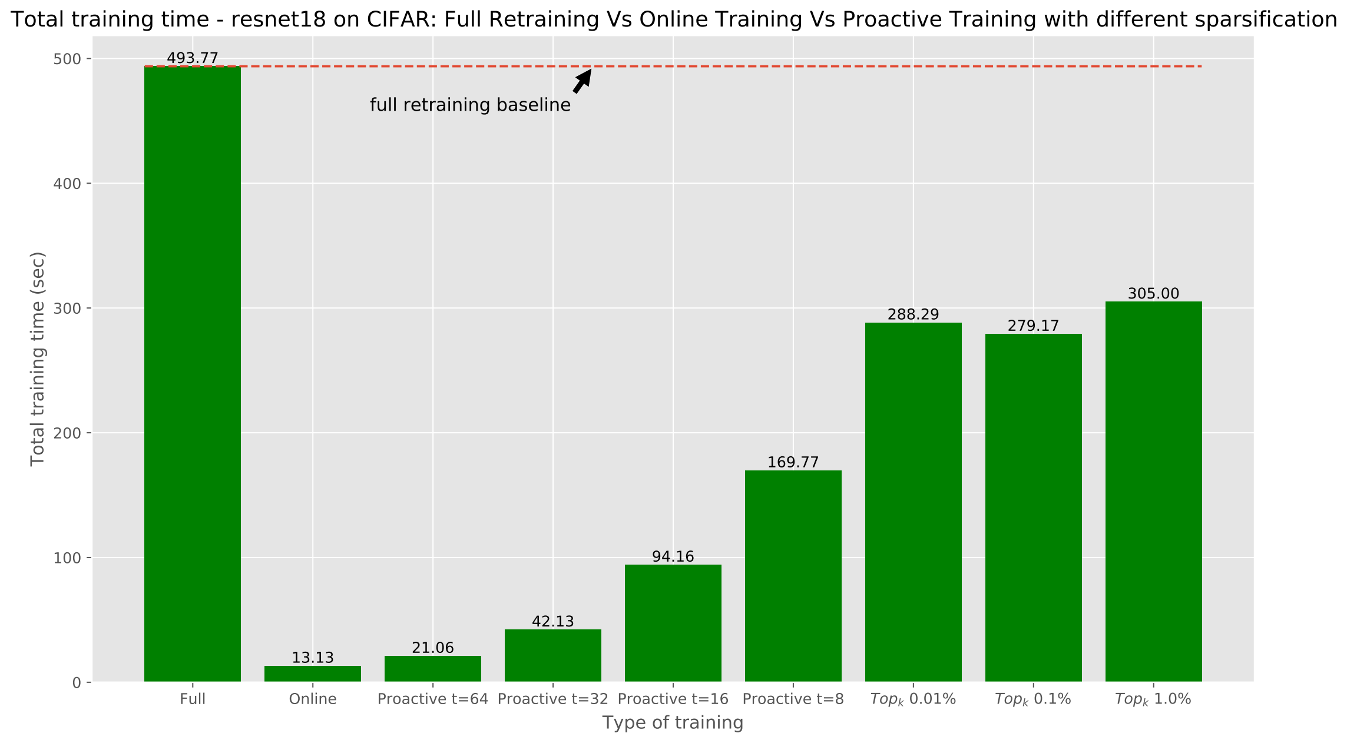
Total Training Time
Total Training Time (sec)
Proactive Trigger 8
Full Retraining
Proactive Trigger 16
Proactive Trigger 32
Proactive Trigger 64
Online
Proactive training needs a fraction of the time of full retraining

Slide 18
Total Training Time
Total Training Time (sec)
Proactive Trigger 8
Full Retraining
Proactive Trigger 16
Proactive Trigger 32
Proactive Trigger 64
Online
Proactive trains approximately $\frac{batch size}{trigger size}$ times more than online training

Slide 19
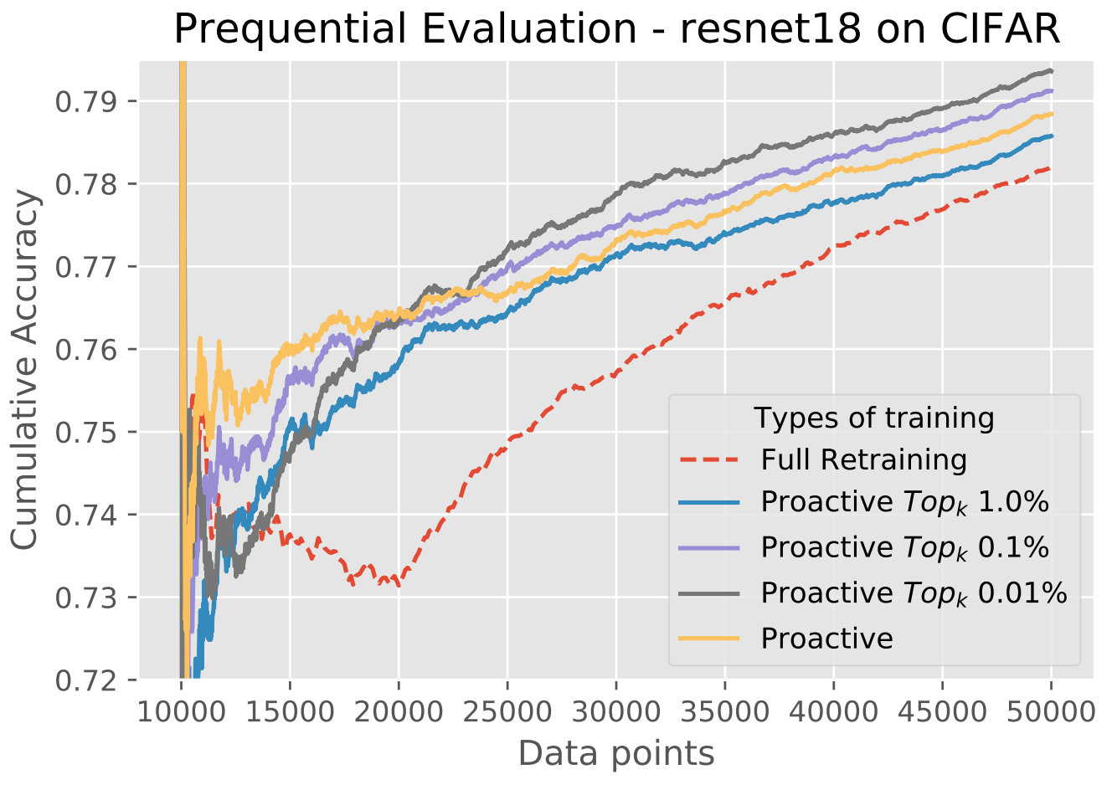
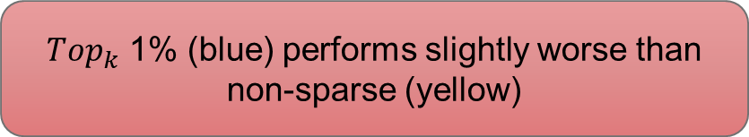
Sparse Proactive Training
$Top_{k}$ 1% (blue) performs slightly worse than non-sparse (yellow)

Slide 20
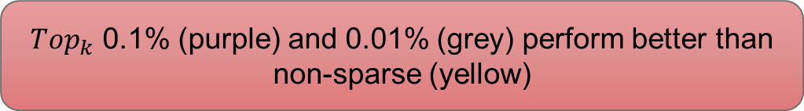
Sparse Proactive Training
$Top_{k}$ 0.1% (purple) and 0.01% (grey) perform better than non-sparse (yellow)

Slide 21
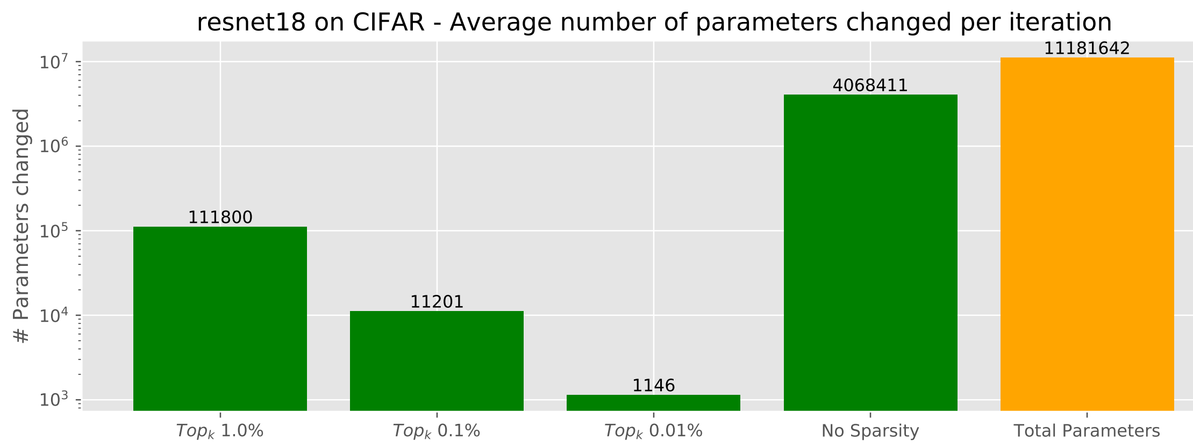
Number of Parameters Changed
Number of Parameters Changed
Top 1.0%
Top 0.1%
Top 0.01%
No sparsity
Total Parameters
Sparse training reduces communication cost by several orders of magnitude
Notes:
Start with the question

Slide 22
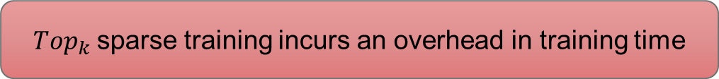
Sparse Training Overhead
Top 0.01%
Top 1%
Top 0.1%
Total Training Time (sec)
Proactive Trigger 8
Full Retraining
Proactive Trigger 16
Proactive Trigger 32
Proactive Trigger 64
Online
$Top_{k}$sparse training incurs an overhead in training time
Notes:
Camel Case for titles consistency. Make sure it is about the overhead starting from the question

Slide 23
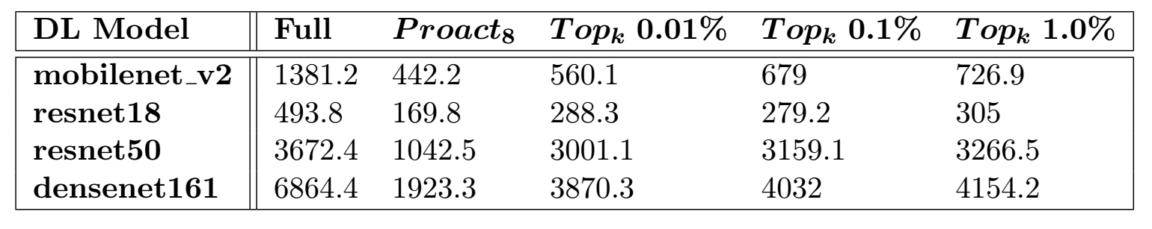
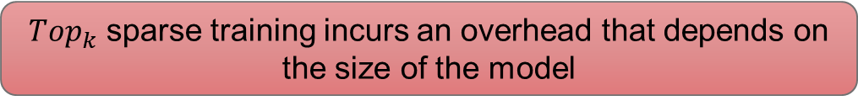
Sparse Training Overhead – All models
Table: Total training time in seconds for all models
$Top_{k}$ sparse training incurs an overhead that depends on the size of the model

Slide 24
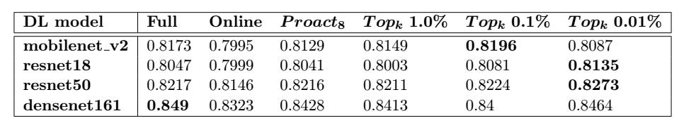
Final Model Quality – All models
Table: Accuracy of final models on a reserved test set
Our methods offer comparable or superior model quality to full retraining
Notes:
Column name, row name. Explain the results a bit. Font

Slide 25
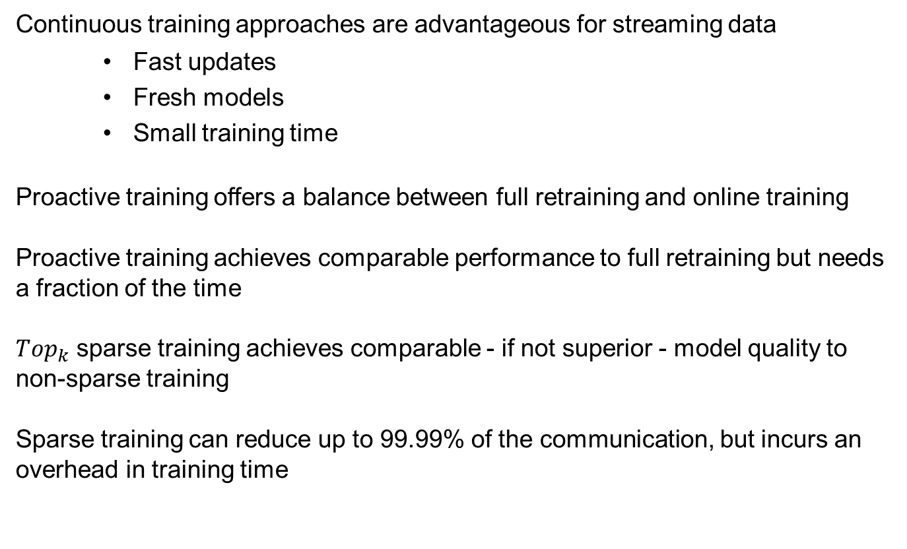
Discussion
Continuous training approaches are advantageous for streaming data
Fast updates
Fresh models
Small training time
Proactive training offers a balance between full retraining and online training
Proactive training achieves comparable performance to full retraining but needs a fraction of the time
$Top_{k}$ sparse training achieves comparable - if not superior - model quality to non-sparse training
Sparse training can reduce up to 99.99% of the communication, but incurs an overhead in training time
Notes:
Merge and leave something for conclusion

Slide 26

Did not present
Experiments on CIFAR10 with Mobilenet_v2, Resnet50 and Densenet161
Experiments on MNIST with LeNet-5 and $random_{k}$ sparse selector
Simple experiments that initially validated our approach
$random_{k}$ more unstable than $top_{k}$ sparse selector
Can be found in the proceedings

Slide 27
Future Work
Compare against state-of-the-art training
Test with non-static datasets
More DL model types in different domains
Adaptive learning rate for sparse training
Notes:
Enhance continuous methods with hyper-parameter tuning and learning rate scheduling and compare against state-of-the-art training configurations.
MNIST and CIFAR datasets are static. Continuous methods can prove more useful with streaming data that exhibit some concept drift.
Try different flavors of DL models, like GANs, LSTMs, Autoencoders in multiple domains.
Adjust the learning rate knowing which gradients have not been used for updates

Slide 28
Summary of contributions
Enabled Continuous Training for DL models Proactive training offers comparable performance to full retraining at a fraction of the cost
Enabled Continuous Deployment for DL models Sparse training offers comparable or superior performance to non-sparse training reducing communication of gradients by 99.99%
Performed sparse training empirical analysis Compared random, top sparse selectors using various sparsification ratios
Revealed a regularizing effect of sparse training Sparse training consistently achieved better model quality than its non-sparse variant on the CIFAR experiments

Slide 29
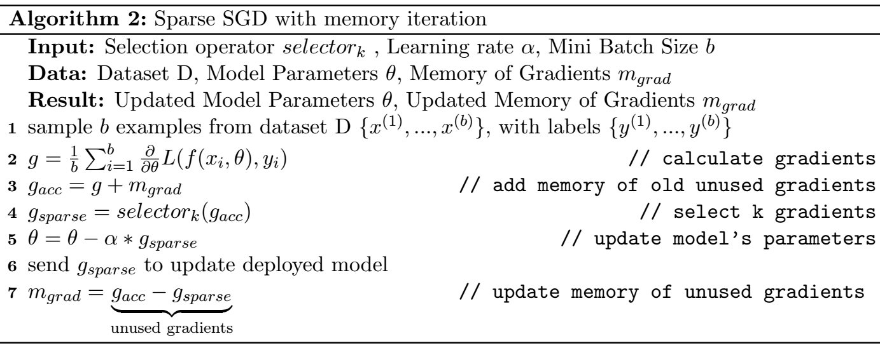
Sparse training algorithm

Slide 30
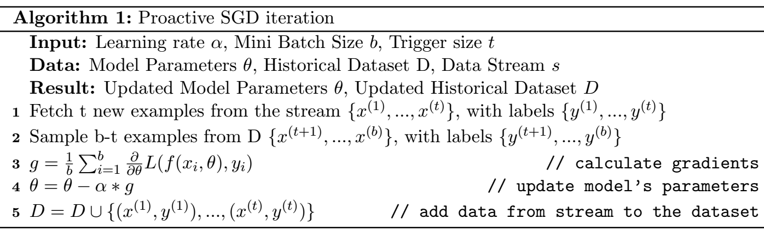
Proactive Training Algorithm
Combines streaming data with samples of historical data to form batches for
mini-batch Stochastic Gradient Descent (SGD).

Slide 31

Deployment - Observations
Different requirements between training and inference
Continuous training implies continuous deployment
Training
Inference
High Throughput
Forward & Backward pass
On dedicated HW (e.g. GPU, TPU)
Low latency
Forward pass (only)
On commodity or dedicated HW
Scale on demand
$$cost_{deployment}=cost_{communication}+cost_{loading}$$
$$≅cost_{communication}$$
For continuous deployment, we need to reduce the communication cost.

