Slide 1
Services
Dávid Hudy

Slide 2

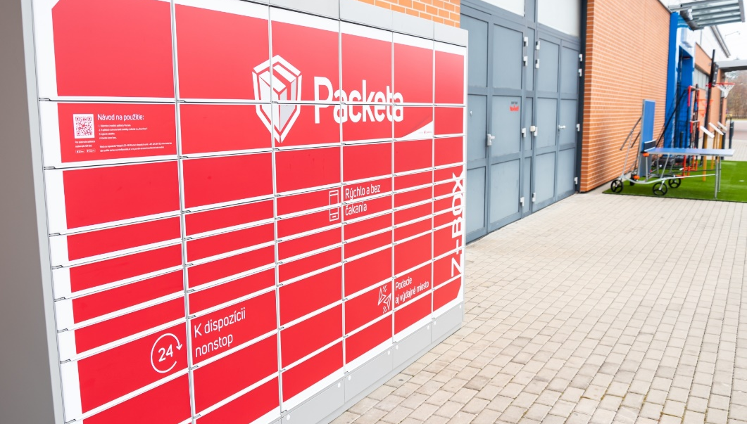
WHICH TYPE OF SERVICES HAVE YOU BEEN USING RECENTLY? WHAT WAS THE QUALITY OF IT?
Streaming services such as Netflix
Delivery services like Packeta
Food delivery services, for example Bistro

Slide 3
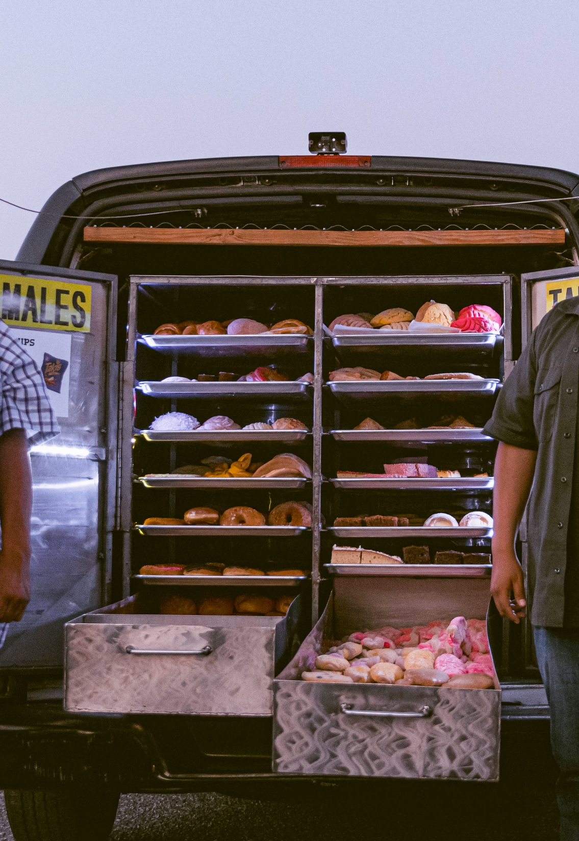

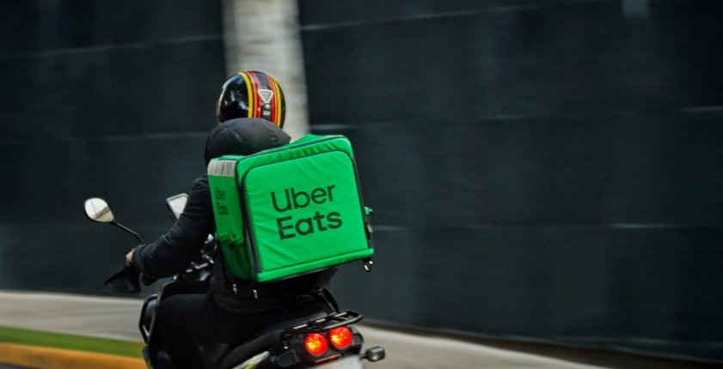
WHAT SERVICES DO YOU MISS IN SNV?
SNV has definitely quite a few services. Yet the quality of the said services is not the best and would definitely need an improvement. But there are definitely services that are missing. Some that would make life more convenient are, for instance: Delivery of groceries, Cleaning services or Corporate food delivery

Slide 4
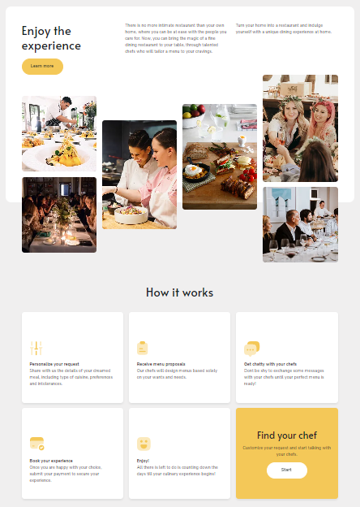

COME UP WITH THE IDEA OF YOUR OWN BUSINESS
Personal chef is a person that comes to your household or place and cooks for you. Therefore you can enjoy fine dining quality food at home without having to cook it yourself.
MY SPIN ON IT
I would like to be a personal chef as side job in order to make having a better meal more affordable for me and my friends

Slide 5
LINKS
PERSONAL CHEF WEBSITE
PICTURES
STEAMING SERVICES
PACKETA
MOBILE BAKERY
UBER EATS DRIVER
CLEANING BUCKET
HOME COOK
PRESENTATION TEMPLATE

Slide 6

THANK YOU
FOR YOUR ATTENTION

