Slide 1
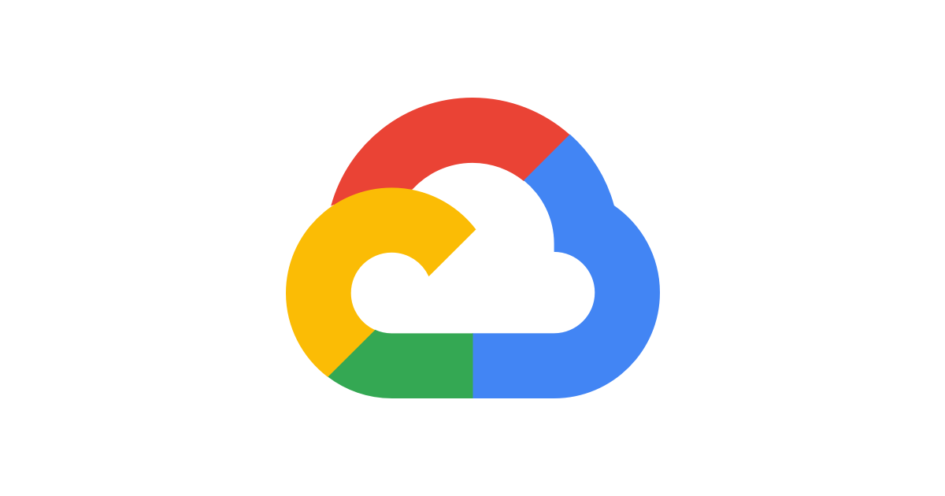

Google Cloud
compute
Lightning talk

Slide 2
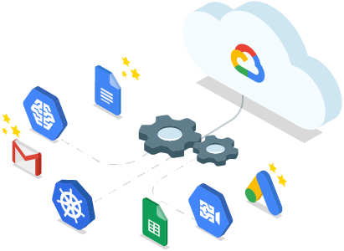
GCP
Google Cloud Platform is a suite of cloud computing services that includes compute, storage, and networking services designed to meet the needs of a wide range of cloud computing customers.
IaaS
PaaS
SaaS

Slide 3
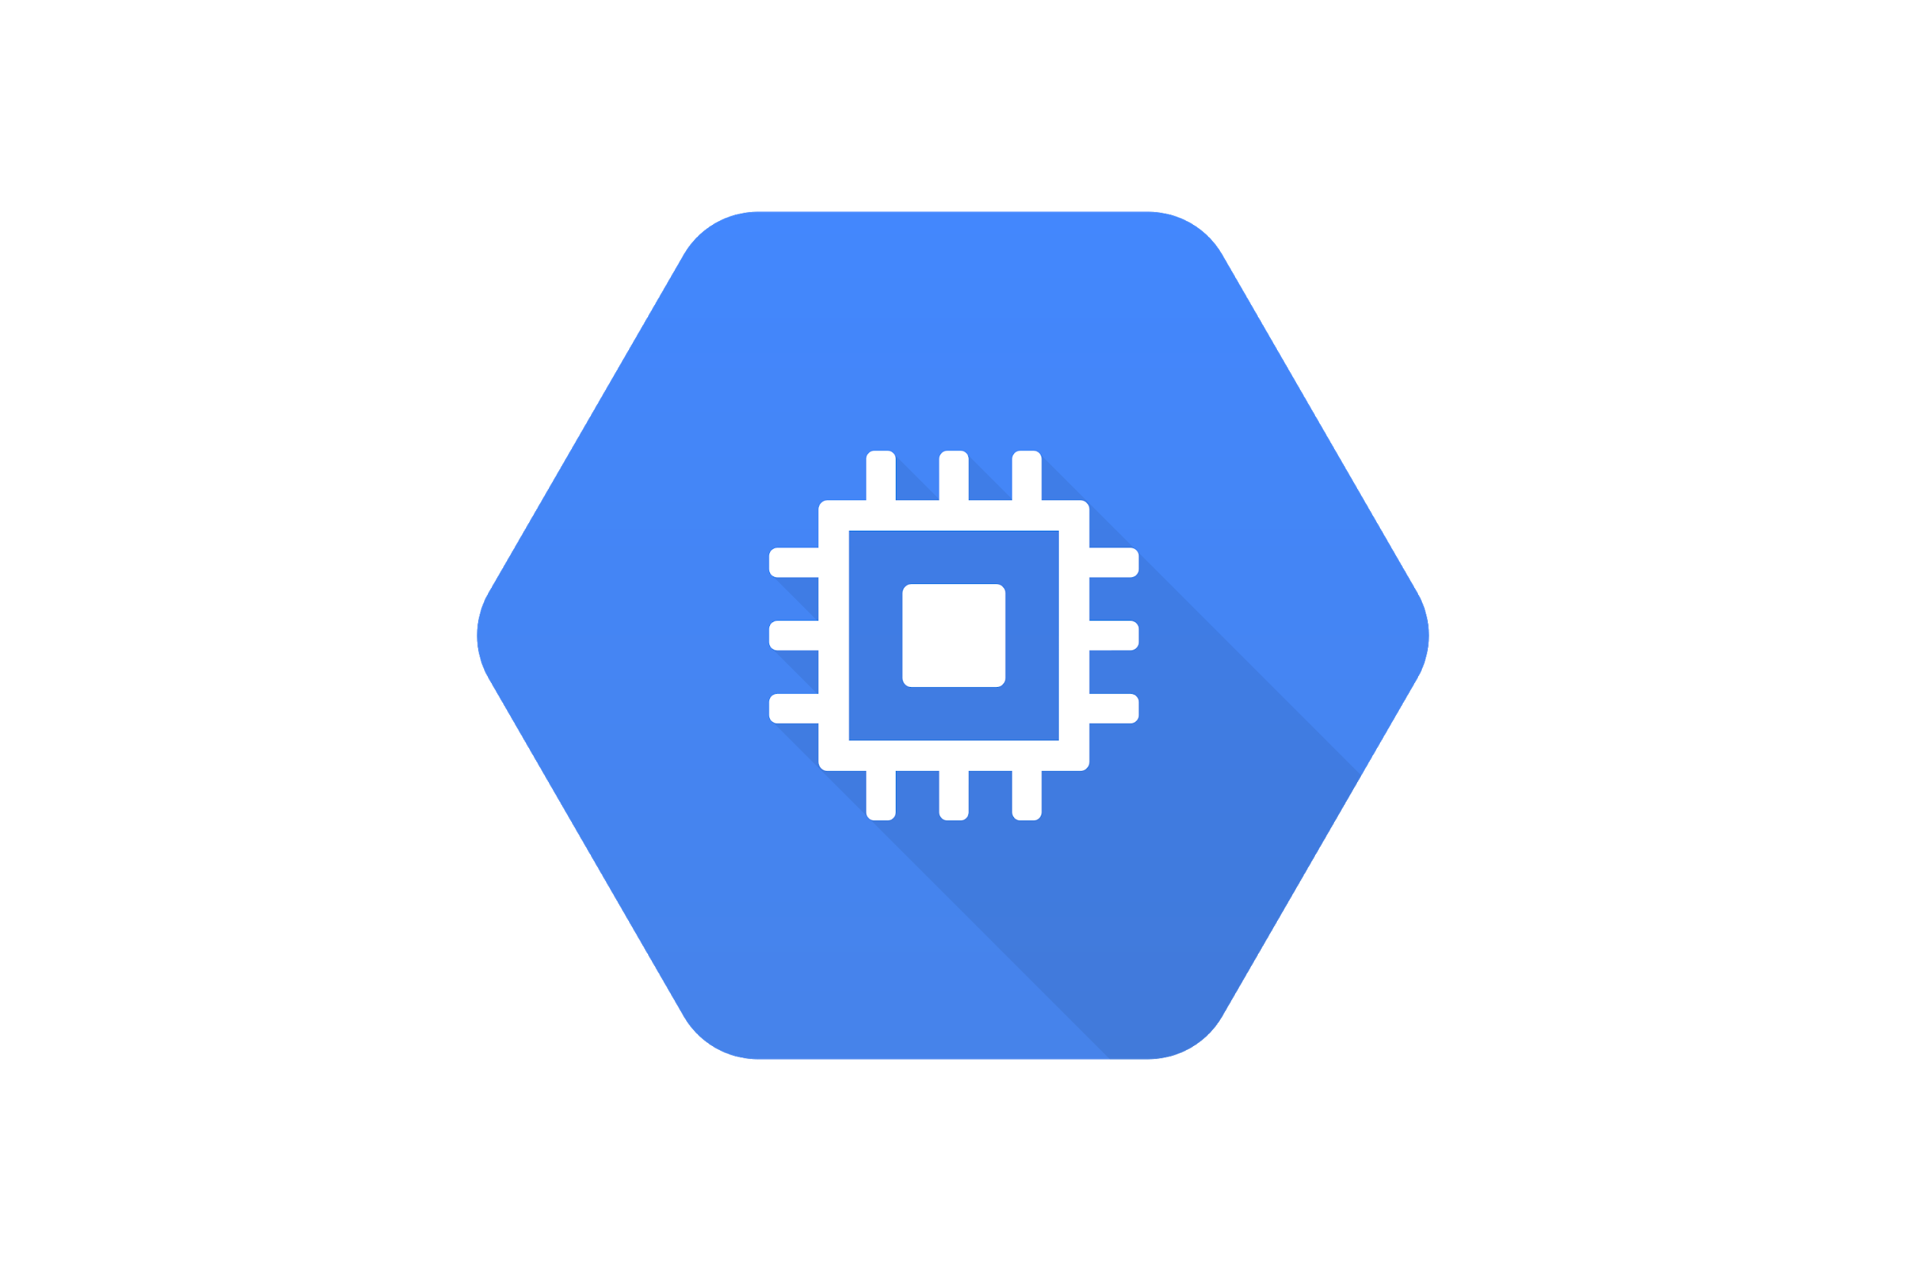
Compute Engine
Compute Engine is a service that allows users to create VMs, attach persistent storage to those VMs, and make use of other GCP services, such as Cloud Storage.
VMs run within a low-level service called a hypervisor.
Hypervisors run on an operating system like Linux or Windows Server. Hypervisors can run multiple operating systems, referred to as guest operating systems, while keeping the activities of each isolated from other guest operating systems.

Slide 4
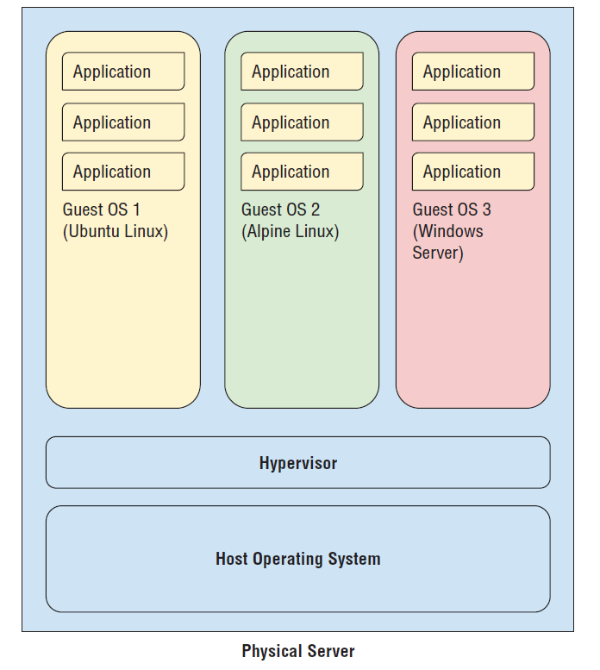

Slide 5
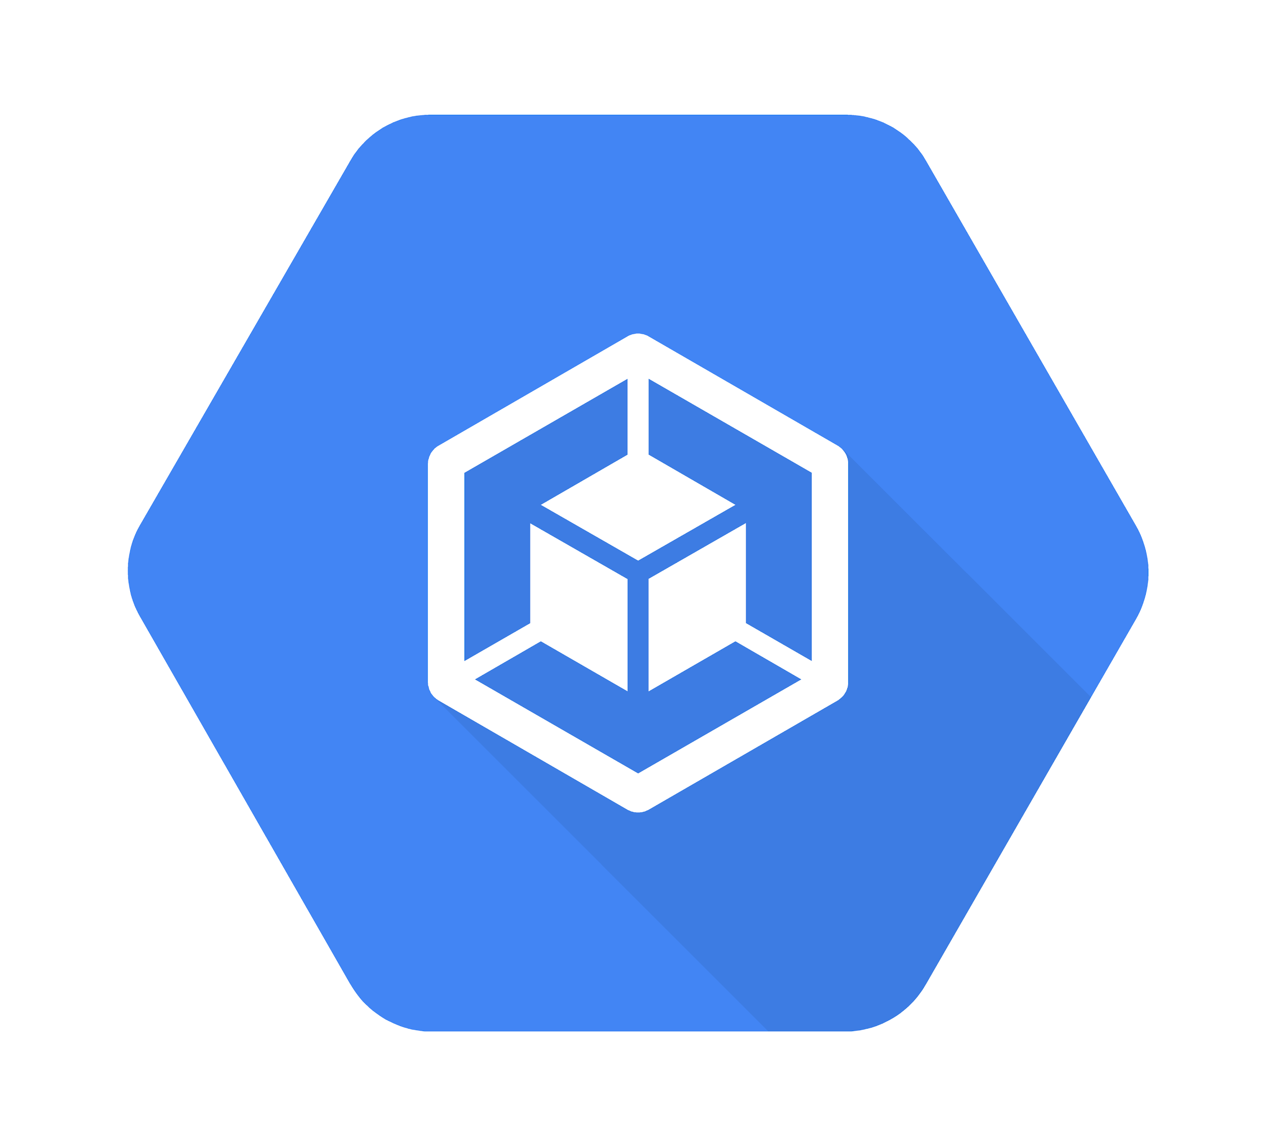
Kubernetes Engine
Kubernetes Engine is designed to allow users to easily run containerized applications on a cluster of servers.
Kubernetes Engine is a GCP product that allows users to describe the compute, storage, and memory resources they’d like to run their services. Kubernetes Engine then provisions the underlying resources.
In addition, Kubernetes monitors the health of servers in the cluster and automatically repairs problems, such as failed servers.

Slide 6
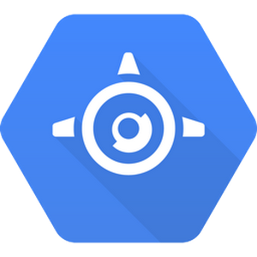
App Engine
With App Engine, developers and application administrators don’t need to concern themselves with configuring VMs or specifying Kubernetes clusters. Instead, developers create applications in a popular programming language.
App Engine manages the underlying computing and network infrastructure. There is no need to configure VMs or harden networks to protect your application.

Slide 7

Cloud Run
Cloud Run takes in a container with your pre-built app on it, deploying it in a serverless environment. Cloud Run eliminates the need to manage resources or create an infrastructure, allowing DevOps teams to stay in the code.

Slide 8
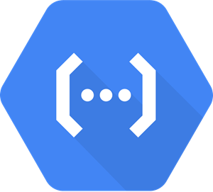
Cloud Functions
Google Cloud Functions is a lightweight computing option that is well suited to event-driven processing.
The code that executes in the Cloud Functions environment must be short-running - this computing service is not designed to execute long-running code.

Slide 9
Live Demo Time!

Slide 10

Used materials
https://cloud.google.com/docs
Official Google Cloud Certified Associate Cloud Engineer Study Guide
https://www.youtube.com/channel/UCJS9pqu9BzkAMNTmzNMNhvg

Slide 11


FIN
@ipriver

