Slide 1
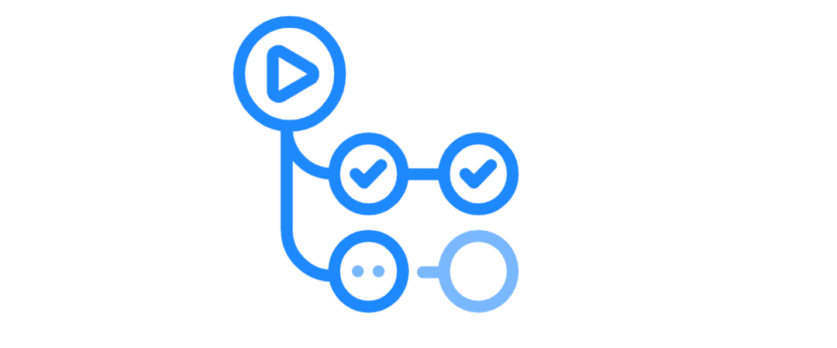

Github Actions
walkthrough
Lightning talk

Slide 2
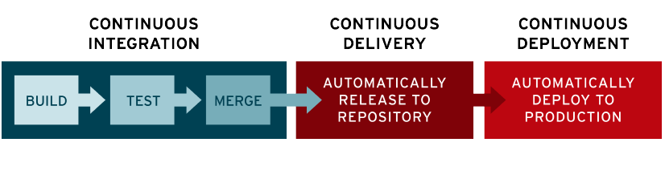
What is CI/CD
CI/CD is a method to frequently deliver apps to customers by introducing automation into the stages of app development. CI/CD introduces ongoing automation and continuous monitoring throughout the lifecycle of apps, from integration and testing phases to delivery and deployment.

Slide 3




Other solutions

Slide 4
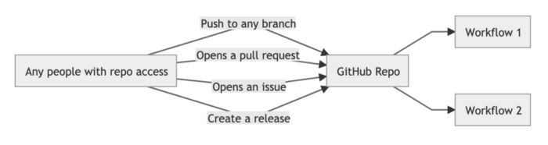
Github in Action
.github/workflows
GitHub Actions help you automate tasks within your software development life cycle. GitHub Actions are event-driven, meaning that you can run a series of commands after a specified event has occurred.

Slide 5
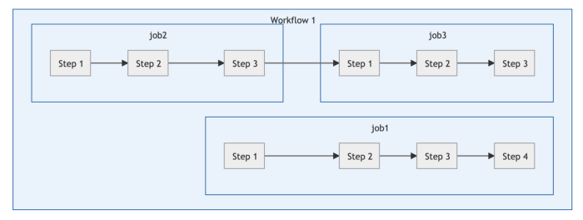
Workflow
The workflow is an automated procedure that you add to your repository. Workflows are made up of one or more jobs and can be scheduled or triggered by an event. The workflow can be used to build, test, package, release, or deploy a project on GitHub.

Slide 6
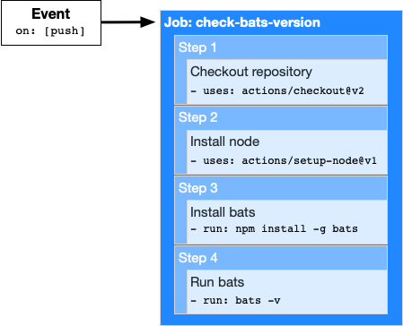
YAML example
name: learn-github-actions on: [push] jobs: check-bats-version: runs-on: ubuntu-latest steps: - uses: actions/checkout@v2 - uses: actions/setup-node@v1 - run: npm install -g bats - run: bats -v

Slide 7
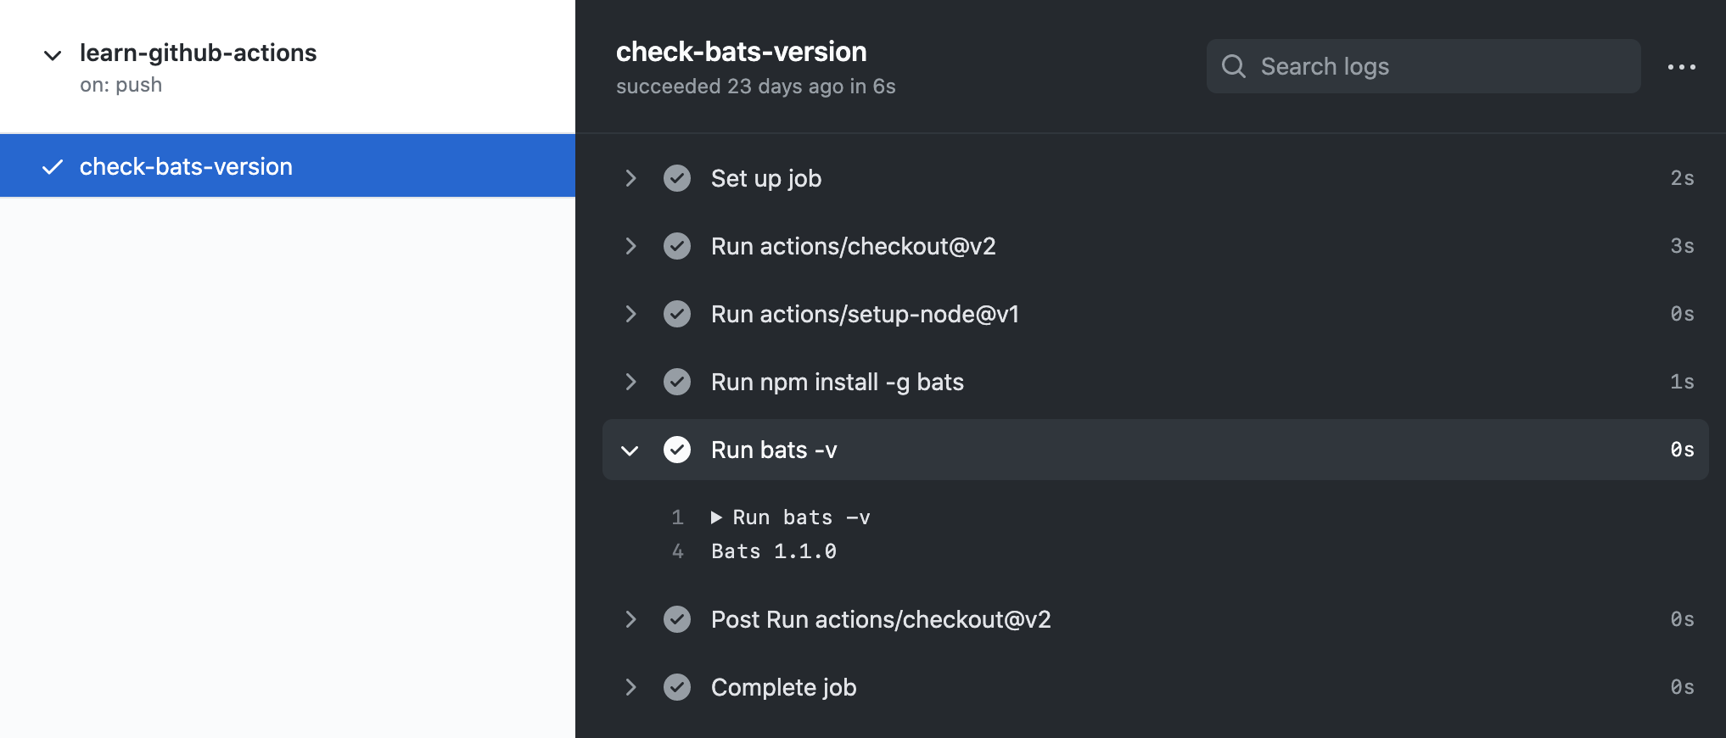

Slide 8
name:
# Each workflow must have a name # Here the workflow will be named as Sample Workflow name: Sample workflow

Slide 9
on:
# will be triggered on push and create pull_request on: [push, pull_request]
# You can filter out branches and tags too on: push: tags: # will be triggered when v1.0 or v2.0 is pushed. - v1.0 - v2.0 branches: # will be triggered when code is pushed to master or any branch starting with release/ - master - release/* pull_request: branches: # will be triggered when a pull request is submitted to develop or master branch - develop - master
# You can trigger any workflow using schedule too on: schedule: 0 12 * * * # this will be triggered on 12pm (UTC) each day

Slide 10
env:
# You can have environment variables in the workflow # this will be available in each job and steps inside it. env: PROJECT_ID: sample-project-id USERNAME: sample-username # So now in each steps you can access them by $PROJECT_ID or $USERNAME # Normally the environment variables will show their value when printed in logs
# You might want to hide sensitive information in logs like password # For this use, secrets. # You can set secrets under Variables in each repository settings # Repo --> Settings --> Variables env: PROJECT_ID: sample-project-id USERNAME: sample-username PASSWORD: ${{secrets.PASSWORD}} # you have to set PASSWORD in variables under repo settings # You can have env variables in jobs and steps too.

Slide 11
jobs:
# One more interesting thing you can do is to run a job in different os # For this, you need to strategy under each job config jobs: first-job: strategy: matrix: os: [ubuntu-latest, macos-latest, windows-latest] # This will allow the job to run in 3 different os runs-on: ${{ matrix.os }} steps: -
# also sometimes you need docker container to be started as sidecar for a job to run jobs: first-job: services: postgres: image: postgres # docker image name ports: - "5432:5432" #port exposed redis: image: redis

Slide 12
Jobs (run in a sequence):
# By default all the jobs that are defined under jobs keywords # Sometime we need to start a job after a job is finished. # for this we need the needs keyword jobs: # as first-job and fourth-job don't have any needs keywords # they will start together first-job: second-job: # only run when first-job is successful needs: [first-job] third-job: # only run when first-job and second-job is successful needs: [first-job, second-job] fourth-job:

Slide 13
steps:
# name of the step name: name of the step id: sample_id # needed if this step has output to be used in other steps run: echo 'Hello World' # command we want to run
# You can have env variables scoped to our steps only name: Env Variable Steps run: echo $HELLO_WORLD env: HELLO_WORLD: hello-world # will not be available to other steps
# sometimes some action might take input from outside to act on # you can pass this using with keywords name: Running simple steps uses: actions/hello-world-javascript-action@master with: who-to-greet: 'Mona the Octocat'
# also you can run a steps based on event type and branches too name: Run only when push to master run: echo the code is pushed to master branch if: ${{ github.event_name == 'push' && github.ref == 'master' }}

Slide 14
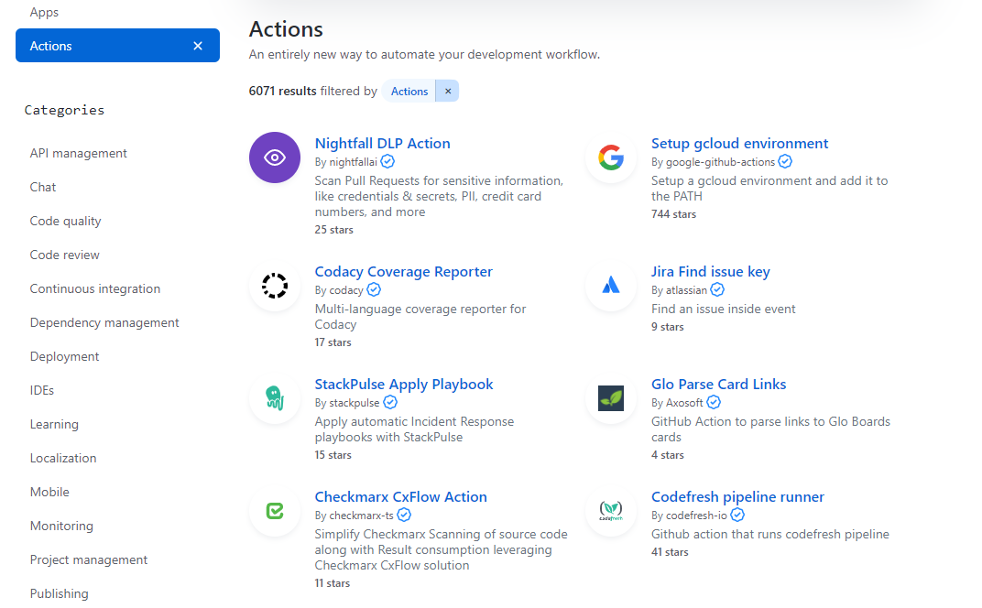
https://github.com/marketplace?type=actions

Slide 15
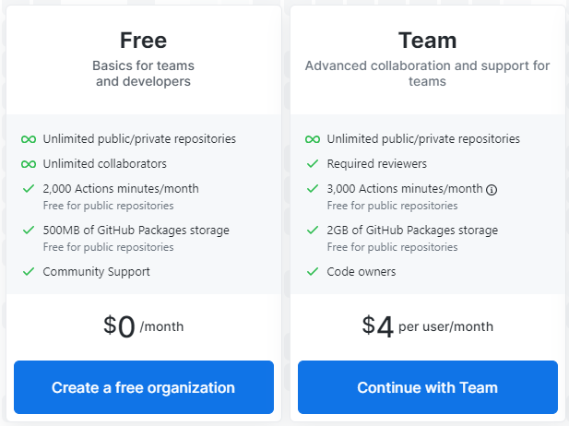
Pricing

Slide 16


The End
Learn more: https://docs.github.com/en/free-pro-team@latest/actions
@ipriver

