Slide 1
Preface
The Rust programming language helps you write faster, more reliable software. High-level ergonomics and low-level control are often at odds in programming language design;
Rust challenges that conflict. Through balancing powerful technical capacity and a great developer experience, Rust gives you the option to control low-level details (such as memory usage) without all the hassle traditionally associated with such control.

Slide 2

Understanding
ownership & lifetime

Slide 3

cargo build --release Compiling ...

Slide 4
The problem
Solution - Smart Pointers (C++11)
while (true) { // allocation of 4 bytes for each int64 value auto i = new int(5); // *int // some other work... }
auto i = std::make_unique<int>(5);
auto i = new int(5); // we clear the memory and OS can set it's bytes value to 0 (not guaranteed tho). delete i; // use the same memory address to increment it, but the value stored in "i" is unpredictable. *i += 10; std::cout << *i;

Slide 5
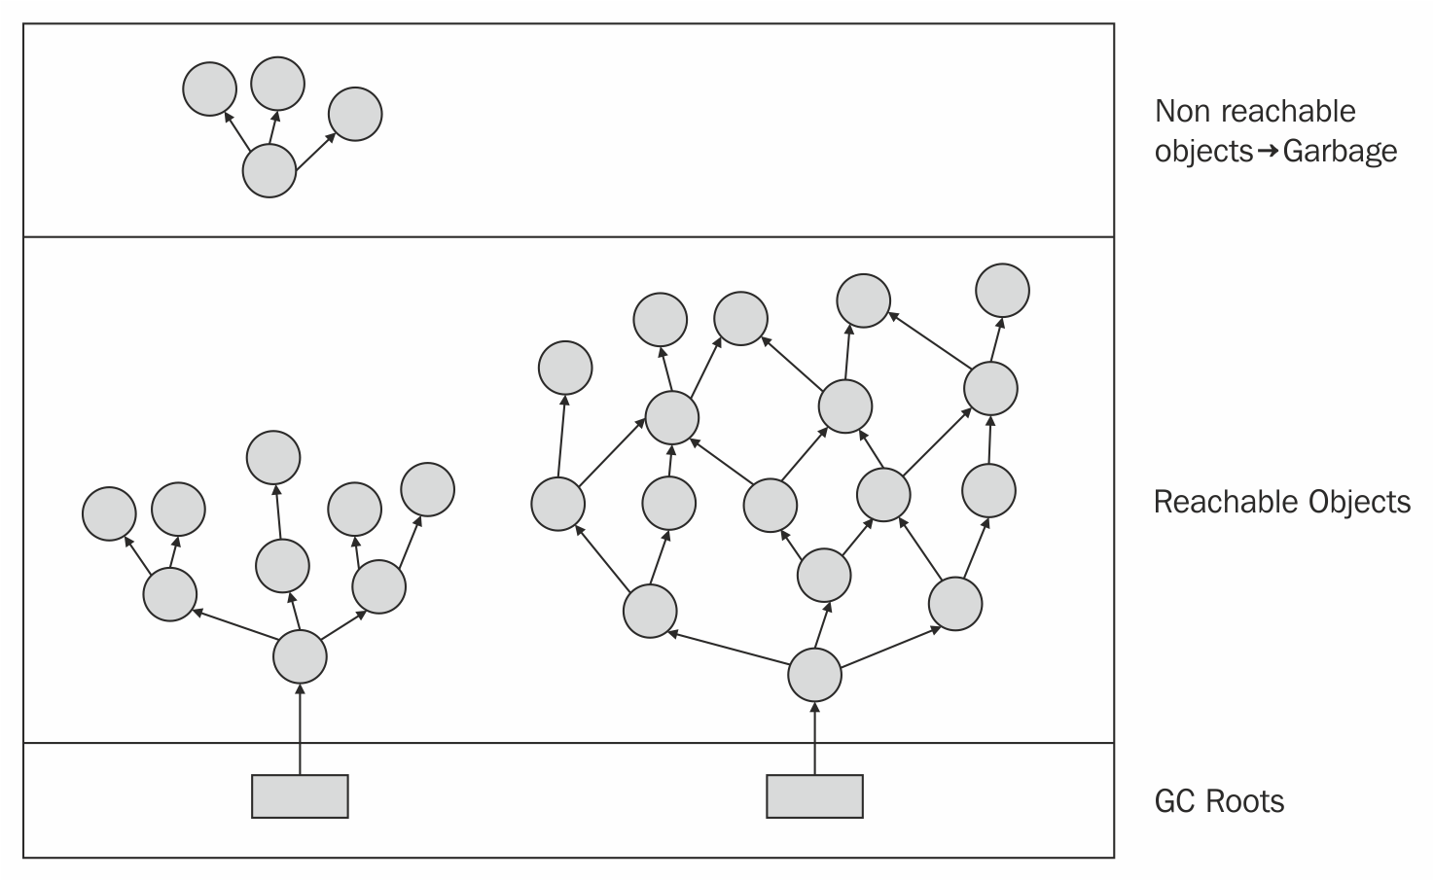
Solution - GC (garbage collector)

Slide 6


Slide 7

Ownership
Ownership is Rust’s most unique feature, and it enables Rust to make memory safety guarantees without needing a garbage collector.
Each value in Rust has a variable that’s called its owner.
There can only be one owner at a time.
When the owner goes out of scope, the value will be dropped.

Slide 8
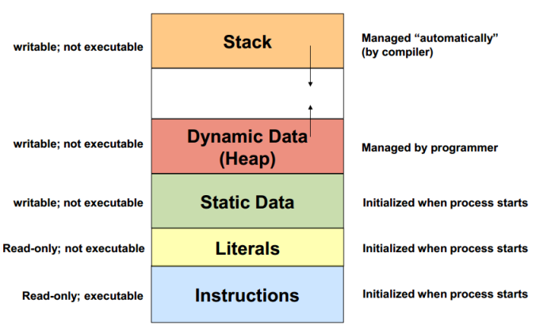

Slide 9
Scope
fn main() { { // s is not valid here, it's not yet declared let s: &str = "hello"; // s is valid from this point forward // do stuff with s } // this scope is now over, and s is no longer valid }

Slide 10
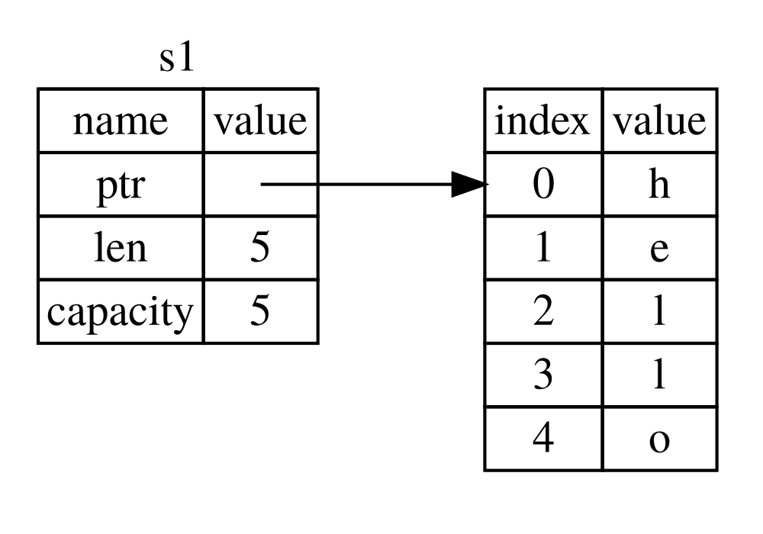
fn main() { { let s1 = String::from("hello"); // s is valid from this point forward // do stuff with s1 } // this scope is now over, and s is no // longer valid } // C++: std::string *s = new std::string("hello");

Slide 11
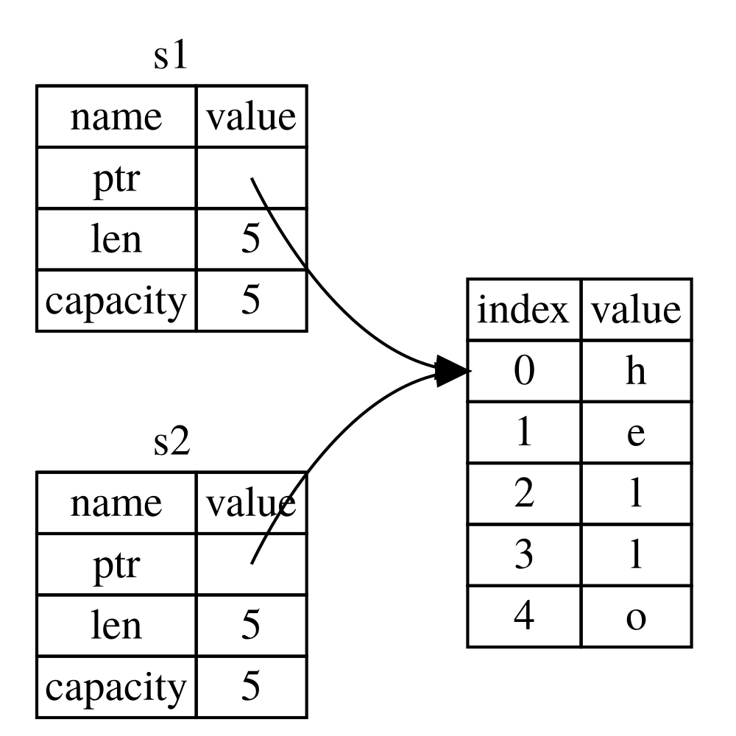
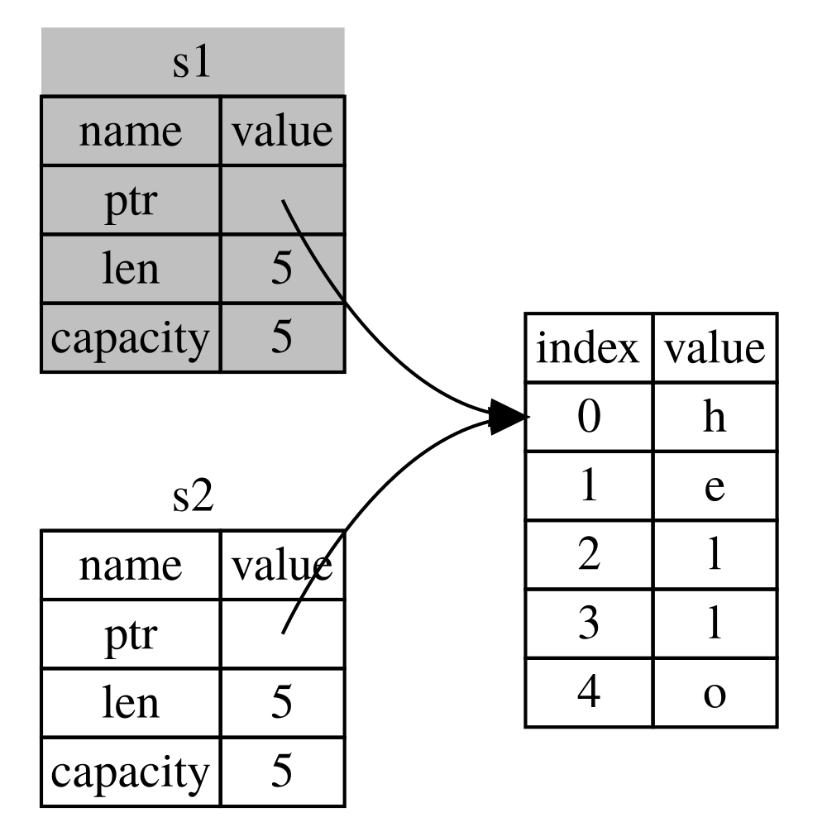
fn main() { let s1 = String::from("hello"); let s2 = s1; }

Slide 12
fn main() { let s1 = String::from("hello"); let s2 = s1; println!("{}, world!", s1); }
fn main() { let x = 5; let y = x; println!("x = {}, y = {}", x, y); }
fn main() { let s1 = String::from("hello"); let s2 = s1.clone(); println!("s1 = {}, s2 = {}", s1, s2); }

Slide 13
Borrowing
fn main() { let s1 = String::from("hello"); let len = calculate_length(&s1); // ← pass by ref (borrow) // all good println!("The length of '{}' is {}.", s1, len); } fn calculate_length(s: &String) -> usize { s.len() }
fn main() { let s1 = String::from("hello"); let len = calculate_length(s1); ← pass s1 ownership println!("The length of '{}' is {}.", s1, len); } fn calculate_length(s: String) -> usize { s.len() }

Slide 14
Mutable references
fn main() { let mut s = String::from("hello"); change(&mut s); } fn change(some_string: &mut String) { some_string.push_str(", world"); }
fn main() { let mut s = String::from("hello"); let r1 = &mut s; let r2 = &mut s; println!("{}, {}", r1, r2); }

Slide 15
Dangling references
fn main() { let reference_to_nothing = dangle(); } fn dangle() -> &String { let s = String::from("hello"); &s }
fn no_dangle() -> String { let s = String::from("hello"); s }

Slide 16
Lifetime
A lifetime is a construct the compiler (or more specifically, its borrow checker) uses to ensure all borrows are valid. Specifically, a variable's lifetime begins when it is created and ends when it is destroyed. While lifetimes and scopes are often referred to together, they are not the same.

Slide 17
Preventing Dangling References with Lifetimes
{ let x = 5; // ----------+-- 'b // | let r = &x; // --+-- 'a | // | | println!("r: {}", r); // | | // --+ | } // ----------+
fn main() { { let r; { let x = 5; r = &x; } println!("r: {}", r); } }
fn main() { { let r; // ---------+-- 'a // | { // | let x = 5; // -+-- 'b | r = &x; // | | } // -+ | // | println!("r: {}", r); // | } // ---------+ }

Slide 18
Explicit lifetime
&i32 // a reference &'a i32 // a reference with an explicit lifetime &'a mut i32 // a mutable reference with an explicit lifetime let s: &'static str = "hello"; // `static let st: String = String::from("hello"); // `a let ref r_st: &'b String = &st; // `b

Slide 19
fn elided_pass(x: &i32) -> &i32 { x } fn annotated_pass<'a>(x: &'a i32) -> &'a i32 { x }
// A function which takes no arguments, but has a lifetime parameter `'a`. fn failed_borrow<'a>() { let _x = 12; // ERROR: `_x` does not live long enough let y: &'a i32 = &_x; }

Slide 20
#[derive(Debug)] struct NamedBorrowed<'a, 'b> { x: &'a i32, y: &'b i32, } fn main() { let x = 18; { let y = 15; let double = NamedBorrowed { x: &x, y: &y }; println!("x and y are borrowed in {:?}", double); } }

Slide 21
#[derive(Debug)] struct NamedBorrowed<'a, 'b> { x: &'a i32, y: &'b i32, } fn main() { let x = 18; { let y = 15; let mut double = NamedBorrowed { x: &x, y: &y }; { let z = 22; double.y = &z; } println!("x and y are borrowed in {:?}", double); } }

Slide 22

Finished release [optimized] target(s)
@ipriver

Slide 23
Used materials
https://doc.rust-lang.org/book/title-page.html
https://doc.rust-lang.org/rust-by-example/index.html

