Slide 1

Chandigarh welfare schemes
Paatrata
Welfare rules anyone can check
Gemini reads a scheme's notification once. An officer approves the rules. Code answers every applicant the same way, citing the clause.
Team clawops
Veydant Bhardwaj · Ipshita Bhardwaj
Theme: AI for Digital Public Infrastructure of Chandigarh
Bonus: Best Open-Source AI Project
Notes:
Paatrata means eligibility. We built a compiler for welfare-scheme rules: Gemini reads the notification once, an officer approves, and plain code answers every applicant the same way with the clause it rests on.

Slide 2
Eligibility rules exist only as prose, and every channel re-reads them by hand
Old Age Pension, Chandigarh: eligibility
Answers drift
No clause behind it
1. The family annual income of the applicant should not exceed Rs. 1,50,000.
2. The applicant should be 60 years of age or above.
3. … residing in Chandigarh UT for more than 3 years.
Two channels, or one chatbot asked twice, give different verdicts for the same person.
A citizen told "not eligible" rarely learns which clause decided it.
Guesses stay hidden
Updates go stale
Undefined terms and unclear ranges are interpreted silently and never recorded.
A circular changes a limit; every downstream copy must be found and fixed by hand.
Who is "family"? Is 3 years enough? Each channel decides on its own.
Notes:
A notification is prose. Portals, Sampark counters, helpdesks and chatbots each turn it into their own logic. The result: inconsistent answers, no traceability, silent guesses on ambiguous wording, and slow updates when a circular changes a limit.

Slide 3

Chandigarh runs two rulebooks, and every state has the same problem
Own schemes + central schemes
The UT administration runs its own pensions and child-support schemes next to central ones.
6 schemes, 30 conditions
Chandigarh schemes already compiled into Paatrata's rulebook, each condition tied to its sentence.
5,000+ schemes across India
Listed by one provider alone (Haqdarshak, via NITI Aayog Frontier Tech). The same bottleneck repeats in every state.
Who uses it Scheme officers · Sampark / e-District operators · Citizens · Portal builders
Palace of Assembly, Chandigarh. Photo: duncid, CC BY-SA 2.0, via Wikimedia Commons
Notes:
Chandigarh is a sharp case: as a Union Territory it administers its own pensions and child schemes beside central ones. We compiled six of them. Nationally, one provider lists more than five thousand schemes, so the document-to-rules bottleneck repeats everywhere.

Slide 4
Existing tools answer citizens; nobody verifies the rules they run on
 | Typical scheme chatbot | Paatrata
When the model runs | On every question | Once per document
Who decides eligibility | The model, each time | Deterministic code
Same question twice | Can differ | Always identical
Why this answer? | Free-text reasoning | Exact clause, page and quote
Unclear wording | Silently guessed | A question that blocks approval
Missing applicant facts | Often guessed | "Needs information", naming the fact
Rule changes | Re-prompt and hope | New version, re-run boundary tests
myScheme, Haqdarshak and Indus Action's eligibility engines do discovery well. Paatrata works one step upstream: document → verified, executable rules.
Notes:
We are not another scheme chatbot. A chatbot asks the model every time. Paatrata compiles once, then code decides, so answers are identical, cited, and ambiguity becomes an explicit question.

Slide 5
Compile once. Decide with code
1
2
3
4
5
Gemini extracts
Code validates
Gemini reviews
Officer approves
Code decides
Each clause becomes field, operator, value, verbatim quote, page, and a question if unclear.
Rejects any condition whose quote is not in the document; parses ₹1.5 lakh → 150000.
Second pass finds missing, misread and ambiguous conditions, each quoted.
Answers every question, checks boundary tests, approves a version.
Eligible, Not eligible or Needs information, with the clause for every condition.
Google AI
Code
Google AI
Human
Code
The model reads once. Every answer after that comes from officer-approved rules run by plain, testable code.
Notes:
Five steps. Blue is Google AI, grey is code, ochre is the officer, green is the deterministic decision. Note that AI never makes the decision; it only reads and questions the document.

Slide 6
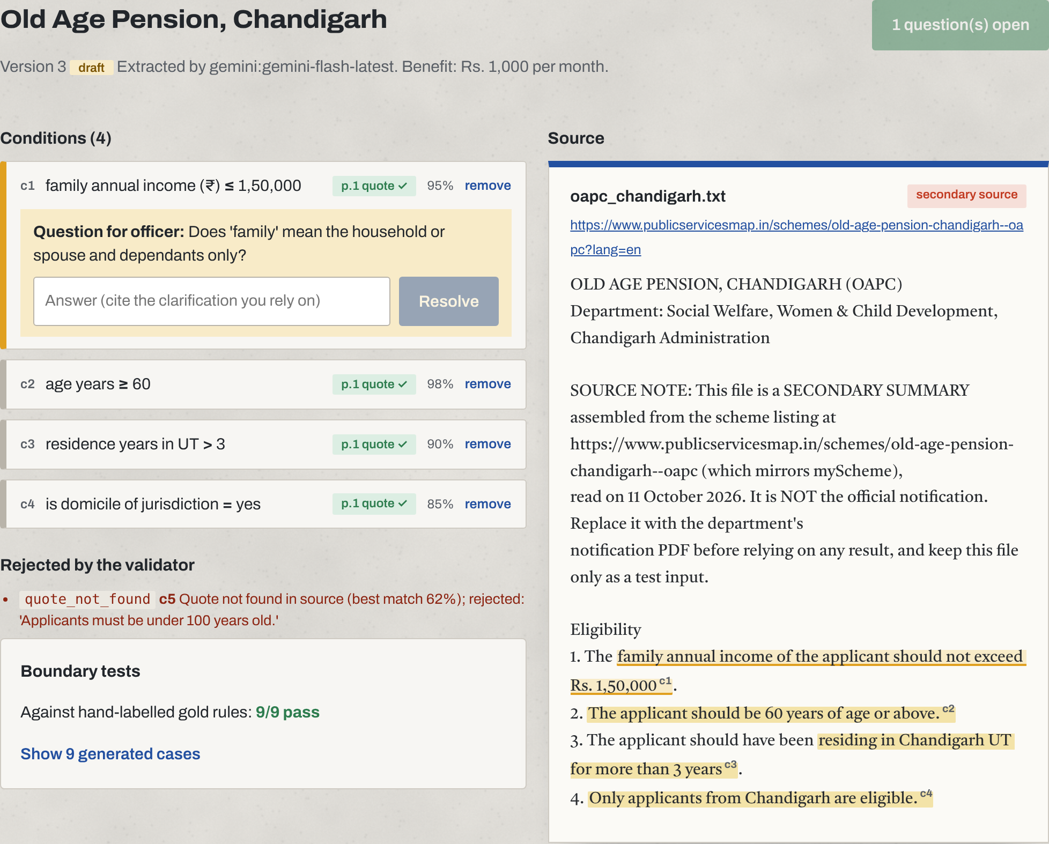
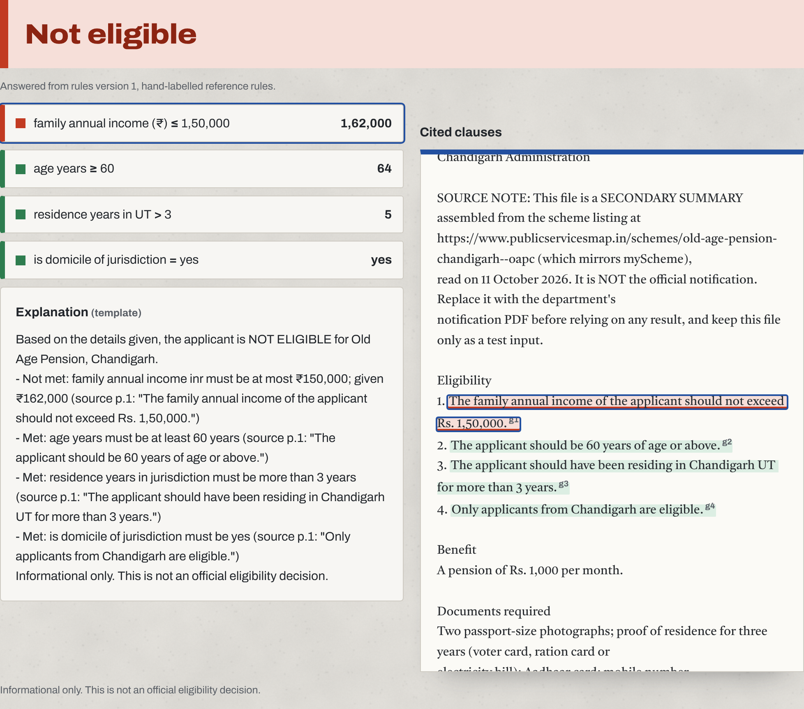
Working prototype: every condition sits beside its sentence
Officer review: questions to answer, rejected conditions, boundary tests
Eligibility check: verdict, each condition coloured, clause highlighted
Notes:
Left: the officer screen. Conditions on the left, the source document on the right with each quote highlighted; an ambiguity question blocks approval; a hallucinated condition was rejected because its quote is not in the document. Right: the citizen check. Not eligible, because income is above 1.5 lakh, with the clause highlighted in red.

Slide 7
Architecture: one small service, AI only on the authoring path
Authoring path (officer)
Notification
Gemini / Gemma 4
Validator
Gemini review
Officer approves
PDF or text
structured extraction
vocabulary · units · quote-in-source
missing · misread · ambiguous
answers questions, tests
Query path (citizen, operator): no AI
Rulebook
versioned, SQLite
Applicant details
Deterministic evaluator
Verdict + citations
Hindi / Punjabi wording
web form or API
three-valued logic over ALL/ANY groups
Eligible · Not eligible · Needs info
Gemini, verdict-checked
Interfaces: React web app · FastAPI REST API · paatrata CLI · Python library · Agent Skill. One Docker image, Cloud Run ready.
Notes:
Two paths. Authoring uses Gemini or Gemma, then code validates, Gemini reviews, an officer approves into a versioned rulebook. The query path has no AI at all: a deterministic evaluator returns the verdict with citations; Gemini only rewords it into Hindi or Punjabi and must echo the same verdict.

Slide 8
Google AI does the reading. Open weights make it deployable anywhere
Where Google AI works
Bonus: open-source AI
Gemini API, structured output
Clause → typed condition with quote, page, confidence, question
Gemma 4 (Apache-2.0) as a real extraction backend
Gemini API, second pass
Finds missing, misread and ambiguous conditions
Agent Skill in the Agent Skill Open Standard format
Gemini multimodal
Reads scanned PDFs that have no text layer
paatrata_core: reusable library with schema, validator, evaluator, test generator
Gemini API
Hindi and Punjabi explanations, checked against the verdict
Evaluation harness with a public answer-key format
Gemma 4 via AI Studio / Ollama
Same compiler on open weights, for on-premise departments
Public GitHub repo, Apache-2.0; 60 offline tests
Never: deciding who is eligible. That is always approved rules + code.
Notes:
Gemini does the hard language work and it is measurable. Gemma 4 gives an open-weight path for departments that cannot send documents outside. For the bonus: an Agent Skill, a reusable library, and an evaluation harness, all Apache-2.0.

Slide 9
Measured against hand-labelled rules, versus a plain RAG chatbot
Results pending the final evaluation run
Run python -m evaluation.run_eval --live --review then node deck/build.js to fill this slide with measured numbers.
Extraction F1 field, operator, value vs answer key
Quotes verified model citations found in the document
Decision accuracy boundary cases + 300 synthetic applicants per scheme
Consistency same question, repeated runs (baseline)
Applicants are synthetic and answer keys are team-labelled: results measure agreement with those labels, not real-world accuracy.
Notes:
The baseline uses the same Gemini model and the same documents; the only difference is asking every time versus compiling once. We report extraction F1, verified quotes, decision accuracy and consistency, with honest caveats: synthetic applicants and team-labelled keys.

Slide 10

Pilot in weeks, then scale to any state
Pilot in weeks
1
Collect the department's current notifications
2
Compile, review and approve with its own officers
3
Give one helpdesk or Sampark counter the read-only checker
Open Hand Monument. Photo: Raakesh Blokhra, CC BY-SA 2.0, via Wikimedia Commons
Reach across India
Every state and ministry publishes schemes as notifications. The vocabulary, compiler and engine are scheme-agnostic; Gemini reads Hindi and other Indian languages; one Docker image runs on Cloud Run.
4
Compare answers with past applications, then widen
Notes:
Deployability: a department uploads notifications it already publishes; officers approve; the rules are served by an API. No government integration needed for a pilot. Scale: nothing in the engine is Chandigarh-specific.

Slide 11
Next: from six schemes to a shared, verified rulebook
Circular delta
Official notifications
Compile a new circular against the approved rules; show exactly what changed and for whom.
Department PDFs for every Chandigarh scheme, including Hindi-only sources.
Gemma 4 measured
Every language, every counter
Published on-premise accuracy for departments that keep documents in-house.
Hindi and Punjabi across the interface; voice input at Sampark counters.
The model reads once. Code decides every time.
Live: paatrata.onrender.com | github.com/ipshitabhardwaj/Paatrata | Apache-2.0 | team clawops
Notes:
For the finale: circular delta, official notifications, measured Gemma results, and full Hindi and Punjabi. The core idea in one line: the model reads once; code decides every time.

