Slide 1
HLTH 650 | OUTBREAK INVESTIGATION AND REPORT
Diphtheria: A Vaccine-Preventable Disease Returns
Outbreaks in Africa and Yemen reported by WHO Disease Outbreak News, 2017 to 2025
Group members: [add names]
Notes:
Introduce the group and the disease. Our four outbreaks, in order: the 2025 African Region resurgence, Nigeria 2022-2023, Guinea 2023, and Yemen 2017. All data come from WHO Disease Outbreak News reports. About 30 minutes total, roughly 2 minutes per slide.

Slide 2
A vaccine-preventable disease is resurging
PROBLEM DEFINITION
20,412
1,252
Why it matters
Fatal in 5 to 10% of cases; up to 40% where antitoxin is hard to reach
Immunity gaps now extend past early childhood: ages 5 to 18 and adults
COVID-19 disruption widened gaps in vaccine uptake
Conflict, displacement and crowding sustain transmission
Global shortage of diphtheria antitoxin (DAT)
WHO graded the African resurgence a grade 2 emergency
suspected cases, 8 African countries, Jan to 2 Nov 2025
deaths in 2025 (average case fatality about 6%)
~57,000
75,789
suspected cases and ~2,000 deaths, 2023 to 2024
suspected cases in the African Region, 2000 to 2024
Source: WHO Disease Outbreak News, African Region, 21 Nov 2025 (ref 1).
Notes:
Nature: diphtheria is a vaccine-preventable bacterial disease, yet WHO reports a large resurgence. Extent: in 2025 alone (1 Jan to 2 Nov) eight African countries reported 20,412 suspected cases and 1,252 deaths; in 2023-2024 about 57,000 suspected cases and 2,000 deaths; 75,789 suspected cases in the African Region from 2000 to 2024. Significance: WHO graded the resurgence a grade 2 emergency; regional risk high, global risk low. Drivers: low routine coverage, COVID-19 disruption, conflict and displacement, global shortage of diphtheria antitoxin (DAT). Case fatality is 5-10 percent, up to 40 percent where antitoxin is not accessible.

Slide 3
The agent: toxin-producing Corynebacterium
DESCRIPTION OF AGENT AND PATHOPHYSIOLOGY
1
Exposure
2
Colonization
3
Local damage
4
Systemic toxin
Respiratory droplets or skin-lesion contact; incubation about 2 to 5 days
Bacteria multiply in throat, nasopharynx or skin; toxigenic strains release toxin
Grey adherent pseudomembrane that bleeds; airway obstruction, neck swelling
Myocarditis, nerve damage (palatal paralysis), kidney injury
The agent
Treatment and prevention
Gram-positive Corynebacterium diphtheriae; C. ulcerans also reported
Humans are the only known reservoir, so carriers drive spread
Immunity prevents disease but not carriage
Antitoxin (DAT) plus antibiotics; DAT supply is scarce worldwide
Full primary vaccine series plus boosters
Contacts get antibiotic prophylaxis and vaccination
Sources: WHO DONs, refs 1 to 4.
Notes:
Agent: gram-positive bacterium Corynebacterium diphtheriae; less commonly toxigenic C. ulcerans and other Corynebacterium species (C. ulcerans was also isolated in Nigeria). Humans are the only known reservoir, so asymptomatic carriers matter. Spread by respiratory droplets or contact with skin lesions. Pathophysiology as described by WHO: toxigenic strains release a toxin that causes tissue damage; in the throat this forms a thick grey adherent pseudomembrane that bleeds when removed and can block the airway; systemic toxin effects include myocarditis, neurological damage (e.g., palatal paralysis) and kidney injury. [Presenter note: the molecular mechanism, toxin inhibition of host protein synthesis, is standard microbiology but is not stated in the WHO DONs; cite a textbook or the WHO fact sheet if you add it.] Treatment: DAT plus antibiotics (azithromycin or penicillin). Prevention: full primary series plus boosters. Immunity prevents disease but not carriage.

Slide 4
Africa 2025: 20,412 suspected cases in eight countries
OUTBREAK 1 | AFRICAN REGION | 2025
20,412
Key findings
9,864 cases (48.3%) classified confirmed: 1,177 by laboratory, the rest by epidemiological link or clinical diagnosis
Algeria, Chad, Guinea, Mali, Mauritania, Niger, Nigeria and South Africa affected; several outbreaks ongoing since 2023
Women, children aged 5 to 18 and adults under 30 hit hardest: the immunity gap extends beyond early childhood
Cases rose and spread in Mali, Mauritania and Niger in recent weeks
Graded a WHO grade 2 emergency; regional risk high, global risk low
suspected cases, 1 Jan to 2 Nov 2025
1,252
deaths; average CFR 6.1%
2026 update (WHO risk assessment, 16 Mar 2026)
5.7%
Over 29,000 suspected cases and 1,420 deaths (CFR 4.9%) from Jan 2025 to 1 Mar 2026. Nigeria: 62.6% of cases. Cases declining or plateauing in Chad, Mali, Mauritania and Nigeria; regional risk lowered from high to moderate.
of suspected cases lab-confirmed (1,177)
Sources: WHO DON, African Region, 21 Nov 2025 (ref 1); WHO rapid risk assessment, 16 Mar 2026 (ref 6).
Notes:
WHO DON of 21 Nov 2025 covering 1 Jan to 2 Nov 2025: Algeria, Chad, Guinea, Mali, Mauritania, Niger, Nigeria, South Africa. 20,412 suspected cases and 1,252 deaths (CFR 6.1%). 9,864 (48.3%) classified as confirmed, but only 1,177 (5.7% of suspected) by laboratory testing, so most confirmation is epidemiological linkage or clinical diagnosis. Women, children aged 5 to 18, and adults under 30 were most affected, showing the immunity gap extends beyond early childhood. Mali, Mauritania and Niger deteriorated in recent weeks. Several countries have had outbreaks since 2023. Graded as a grade 2 emergency under the WHO Emergency Response Framework. 2026 update from the WHO rapid risk assessment v2 (16 March 2026): from the start of 2025 to 1 March 2026, over 29,000 suspected cases and 1,420 deaths (CFR 4.9 percent) across the same eight countries, 11,749 more cases and 529 more deaths than the October 2025 assessment. Nigeria accounts for 62.6 percent of cases and 66 percent of deaths. Only 752 of 18,130 confirmed cases (4 percent) were laboratory confirmed. Reporting in 2026 is delayed and incomplete, but cases are declining or plateauing in Chad, Mali, Mauritania and Nigeria. WHO lowered regional risk from high to moderate; global risk remains low. Note this is a WHO risk assessment, not a Disease Outbreak News report.

Slide 5
Nigeria carried 60% of cases; Guinea had the highest fatality
OUTBREAK 1 | AFRICAN REGION | 2025
*Among probable and confirmed respiratory cases (12/67). Source: WHO DON, African Region, 21 Nov 2025, Table 1 (ref 1).
Notes:
Left: suspected cases by country, from Table 1 of the DON. Nigeria 12,150 of 20,412 is about 60 percent, followed by Chad 4,462 and Niger 1,926. Right: case fatality ratio among suspected cases. Guinea 25.8 percent, South Africa 18 percent (among probable and confirmed respiratory cases, 12 of 67), Algeria 15.4 percent (small outbreak, 13 cases, 2 deaths in 2025; Algeria also had more than 900 suspected cases and 119 deaths in 2024). Chad's CFR is only 1.1 percent but only 4 cases were laboratory confirmed. CFR is based on suspected cases, so it is influenced by case definition and reporting quality. Guinea: gold mining area, high mobility, delayed presentation, limited DAT.

Slide 6
Low coverage, fragile settings and scarce antitoxin
OUTBREAK 1 | AFRICAN REGION | 2025
Response and risk
Enhanced surveillance, DAT plus antibiotics, IPC, community engagement
Reactive vaccination in Nigeria, Niger and Mauritania; Gavi support requested
Regional stockpiles proposed in Dakar and Nairobi
Hurdles: DAT shortage, weak labs, conflict, displacement, concurrent outbreaks
Risk: high regionally in the Nov 2025 DON; lowered to moderate in Mar 2026 (ref 6); low globally
Source: WHO DON, African Region, 21 Nov 2025 (ref 1). Coverage values as reported in the DON text.
Notes:
DTP3 coverage in 2024 (WUENIC) as reported in the DON: Algeria 92, South Africa 74, Nigeria 67, Chad 68, Guinea 63, Mali 82, Mauritania 86, Niger 86. Note the DON text gives Niger the same 95/86 figures as Mauritania; verify against the original table if challenged. Coverage is national; pockets (refugees in southern Algeria, displaced people in Chad, mining areas in Guinea) are far lower. Response: surveillance and active case finding, DAT and antibiotics, IPC, risk communication, reactive vaccination, and contingency stockpiles of DAT, antibiotics and lab supplies proposed for regional hubs in Dakar and Nairobi. Challenges: global DAT shortage, weak laboratory capacity, delayed presentation, funding, competing outbreaks such as cholera, measles and Rift Valley fever. Risk: regional high, global low; confidence in information moderate.

Slide 7
Nigeria first wave: 1,439 suspected cases, centered on Kano
OUTBREAK 2 | NIGERIA | 2022 TO 2023
1,439
557
suspected cases, 21 states
confirmed (39%)
13%
>150
CFR: 73 deaths among confirmed
weekly cases at peak, week 4 of 2023
Pentavalent dose 3 coverage was only 57% in 2021. WHO risk: high nationally, low regionally and globally.
Source: WHO DON, Nigeria, 27 Apr 2023 (ref 2). Other states = 1,439 minus listed states.
Notes:
First WHO DON on Nigeria, 27 Apr 2023. NCDC was notified of suspected outbreaks in Kano and Lagos on 1 Dec 2022. From 14 May 2022 to 9 Apr 2023, 1,439 suspected cases from 21 states; 557 (39 percent) confirmed: 51 laboratory, 504 clinically compatible, 2 epidemiologically linked; 73 deaths among confirmed, CFR 13 percent. Confirmed cases peaked at over 150 in epi week 4 of 2023, then declined. Kano alone had 1,188 suspected cases. The CFR fell as DAT access improved. Context: pentavalent third-dose coverage was 57 percent in 2021 (MICS/NICS); insecurity in the northeast; concurrent Lassa fever, cholera, mpox, meningitis. Previous largest outbreak: Borno 2011, 98 cases. WHO risk: high national, low regional and global.

Slide 8
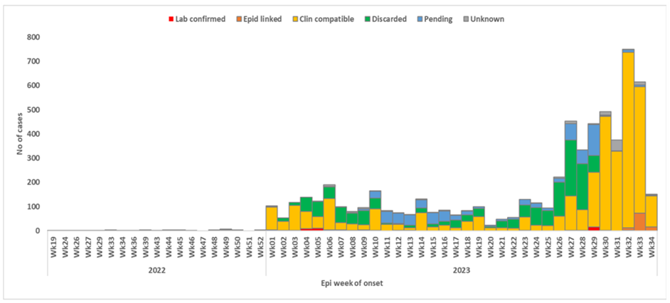
Second wave: 5,898 suspected cases in nine weeks
OUTBREAK 2 | NIGERIA | 2022 TO 2023
8,353
cumulative suspected cases since 2022
4,717
confirmed (56.5%); only 169 by laboratory
WHO Figure 1: cases by epi-week of onset and classification, Nigeria, May 2022 to Aug 2023. Cases surged from week 26 of 2023.
6.1%
Response: NCDC-led working group, rapid response teams, DAT distribution, lab training, routine immunization push.
CFR, down from 13% in April 2023
Source: WHO DON, Nigeria, 13 Sep 2023 (ref 3).
Notes:
Second WHO DON, 13 Sep 2023. From 30 June to 31 August 2023, 5,898 suspected cases from 59 LGAs in 11 states; 99.4 percent from Kano (1,816), Katsina (234), Yobe (158), Bauchi (79), Kaduna (45) and Borno (33). Week 34 had 234 suspected cases from 20 LGAs in five states. Cumulative since 2022: 8,353 suspected, 4,717 confirmed (56.5 percent): 169 laboratory (3.6 percent), 117 epidemiologically linked, 4,431 clinically compatible (93.9 percent). CFR slipped from 6.7 to 6.1 percent. Chart is WHO Figure 1 from the DON (epi-week of onset by classification). Response: NCDC-led national technical working group, rapid response teams, DAT distribution since Dec 2022, laboratory training and reagents, routine immunization strengthening.

Slide 9
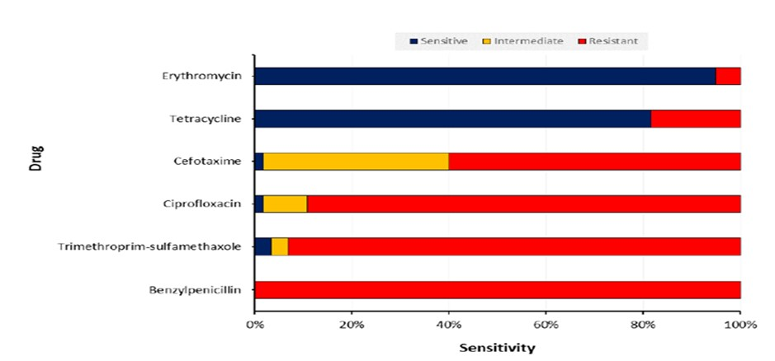
Unvaccinated children and penicillin-resistant isolates
OUTBREAK 2 | NIGERIA | 2022 TO 2023
WHO Figure 2: drug sensitivity of C. diphtheriae isolates, Nigeria
All 62 isolates resistant to penicillin; erythromycin became the drug of choice.
Takeaway: 59% of confirmed cases were unvaccinated, and 73.5% were aged 1 to 14 years. Susceptibility testing changed first-line therapy.
*Computed: 4,717 minus 3,466. Unknown vaccination status computed as the remainder. Source: WHO DON, Nigeria, 13 Sep 2023 (ref 3).
Notes:
Among 4,717 confirmed cases: 73.5 percent (3,466) were aged 1 to 14 years (0 to 4 yrs 699; 5 to 9 yrs 1,505; 10 to 14 yrs 1,262); 15 and older is the remainder, 1,251, computed. 56.3 percent were female. Vaccination status: fully vaccinated 1,074 (22.8 percent), partially 299 (6.3 percent), unvaccinated 2,801 (59.4 percent); the remaining 543 are unknown, computed as the difference. Laboratory testing found C. diphtheriae as the main pathogen and C. ulcerans also. All 62 isolates tested were resistant to penicillin; most were resistant to trimethoprim-sulfamethoxazole and ciprofloxacin; susceptible to erythromycin, which became the drug of choice. Lesson: antimicrobial susceptibility testing must guide treatment and prophylaxis guidance.

Slide 10
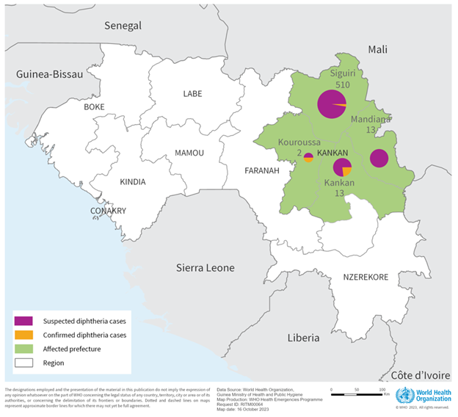
Guinea 2023: 538 cases, concentrated in Siguiri
OUTBREAK 3 | GUINEA | 2023
538
58
cases: 520 suspected, 18 confirmed
deaths; CFR 11% across all cases
95%
0
of cases in Siguiri prefecture (510)
of 538 cases were vaccinated
WHO was notified on 5 Sep 2023. Two children, aged 2 and 4, presented at Siguiri hospital on 4 July with breathing difficulty and fever. 461 contacts were followed up.
Source: WHO DON, Guinea, 18 Oct 2023, Figure 1 map (ref 4).
Notes:
WHO DON of 18 Oct 2023. Ministry of Health notified WHO on 5 September 2023. Index: two children aged 2 and 4 presented on 4 July 2023 at Siguiri prefectural hospital with dyspnea, dysphagia, fever and cough. From 4 July to 13 Oct 2023: 538 cases (520 suspected, 18 confirmed), 58 deaths (13 among confirmed), CFR 11 percent; 461 contacts followed. Siguiri had 510 cases (95 percent); Mandiana 13; Kankan 13; Kouroussa 2; Kerouane none. None of the 538 cases was vaccinated. The map is the WHO map from the DON (purple suspected, orange confirmed).

Slide 11
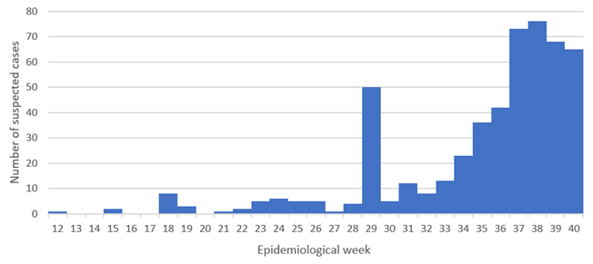
Young children bore the burden; Kankan deaths were extreme
OUTBREAK 3 | GUINEA | 2023
WHO Figure 2: suspected cases by epidemiological week, as of 13 Oct 2023.
Siguiri treatment centres
Kankan treatment centre
37 of 363 admitted died (10%)
12 of 15 admitted died (80%)
Source: WHO DON, Guinea, 18 Oct 2023 (ref 4).
Notes:
Age: 1 to 4 years 445 cases (82 percent), 5 to 9 years 5 percent, 10 and older 5 percent; children under 12 months 7 percent (overlaps with the 1 to 4 group definition in the DON text; percentages as stated). 62 percent of cases were female. Epi curve is WHO Figure 2: a spike in epi week 29, then sustained growth to a peak around weeks 37 to 38. Treatment centres: Siguiri 37 of 363 admitted patients died (10 percent); Kankan 12 of 15 died (80 percent). Treatment centres lacked staff and materials; first-line therapy was amoxicillin and azithromycin; antitoxin was not mentioned among available treatments.

Slide 12
Why Guinea was vulnerable, and what came next
OUTBREAK 3 | GUINEA | 2023
Drivers and response
Chronically low DTP3 coverage: under 50% since 2014
Overcrowded Siguiri, mining-related population movement
Under-staffed, under-equipped treatment centres; DAT supply very limited
Concurrent pertussis, polio and rabies
Response: contact tracing, isolation, amoxicillin and azithromycin, MSF-supported free care, community engagement
WHO risk: high nationally, moderate regionally, low globally
Recurrence, June to Nov 2025
476 cases, 123 deaths (CFR 25.8%)
Sources: WHO DON, Guinea, 18 Oct 2023 (ref 4); WHO DON, African Region, 21 Nov 2025 (ref 1). Threshold 80% is the low end of the DON's 80 to 85% range.
Notes:
WHO assessed risk as high nationally, moderate regionally and low globally. DTP3 coverage: 47 percent nationally in 2022 and below 50 percent since 2014; 36 percent in the affected region per a 2023 household survey; community protection needs roughly 80 to 85 percent. Other drivers: overpopulated Siguiri health district, weak and under-staffed health system, mining-related population movement, concurrent pertussis, polio and rabies. Response: surveillance, daily regional coordination with MSF Belgium, contact tracing and isolation, antibiotic treatment and prophylaxis, risk communication. DAT supply was very constrained globally. The 2025 AFRO DON shows resurgence in the same Siguiri area: 476 suspected cases and 123 deaths (CFR 25.8 percent) since June 2025, and that 2023 event totalled over 4,500 suspected cases.

Slide 13
Yemen 2017: 333 suspected cases in 20 governorates
OUTBREAK 4 | YEMEN | 2017
333
35
suspected cases, 13 Aug to 21 Dec
deaths; CFR 10.5%
20
0
governorates affected
cases laboratory confirmed
No laboratory confirmation was possible, so the outbreak was classified on clinical diagnosis. It overlapped with armed conflict and an unprecedented cholera outbreak.
*Computed: 333 minus 187. Source: WHO DON, Yemen, 22 Dec 2017 (ref 5).
Notes:
WHO DON of 22 Dec 2017. WHO's Sana'a team received reports from Ibb governorate on 29 Oct 2017. From 13 Aug to 21 Dec 2017: 333 suspected cases including 35 deaths (CFR 10.5 percent) from 20 governorates. No laboratory confirmation was possible, so this was treated as a suspected outbreak based on clinical diagnosis. Ibb had 187 cases; the other 19 governorates had the remaining 146 (computed). 79 percent of cases under 20 years; 19 percent under 5; 61 percent never vaccinated; 14 of the 35 deaths were in children under five. Note: the DON's epidemic curve (Figure 1, MoPHP data, onset missing for 31 cases and 10 deaths) was not available in the copy we hold, so no figure is reproduced.

Slide 14
Young and unvaccinated: 79% under 20, 61% never immunized
OUTBREAK 4 | YEMEN | 2017
14 of 35
WHO interpretation: insufficient childhood coverage combined with waning immunity in previously vaccinated people.
deaths were children under 5 (40%*)
*Computed from reported percentages and counts. Source: WHO DON, Yemen, 22 Dec 2017 (ref 5).
Notes:
Age: 79 percent of suspected cases were under 20 and 19 percent were under 5; the 5 to 19 group is computed as 60 percent and 20 and over as 21 percent. Sex: similar numbers of males and females. Vaccination: 61 percent never received any diphtheria vaccine; the remaining 39 percent are vaccinated or unknown (computed). Deaths: 14 of 35 (40 percent, computed) occurred in children under five. WHO interpretation: an outbreak indicates insufficient coverage of national childhood programs plus waning immunity in previously vaccinated people.

Slide 15
Yemen response: antitoxin, antibiotics and vaccination
OUTBREAK 4 | YEMEN | 2017
8,500
1,000
2.1M + 9M
children under 5 vaccinated in Ibb in November
vials of antitoxin plus US$ 200,000 of antibiotics delivered
pentavalent and Td doses planned, three rounds each
Response
WHO risk: very high nationally, high regionally
Task Force (Ministry, WHO, UNICEF) and emergency operations centre
Active case finding, contact antibiotics, treatment units with ICUs
Community engagement; vaccine acceptance still very high
Armed conflict and an unprecedented cholera outbreak
Health workers unpaid, services disrupted
Limited global DAT supply, no lab reagents in country
Source: WHO DON, Yemen, 22 Dec 2017 (ref 5).
Notes:
Response: Diphtheria Task Force (MoPHP, WHO, UNICEF) and an Emergency Operating Centre; active case detection and contact tracing with antibiotics for contacts; treatment units with ICUs in affected districts with MSF; WHO delivered 200,000 US dollars of antibiotics and 1,000 vials of DAT; in November 8,500 children under 5 were vaccinated in al-Saddah and Yarim districts of Ibb; planned campaign for pentavalent (age 6 weeks to 7 years) and Td (7 to 25 years), three rounds each, with UNICEF delivering 600,000 pentavalent and 3 million Td doses initially, scaling to 2.1 million and 9 million. WHO risk: very high nationally and high regionally, due to conflict, cholera, disrupted health services, unpaid health workers, limited global DAT supply and no lab reagents in country. Community vaccine acceptance was still very high.

Slide 16
Limitations, conclusions and lessons learned
LIMITATIONS, CONCLUSIONS AND LESSONS LEARNED
Limitations
Conclusions
Lessons learned
Mostly suspected or clinical cases: lab confirmation 5.7% (Africa 2025), 169 of 4,717 (Nigeria), none (Yemen)
Under-reporting and delayed data
DON snapshots differ in dates and definitions; CFRs not directly comparable
National coverage hides local gaps
Outbreaks followed low coverage and waning immunity in fragile, conflict-affected settings
Burden shifted to older children and adults
Fatality tracks access to antitoxin: Nigeria CFR 13% to 6.1%; Guinea's Kankan centre 80%
Antibiotic resistance (penicillin) changed therapy
Keep DTP3 above 80 to 85% and boost older children
Stockpile antitoxin and supplies regionally
Build lab capacity and susceptibility testing
Strengthen IPC, early case finding and community engagement
Reach displaced and mobile populations
Sources: WHO DONs, refs 1 to 5; WHO risk assessment, ref 6.
Notes:
Limitations: most cases are suspected or clinically diagnosed, not laboratory confirmed (5.7 percent of suspected cases in the 2025 African Region report; 169 of 4,717 in Nigeria; none in Yemen), so counts may include non-diphtheria illness and miss true cases. Under-reporting is acknowledged in Nigeria and Mali. Reports are snapshots with different dates, case definitions and denominators, so CFRs and coverage are not strictly comparable. Some DON figures were images we could not recover (Yemen epi curve). Coverage numbers are national and hide local gaps. Conclusions: every outbreak occurred where vaccine coverage was low or immunity waned, in fragile or conflict-affected settings. Case fatality tracks access to antitoxin and care: Nigeria fell from 13 to 6.1 percent as DAT arrived, Guinea had 80 percent in one centre and 25.8 percent in 2025. Lessons: sustain routine immunization above 80 to 85 percent, close gaps in older children and adults, stockpile DAT regionally, fund laboratories and susceptibility testing, strengthen IPC and community engagement, and reach displaced populations.

Slide 17
References
SOURCES, AMA FORMAT
World Health Organization. Diphtheria - African Region (AFRO). Disease Outbreak News. November 21, 2025. Accessed November 13, 2026. https://www.who.int/emergencies/disease-outbreak-news/item/2025-DON588
World Health Organization. Diphtheria - Nigeria. Disease Outbreak News. April 27, 2023. Accessed November 13, 2026. https://www.who.int/emergencies/disease-outbreak-news/item/2023-DON452
World Health Organization. Diphtheria - Nigeria. Disease Outbreak News. September 13, 2023. Accessed November 13, 2026. https://www.who.int/emergencies/disease-outbreak-news/item/2023-DON485
World Health Organization. Diphtheria - Guinea. Disease Outbreak News. October 18, 2023. Accessed November 13, 2026. https://www.who.int/emergencies/disease-outbreak-news/item/2023-DON492
World Health Organization. Diphtheria - Yemen. Disease Outbreak News. December 22, 2017. Accessed November 13, 2026. https://www.who.int/emergencies/disease-outbreak-news/item/22-december-2017-diphtheria-yemen-en
World Health Organization. Rapid risk assessment, acute event of potential public health concern: diphtheria, African Region. Version 2. March 16, 2026. Accessed November 13, 2026. https://cdn.who.int/media/docs/default-source/_sage-2026/who-rapid-risk-assessment---diphtheria---african-region-v.2.pdf
Notes:
All sources are WHO Disease Outbreak News reports. Update the accessed date to the day you open each page.

