Slide 1
Sketch2Face
Cross-modal face retrieval
CUFS CUHK subset
Ipsita | Roll: 12308012 (placeholder)
B.Tech in Artificial Intelligence and Machine Learning
Lovely Professional University | 2023-2027
Guide: [Guide name - placeholder]
Notes:
Introduce the project as sketch-to-photo retrieval. Replace the two marked placeholders before submission. All numeric results come from completed local experiments.
Evidence: outputs/results/summary.json. Paper source targets the official IEEE SPS ieeeconf.cls with cameraready. The paper template does not define slide formatting.

Slide 2
Problem and objective
Input: one face sketch and a gallery of candidate photos
Output: photos ranked by similarity to the person in the sketch
Challenge: preserve identity across pencil strokes and photographic appearance
Objective: build the matcher and measure rank-k retrieval accuracy
2
Notes:
This is a retrieval project, not a face generation project. Training identities differ from test identities. Motivation is forensic search, but the evaluation uses viewed artist sketches.
Evidence: outputs/results/summary.json. Paper source targets the official IEEE SPS ieeeconf.cls with cameraready. The paper template does not define slide formatting.

Slide 3
Dataset audit
Full CUFS description: 606 identities across CUHK, AR, and XM2VTS
Downloaded mirror: 188 usable CUHK sketch-photo pairs
Extra unpaired sketches and duplicate original files were excluded
Every reported result is for the verified CUHK subset
3
Notes:
Sources: references [1], [2], [6]. Official archive returned HTTP 500. Public mirror version 1 has 188 files in photos and 188 files in sketches. Archive checksum and mapping rules are in outputs/data_provenance.json.
Evidence: outputs/results/summary.json. Paper source targets the official IEEE SPS ieeeconf.cls with cameraready. The paper template does not define slide formatting.

Slide 4
Identity-disjoint evaluation
114 training identities: learn sketch-photo correspondence
37 validation identities: select the checkpoint
37 test identities: final held-out experiment
Each test sketch searches all 37 held-out photos
4
Notes:
Split seed 42, one pair per identity, custom 60/20/20 split with floor rounding. Both images of each person stay in the same split. The correct photo is present by design: this is closed-set evaluation.
Evidence: outputs/results/summary.json. Paper source targets the official IEEE SPS ieeeconf.cls with cameraready. The paper template does not define slide formatting.

Slide 5
Model architecture
Stage | Operation | Output
Preprocessing | Grayscale, resize, normalize | 3 x 224 x 224
Modality input | Sketch or photo residual adapter | 3 x 224 x 224
Shared encoder | ImageNet-pretrained ResNet-18 | 512 features
Projection | Linear, ReLU, Linear, normalize | 256-D embedding
Retrieval | Cosine similarity to gallery | Ranked photos
5
Notes:
ResNet-18: He et al. [3]. The adapters are residual 1x1 convolutions, zero-initialized. There are only 18 adapter parameters total. No face detector, landmark alignment, photo synthesis, or language model is used.
Evidence: outputs/results/summary.json. Paper source targets the official IEEE SPS ieeeconf.cls with cameraready. The paper template does not define slide formatting.

Slide 6
Paired contrastive learning
A batch contains sketches and photos of distinct paired identities
Correct sketch-photo pairs are positives; other people are negatives
Learn in both directions: sketch to photo and photo to sketch
L = 0.5 x [CE(S Pᵀ / τ) + CE(P Sᵀ / τ)], τ = 0.07
6
Notes:
The diagonal pair indices are the cross-entropy targets. S and P are L2-normalized embeddings. The symmetric paired objective follows the form used in CLIP [4]; no CLIP weights or text encoder are used. Similarity is not an identity probability.
Evidence: outputs/results/summary.json. Paper source targets the official IEEE SPS ieeeconf.cls with cameraready. The paper template does not define slide formatting.

Slide 7
Training and comparisons
20 epochs; batch size 32; AdamW optimization
Freeze backbone for 3 epochs, then fine-tune the final residual stage
Compare frozen baseline, trained matcher, and no-adapter ablation
Repeat matcher training with seeds 42, 43, and 44
7
Notes:
Learning rates: 3e-4 projection/adapters and 3e-5 encoder; weight decay 1e-4. Frozen BatchNorm statistics. Checkpoint selection uses validation rank-1, then MRR. Primary seed fixed at 42. Test never selects the model. AdamW: [5].
Evidence: outputs/results/summary.json. Paper source targets the official IEEE SPS ieeeconf.cls with cameraready. The paper template does not define slide formatting.

Slide 8
Measured retrieval accuracy
Model | Epoch | Rank-1 (%) | Rank-5 (%) | Rank-10 (%)
Frozen baseline | 0 | 27.03 | 51.35 | 72.97
Matcher seed 42 | 20 | 72.97 | 89.19 | 100.00
Matcher seed 43 | 20 | 67.57 | 89.19 | 100.00
Matcher seed 44 | 16 | 67.57 | 91.89 | 100.00
Without adapters | 18 | 67.57 | 97.30 | 100.00
8
Notes:
All values are percentages on the same 37-photo test gallery. Epoch is selected using validation. Source: outputs/results/summary.json. All predeclared runs are included.
Evidence: outputs/results/summary.json. Paper source targets the official IEEE SPS ieeeconf.cls with cameraready. The paper template does not define slide formatting.

Slide 9
CMC comparison
37 test sketches searching the same 37-photo gallery
9
Notes:
Source: actual CMC arrays in per-run metrics.json. CMC is the fraction of correct photos found by rank k. The primary model reaches 100 percent at rank 10 within this gallery; this does not predict accuracy on larger galleries.
Evidence: outputs/results/summary.json. Paper source targets the official IEEE SPS ieeeconf.cls with cameraready. The paper template does not define slide formatting.

Slide 10
Rank-k comparison
37 test sketches searching the same 37-photo gallery
10
Notes:
Editable native PowerPoint chart. Source: outputs/results/summary.json. The primary model has higher rank-1, while the no-adapter ablation has higher rank-5. Both reach 100 percent rank-10 on these observed queries.
Evidence: outputs/results/summary.json. Paper source targets the official IEEE SPS ieeeconf.cls with cameraready. The paper template does not define slide formatting.

Slide 11
What the experiments show
Primary rank-1: 27 correct queries out of 37 (72.97%)
Frozen baseline: 10 correct queries out of 37 (27.03%)
Paired rank-1 gain: 45.95 percentage points; 95% interval 27.03–64.86
Three-seed mean rank-1: 69.37% ± 3.12 percentage points
11
Notes:
The gain interval uses 10000 paired query bootstrap samples. The ± quantity is sample standard deviation across three training seeds, not a confidence interval. The primary model recovers 19 baseline failures and loses two baseline successes.
Evidence: outputs/results/summary.json. Paper source targets the official IEEE SPS ieeeconf.cls with cameraready. The paper template does not define slide formatting.

Slide 12
Adapter ablation and errors
Without adapters: 67.57% rank-1, 97.30% rank-5
Adapters improve primary rank-1, but reduce rank-5 in this comparison
Ten primary queries fail at rank 1; the hardest correct match is rank 10
One ablation seed does not establish a consistent adapter benefit
12
Notes:
Source: summary.json and matcher/retrievals.json. Do not claim that the adapters explain all improvement. The safer finding is the benefit of the trained representation relative to generic frozen features. Demonstrate actual failures in the local app instead of embedding dataset photos in the public deck.
Evidence: outputs/results/summary.json. Paper source targets the official IEEE SPS ieeeconf.cls with cameraready. The paper template does not define slide formatting.

Slide 13
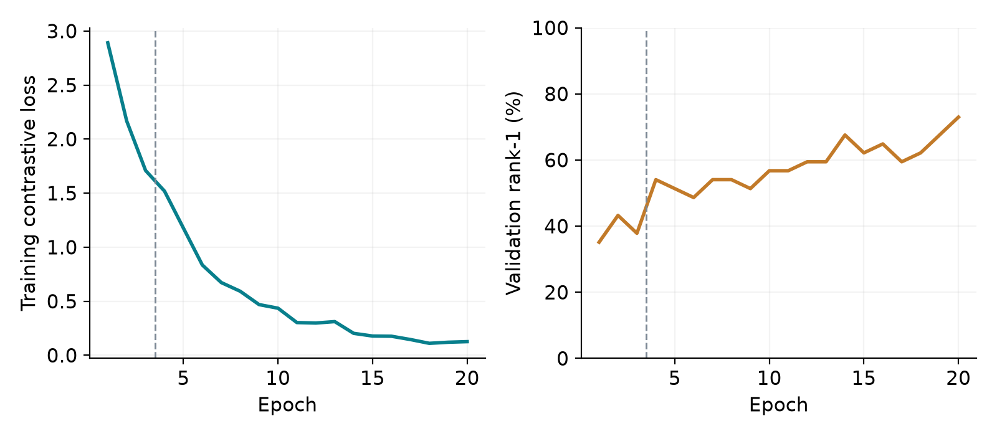
Learning curves
13
Notes:
Source: runs/matcher/history.json copied into outputs/results/matcher/history.json. The dashed line separates warmup and layer-4 fine-tuning. The selected primary epoch is 20, at the training budget boundary, so optimal duration and convergence are not established.
Evidence: outputs/results/summary.json. Paper source targets the official IEEE SPS ieeeconf.cls with cameraready. The paper template does not define slide formatting.

Slide 14
Limitations
Only the CUHK subset; AR and XM2VTS pairs remain untested
Small closed-set gallery: 37 photos; no unknown-person rejection
Viewed artist sketches differ from eyewitness and composite sketches
No demographic fairness, forensic reliability, or state-of-the-art claim
14
Notes:
Each test success changes accuracy by 2.70 percentage points. Bootstrap intervals condition on this fixed gallery. A 100 percent observed rank-10 result is not proof of perfect future retrieval. Pretraining identity overlap was not independently audited.
Evidence: outputs/results/summary.json. Paper source targets the official IEEE SPS ieeeconf.cls with cameraready. The paper template does not define slide formatting.

Slide 15
Demo and conclusion
Website: http://localhost:8000
Upload a sketch and candidate photos, then inspect the ranked results
Paired training improves the measured frozen baseline
Next: full CUFS, larger galleries, repeated ablations, forensic datasets
15
Notes:
Launch: uv run uvicorn sketch2face.web:app --host 127.0.0.1 --port 8000. Open http://localhost:8000. The FastAPI backend and responsive HTML/CSS/JavaScript frontend accept actual image uploads and execute real model retrieval. Upload one query sketch and candidate photographs, run retrieval, inspect rank and similarity, and explain that the correct person may be absent. This upload workflow has no independently measured forensic accuracy. Streamlit remains a legacy optional interface. Never present cosine similarity as identity probability. Use local, authorized face data for demonstrations; no dataset faces are embedded in this public deck.
Evidence: outputs/results/summary.json. Paper source targets the official IEEE SPS ieeeconf.cls with cameraready. The paper template does not define slide formatting.

Slide 16
References
Wang & Tang, Photo-Sketch Synthesis and Recognition, TPAMI 2009
Zhang et al., Coupled Information-Theoretic Encoding, CVPR 2011
He et al., Deep Residual Learning, CVPR 2016
Radford et al., Contrastive multimodal learning, ICML 2021
Loshchilov & Hutter, AdamW, ICLR 2019; CUFS mirror, Kaggle v1
16
Notes:
Full citations and access URLs:
[1] X. Wang and X. Tang, "Face Photo-Sketch Synthesis and Recognition," IEEE Transactions on Pattern Analysis and Machine Intelligence, vol. 31, no. 11, pp. 1955-1967, 2009. doi:10.1109/TPAMI.2008.222.
[2] W. Zhang, X. Wang, and X. Tang, "Coupled Information-Theoretic Encoding for Face Photo-Sketch Recognition," IEEE CVPR, pp. 513-520, 2011.
[3] K. He, X. Zhang, S. Ren, and J. Sun, "Deep Residual Learning for Image Recognition," IEEE CVPR, pp. 770-778, 2016. https://arxiv.org/abs/1512.03385.
[4] A. Radford et al., "Learning Transferable Visual Models From Natural Language Supervision," ICML, PMLR 139, pp. 8748-8763, 2021. https://arxiv.org/abs/2103.00020.
[5] I. Loshchilov and F. Hutter, "Decoupled Weight Decay Regularization," ICLR, 2019. https://arxiv.org/abs/1711.05101.
[6] Arbaz Khan, "CUHK Face Sketch Database (CUFS)," Kaggle public mirror, version 1, updated October 8, 2020; accessed November 9, 2026. https://www.kaggle.com/datasets/arbazkhan971/cuhk-face-sketch-database-cufs. Data rights retained by original authors.
Evidence: outputs/results/summary.json. Paper source targets the official IEEE SPS ieeeconf.cls with cameraready. The paper template does not define slide formatting.

