Slide 1
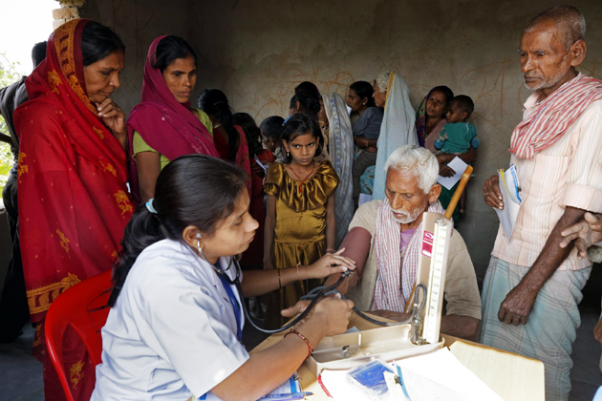

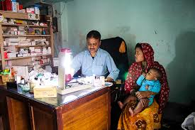
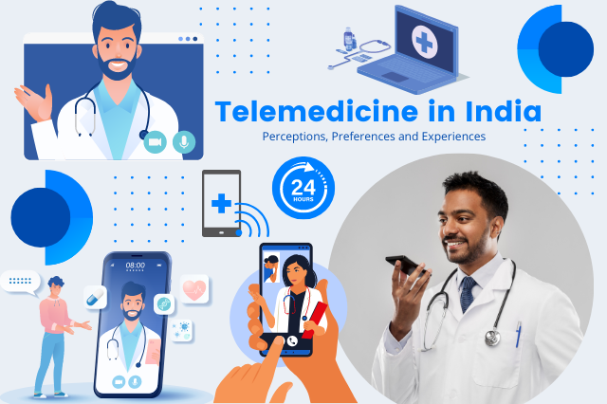
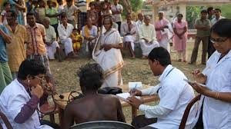

INDIA HAS THE HIGHEST RURAL POPULATION IN THE WORLD, ITS HIGH TIME WE TAKE ACTION
Created by Team HAITech

Slide 2

1.About us
We’re HAITech, a group of three friends—Hemashree, Aswin, and Ipsita. We’re currently in our 3rd year of B.Tech in Artificial Intelligence & Data Science.
Medec+ is a project very close to our hearts as we aim to fulfill the necessities of Rural India using modern Tech.
130280aswin.gbkm@gmail.com
kipsita205@gmail.com
https://www.linkedin.com/in/ipsita-kar-/
auroradestiny123@gmail.com

Slide 3




2.Problem HEALTH CARE ACCESIBILITY IN RURAL INDIA
Market Gap
Customers
The healthcare system in rural India faces challenges due to limited access to medical services. This is exacerbated by geographic and resource constraints, making it difficult for patients in remote areas to receive adequate care
Patients in rural areas often face communication barriers and lack access to reliable telehealth services. These challenges lead to misunderstandings and sub-optimal care, proving a need for user-friendly solutions.
Usability
Financials
The application designed for rural populations must be easy to operate, even for those who are not tech-savvy or are non-native speakers. It should minimize dependency on others and be user-friendly.
Improving healthcare accessibility could lead to significant financial gains by tapping into the underserved market, increasing revenue, and reducing costs associated with delayed or inadequate care.

Slide 4





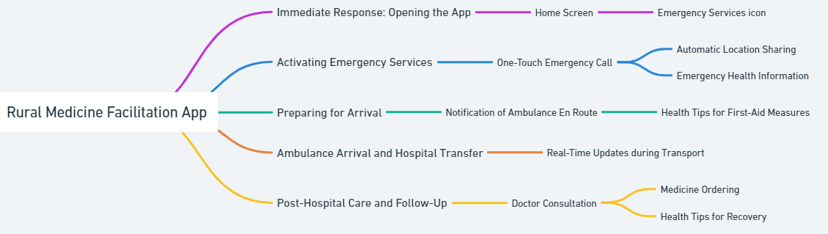
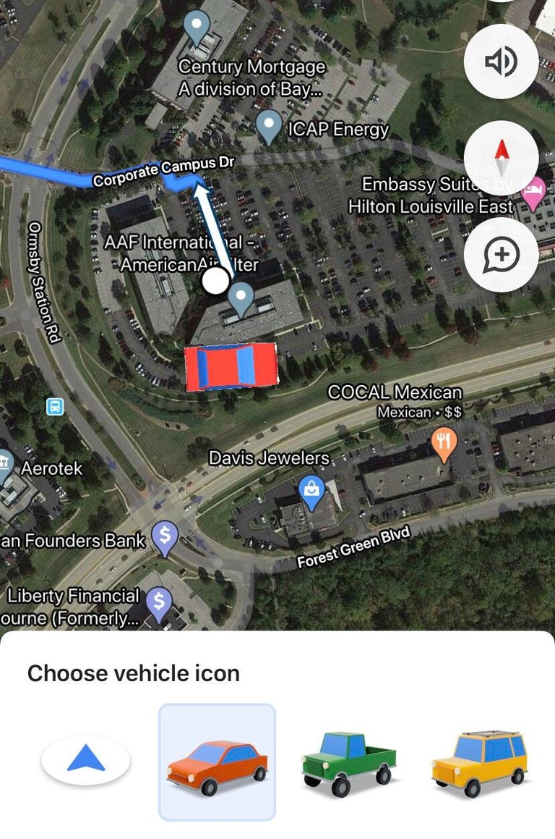
SCENARIO (EXAMPLE)
You have just experienced a hemorrhage while working on the farm. Your husband, noticing the emergency, takes out his phone and opens the rural medicine facilitation app.
1)Open App → Select "Emergency Services"
Your husband taps the "Call Ambulance" button.
The app automatically shares your location and critical health information.
2)Receive First-Aid Guidance
The app provides audio instructions on immediate care.
3)Ambulance Arrival and Hospital Transfer
Your husband follows real-time updates provided by the app.
4)Post-Hospital Care
Book a follow-up consultation.
Order prescribed medicines.
Receive ongoing health tips and guidance for recovery.

Slide 5

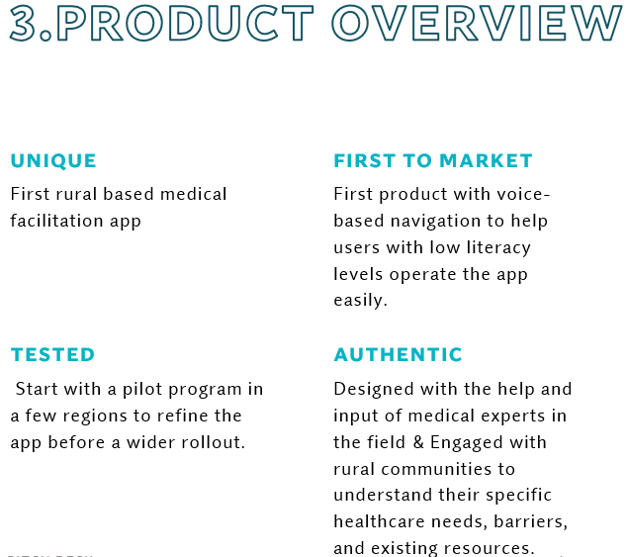






KEY FEATURES
Multilingual Support: Incorporate regional languages with simple and clear communication, including text, audio, and video instructions.
Voice Assistance: Use voice-based navigation to help users with low literacy levels operate the app easily.
Offline Access: Include an offline mode for areas with limited internet connectivity. Information and consultation histories should sync when the device reconnects.
User-Friendly Interface: Design an intuitive, minimalistic interface with clear icons, images, and simple language.
Telemedicine Integration: Enable easy access to telemedicine consultations with healthcare professionals, including features like video calls, chat, and prescription management.
Health Education: Provide accessible health education content on common diseases, preventive care, and maternal health.
Emergency Services: Integrate a feature to connect users with nearby healthcare facilities or ambulances in case of emergencies.

Slide 6




Solution
Close the gap
Target Audience
Our product makes medical equipment/appointments easier​ to access even in rural areas.
Rural areas & Remote villages
Cost savings
Easy to use
Online access to telemedicine consultations with healthcare professionals, including features like video calls, chat, and prescription management.
Provide accessible health education content on common diseases, preventive care, and maternal health.
Integrates a feature to connect users with nearby healthcare facilities or ambulances in case of emergencies.

Slide 7






Technology stack
Cross-Platform Development:
We use a cross-platform framework like Flutter or React Native to ensure the app runs on Android
Backend Infrastructure:
Developed a robust backend that supports real-time communication, user management, and data synchronization.
Scalable Cloud Services:
Hosted the application on scalable cloud services (like AWS, Azure) to ensure it can handle varying loads.

Slide 8



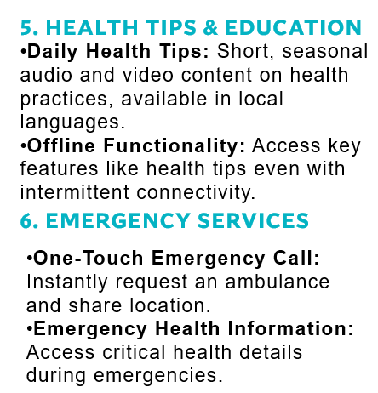
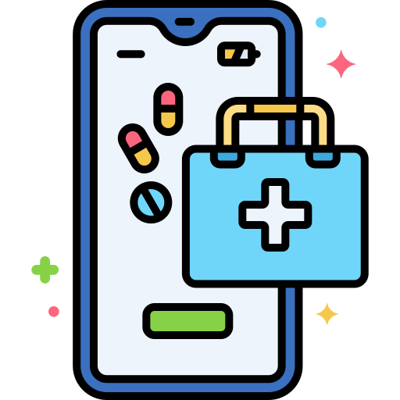

workflow
1.User Onboarding & Accessibility
2. Main Interface & Navigation
Multi-Language Support: Available in regional languages and dialects.
Voice Commands & Audio Guides: Navigate and receive instructions in local languages, catering to all literacy levels.
Simple Registration: Quick sign-up via phone number or Aadhar, guided by icons and voice prompts.
Home Screen: Features large, culturally resonant icons (e.g., green for health, red for emergencies).
Voice-Based Assistance: Users can speak commands like “Book a Doctor” or “Order Medicine.”
3. Doctor Consultation
4. Medicine Ordering
Appointment Booking: Choose between in-person visits or teleconsultations, with automated scheduling.
Consultation: Optimized for low bandwidth with options for video/audio calls and digital prescriptions (with audio descriptions).
Prescription Upload: Use photo or voice search to identify and order medicines instantly. Upload a photo, and our AI recognizes the text for direct ordering.Delivery Options: Home delivery or local pharmacy pick-up with cash on delivery.

Slide 9
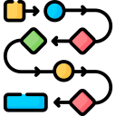
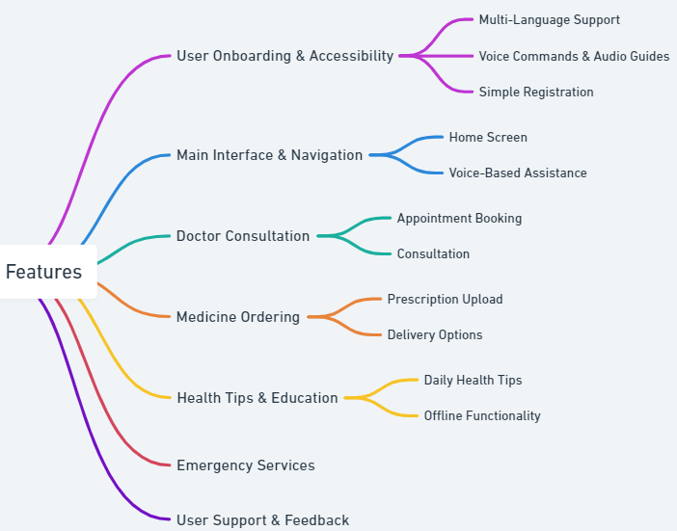
workflow (Architecture)

Slide 10


Our competition
MEDEC+​
Competitors​
Our product is priced below that of other medical supply companies on the market​
Quick and easy to use, compared to the complex ordering system of the competitors​
Affordability is the main draw for our hospitals to our product​
TATA 1MG & Mfine Product is more expensive​
Practo :​ Product is expensive and inconvenient to use​
Ayu Health & Ayushman Bharat: : Product is affordable, but inconvenient to use
Apollo Pharmacy: Good for appointments and orders, but no rural delivery, emergency services, or multi-language support

Slide 11

Growth Strategy
How we’ll scale in the future
Feb 2025
May 2027
June 2028
Roll out product to hospitals in the region to help establish the product​
Release the product to all hospitals and monitor press and regional market trends​
Gather feedback from the medical staff and the healthcare community to expand availability of the product​

Slide 12

Two-year action plan
Supply volunteers​
Run focus groups​
Gather feedback​
2025
Jan
Feb
Mar
Apr
May
Jun
Jul
Aug
Sep
Oct
Nov
Dec
Test ordering​
Regional launch​
Deliver to hospitals​
2027
Jan
Feb
Mar
Apr
May
Jun
Jul
Aug
Sep
Oct
Nov
Dec

Slide 13



FUNCTIONALITY
4. Design Considerations
5. Testing & Iteration
6. Community Engagement & Training
Localized Design: Adapt the design to local cultural contexts, including appropriate color schemes, symbols, and imagery.
Minimal Data Usage: Optimize the app to use minimal data, essential for rural areas with limited connectivity.
Simple Navigation: Use large buttons and icons, clear pathways, and limit the number of steps to complete any task.
Accessibility Features: Ensure compatibility with assistive technologies like screen readers.
Field Testing: Conduct extensive testing with users in rural areas to gather feedback and iterate on the design.
Usability Testing: Ensure the app is intuitive for non-tech-savvy users by observing real-world usage and making necessary adjustments.
Language Testing: Verify the accuracy and effectiveness of translations and voice recognition in all supported languages.
Local Partnerships: Partner with local health workers and NGOs to promote the app and train users.
Train-the-Trainer Programs: Equip local healthcare workers with the knowledge to teach others in the community how to use the app.
Awareness Campaigns: Use local radio, community gatherings, and posters to spread awareness about the app and its benefits.

Slide 14




MANAGEMENT
8. Sustainability & Impact Measurement
7. Deployment & Scaling
Data Collection: Implement analytics to track usage patterns, outcomes, and areas for improvement.
Impact Assessment: Regularly evaluate the app’s impact on healthcare accessibility and quality in rural areas.
Iterative Improvements: Continue refining the app based on user feedback and changing needs.
Phased Rollout: Start with a pilot program in a few regions to refine the app before a wider rollout.
Monitoring & Support: Establish a system for continuous monitoring, user support, and regular updates based on feedback.
Feedback Loops: Create mechanisms for users to provide feedback directly within the app.
9. Security & Privacy
10. Funding & Support
Data Encryption: Ensure that all user data is encrypted and stored securely to protect patient confidentiality.
Compliance: Adhere to local and national regulations regarding healthcare data, such as the Indian IT Act and GDPR for data protection.
Government Collaboration: Work with government bodies to secure funding, support, and endorsements.
NGO Partnerships: Collaborate with NGOs for on-the-ground support and funding opportunities.
Grants & Sponsorships: Seek grants or corporate sponsorships aimed at improving rural healthcare.

Slide 15



Summary
At Medec+, we believe in giving 110%. By closing the loop and delivering medical support, we help hospitals grow and nurture their patients with the latest healthcare products in rural areas. We thrive because of our market knowledge and a great team behind our product.

