Slide 1


Exceptional points, Puiseux series, and Symmetry-allowed Hessenberg forms
IPSITA MANDAL

Slide 2
Why Non-Hermitian (NH) Systems?
Not a new topic ...
Dissipative systems  Experiments
Open, non-equilibrium systems
 interaction with surrounding environment
Effective description of systems with finite lifetime τ
 one-body quasiparticle Hamiltonian
is non-Hermitian as Im[Σ] ~ τ ⁻¹
Photonic systems with gain or loss
Need basic theory involving “Complex Hamiltonians”
Notes:
In photonics, the term gain is usually used to quantify the amplification of optical amplifiers or of a laser gain medium. The gain can simply be an amplification factor, i.e., the ratio of output power and input power.
In laser physics, gain or amplification is a process where the medium transfers part of its energy to the emitted electromagnetic radiation, resulting in an increase in optical power. This is the basic principle of all lasers. Quantitatively, gain is a measure of the ability of a laser medium to increase optical power
https://arxiv.org/pdf/2308.07388.pdf

Slide 3
NH Systems: Specific Examples
Optical model for scattering of nucleons  single particle wavefunction satisfies Schrödinger eqn with NH optical potential
[ F. Coester & H. Kümmel, Nuclear Physics (1958) ]
Decaying states in time-dependent perturbation theory arising as bound states of 2 particles  NH potential
[ M. M. Sternheim & J. F. Walker, PRB (1972) ]
Classical mechanical, electrical, optical systems with dissipation
Notes:
We had to consider an effective TBG, which is the Hamiltonian written in the Wannier orbital basis
These orbitals capture the structure of the low-energy bands
They are centred at AB and BA sites forming a honeycomb
They have a peculiar 3 lobe shape

Slide 4
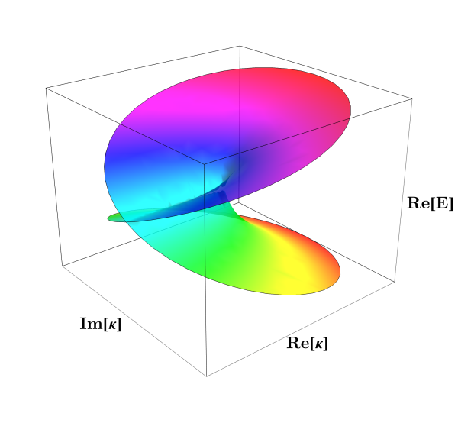



Complex Matrix: Exceptional Points
Singular points of Complex Matrix ☛ Matrix becomes non-diagonizable
☛ Two or more eigenvalues coincide
+ corresponding eigenvectors coalesce into one
A minimal example

Slide 5

Exceptional Points: Minimal Example
Exceptional Point (EP) ☛
Incomplete set of linearly-independent eigenvectors at EP
 H cannot be diagonalized
Winding of κ twice about EP yields winding of E once
EP is a branch point
When can we expect EPs to occur?
What are their consequences?

Slide 6
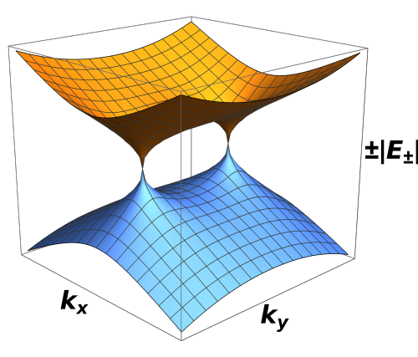
Exceptional Nodal Phases

Slide 7

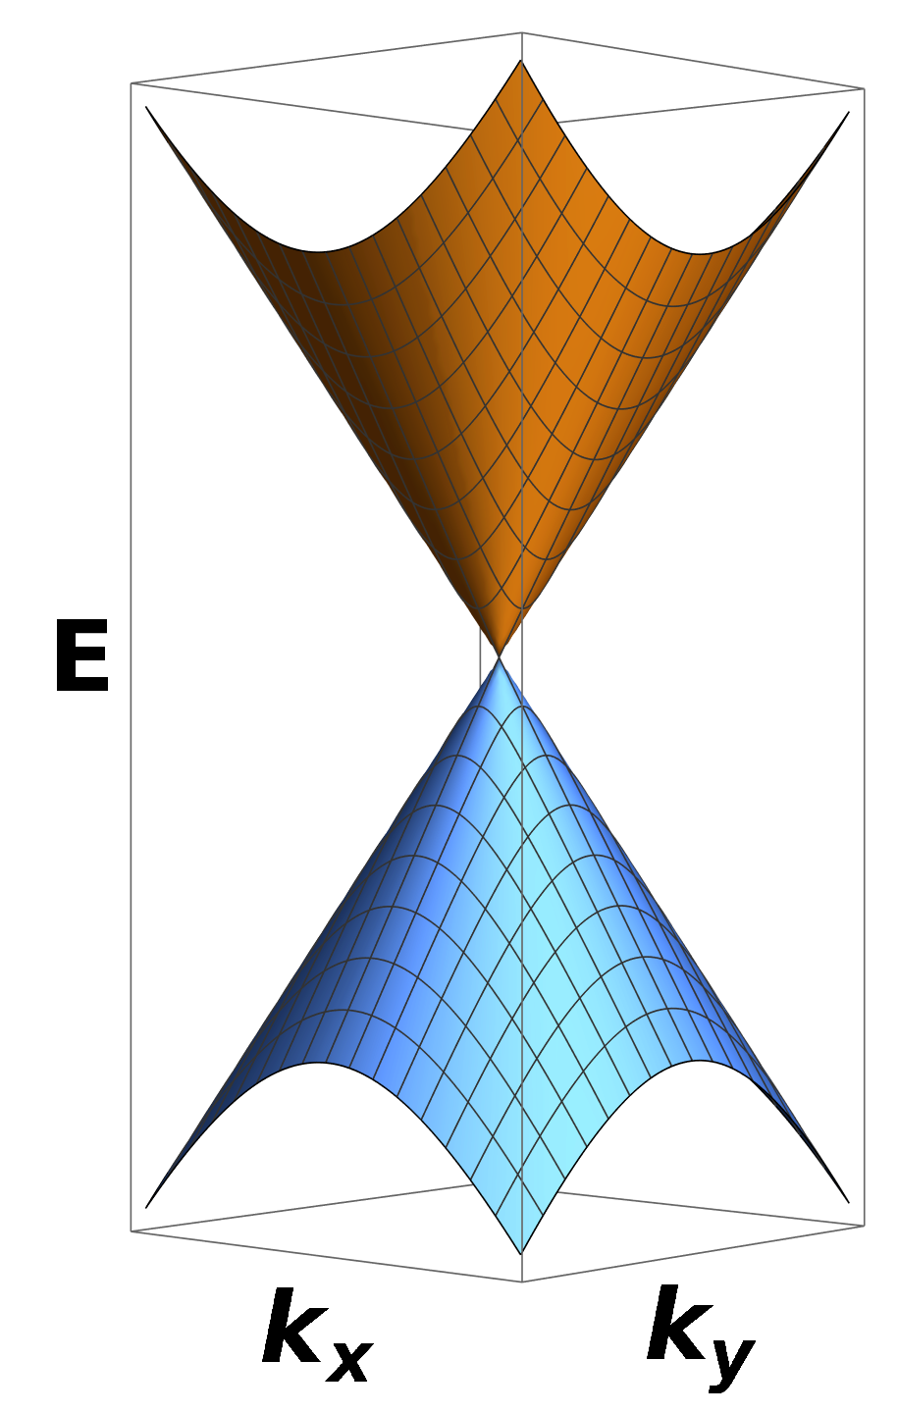
Stable Band Crossing: Topological Phase
Hermitian system  d₁, d₂, d₃ real
Need 3 equations to get a gap closing point  d₁ = d₂ = d₃ = 0
Fine-tuned in d = 2
Stable / generic in d = 3 as 3 equations can be solved for 3 momenta {k_{x}, k_{y}, k_{z}}
 simplest example: Weyl node
Notes:
We had to consider an effective TBG, which is the Hamiltonian written in the Wannier orbital basis
These orbitals capture the structure of the low-energy bands
They are centred at AB and BA sites forming a honeycomb
They have a peculiar 3 lobe shape

Slide 8

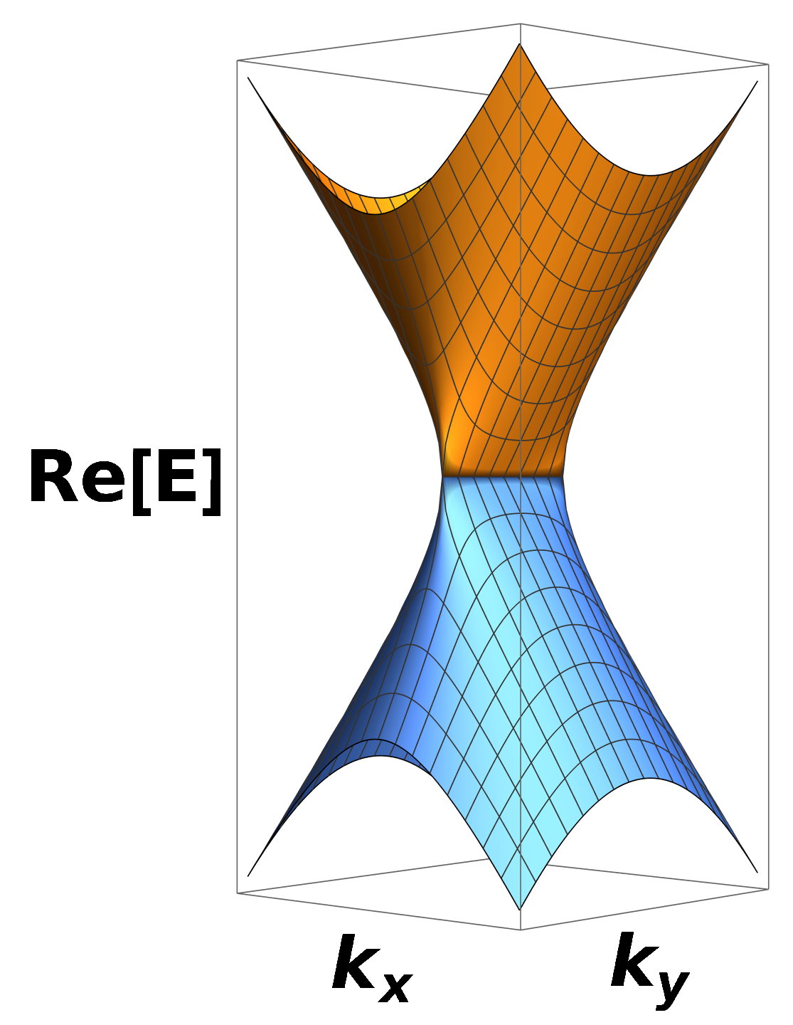
Non-Hermitian (NH) Topology
Non-Hermitian system
Need 2 equations to get a gap closing point
Stable/generic in d = 2 as 2 equations
can be solved for 2 momenta {k_{x}, k_{y}}
Degeneracies appear as EPs
 come in pairs
EP₂
EP₂
Notes:
We had to consider an effective TBG, which is the Hamiltonian written in the Wannier orbital basis
These orbitals capture the structure of the low-energy bands
They are centred at AB and BA sites forming a honeycomb
They have a peculiar 3 lobe shape

Slide 9
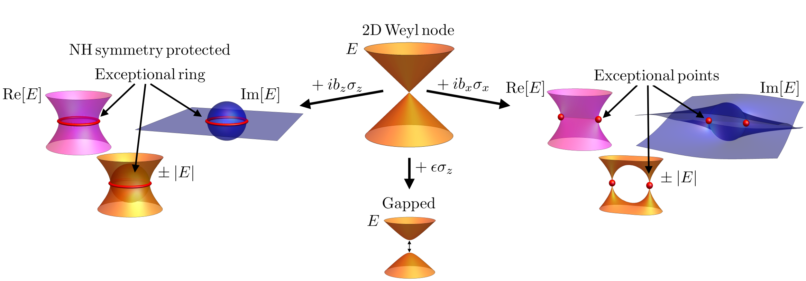
Splitting Weyl Nodes
[ Bergholtz et al (2020) ]
Notes:
We had to consider an effective TBG, which is the Hamiltonian written in the Wannier orbital basis
These orbitals capture the structure of the low-energy bands
They are centred at AB and BA sites forming a honeycomb
They have a peculiar 3 lobe shape

Slide 10

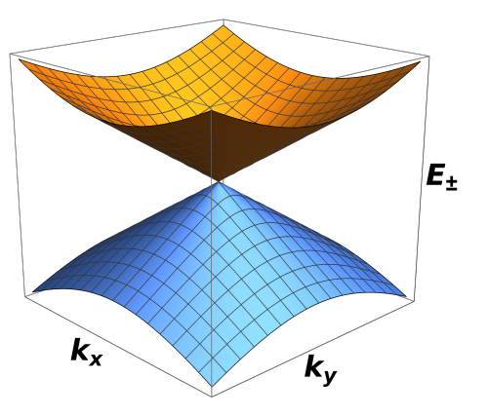
Spectral Features
EPs are non-analytical  “square roots of Weyl points” ☛
EPs come in pairs + generic in 2d
 much more abundant than in Hermitian case
ϵ = 0
ϵ = 0.1
Notes:
We had to consider an effective TBG, which is the Hamiltonian written in the Wannier orbital basis
These orbitals capture the structure of the low-energy bands
They are centred at AB and BA sites forming a honeycomb
They have a peculiar 3 lobe shape

Slide 11
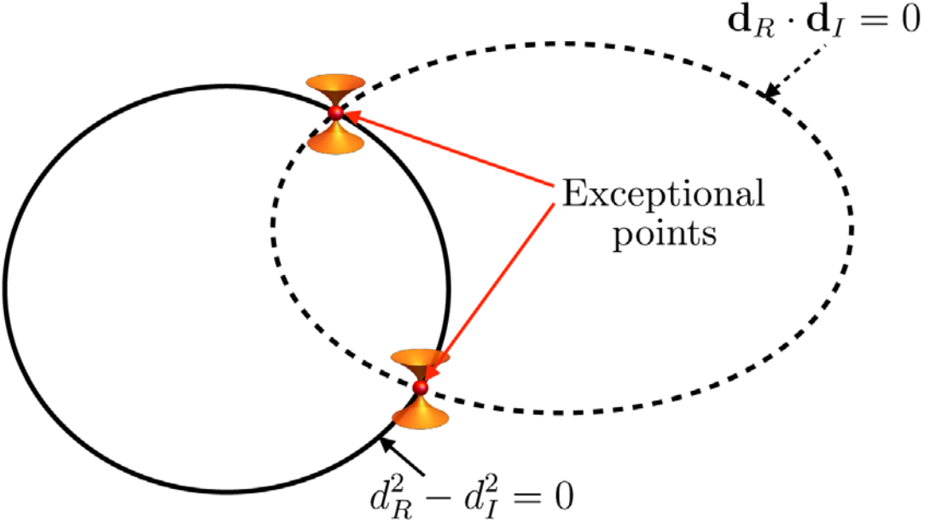
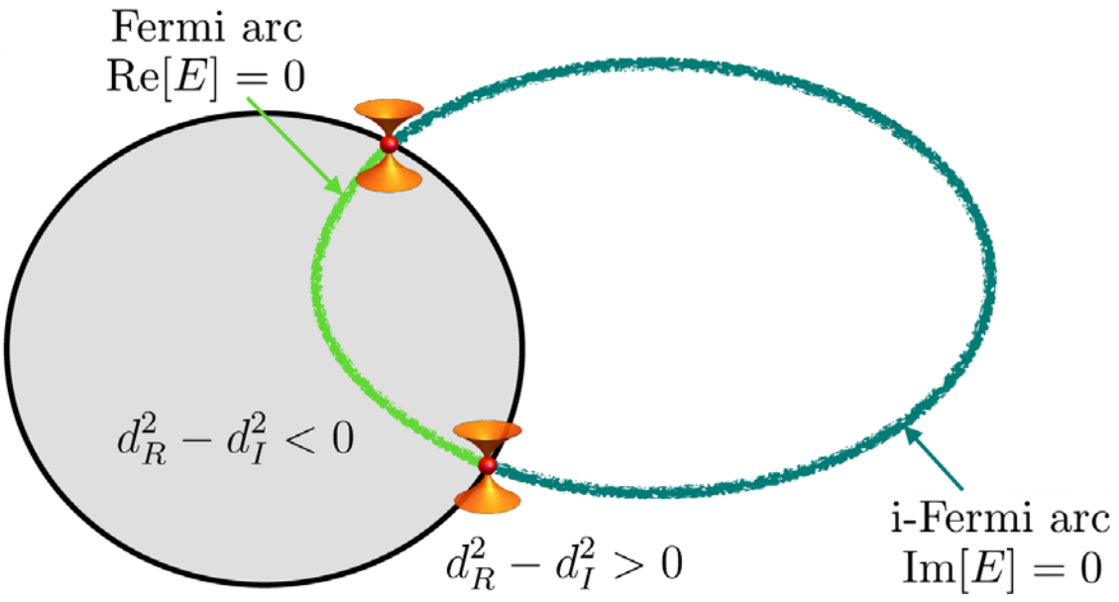
Stable NH Phases
[ Bergholtz et al (2020) ]
Generic (d-1)-dimensional open nodal surfaces / arcs ☛ Stable degeneracies
Notes:
We had to consider an effective TBG, which is the Hamiltonian written in the Wannier orbital basis
These orbitals capture the structure of the low-energy bands
They are centred at AB and BA sites forming a honeycomb
They have a peculiar 3 lobe shape

Slide 12

Around an EP
Move around an EP₂, tracking an eigenstate
We end up in the other eigenstate after one closed orbit
☛ 4π periodicity
Notes:
We had to consider an effective TBG, which is the Hamiltonian written in the Wannier orbital basis
These orbitals capture the structure of the low-energy bands
They are centred at AB and BA sites forming a honeycomb
They have a peculiar 3 lobe shape

Slide 13
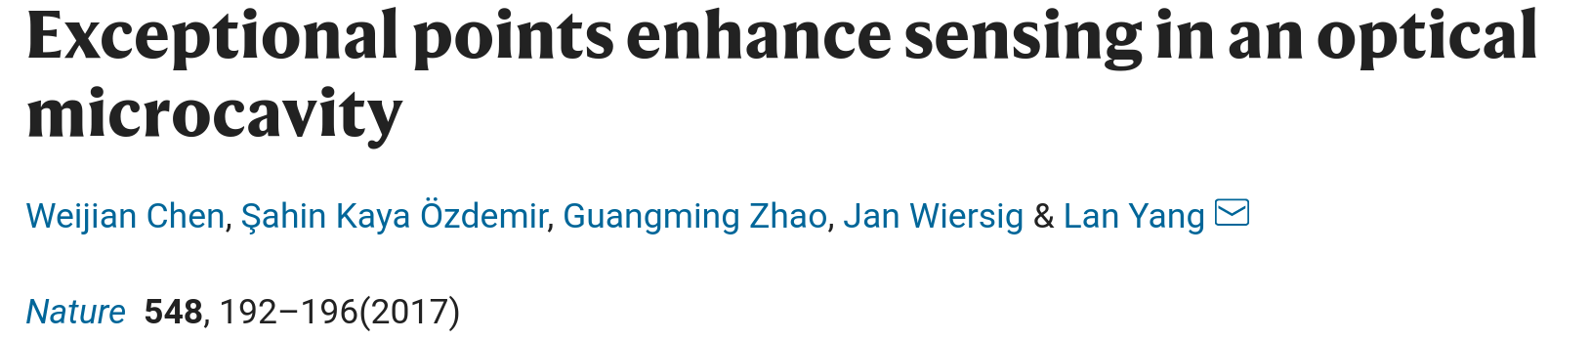
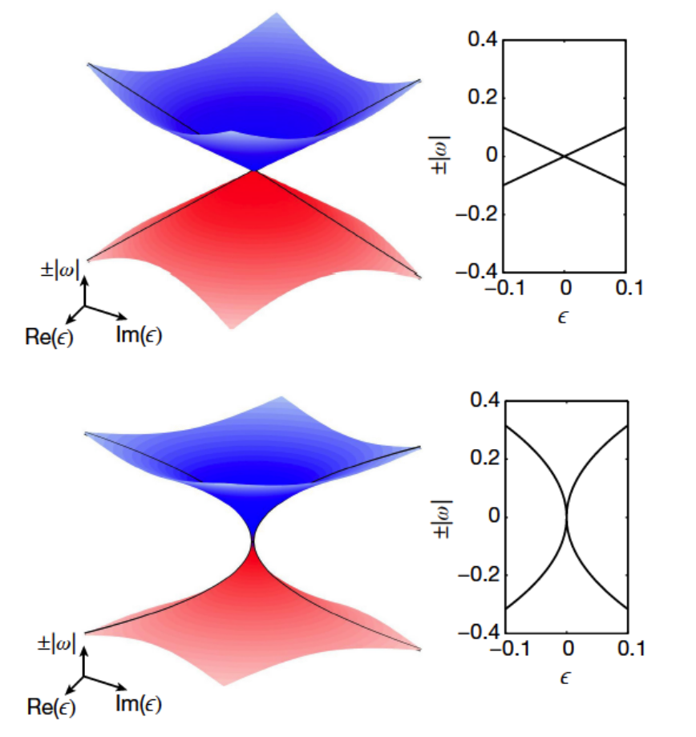
Enhanced Sensitivity at EPs
Energy splitting ∝ ϵ
Energy splitting ∝ ϵ^{1/2}
EP₂
Non-Hermitian sensing devices operating at Exceptional points / rings
☛ enhanced sensitivity
Notes:
We had to consider an effective TBG, which is the Hamiltonian written in the Wannier orbital basis
These orbitals capture the structure of the low-energy bands
They are centred at AB and BA sites forming a honeycomb
They have a peculiar 3 lobe shape

Slide 14
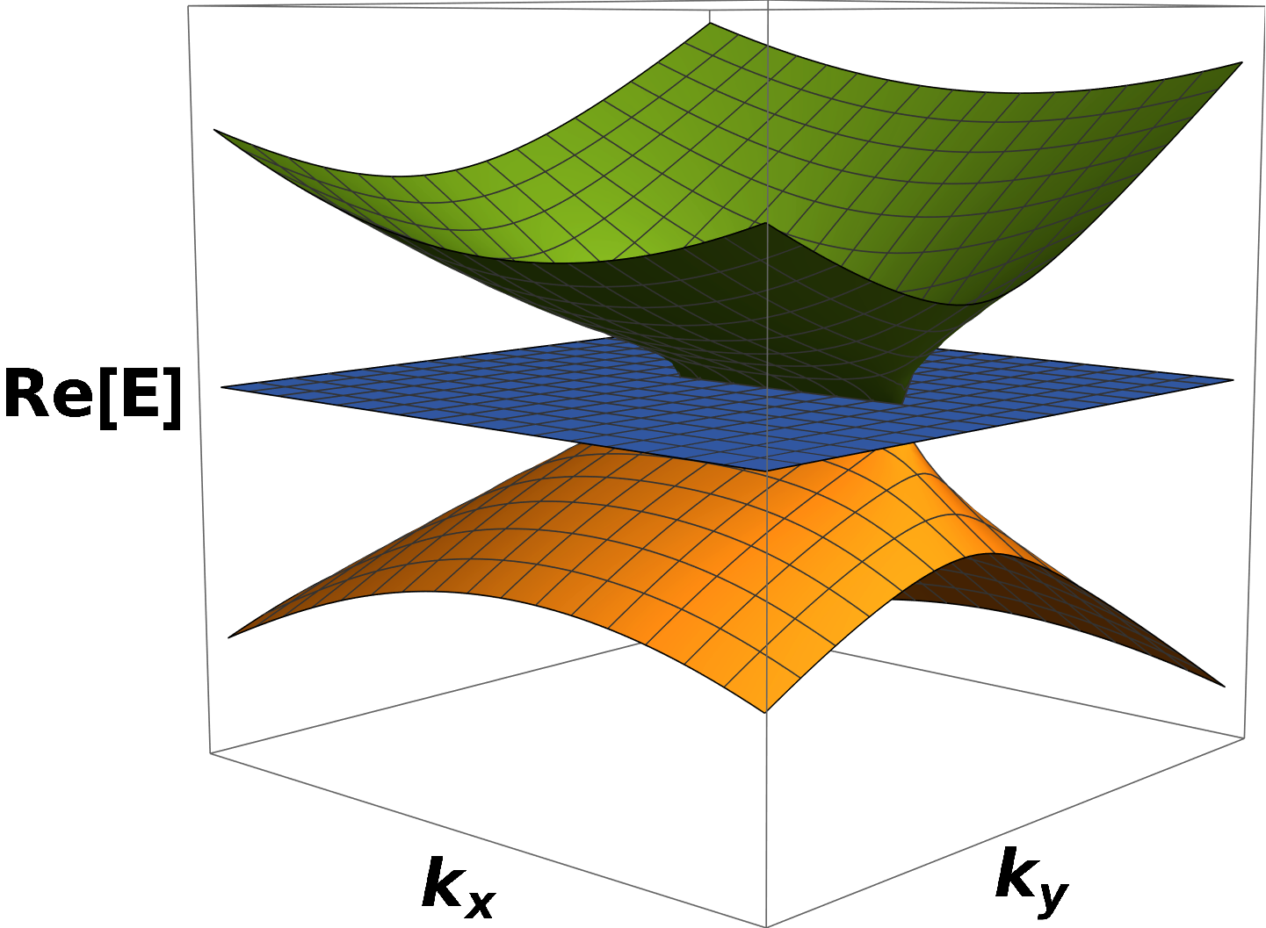
Higher-Order Exceptional Points

Slide 15


Higher-Order EPs: Number of Constraints
Any complex square matrix is triangularizable (Schur’s lemma)
Eigenvalues are the diagonal entries of this upper or lower triangular form
Hence, a generic N x N non-Hermitian complex matrix can be brought into the form:
has an EP of order N
Need (N -1) complex constraint equations to get N^{th} order EP
Notes:
We had to consider an effective TBG, which is the Hamiltonian written in the Wannier orbital basis
These orbitals capture the structure of the low-energy bands
They are centred at AB and BA sites forming a honeycomb
They have a peculiar 3 lobe shape

Slide 16



Higher-Order EPs: My Work
N^{th} order EP = EP_{N} ☛ N Eigenvalues + N Eigenvectors coalesce
Need N × N complex matrix
Need (2N-2) dimensions for stable EP_{N}
Simplest Case ☛ EP₃
Need (2 × 3) - 2 = 4 dimensions for stable EP₃
Physical systems have d ≤ 3 ☛ d = 4 not possible
Generic NH symmetries / constraints ☛s stable EP₃ in d = 2
Parity (P) symmetry
Parity–Time (PT) symmetry
[ IM & E. J. Bergholtz, Phys. Rev. Lett. (2021) ]
Parity (P)
symmetry
Parity–Time (PT)
symmetry
Notes:
We had to consider an effective TBG, which is the Hamiltonian written in the Wannier orbital basis
These orbitals capture the structure of the low-energy bands
They are centred at AB and BA sites forming a honeycomb
They have a peculiar 3 lobe shape

Slide 17


3-Band Model With P-Symmetry
2 real constraints ☛ Generic EP₃ in 2d
[ IM & E. J. Bergholtz, PRL (2021) ]
Notes:
We had to consider an effective TBG, which is the Hamiltonian written in the Wannier orbital basis
These orbitals capture the structure of the low-energy bands
They are centred at AB and BA sites forming a honeycomb
They have a peculiar 3 lobe shape

Slide 18

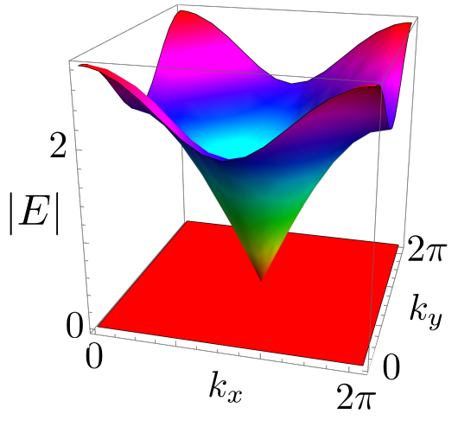
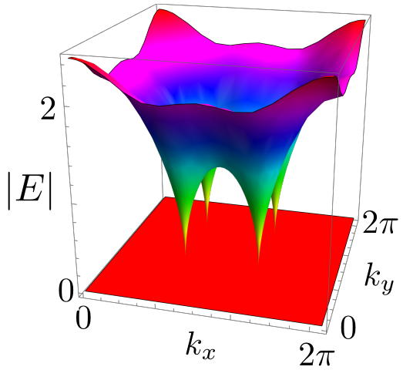
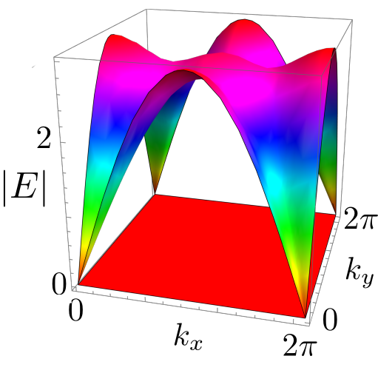
3-Band Model With P-Symmetry
Physical System ☛ NH Lieb lattice model
ϵ = 0
ϵ = 1
ϵ = 2
[ IM & E. J. Bergholtz, PRL (2021) ]
Notes:
We had to consider an effective TBG, which is the Hamiltonian written in the Wannier orbital basis
These orbitals capture the structure of the low-energy bands
They are centred at AB and BA sites forming a honeycomb
They have a peculiar 3 lobe shape

Slide 19
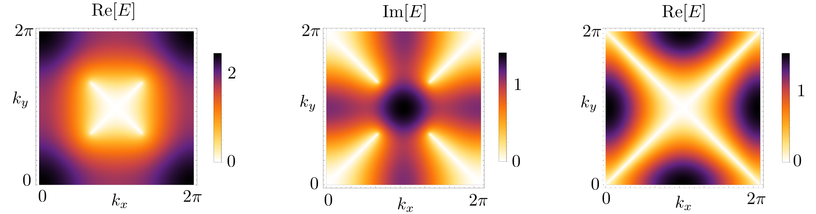
3-Band Model With P-Symmetry
Fermi arcs ☛
ϵ = 1
ϵ = 1
ϵ = 2
[ IM & E. J. Bergholtz, PRL (2021) ]
Notes:
We had to consider an effective TBG, which is the Hamiltonian written in the Wannier orbital basis
These orbitals capture the structure of the low-energy bands
They are centred at AB and BA sites forming a honeycomb
They have a peculiar 3 lobe shape

Slide 20
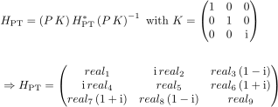

3-Band Model With PT-Symmetry
Eigenvalues ☛ Cardano’s method:
2 real constraints ☛ Generic EP₃ in 2d
[ IM & E. J. Bergholtz, PRL (2021) ]
Notes:
We had to consider an effective TBG, which is the Hamiltonian written in the Wannier orbital basis
These orbitals capture the structure of the low-energy bands
They are centred at AB and BA sites forming a honeycomb
They have a peculiar 3 lobe shape

Slide 21

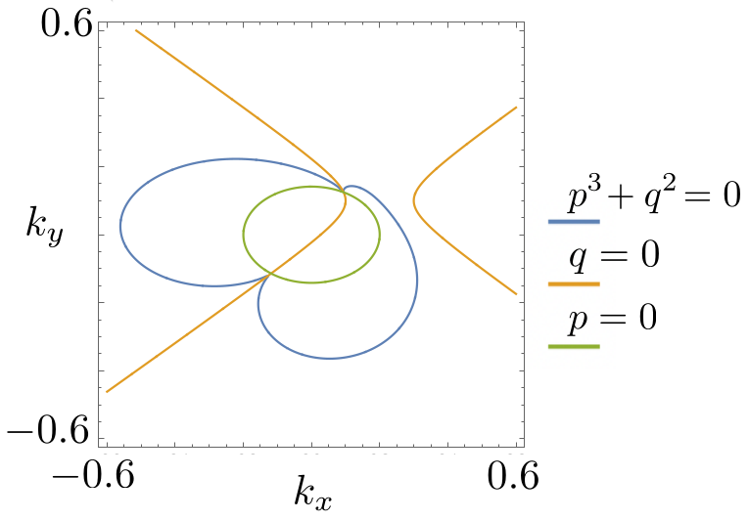
EP₃ in 2d: Case 2
Linearised Dirac-like NH Hamiltonian obeying PT-symmetry
ϵ = 0.1
EP₃
Blue curves ☛ lines of EP₂
EP₃
[ IM & E. J. Bergholtz, PRL (2021) ]
Notes:
We had to consider an effective TBG, which is the Hamiltonian written in the Wannier orbital basis
These orbitals capture the structure of the low-energy bands
They are centred at AB and BA sites forming a honeycomb
They have a peculiar 3 lobe shape

Slide 22
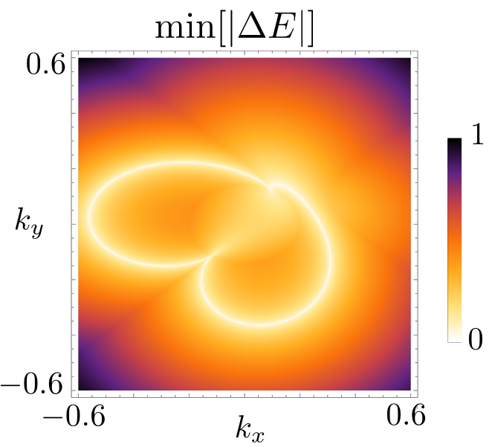
3-Band Model with PT-Symmetry
ϵ = 0.1
EP₃
EP₃
Blue curves ☛ lines of EP₂
[ IM & E. J. Bergholtz, PRL (2021) ]
Notes:
We had to consider an effective TBG, which is the Hamiltonian written in the Wannier orbital basis
These orbitals capture the structure of the low-energy bands
They are centred at AB and BA sites forming a honeycomb
They have a peculiar 3 lobe shape

Slide 23
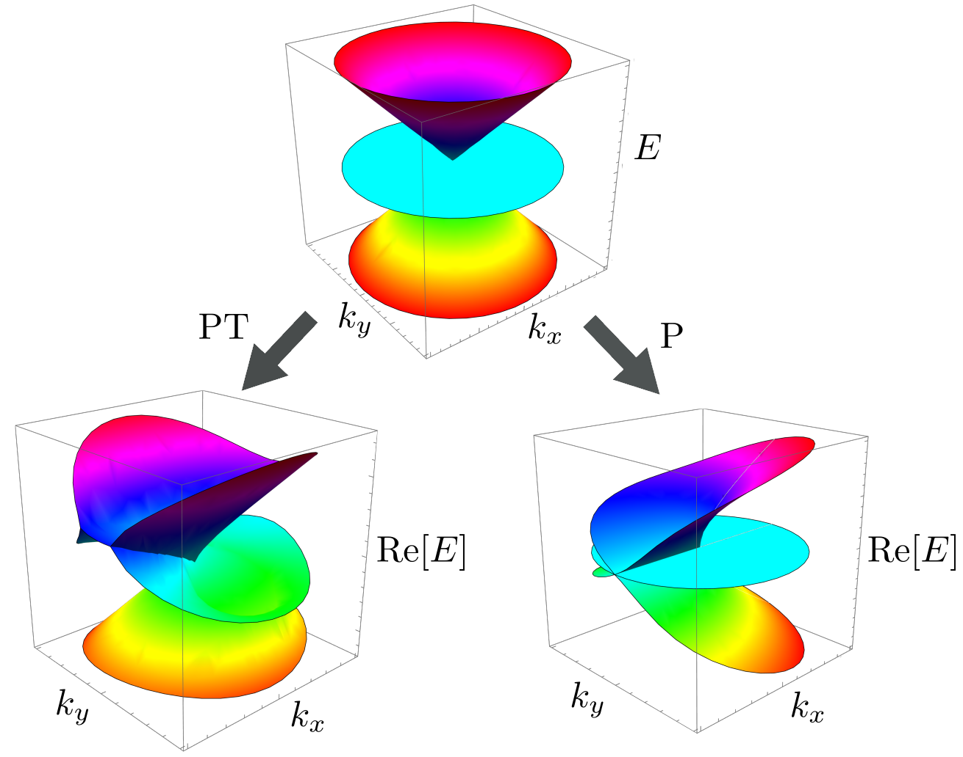
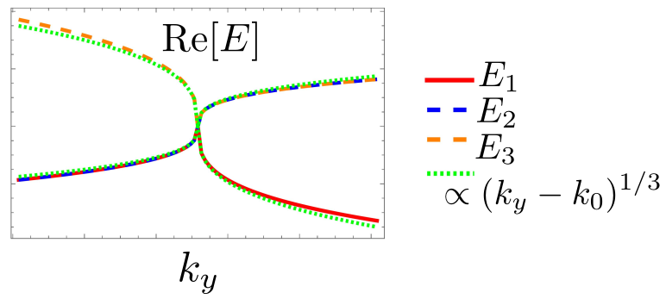
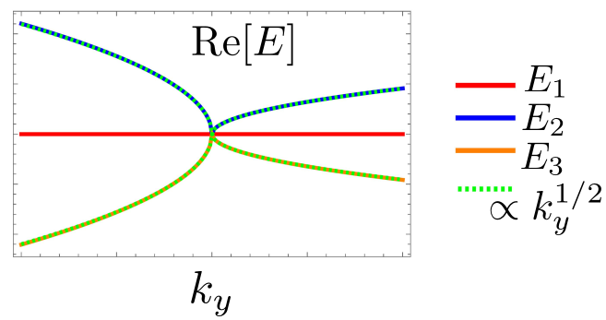
EP₃’s: Contrasting Singular Behaviour
Different symmetries stabilise branch points of different orders
Energy splitting ∝ k^{1/3} for PT
∝ k^{1/2} for P
[ Puiseux series ]
[ IM & E. J. Bergholtz, Phys. Rev. Lett. (2021) ]
Notes:
We had to consider an effective TBG, which is the Hamiltonian written in the Wannier orbital basis
These orbitals capture the structure of the low-energy bands
They are centred at AB and BA sites forming a honeycomb
They have a peculiar 3 lobe shape

Slide 24
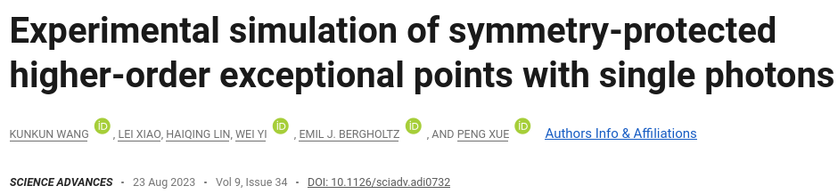
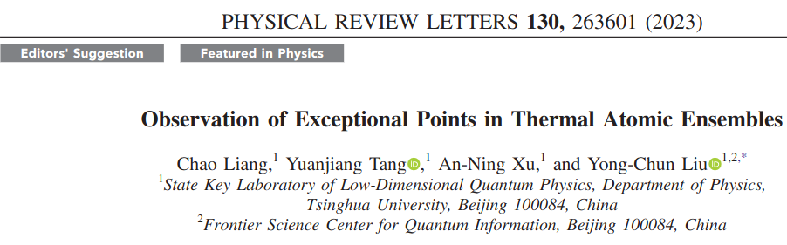
EP₃: Experimental Realization
Experimentally simulated 2d NH band structures using
single-photon interferometry
Observed stable EP₃s by tuning only 2 real parameters
Notes:
We had to consider an effective TBG, which is the Hamiltonian written in the Wannier orbital basis
These orbitals capture the structure of the low-energy bands
They are centred at AB and BA sites forming a honeycomb
They have a peculiar 3 lobe shape

Slide 25
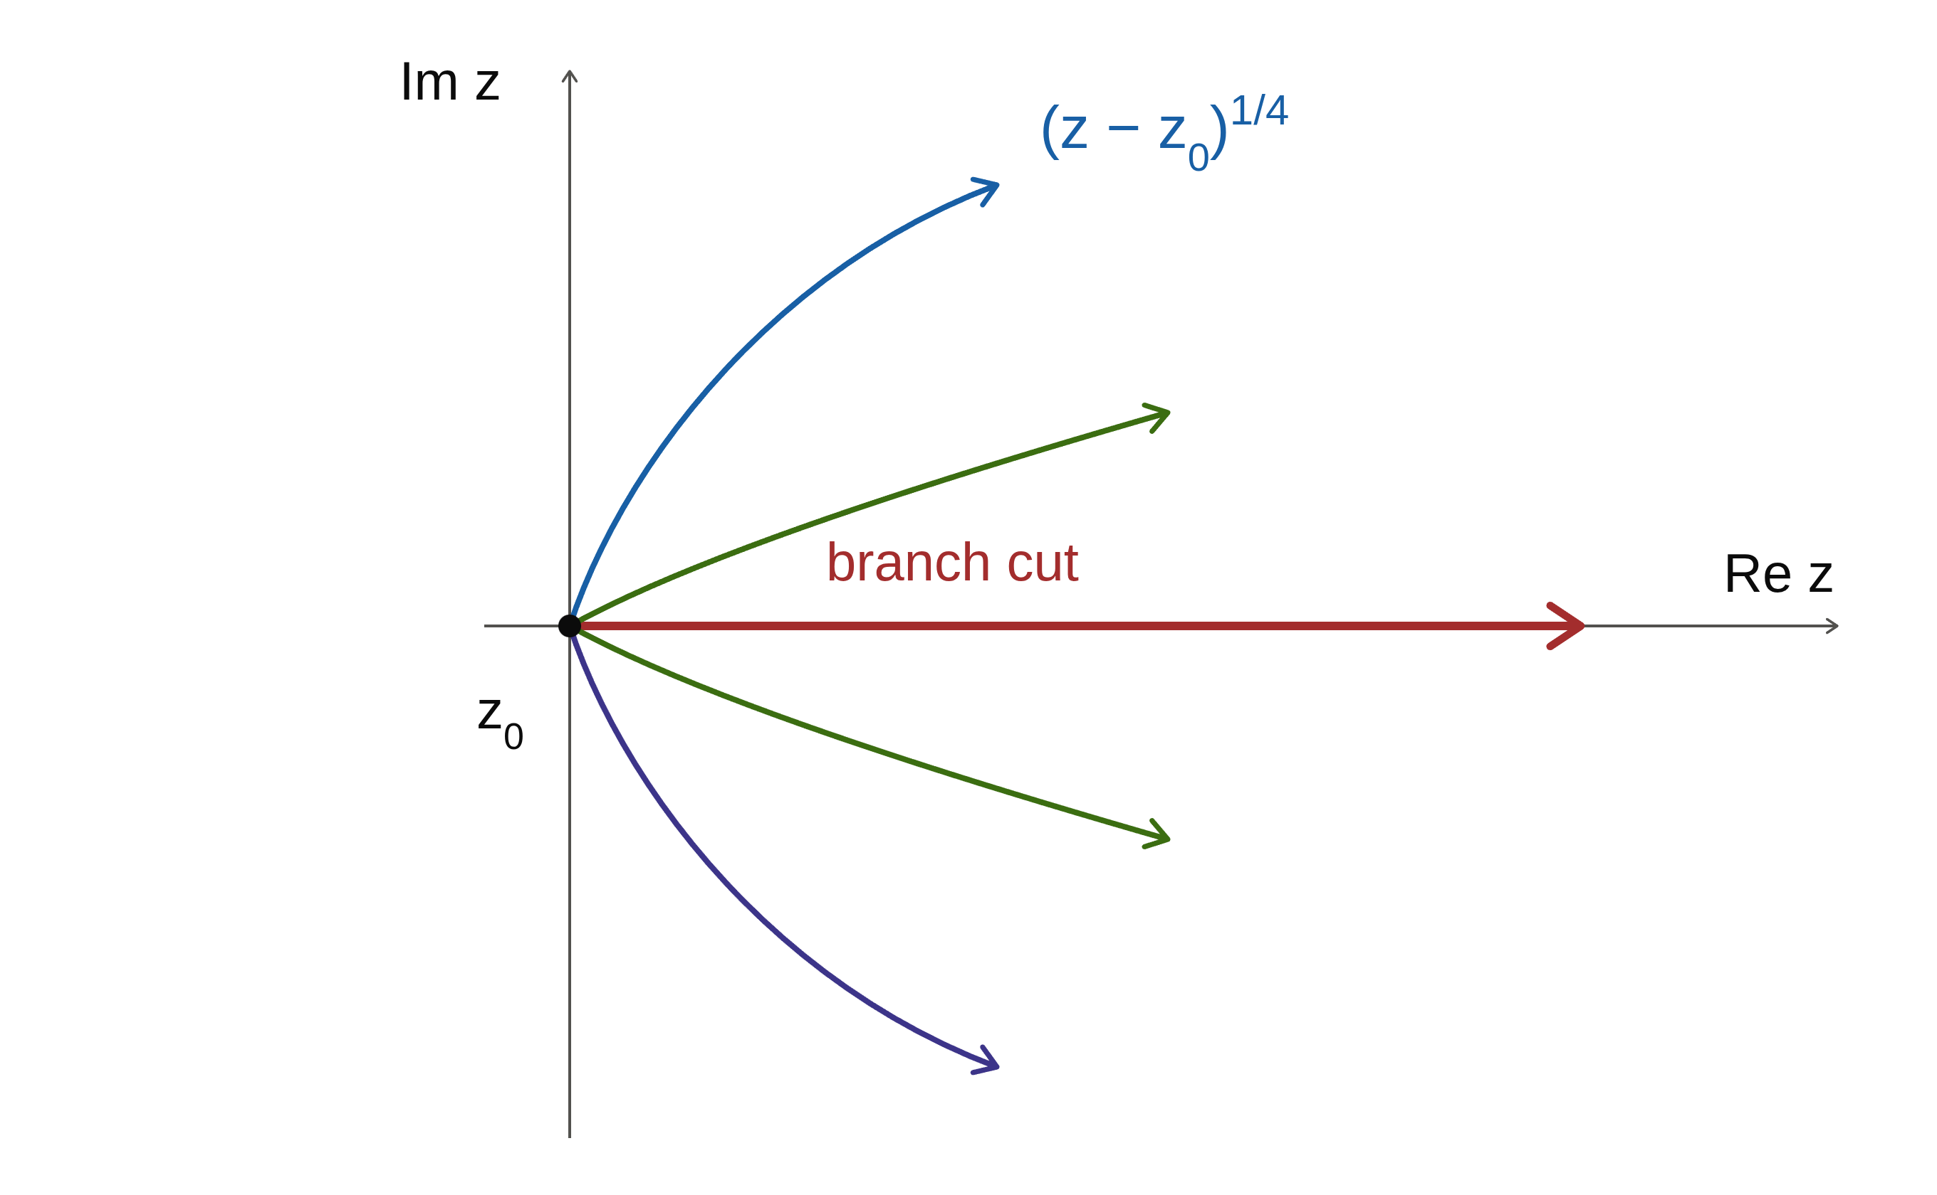
Puiseux Series ☛ Power series in deviation from EP, admitting fractional exponents

Slide 26
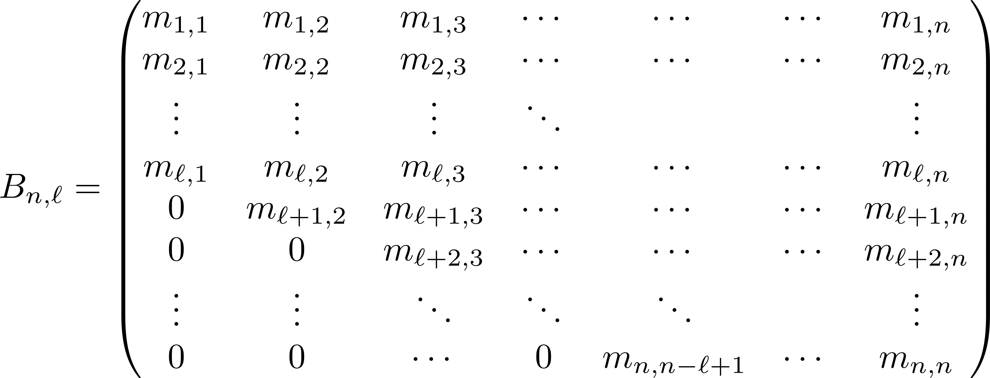
Hessenberg Matrices
Upper-ℓ Hessenberg matrix B_{n,ℓ} of dim. n x n
 (ℓ−1) nonzero sub-diagonals below principal diagonal
Notes:
In photonics, the term gain is usually used to quantify the amplification of optical amplifiers or of a laser gain medium. The gain can simply be an amplification factor, i.e., the ratio of output power and input power.
In laser physics, gain or amplification is a process where the medium transfers part of its energy to the emitted electromagnetic radiation, resulting in an increase in optical power. This is the basic principle of all lasers. Quantitatively, gain is a measure of the ability of a laser medium to increase optical power
https://arxiv.org/pdf/2308.07388.pdf

Slide 27
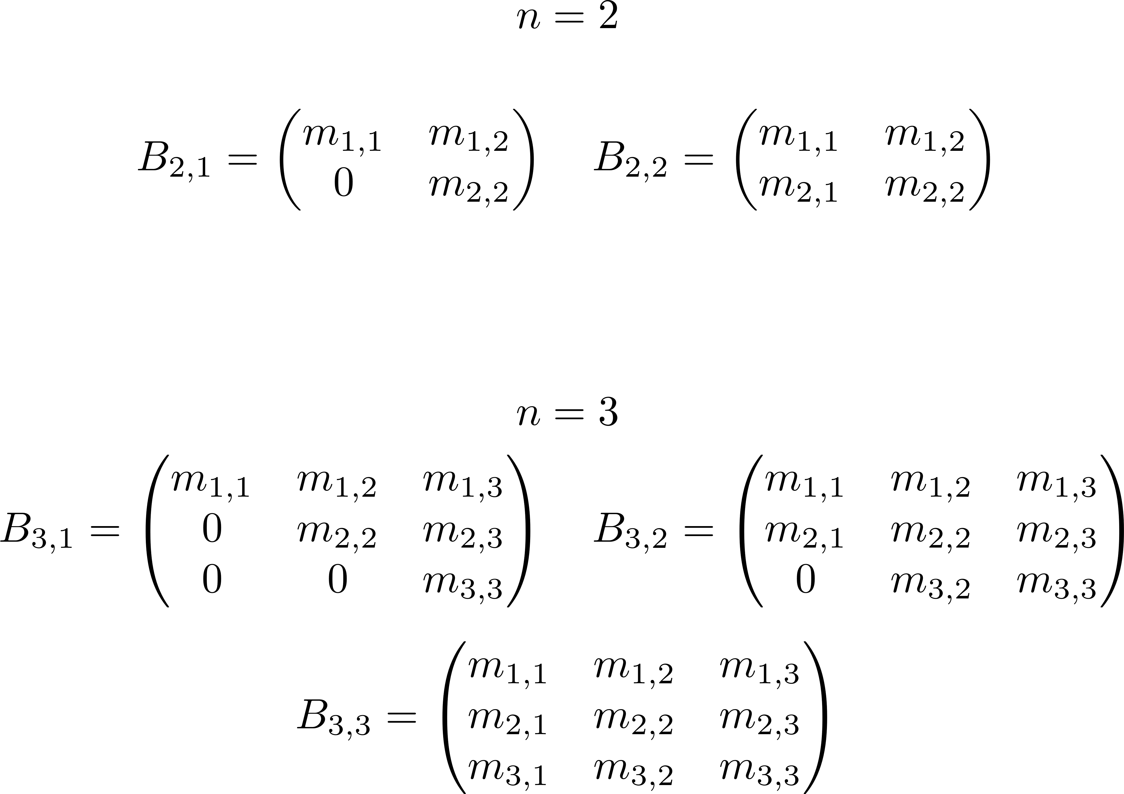
Hessenberg Matrices
Notes:
In photonics, the term gain is usually used to quantify the amplification of optical amplifiers or of a laser gain medium. The gain can simply be an amplification factor, i.e., the ratio of output power and input power.
In laser physics, gain or amplification is a process where the medium transfers part of its energy to the emitted electromagnetic radiation, resulting in an increase in optical power. This is the basic principle of all lasers. Quantitatively, gain is a measure of the ability of a laser medium to increase optical power
https://arxiv.org/pdf/2308.07388.pdf

Slide 28
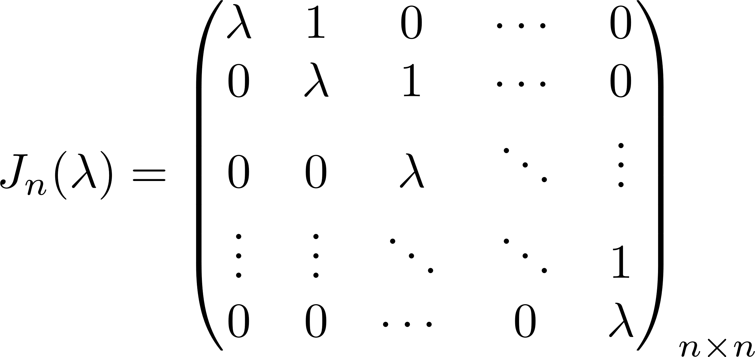
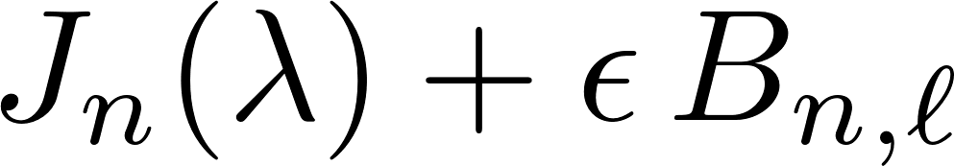
Perturbation around EP_{n}
Perturbed matrix around EP_{n}
How do degenerate eigenvalues of J_{n} split?
Notes:
In photonics, the term gain is usually used to quantify the amplification of optical amplifiers or of a laser gain medium. The gain can simply be an amplification factor, i.e., the ratio of output power and input power.
In laser physics, gain or amplification is a process where the medium transfers part of its energy to the emitted electromagnetic radiation, resulting in an increase in optical power. This is the basic principle of all lasers. Quantitatively, gain is a measure of the ability of a laser medium to increase optical power
https://arxiv.org/pdf/2308.07388.pdf

Slide 29
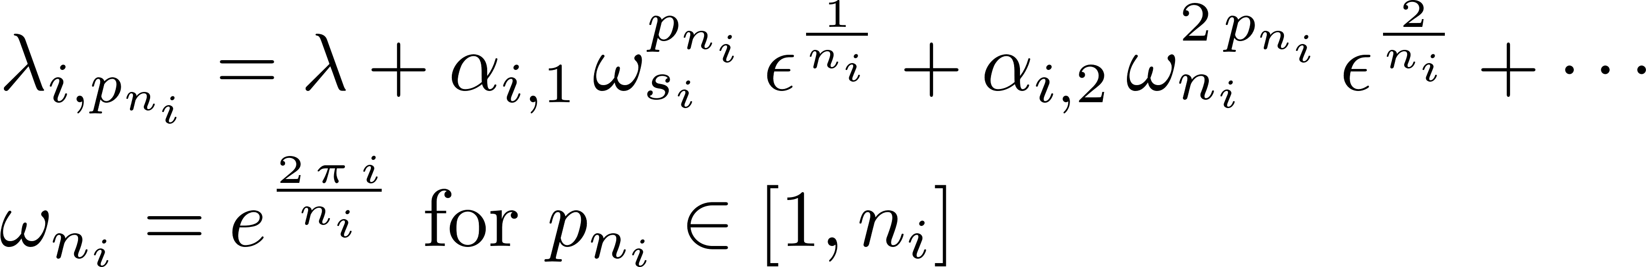
Perturbation around EP_{n}
Nature of eigenvalues under all possible perturbed matrices
☛ characterised by Puiseux series
Prepare all possible sets of {n_{i}} with ∑_{i} n_{i} = n
For each i we have a ring of size n_{i}, defined by
[ Y. Ma & A. Edelman, Linear Algebra … (1998) ]
Notes:
In photonics, the term gain is usually used to quantify the amplification of optical amplifiers or of a laser gain medium. The gain can simply be an amplification factor, i.e., the ratio of output power and input power.
In laser physics, gain or amplification is a process where the medium transfers part of its energy to the emitted electromagnetic radiation, resulting in an increase in optical power. This is the basic principle of all lasers. Quantitatively, gain is a measure of the ability of a laser medium to increase optical power
https://arxiv.org/pdf/2308.07388.pdf

Slide 30
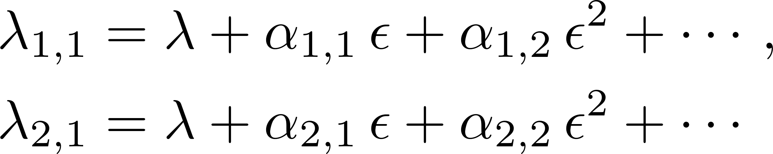
Puiseux Series about EP₂: n = 2
2 sets of rings: {n₁ = 1, n₂ = 1} & {n₁ = 2}
Ring index i ∈ {1, 2} & sizes ∈ {n₁ = 1, n₂ = 1}
Ring index i ∈ {1} & size ∈ {n₁ = 2}
Notes:
In photonics, the term gain is usually used to quantify the amplification of optical amplifiers or of a laser gain medium. The gain can simply be an amplification factor, i.e., the ratio of output power and input power.
In laser physics, gain or amplification is a process where the medium transfers part of its energy to the emitted electromagnetic radiation, resulting in an increase in optical power. This is the basic principle of all lasers. Quantitatively, gain is a measure of the ability of a laser medium to increase optical power
https://arxiv.org/pdf/2308.07388.pdf

Slide 31
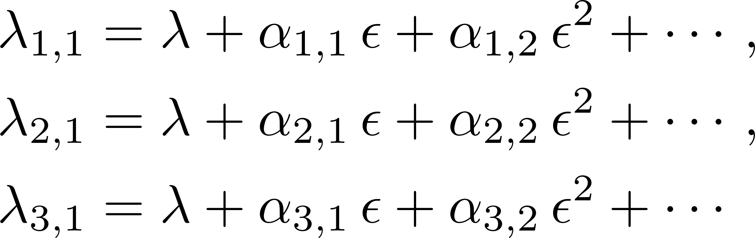
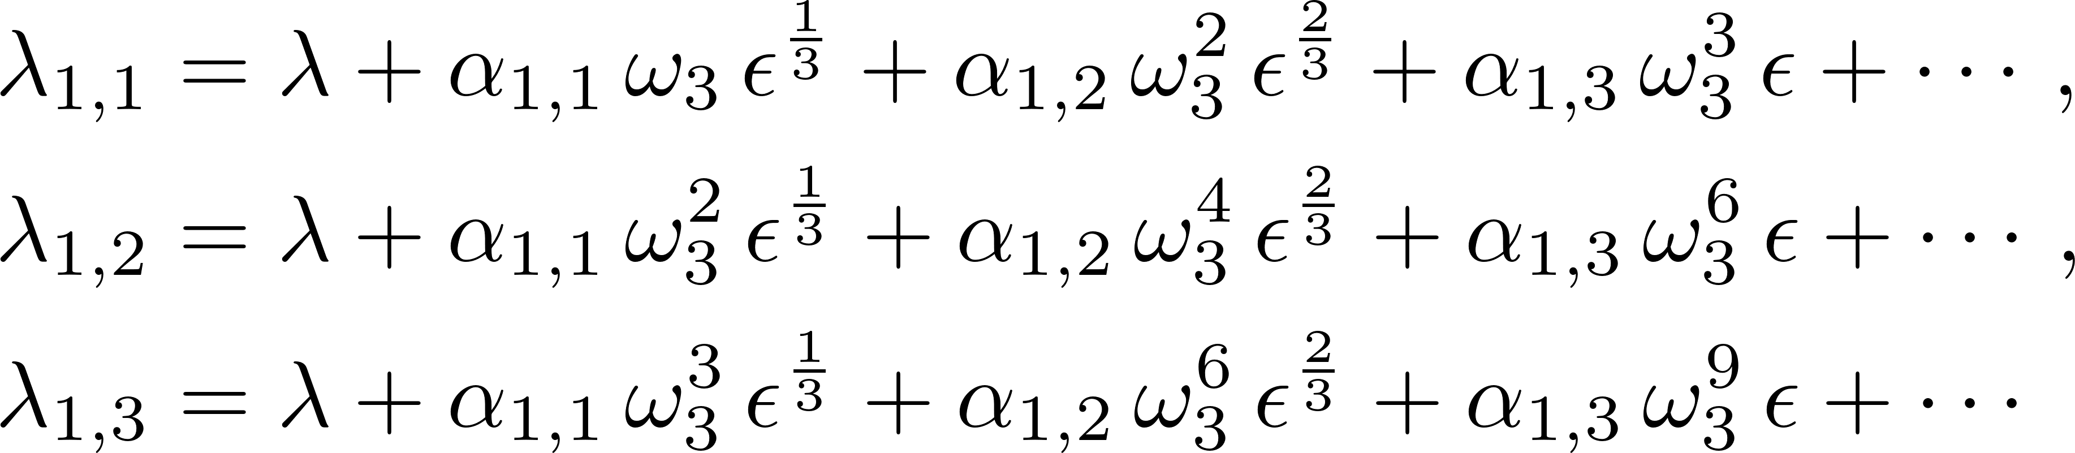
Puiseux Series about EP₃: n = 3
3 sets of rings: {n₁ = 1, n₂ = 1, n₃ = 1}, {n₁ = 2, n₂ = 1}, {n₁ = 3}
Ring index i ∈ {1, 2, 3} & sizes ∈ {n₁ = 1, n₂ = 1, n₃ = 1}
Ring index i ∈ {1, 2} & sizes ∈ {n₁ = 2, n₂ = 1}
Ring index i ∈ {1} & size ∈ {n₁ = 3}
Notes:
In photonics, the term gain is usually used to quantify the amplification of optical amplifiers or of a laser gain medium. The gain can simply be an amplification factor, i.e., the ratio of output power and input power.
In laser physics, gain or amplification is a process where the medium transfers part of its energy to the emitted electromagnetic radiation, resulting in an increase in optical power. This is the basic principle of all lasers. Quantitatively, gain is a measure of the ability of a laser medium to increase optical power
https://arxiv.org/pdf/2308.07388.pdf

Slide 32
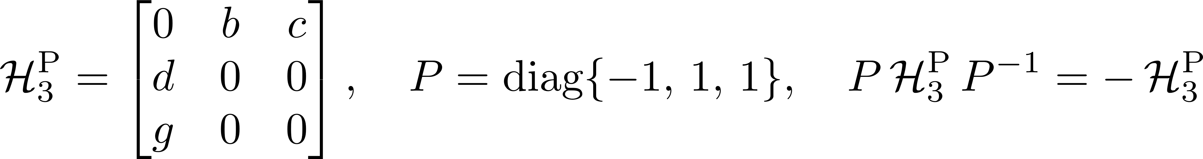
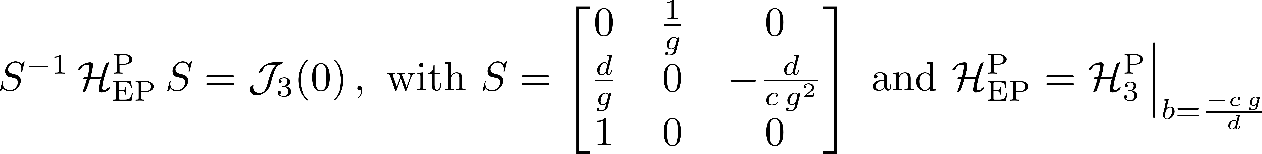
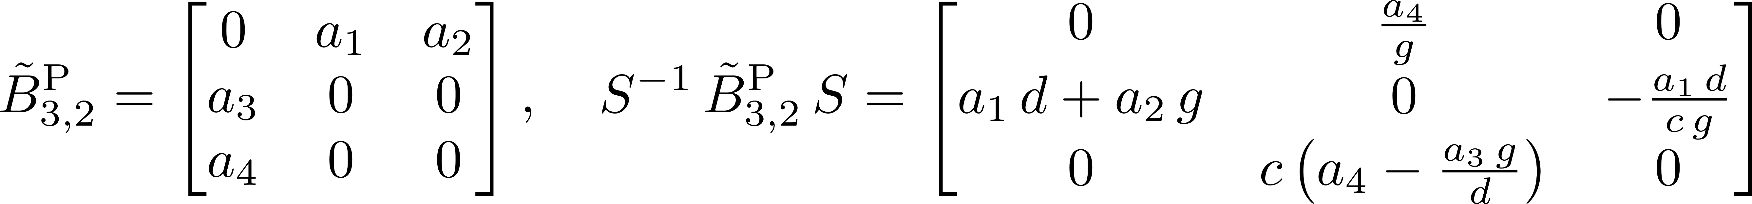
Perturbation around EP₃: P-symmetric
P-symmetry-preserving perturbation  upper-2 Hessenberg matrix
[ IM, PRA (2026) ]
Notes:
In photonics, the term gain is usually used to quantify the amplification of optical amplifiers or of a laser gain medium. The gain can simply be an amplification factor, i.e., the ratio of output power and input power.
In laser physics, gain or amplification is a process where the medium transfers part of its energy to the emitted electromagnetic radiation, resulting in an increase in optical power. This is the basic principle of all lasers. Quantitatively, gain is a measure of the ability of a laser medium to increase optical power
https://arxiv.org/pdf/2308.07388.pdf

Slide 33
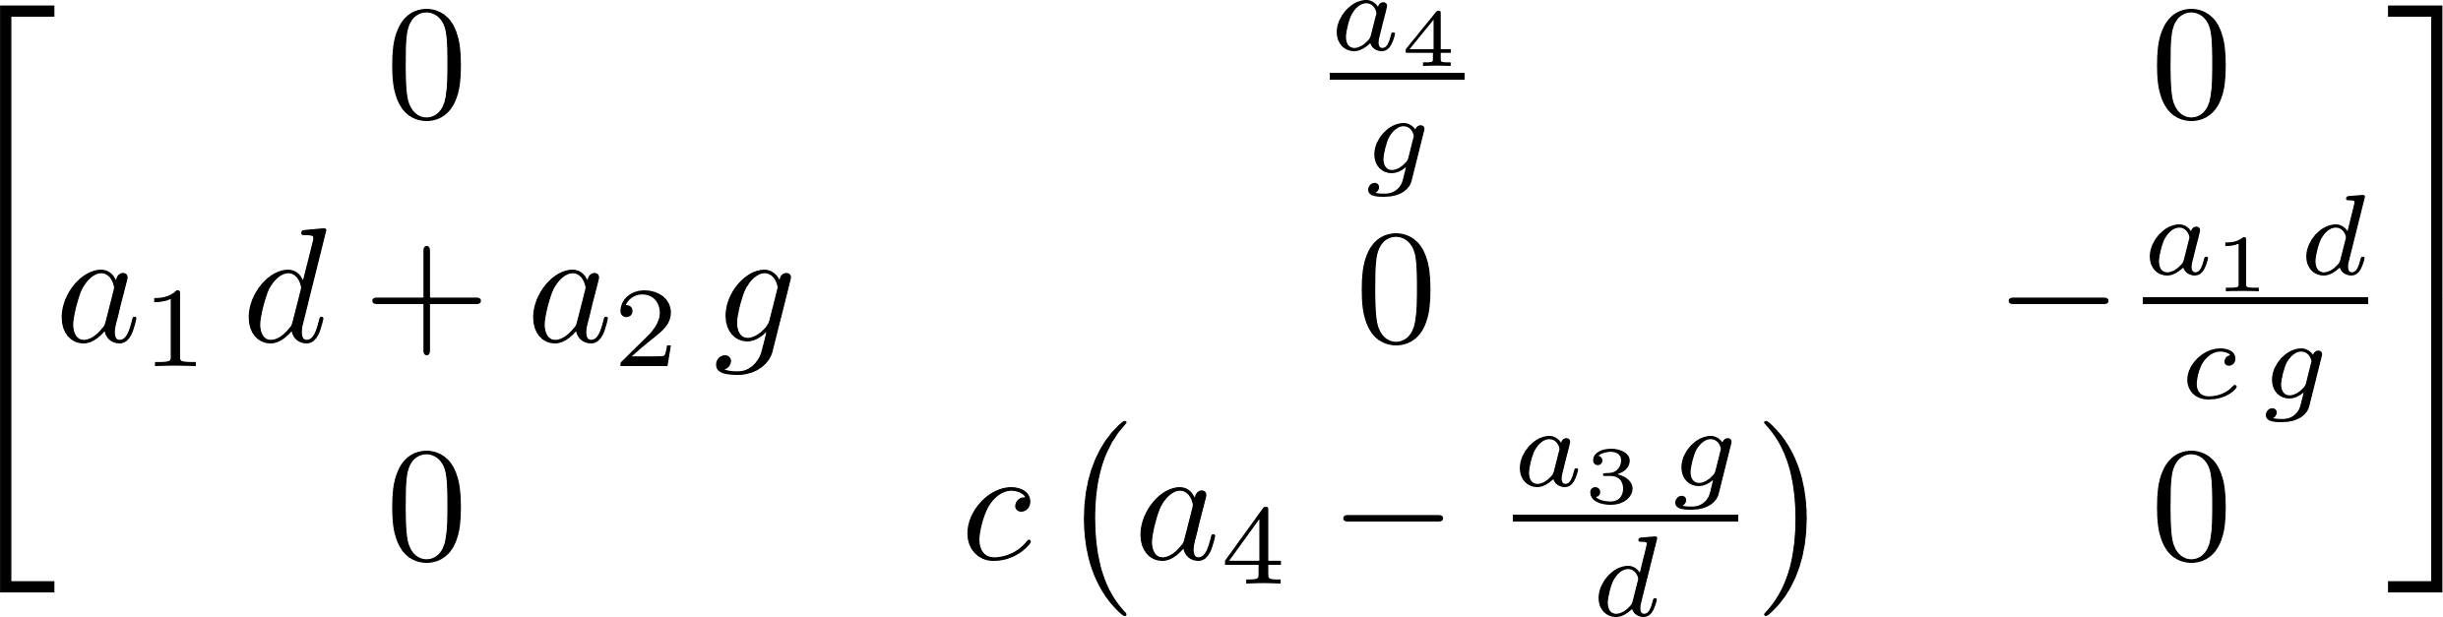
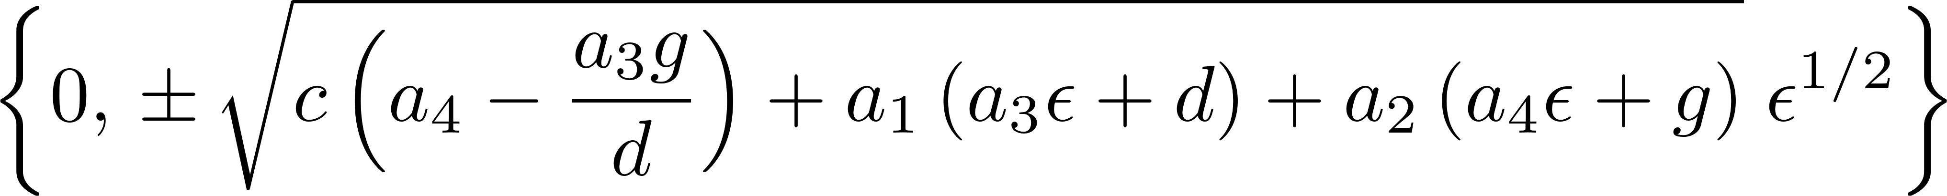
Perturb around EP₃: P-symmetric
P-symmetry-preserving perturbation  upper-2 Hessenberg matrix
Split eigenvalues
[ IM, PRA (2026) ]
Notes:
In photonics, the term gain is usually used to quantify the amplification of optical amplifiers or of a laser gain medium. The gain can simply be an amplification factor, i.e., the ratio of output power and input power.
In laser physics, gain or amplification is a process where the medium transfers part of its energy to the emitted electromagnetic radiation, resulting in an increase in optical power. This is the basic principle of all lasers. Quantitatively, gain is a measure of the ability of a laser medium to increase optical power
https://arxiv.org/pdf/2308.07388.pdf

Slide 34
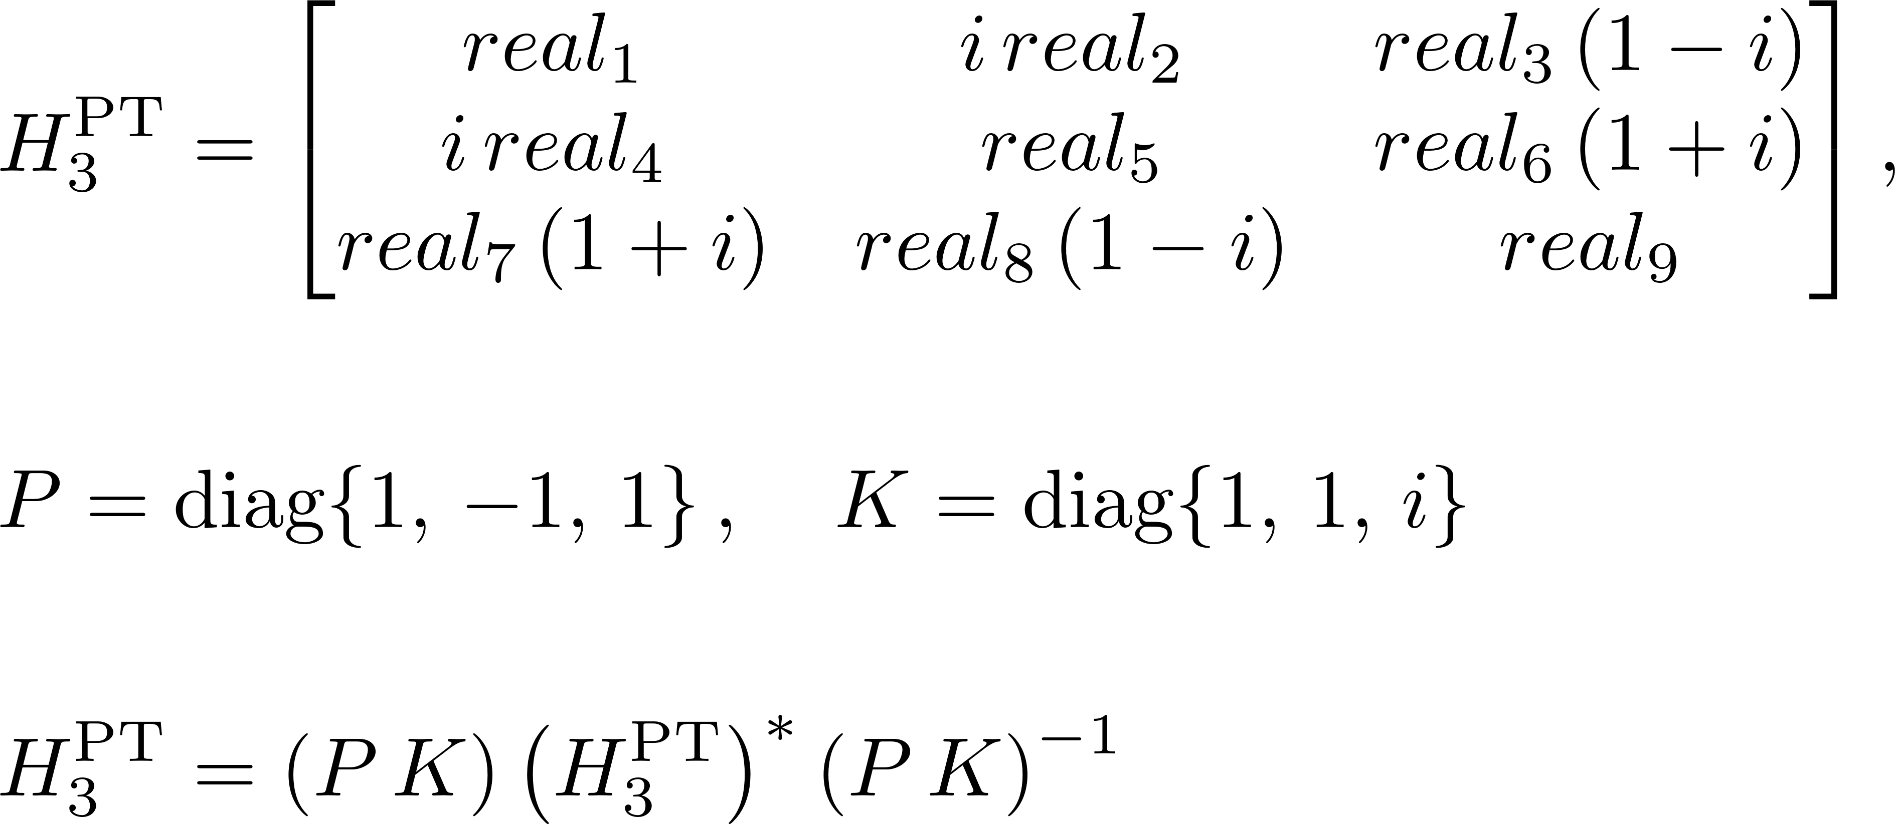
Perturb around EP₃: PT-symmetric
PT-symmetry-preserving perturbation  upper-3 Hessenberg matrix
 eigenvalues ~ ϵ^{1/3}
[ IM, PRA (2026) ]
Notes:
In photonics, the term gain is usually used to quantify the amplification of optical amplifiers or of a laser gain medium. The gain can simply be an amplification factor, i.e., the ratio of output power and input power.
In laser physics, gain or amplification is a process where the medium transfers part of its energy to the emitted electromagnetic radiation, resulting in an increase in optical power. This is the basic principle of all lasers. Quantitatively, gain is a measure of the ability of a laser medium to increase optical power
https://arxiv.org/pdf/2308.07388.pdf

Slide 35
Leading-Order Singularity
Transform an allowed perturbing matrix to Jordan-normal basis
of defective matrix
☛ its upper-ℓ Hessenberg structure reveals leading-order
algebraic singularity ~ ϵ^{1/ℓ}
Energy splitting ∝ ϵ^{1/3} for PT
∝ ϵ^{1/2} for P
Different symmetries stabilise branch points of different orders
Notes:
In photonics, the term gain is usually used to quantify the amplification of optical amplifiers or of a laser gain medium. The gain can simply be an amplification factor, i.e., the ratio of output power and input power.
In laser physics, gain or amplification is a process where the medium transfers part of its energy to the emitted electromagnetic radiation, resulting in an increase in optical power. This is the basic principle of all lasers. Quantitatively, gain is a measure of the ability of a laser medium to increase optical power
https://arxiv.org/pdf/2308.07388.pdf

Slide 36
Thank you for your attention!

