Slide 1
Linux System & Process Monitoring Tool using C++ on Ubuntu
WIPRO TRAINING PROJECT
$ g++ -std=c++17 *.cpp -o monitor
$ ./monitor
> Memory | CPU | Top 10
> Refresh every 2 seconds
> Enter PID to terminate: _
Built in 5 days using C++17 on Ubuntu Linux
STUDENT
ROLL NUMBER
DEPARTMENT
TRAINING ORGANIZATION
Ipsita Behera
2341002106
Computer Science and Engineering
Wipro
Notes:
Introduce yourself: name, roll number, department, and that this is a Wipro training project completed in 5 days. State the title and say the tool is a terminal-based Linux system and process monitor written in C++17 on Ubuntu.

Slide 2




Project Introduction & Objective
A terminal tool for Ubuntu that reads live data from the Linux kernel and shows memory, CPU and process information in one place — and lets the user act on it.
5
days of development
Objectives
Monitor system memory and CPU usage in real time
4
core features: memory, CPU, processes, termination
List active processes and rank them by CPU or memory
Terminate a chosen process using its PID
2 s
automatic refresh interval
Combine everything into a continuous terminal monitor
Notes:
Explain the problem: Linux exposes system data through the kernel and /proc, but there is no simple custom tool. Objective: build a monitor step by step over 5 days — memory, CPU, processes, termination, then a continuous monitor.

Slide 3



System Architecture / Working Flow
Linux Kernel
C++17 Modules
Terminal UI
sysinfo()
/proc/stat
/proc/[PID]/stat
/proc/[PID]/status
Memory module
CPU module
Process module (vector + sort)
Control module (kill)
Memory and CPU summary
Top 10 processes by CPU
Input: PID | Enter | q
reads
shows
Refresh data
Sort & show top 10
Read PID to kill
Enter / q
Wait 2 s, repeat
Notes:
Walk left to right: the kernel exposes data through sysinfo() and /proc files; four C++ modules read and process it; the terminal UI shows the summary and the top 10 processes and takes input. The bottom strip is the main loop that repeats every 2 seconds.

Slide 4


Day 1 – Memory Monitoring
DAY 1 OF 5
Read with sysinfo()
Day 1 | excerpt from day1.cpp
One call fills struct sysinfo from <sys/sysinfo.h>.
#include <sys/sysinfo.h>
struct sysinfo info;
if (sysinfo(&info) == 0) {
cout << "Total RAM In MB: "
<< info.totalram / (1024 * 1024) << " MB\n";
cout << "Total RAM In GB: "
<< info.totalram / (1024 * 1024 * 1024)
<< " GB\n";
cout << "Total unused RAM: "
<< info.freeram / (1024 * 1024) << " MB\n";
}
Total RAM
Displayed in both MB and GB.
Unused RAM
Free memory taken from the freeram field.
Key idea: RAM values are in bytes → ÷ 1024² for MB, ÷ 1024³ for GB
Notes:
sysinfo() fills a struct with total and free RAM. Values are multiplied by mem_unit to get bytes, then converted to MB and GB for display.

Slide 5
Day 2 – CPU Monitoring
DAY 2 OF 5
Fields read from the first line of /proc/stat
Day 2 | excerpt from day2.cpp
user
nice
system
idle
iowait
struct CPUData {
long user, nice, system, idle, iowait,
irq, softirq, steal, guest, guest_nice;
};
ifstream file("/proc/stat");
getline(file, line); // first line
istringstream ss(line);
ss >> cpuLabel >> cpu.user >> cpu.nice >> cpu.system
>> cpu.idle >> cpu.iowait >> cpu.irq
>> cpu.softirq >> cpu.steal >> cpu.guest
>> cpu.guest_nice;
int idle = cpu.idle + cpu.iowait;
// total = sum of all 10 counters
int ActiveTime = totalCPUTime - idle;
irq
softirq
steal
guest
guest_nice
All 10 counters are summed into total CPU time
Calculations
Total CPU time: sum of all 10 counters
Idle time: idle + iowait
Active time: total − idle
CPU usage %: active ÷ total × 100
Notes:
The first line of /proc/stat holds cumulative CPU time in clock ticks. Total time is the sum of all ten counters; idle time is idle + iowait; active time is total minus idle. These counters are cumulative since boot.

Slide 6




Day 3 – Process Monitoring
DAY 3 OF 5
Scan /proc
Read stat
Read status
Calculate
Store & sort
numeric folders = PIDs
PID, name, CPU ticks
VmRSS = memory
CPU % per process
vector + std::sort
Day 3 | excerpt from day3.cpp
How it works
struct Processinfo {
int pid;
std::string name;
double cpuUsage = 0;
long memoryUsage = 0; // VmRSS
};
std::vector<Processinfo> getAllprocess();
std::sort(processes.begin(), processes.end(),
[](const Processinfo& a, const Processinfo& b) {
return a.cpuUsage > b.cpuUsage;
});
CPU %: (utime + stime) ÷ clock ticks per second, divided by process lifetime
Memory: VmRSS (resident set size) read from status
Sort: descending by CPU (set the flag to sort by memory)
Notes:
Every numeric folder under /proc is a running process. From stat we take PID, name and CPU ticks; from status we take VmRSS for memory. Processes are stored in a vector and sorted with std::sort using a comparator on CPU or memory.

Slide 7



Day 4 – Process Termination
DAY 4 OF 5
Display top processes
User enters a PID
kill(pid, SIGKILL)
Check the result
Day 4 | excerpt from day4.cpp
About SIGKILL
int targetPid;
cout << "Enter pid to kill ";
cin >> targetPid;
if (targetPid > 0) {
if (kill(targetPid, SIGKILL) == 0) {
cout << "Process " << targetPid
<< " terminated successfully";
} else {
perror("Failed to kill process");
}
}
Signal 9: cannot be caught or ignored
Permission: own processes, or root
Return value: 0 on success, −1 with errno on failure
Notes:
kill() sends a signal to a process. SIGKILL forces termination and cannot be handled by the target. kill() returns 0 on success; on failure it returns -1 and sets errno (for example EPERM for no permission, ESRCH for no such process).

Slide 8

Day 5 – Continuous Monitoring
DAY 5 OF 5
Refresh process list
Show top 10 by CPU
Accept PID to kill
Enter or q, then wait 2 s
Repeats until q is pressed
PID
Enter
q
Day 5 | excerpt from day5.cpp
while (true) {
system("clear");
getAllprocess(); sortProcesses();
// print top 10, ask PID, kill()
input = getchar();
if (input == 'q' || input == 'Q')
break;
sleep_for(seconds(2));
}
Terminate that process
Refresh immediately
Quit the monitor
Notes:
Day 5 combines Days 1-4 into one loop: refresh data, display the top 10 CPU consumers, accept input, wait 2 seconds and repeat. The user can enter a PID to kill, press Enter to refresh immediately, or press q to quit.

Slide 9
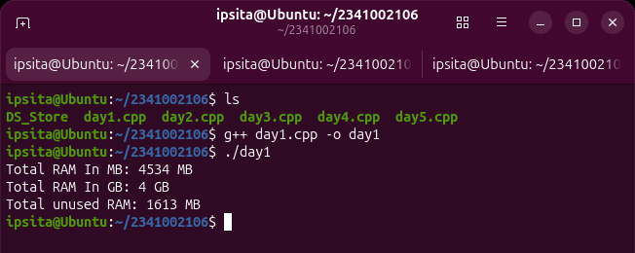
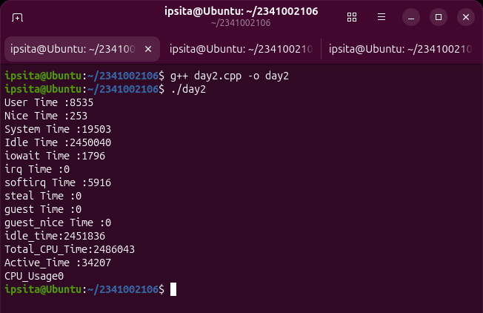
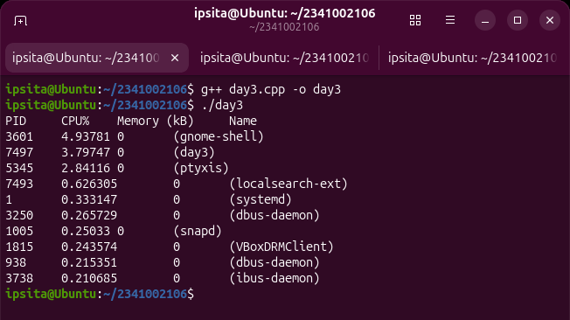
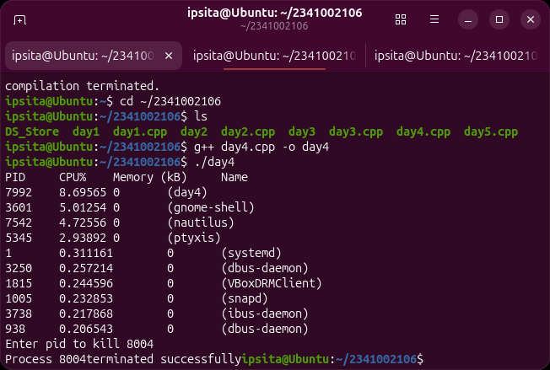
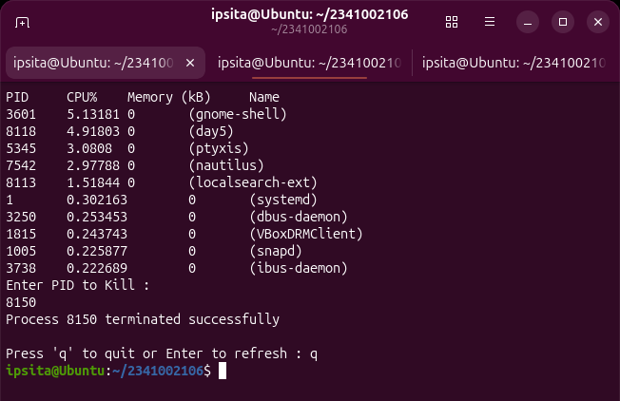
Ubuntu Execution Screenshots
Day 1 | Memory monitoring
Day 2 | CPU statistics
Day 3 | Active processes
What the runs show
Day 1: total and unused RAM in MB / GB
Day 2: raw /proc/stat counters and totals
Days 3–5: top 10 processes, kill by PID, q to quit
Day 4 | Kill by PID
Day 5 | Continuous monitor
Notes:
Real output captured on Ubuntu for each day. Day 1: total RAM and unused RAM. Day 2: CPU counters. Day 3: top 10 processes sorted by CPU. Day 4: terminating a process by PID. Day 5: the continuous monitor with q to quit.

Slide 10

Technologies Used
Platform & Language
POSIX / System APIs
C++ Standard Library
C++17
Language standard for the whole tool
POSIX APIs
Portable OS-level interfaces
vector
Stores the process list
Ubuntu Linux
Development and runtime environment
sysconf()
Clock ticks per second
algorithm
std::sort by CPU or memory
/proc filesystem
Kernel data exposed as files
kill()
Send a signal to a process
filesystem
Iterate numeric /proc folders
SIGKILL
Force-terminates (signal 9)
ifstream
Read /proc files
stringstream
Parse fields from each line
Notes:
Group the technologies: platform and language, POSIX and system APIs, and C++ standard library components. Be ready to say where each one is used in the project.

Slide 11


Learning Outcomes
Linux internals
System programming
Modern C++17
Read live kernel data from /proc: memory, CPU and per-process statistics.
Used POSIX calls such as sysinfo(), sysconf() and kill().
Applied vector, algorithm, filesystem and stream classes.
Process management
Incremental design
Terminal tooling
Understood PIDs, CPU time, resident memory and signals.
Built the tool in 5 stages, testing each before the next.
Created an interactive, auto-refreshing CLI on Ubuntu.
Notes:
Summarise what you learned: how Linux exposes data, how to use system calls from C++, how to structure a program in stages, and how to build an interactive terminal tool.

Slide 12



Conclusion & Future Scope
Conclusion
Future Scope
Built a working Linux monitor in C++17 covering memory, CPU and processes
Usage graphs and history
ncurses-based interactive UI
Reads live data from the /proc filesystem and system calls
Try SIGTERM first, then SIGKILL
Ranks processes and terminates any chosen PID in real time
Search and filter by name or user
Disk and network monitoring
Thank you | Questions?
Ipsita Behera • 2341002106 • Computer Science and Engineering • Wipro
Notes:
Close by restating that the tool meets the objectives: memory, CPU, process listing, termination and continuous monitoring. Mention the future scope items as realistic next steps, then invite questions.

