Slide 1


PRESENTATION ON
DIWALI SALES REPORT
PRESENTED BY :-
Ipsita Panda
Trupti Rath
Alibha Pradhan
Jyoti Senapati
Smruti Sikha Sahoo
Guided By:-
Ms. Gitanjali Digal

Slide 2
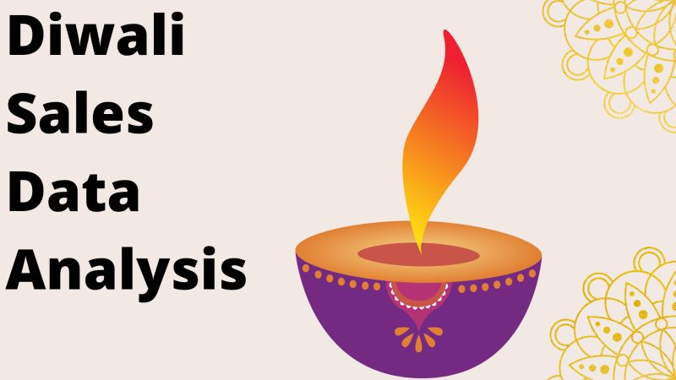
Introduction
Diwali, the festival of lights, is one of the most significant festivals in India, often resulting in a substantial increase in consumer spending. This project aims to analyze Diwali sales data to identify trends, patterns, and insights that can help businesses optimize their marketing strategies and improve sales performance.
This report provides a comprehensive overview of our Diwali sales performance and offers valuable insights to guide our future business decisions. By implementing the recommended strategies and products, we aim to further enhance our Diwali product sales and maintain our position in the market.

Slide 3
Project Overview
Analyze overall sales performance during the Diwali season.
Determine the best-selling products and categories.
Assess the impact of marketing campaigns on sales.
Identify purchasing trends and patterns.
Provide actionable insights and recommendations for future sales strategies.
Description
The “Diwali Sales Analysis” project will provide a comprehensive understanding of consumer behavior and sales performance during the festive season. The insights gained will help businesses tailor their marketing strategies, improve customer targeting, and enhance product offerings to maximize sales and customer satisfaction in future Diwali seasons

Slide 4
Advantages
Enhanced Marketing Strategies:Understanding when consumers are most likely to make purchases during the Diwali period helps in scheduling promotions and advertising at the most impactful times.
Improved Inventory Management:Identifying best-selling products and categories allows businesses to adjust their inventory to focus on high-demand items, ensuring a better product mix.
Increased Customer Satisfaction:Insights into customer preferences and buying behavior enable businesses to create personalized offers and recommendations, enhancing the shopping experience.
Revenue Growth:By understanding sales patterns, businesses can capitalize on peak shopping times and maximize revenue opportunities.
Enhanced Customer Retention:Sales analysis provides concrete data to support strategic decisions, reducing reliance on guesswork and intuition.

Slide 5
Disadvantage
Data Quality Issues:Poor quality data, such as incomplete, outdated, or inaccurate records, can lead to incorrect analysis and misleading conclusions.
Complexity in Interpretation:Extracting actionable insights from complex data analysis can be difficult, especially for stakeholders who are not well-versed in data analytics.
Market Variability:Consumer behavior and market trends can change rapidly, making past data less relevant for predicting future sales.
Dependence on Technology:Analytical tools and software may have limitations or bugs that affect the accuracy and completeness of the analysis.

Slide 6
Problem Statement
This analysis looks at sales data during the Diwali season in order to pinpoint important patterns, consumer preferences, and factors influencing sales. The knowledge acquired will benefit companies in the future Diwali seasons by helping them organize their inventory better, optimize their marketing activities, and raise customer happiness.
Following are needed tasks to perform for Analysis of a datasets:-
Reading and Cleaning the datasets.
Analysing the datasets by using different Charts and Patterns.
Encoding and performing the i/p and o/p operation of the analysed data.
Build and train the model to classify the data.
Test the model and further improve the model using different techniques.

Slide 7
What does it Predict?
Total revenue, Average order value, Total product sold,Total Orders and Average product per order of diwali sales.
State wise trend for Diwali Sales.
Percentage of sales by product category.
Percentage of sales by Zone Wise.
Total orders and product sold by product-category.

Slide 8
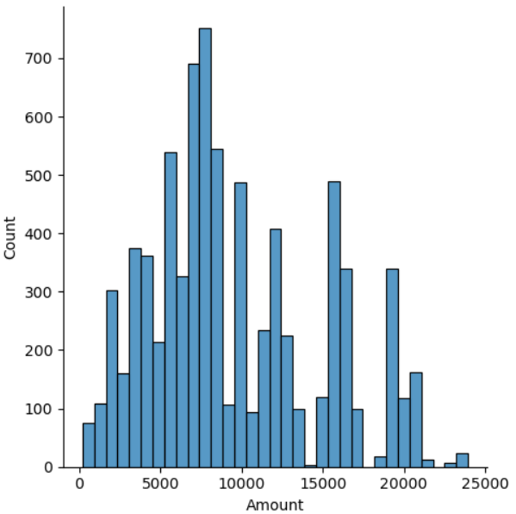
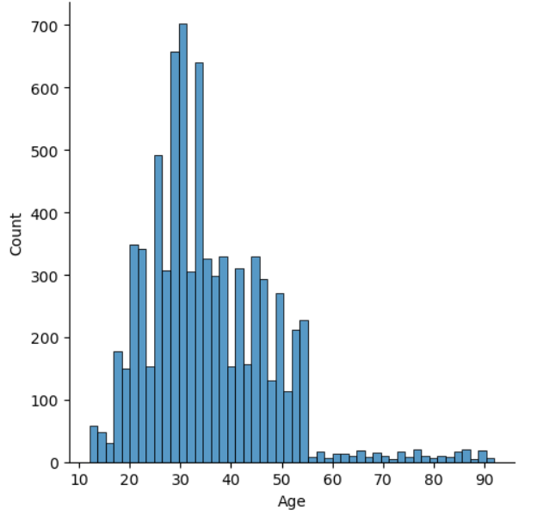
Approach
Following approaches are performed during the Diwali Sales Analysis:-
1. Data Analysis of Datasets
Displot

Slide 9
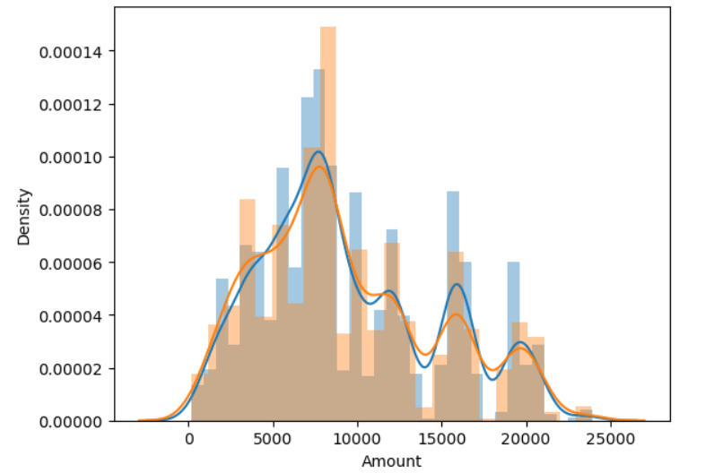
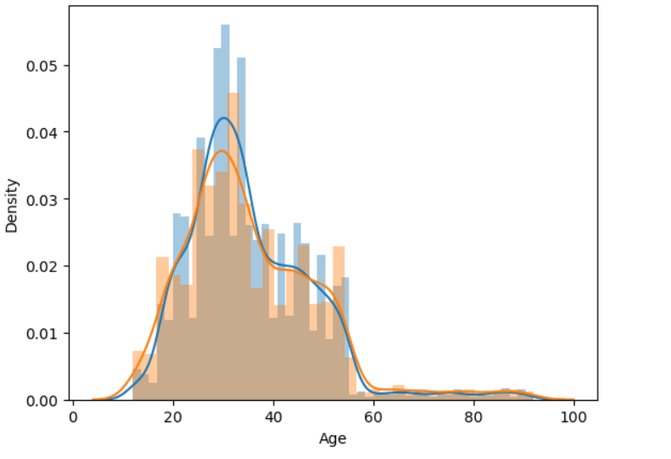
Distplot

Slide 10
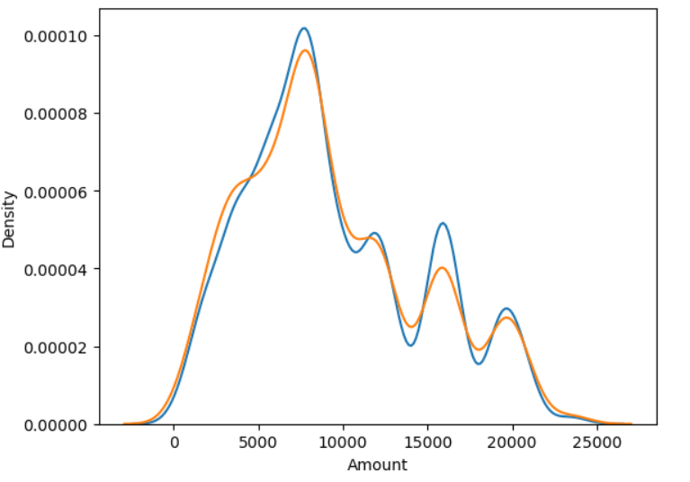
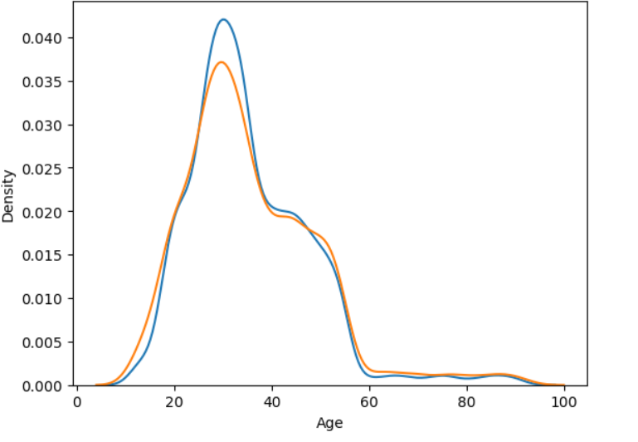
Kdeplot

Slide 11
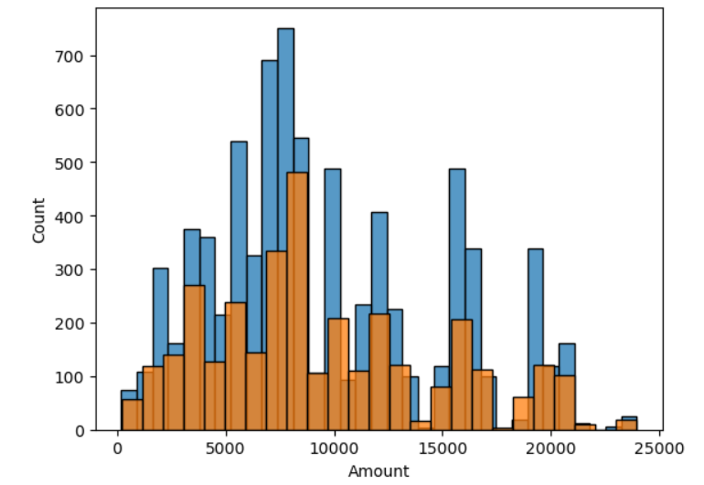
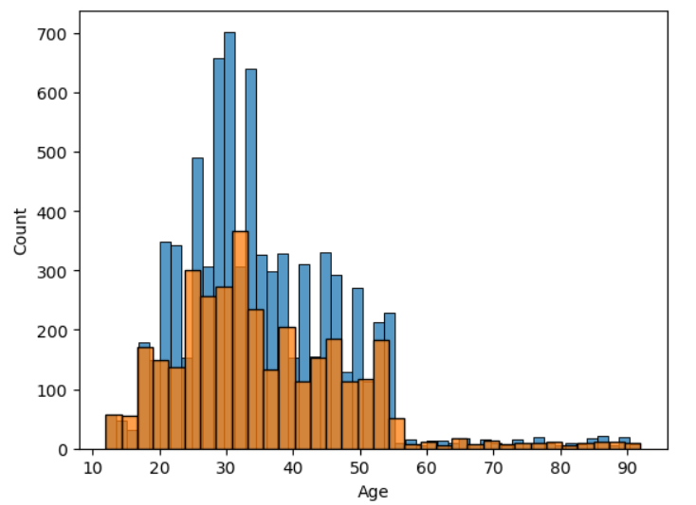
Histplot

Slide 12
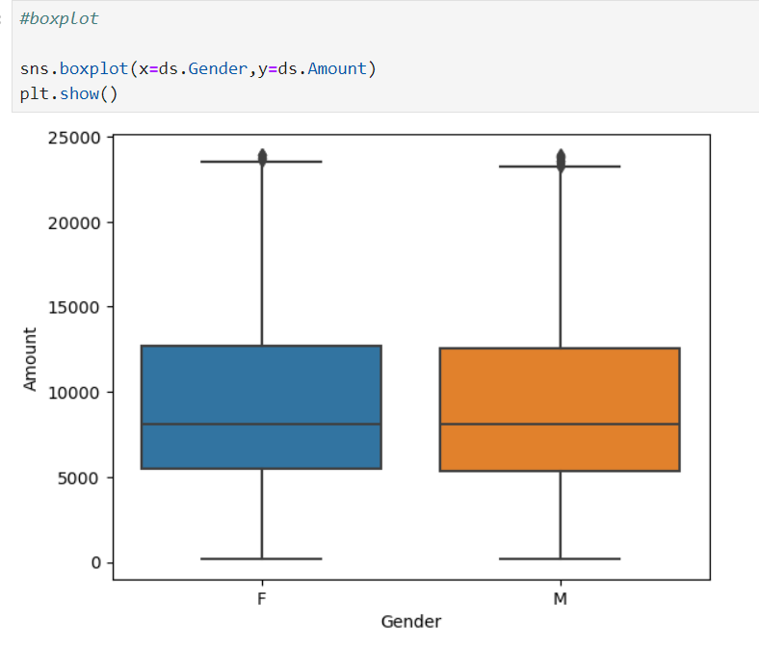
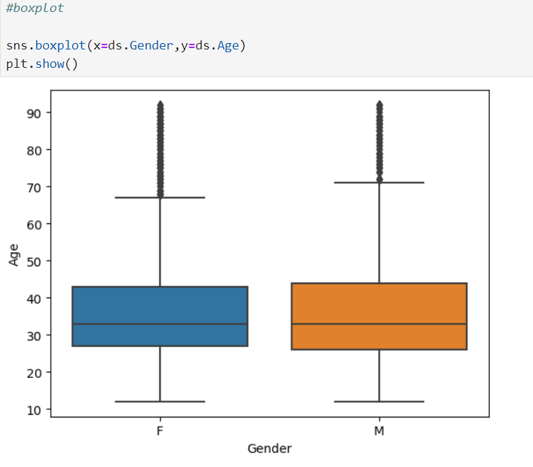
Boxplot

Slide 13
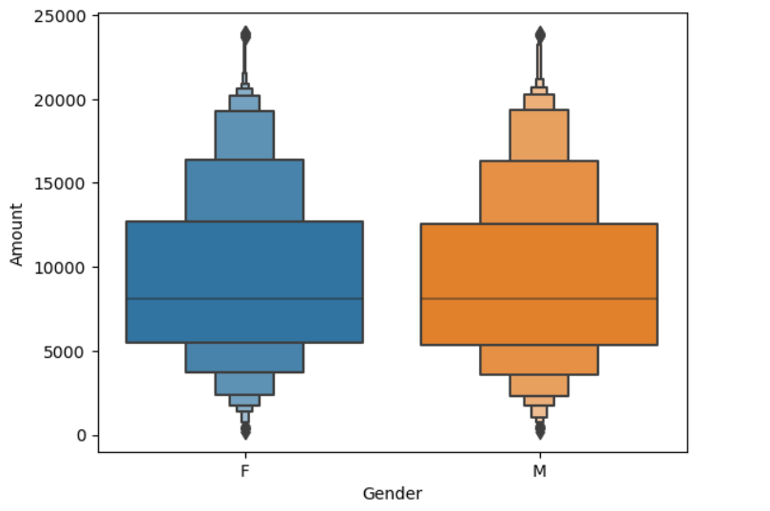
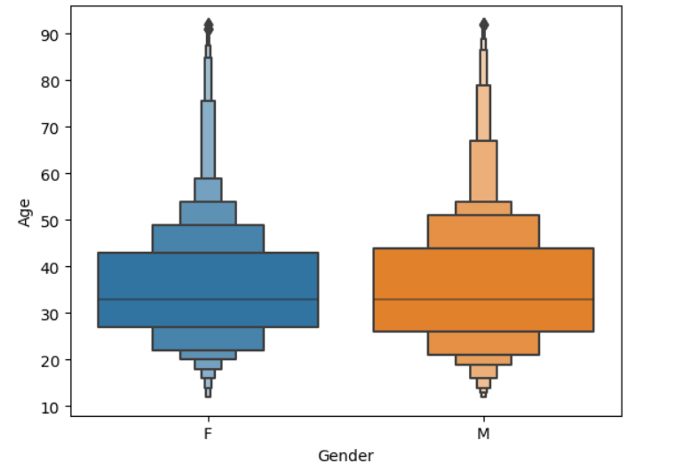
Boxenplot

Slide 14
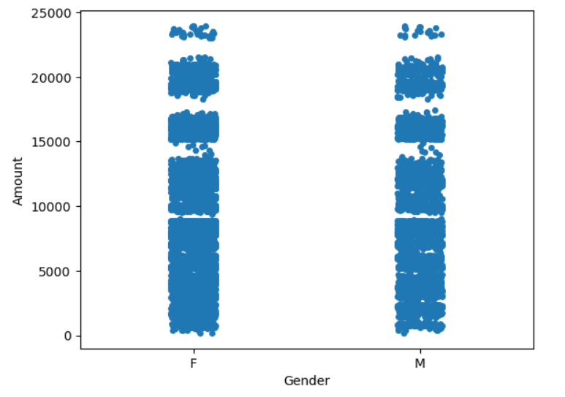
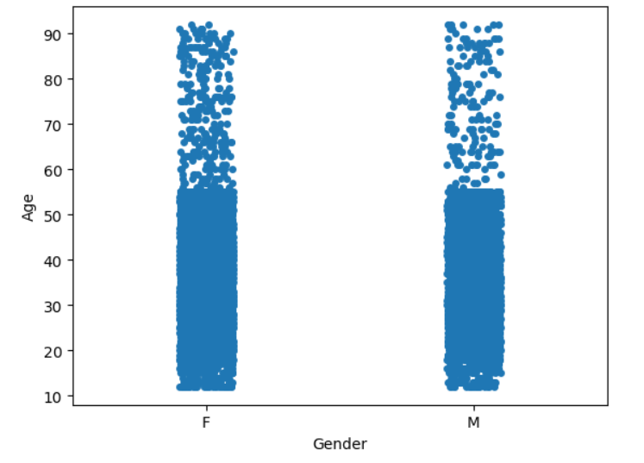
Stripplot

Slide 15
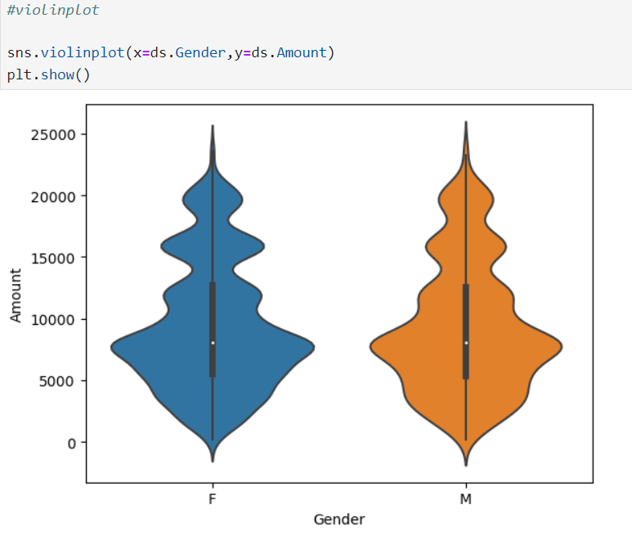
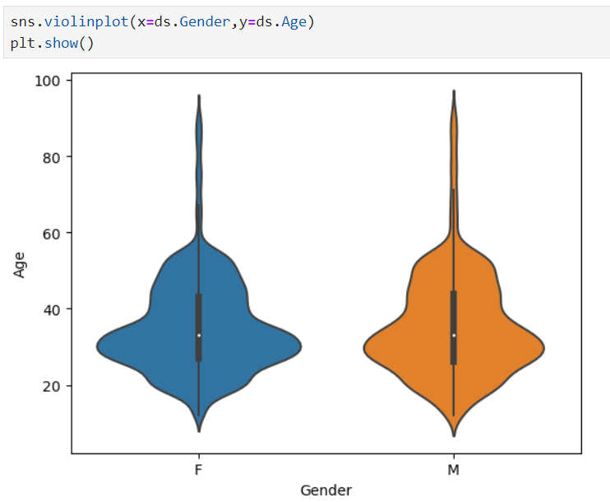
Violinplot

Slide 16
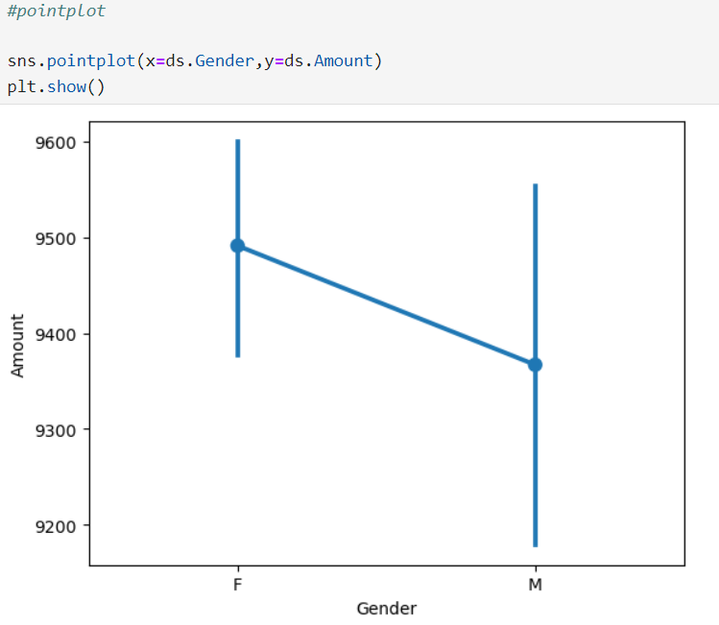
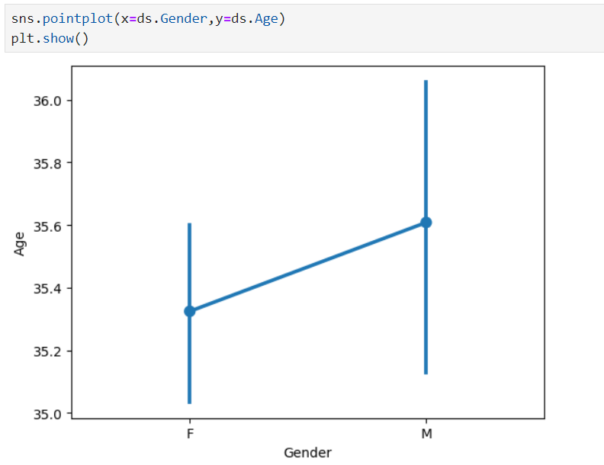
Pointplot

Slide 17
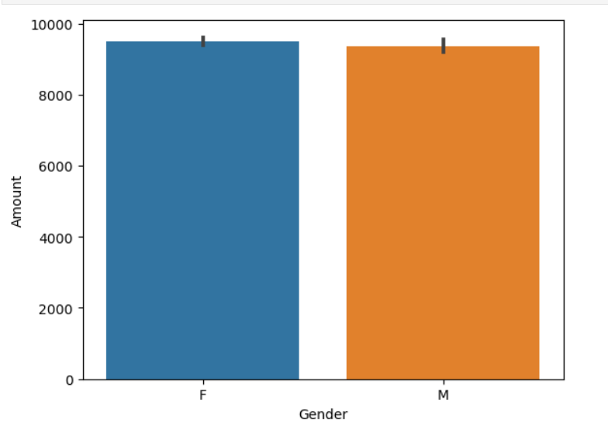
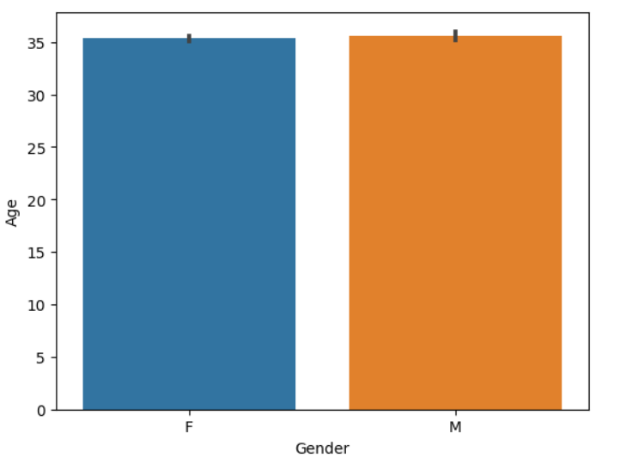
Bar plot

Slide 18
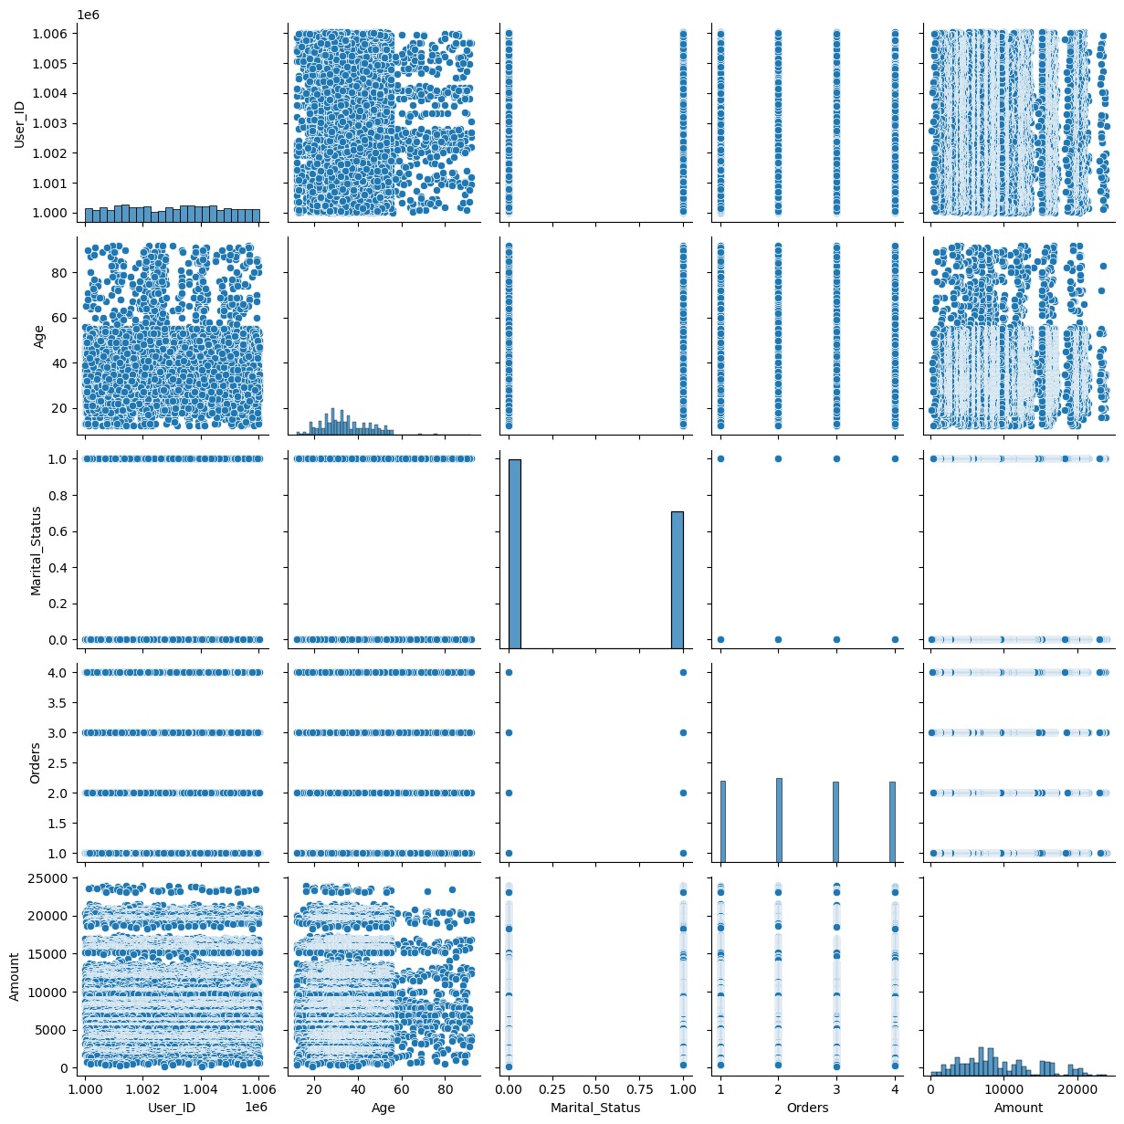
Pair plot

Slide 19
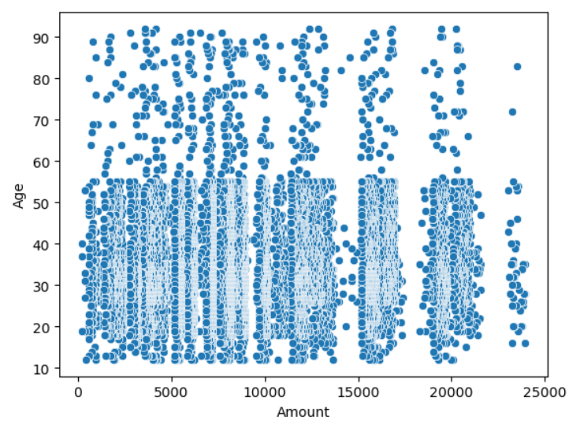
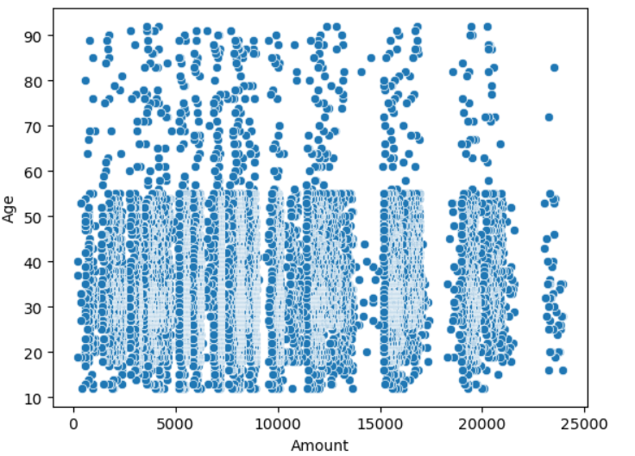
Scatterplot

Slide 20
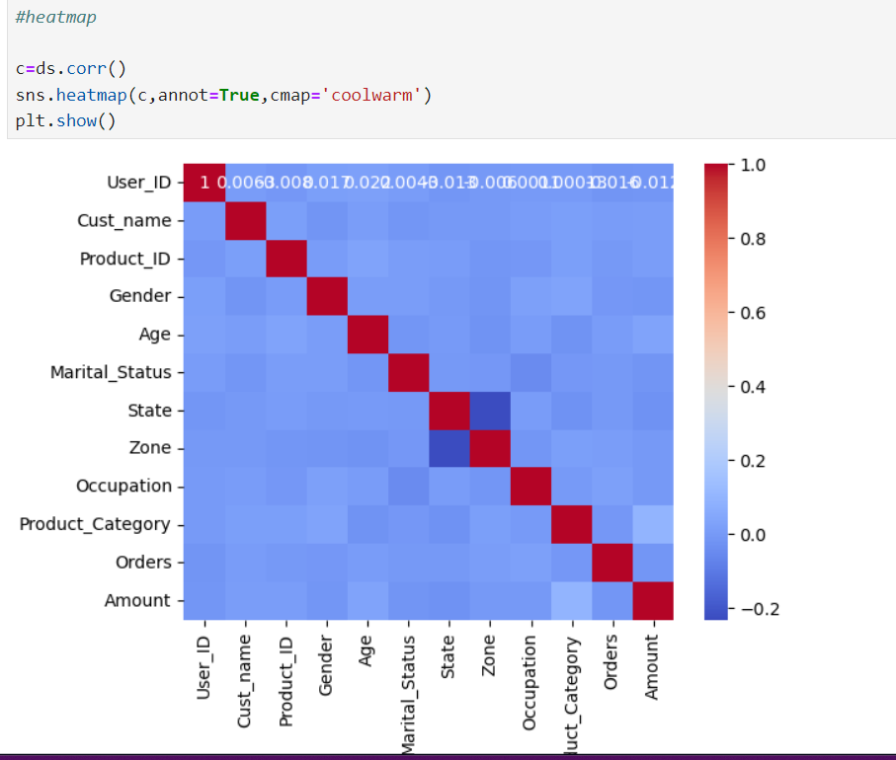
Heatmap

Slide 21
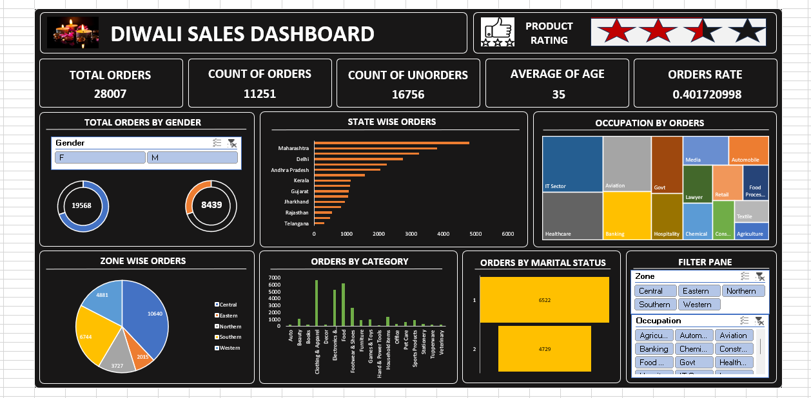
2. Making a Dashboard using Excel Worksheets

Slide 22
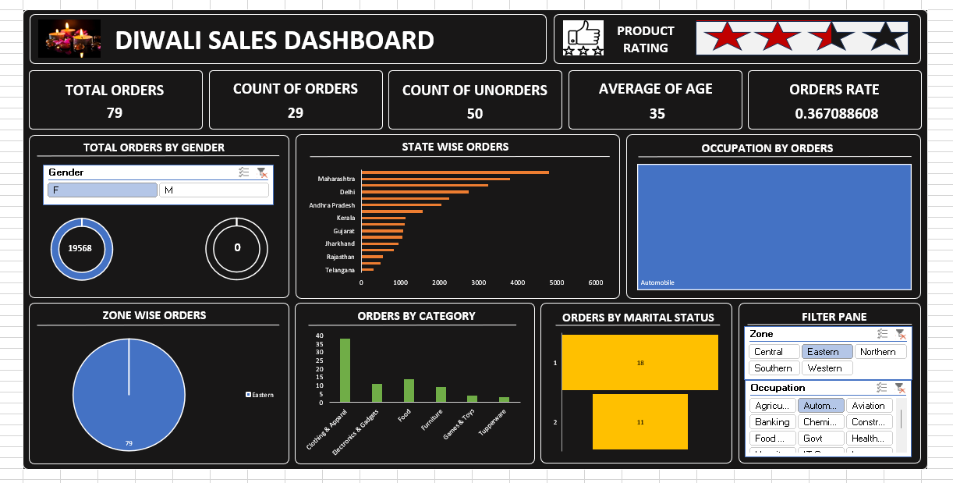
Changes according to the Categories:-
Total Orders By Gender-Female----> Zone- Eastern-----> Occupation-Automobile

Slide 23
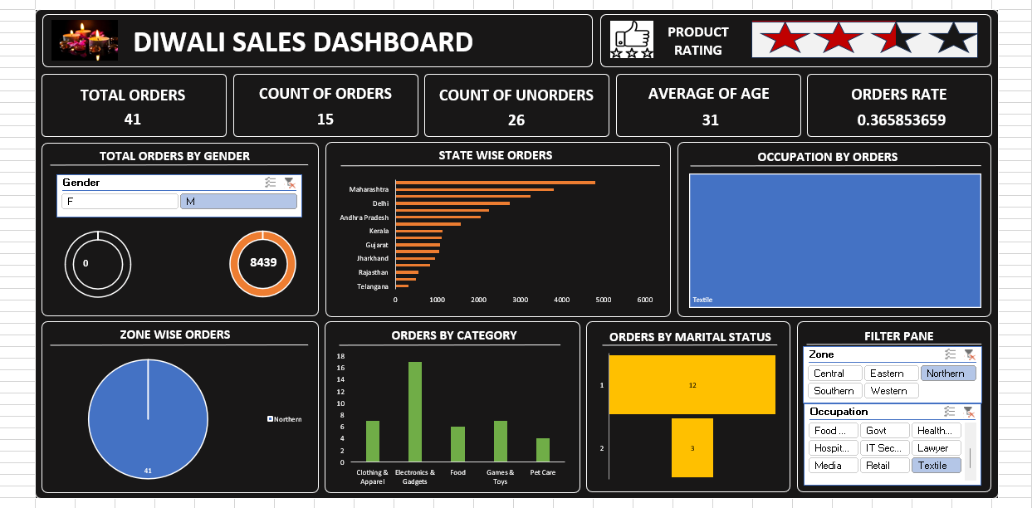
Total Orders By Gender-Male----> Zone- Northern-----> Occupation-Textile

Slide 24
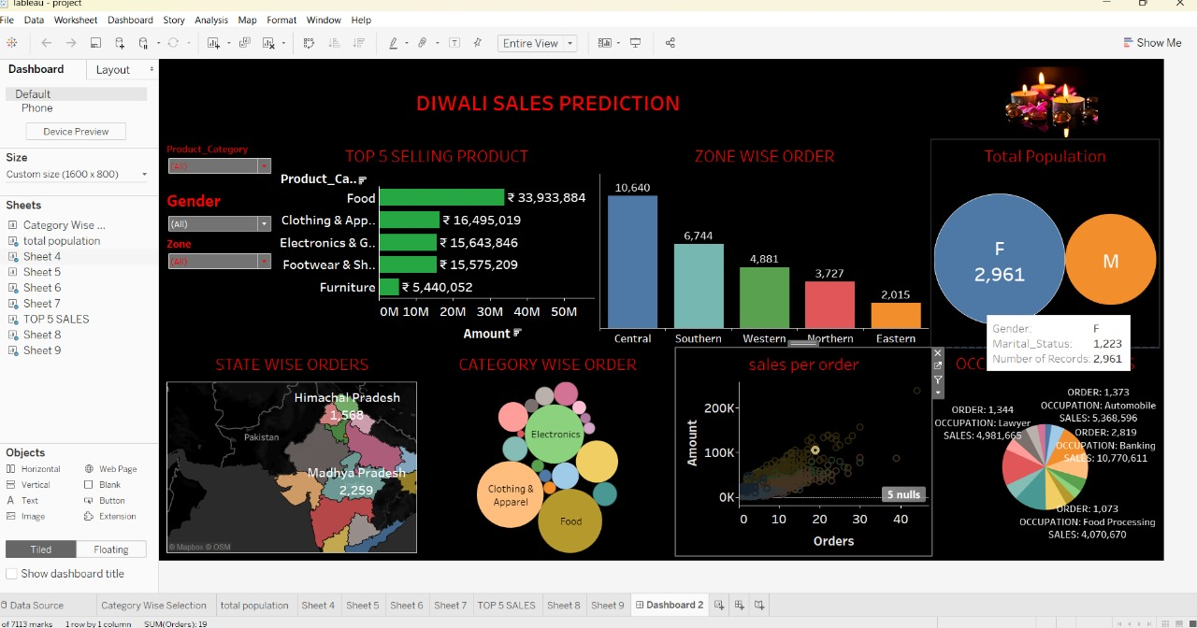
3. Making a Dashboard using Tableau

Slide 25
Conclusion
While Diwali sales analysis provides valuable insights and benefits, it also comes with several disadvantages, including data quality issues, resource intensity, complexity in interpretation, privacy concerns, and potential for bias. Businesses must address these challenges to ensure that their sales analysis efforts are effective and yield accurate, actionable insights. Balancing data-driven strategies with qualitative insights and long-term planning is essential for sustained success.

Slide 26
Installation
Install Jupyter Notebook for Python on your Local Machine.
Install Required by python libraries.
*pip install pandas and numpy
Create a Excel Worksheet(Dashboard)
Install Tableau Desktop (Dashboard)

Slide 27
THANK YOU

