Slide 1
3D Object Recognition
Ipsita Parida
20918570
Date – 24 June 2022

Slide 2
What is Object Recognition?
Object detection, feature extraction, recognition
Obtaining environmental information by a set of sensors
Identifying specific objects in the scene through computer analysis
Recognition of specific objects in the scene and give the position and posture
Application :
Robot Navigation
Industrial inspection
Aerospace and military reconnaissance and so on

Slide 3
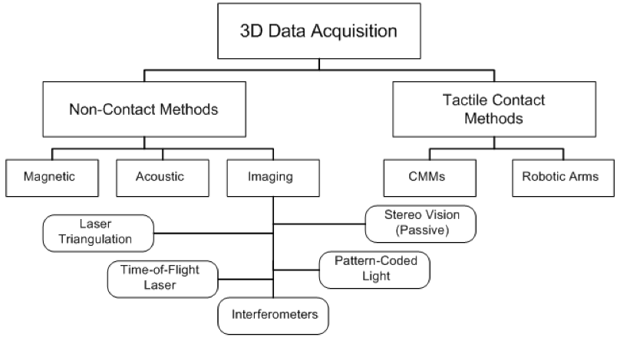
Data Acquisition Methods
Popular in existing research on object detection
LiDAR
Stereo Vision
RGB-D cameras
Fig 1: Classification of 3D data acquisition techniques[1]

Slide 4
3D Object Recognition Methods [2]
Algorithm | Introduction | Advantage | Disadvantage
Geometric or model-based method | Description from the input images or data | Straightforward to compare shapes Easy to understand | Not suitable for noise interference or complex backgrounds
Appearance or view-based method | View similarity | Easy to get data Simple | View angle, illumination Sensitive to occlusion, noise
Feature matching- based method | Area with high discriminability as a feature | Robust to complex background, noise, occlusion, pose | Complexity and accuracy is dependent on feature selection
Depth image-based method | Geometric info from depth data | Unaffected by illumination and surface texture | Affected by sensor performance
Intelligent algorithm- based method | Natural phenomena | Novel, widely used | Optimization problem

Slide 5
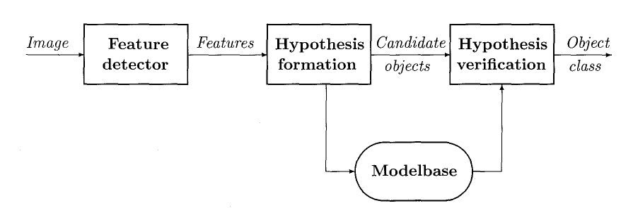
Object Recognition System
Input
Fig 1: Different components of an object recognition system[3]

Slide 6
Feature Extraction
Variations in RANSAC
RANSAC – Plane Extraction[4]
CC-RANSAC[5]
NCC-RANSAC[6]
Features from the Planar patch[7]
Voxel Feature Generation and Normalization[8]

Slide 7
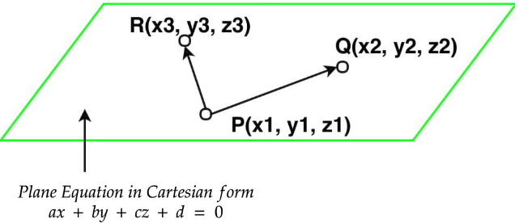
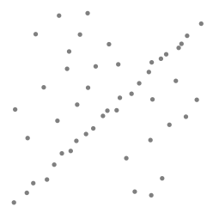
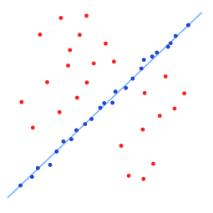
RANSAC – Plane Extraction[4]
RANSAC stands for RANdom Sampling and Consensus
Use-case- segment the ground plane from the other planes given LiDAR point cloud [9]
Step 1- Select 3 points. 3 points are required to form a plane
Step 2- Calculate the parameters required for the plane equation.
Fig 1: A data set with many outliers
Fig 2: Fitted line with RANSAC

Slide 8
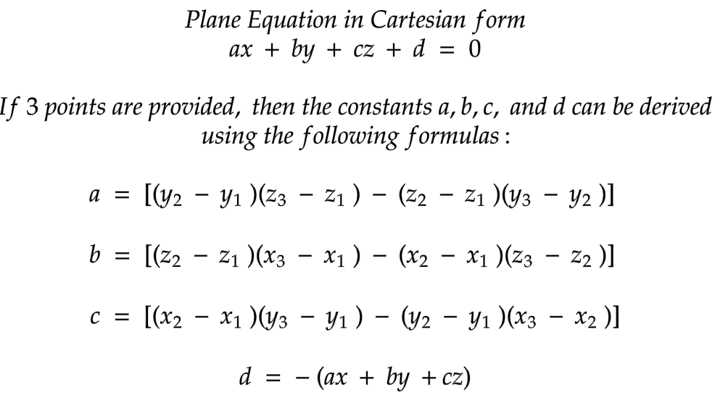
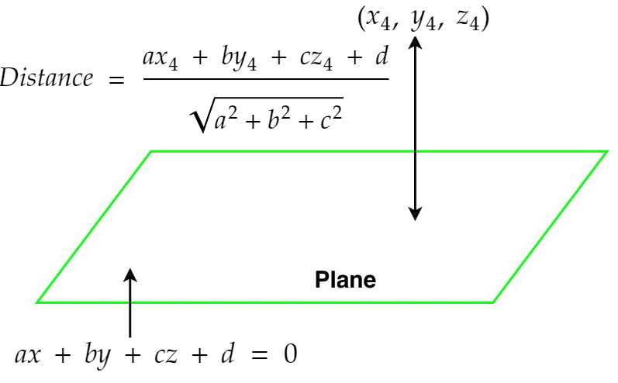
RANSAC – Plane Extraction[4]
Step 3- Calculate the distance of all the points in the point cloud from the plane
Step 4 – if distance, d < threshold δ, it is an inliner
Step 5- Store the plane points and points having the maximum number of inliners.
Step 6 – Repeat the process again for #iterations specified
Model having highest inliners is the best model.

Slide 9
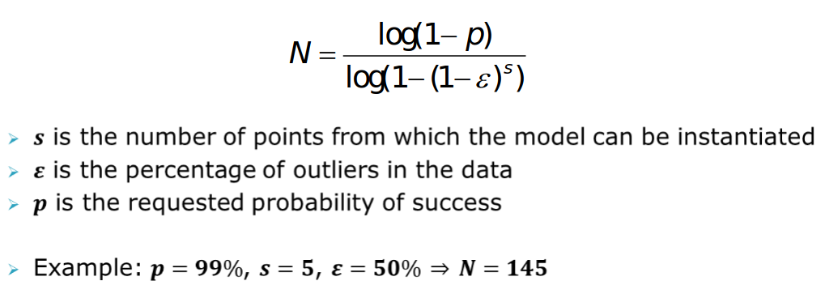
RANSAC – Plane Extraction[4]
How many trials(N) ?
Overall success probability – p
Choose N such that with p at least one sample set is free from outliner

Slide 10





RANSAC – Plane Extraction[4]
M Steps : N = 2M planes
Length of a step (AB+BC):
2L/N, L is the total length of the stairway.
Plane
Result in a slant plane (depicted by the oblique solid line in Fig. 3)
This plane produces more data points di < δ
# data points between 2 planes(dotted) :
# data points of AB or BC, whichever is larger
Resulting plane with slope
if
=>
Fig 2. RANSAC plane-fitting on a stairway scene
where,
h—stairway height,
AB—height of stair riser,
BC—depth of stair tread,
δ—distance threshold for plane-fitting,
α—stairway slope,
W – stairway’s width
*Each of them is measured in term of number of data points.

Slide 11
CC-RANSAC [5]
Principle
plane straddling multiple planes produces multiple disconnected planar patches
maximize the number of connected inliers
Assumption AB < BC (i.e., DE < FG)
Procedure
Selects the largest contiguous inlier set (i.e., FG)
attempts to maximize its data points, and obtains plane BC
continues on the remaining data until no more planes are found.
Limitations
over-extract a plane- does not extract the exact planar patch for the inliers
when there are intersecting planes
fail in case of a scene with a stairway that contains a stair wall
Fig. 3. CC-RANSAC plane-fitting (a) Intersecting planes. (b) Stairway with a stair wall.
Notes:
Notes-
Limitations-
The CC-RANSAC method results in the plane depicted by the dotted lines. The inliers include all data points on the horizontal plane and the data points on the lower portion of the vertical plane because all of these data points satisfy di < δ.
As p1 connects all the other patches to form a single contiguous inlier set, the CC-RANSAC is unable to find any inlier patch that is on a riser or a tread.

Slide 12
Normal Coherence CC-RANSAC (NCC-RANSAC) [6]
2 fold process
Examine normal coherence of all inliers resulted from RANSAC plane-fitting
Stair wall is perpendicular to that of the fitted plane
inlier data point satisfying β = 90◦ - remove, violates normal coherence,
β - ∠ the surface normal of the inlier and the fitted plane
process removes p1 and results in a number of disconnected planar patches (p2, p3, . . . , p6)
Each patch as candidate plane
a plane is fitted to the patch and the distance from each data of the scene to the plane is calculated
point-to-plane distance < threshold δ
angle between the point’s surface normal and the plane’s normal < threshold θ₀.
steps 1 and 2 repeat until no data may be added to the patch.
Notes:
The normal coherence test exploits the fact that the stair wall’s normal is perpendicular to that of the fitted plane (ABC)
It can be observed that the NCC-RANSAC method uses one RANSAC plane-fitting procedure to find multiple inlier patches, each of which is then used as a seed to grow and extract the corresponding plane. As a result, the NCC-RANASC method is much more computationally efficient than the CC-RANSAC method.

Slide 13




Normal Coherence CC-RANSAC (NCC-RANSAC) [6]
Computation Cost
True inlier ratio for extracting the i^{th} plane : 1/(N + i-1) for i = 1, . . . ,N
Min # iteration for extracting outliner free plane with a confidence level η
where, n - # of data points used for the plane
For CC-RANSAC with N planes of the stairway,
Similarly, the required number of RANSAC plane-fitting processes for the NCC-RANSAC
η
where

Slide 14

Normal Coherence CC-RANSAC (NCC-RANSAC) [6]
Quality of Extracted Planes
Plane fitting error
M - # data points in plane
d_{i} - distance from the i^{th} data point to the plane
With ground truth data
e_{t} is calculated using the above eqn. d_{i,} distances from the ground truth data points to the extracted plane
ξ_{n} is ∠ the normal of the extracted plane and ground truth plane

Slide 15
Normal Coherence CC-RANSAC (NCC-RANSAC) [6]
Advantages
Computationally efficient than CC-RANSAC
free of the over-extraction problem of the existing RANSAC method and its variants
The experimental results demonstrate that the NCC-RANSAC method has a very high rate of success (close to 100%) in PE.
High parallelism and is suitable for parallel computing.

Slide 16



Feature from Planar Patch[7]
Basic Features – patch’s intrinsic attributes
Orientation, Area, Height
Orientation –
Area –
Height-
where,
n_{i} - the patch’s normal and
Z= (0, 0 , 1)is the vector of Z-axis
where,
d_{ij} - distance from the j^{th} point of the patch to the camera,
h - pixel width/pitch of the camera,
f - camera’s focal length
where,
z_{ij} - z coordinate of the j^{th} point,
K - total number of points of the i^{th} patch

Slide 17

Voxel Feature Generation and Normalization[8]
Cube-shaped voxel units
non-ground points - assigned voxel units based on x, y, and z position in Cartesian coordinate system
Features w.r.t. each voxel
Point count, N
Determines voxel’s importance
Point density, ρ
Determines voxel’s importance
ρ = N∕(l × w × h), where l, w and h – size of voxel in x, y, and z direction
Voxel centroid, μ
geometric center of a voxel
Represented as {x̄, ȳ, z̄} where x̄, ȳ,̄ z̄ are the mean values of the point cloud in x, y and z directions
Point Variance, σ²
Point cloud distribution difference in x, y, and z directions

Slide 18

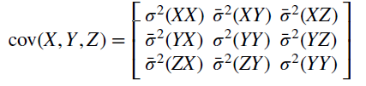

Voxel Feature Generation and Normalization[8]
Features w.r.t. each voxel (cont..)
Point covariance, σ²
covariance variable that measures the point distribution differences in the x–y, x–z, and y–z directions
Covariance matrix -
Point eigenvector, υ and Point eigenvalues, λ
Calculated using singular value decomposition algorithm (SVD)
λ = {λ1, λ2, λ3} – sorted
Surface curvature κ
Describes point cloud curvature

Slide 19
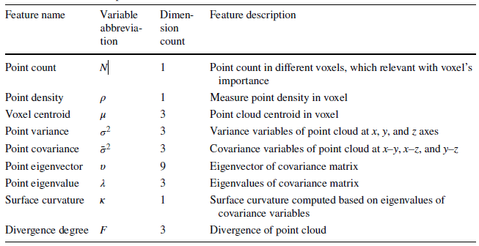

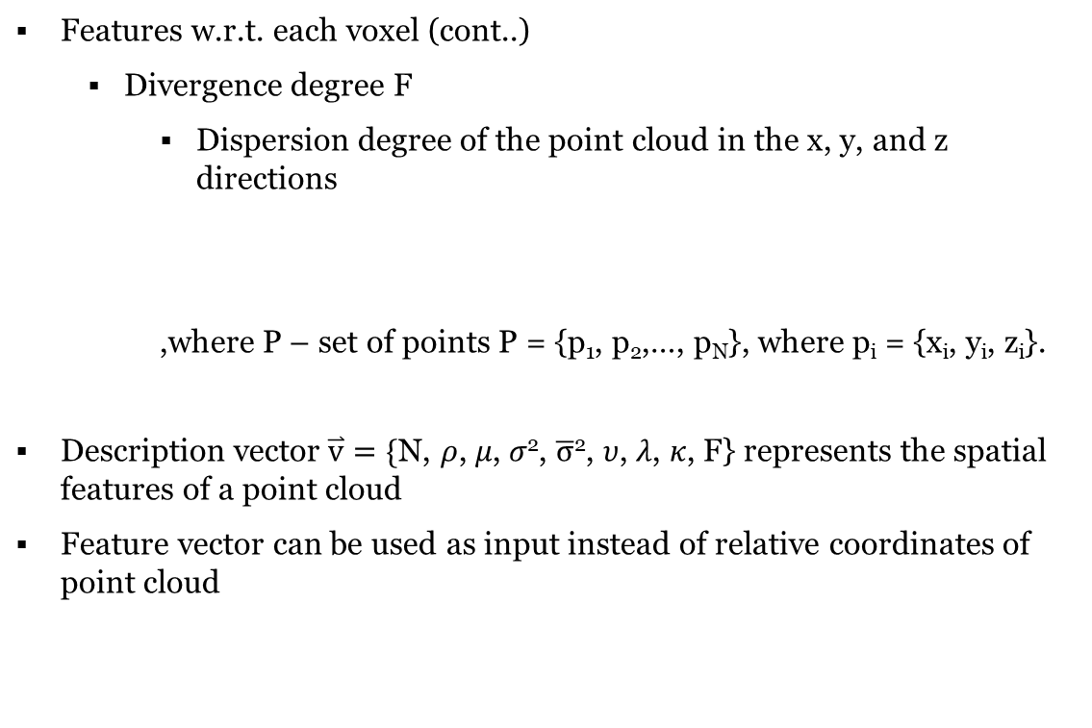
Voxel Feature Generation and Normalization[8]
Features w.r.t. each voxel (cont..)
Divergence degree F
Dispersion degree of the point cloud in the x, y, and z directions
,where P – set of points P = {p₁, p₂,…, p_{N}}, where p_{i} = {x_{i}, y_{i}, z_{i}}.
Description vector$\overset{⃑}{v}=\{$N, 𝜌, 𝜇, 𝜎², $\overline{σ}$², 𝜐, 𝜆, 𝜅, F} represents the spatial features of a point cloud
Feature vector can be used as input instead of relative coordinates of point cloud
Table- Feature list computed in valid voxel

Slide 20
Voxel Feature Generation and Normalization[8]
Why Normalization?
Different objects – different sizes – different voxel count
Under different rotation angle, same object have different point cloud/ voxel distribution
Object features normalization
Fig 4. Flowchart of object feature normalization

Slide 21
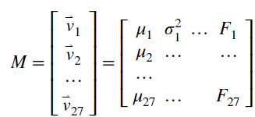
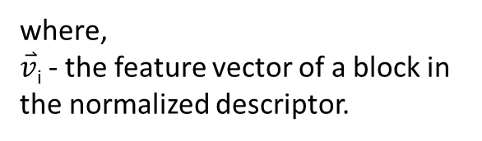
Voxel Feature Generation and Normalization[8]
Object Feature Normalization(cont..)
Normalization required for equal down sampling/up sampling irrespective of voxel count
Voxel feature vector is transformed from an uncertain count to fixed 3×3×3 feature vectors using object feature’s normalized descriptor
feature matrix M of each object-
M can be used as input data to classification model. eg - multilayer Neural Network model [10]
where,
$\overset{⃑}{v}$_{i} - the feature vector of a block in the normalized descriptor.

Slide 22
Thank you

Slide 23
References
Page, D., Koschan, A., Voisin, S., Ali, N., & Abidi, M. (2005). 3D CAD model generation of mechanical parts using coded‐pattern projection and laser triangulation systems. Assembly Automation.
Model Fitting and Robust Estimation: RANSAC Algorithm [Online].Available: http://www.csse.uwa.edu.au/∼pk/research/matlabfns
Dong, T., Qi, X., Zhang, Q., Li, W., & Xiong, L. (2019, August). Overview on Vision-Based 3D Object Recognition Methods. In International Conference on Image and Graphics (pp. 243-254). Springer, Cham.
Jain, R., Kasturi, R., & Schunck, B. G. (1995). Machine vision (Vol. 5, pp. 309-364). New York: McGraw-hill.
Gallo, O., Manduchi, R., & Rafii, A. (2011). CC-RANSAC: Fitting planes in the presence of multiple surfaces in range data. Pattern Recognition Letters, 32(3), 403-410.
Qian, X., & Ye, C. (2014). NCC-RANSAC: A fast plane extraction method for 3-D range data segmentation. IEEE transactions on cybernetics, 44(12), 2771-2783.
Qian, X., & Ye, C. (2014, May). 3D object recognition by geometric context and Gaussian-mixture-model-based plane classification. In 2014 IEEE international conference on robotics and automation (ICRA) (pp. 3910-3915). IEEE.
Tian, Y., Song, W., Sun, S., Fong, S., & Zou, S. (2019). 3D object recognition method with multiple feature extraction from LiDAR point clouds. The Journal of Supercomputing, 75(8), 4430-4442.
Derpanis, K. G. (2010). Overview of the RANSAC Algorithm. Image Rochester NY, 4(1), 2-3.
Song, W., Zou, S., Tian, Y., Fong, S., & Cho, K. (2018). Classifying 3D objects in LiDAR point clouds with a back-propagation neural network. Human-centric Computing and Information Sciences, 8(1), 1-12.

