Slide 1
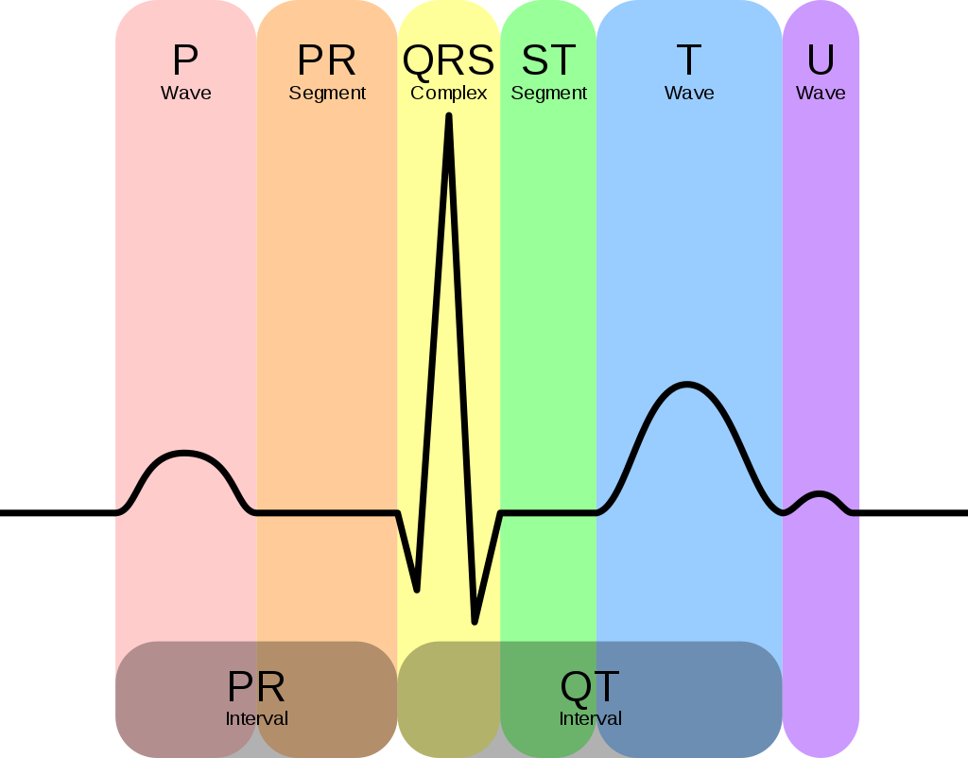
Wavelet-based ECG-Delineator and ECG signal compression
Amol Girish Shah - 18D070005
Mantri Krishna Sri Ipsit - 180070032
Shlok Vaibhav Singh - 18D070064

Slide 2
Brief introduction to wavelets

Slide 3
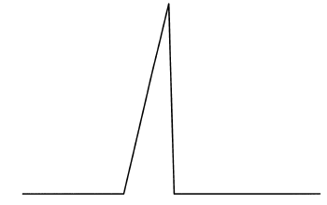
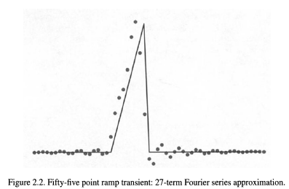
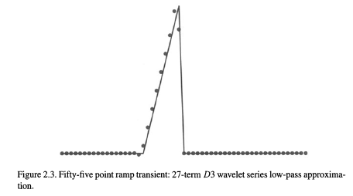
Brief Introduction to wavelets
Fourier basis not localized in space.
Need to characterize signal with discontinuities with less coefficients:
Wavelets are much more than this, wavelets allow use to obtain useful information about various frequency components of signal as well, with each wavelet, lies a filter bank for analysis and synthesis.
Source: Wavelet analysis, Resnikoff, Wells

Slide 4
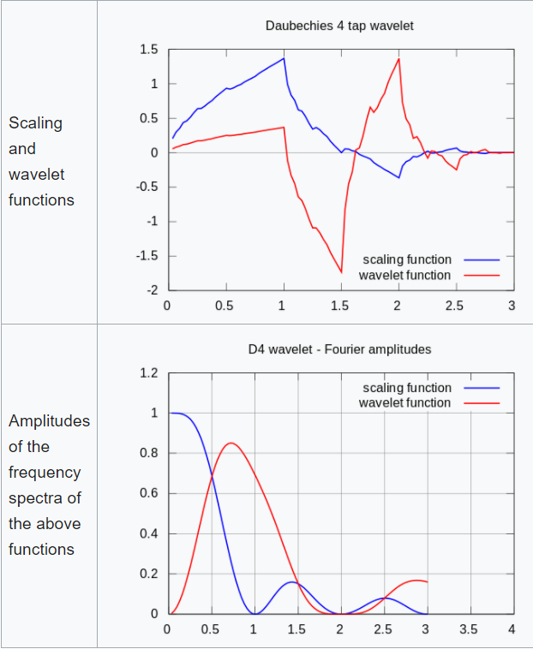
Wavelets are localized in both time and frequency domain
(Shown here is celebrated Daubechies wavelet)
Image Source : Wikipedia

Slide 5
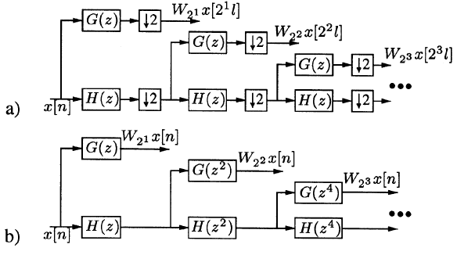
Algorithm a trous

Slide 6
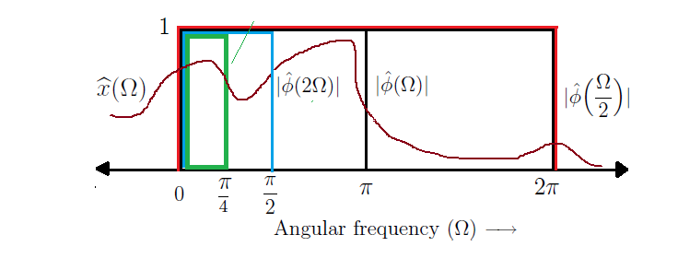
Each wavelets is related to a set of filters,
Which aspire to form bandpass filters as shown below:

Slide 7
Filter Bank Design

Slide 8




Dyadic Wavelet Transform
Discretized scale (a) and translation (b) factors
Octave filter bank realization using Mallat’s algorithm

Slide 9
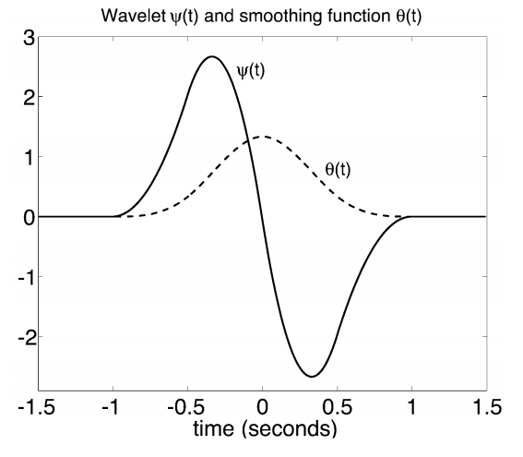
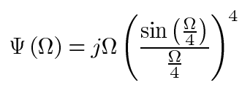
Quadratic Spline Wavelet
Fourier Transform of Wavelet

Slide 10
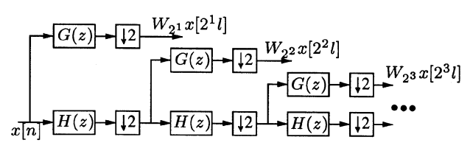
Mallat’s Realization
Taken from Fig.1(a), Martinez.et.al

Slide 11
Drawbacks
Down-samplers remove redundancy of signal representation
Makes the signal representation time-variant
Reduces temporal resolution of the wavelet coefficients
Solution?

Slide 12
Algorithme à trous

Slide 13
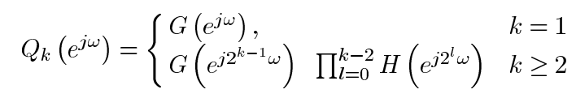
Algorithme à trous
Remove the decimation stages
Interpolating the impulse responses of the previous scale
Equivalent frequency response for k^{th} scale:

Slide 14
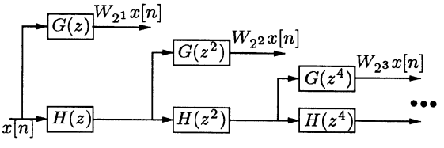
Algorithme à trous
Taken from Fig.1(b), Martinez.et.al

Slide 15
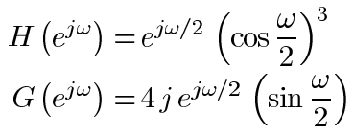
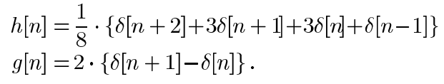
Filter Responses (FIR)

Slide 16
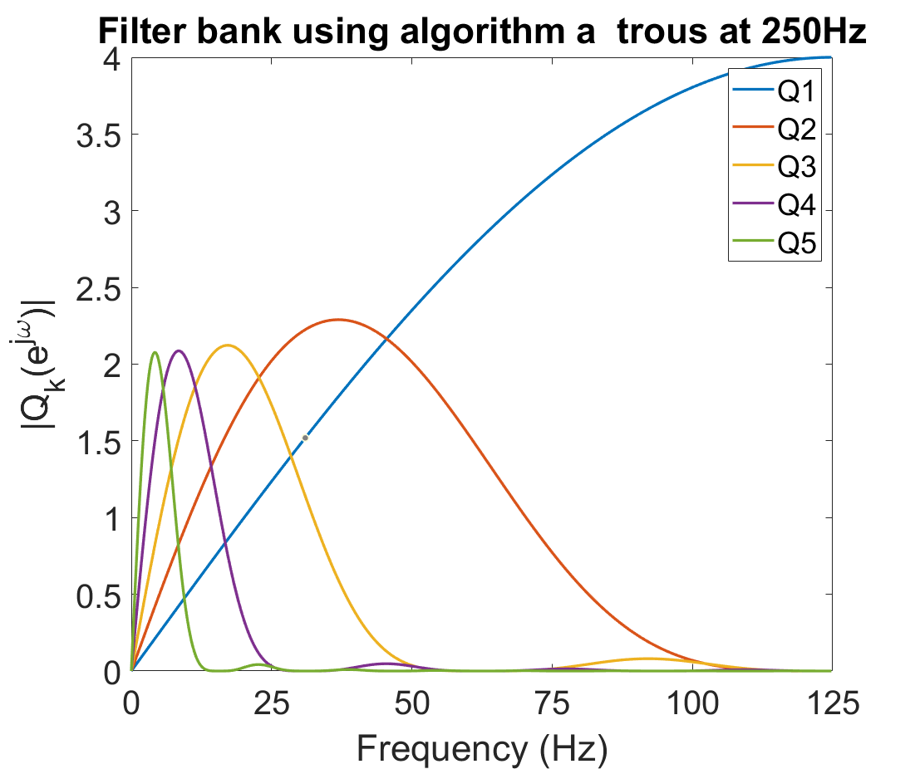
Frequency Response Visualization

Slide 17
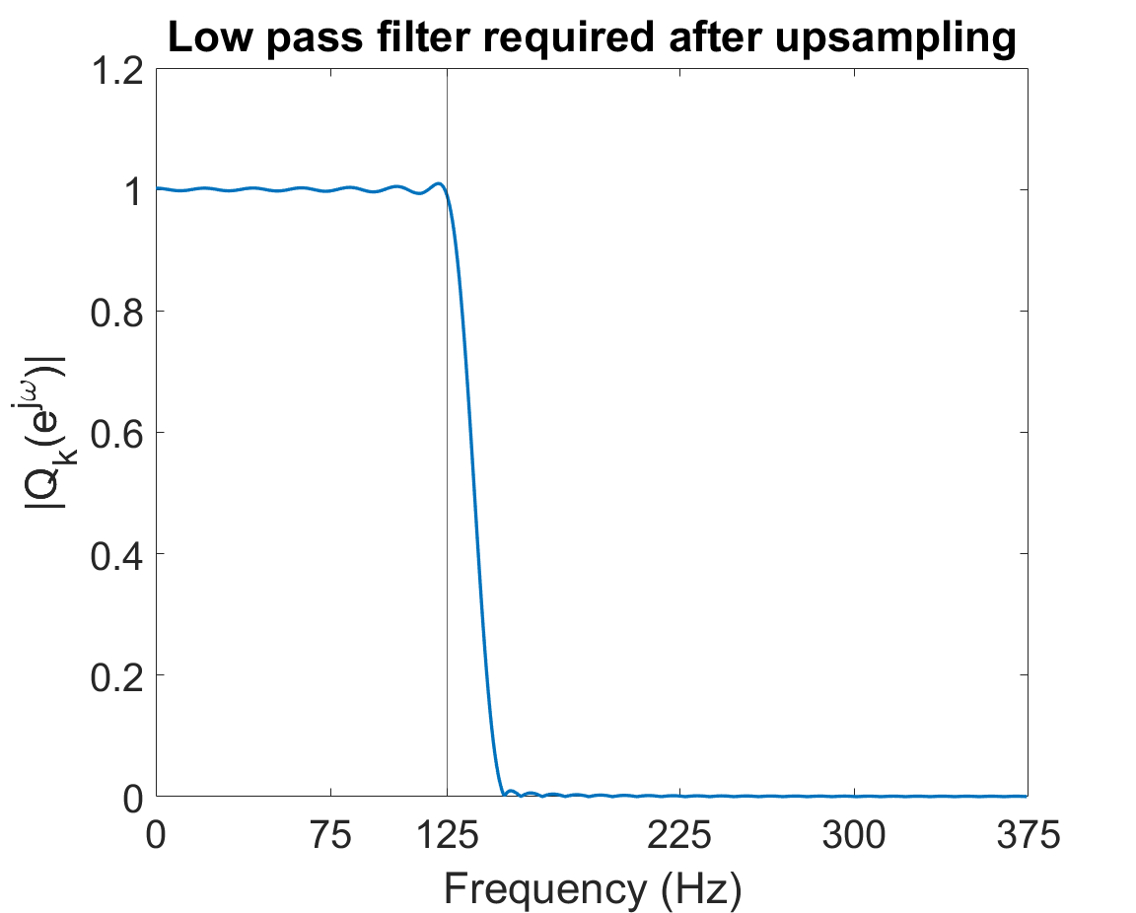
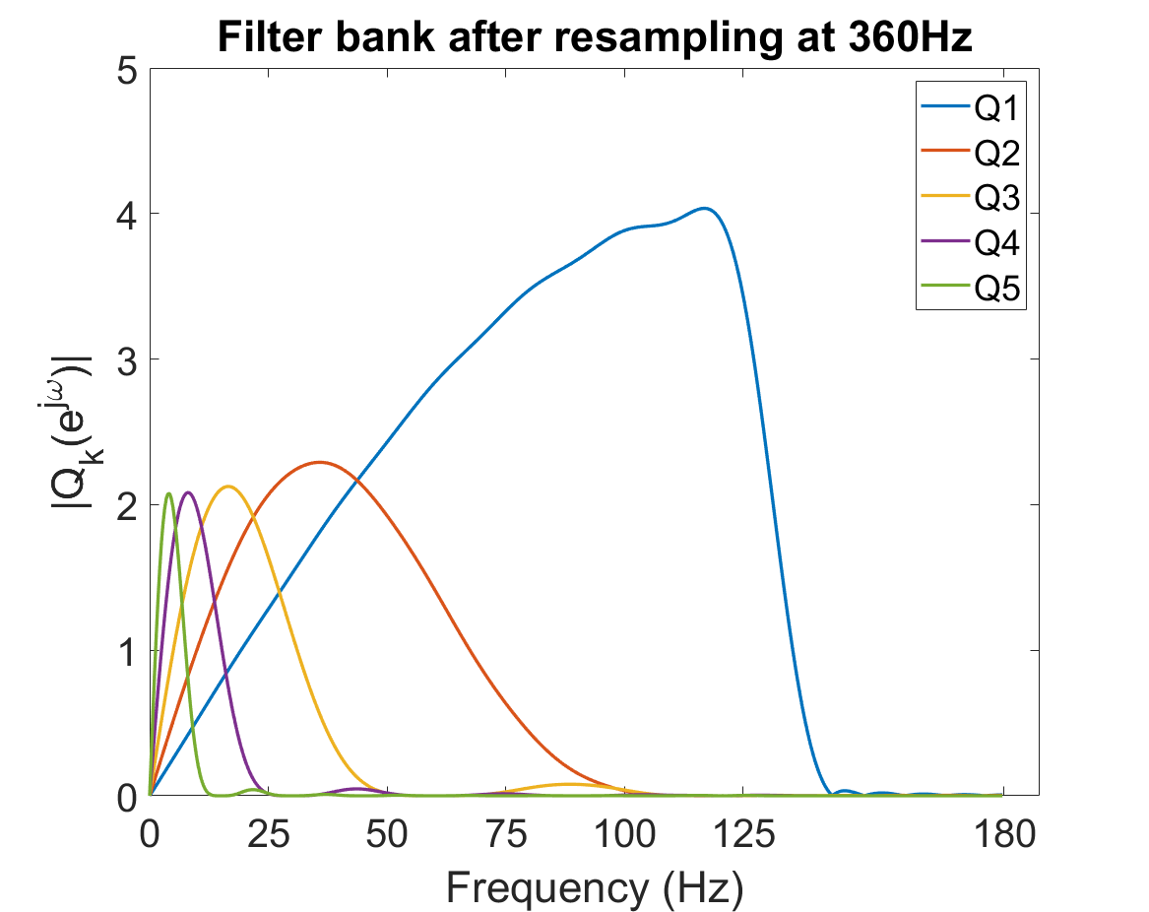
Frequency Response Visualization

Slide 18
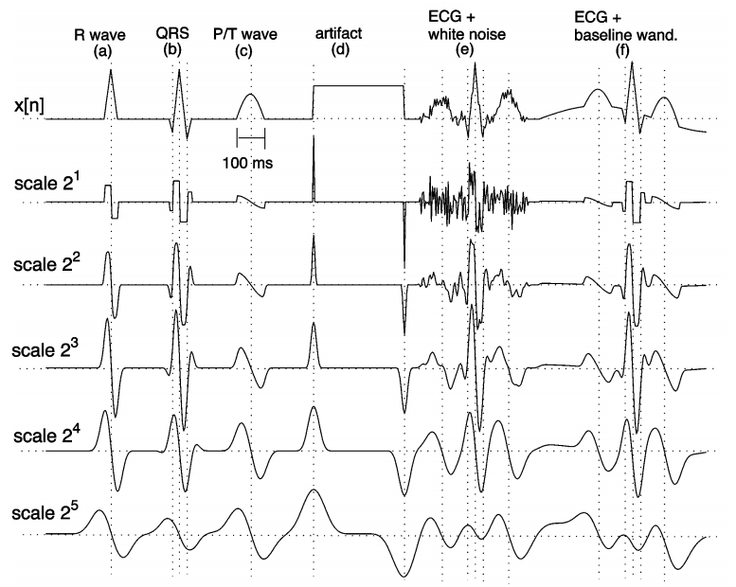
Sample Output
Fig. 5, Martinez.et.al

Slide 19
QRS complex detection and dilineation

Slide 20
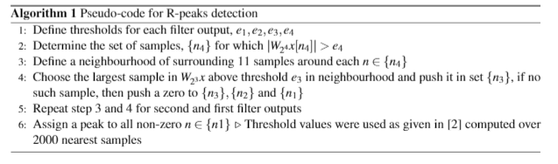
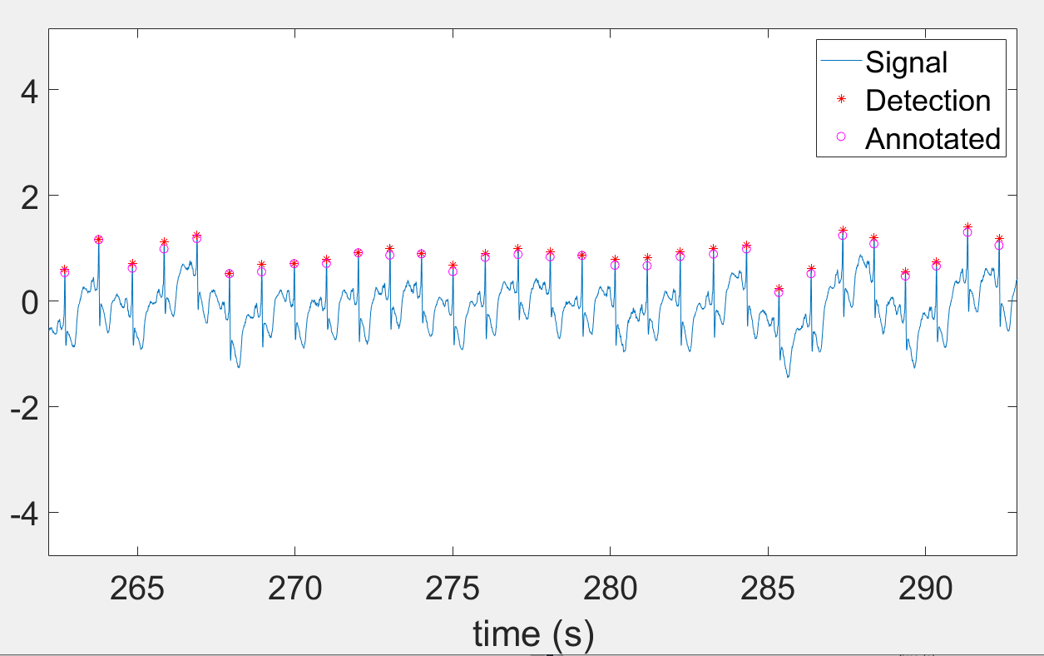
QRS complex:
Step 1
Find R peaks

Slide 21
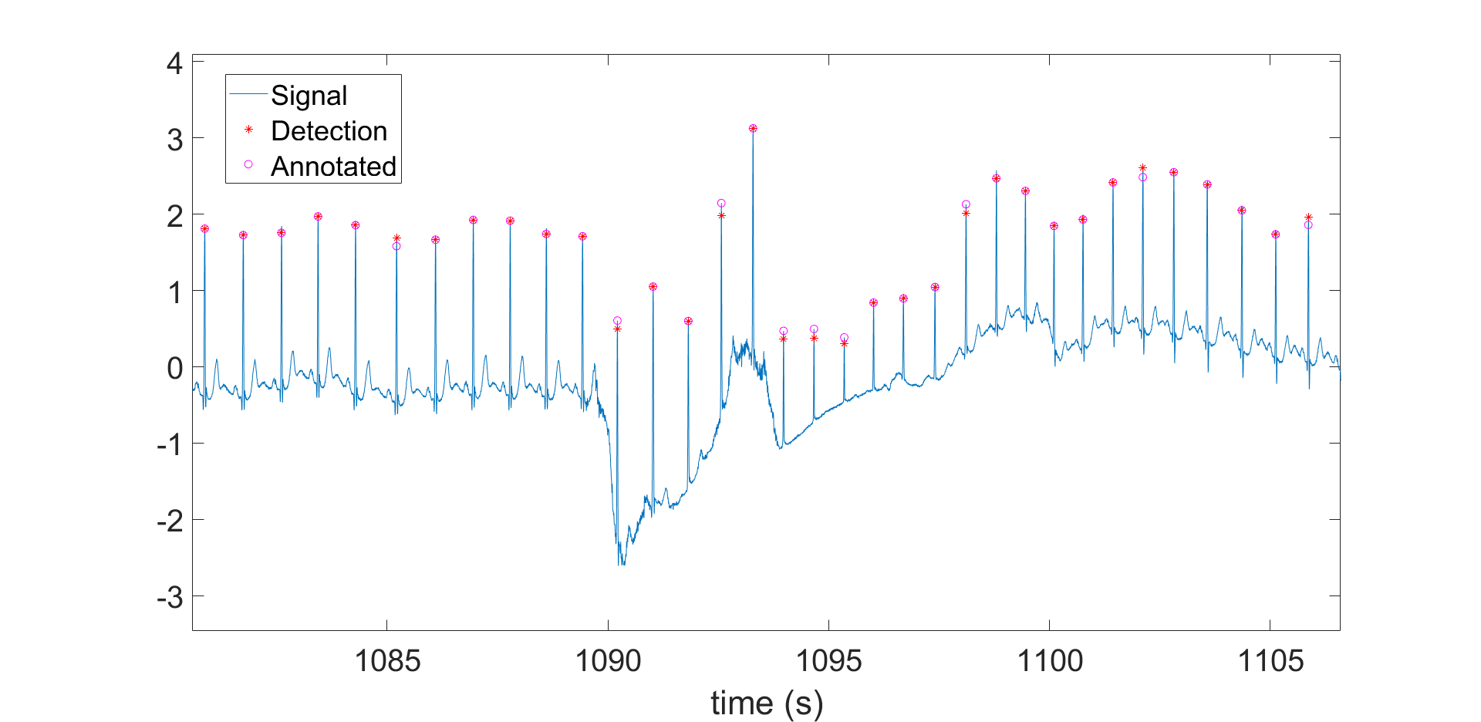
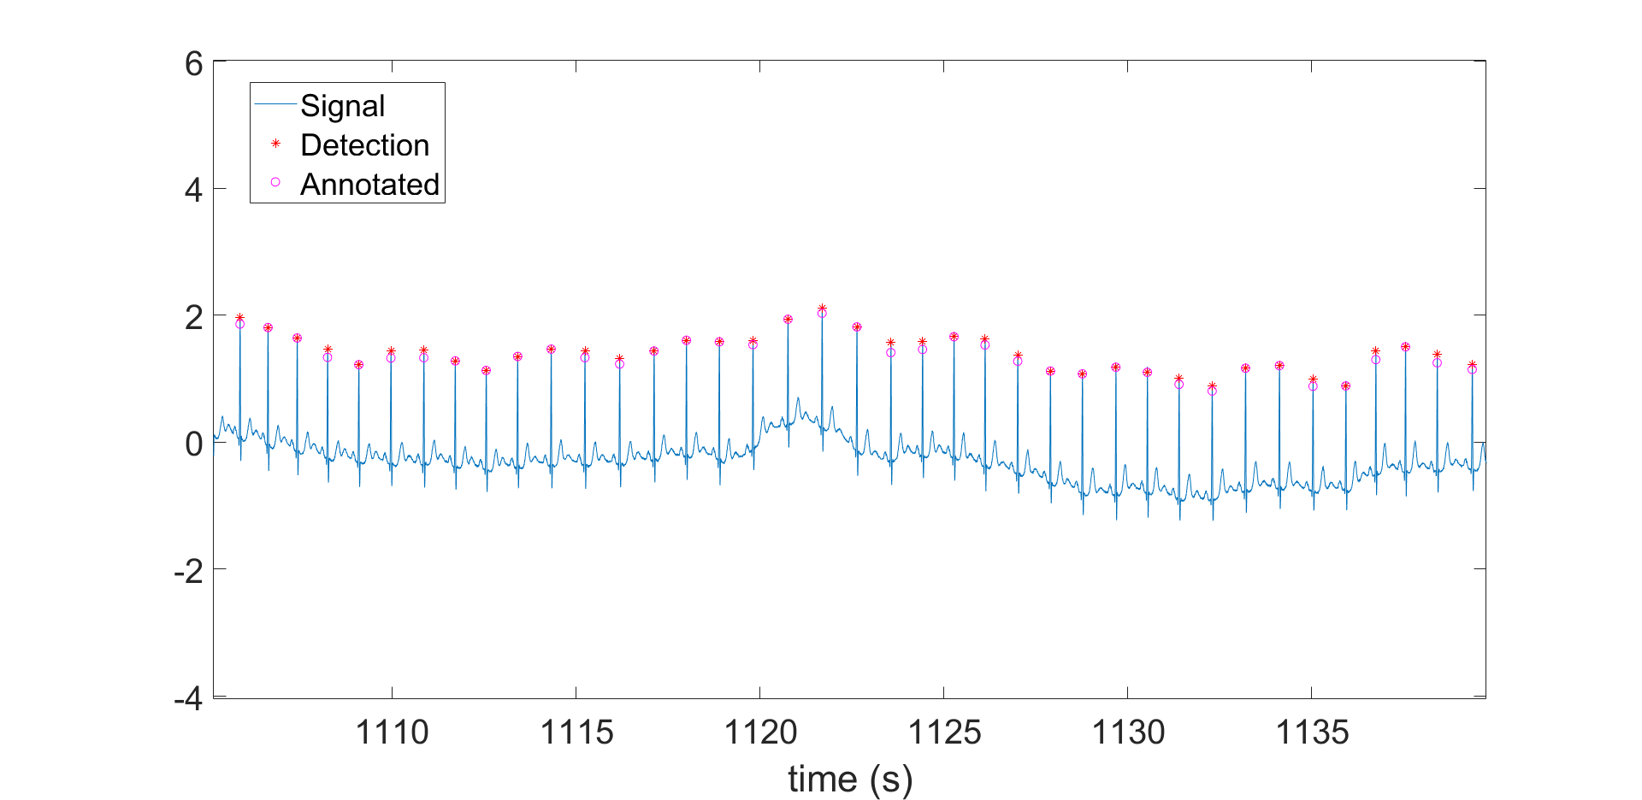
Robust to artifacts.
Robust to noise
(since we started detection from higher filters)

Slide 22
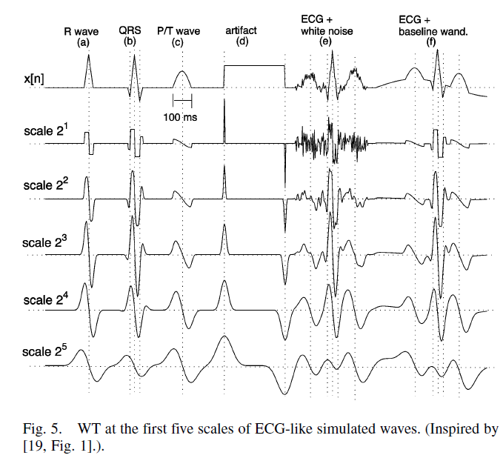
QRS complex:
Step 2
Find Q onset and
S end near R peaks

Slide 23
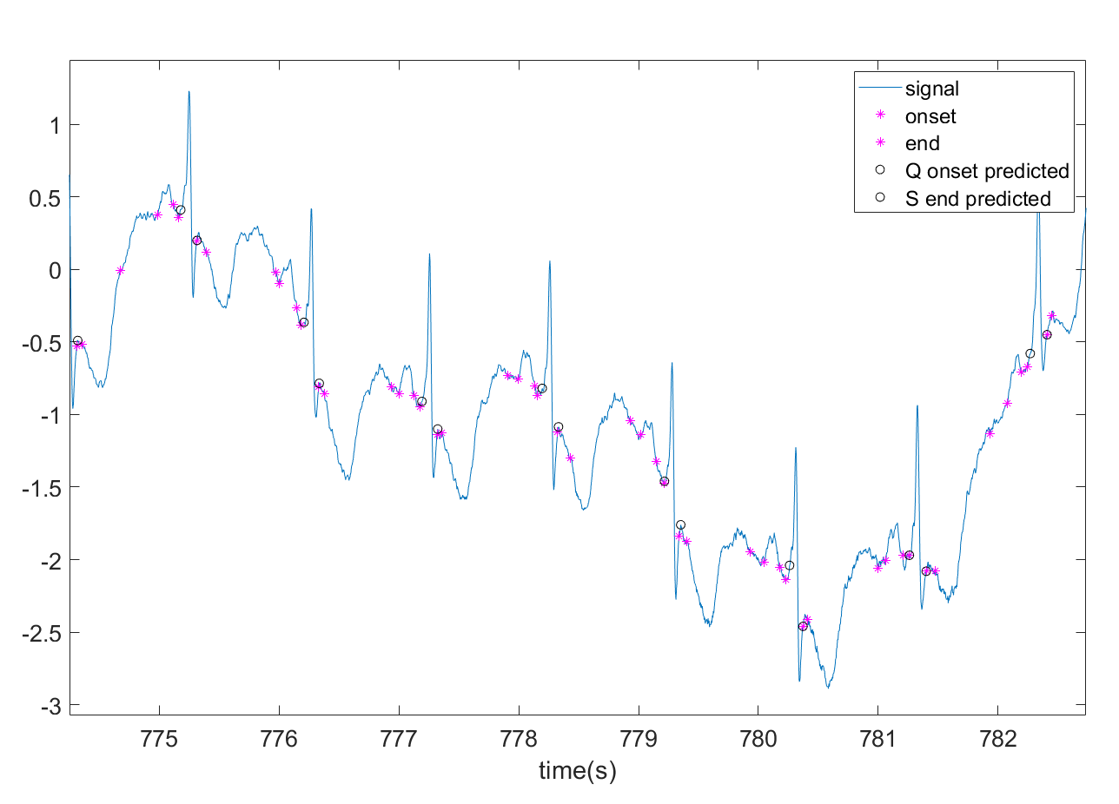
Robust
to artifacts.
Currently bottleneck of the implementation,
Needs some more
improvement

Slide 24
T Wave Detection and Delineation

Slide 25
T Wave
Ventricular Repolarization
Occurs rapidly in the cardiac cycle
Low Amplitude Broad Hump
Follows QRS complex

Slide 26

Multiresolution Analysis
x[n]
Major components in 2⁴ and 2⁵ scales
2⁵ and higher scales get affected by baseline wander
We will use 2⁴ scale for our analysis
Scale 2¹
Scale 2²
Scale 2³
Scale 2⁴
Scale 2⁵

Slide 27
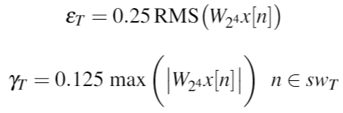
Detection
Window length = 420ms = 0.420 x f_{s}
Search window starting from QRS end
Search for atleast two local maxima in 2⁴ scale > ε_{T}
If they are present, then find significant peaks > 𝛾_{T}
Zero crossing between the significant peaks gives the location

Slide 28
Uniphasic and Biphasic
Sometimes 3 significant peaks are detected
They correspond to 2 peaks in the ECG signal -- Biphasic
The second peak is generally weak but is of clinical significance
n_{first} = leftmost significant peak’s location
n_{last} = rightmost significant peak’s location

Slide 29
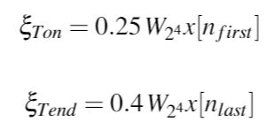
Delineation
Search window on left (right) side of n_{first} ( n_{last})
Window size = 80ms = 0.08 x f_{s}
Two criteria are used to determine onset (end)
Search for a sample where absolute value of scale 2⁴ < 𝛏_{on} (𝛏_{end})
Search for a local minimum of absolute value of scale 2⁴ before (after) n_{first} ( n_{last})

Slide 30
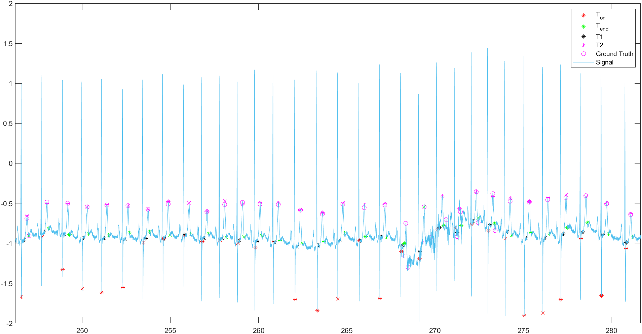
Sample Detection

Slide 31
Results
Predictivity of > 95% in many cases
Predictivity of 99% in some cases
Live Demonstration

Slide 32
P Wave Detection and Delineation

Slide 33
P Wave
Atrial Depolarization
Occurs rapidly in cardiac cycle
Small deflection from isoelectric baseline
Before QRS complex

Slide 34
Multiresolution Analysis
x[n]
Similar characteristics as T wave
Major components in 2⁴ and 2⁵ scales
2⁵ and higher scales get affected by baseline wander
We will use 2⁴ scale for our analysis
Scale 2¹
Scale 2²
Scale 2³
Scale 2⁴
Scale 2⁵

Slide 35
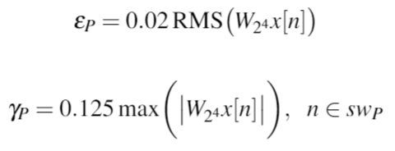
Detection
Window length = 200ms = 0.2 x f_{s}
Search window starting from QRS onset
Search for atleast two local maxima in 2⁴ scale > ε_{P}
If they are present, then find significant peaks > 𝛾_{P}
Zero crossing between the significant peaks gives the location

Slide 36
Uniphasic and Biphasic
Sometimes 3 significant peaks are detected
They correspond to 2 peaks in the ECG signal -- Biphasic
The second peak is generally weak but is of clinical significance
n_{first} = leftmost significant peak’s location
n_{last} = rightmost significant peak’s location

Slide 37
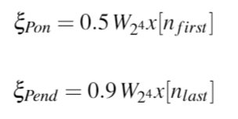
Delineation
Search window on left (right) side of n_{first} ( n_{last})
Window size = 40ms = 0.04 x f_{s}
Two criteria are used to determine onset (end)
Search for a sample where absolute value of scale 2⁴ < 𝛏_{on} (𝛏_{end})
Search for a local minimum of absolute value of scale 2⁴ before (after) n_{first} ( n_{last})

Slide 38
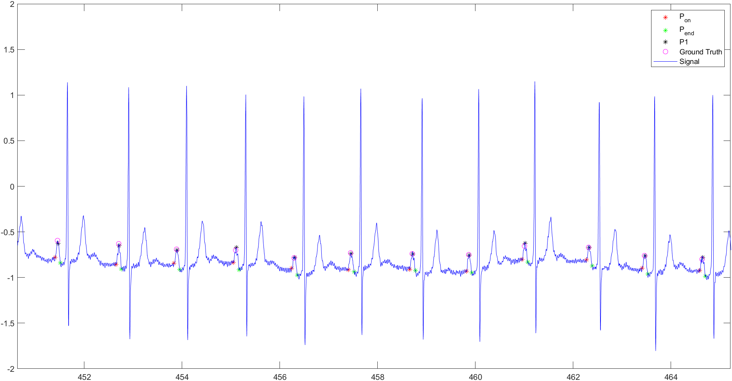
Sample Detection

Slide 39
Results
Predictivity of > 95% in many cases
Predictivity of 99% in some cases
Live Demonstration

Slide 40
ECG Compression using SVD

Slide 41
Truncated singular value decomposition (SVD)
Exploits Quasi-periodic ECG
MIT- BIH database
Reference paper:
“ECG Data Compression Using Truncated Singular Value Decomposition” , Jyh-Jong Wei, Chuang-Jan Chang, Nai-Kuan Chou, and Gwo-Jen Jan

Slide 42

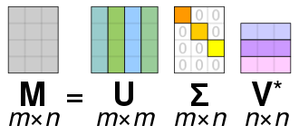
SVD decomposition
where U ,V are orthogonal matrices which are also are the left and right singular vectors respectively. S is a diagonal matrix.

Slide 43
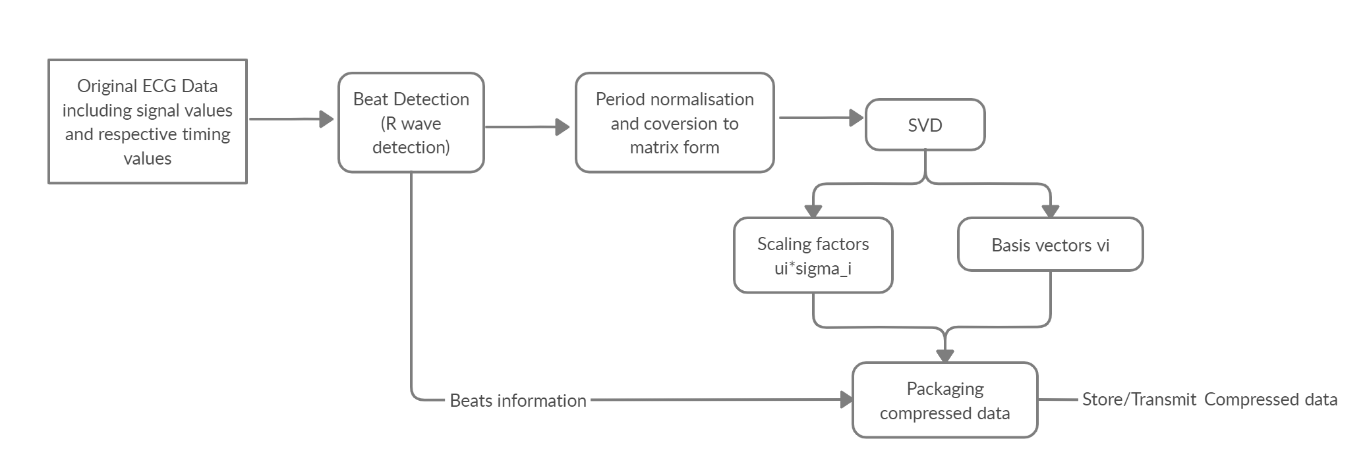
Implementation flowchart

Slide 44

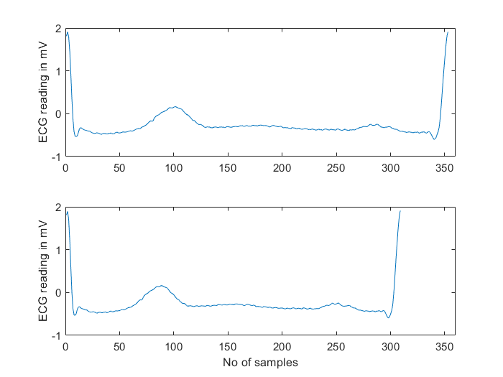


To be converted to
Transformation used:

Slide 45

Compression and decompression
In the compressed form - 1) q singular triplets 2) period information
Decompression: Construct
Then we linearize â and again apply the transform using the original periods to get the reconstructed signal

Slide 46
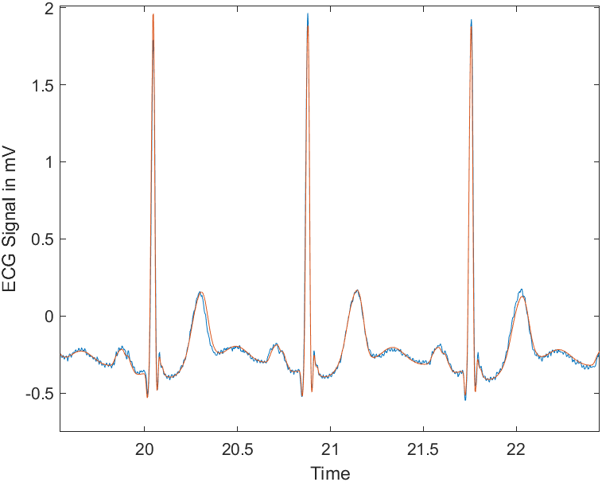
q = 3
Signal Data compression is 62 times!
Reconstruction is very accurate
Percent root mean square difference - 7.7% for 1000 cycles

