Slide 1


The Parkes Pulsar Timing Array
R. N. Manchester
CSIRO Astronomy and Space Science Sydney Australia
Summary
The PPTA – what is it?
Processing pipeline
PPTA data sets
The extended PPTA data set
The future

Slide 2
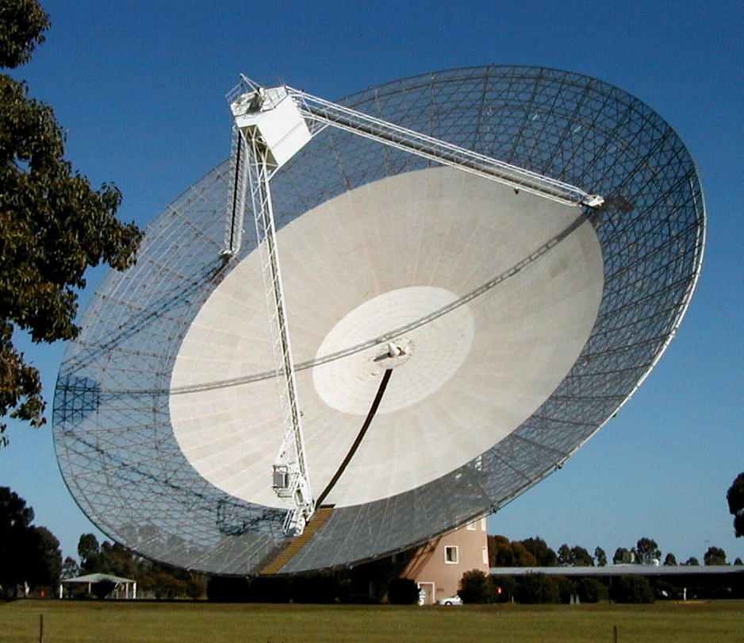
The Parkes Pulsar Timing Array Collaboration
CSIRO Astronomy and Space Science, Sydney
Dick Manchester, George Hobbs, Ryan Shannon, Mike Keith, Sarah Burke-Spolaor, Aidan Hotan, John Sarkissian, John Reynolds, Mike Kesteven, Warwick Wilson, Grant Hampson, Andrew Brown, Ankur Chaudhary, (Russell Edwards), (Jonathan Khoo), (Daniel Yardley)
Swinburne University of Technology, Melbourne
Matthew Bailes, Willem van Straten, Stefan Oslowski, Andrew Jameson, (Ramesh Bhat), (Jonathon Kocz)
Monash University, Melbourne
Yuri Levin
University of Melbourne
Vikram Ravi (Stuart Wyithe)
University of California, San Diego
Bill Coles
University of Texas, Brownsville
(Rick Jenet)
MPIfR, Bonn
(David Champion), (Joris Verbiest), (KJ Lee)
Southwest University, Chongqing
Xiaopeng You
Xinjiang Astronomical Observatory, Urumqi
(Wenming Yan), Jingbo Wang
National Space Science Center, Beijing
Xinping Deng

Slide 3
The PPTA Project
Using the Parkes 64-m radio telescope in three bands, 50cm (700 MHz), 20cm (1400 MHz) and 10cm (3100 MHz) to observe 21 MSPs
Observations at 2 - 3 week intervals
Regular good-quality observations since 2005 March
Digital filterbanks and baseband recording systems used
Database and processing pipeline – PSRCHIVE and TEMPO2
Studying limit and detection algorithms for different types of GW sources
Simulating GW signals and studying implications for galaxy evolution models
Establishing a pulsar-based timescale and investigating Solar system properties
Using PPTA data sets to investigate individual pulsar properties, e.g., pulse polarisation, binary evolution, astrometry etc.
Website: www.atnf.csiro.au/research/pulsar/ppta

Slide 4
PPTA-related papers in the last year
Keith, M. et al., 2012, “Measurement and correction of variations in interstellar dispersion in high precision pulsar timing” MNRAS, submitted
Manchester, R. N. et al. 2012, “The Parkes Pulsar Timing Array Project”, PASA, submitted
Hobbs, G. et al. 2012, “Developing a pulsar-based timescale” MNRAS, submitted
Deng, X. P., et al. 2012, “Optimal interpolation, prediction in pulsar timing”, MNRAS, in press
You, X. P., Coles, W. A., Hobbs, G. B., Manchester, R. N. 2012, “Measurement of the electron density, magnetic field of the solar wind using millisecond pulsars”, MNRAS, 422, 1160-1165
Coles, W., Hobbs, G., Champion, D. J., Manchester, R. N., Verbiest, J. P. W. 2011, “Pulsar timing analysis in the presence of correlated noise”, MNRAS, 418, 561-570
Oslowski, S., van Straten, W., Hobbs, G. B., Bailes, M., Demorest P. 2011, “High signal-to-noise ratio observations and the ultimate limits of precision pulsar timing”, MNRAS, 418, 1258-1271
van Straten, W. and Bailes, M. 2011, “DSPSR: Digital signal processing software for pulsar astronomy”, PASA, 28, 1-14
Hobbs, G. et al. 2011, “The Parkes Observatory Data Archive”, PASA, 28, 202-214
Yan, W. M. et al. 2011, “Rotation measure variations for 20 millisecond pulsars”, ApSS, 335, 485-498
Yardley, D. R. B. et al. 2011, “On detection of the stochastic gravitational-wave background using the Parkes Pulsar Timing Array”, MNRAS, 414, 1777-1787
Yan, W. M. et al. 2011, “Polarization observations of 20 millisecond pulsars”, MNRAS, 414, 2087-2100

Slide 5
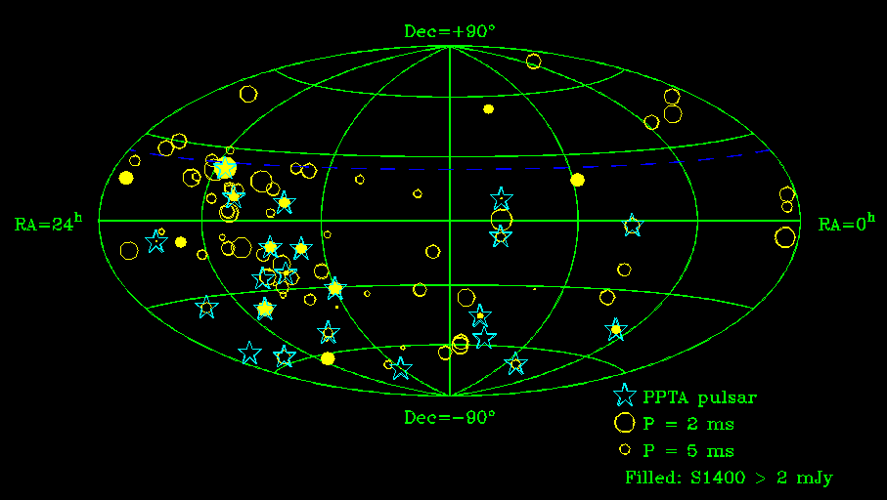
The PPTA Pulsars
All (published) MSPs not in globular clusters

Slide 6
PPTA Data Processing Pipeline
Band edges (5%) and known RFI zapped
Data files summed in time to give 8 sub-integrations
Start times adjusted for instrumental delays
Data calibrated for instrumental gain and phase, feed cross-coupling (20cm) and placed on flux density scale (Willem’s talk)
Data summed in time, frequency and polarisation to give Stokes I (invariant interval for J0437-4715) profile for each observation (typically 1 hr duration) and each band
Profiles cross-correlated with noise-free template to give ToAs
Three-band data sets analysed using TEMPO2, fitting for DM offsets and pulsar parameters (spin freq. just F0, F1) using Cholesky method
“Best” single-band data set chosen (selecting DM correction or not and optimal calibration method) to give lowest rms timing residuals
Final fit with all parameters except F0 and F1 held fixed at values from three-band solution

Slide 7
PPTA Profile Templates
von Mises functions fitted to high S/N profiles using PSRCHIVE program PAAS
Up to 17 components fitted per profile
10cm and 50cm profiles aligned with 20cm profiles for maximum correlation
(Manchester et al. 2012)

Slide 8
Three-Band Timing Residuals
50cm
10cm
20cm

Slide 9
DM Variations and Correction
DM offsets solved for along with pulsar parameters and frequency-independent (“common-mode”) signal using Cholesky algorithm in Tempo2 on PPTA three-band data sets
DM offsets measured at intervals through data sets with linear interpolation between values
Interval size taken to be inverse of modulation frequency where red (DM) signal is same power as white noise
Mean DM offset constrained to be zero
Effectiveness of algorithm tested using simulations
(Keith et al. 2012)
(Also Xiaopeng’s talk tomorrow)

Slide 10
Simulated Modulation Power Spectra
No common-mode term
Common-mode term included
“Pre-fit” spectrum
Post-fit spectrum
GW term not attenuated!
Spectrum with no DM term

Slide 11
DM Variations
(NANOGrav and EPTA DM talks later this morning)

Slide 12
“Best” Band Timing Parameters

Slide 13
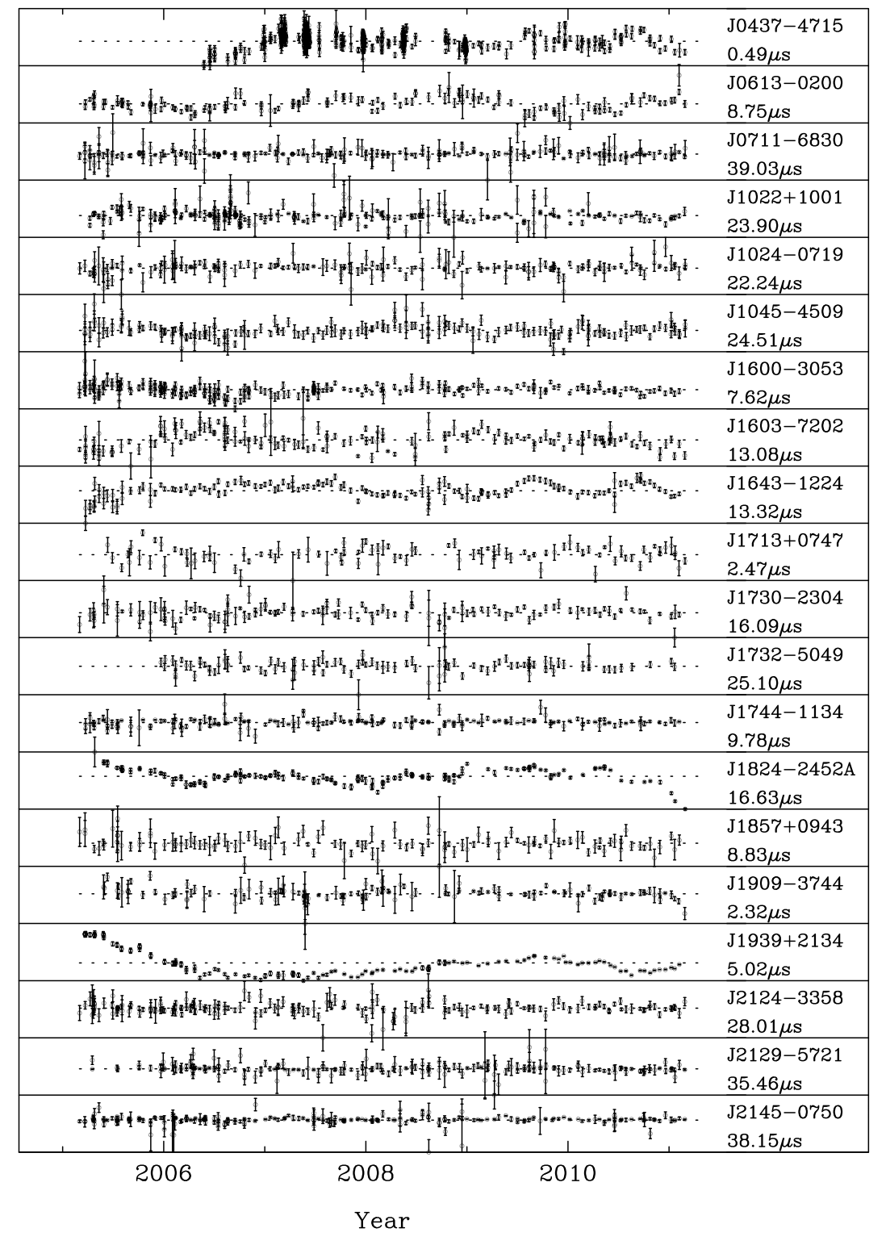
PPTA “Best” Data Sets
6-year data span
Lowest rms residuals for:
J0437-4715 – 75 ns
J1909-3744 – 133 ns
(both at 10cm)
Significant “red” noise
“White” rms residuals:
J0437-4715 – 46 ns
J1909-3744 – 61 ns

Slide 14
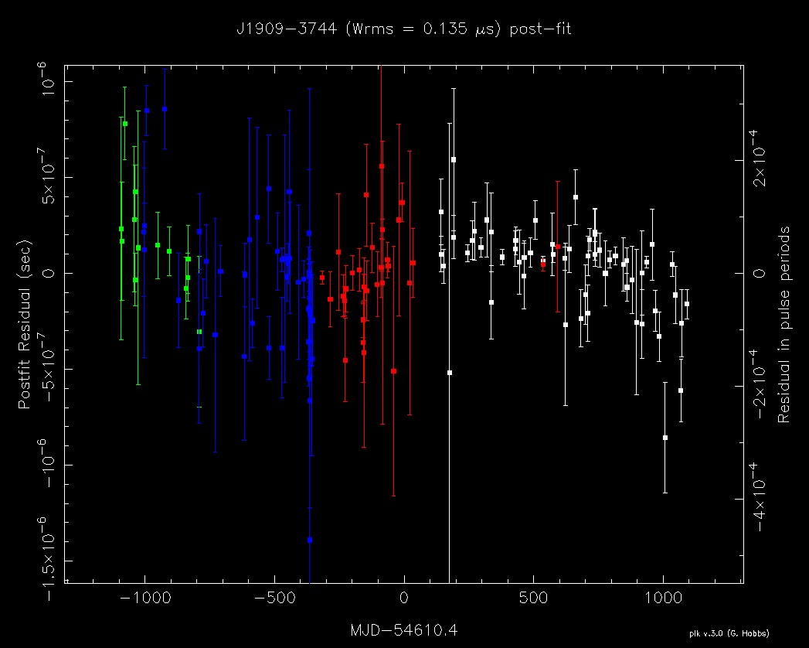
Red Timing Noise
PSR J1909-3744
Half of the PPTA pulsars have > 3σ values for F2
Largest value is for PSR J1939+2134
Strongest observed F2s can’t be GW since not seen in other pulsars
Can’t be DM variations since these corrected for where necessary
10 cm
Rms residual 133 ns; F2 = (11 +/- 2) x 10⁻²⁸ s⁻³
Most likely intrinsic spin noise – a significant problem for PTA projects

Slide 15
Modulation Spectra
Power spectra of residual time series after Cholesky fit
Wide variation in levels of both white and red noise
Dashed line is expected spectrum of GW background of amplitude A_{g} = 10⁻¹⁵
Already some pulsars at or below GW line at low freq.
GW bkgnd has steeper spectrum than pulsar red noise – should eventually win out
(Talks by Ryan Shannon and Mike Keith)

Slide 16
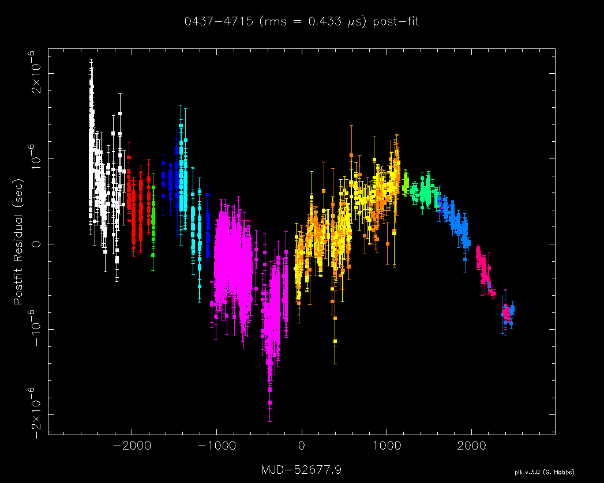
Extended PPTA Data Sets
Parkes data from Swinburne timing program for 1994 – 2006 (Verbiest et al. 2008, 2009) added to PPTA three-band data sets
Extended data sets cover up to 17 years
Most instrumental offsets measured from overlapping data and fixed
DM offsets included and held fixed
Fit with Cholesky algorithm to pulsar parameters and remaining instrumental offsets
Fit to just F0, F1 for best-band data; all other parameters fixed

Slide 17
PPTA Extended data sets – Timing parameters
“Red” signal significant for most pulsars

Slide 18
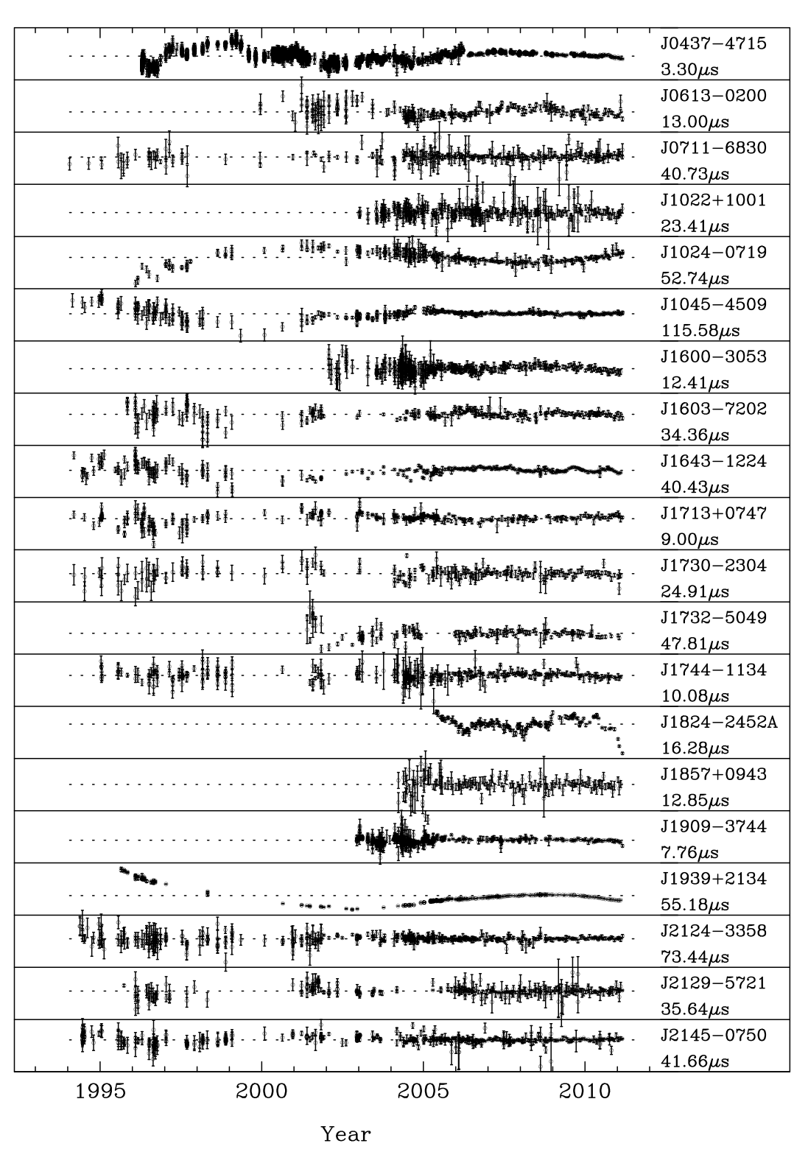
Extended PPTA Best-band Data Sets
DM and PCM corrected where necessary
Residuals after fitting for astrometric parameters and F0, F1
Best rms residuals for:
J0437-4715 (190 ns) J1909-3744 (260 ns)
Clear “red” signal for most pulsars

Slide 19
Applications of PPTA Extended Data Sets
Increased data span is very valuable for detection or limiting the GW background – sensitivity ~ T^{13/6}
Important also for solar-system projects – identification of long-period orbits
Vital to establishment of a pulsar-based based timescale – stability of atomic timescales less certain in past
George’s talk on Thursday

Slide 20
Recent Tempo2 Updates (from George)
Significant updates to clock plugin (George's talk)
Ability to simulate the GW memory effect (Jingbo's talk)
Ability to simulate realistic-looking data sets with correct sampling, red noise etc. (Mike's talk)
Update to Yardley algorithm for detecting a GW background (using the Cholesky spectral analysis routines) (Mike's talk)
Development of the "interpolate" plugin (Xinping's talk)
Ability to carry out a constrained least-squares fit (Mike's paper)
Simulate individual, non-evolving sources of GWs (George, Ryan, Sarah Burke-Spolaor, Vikram)
Fit for offset in observatory position with respect to the planetary ephemeris (George, Ryan)
Updates to the "fixData" plugin enabling the user to search for EFACs and EQUADs
Various plugins to predict the covariance function for use with the Cholesky algorithm (e.g., analytic Cholesky and autoSpectralFit - George, Mike, Ryan)
Complete update of the glitch plugin (George, Dick, Meng Yu)

Slide 21
Data Release
Both PPTA and extended PPTA data sets are available on the www.ipta4gw.org/wiki website
PPTA project paper (Manchester et al. 2012) describing data sets is also available on website
README file giving processing details in tar file
Extended Tempo2 format ToAs with flags for PTA, receiver, back-end, band, etc
Par files used to produce published residuals are included in tar file
Clock correction files, observatory coordinates etc in tar file

Slide 22
The Future
PPTA data sets provide the raw material for many investigations as well as inspiration for numerous theoretical studies
Continuation of timing observations with improved instrumentation and signal processing algorithms vital to achieving PPTA goals
Realisation of PTA goals will be aided combining PPTA data sets with those from NANOGrav and the EPTA to form the IPTA
Other PTAs based on Meerkat, GMRT, FAST and the proposed Xinjiang 110m telescope will contribute to IPTA data sets
In the longer term, the SKA should enable detailed studies of nanoHertz gravitational waves and their sources as well as greatly improved results for other PTA objectives
Finally, George is taking over the leadership of the PPTA project – thereby ensuring that the PPTA and IPTA have a bright future
Thank you all!

Slide 23
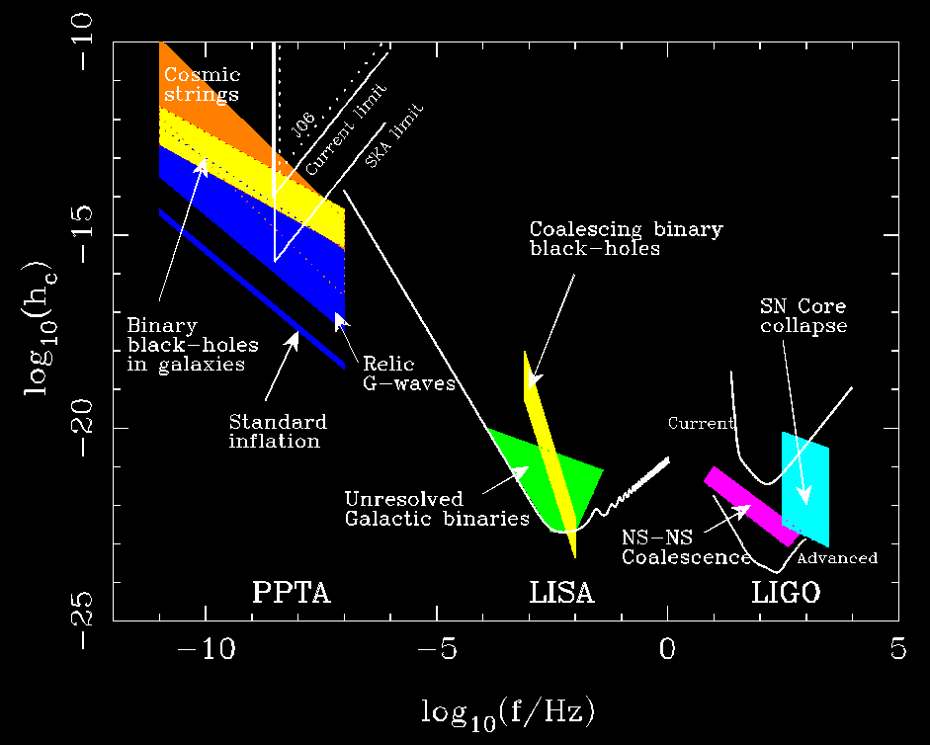
The Gravitational Wave Spectrum

