Slide 1

Dispersion Measure Variability in NANOGrav data
David Nice
IPTA 2012, Kiama, NSW
25 June 2012
NANOGrav

Slide 2
Overview of DM and dual-frequency measurements (because I didn’t give a student talk last week)
NANOGrav observations & a few pretty plots (depending on your definition of “pretty”)
Impact on fitting DM at every epoch on timing (a very qualitative discussion)
Wide-band timing analysis (what happens next….)
A scary plot (a reminder that DM variations are just one aspect of our ISM troubles)

Slide 3
Overview of DM and dual-frequency measurements (because I didn’t give a student talk last week)
NANOGrav observations & a few pretty plots (depending on your definition of “pretty”)
Impact on fitting DM at every epoch on timing (a very qualitative discussion)
Wide-band timing analysis (what happens next….)
A scary plot (a reminder that DM variations are just one aspect of our ISM troubles)

Slide 4
Interstellar Dispersion
431 MHz
430 MHz
column density of electrons: DM = ∫ n_{e}(l) dl usual units: pc cm⁻³
excess delay (in seconds): t_{delay}(sec)= t_{f}-t∞= DM / 2.41×10^{–4} [f(MHz)]²
typical delay: t_{delay}=43 ms for a DM=20 pulsar at 1400 MHz.
a change in DM by 1 part in 10⁴ changes the delay by 200 ns at 1400 MHz

Slide 5
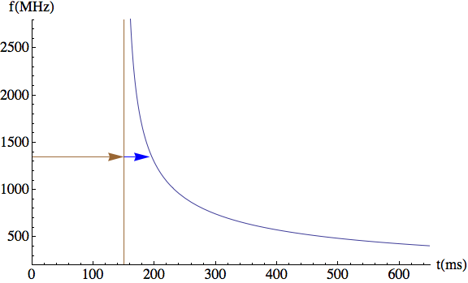
t_{f} = t∞ + DM / 2.41×10^{–4} [f(MHz)]²

Slide 6
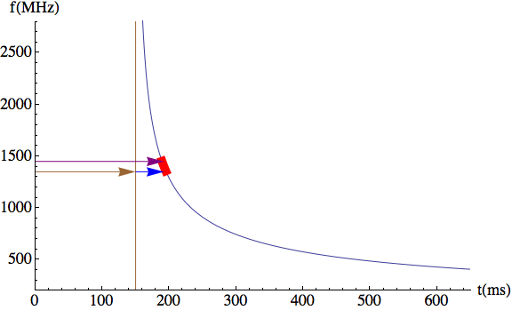
t_{f} = t∞ + DM / 2.41×10^{–4} [f(MHz)]²

Slide 7
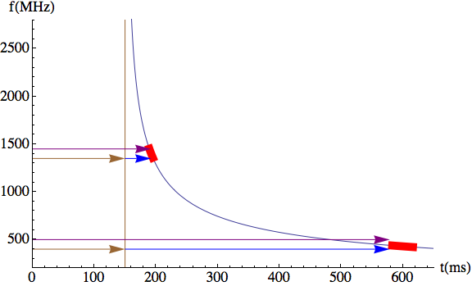
t_{f} = t∞ + DM / 2.41×10^{–4} [f(MHz)]²

Slide 8
Overview of DM and dual-frequency measurements (because I didn’t give a student talk last week)
NANOGrav observations & a few pretty plots (depending on your definition of “pretty”)
Impact on fitting DM at every epoch on timing (a very qualitative discussion)
Wide-band timing analysis (what happens next….)
A scary plot (a reminder that DM variations are just one aspect of our ISM troubles)

Slide 9
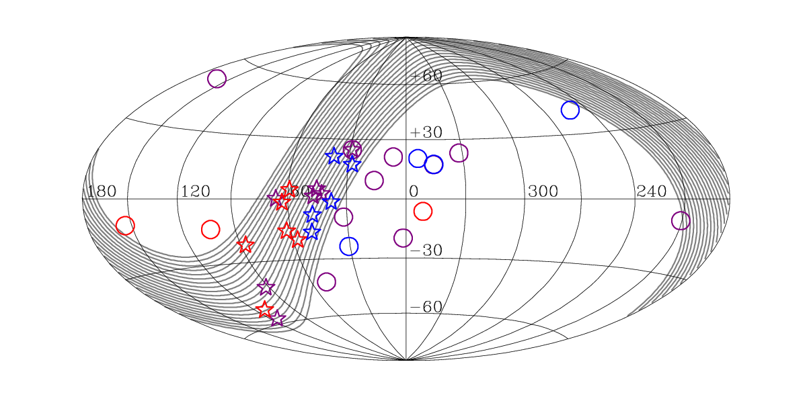
Pulsars We Observe
Under observation since 2005
using ASP/GASP
Arecibo
Green Bank
Millisecond pulsars added to NANOGrav campaigns starting in ~2009
Arecibo
Green Bank
Millisecond pulsars added to NANOGrav campaigns starting in ~2011
Arecibo
Green Bank

Slide 10
Demorest et al (2012) data set arXiv:1201.6641
17 Pulsars (8 Arecibo, 10 GBT; 1 overlap)
5 years of observations, typically monthly (with some gaps)
ASP (Arecibo) and GASP (Green Bank) backends
64 MHz software coherent dedispersion, 4 MHz channels, full Stokes
Dual frequency observations of all but three sources at every epoch
Green Bank
800/1400 MHz
Arecibo: depends on pulsar spectrum, flux density, scintillation
327/430 MHz
430/1400 MHz
1400/2350 MHz
Timing analysis (tempo) fits for DM at every epoch in addition to fitting for all other usual parameters (spin, astrometry, binary).

Slide 11
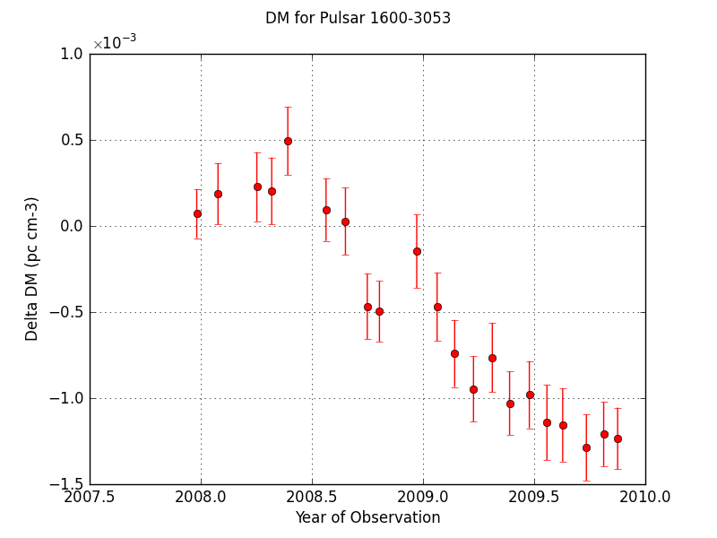

Slide 12
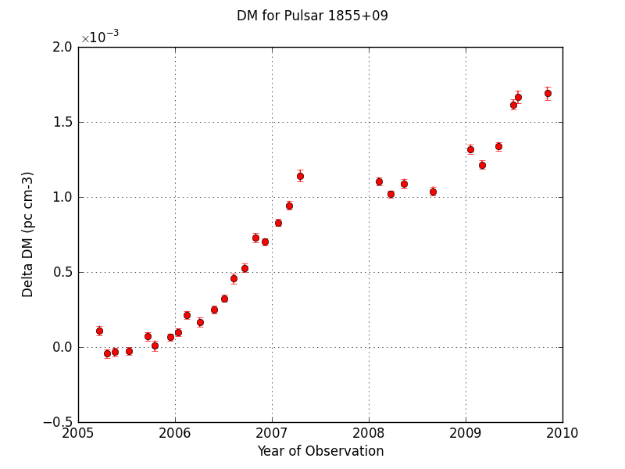

Slide 13
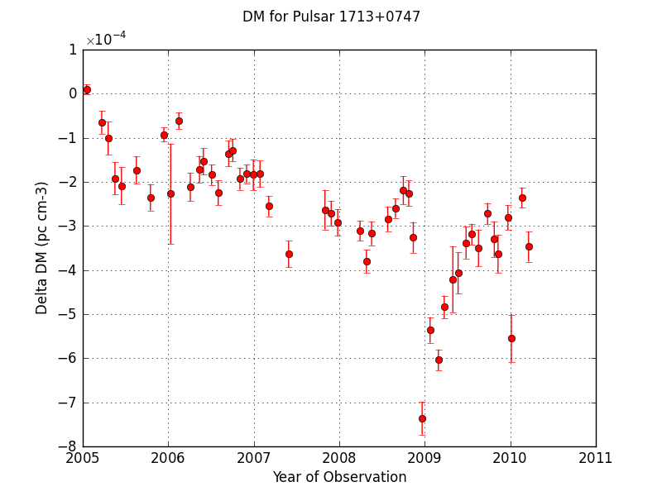

Slide 14
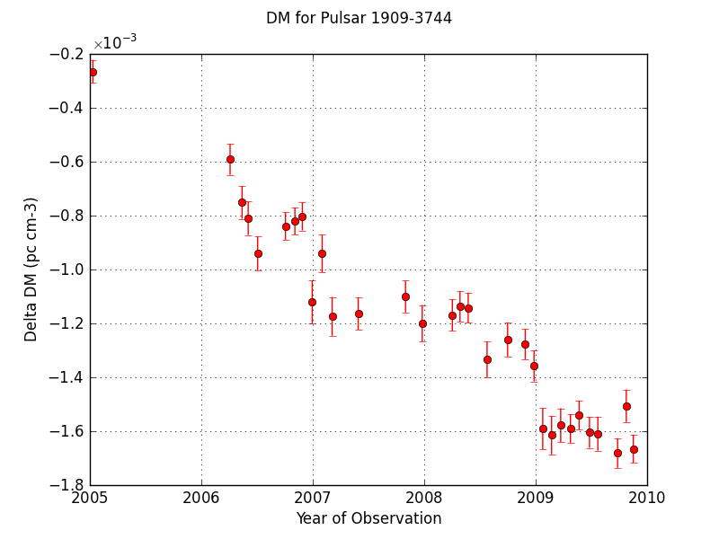

Slide 15
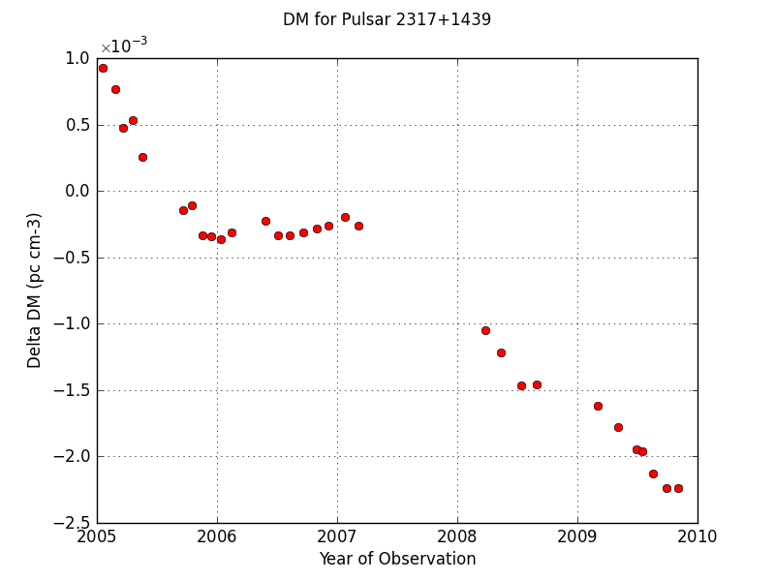

Slide 16
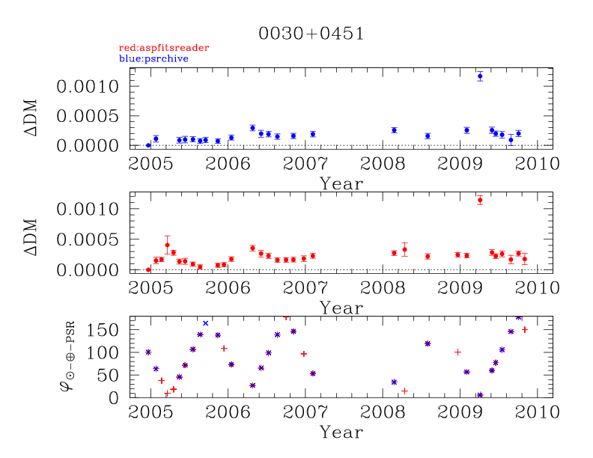
Dispersion Measure Variation

Slide 17
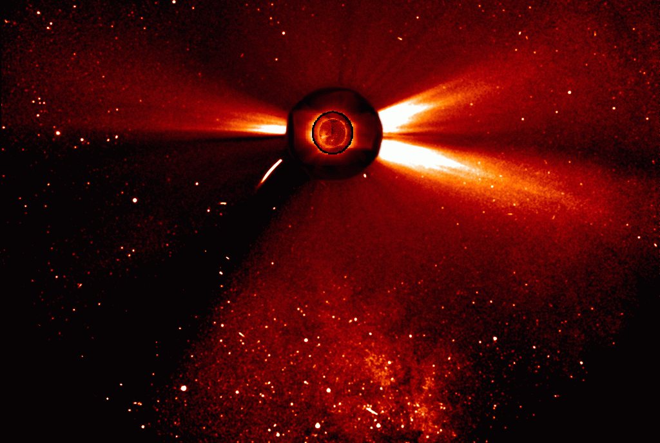
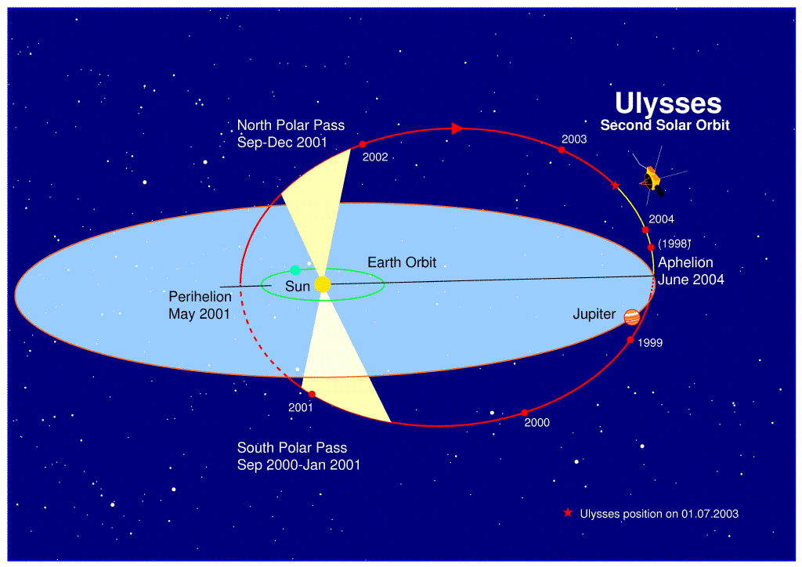
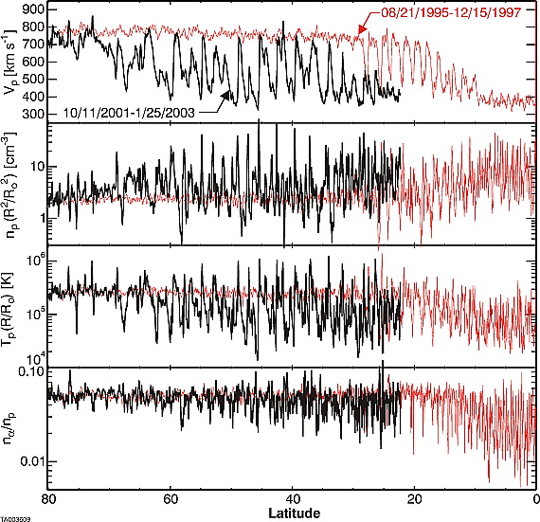
Variations in dispersion on small scales are inevitable due to the solar wind. Multi-frequency observations at each epoch are crucial to removing imprint of these variations from the data.
Twelve-Hour running average solar wind proton speed, density, temperature, and alpha-to-proton ratio over the equivalent portions of two orbits of Ulysses. From McComsas et al. 2003, Geophysical Research Letters, 30: 1517.
Solar Image: SOHO/NASA Ulysses Orbit Figure: ESA

Slide 18
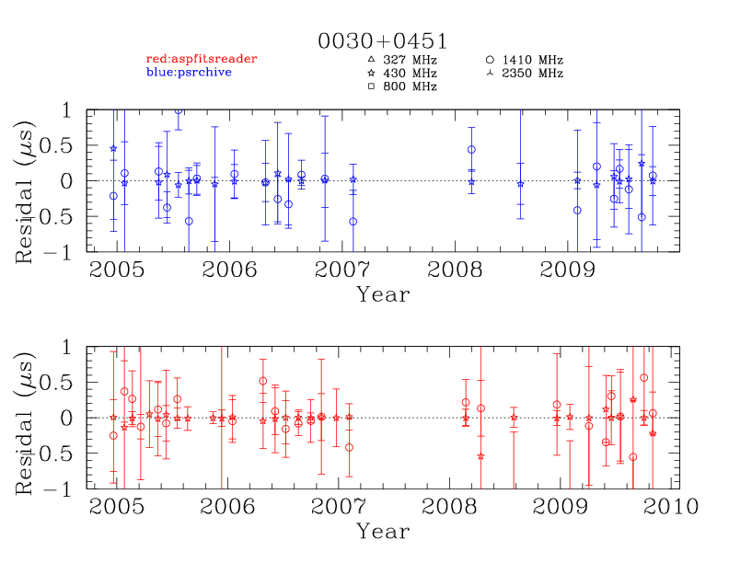

Slide 19
Overview of DM and dual-frequency measurements (because I didn’t give a student talk last week)
NANOGrav observations & a few pretty plots (depending on your definition of “pretty”)
Impact on fitting DM at every epoch on timing (a very qualitative discussion)
Wide-band timing analysis (what happens next….)
A scary plot (a reminder that DM variations are just one aspect of our ISM troubles)

Slide 20
We fit for DM at each epoch within tempo or tempo 2 (“DMX”). The fit is simultaneous with the fit for all other parameters.
This approach is good if the timing model being used by tempo or tempo2 completely describes the data (i.e., post-fit residuals truly should be Gaussian).
If the timing model is incomplete then tempo/tempo2 may mis-adjust DMX offsets in its effort to minimize the weighted residual. Un-modeled (non-white) signals in the residuals can be reduced by this.
Because low-frequency points are usually weighted more heavily than high-frequency points, the daily post-fit-residuals for low-frequency points tend to be artificially low (see PSR J0030+0451 residuals on previous slide.) Better to use “common mode” residuals.
TOAs
Initial guess parameters
Clock Information
Solar System Ephemeris
TEMPO or
TEMPO2
Refined parameters
Residuals

Slide 21
Our approach of fitting DM independently at every epoch is absolutely necessary. At our desired level of measurement, DM(t) is not necessarily a smooth function; we must treat it as a “random variable” which must be measured at every epoch.
As with any measurement, DM(t) can only be measured to finite precision. Uncertainty in DM(t) leads to effectively reduced precision of absolute (infinite frequency) TOAs within timing codes.
At any given epoch, the inferred DM(t) and the inferred “average infinite frequency TOA” are covariant with each other. This magnifies the effect of uncertainty of DM(t) values.
To date, we have taken the conservative approach of not attempting to take this additional noise into account when placing an upper limit on the GWB. Crudely speaking, the observed pulsar measurements might have: observed red noise = GWB signal + timing noise + DM-related-noise Hence: GWB signal = observed red noise - timing noise - DM-related-noise In other words, accounting for DM-covariance-noise might (in principle) allow for a reduced upper limit on the GWB signal. (But how to do this??)

Slide 22
Overview of DM and dual-frequency measurements (because I didn’t give a student talk last week)
NANOGrav observations & a few pretty plots (depending on your definition of “pretty”)
Impact on fitting DM at every epoch on timing (a very qualitative discussion)
Wide-band timing analysis (what happens next….)
A scary plot (a reminder that DM variations are just one aspect of our ISM troubles)

Slide 23
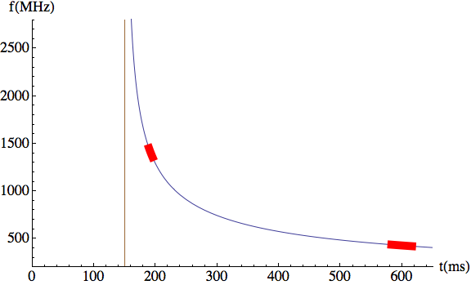
t_{f} = t∞ + DM / 2.41×10^{–4} [f(MHz)]²
Arecibo/ASP 430 MHz bandwidth ~16 MHz
1400 MHz bandwidth ~64 MHz

Slide 24
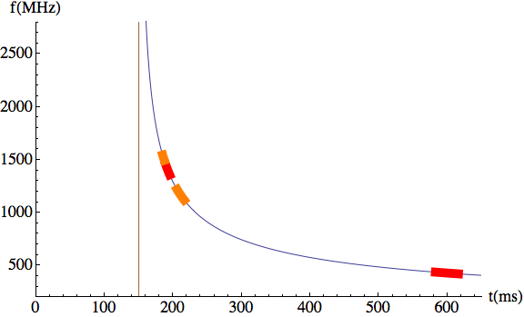
t_{f} = t∞ + DM / 2.41×10^{–4} [f(MHz)]²
Arecibo/ASP/WAPP 430 MHz bandwidth ~16 MHz
1400 MHz bandwidth ~64 MHz
+150 MHz

Slide 25
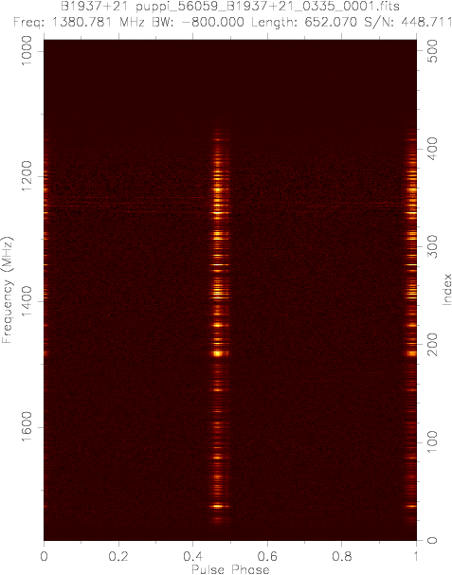
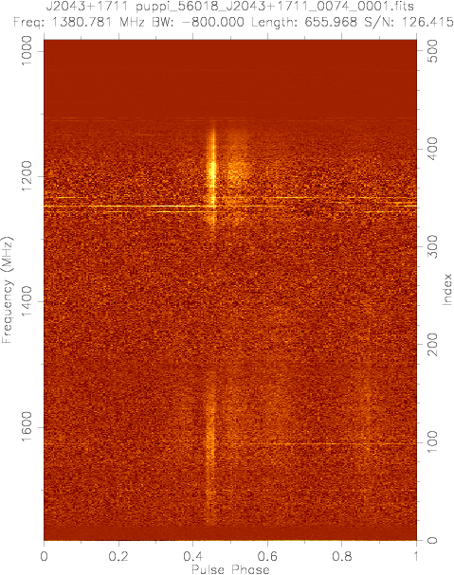
GUPPI (GBT), PUPPI (Arecibo)
coherent dedispersion 800 MHz bandwidth

Slide 26
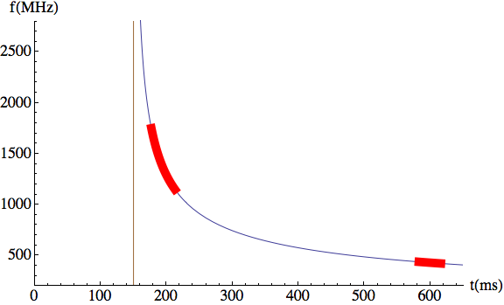
t_{f} = t∞ + DM / 2.41×10^{–4} [f(MHz)]²
Arecibo/PUPPI 430 MHz bandwidth ~16 MHz
1400 MHz bandwidth ~600 MHz

Slide 27
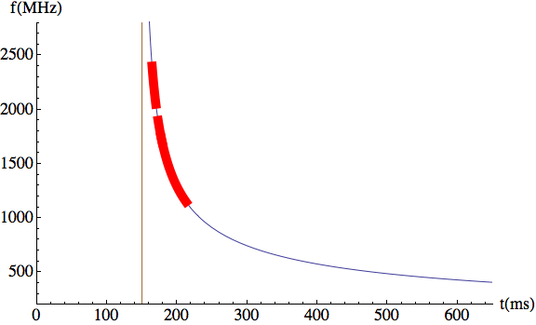
t_{f} = t∞ + DM / 2.41×10^{–4} [f(MHz)]²
Arecibo/PUPPI 1400 MHz bandwidth ~600 MHz
2050 MHz bandwidth ~550 MHz

Slide 28
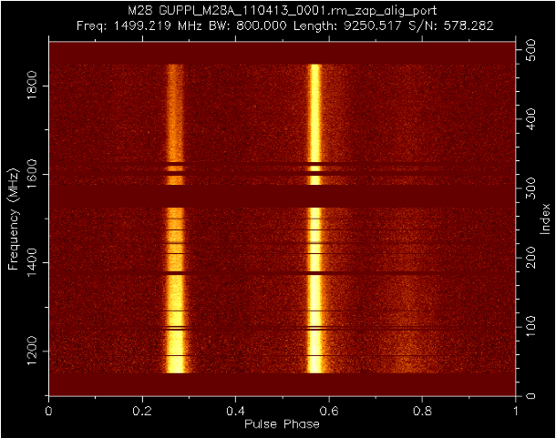
Figure: Tim Pennucci
In the works: Broadband timing code
Profile variation over the band
A possible standard profile model: sum of Gaussian components with properties which vary over the band
Cross correlate standard profile to data
Simultaneously fit for time shift and DM shift
Work in Fourier domain (similar to fftfit)

Slide 29
Overview of DM and dual-frequency measurements (because I didn’t give a student talk last week)
NANOGrav observations & a few pretty plots (depending on your definition of “pretty”)
Impact on fitting DM at every epoch on timing (a very qualitative discussion)
Wide-band timing analysis (what happens next….)
A scary plot (a reminder that DM variations are just one aspect of our ISM troubles)

Slide 30
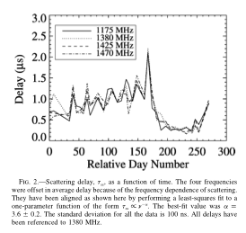
DM variations are just one aspect of the corruption of pulsar signals by the ISM.
Hemberger & Stinebring 2008
(One of the scariest plots in the history
of pulsar timing!)

Slide 31
End of talk…
… beginning of discussion.
Overview of DM and dual-frequency measurements (because I didn’t give a student talk last week)
NANOGrav observations & a few pretty plots (depending on your definition of “pretty”)
Impact on fitting DM at every epoch on timing (a very qualitative discussion)
Wide-band timing analysis (what happens next….)
A scary plot (a reminder that DM variations are just one aspect of our ISM troubles)

