Slide 1
Using Cyclic Spectroscopy to Improve Pulsar Timing
Dan Stinebring
Oberlin College
Kiama – IPTA 2012

Slide 2
Using Cyclic Spectroscopy to Improve Pulsar Timing
Thanks to:
Jim Cordes
Paul Demorest
Maura McLaughlin
Nipuni Palliyaguru
Mark Walker
& the NANOGrav IMM Team

Slide 3
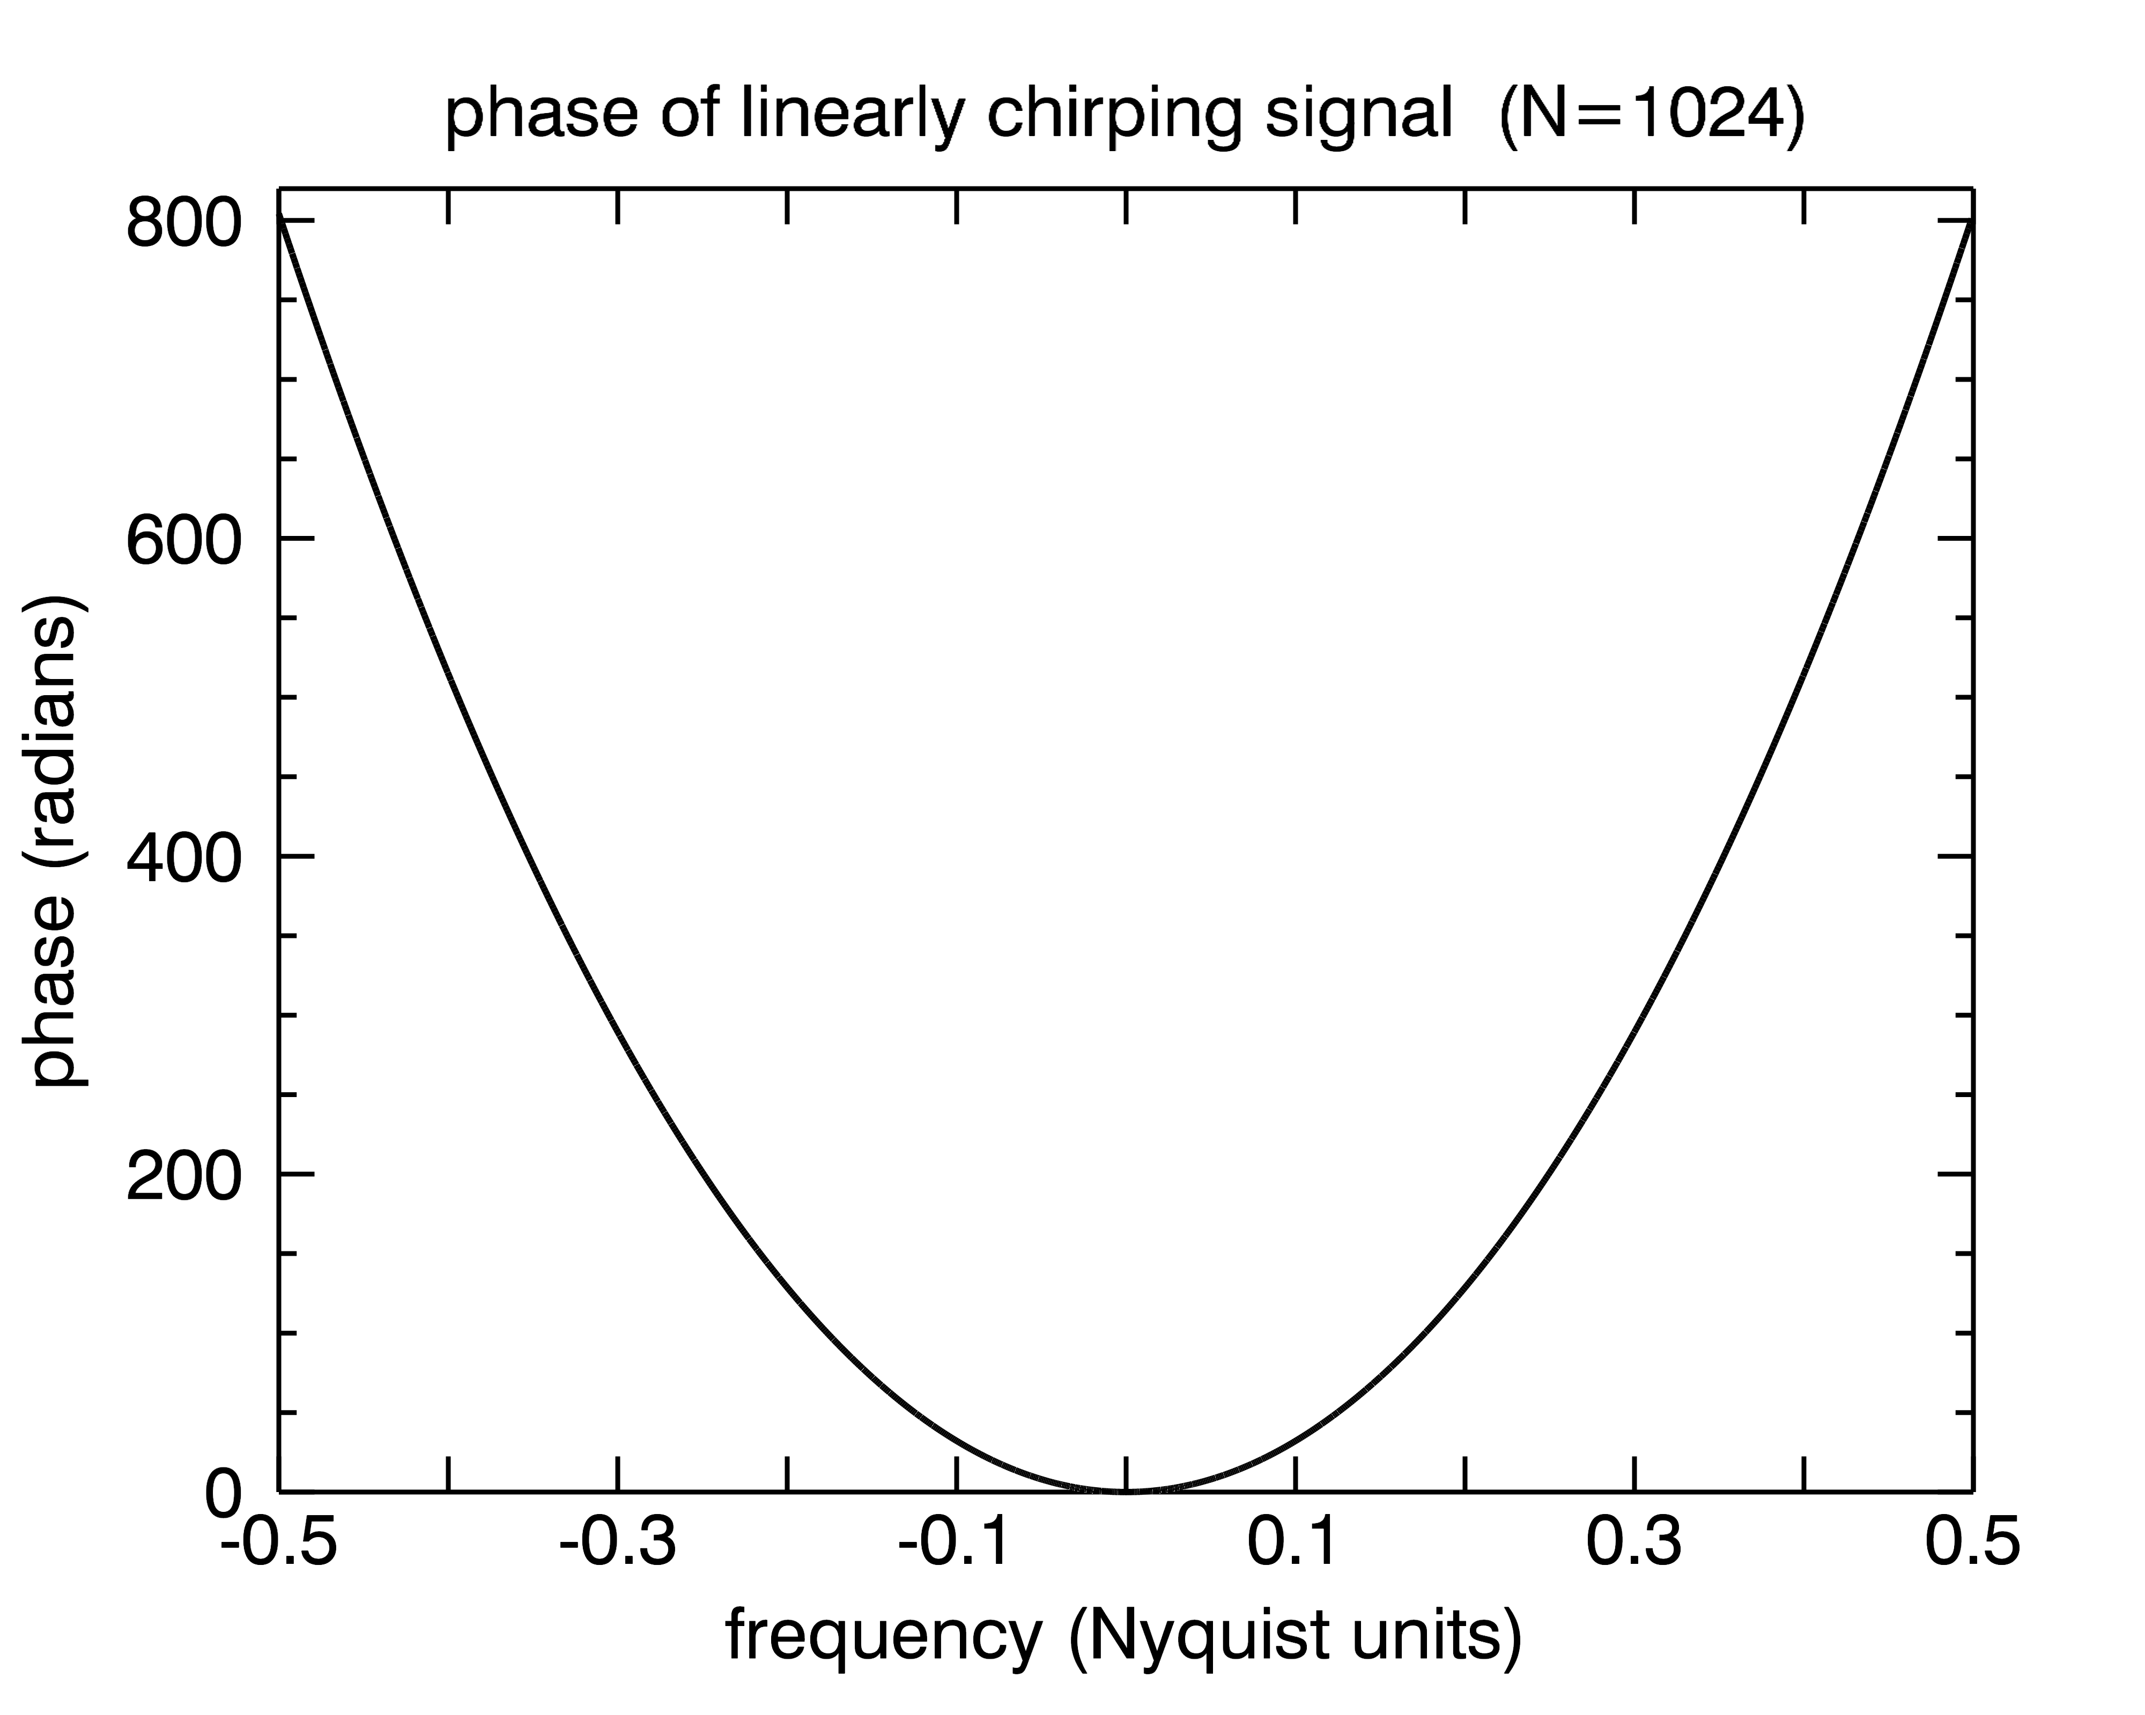
Coherent Dedispersion
Developed in 1971 by Tim Hankins. Use the phase information of the ISM transfer function, B(ν), to perfectly remove dispersion.

Slide 4
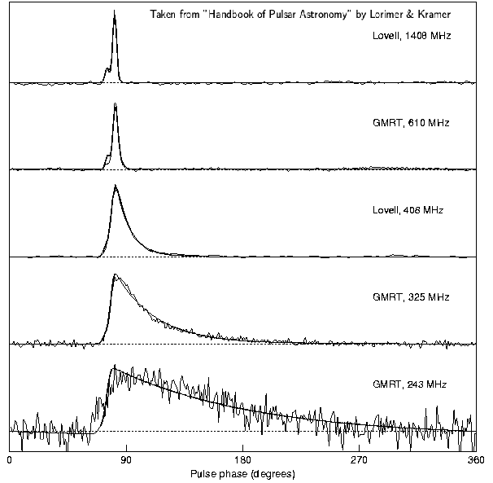
Scatter Broadening

Slide 5
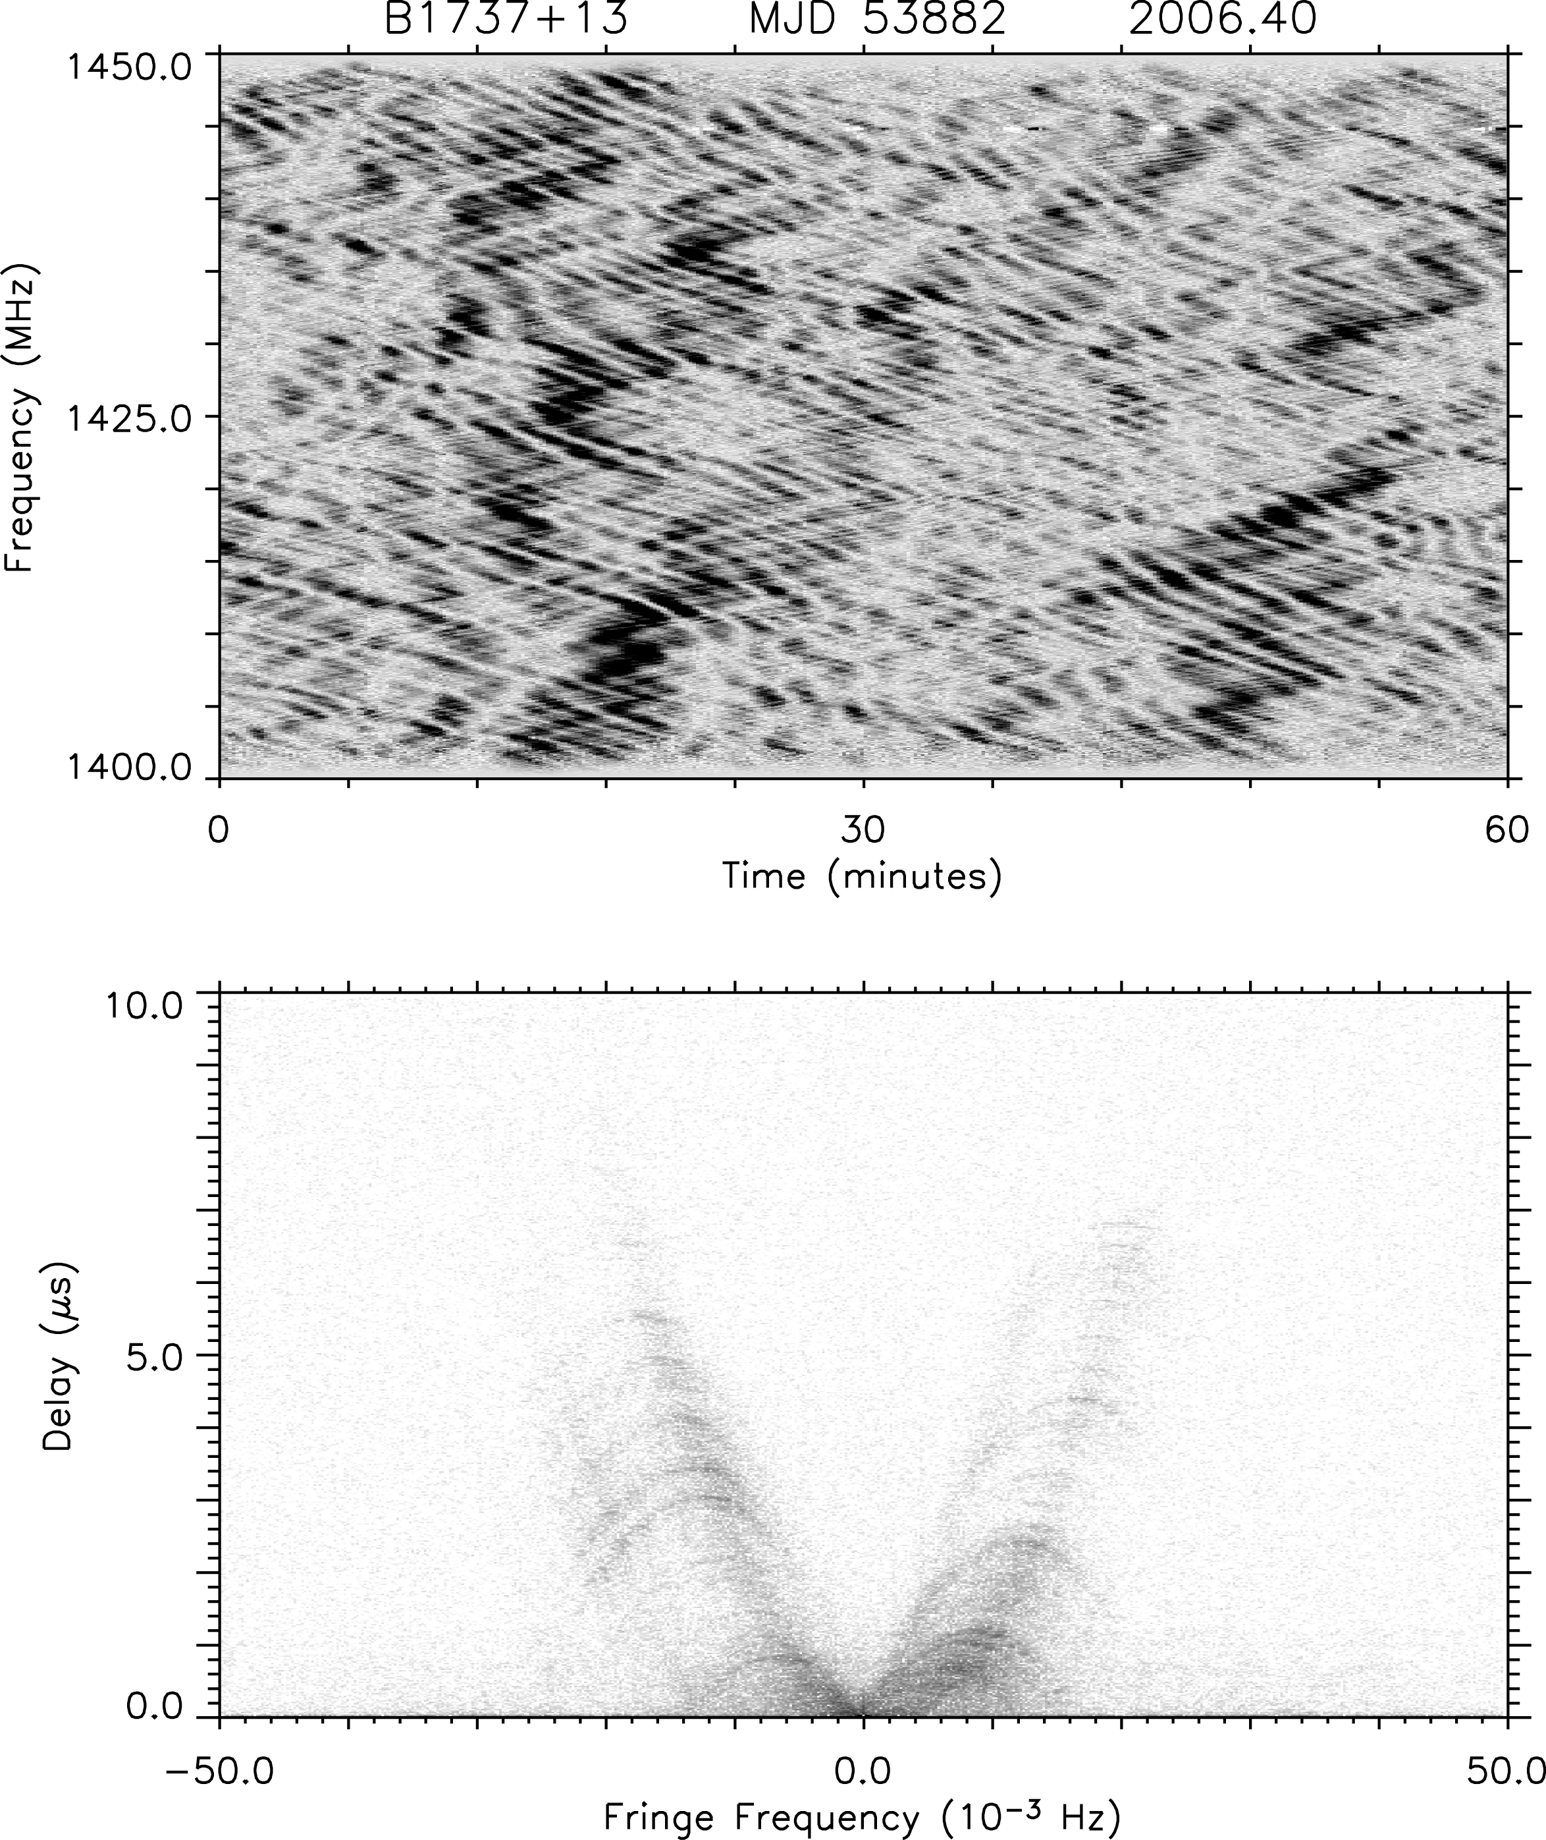
linear
grayscale
secondary spectrum
logarithmic
grayscale

Slide 6
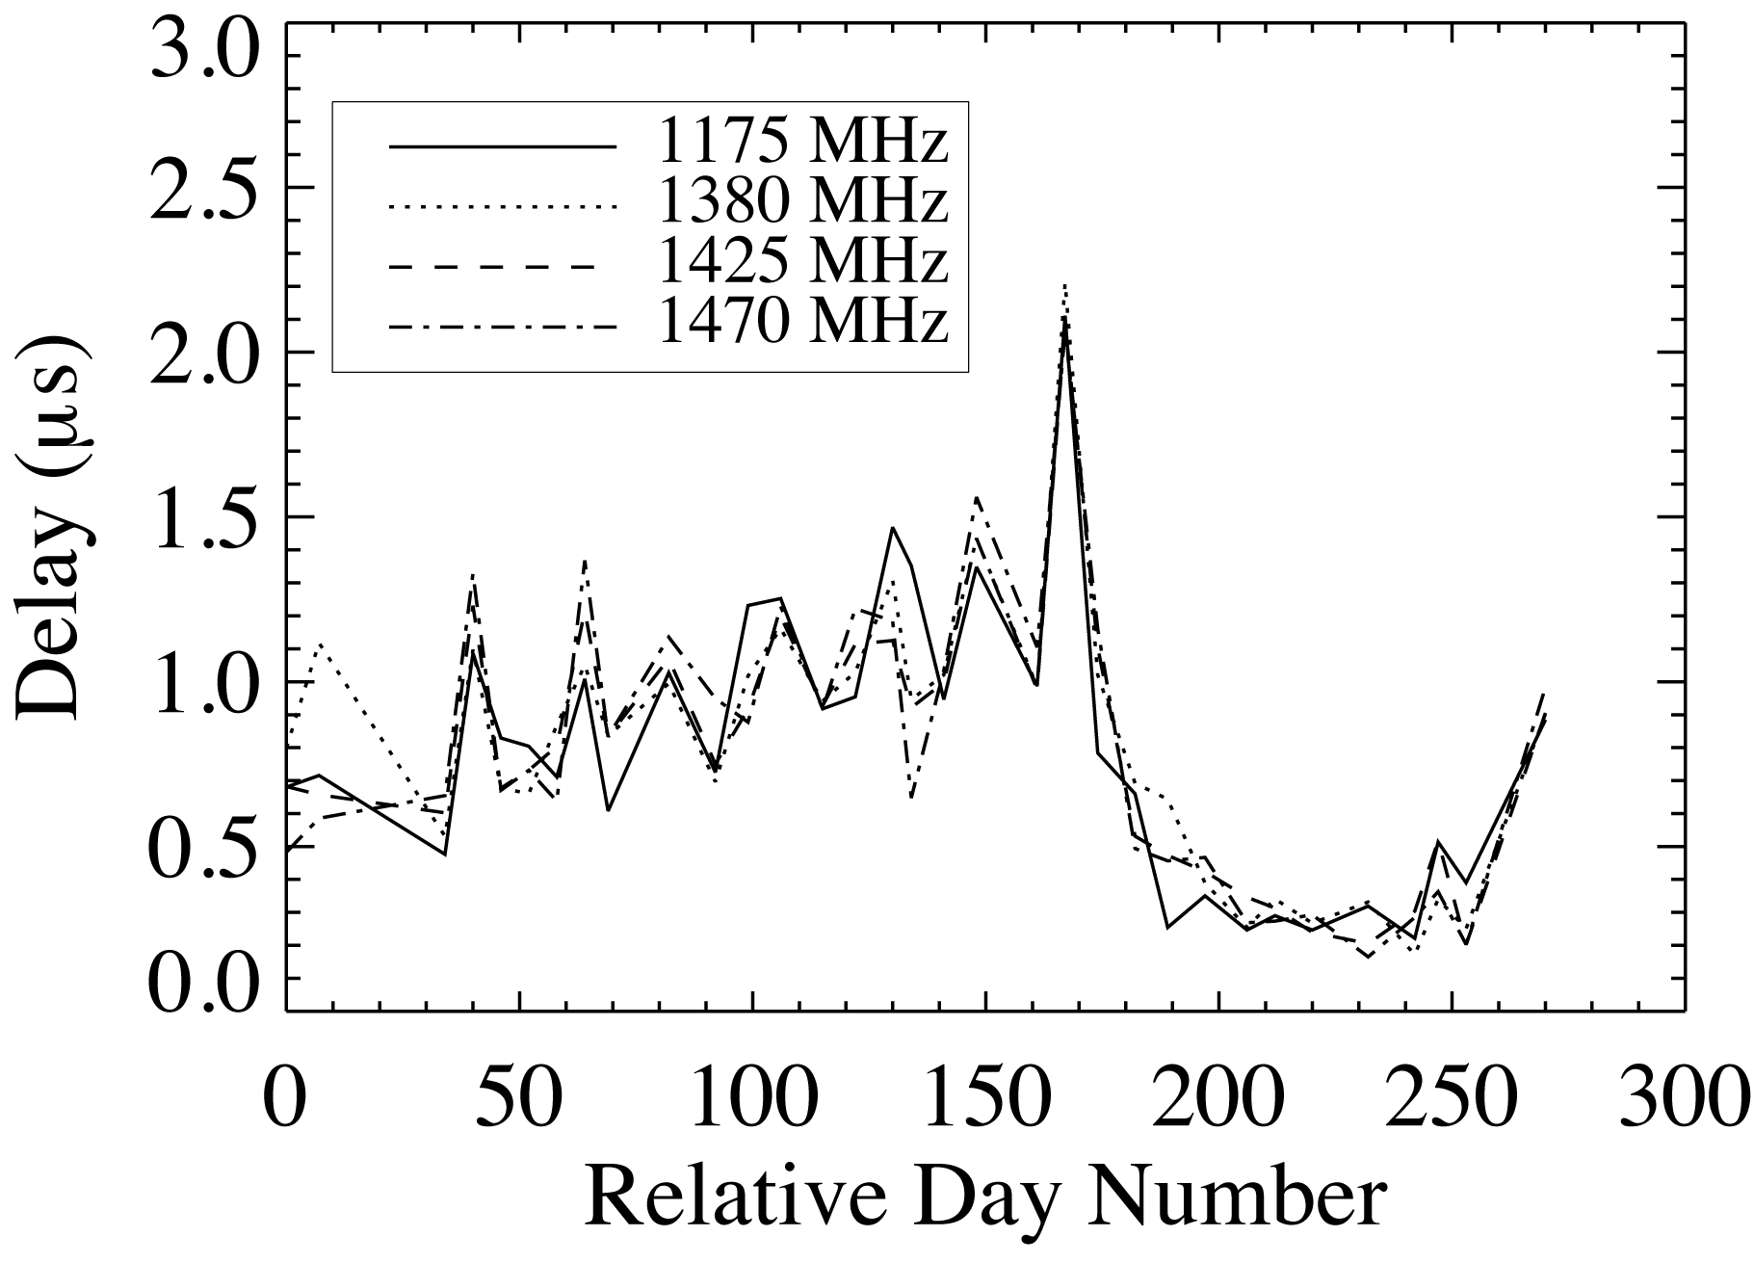
Hemberger & Stinebring 2008, ApJ, 674, L37

Slide 7
AMN model
The pulsar signal is consistent with an amplitude modulated noise process (Rickett 1976, …)
Including the pulse broadening of the ISM and additive noise, we have

Slide 8
AMN model 2
In the frequency domain
is the transfer function of the ISM, the Fourier transform of the pulse broadening function .

Slide 9
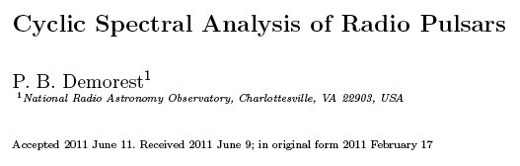
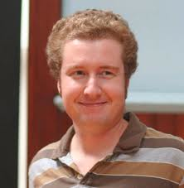
Black slide
MNRAS 2011, 416, 2821
MNRAS, 2011, 416, 2821

Slide 10
Cyclic Spectrum
The standard spectrum of the source is
But, the spectrum is more informative for a periodic source (Demorest 2011)

Slide 11
Black slide
Cyclic Spectroscopy
Take the complex voltage spectrum, amplitude and phase, and … the conjugate of the voltage spectrum …
frequency →

Slide 12
Black slide
Cyclic Spectroscopy
shift one sample to the right shift one sample to the left
(note – we have to oversample by a factor of two in order to get a symmetric shift – net shift is 1/P)
frequency →

Slide 13
Black slide
Cyclic Spectroscopy
X
Multiply the arrays together (the end effects are minor in
practice)
This is a complex, intensity-like array that can be averaged over
many pulses!
frequency →

Slide 14
CS of (AMN + ISM)
pulsar noise power
When amplitude modulated noise propagates through the ISM this becomes (no additive noise)
ISM transfer function
FT of pulse profile

Slide 15
CS of (AMN + ISM)
pulsar noise power
When amplitude modulated noise propagates through the ISM this becomes (no additive noise)
ISM transfer function
FT of pulse profile
Comment 1: There is one such spectrum for each of the k values. But, in practice, k_{max} will be set by the sharpness of the pulse. A duty cycle of d will yield k_{max} ~ 1/d.

Slide 16
CS of (AMN + ISM)
pulsar noise power
When amplitude modulated noise propagates through the ISM this becomes (no additive noise)
ISM transfer function
FT of pulse profile
Comment 2: Each of the k_{max} spectra contains similar information. They can be combined in a weighted manner to estimate quantities of interest, e.g.

Slide 17
CS of (AMN + ISM)
pulsar noise power
When amplitude modulated noise propagates through the ISM this becomes (no additive noise)
ISM transfer function
FT of pulse profile
Comment 3: The amplitude and phase of depends critically on . If you change the profile you change the CS. Later … comment about pulse jitter.

Slide 18
CS of (AMN + ISM)
pulsar noise power
When amplitude modulated noise propagates through the ISM this becomes (no additive noise)
ISM transfer function
FT of pulse profile
Comment 4: With P = 4 ms, e.g., the frequency shift represented by α₁ = 1/P = 250 Hz. This is a small shift, particularly compared to large bandwidths of 10 – 100 MHz (baseband sample intervals of 100 – 10 ns).

Slide 19
CS of (AMN + ISM)
pulsar noise power
When amplitude modulated noise propagates through the ISM this becomes (no additive noise)
ISM transfer function
FT of pulse profile
Comment 5: Additive noise simply adds a power N₀ to the RHS of this equation.

Slide 20
Determining the phase
Use the CS to determine to within an additive constant. Represent as an amplitude and a phase. Then substitute into the CS formula:
The phase of the CS is the change in phase of the transfer function over .

Slide 21
Reconstructing
The amplitude is easy: the standard spectrum provides a good measurement of it.
The phase is harder, but that’s where the payoff comes from. Some approaches:
Direct Phase Integration
Demorest-Walker least-squares optimization. Adjust to minimize:

Slide 22
Signal-to-Noise
How big is the signal that we’re trying to estimate with Cyclic Spectroscopy?
The CS – corrected for the profile A(α_{k}) – is almost completely Real. You are typically estimating a very small Φ_{B} in the presence of noise (see next slides).

Slide 23
An example – linear shift
If the profile is shifted by 1 (Nyquist) sample there is a 2π phase change across the band for B(ν).
For P = 4 ms, BW = 10 MHz, N = 4 x 10⁴. This yields a CS signal of

Slide 24
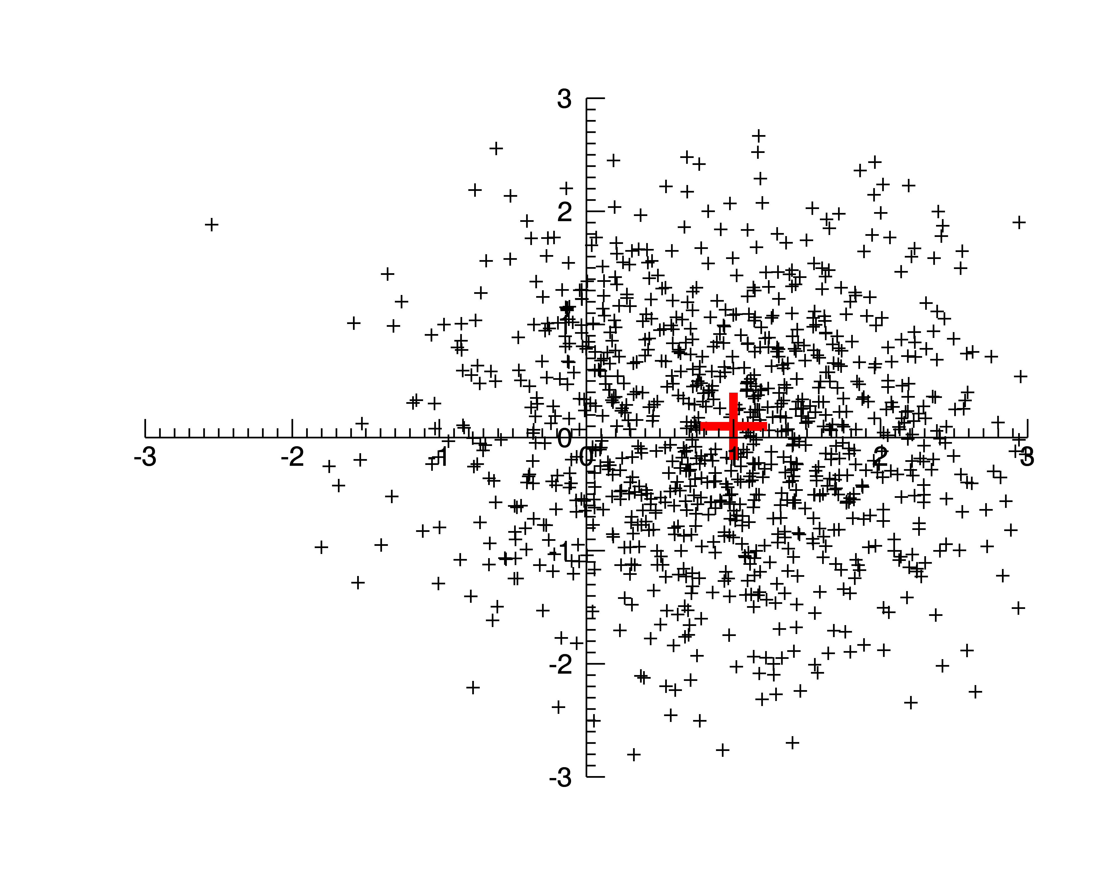
Imag
N = 1
Real

Slide 25
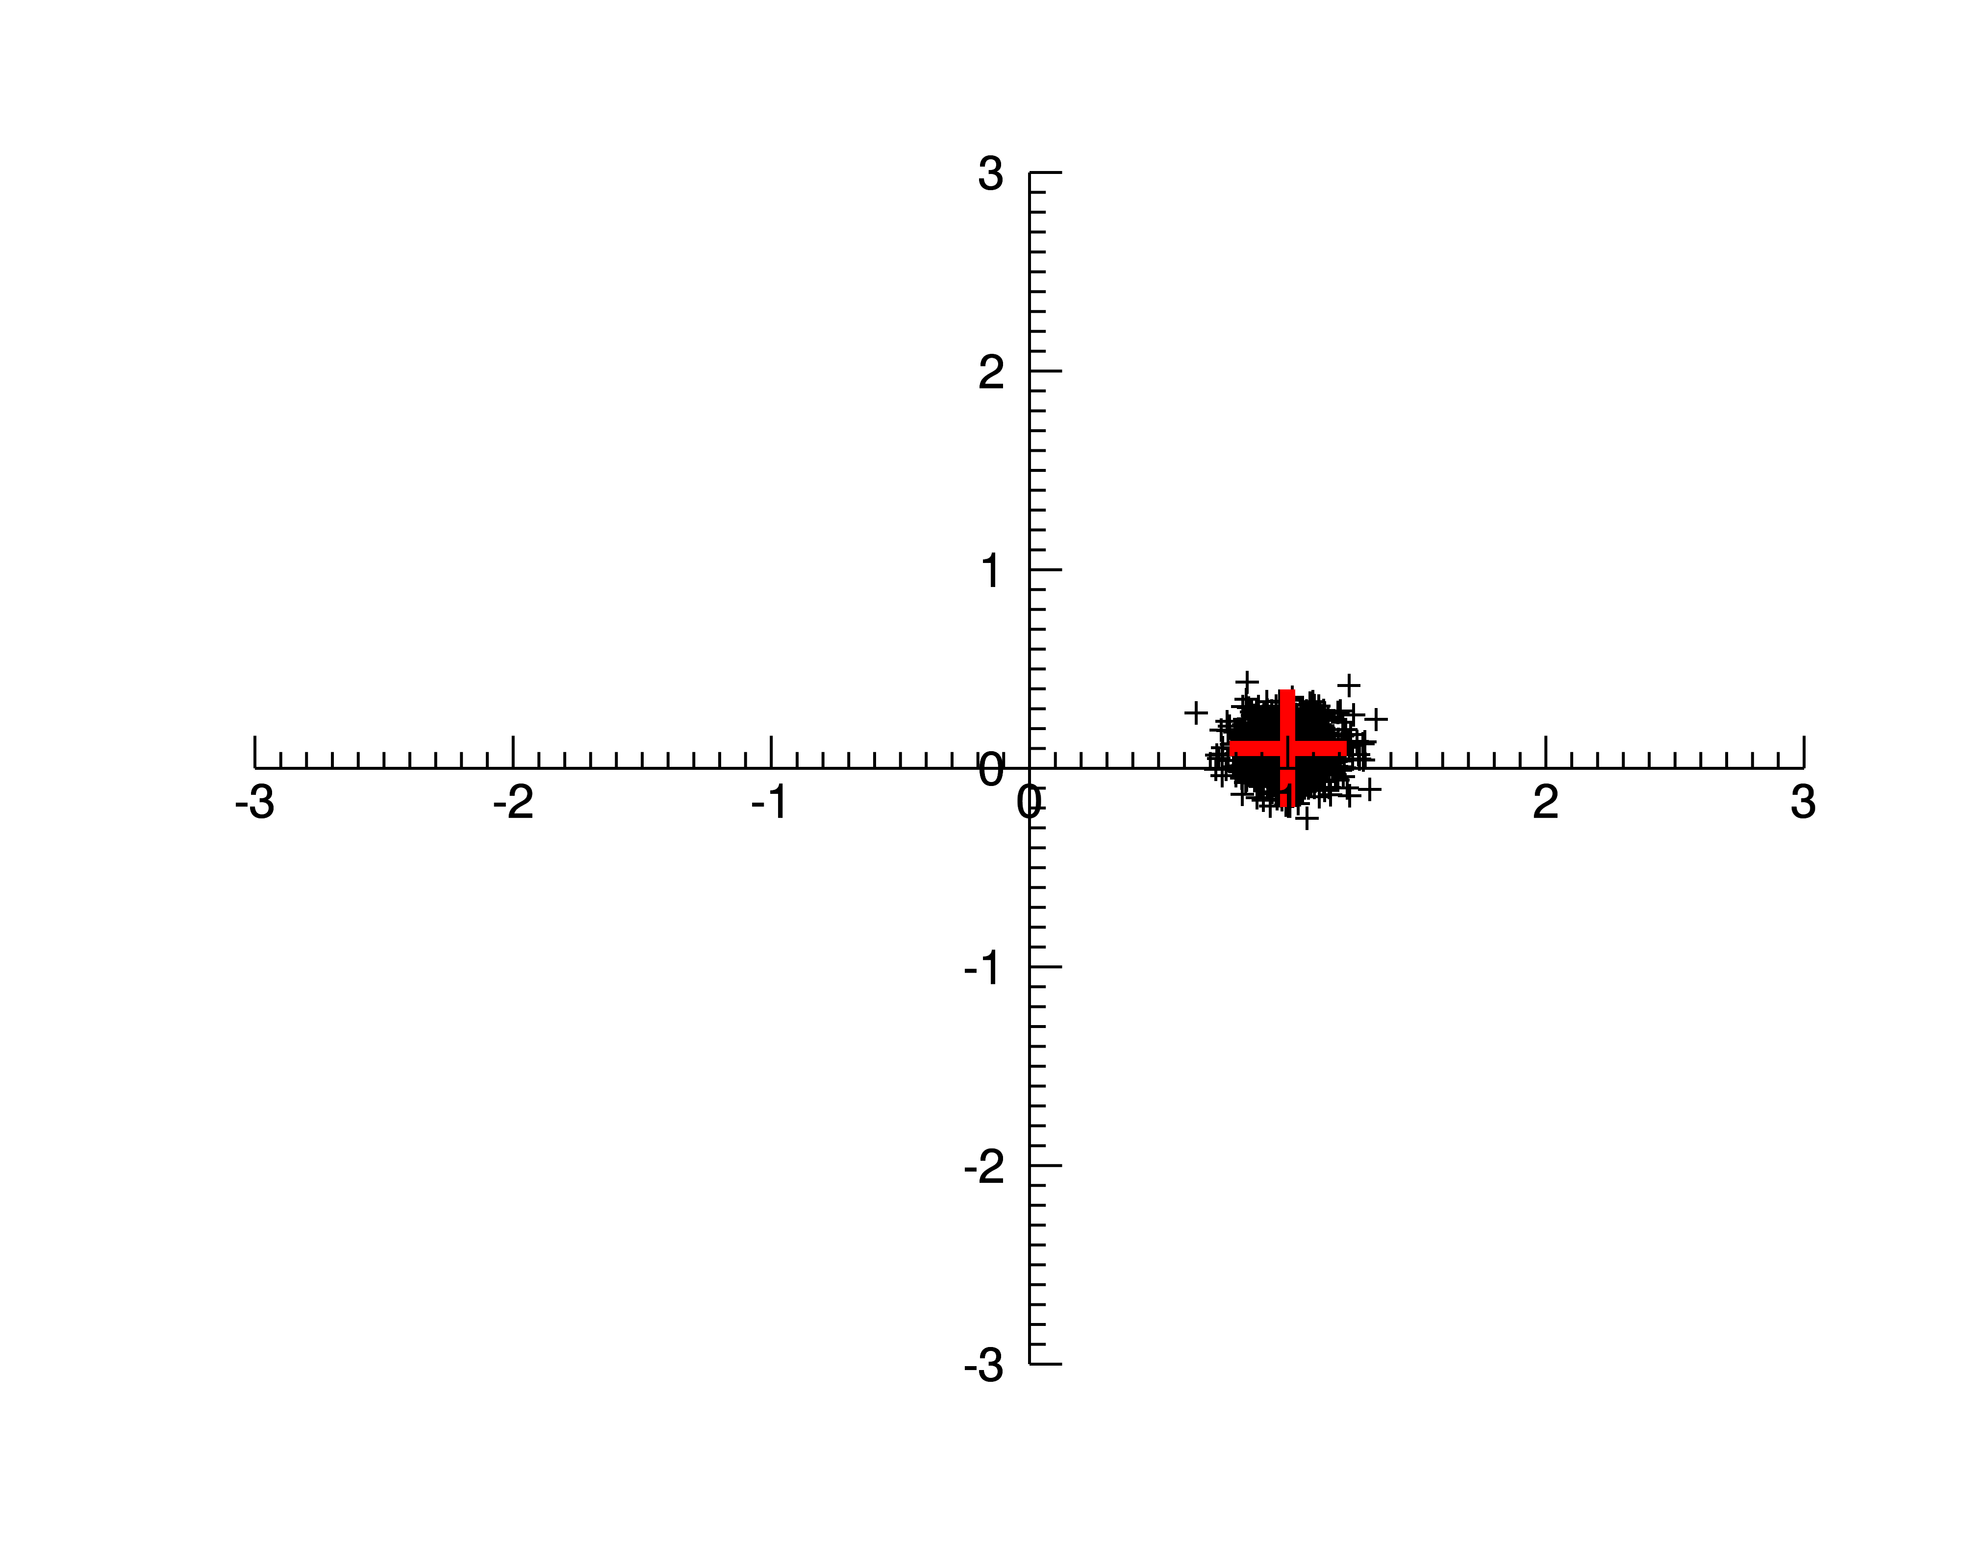
Imag
N = 100
Real

Slide 26
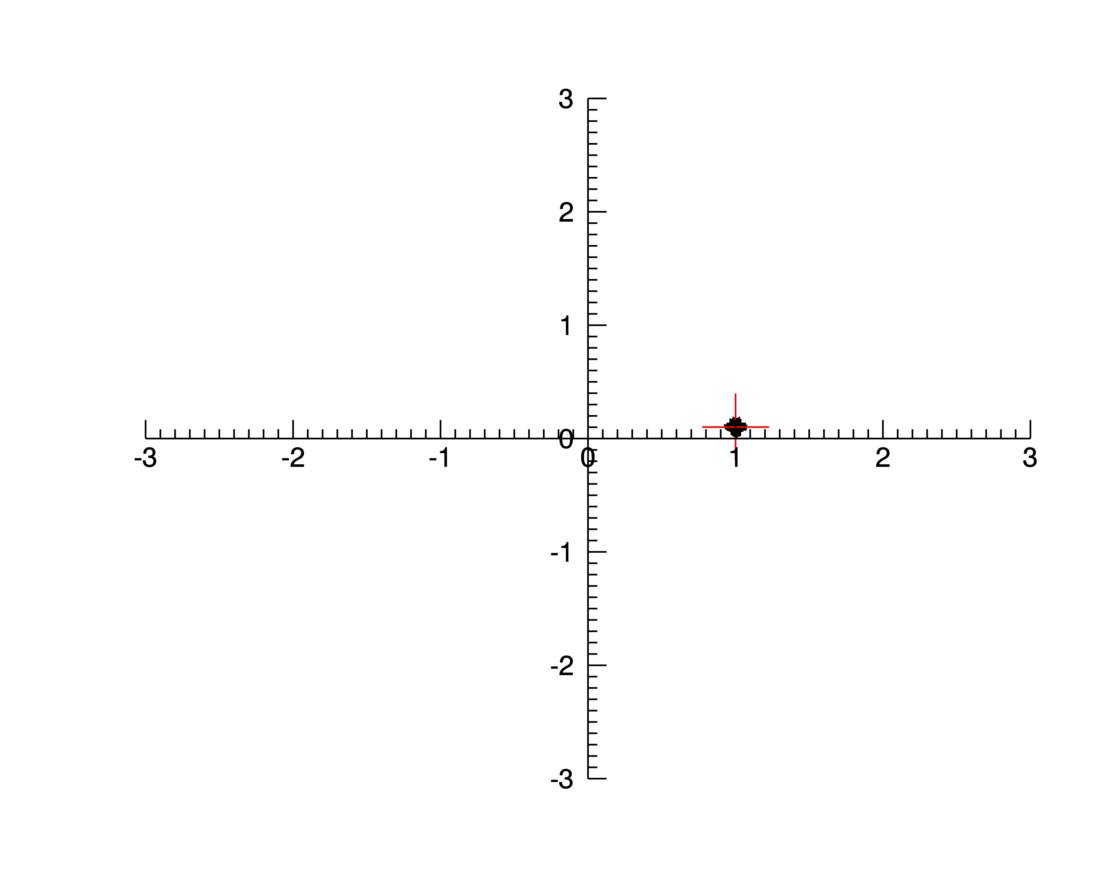
Imag
N = 10⁴
Real

Slide 27
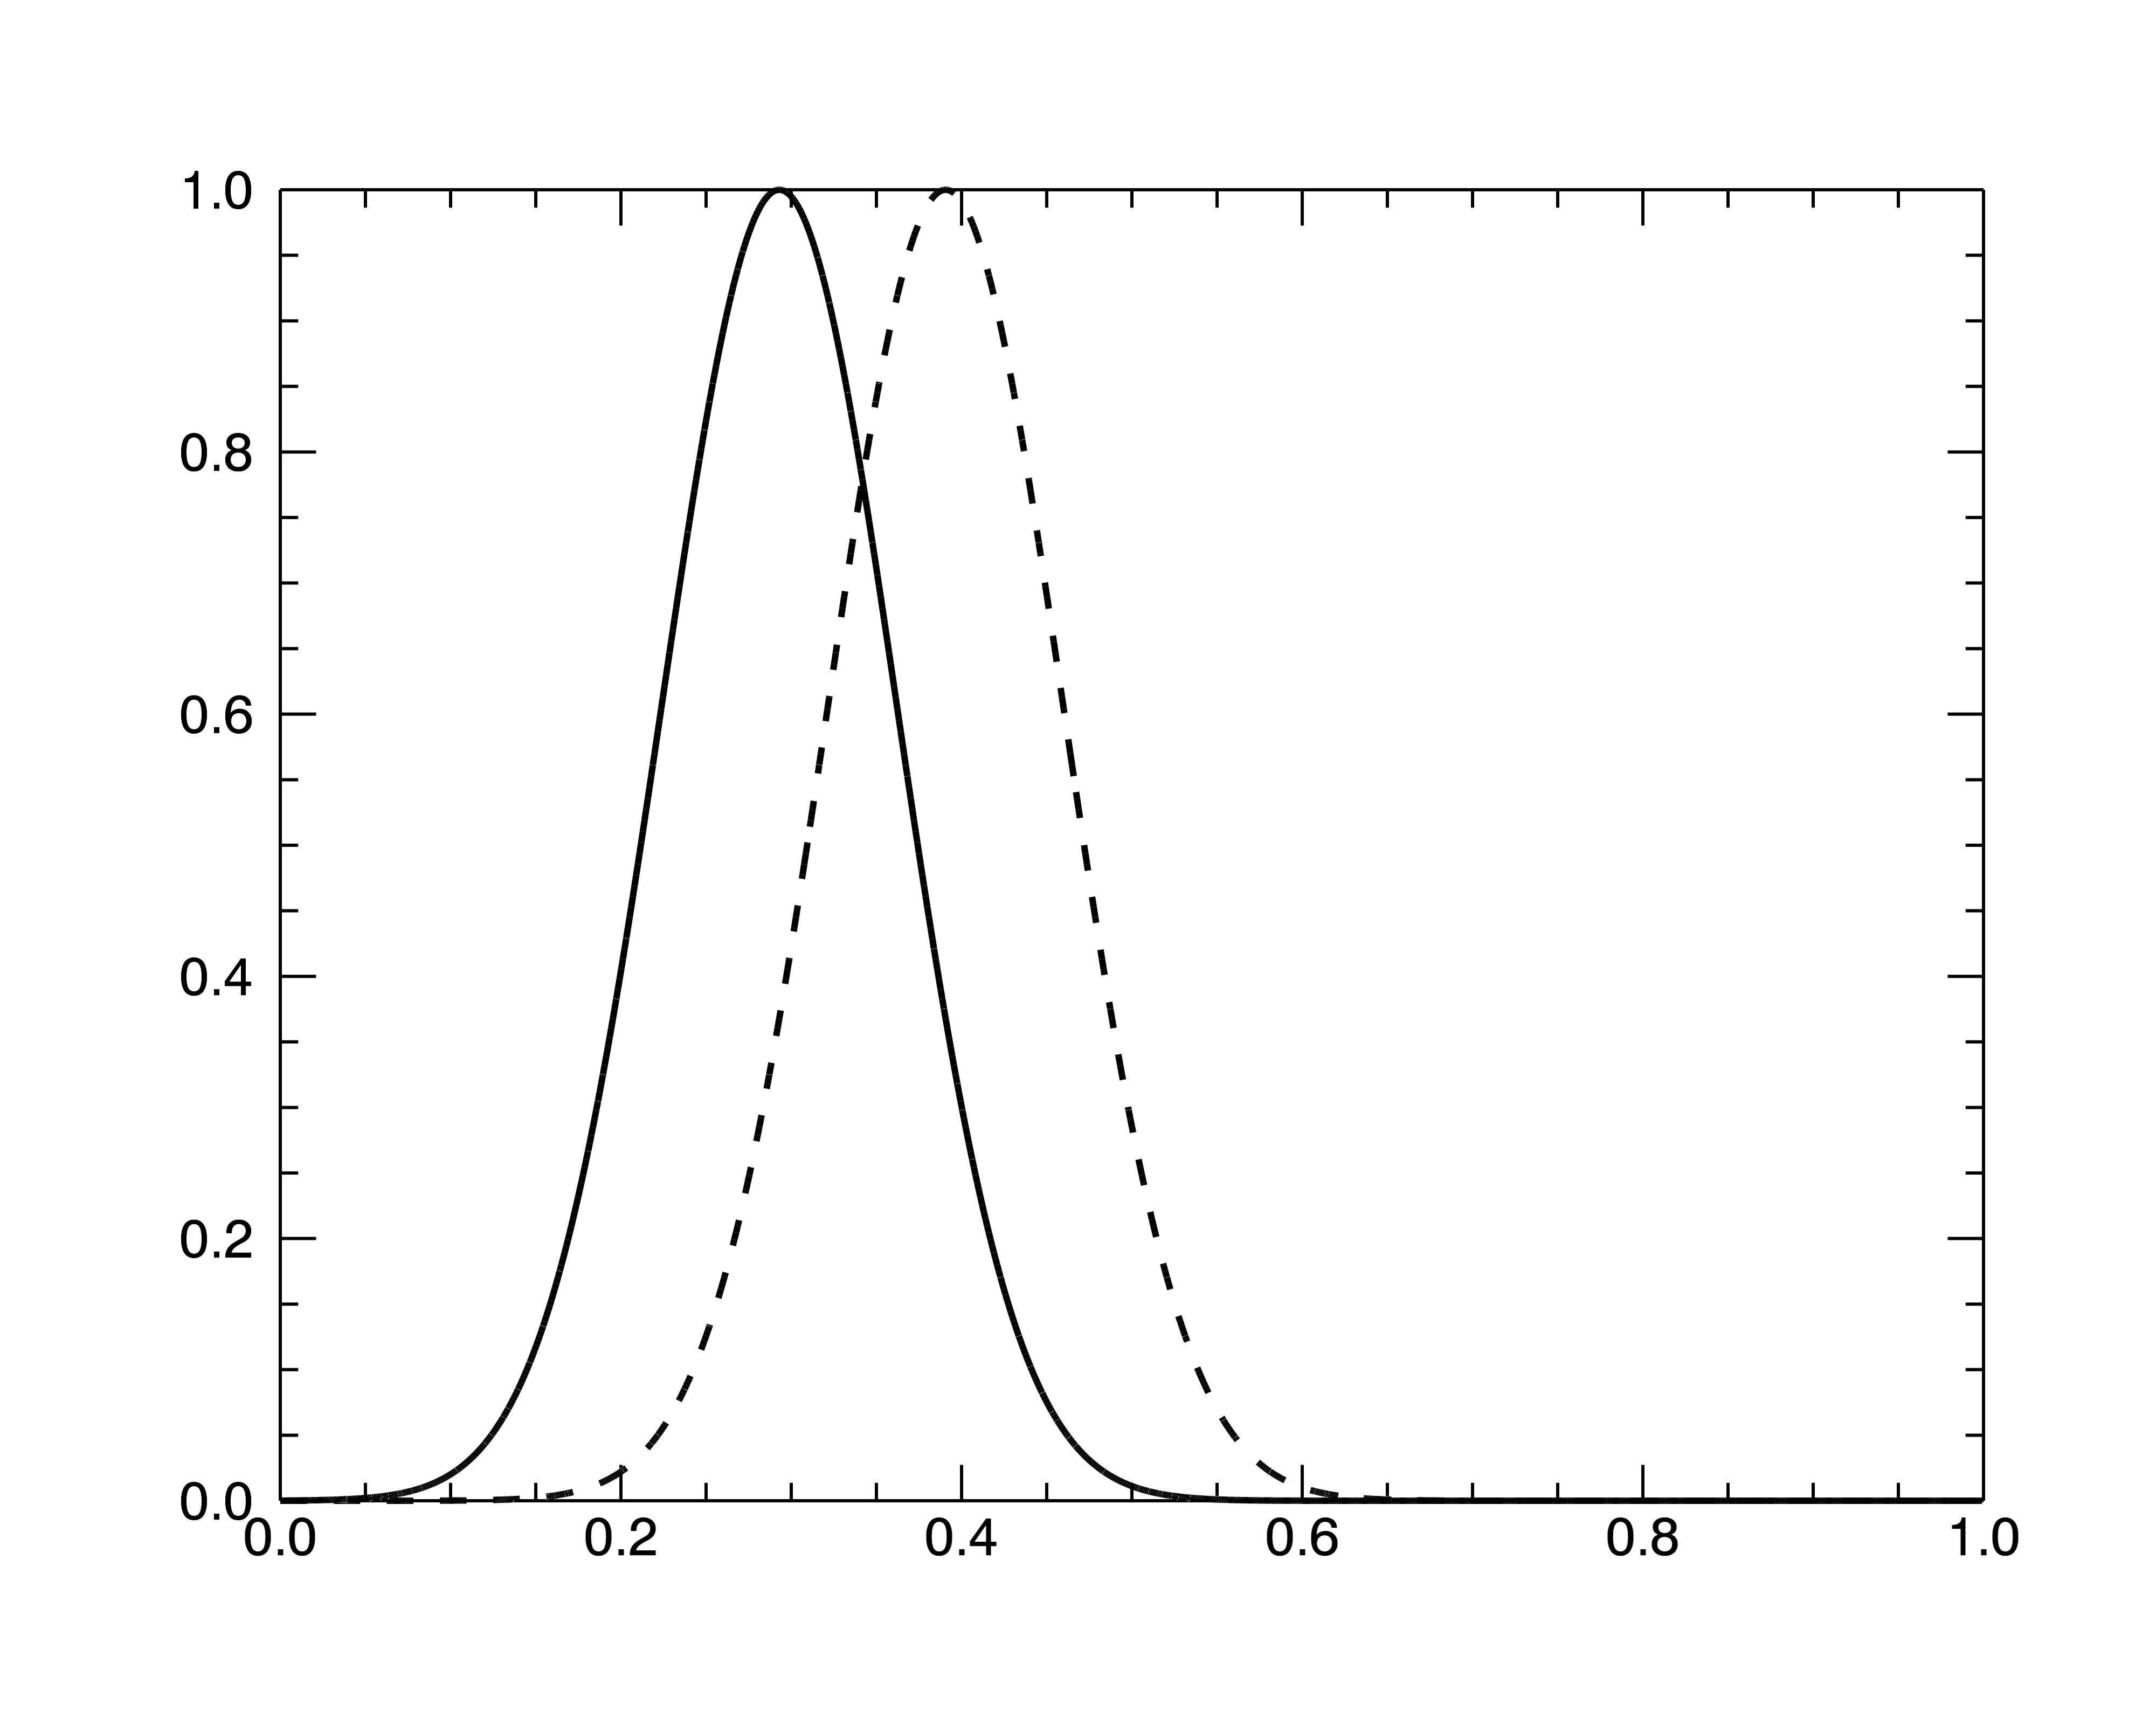
Pulse Jitter
A shift in the pulse is a phase ramp in B(ν).
If you shift by a fraction ε
of the period, it will produce
a phase error of
This is an offset (either positive or negative) in the phase of the Cyclic Spectrum, Φ_{S}(ν). This will be another form of phase noise (i.e. similar to the N=1, N=100, N= 10⁴ plots).

Slide 28
Closing Comments
CS produces a function (the pulse broadening function) instead of only a single number, the TOA. This is useful for detecting and mitigating scattering noise.
The signal-to-noise ratio of the TOA estimate is the same in both cases, but the CS has additional information about the nature of the time delay: scattering and profile changes.
We are still very much in the Research and Development phase. Next crucial step: demonstrate that CS correction of real data improves arrival times (Nipuni Palliyaguru’s PhD work).

