Slide 1

Measurement of dispersion measure variations and solar wind effect by millisecond pulsars
Xiaopeng YOU
Southwest University, Chongqing, China
2012 IPTA Conference, Kiama
Notes:
Pulsar Conference 2010, Sardinia, Cagliari, Italy

Slide 2
DM variations mentioned yesterday
Dick’s talk
Maura’s talk
Ben’s talk
David’s talk
Gemma’s talk
Bill’s talk
KJ’s advertisement for poster
Paul’s talk tomorrow maybe?

Slide 3
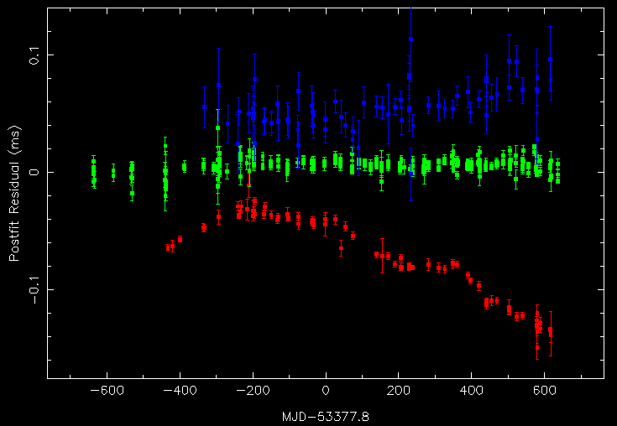
PSR J1045-4509
3100 MHz
PSR J1045-4509
1400 MHz
685 MHz

Slide 4
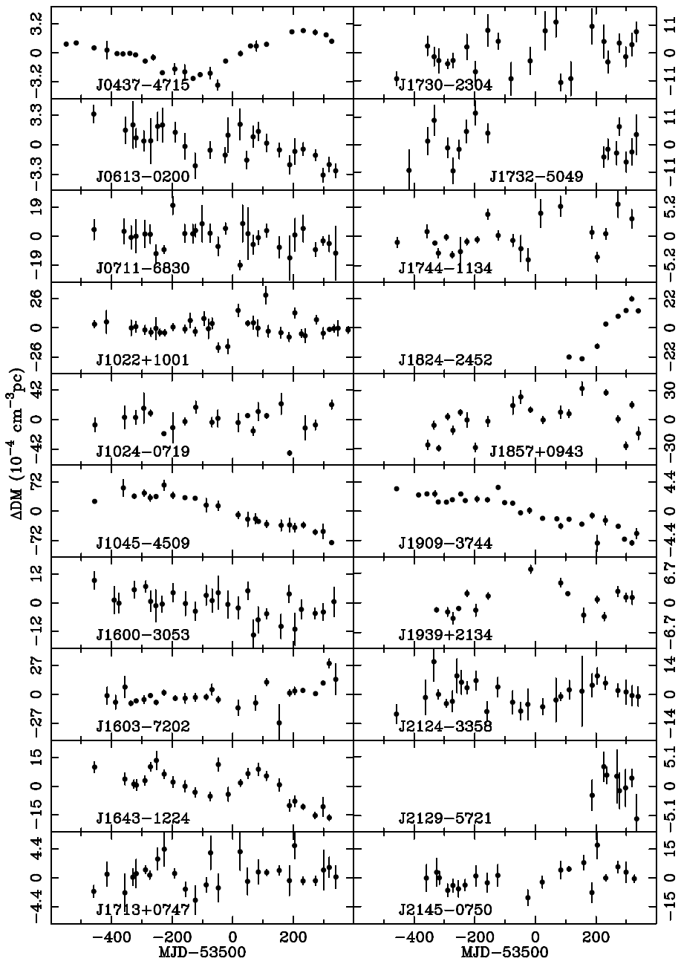
DM variations from ISM
20 millisecond pulsars
(You et al., 2007)

Slide 5
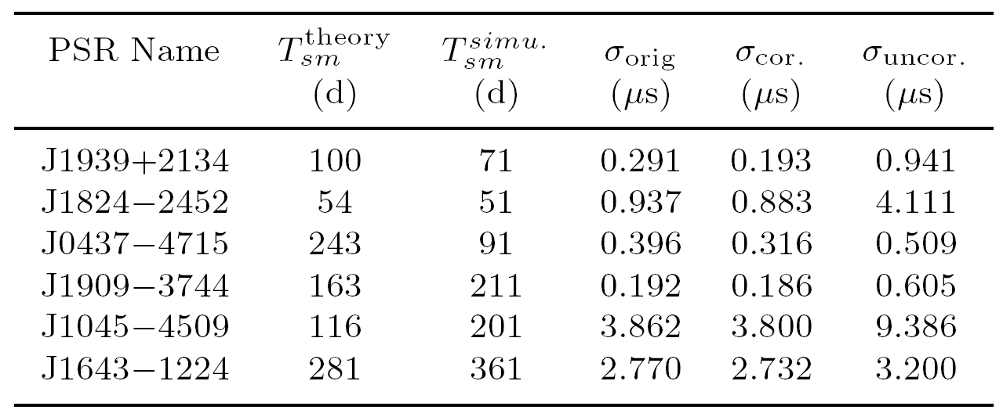
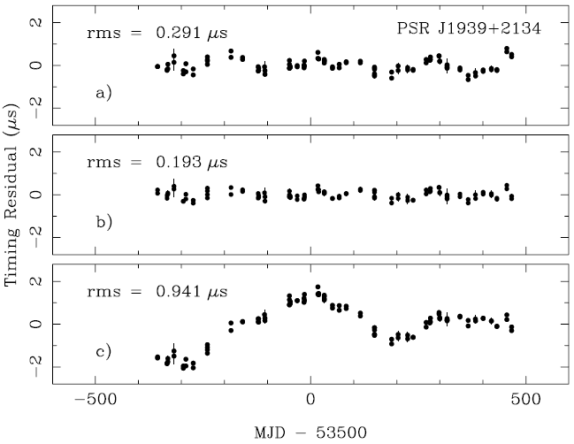
Smoothing method to improve pulsar timing residuals
6 pulsars’ residuals improved
Timing parameters changed
J1939 J1045
P 28 σ 10 σ
dp/dt 28 σ 6 σ
PM 17 σ no
(You et al., 2007)

Slide 6

DM Variations and Correction
DM offsets solved for along with pulsar parameters and frequency-independent (“common-mode”) signal using Cholesky algorithm in Tempo2 on PPTA three-band data sets
DM offsets measured at intervals through data sets with linear interpolation between values
Interval size taken to be inverse of modulation frequency where red (DM) signal is same power as white noise
Mean DM offset constrained to be zero
Effectiveness of algorithm tested using simulations
(Keith et al. 2012)
(From Dick’s talk yesterday)

Slide 7
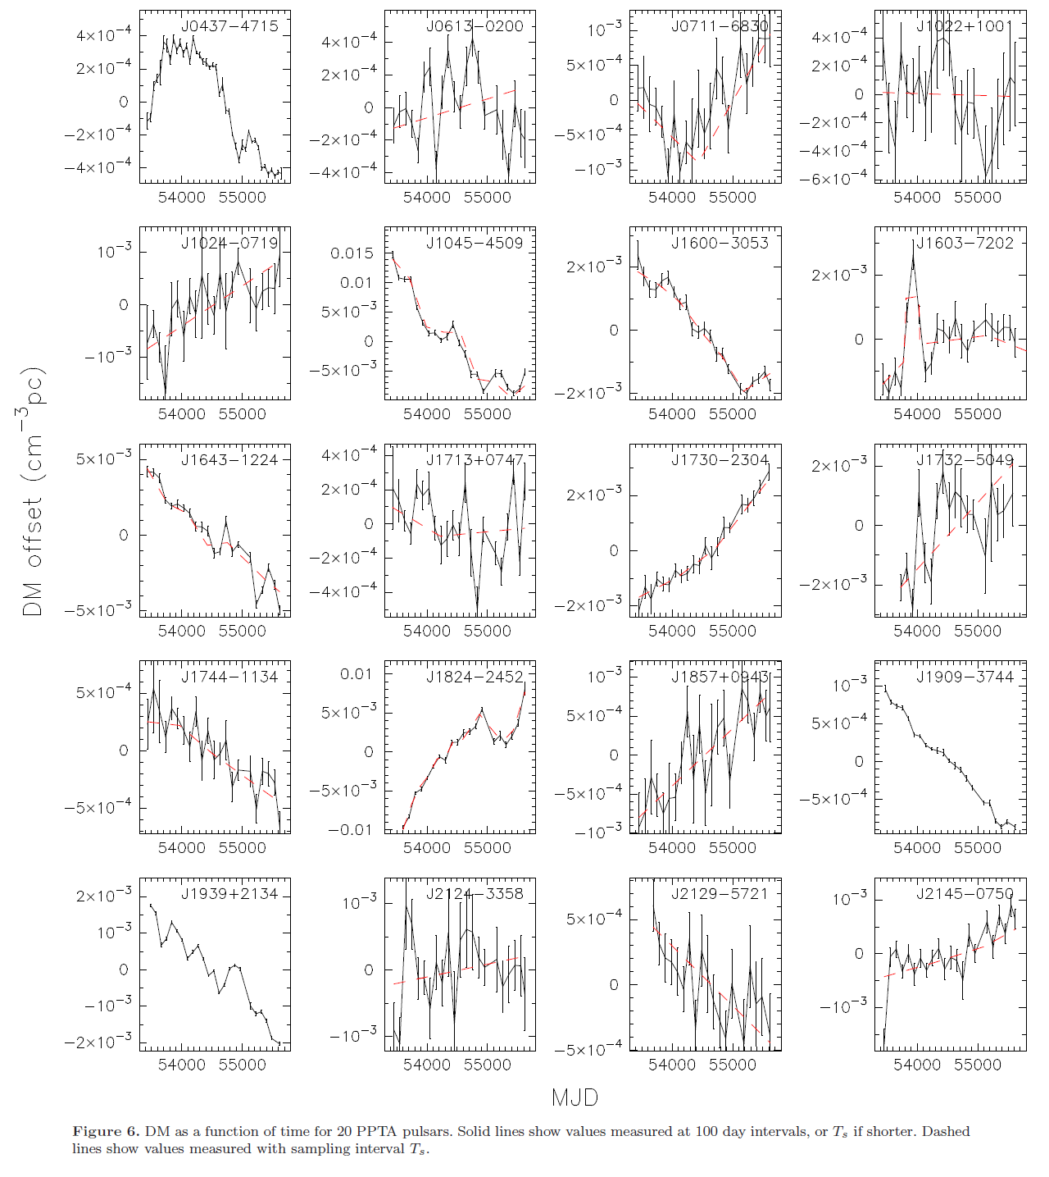
(Keith et al. 2012)

Slide 8
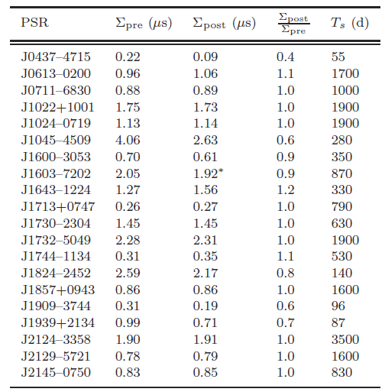
7 pulsar’s residual improved
(Keith et al. 2012)

Slide 9
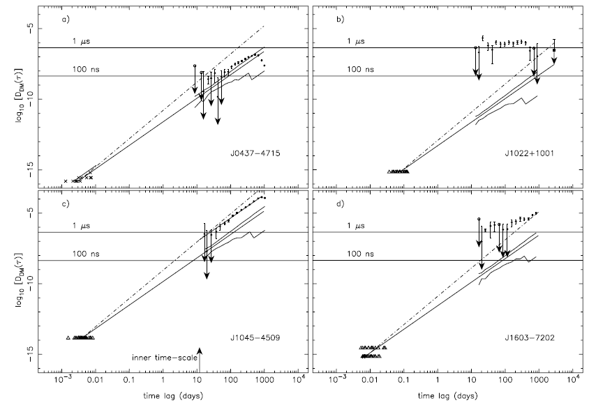
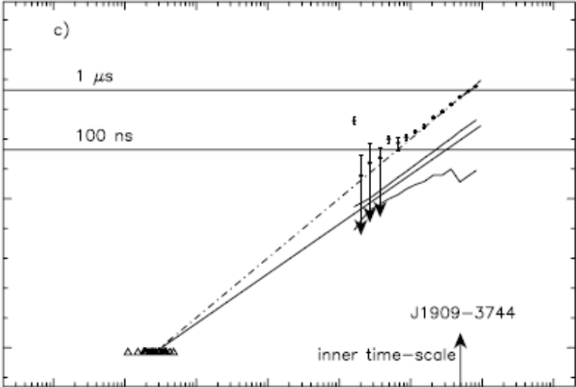

Study spectrum of turbulence of ISM
(You et al., 2007)

Slide 10
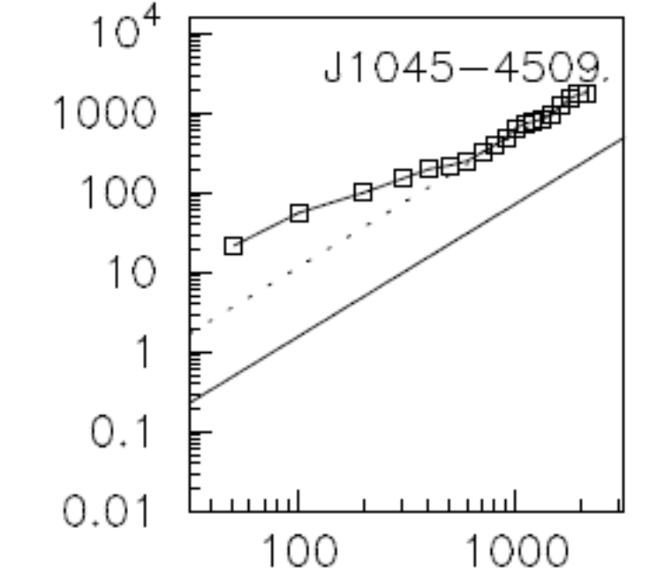
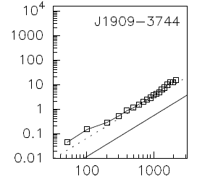

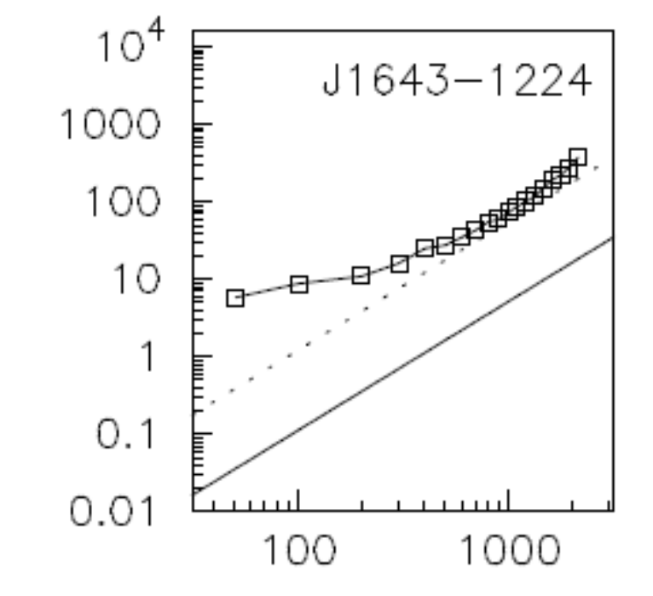
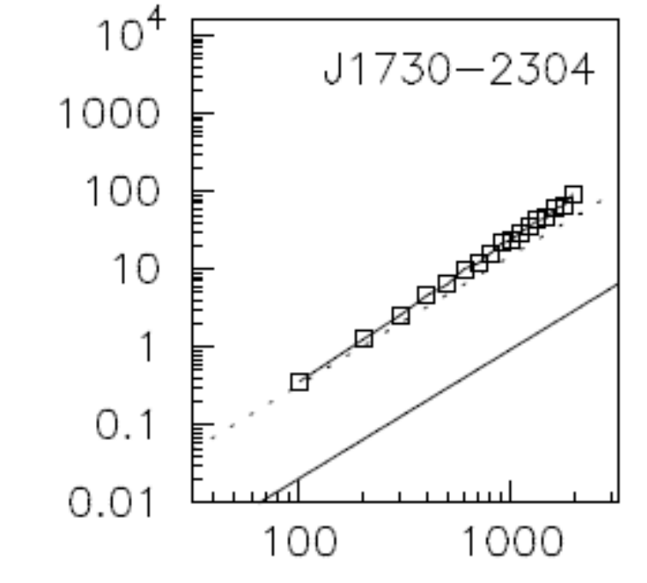
(Keith et al. 2012)

Slide 11
Summary
Researching DM variations is very important both for improving pulsar timing residuals and studying properties of interstellar medium

Slide 12
Brief introduction of the solar wind
Solar wind --- plasma with speed ~ 400 km/s, complex structure
Quasi-static and transient component
  quasi-static ：co-rotating with the Sun；
  Transient component：changes very quickly，coronal mass ejections (CME)
Our work, concentrate on quasi-static component

Slide 13
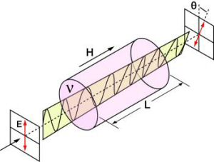
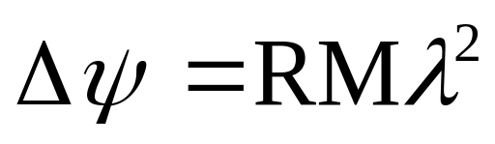
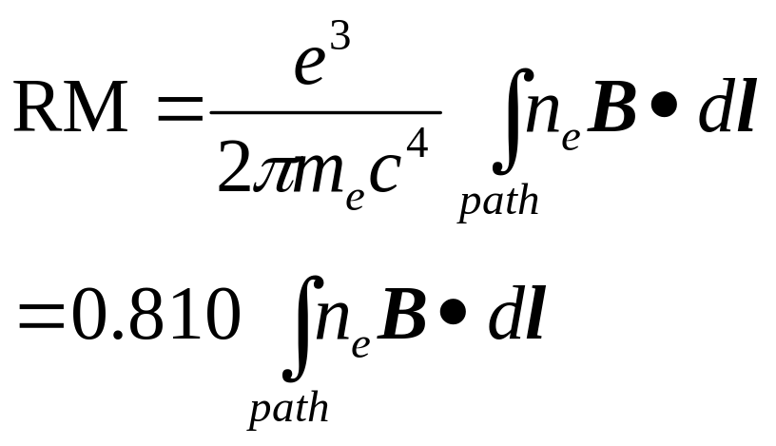
The magnetic field of the solar wind
Very important, control structure and dynamics of the coronal and solar wind plasma
Difficult to measure
The most reliable method is:
Faraday rotation of linearly polarized radio background sources

Slide 14
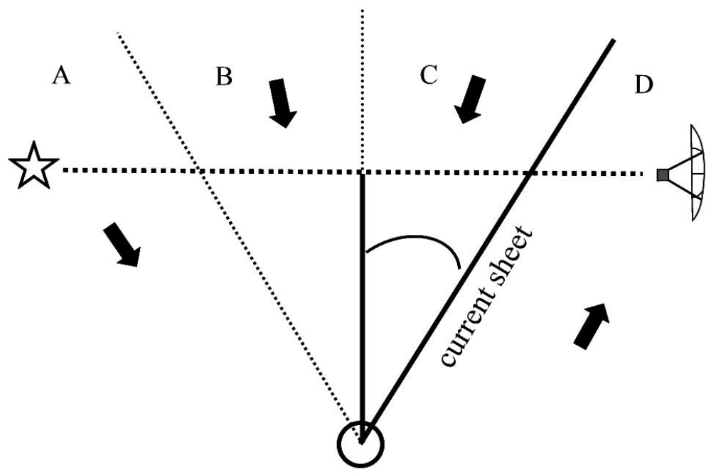

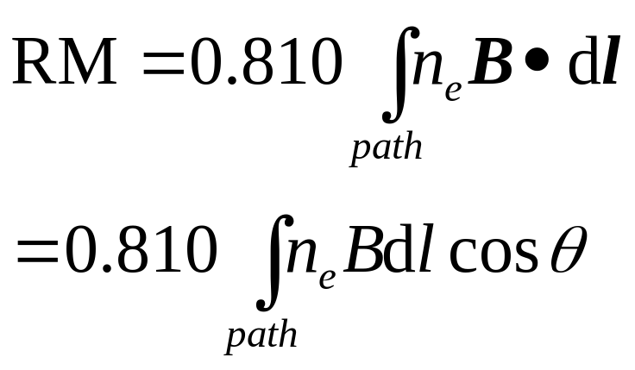
The magnetic field of the solar wind
Radial Magnetic field close to the Sun
Importance of “current-sheet”, radial component of field change sign.

Slide 15
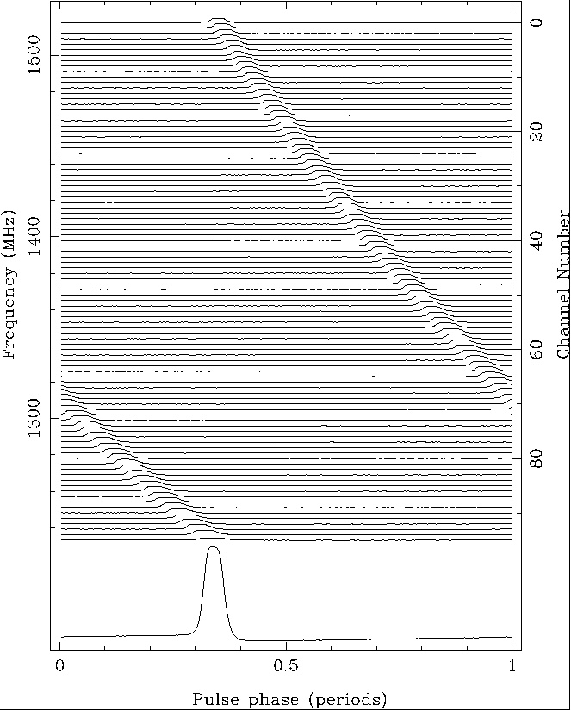
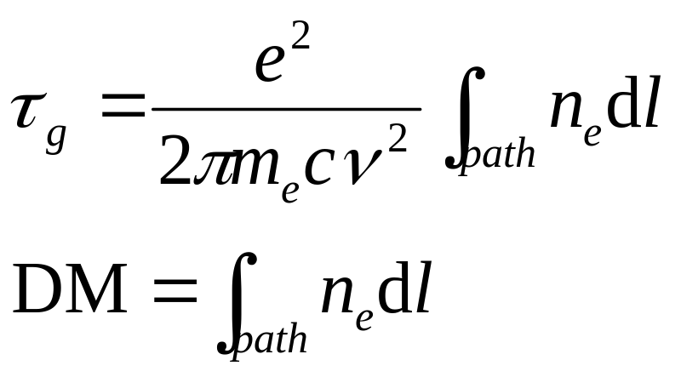
The problem of n_{e}
Pulsars as an unique source to get information of n_{e}
Dispersion Measure（DM）

Slide 16
Group delay from the solar wind
Simultaneously getting group delay and rotation measure is important
Comparing with ISM, group delay from the solar wind is very small
Only high precise timing can measure it
Need millisecond pulsars.

Slide 17
Previous work
Using extragalactic radio sources
  Ingleby et al 2007, 30-34 mG at 6.2 R_{s}
  Spangler 2005, 39mG at 6.2 R_{s}
Using normal pulsars
  Ord et al, 2007, RM changes 170 rad m²
Both of them can NOT measure DM from the solar wind

Slide 18
Our work
Using a millisecond pulsars PSRs J1022+1001 (b_{e}=-0.06º)
Obtain both RM and DM from the solar wind
Model fitting our measurement to obtain magnetic field of solar wind
(You et al., 2007)

Slide 19
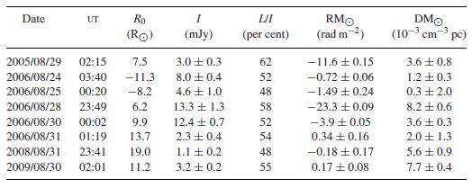
Observation and data process
Part of the PPTA project
Using the observations when the line of the pulsar close to the Sun.
Frequency, ~1400 MHz , bandwidth, 256MHz
Full flux and polarization calibrated

Slide 20
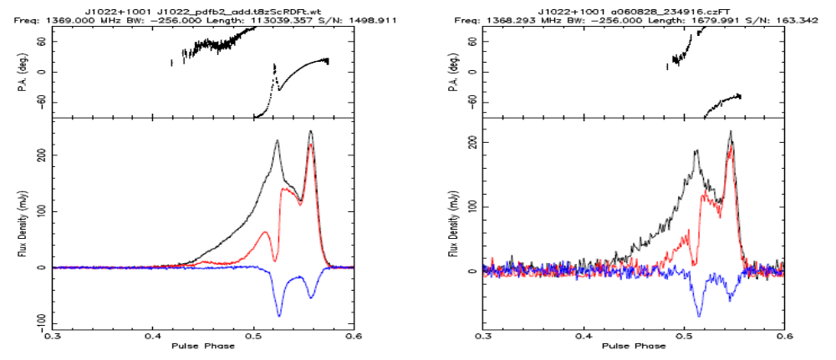
Obtain RM from the Sun
Adjust RM to optimize the linearly polarized intensity, depolarization
Separate the each observation into two halves
Calculating PA difference close and far from the Sun (taking weighted average of the difference between PAs across an individual observation profile and the PAs across the grand average profile)
Subtracting the contribution from ionosphere (IRI model)
060828:23:49 R0=6.2 Rs PA=-68.5º, RM_sun=-23.7 rad m²

Slide 21
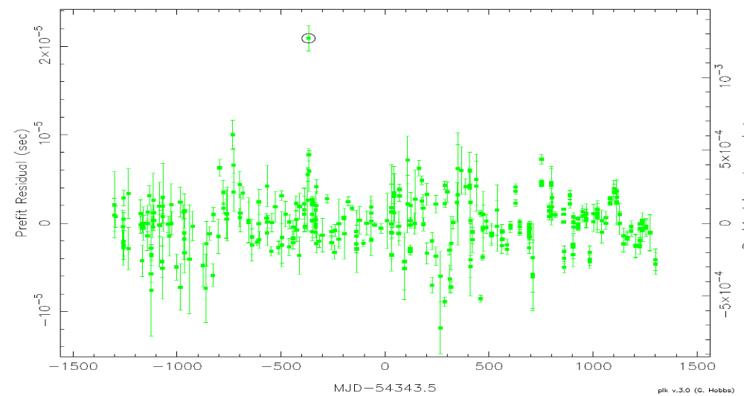
Obtain DM from the Sun
Fitting timing model
Obtain extra timing residual from the Sun
060828:23:49 R0=6.2 Rs t=20.5 μs, DM_sun=8.2X10⁻³ cm⁻³pc

Slide 22
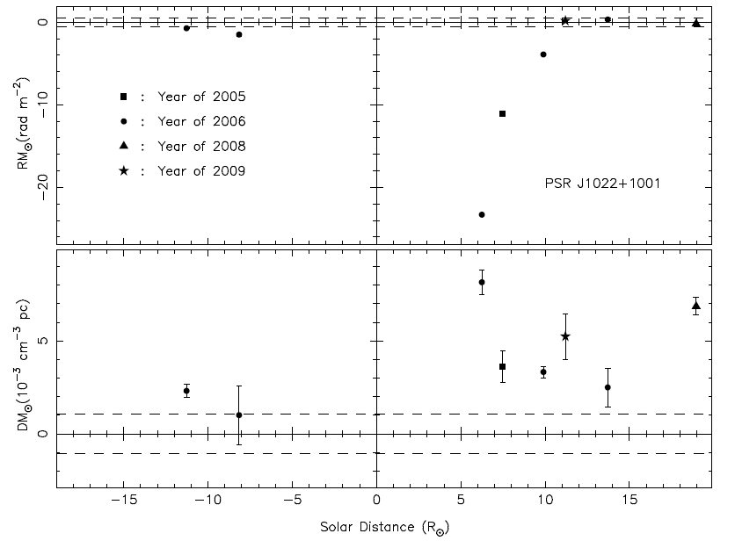
Observational results

Slide 23
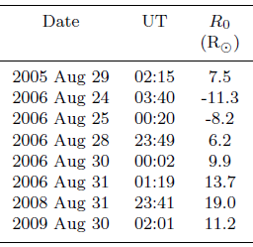
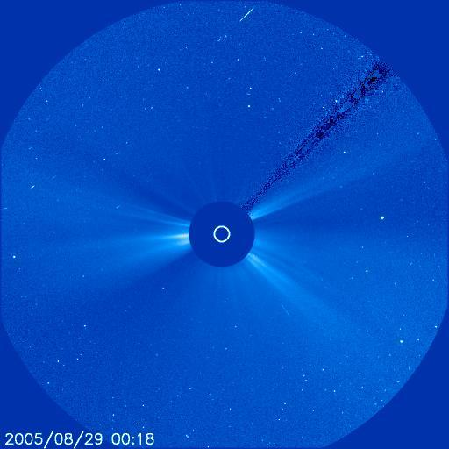
Model fitting
Step 1, check there is no transient event
Using LASCO C3 movie

Slide 24


Step 2: modelling electron density
Two-state model：fast and slow wind
Fast wind：lower density, originate in active regions at high latitude
Slow wind：relatively high density, originate in active regions at low or middle latitude
Assume slow wind occupies the zone within 20º of the magnetic neutral line and outside this is dominated by the fast wind and that both winds flow radially.

Slide 25
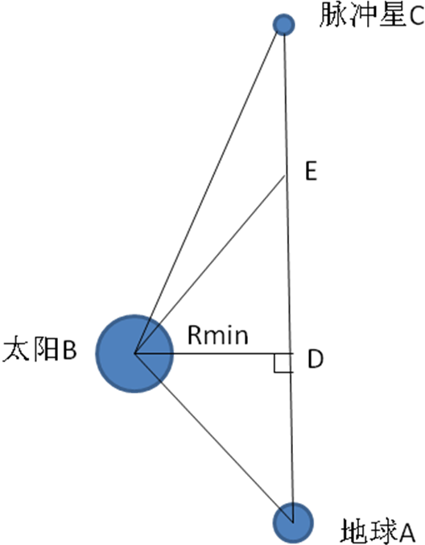
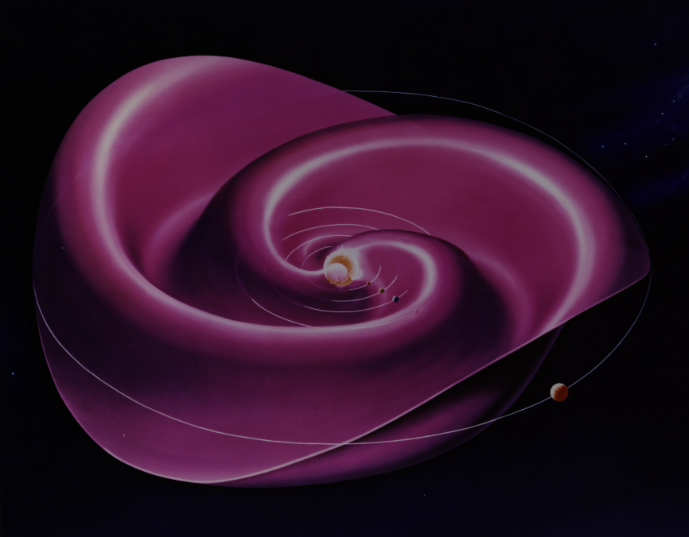
obtain the current-sheet
Position of pulsars relatively
positions of the pulsar, the Sun
and the Earth
Observing time make sure the
Carrington rotation (starting 1976, May)
Data from Wilcox Solar Observatory
According the data, determine the
position of the current-sheet
Pulsar C
Pulsar C
Pulsar C
Pulsar C
Pulsar C
The Sun B
The Sun B
The Sun B
The Sun B
The Sun B
The Sun B
The Earth A
The Earth A
The Earth A
The Earth A
The Earth A
Notes:
Pulsar Conference 2010, Sardinia, Cagliari, Italy
刘项琨
西南大学物理科学与技术学院2006级本科生论文答辩

Slide 26
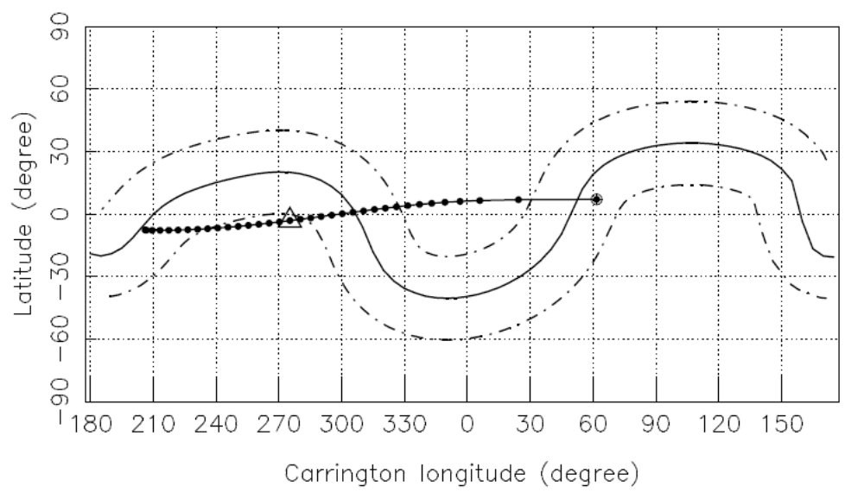
Projection onto a sphere at 2.5 Rs
PSR J1022+100, Aug 25th, 2006

Slide 27
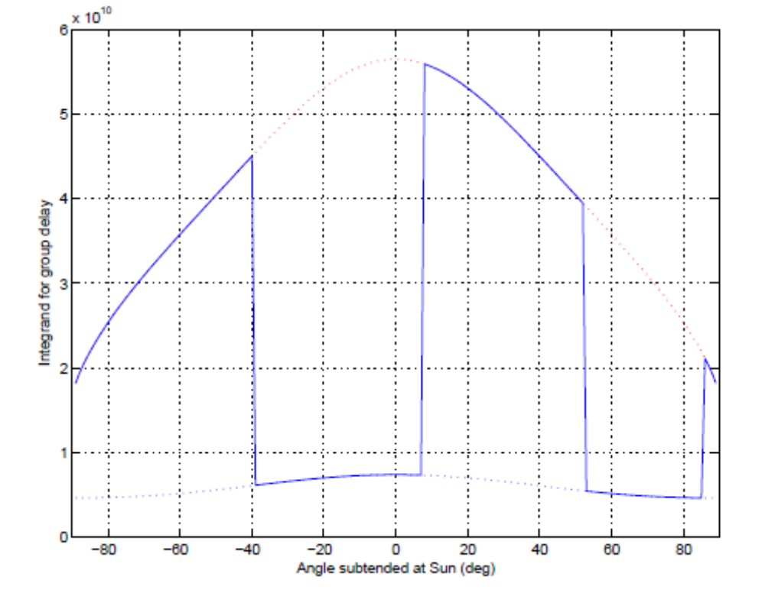
Integration of n_{e}

Slide 28
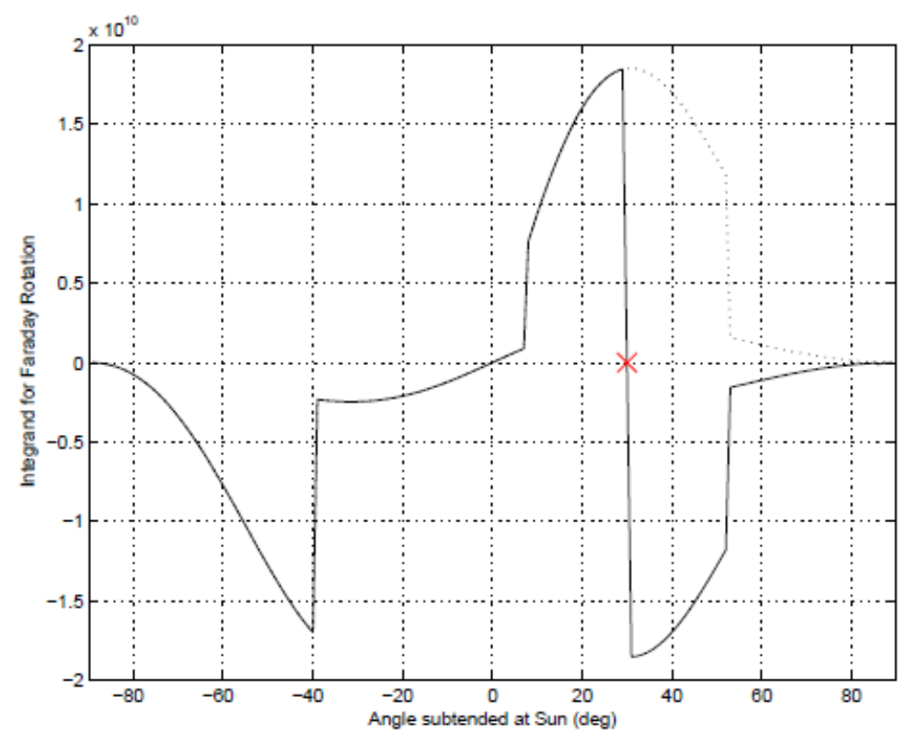

Step 3: modeling B
Assuming B is radial,
sign reversal at current-sheet
quadratic decrease with distance
Integration of n_{e} B

Slide 29
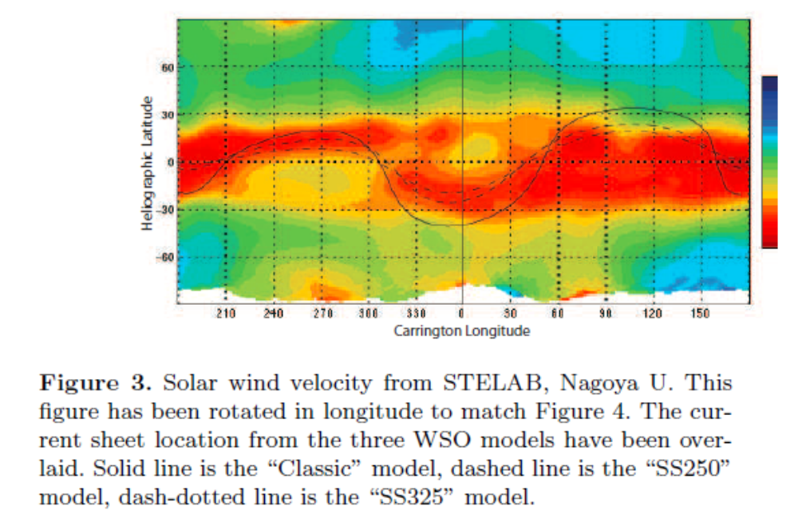
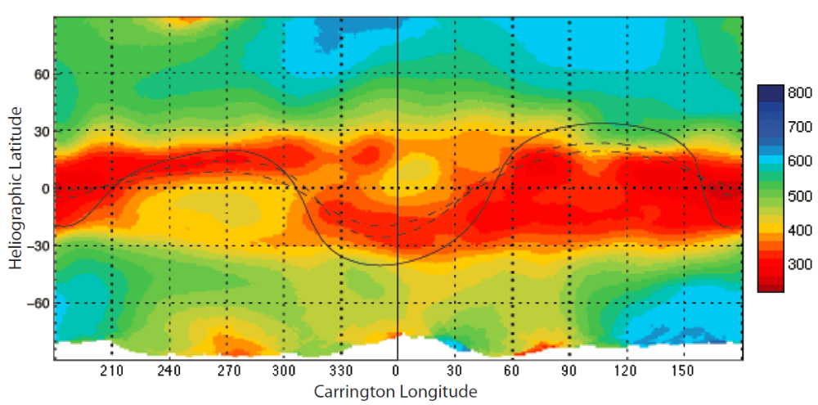
Three WSO models
Classic model, Radial 250 model, Radial 325 model
Boundary of slow and fast wind is not clear
Solar-Terrestrial Environment Laboratory, Nagoya University

Slide 30
Completely modeling for three observations
DM modeling:
  Width of slow wind is not clear, 10º, 20º, 30º
  Three different extrapolation model
  Times a factor F for both slow and fast wind to match the observation
RM modeling:
  Find |B| to match the observation
  Check the sensitivity of the model

Slide 31
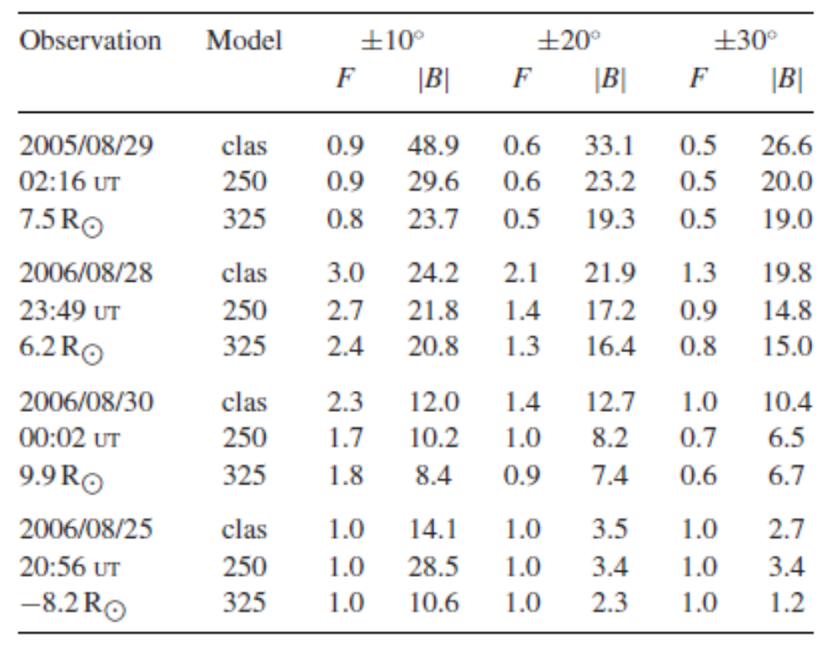
Result of model sensitivity
Three observations in 2006 are less model sensitive than the one in 2005

Slide 32
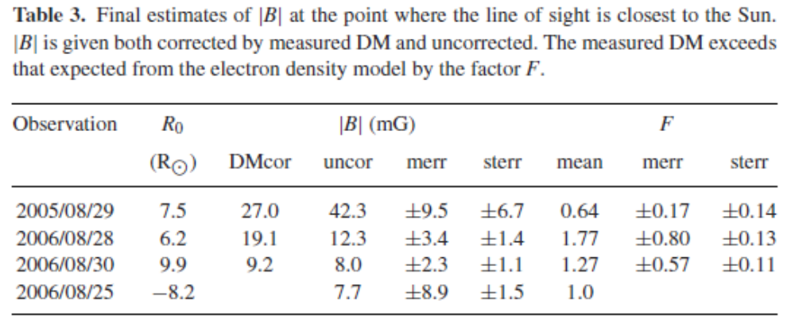
Estimated error

Slide 33
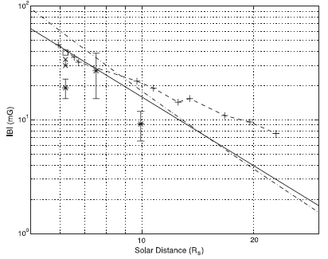
Comparing with previous results
The extrapolated mean |B| from Helios of 0.38mG at 64.5 Rs (Burlaga 2001)
B=1000(6R⁻³+1.18R⁻²) (Patzold 1987)
Estimate if the field in a CME shock (Gopalswamy and Yashiro 2011)
Ingleby et al. (2007) 30 -34 mG at 6.2 Rs
Spangler (2005) 39 mG at 6.2 Rs
Our result broadly consistent with Helios space craft observations
Model error depends on 1) current sheet, 2) width of slow and fast region
Analysis must include a range of model variation to estimate model error

Slide 34
Conclusion and summary
We have the observation both of DM and RM near the Sun.
The technique to measure the magnetic field of the solar wind is very important
Using our model, we can estimate the B when our model prediction match the observation
Error strongly depend on the geometry of current sheet and region of slow and fast wind
Relatively weaker pulsar J1730-2304 and J1824-2452 could be modeled by larger telescope

