Slide 1
Covariances Between ISM and Timing Parameters in Millisecond Pulsars
Timothy Dolch
Willie Kunert
Ryan Shannon
Dan Stinebring
Joris Verbiest

Slide 2
Refractive effects in the ISM
Time delay due to angle-of-arrival θ is ∝ θ²
Frequency dependence: θ ∝ν ⁻²
∆t_{AOA} ∝ ν ⁻⁴
Here we assume Kolmogorov power spectrum for (isotropic) spatial fluctuations in refractive screen
Focus here on refractive effects – time delays due to diffraction as well
Result – varying DM as well as refractive component
From Shannon 2011 (PhD Dissertation)

Slide 3
Model for timing residuals
N_{days} = 128 (about every 2 weeks over 5 yr)
Linear least squares – no iterations
DM at each time is a separate parameter for the model – 131 parameters total
Time cadence is varied to be more and more “Poisson” -like

Slide 4
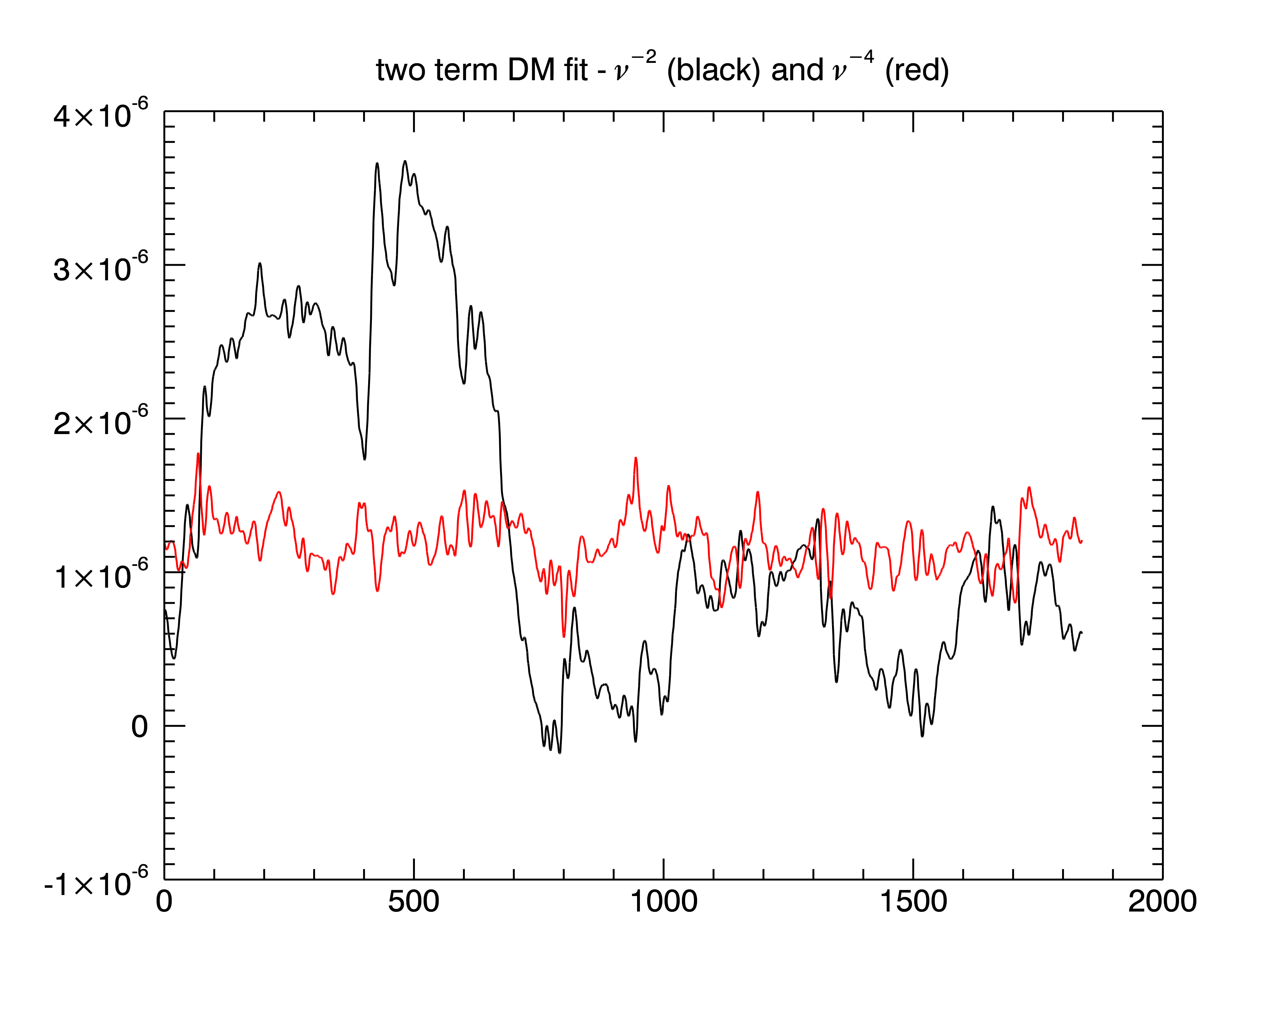
∆t (sec)
day

Slide 5
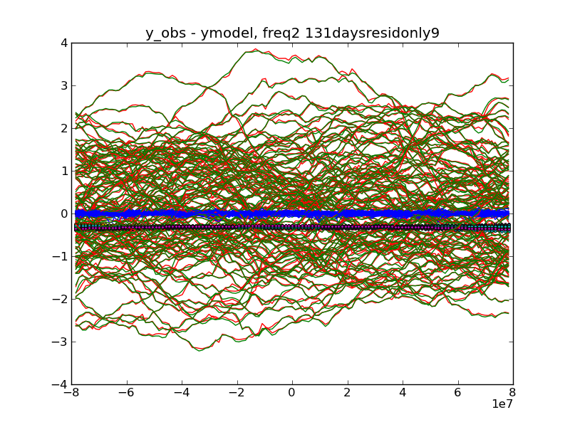
Time Delays due to ISM: DM and Refraction
∆t (microsec)
day

Slide 6
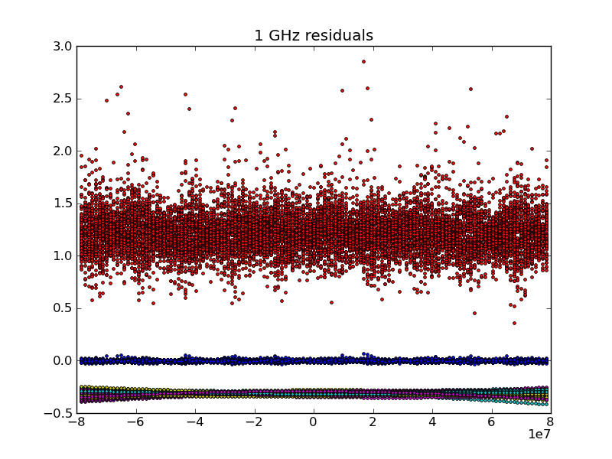
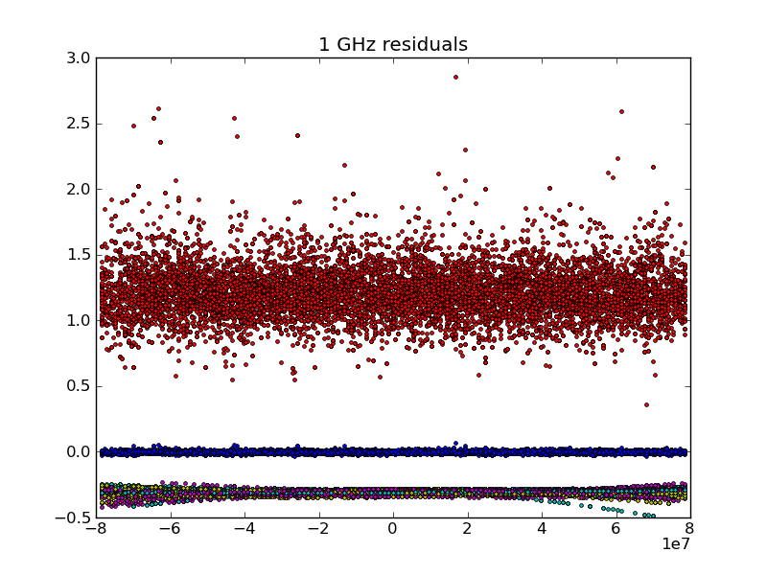
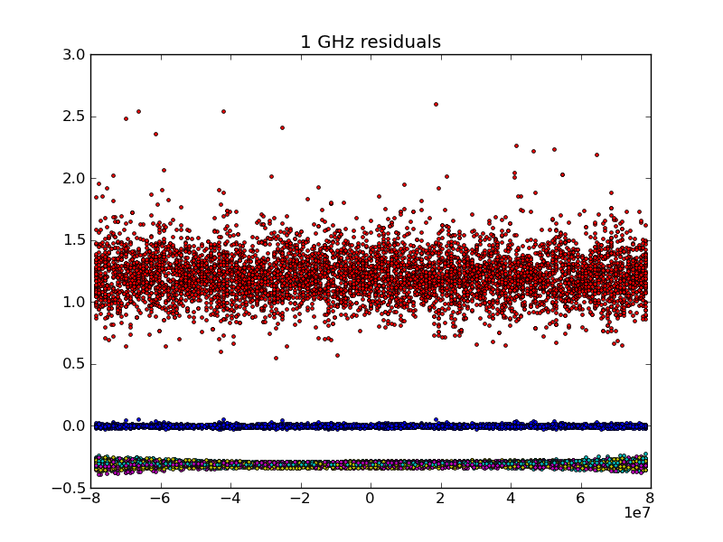
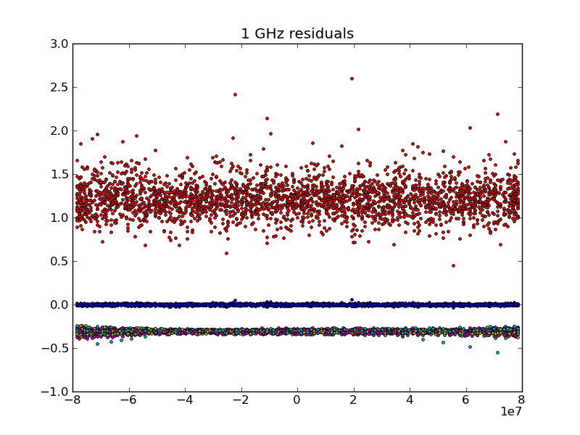
Residuals after DM term removed: 1GHz
∆t (sec)

Slide 7
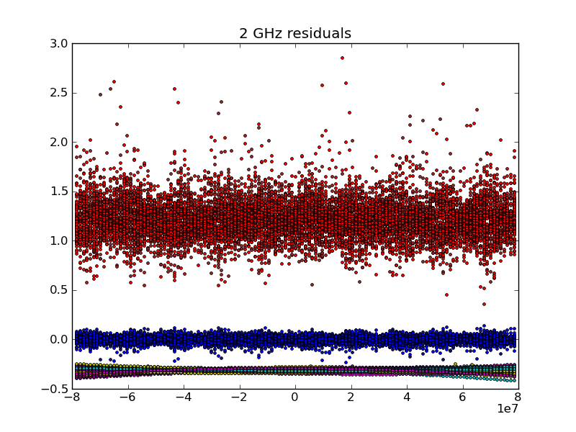
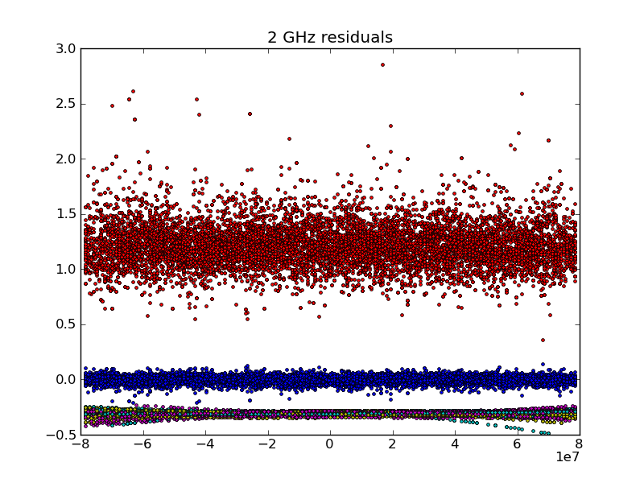
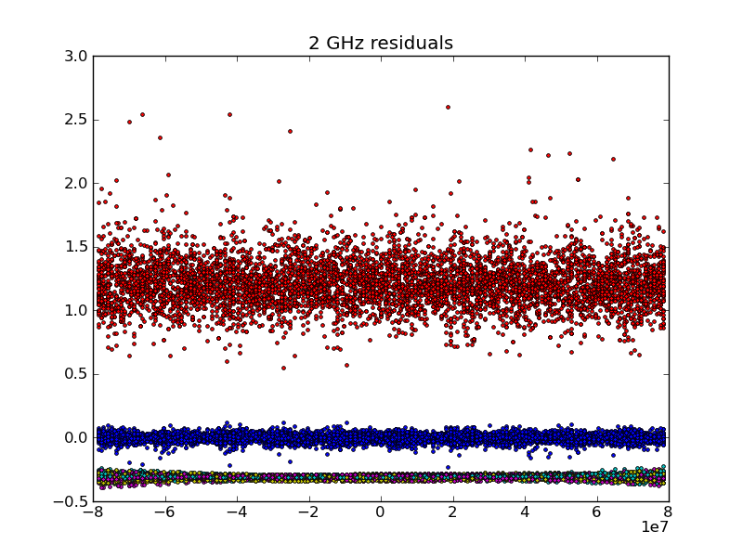
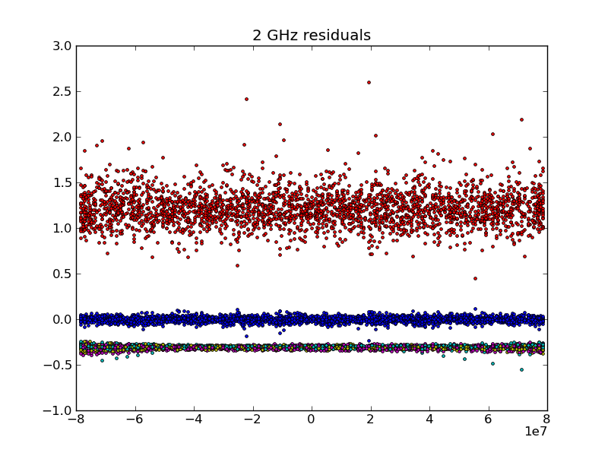
Residuals after DM term removed: 2GHz

Slide 8
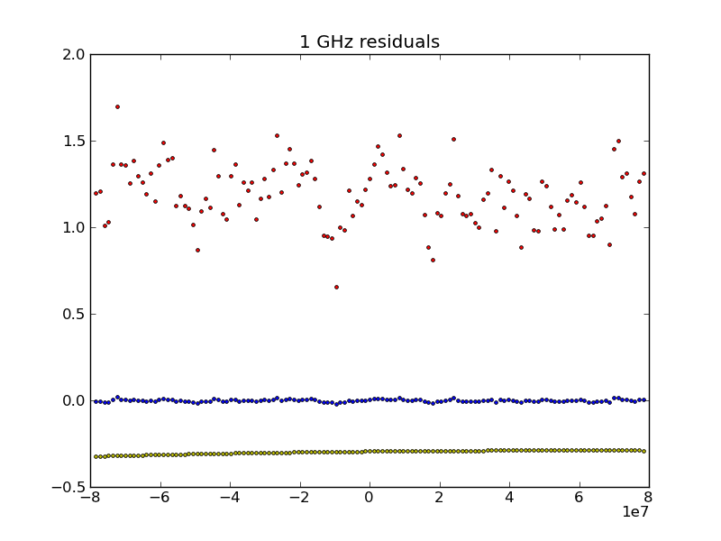
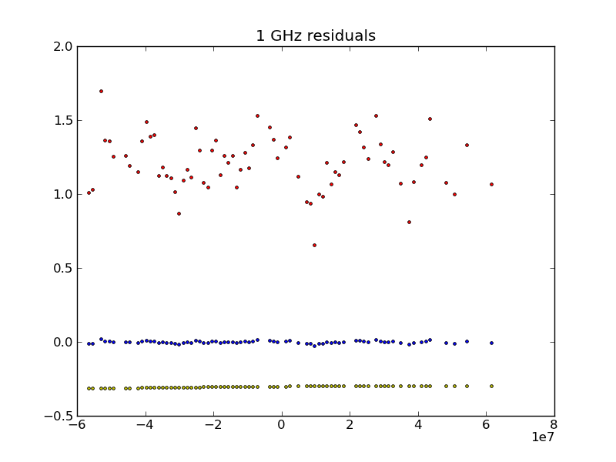
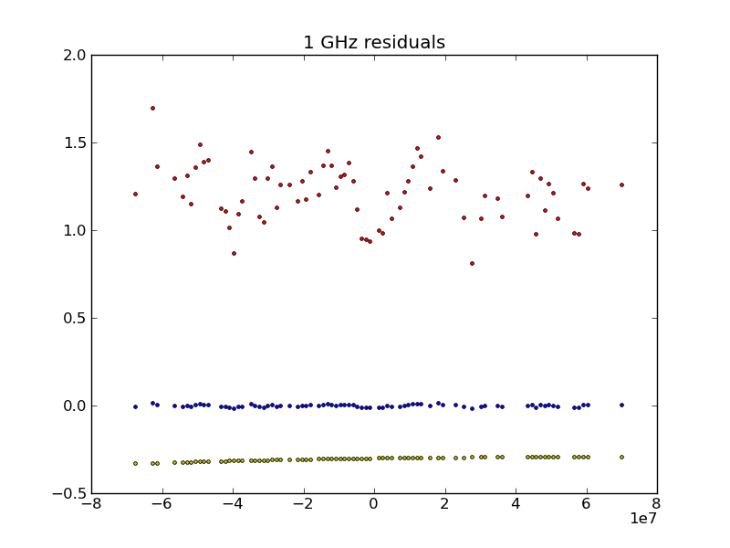
Single iteration residuals after DM term removed: 1 GHz

Slide 9
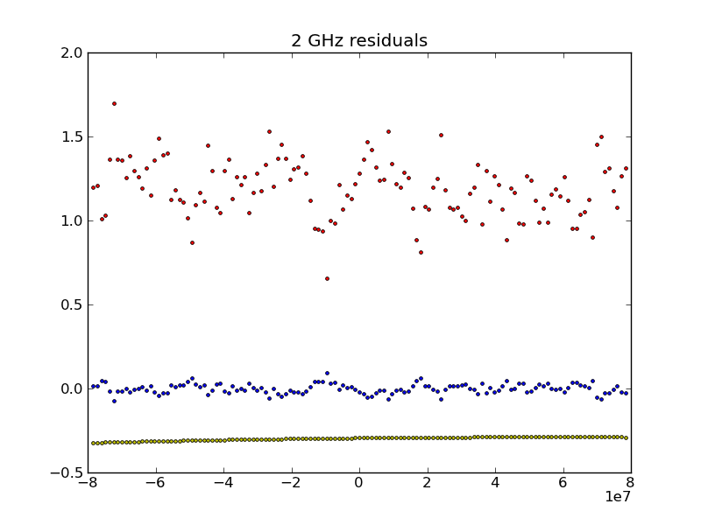


Single iteration residuals after DM term removed: 2 GHz

Slide 10
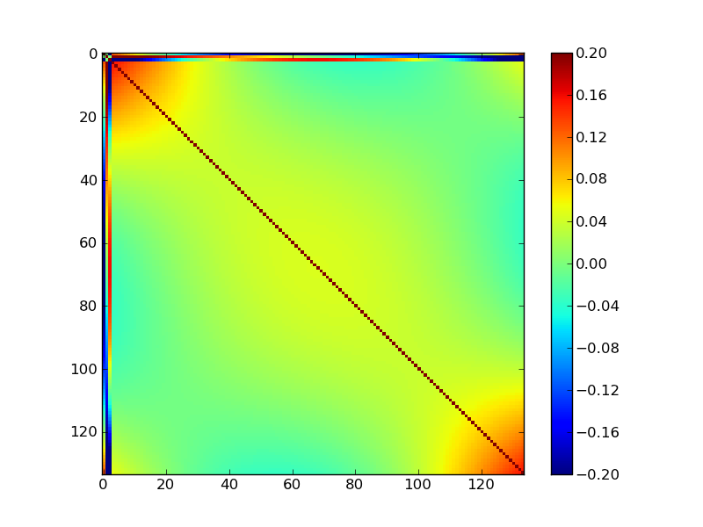
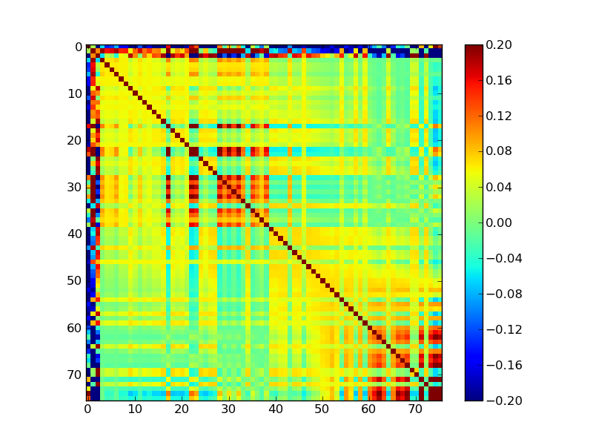
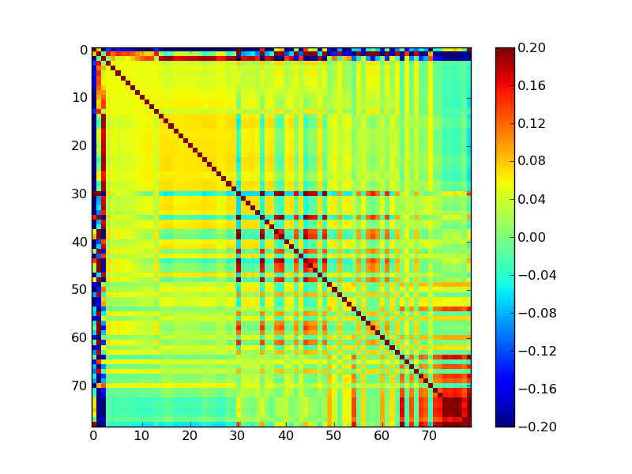
Covariance Matrix of Model Parameters

Slide 11
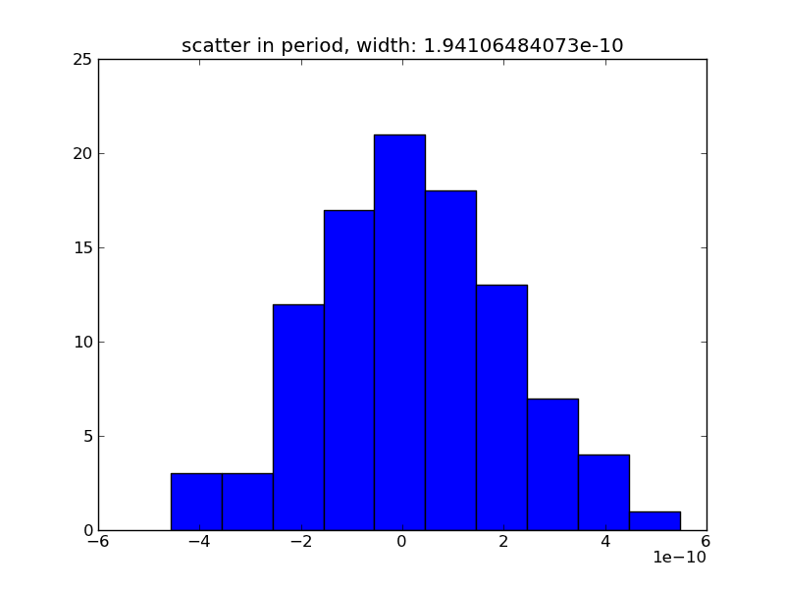
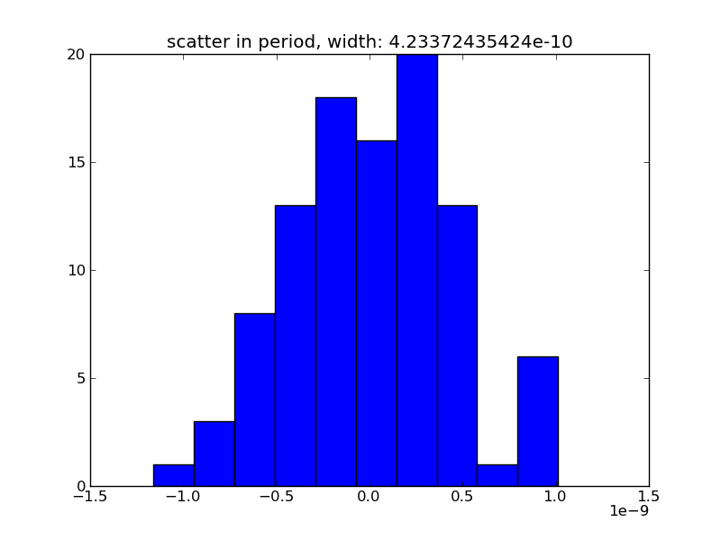
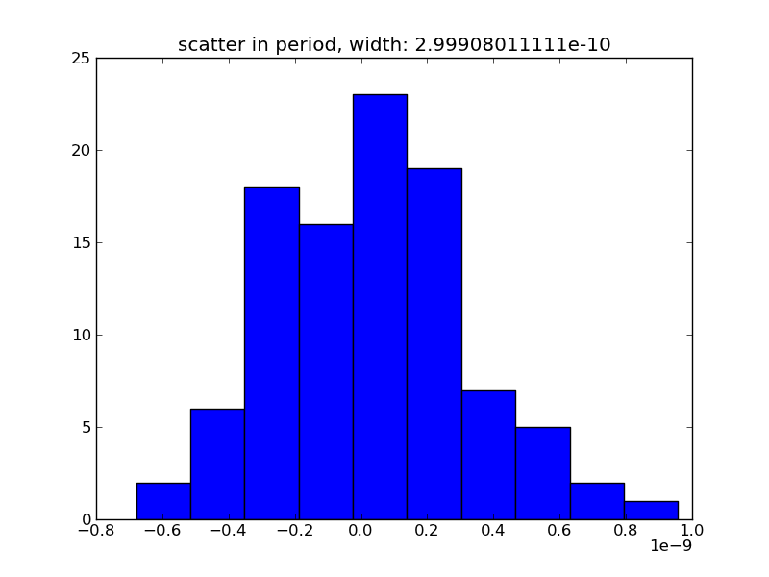
Scatter in B Parameter

Slide 12
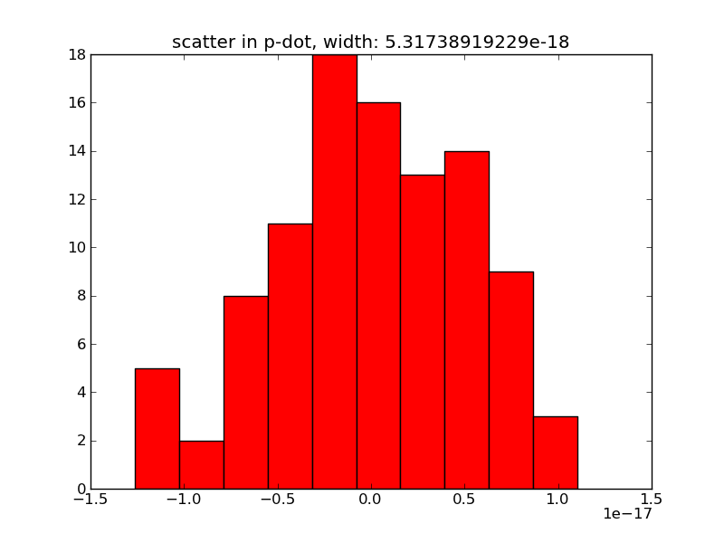
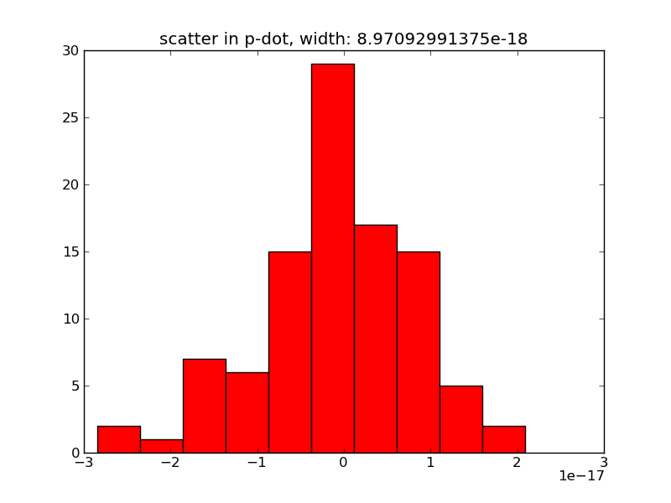
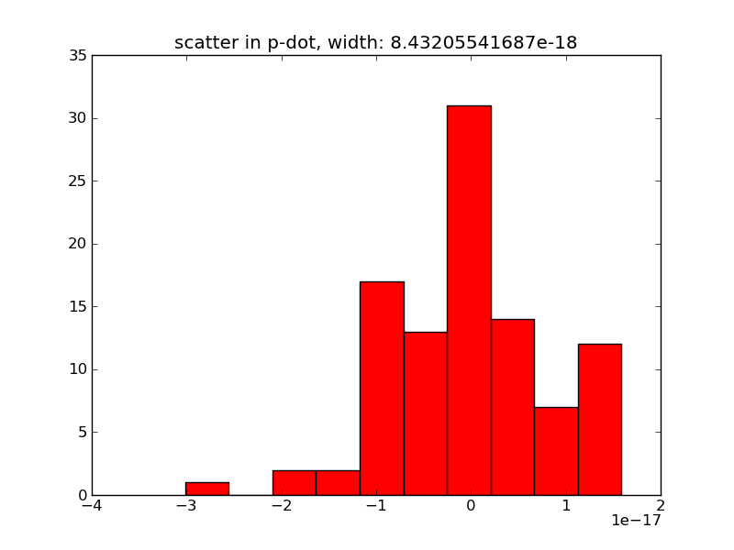
Scatter in C Parameter

Slide 13
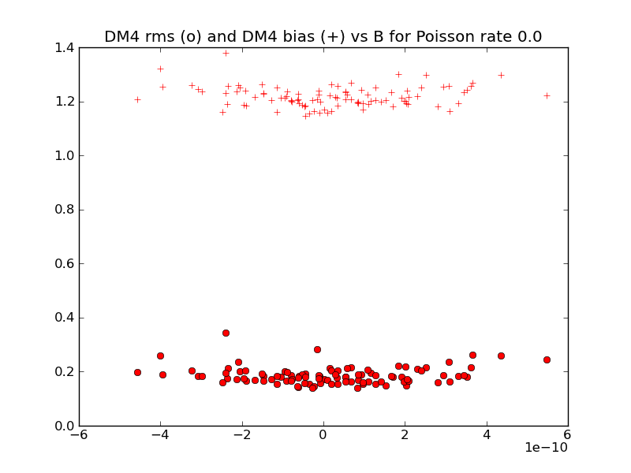
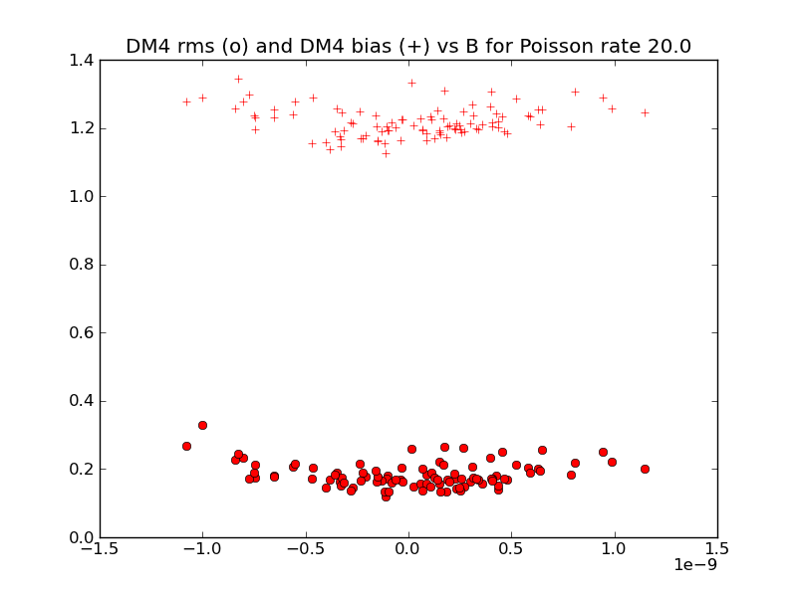
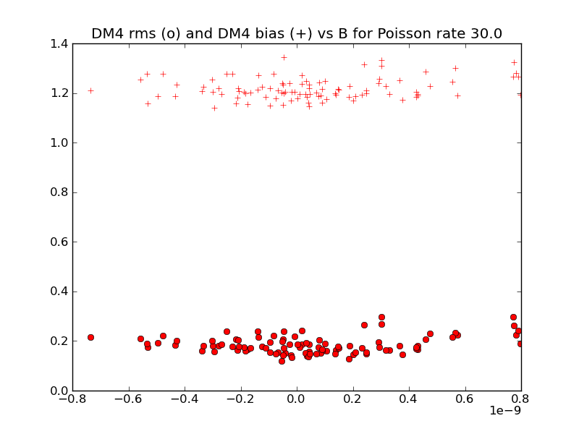
Scatter in Refractive Time Delay

Slide 14
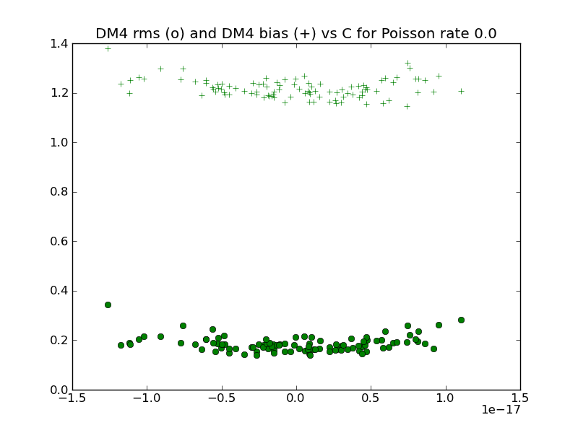
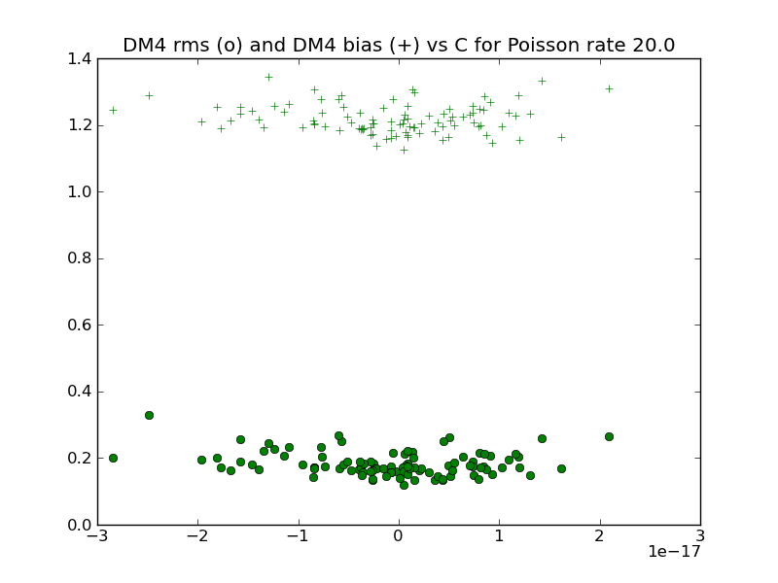
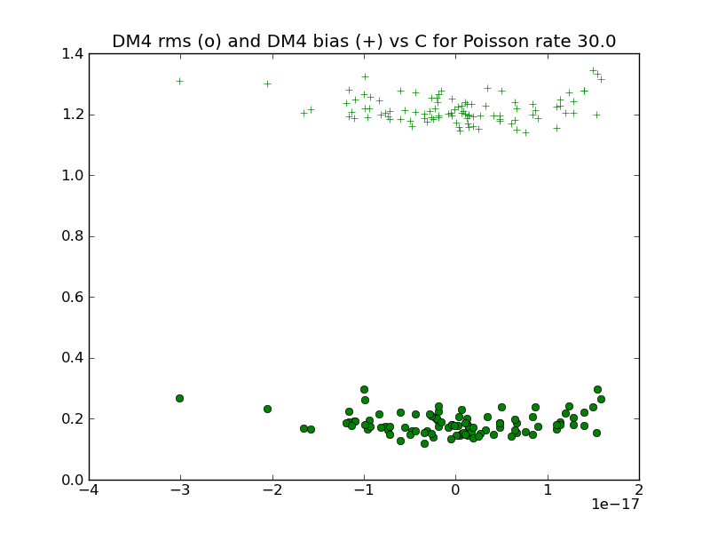
Scatter in Refractive Time Delay

Slide 15
Towards modeling the ISM beyond DM
Beyond Kolmogorov fluctuation spectrum
Introduction of anisotropies
as timing residuals approach 10ns, explicit modeling of refractive and diffractive effects should be employed in addition to DM variations

Slide 16
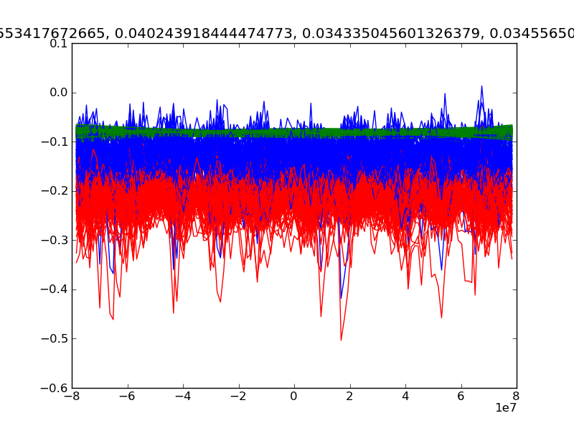
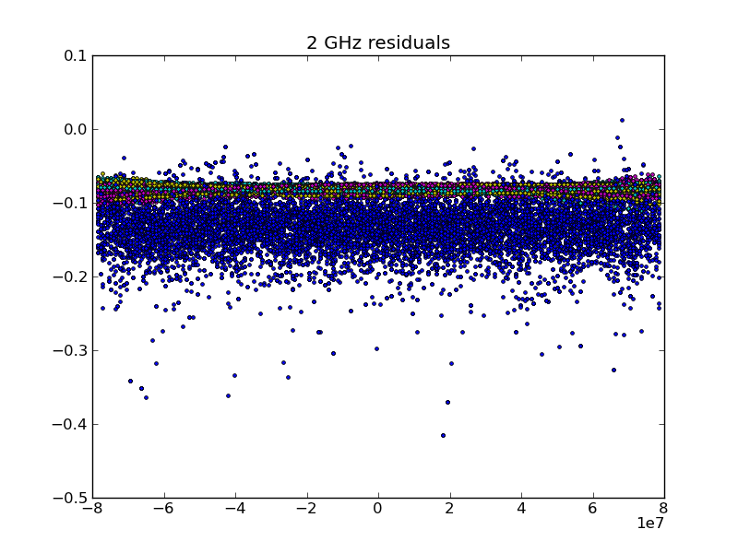
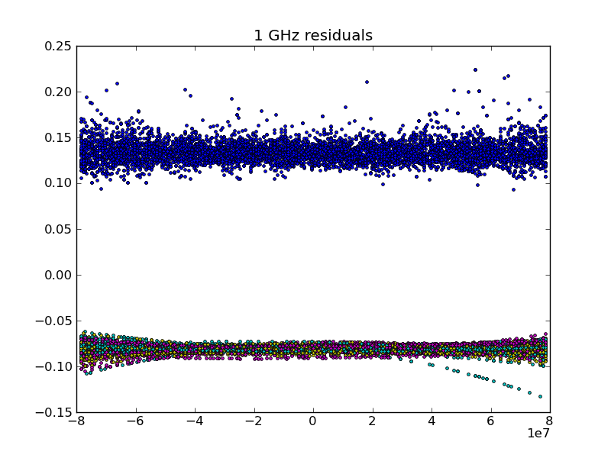
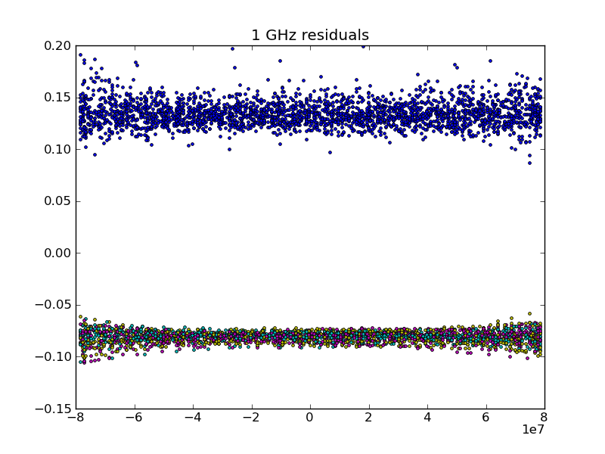

Slide 18
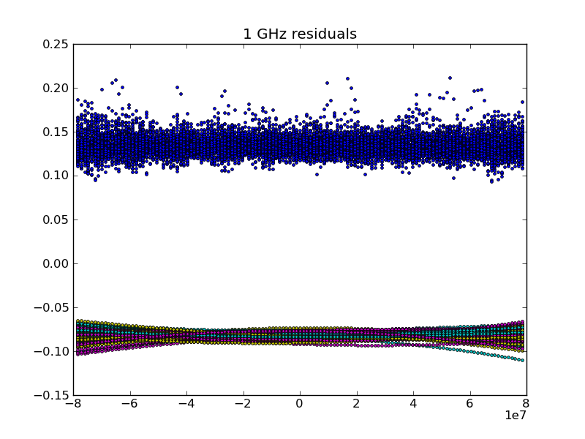
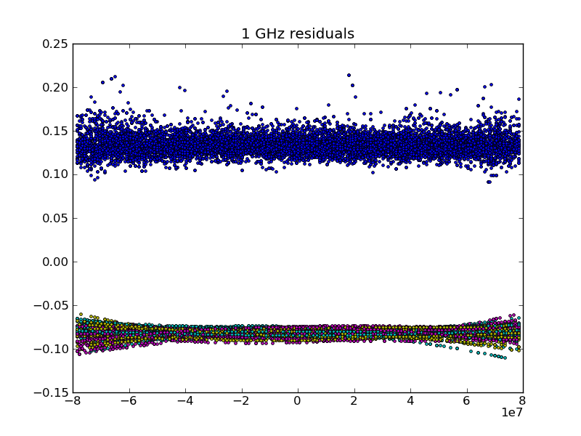

Slide 19
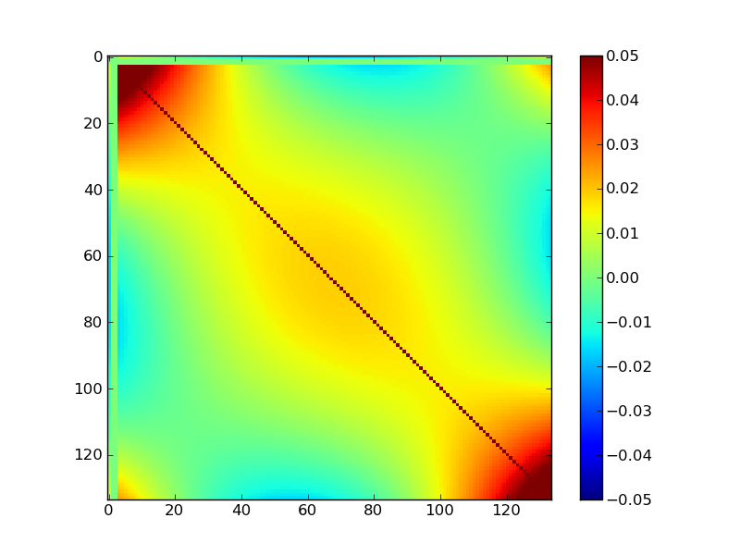
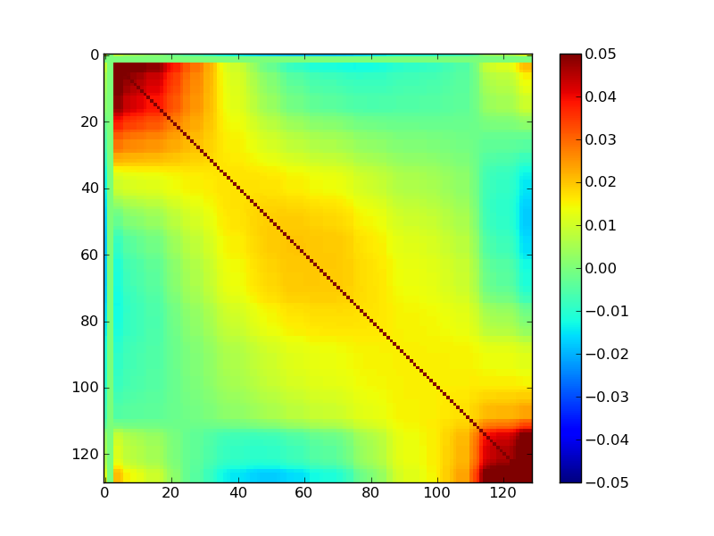
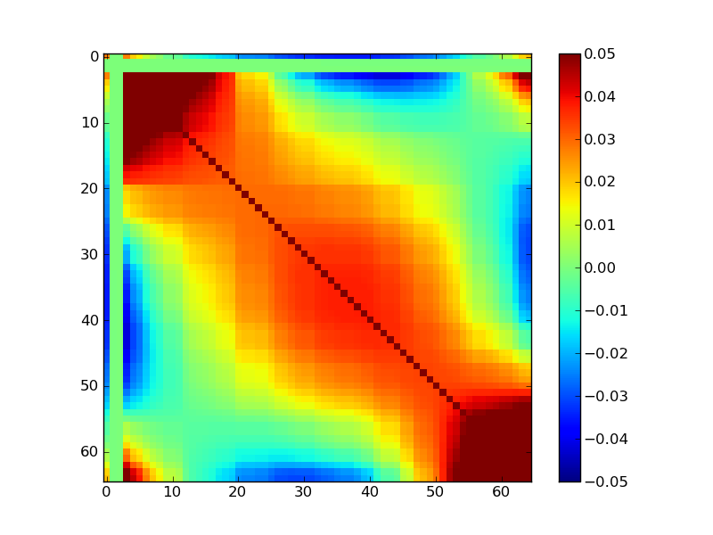
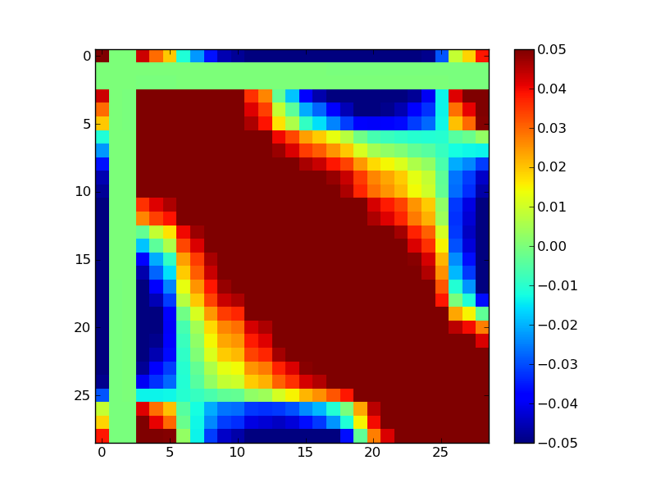

Slide 20
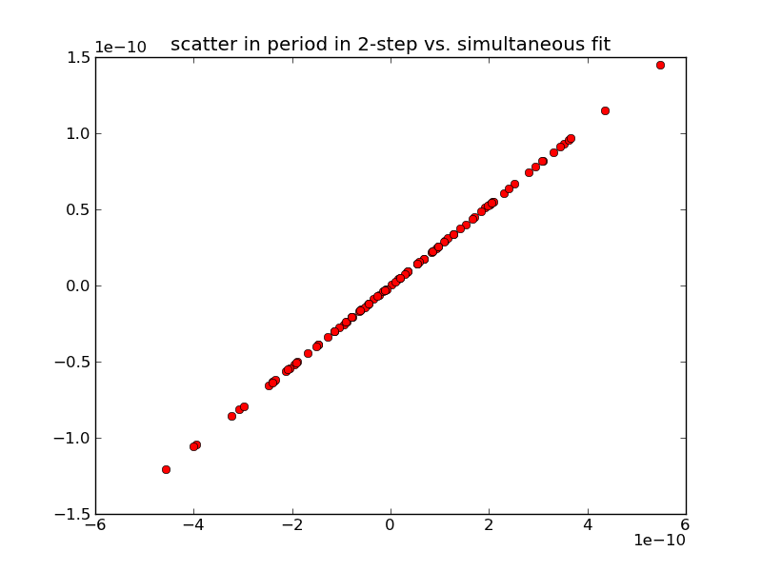
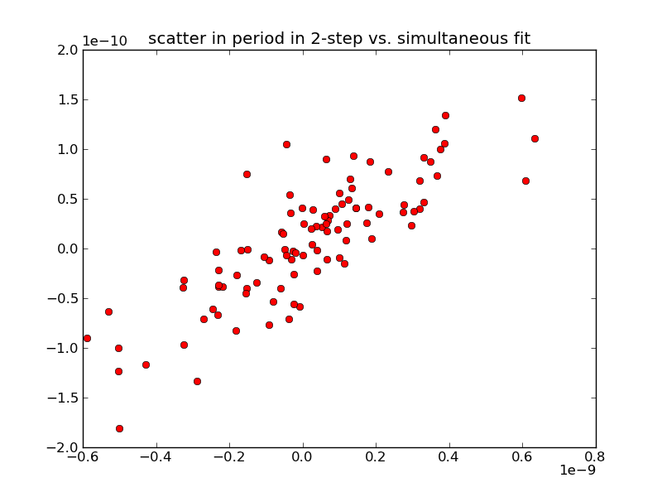
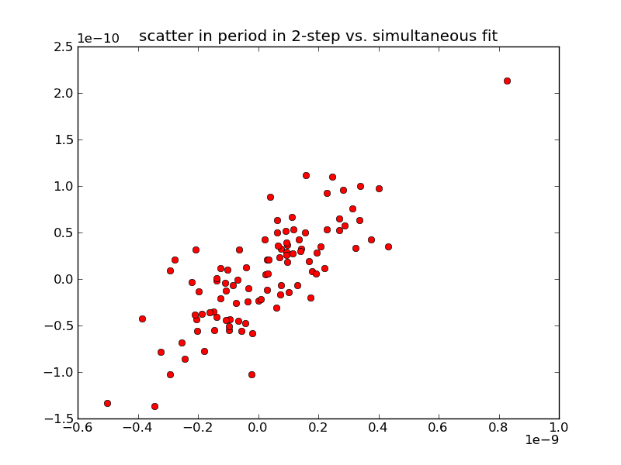
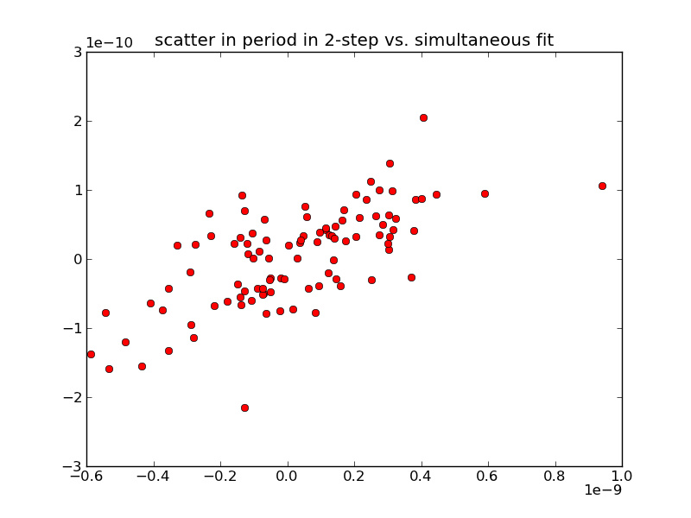

Slide 21
