Slide 1




Updates on Bayesian PTA analysis
& the EPTA data analysis pipeline
Rutger van Haasteren
AEI Hannover
June 26th 2012

Slide 2
Outline
General comments on analyses
  Detection & ROC curves
  Parameter estimation & method tests
EPTA data analysis pipeline
Results mock data challenge
Notes:
The web site of the ipta data challenge is at ipta website. You can accesse the page via the link there. We have release the data to ipta related group 16th Jan 2012 to gather initial feed back from various of groups to avoid apparent mistakes. After collect feedback from R, M, X, we release the final data. In this way, the final release and the initial internal release have different data! If you are doing data analysis, you should use the public data now.

Slide 3
Detection and limiting
Detection: decision rule + diagnostics
  Decision rule: yes / no there was a gravitational wave signal
  Diagnostics: produce Hellings & Downs curve etc.
Parameter estimation: what are the signal parameters?
  Produce estimators or posteriors
Limiting = parameter estimation: assuming there is a GW signal in the data, what is the maximum amplitude consistent with the data?
Bayesian, frequentist, ad-hoc
False alarm, detection probability...
Notes:
The web site of the ipta data challenge is at ipta website. You can accesse the page via the link there. We have release the data to ipta related group 16th Jan 2012 to gather initial feed back from various of groups to avoid apparent mistakes. After collect feedback from R, M, X, we release the final data. In this way, the final release and the initial internal release have different data! If you are doing data analysis, you should use the public data now.

Slide 4
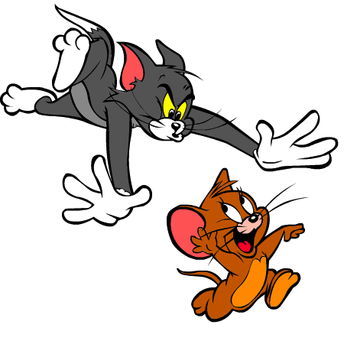
Unresolvable differences?

Slide 5
Uniform most powerful test (UMP)
Detection methods: answer the question “was there a signal yes/no”
Make an Receiver Operating Characteristic (ROC) curve: false positive vs detection probability
On an ensemble of mock data, with and without a signal, run the detection statistic and calculate the detection probability & false alarm rate.
Uniform most powerful test (UMP) is the test that has the highest detection probability for all false alarm rates.
The UMP depends on the mock data: if other noise characteristics are used the UMP will have a different form.
For simple parametrised point hypotheses, the Neyman-Pearson lemma states that the likelihood ratio is the UMP. But is it possible to derive the UMP in general??
Notes:
The web site of the ipta data challenge is at ipta website. You can accesse the page via the link there. We have release the data to ipta related group 16th Jan 2012 to gather initial feed back from various of groups to avoid apparent mistakes. After collect feedback from R, M, X, we release the final data. In this way, the final release and the initial internal release have different data! If you are doing data analysis, you should use the public data now.

Slide 6
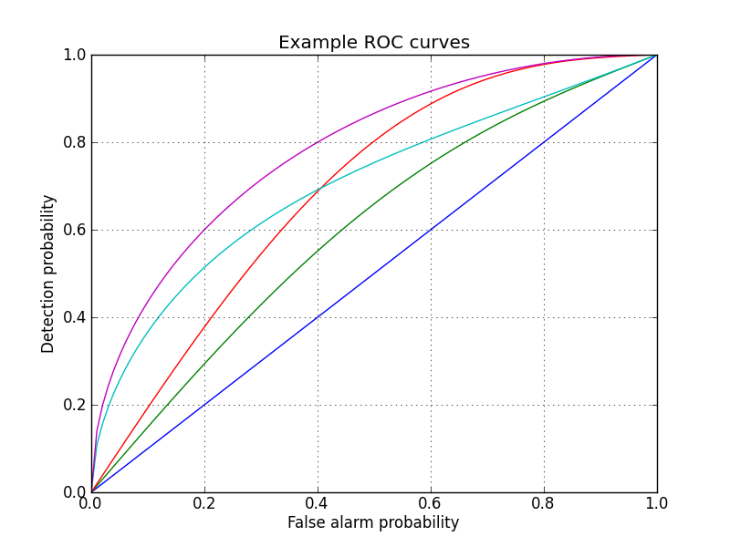
ROC Curve
UMP

Slide 7
Uniform most powerful test (UMP)
But is it possible to derive the UMP in general??
Yes!!! That quantity is called the 'Bayes factor'.
The priors used in calculating the Bayes factor are the distributions used in realising the ensemble of mock datasets.
Different priors lead to:
  A different Bayes factor for Bayesians
  Different mock datasets and therefore a different UMP for Frequentists.
Notes:
The web site of the ipta data challenge is at ipta website. You can accesse the page via the link there. We have release the data to ipta related group 16th Jan 2012 to gather initial feed back from various of groups to avoid apparent mistakes. After collect feedback from R, M, X, we release the final data. In this way, the final release and the initial internal release have different data! If you are doing data analysis, you should use the public data now.

Slide 8

Unresolvable differences?
Bayes factor is the UMP statistic if the same priors are used for frequentist and Bayesian methods

Slide 9
The big question of detection
What simulations do we use to generate our ROC curves?
Should include all effects that could possibly mimick a GW(B) that we want to be insensitive to (e.g. Clock errors).
Our models are by far not accurate enough to derive a good detection statistic. And even if they were, our current detection statistics are either suboptimal, or too computationally expensive to calculate.

Slide 10
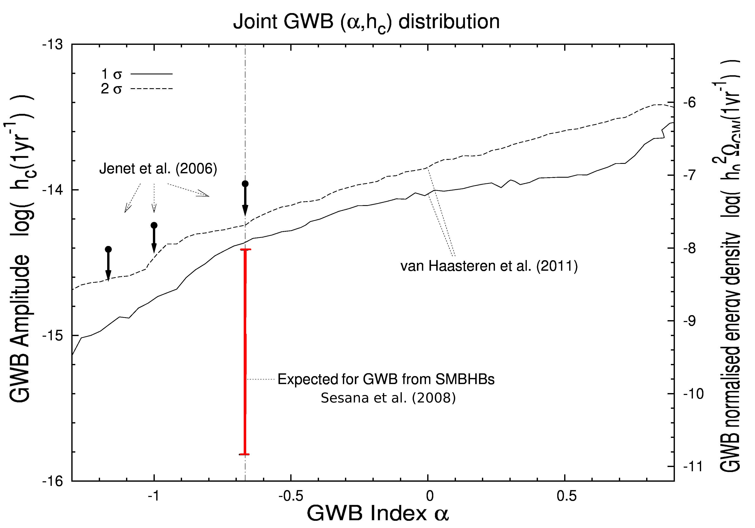
Parameter estimation
Notes:
The web site of the ipta data challenge is at ipta website. You can accesse the page via the link there. We have release the data to ipta related group 16th Jan 2012 to gather initial feed back from various of groups to avoid apparent mistakes. After collect feedback from R, M, X, we release the final data. In this way, the final release and the initial internal release have different data! If you are doing data analysis, you should use the public data now.

Slide 11
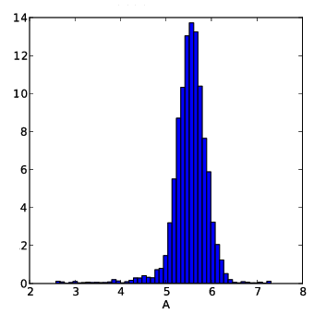
Parameter estimation
How well can we estimate the value of a parameter, and can we trust the uncertainties? Simulations!
Frequentists look for accurate
estimators: compare estimator
with true value for lots of
simulations
Bayesians look for accurate
posteriors: how do we test
correctly with simulations??
Notes:
The web site of the ipta data challenge is at ipta website. You can accesse the page via the link there. We have release the data to ipta related group 16th Jan 2012 to gather initial feed back from various of groups to avoid apparent mistakes. After collect feedback from R, M, X, we release the final data. In this way, the final release and the initial internal release have different data! If you are doing data analysis, you should use the public data now.

Slide 12
Example: red noise analysis
Method from van Haasteren & Levin, submitted. Similar to Cholesky method: a red noise model used to obtain solution for timing model.
  No computational overhead
  Accurate estimates for both red noise & timing model
  No approximations. Statistically correct if model is correct
Coles et al. (2011) compared their estimates for n=100 realisations of mock data. Rms of estimates was in agreement with true values for all timing model parameters, except for F0 and F1.
Notes:
The web site of the ipta data challenge is at ipta website. You can accesse the page via the link there. We have release the data to ipta related group 16th Jan 2012 to gather initial feed back from various of groups to avoid apparent mistakes. After collect feedback from R, M, X, we release the final data. In this way, the final release and the initial internal release have different data! If you are doing data analysis, you should use the public data now.

Slide 13
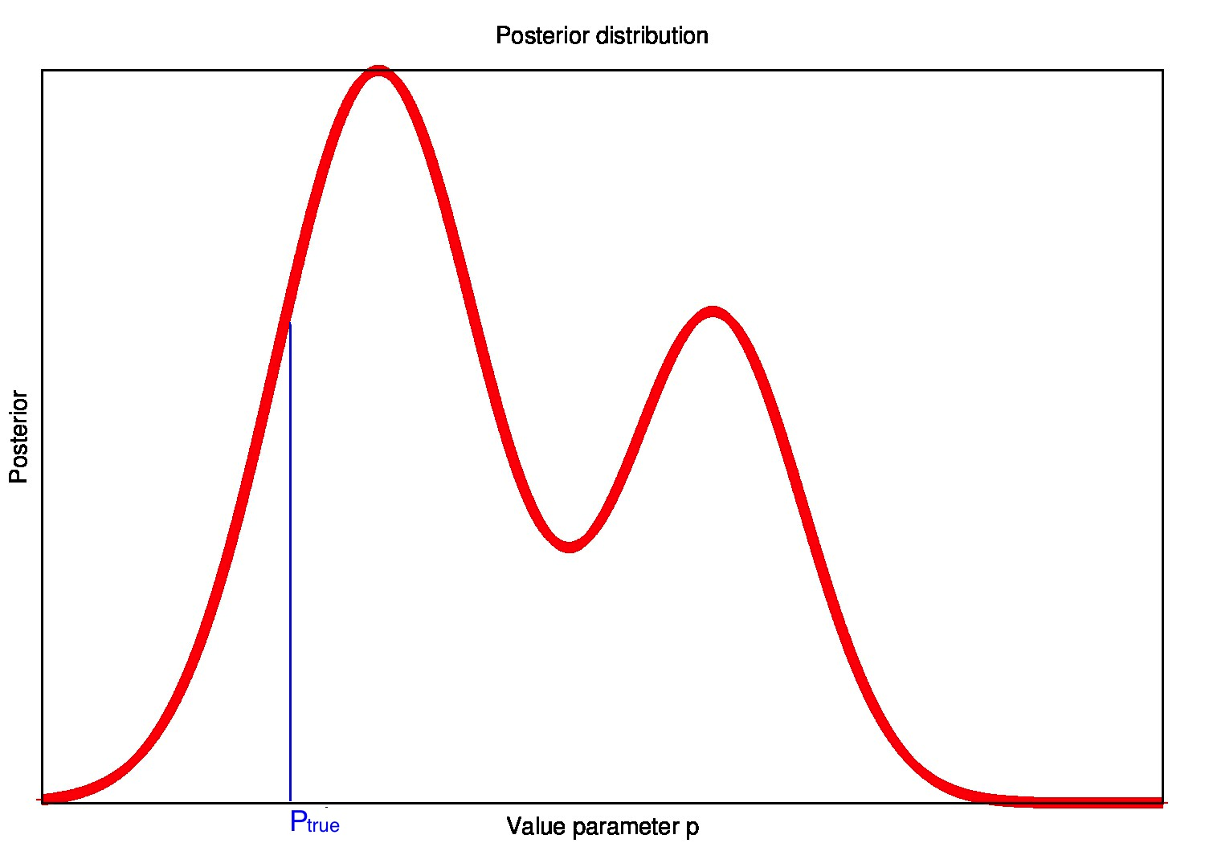
Posterior distribution
1000 realisations of J1713+0747
power-law red noise
radiometer noise + fudge factor
Notes:
The web site of the ipta data challenge is at ipta website. You can accesse the page via the link there. We have release the data to ipta related group 16th Jan 2012 to gather initial feed back from various of groups to avoid apparent mistakes. After collect feedback from R, M, X, we release the final data. In this way, the final release and the initial internal release have different data! If you are doing data analysis, you should use the public data now.

Slide 14
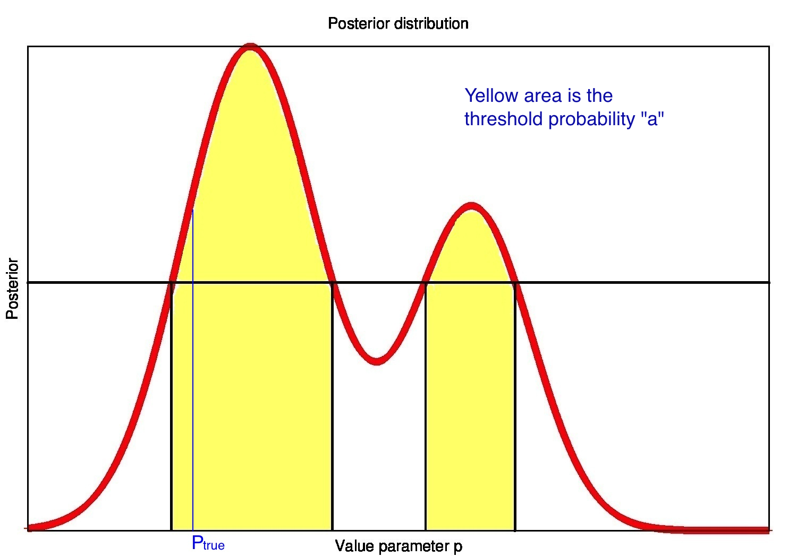
Threshold probability a
Notes:
The web site of the ipta data challenge is at ipta website. You can accesse the page via the link there. We have release the data to ipta related group 16th Jan 2012 to gather initial feed back from various of groups to avoid apparent mistakes. After collect feedback from R, M, X, we release the final data. In this way, the final release and the initial internal release have different data! If you are doing data analysis, you should use the public data now.

Slide 15
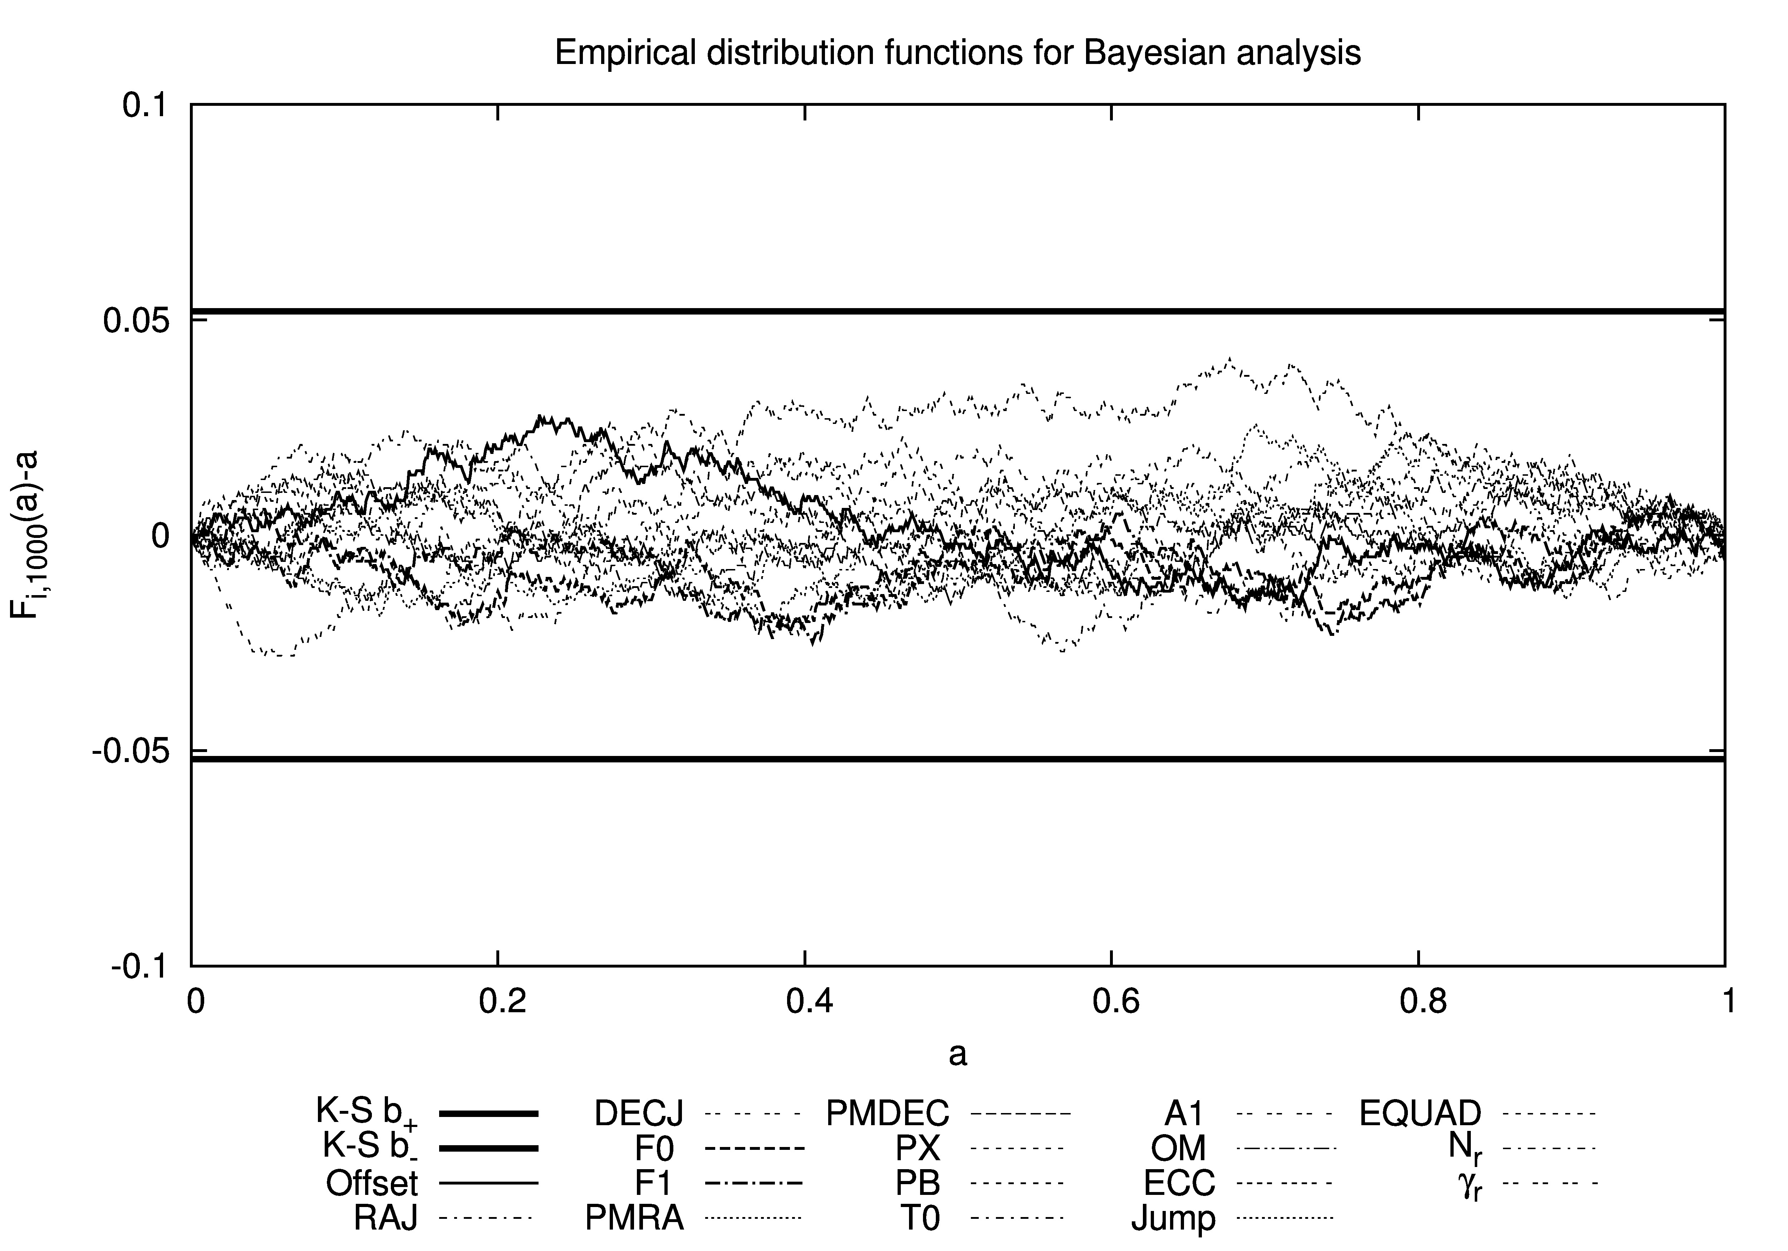
Kolmogorov-Smirnov test
Notes:
The web site of the ipta data challenge is at ipta website. You can accesse the page via the link there. We have release the data to ipta related group 16th Jan 2012 to gather initial feed back from various of groups to avoid apparent mistakes. After collect feedback from R, M, X, we release the final data. In this way, the final release and the initial internal release have different data! If you are doing data analysis, you should use the public data now.

Slide 16
Extra notes
In principle, we knew this would be the answer. There were no approximations! But, good test for implementation
Works for all model parameters
  Binary parameters
  Frequency & frequency derivative
  Red noise parameters
Of course, whether our model is good is another thing
Sensitive test for consistency of analysis method.
Works for frequentist estimators, too! Example...
Notes:
The web site of the ipta data challenge is at ipta website. You can accesse the page via the link there. We have release the data to ipta related group 16th Jan 2012 to gather initial feed back from various of groups to avoid apparent mistakes. After collect feedback from R, M, X, we release the final data. In this way, the final release and the initial internal release have different data! If you are doing data analysis, you should use the public data now.

Slide 17
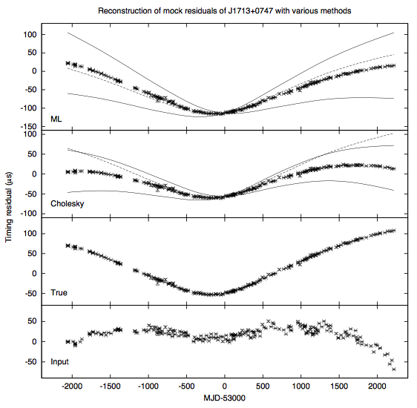
Residuals reconstruction
Notes:
The web site of the ipta data challenge is at ipta website. You can accesse the page via the link there. We have release the data to ipta related group 16th Jan 2012 to gather initial feed back from various of groups to avoid apparent mistakes. After collect feedback from R, M, X, we release the final data. In this way, the final release and the initial internal release have different data! If you are doing data analysis, you should use the public data now.

Slide 18
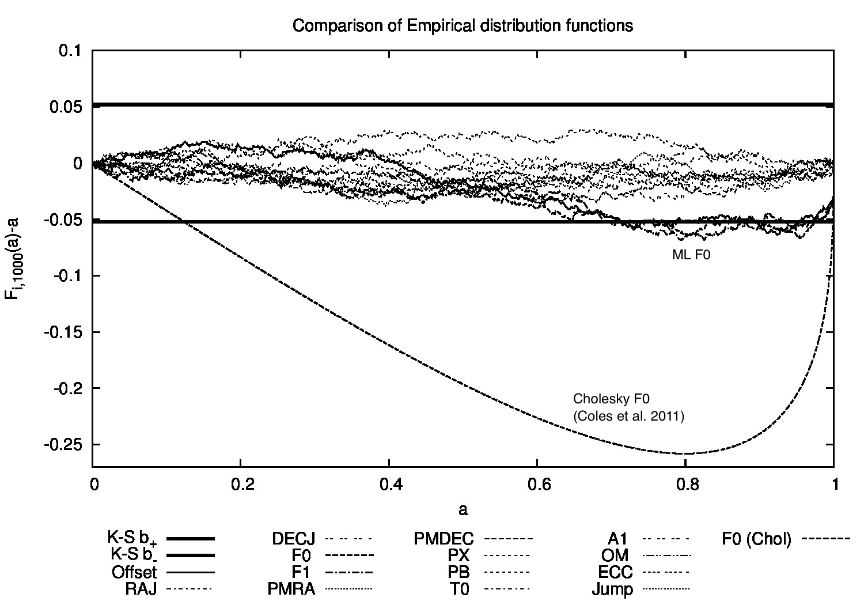
Getting the covariance right
Notes:
The web site of the ipta data challenge is at ipta website. You can accesse the page via the link there. We have release the data to ipta related group 16th Jan 2012 to gather initial feed back from various of groups to avoid apparent mistakes. After collect feedback from R, M, X, we release the final data. In this way, the final release and the initial internal release have different data! If you are doing data analysis, you should use the public data now.

Slide 19
GWB is very low-frequency!
Lowest frequencies are most important for optimal GW(B) detection
Covariance matrix is essential to get right. Also: non-stationary!
Timing noise non-stationary on longer time scales (e.g. DM correction done yes/no)
Clock errors
Notes:
The web site of the ipta data challenge is at ipta website. You can accesse the page via the link there. We have release the data to ipta related group 16th Jan 2012 to gather initial feed back from various of groups to avoid apparent mistakes. After collect feedback from R, M, X, we release the final data. In this way, the final release and the initial internal release have different data! If you are doing data analysis, you should use the public data now.

Slide 20
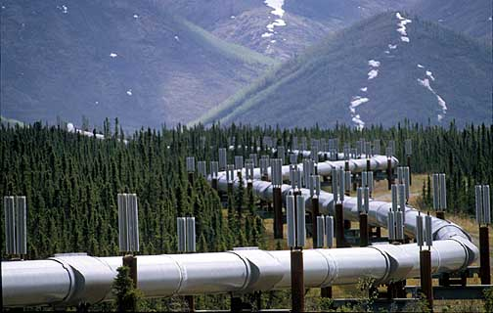
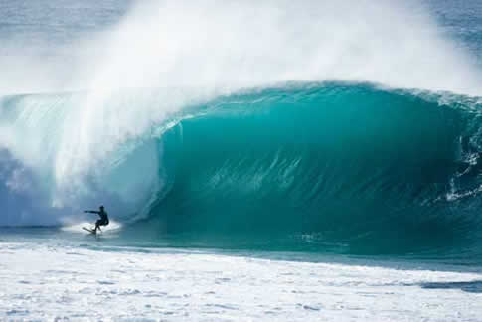
Bayesian/EPTA pipeline
We want to search for different kinds of waves...
Under construction
What do we have?
Notes:
The dead line of the chanllenge is very soon. The results is gathered by a web form following the the link on ipta webpage. Please do have a look at the webpage, if you are taking the data chanllenge, especially it is possible that the web form is too sctrict and you want to send something special to us.
The chanllenge is devided in to two group of data, the open and closed chanllenges. The open one contain the final TOA and also include a description for each individual componnets of singal simulated, i.e. GW singal, red noise and white noise. This can be used as training data sets.

Slide 21
Bayesian/EPTA pipeline
Implemented/tested in some form:
  Random Gaussian process
  Noise: white (radiometer, jitter, …) red noise, clock errors
  Linearised timing moded (from Tempo2)
  Isotropic GW background
  GW memory
  Non-evolving BH binaries
  Optimal DM correction (see poster K.J.)
  ...
Not all part of same pipeline yet
  Include other work (Babak, Sesana, Mingarelli, Vecchio, Lassus, ...)
  Non-Gaussian noise
  ...
We need one environment to do timing data analysis without having to re-do work all the time! EPTA data analysis project: see poster by Antoine
Notes:
The web site of the ipta data challenge is at ipta website. You can accesse the page via the link there. We have release the data to ipta related group 16th Jan 2012 to gather initial feed back from various of groups to avoid apparent mistakes. After collect feedback from R, M, X, we release the final data. In this way, the final release and the initial internal release have different data! If you are doing data analysis, you should use the public data now.

Slide 22
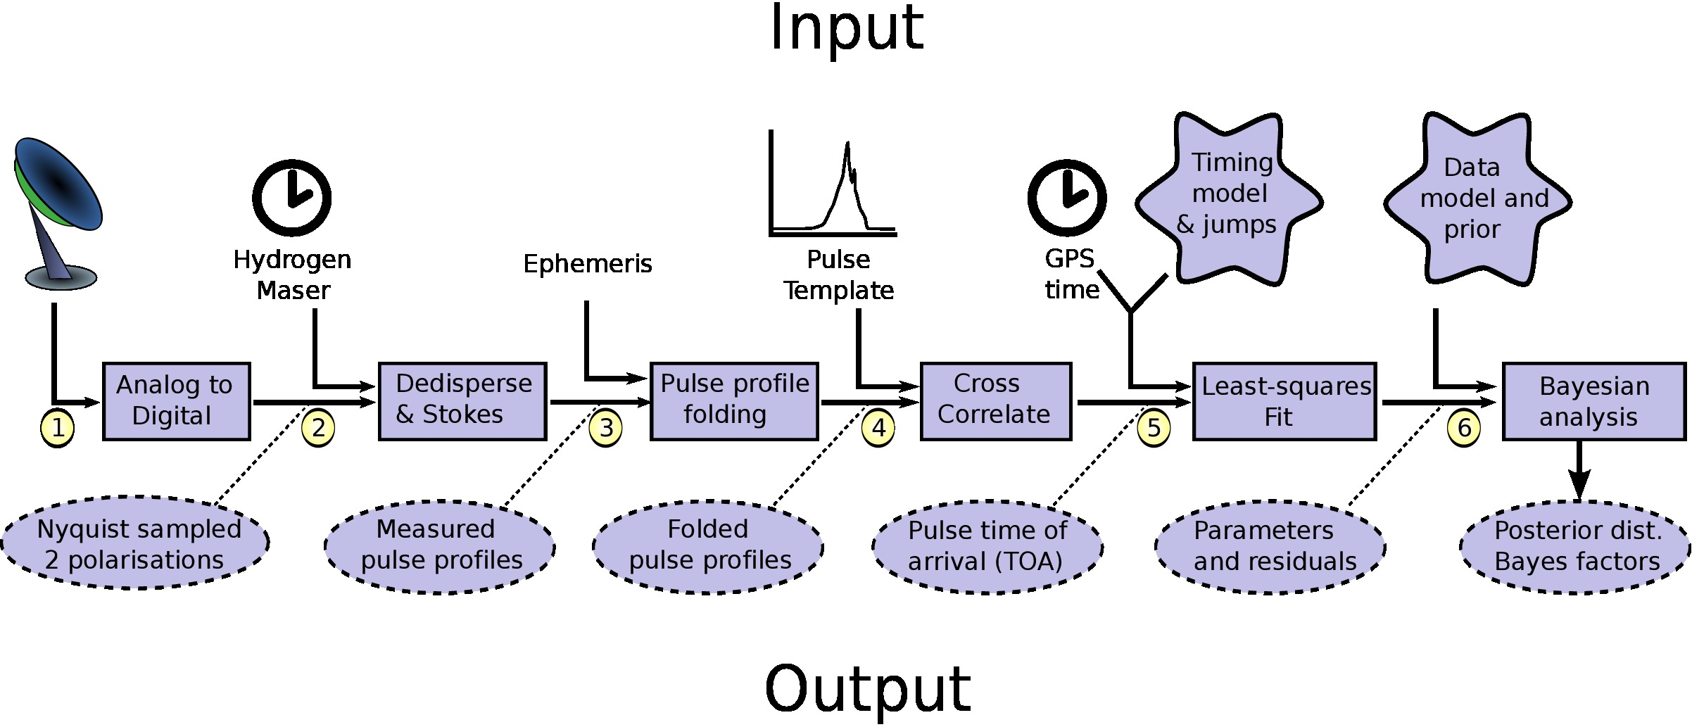
EPTA data analysis library: 5&6
Notes:
The dead line of the chanllenge is very soon. The results is gathered by a web form following the the link on ipta webpage. Please do have a look at the webpage, if you are taking the data chanllenge, especially it is possible that the web form is too sctrict and you want to send something special to us.
The chanllenge is devided in to two group of data, the open and closed chanllenges. The open one contain the final TOA and also include a description for each individual componnets of singal simulated, i.e. GW singal, red noise and white noise. This can be used as training data sets.

Slide 23
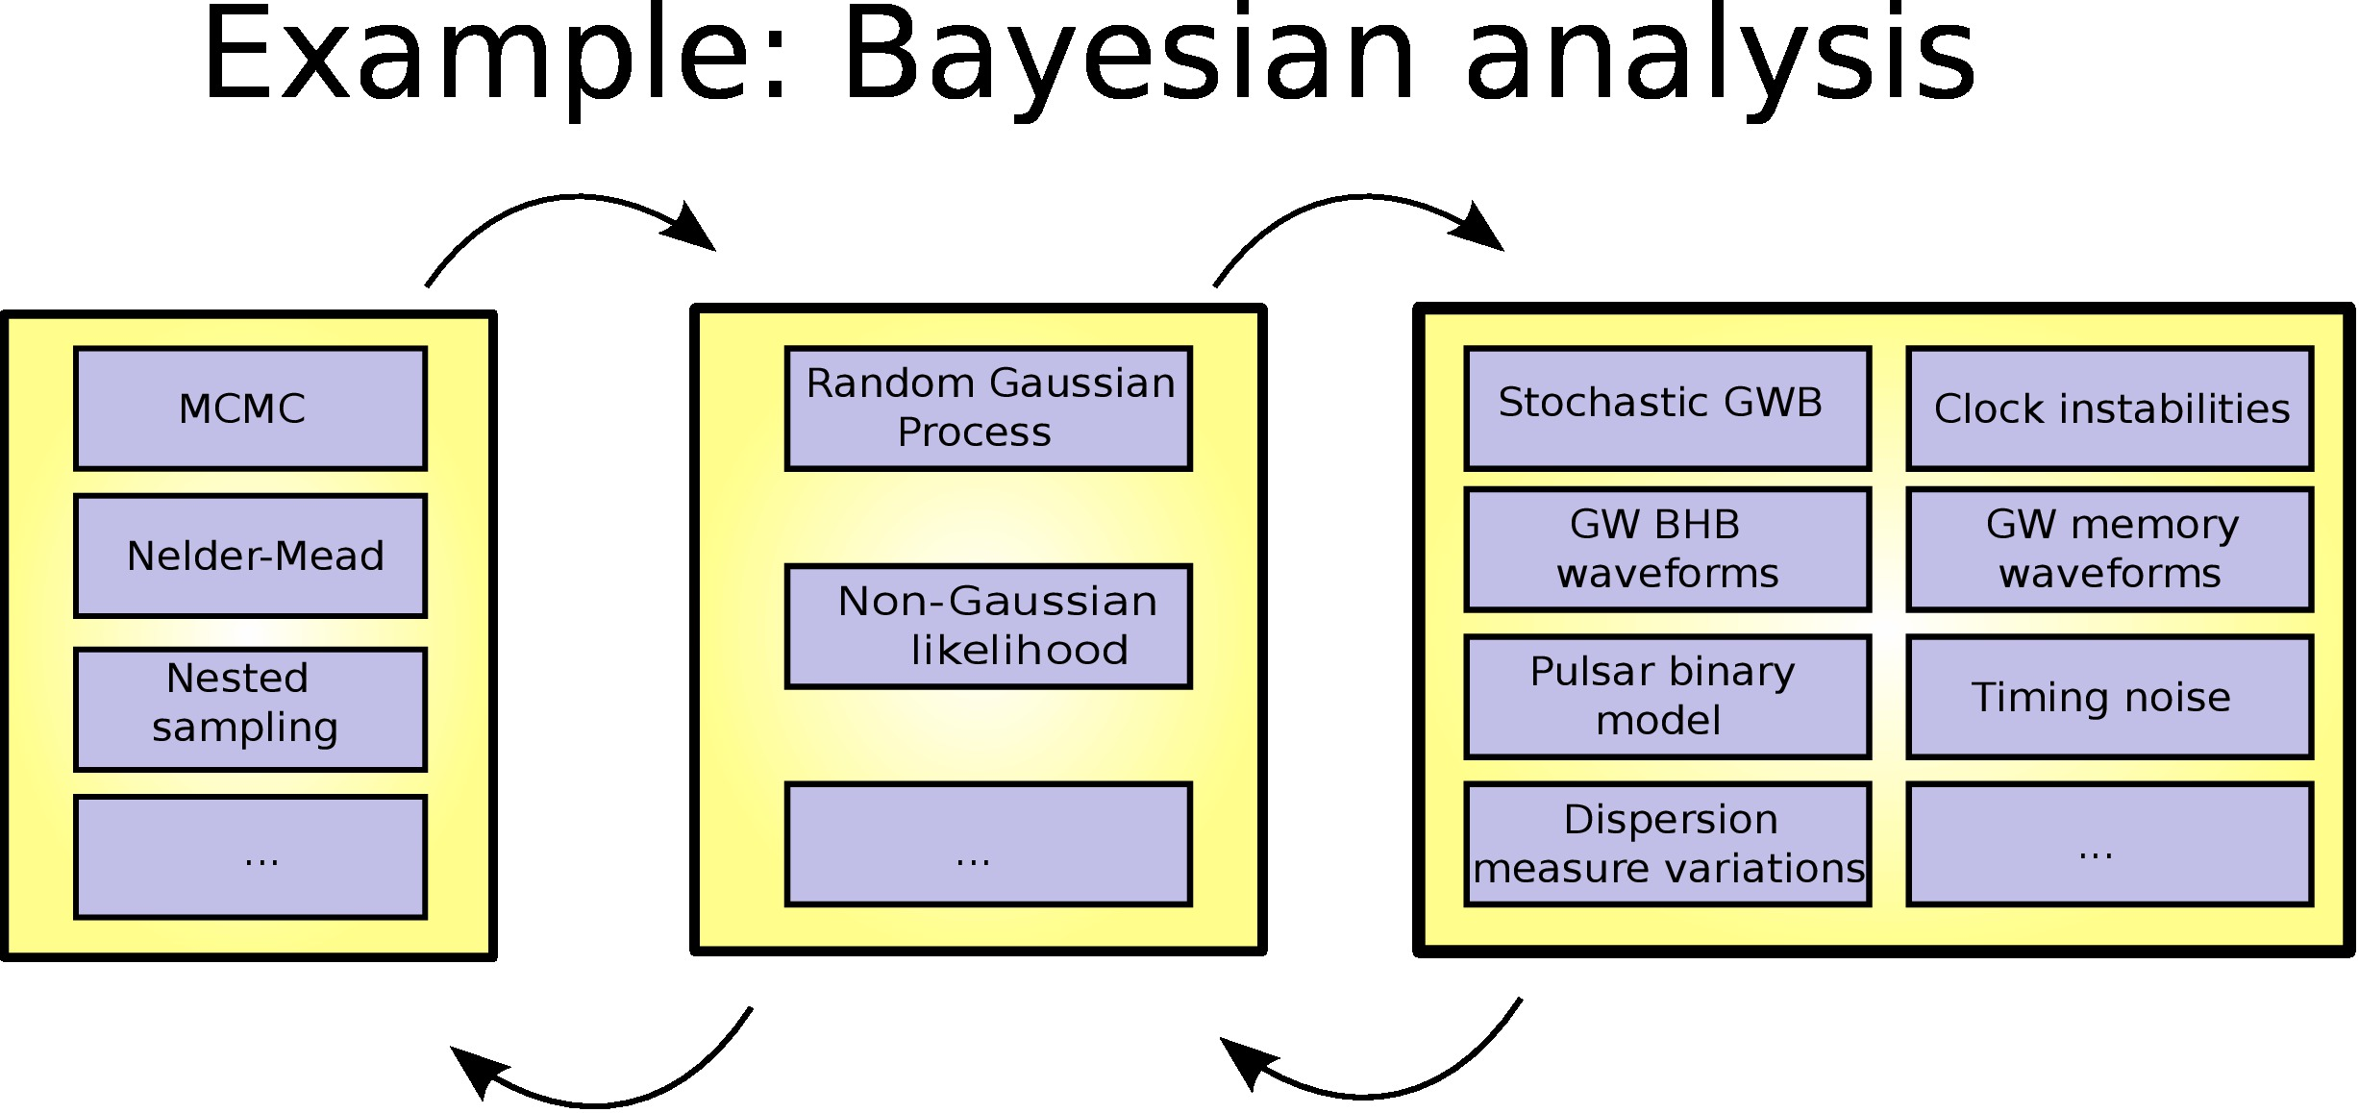
EPTA data analysis library
Notes:
The dead line of the chanllenge is very soon. The results is gathered by a web form following the the link on ipta webpage. Please do have a look at the webpage, if you are taking the data chanllenge, especially it is possible that the web form is too sctrict and you want to send something special to us.
The chanllenge is devided in to two group of data, the open and closed chanllenges. The open one contain the final TOA and also include a description for each individual componnets of singal simulated, i.e. GW singal, red noise and white noise. This can be used as training data sets.

Slide 24
EPTA data analysis project
Antoine Lassus, K.J. Lee, Chiara Mingarelli, Alberto Vecchio, Rutger van Haasteren
Open source as soon as possible
Written in Python/C
Should become a library for all kinds of timing data analysis, aimed both at rapid implementation of new methods, and routine work
Notes:
The web site of the ipta data challenge is at ipta website. You can accesse the page via the link there. We have release the data to ipta related group 16th Jan 2012 to gather initial feed back from various of groups to avoid apparent mistakes. After collect feedback from R, M, X, we release the final data. In this way, the final release and the initial internal release have different data! If you are doing data analysis, you should use the public data now.

Slide 25
Mock data challenge
One telescope: virtual axis telescope
36 pulsars, overlapping dataset, no gaps
Timing noise simple: power-law + radiometer (error bars)
No jumps: only one receiver used
Isotropic GWB with spectral index -2/3
Notes:
The web site of the ipta data challenge is at ipta website. You can accesse the page via the link there. We have release the data to ipta related group 16th Jan 2012 to gather initial feed back from various of groups to avoid apparent mistakes. After collect feedback from R, M, X, we release the final data. In this way, the final release and the initial internal release have different data! If you are doing data analysis, you should use the public data now.

Slide 26
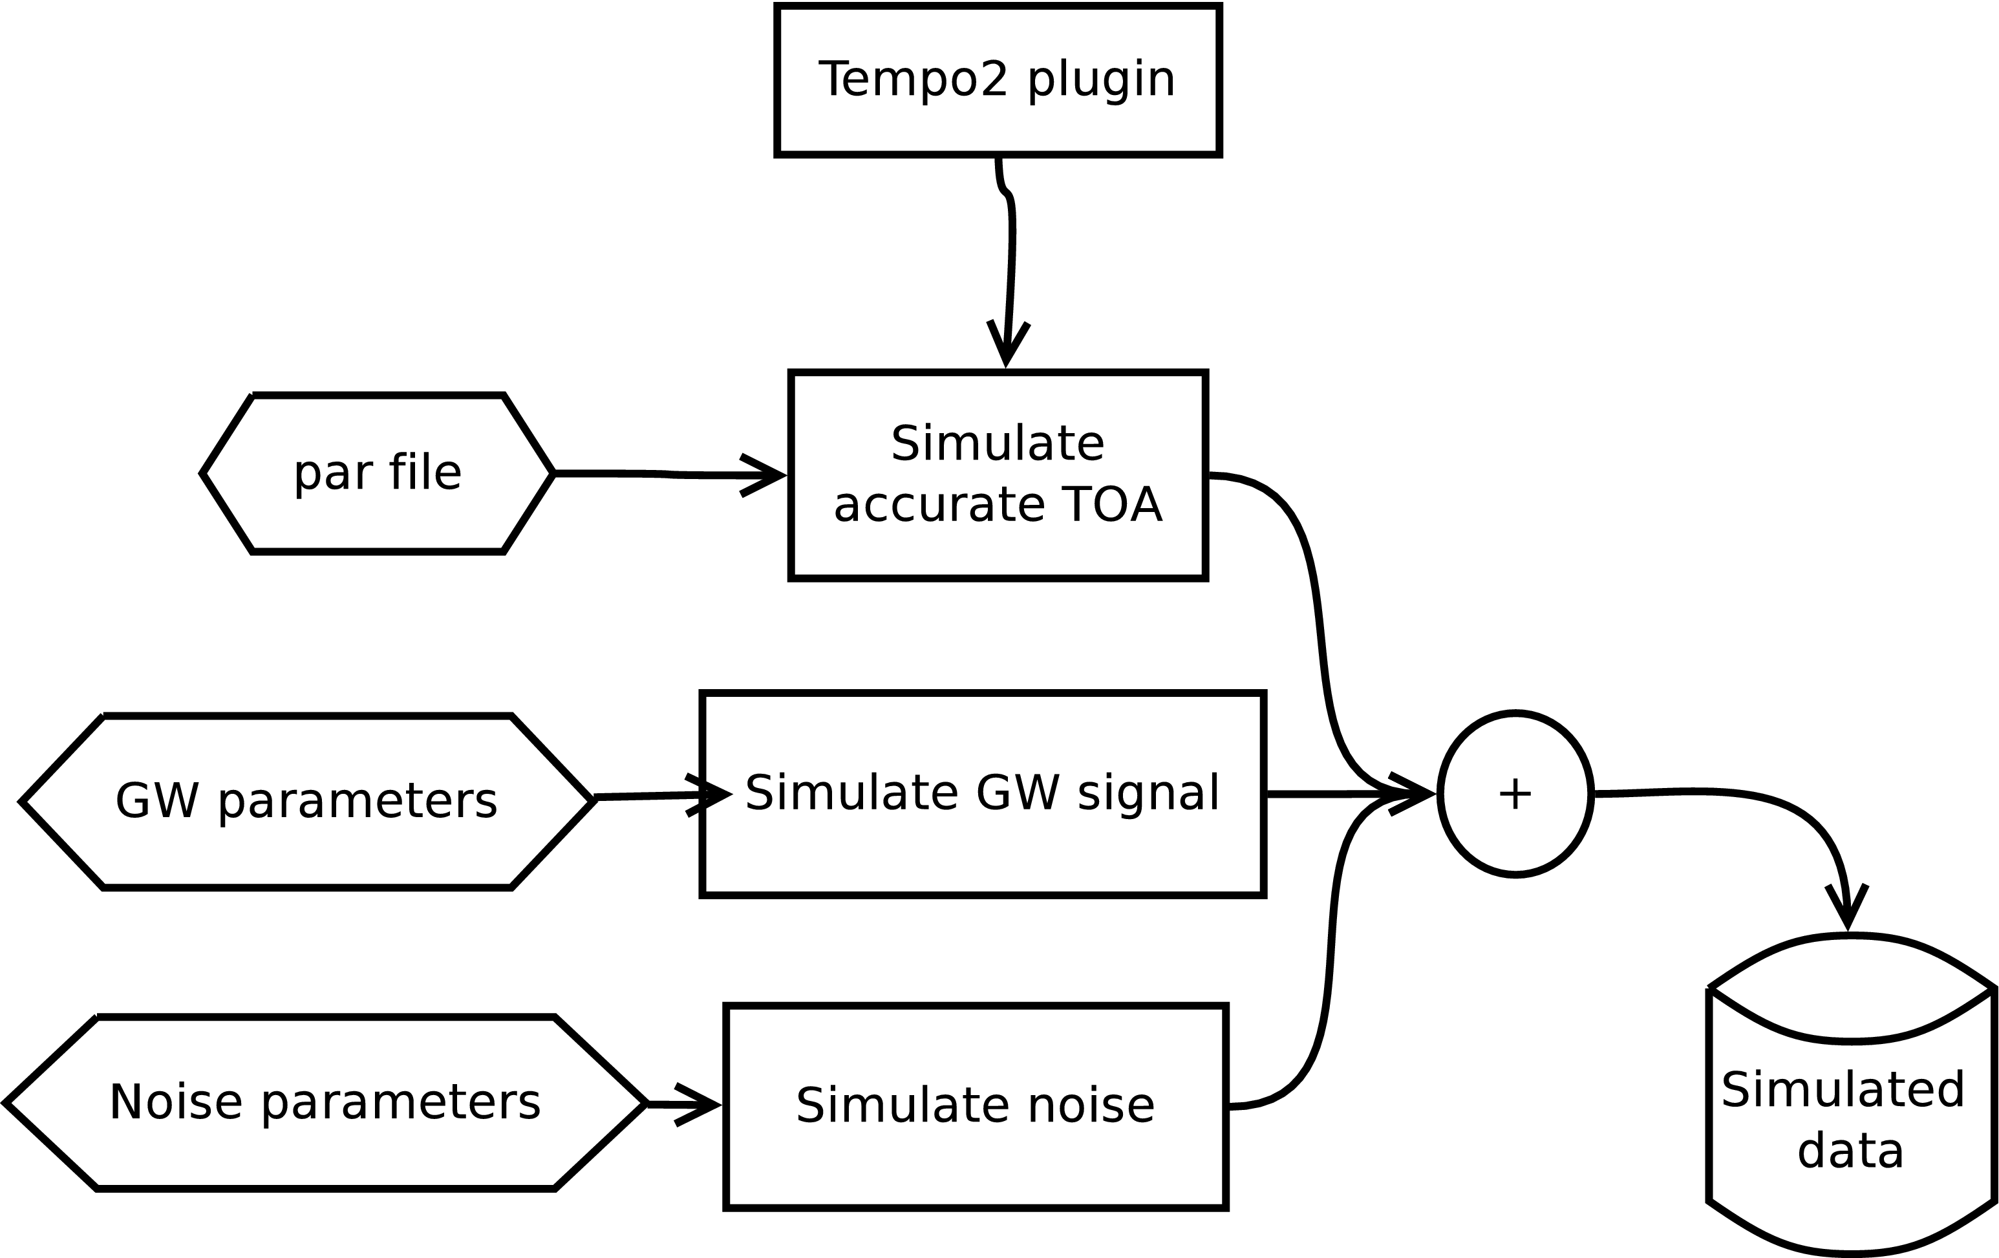


Conversions, code implementation and algorithm
GW spectrum
Noise spectrum
Notes:
The current implemention of the code is in idl, the code will be published after the chanlenge finishes. The algorithm we simulate the data is given in the figure. Where the red noise, white noise and accurate pulsar TOA are generated separately and the final TOA is a addition of these three singals. The stochastic GW background is generated by generate uncorrelated stochastic signal first and transform them into appropriate correlated signals.

Slide 27
Results
Given the challenge, we will treat it as a parameter estimation problem: either limit or characterise the GWB signal in the data
Model:
  Random Gaussian process
  TOA error bars (no fudge factors)
  Tempo2 timing model
  Power-law red noise
  GWB with H&D correlations and power-law PSD
Notes:
The web site of the ipta data challenge is at ipta website. You can accesse the page via the link there. We have release the data to ipta related group 16th Jan 2012 to gather initial feed back from various of groups to avoid apparent mistakes. After collect feedback from R, M, X, we release the final data. In this way, the final release and the initial internal release have different data! If you are doing data analysis, you should use the public data now.

Slide 28
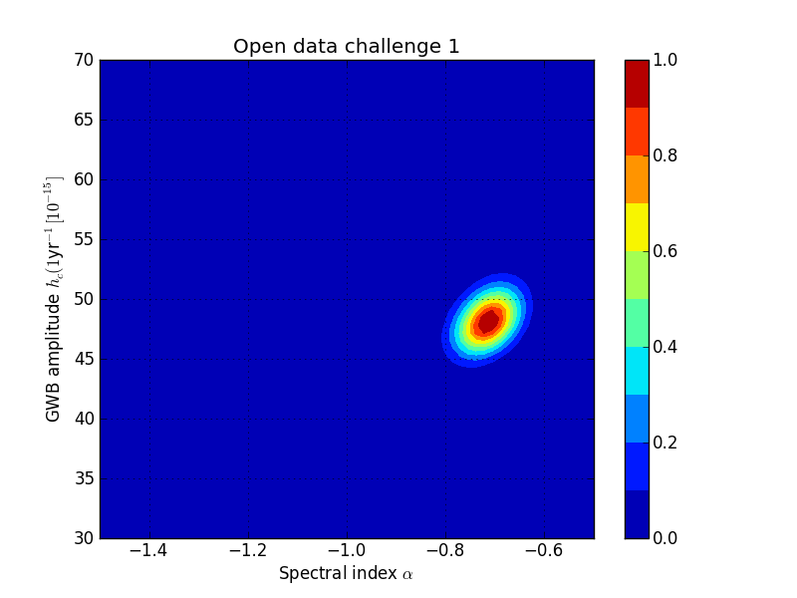
Results open challenge
Notes:
The dead line of the chanllenge is very soon. The results is gathered by a web form following the the link on ipta webpage. Please do have a look at the webpage, if you are taking the data chanllenge, especially it is possible that the web form is too sctrict and you want to send something special to us.
The chanllenge is devided in to two group of data, the open and closed chanllenges. The open one contain the final TOA and also include a description for each individual componnets of singal simulated, i.e. GW singal, red noise and white noise. This can be used as training data sets.

Slide 29
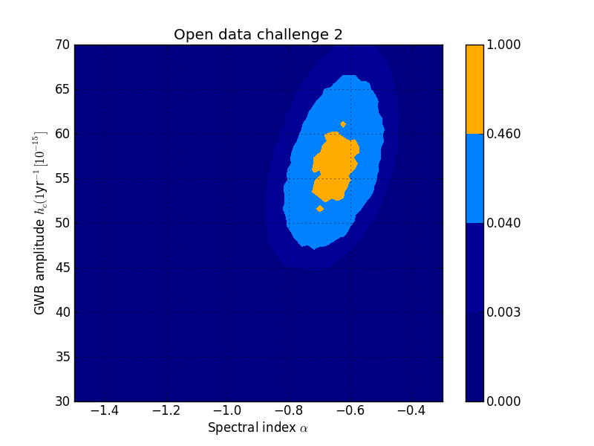
Results open challenge
Notes:
The dead line of the chanllenge is very soon. The results is gathered by a web form following the the link on ipta webpage. Please do have a look at the webpage, if you are taking the data chanllenge, especially it is possible that the web form is too sctrict and you want to send something special to us.
The chanllenge is devided in to two group of data, the open and closed chanllenges. The open one contain the final TOA and also include a description for each individual componnets of singal simulated, i.e. GW singal, red noise and white noise. This can be used as training data sets.

Slide 30
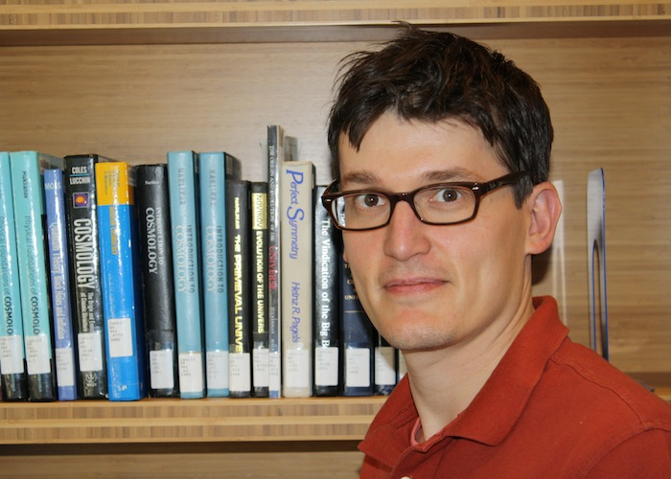
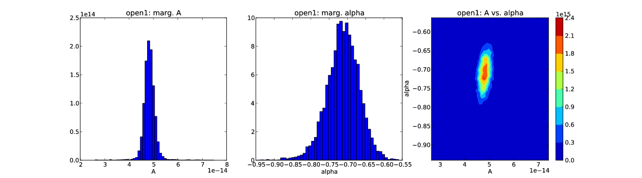
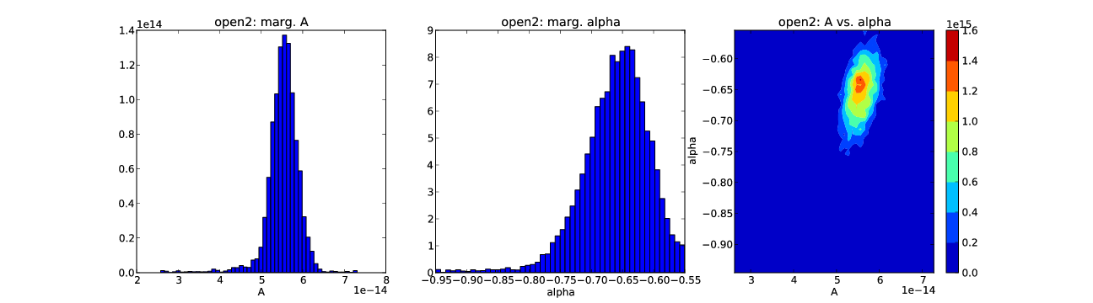
Independent implementation by Michele Vallisneri (JPL)
Notes:
The web site of the ipta data challenge is at ipta website. You can accesse the page via the link there. We have release the data to ipta related group 16th Jan 2012 to gather initial feed back from various of groups to avoid apparent mistakes. After collect feedback from R, M, X, we release the final data. In this way, the final release and the initial internal release have different data! If you are doing data analysis, you should use the public data now.

Slide 31
Conclusions
Detection: Bayesian and Frequentist UMP test the same. Produce ROC curves!
  We should start comparing those as well.
  Data challenge very good first start!
Parameter estimation: K-S test
  Are methods accurate enough
  Are lowest frequencies handled correctly?
EPTA data analysis pipeline (see poster by Antoine). Implemented in Python/C
Data challenge approach as a parameter estimation problem. Different Bayesian analysis implementations already been tested, and results of open set have been confirmed to be correct.
Notes:
The web site of the ipta data challenge is at ipta website. You can accesse the page via the link there. We have release the data to ipta related group 16th Jan 2012 to gather initial feed back from various of groups to avoid apparent mistakes. After collect feedback from R, M, X, we release the final data. In this way, the final release and the initial internal release have different data! If you are doing data analysis, you should use the public data now.

