Slide 1
Search for the gravitational wave memory effect with the Parkes Pulsar
Timing Array
Jingbo Wang, George Hobbs,
Dick Manchester, Na Wang
Xinjiang Astronomical Observatory/CSIRO
IPTA Science meeting, Kiama,2012-6-26

Slide 2
Contents
Introduction to Gravitational Wave Memory effect
Observations
Algorithm for searching and limiting GWM signal
Prospect
IPTA Science meeting,Kiama,2012-6-26

Slide 3
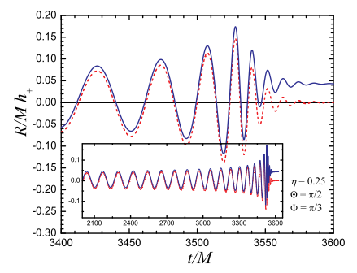

Introduction to Gravitational wave memory effect
The Gravitational wave memory is a growing, non-oscillatory contribution to the gravitational wave amplitude
Gravitational waves with memory will leave a permanent imprint on space-time
Gravitational waves with memory can be produced by merger of binary black holes
It increases rapidly during the
merger phase of binary black holes
We can treat it as a discontinuous jump propagating through space
See Fvata 2009, PRD
IPTA Science meeting,Kiama,2012-6-26

Slide 4





Introduction to Gravitational wave memory effect
A gravitational wave will distort space-time between the Earth and the pulsar. This affects the distance traveled by each pulse
The pulse times-of-arrival will be different from those predicted by timing model, so it will induce timing residuals
The memory jump would cause a pair of pulse frequency jumps of equal magnitude and the opposite sign (the earth term and the pulsar term)
The earth term will cause a frequency jump simutanously for all pulsars
The fractional frequency jump
The angular factor
The GWM signal
The pre-fit residuals
See van Hasteren & Levin 2010
IPTA Science meeting,Kiama,2012-6-26

Slide 5
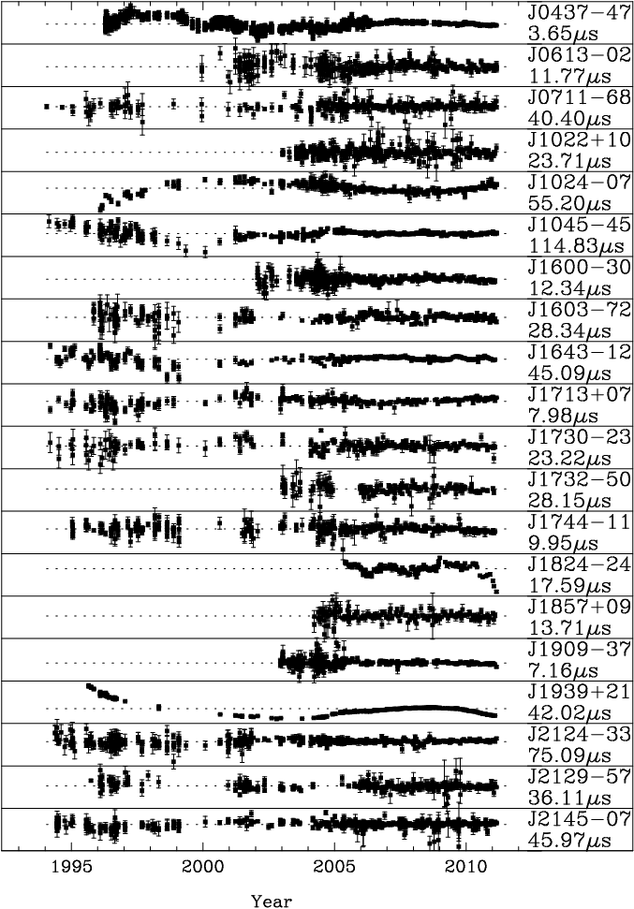
The Observations
The extended PPTA data set
Three questions
Does a GW memory signal exist in the PPTA data sets?
What is the size of the maximum possible GW
memory event that could have taken place?
What are the astrophysical implications of our upper bounds on such events.
IPTA Science meeting,Kiama,2012-6-26

Slide 6
Algorithm for searching and limiting GWM
Searching
1. Incorporate the residual induced by GWM signal into TEMPO2
1.Set the global par file and, fit for the amplitude of GWM
2.The detection significance is defined as
S=gwm_amp/gwm_amp_err
3. If S larger than the detection threshold, we make a detection
Limiting
1.Add a GWM signal into the data set
2.Get a new significance value (S_i)
3.Compare it with the original significance (S_real )
4.Repeat it 100 times
5.Find a amplitude of GWM signal which can make 95%
S_i > S_real

Slide 7
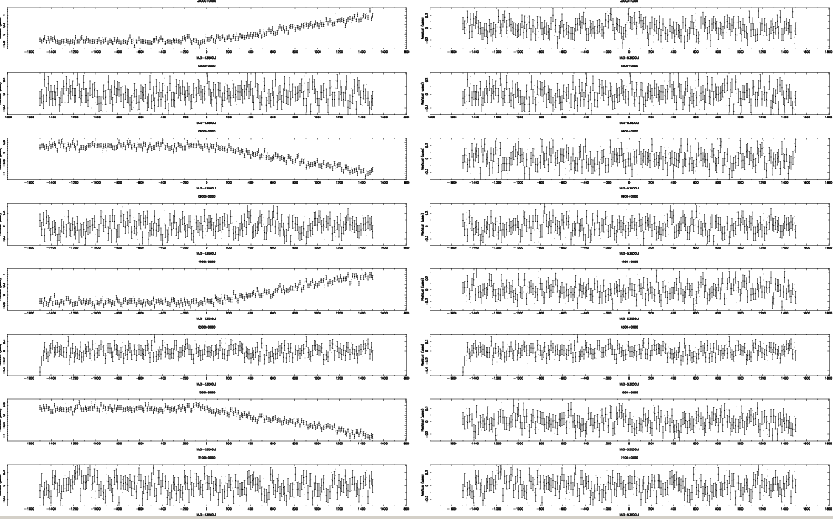
Algorithm for searching and limiting GWM
Put the pulsar in a ring on the equator, the GWM soure in the north pole
IPTA Science meeting,Kiama,2012-6-26

Slide 8
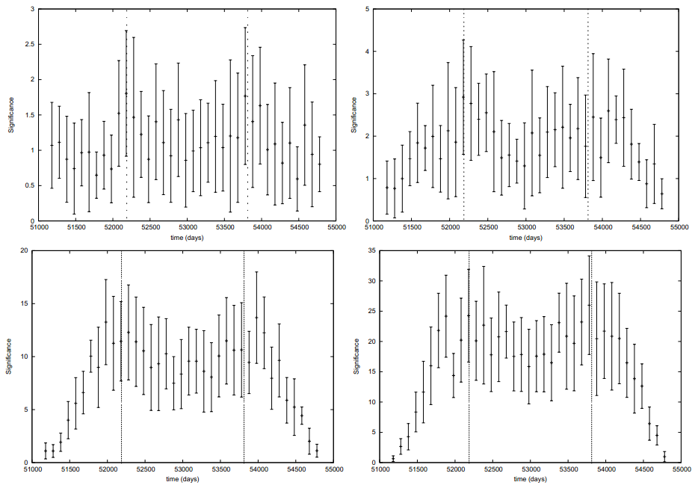
Algorithm for searching and limiting GWM
The detection significance as a function of GWM event epoch for diffrent amplitude of GWM signal
h = 0
White data
h= 1e-15
h= 5e-15
h= 1e-14
IPTA Science meeting,Kiama,2012-6-26

Slide 9
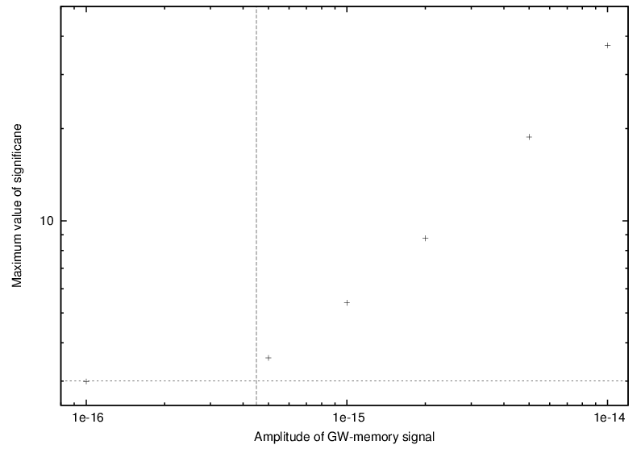
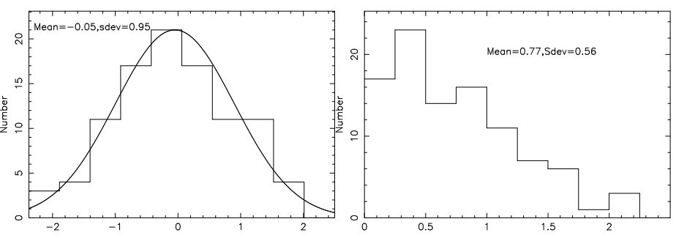
Algorithm for searching and limiting GWM
The maximum significance for a certain gwm magnitude
The distribution of S at a certain
epoch for 100 simulations of white data
The distribution of |S| at a certain epoch for 100 simulations
IPTA Science meeting,Kiama,2012-6-26

Slide 10

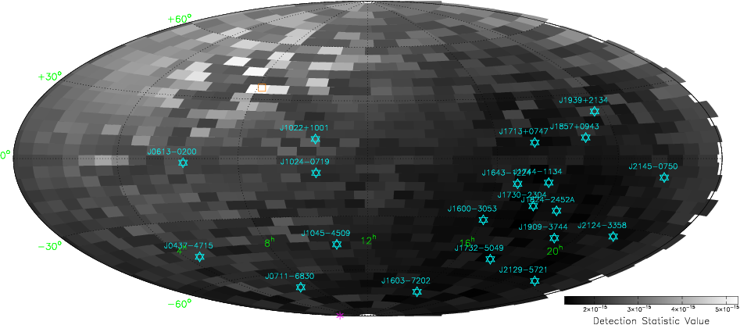
Algorithm for searching and limiting GWM
100 ns rms level for each pulsar
The GWM ampulitude which can make a detection at 95% conﬁdence level
IPTA Science meeting,Kiama,2012-6-26

Slide 11

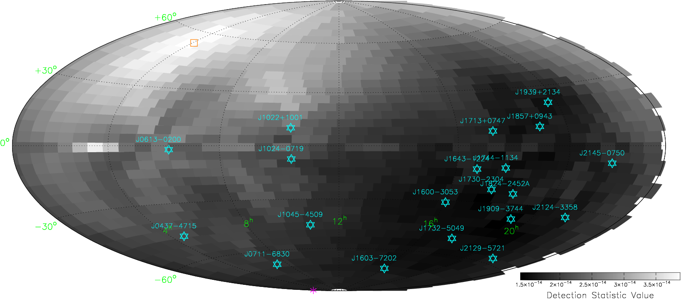
Algorithm for searching and limiting GWM
Realistic rms level
The GWM ampulitude which make a detection at 95% conﬁdence level
IPTA Science meeting,Kiama,2012-6-26

Slide 12
Prospect
Apply the algorithm to extension PPTA data set
Search/limit GWM signal with extension PPTA data set
Algorithm for searching and limiting a glitch
Search for glitches or put a upper limit on the size of the glitches in young pulsars from PPTA pulsars, young pulsars observed by Parkes and Nanshan
Thank you!
IPTA Science meeting,Kiama,2012-6-26

Slide 13
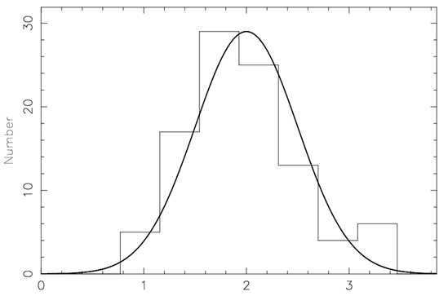
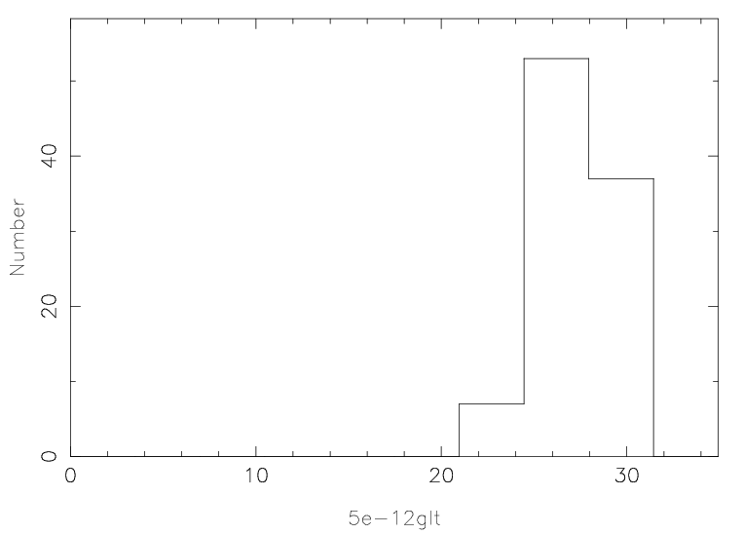
Algorithm for searching and limiting a normal glitch
Simulating timing residuals only contain white noise, regular sampling, same error bars ,100ns rms, 5 years
Fitting for a glitch at different times in the data sets and calculating a statistic, find the maxium value, S=|GLF0/GLF0_err|, Repeat it 100 times
Add a glitch at the middle of the observations into the white timing residuals,calculating the statistic, find the maximum value, Repeat it 100 times
Distribution of S_max for glitch size of 5e-12 Hz
Distribution of S_max for 100 white data
White data
Glitch add to white data
S_max
S_max
IPTA Science meeting,Kiama,2012-6-26

Slide 14
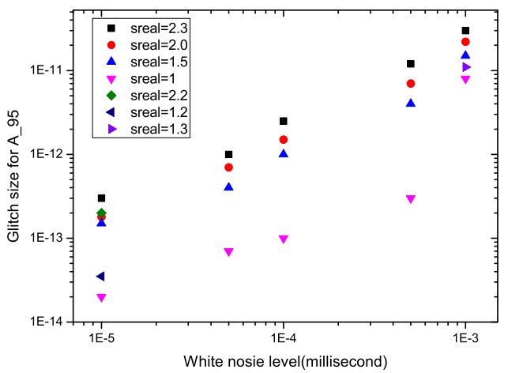
Algorithm for searching and limiting a normal glitch
Simulate a white data set, pretend it is "real" data, calculate the statistic S_real
Add a glitch of a given size at a random position in the data set, get the statistic, S_i repeat it 100 times
Change the glitch size, find the glitch size which make
95% percents S_i > S_real, record it as A_95
Try different white noise levels
IPTA Science meeting,Kiama,2012-6-26

Slide 15
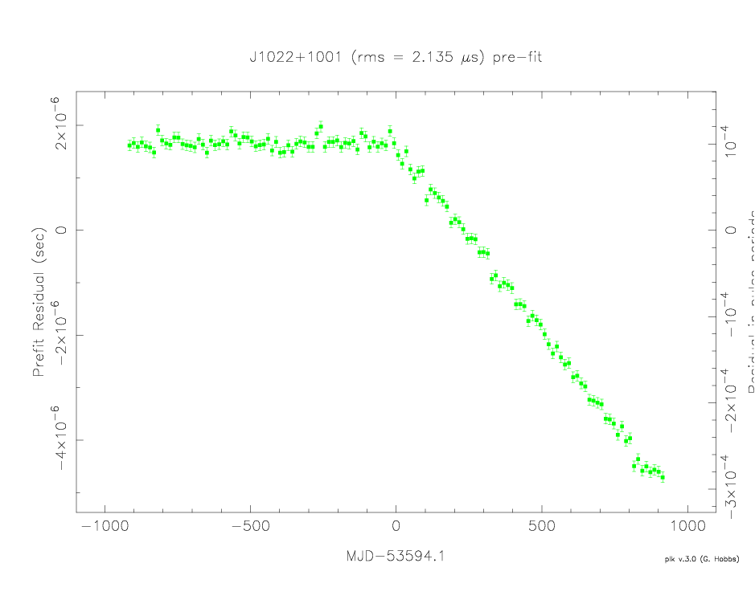
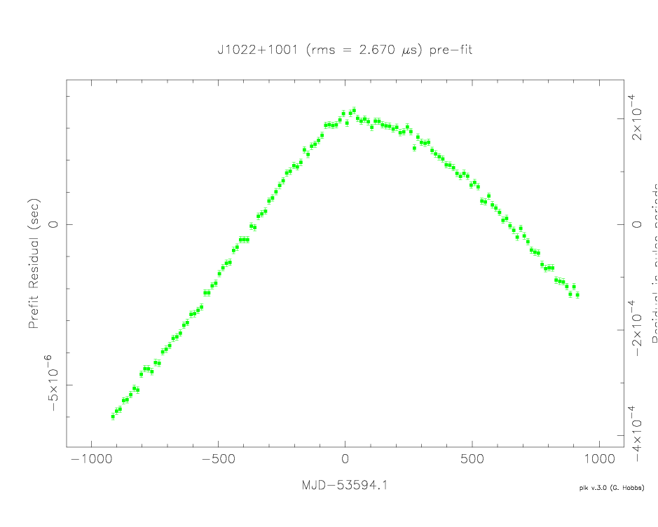
Algorithm for searching and limiting a normal glitch
Add red noise (GW background) into the simulated white timing residuals
Fit for the glitch,turn off the fitting of GLF0, get the covariance function with the Cholesky method; Then fit for the glitch by using the covariance function. Repeat it 3 times
The significance will increase a lot if the glitch epoch is right
White data + glitch
White data + glitch + red noise
IPTA Science meeting,Kiama,2012-6-26

