Slide 1
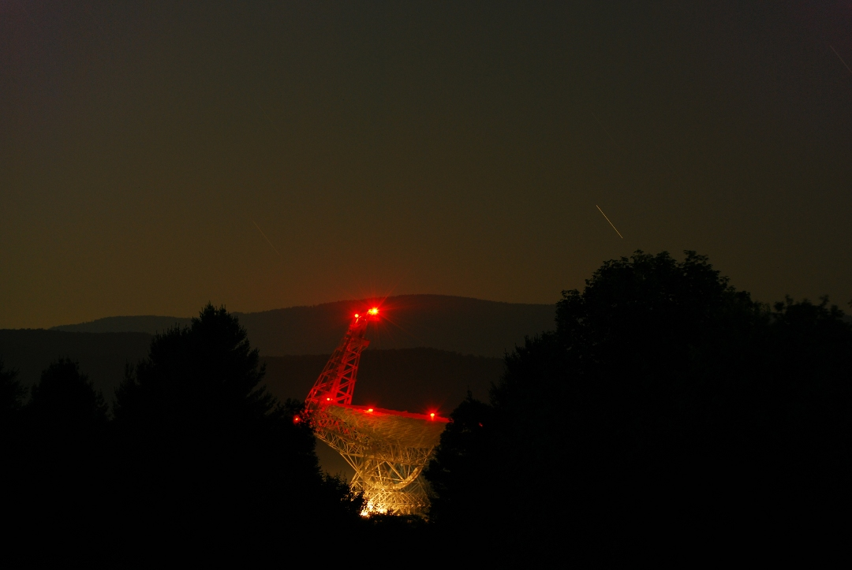
The Green Bank North Celestial Cap Pulsar Survey
Ryan Lynch
McGill University
IPTA Science Meeting 2012

Slide 2
Collaborators
Scott Ransom (NRAO)
Dunc Lorimer (WVU)
Maura McLaughling (WVU)
Ingrid Stairs (UBC)
Vicky Kaspi (McGill)
Rick Jenet (UTB)
Xavi Siemens (UWM)
Kevin Stovall (UTB)
Jason Hessels (ASTRON)
Vlad Kondratiev (ASTRON
Jason Boyles (WVU))
Joeri van Leeuwen (ASTRON)
Chen Karako (McGill)
David Kaplan (UWM)
Mallory Roberts (Eureka)
David Day (UWM)
Matt Rohr (UWM)
Chris Pankow (UWM)
ARCC (UTB/UWM)

Slide 3
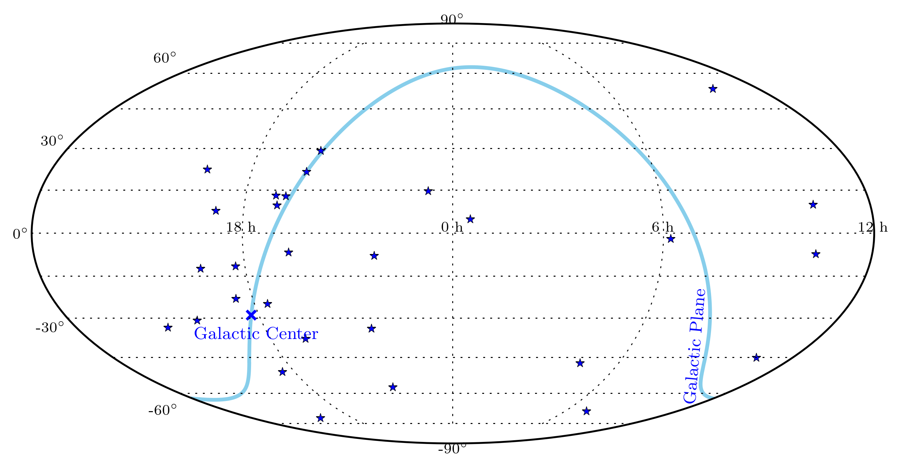
Current IPTA Pulsars

Slide 4
Current IPTA Pulsars
A straight forward way of improving PTA sensitivity is to find more suitable MSPs, especially in the north

Slide 5
The Green Bank North Celestial Cap Survey
The most recent in a line of GBT pulsar searches
Data taking begin in 2009
Stage I surveyed all δ > 38º
Stage II will cover the rest of the visible sky
The primary science goal is to find more MSPs for use in PTAs
  Simulations suggest that ~200 long-period pulsars and dozens of MSPs could be discovered

Slide 6
The Green Bank North Celestial Cap Survey
2-minute pointed integrations
350 MHz center frequency
  100 MHz bandwidth
  4096 frequency channels
Uses the GUPPI back-end

Slide 7
The GBNCC Survey
Total data volume will be ~360 TB when completed (2030 observing hours)
  Each 120-second integration takes ~90 CPU hours to process (~620 CPU years for whole survey)
Data reduction pipeline based on PRESTO, written by Kevin Stovall

Slide 8
The GBNCC Survey
Early data processing focused on beams containing bright NVSS or Fermi sources
All data now being reduced at McGill, UTB, and UWM
  Bulk of data processing carried out on CLUMEQ's Guillimin super computer
  2048 cores dedicated to pulsar processing

Slide 9
Early Results
The GBNCC survey has found 28 pulsars to date, including 5 new MSPs
  Just over 50% of Stage I data reduced
  Includes only a preliminary visual inspection of candidate pulsars
The rate of discovery will only increase as more data is processed and inspected

Slide 10
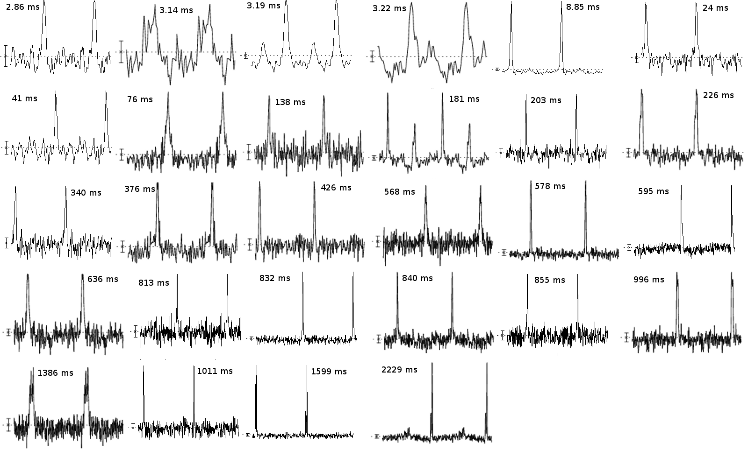

Slide 11
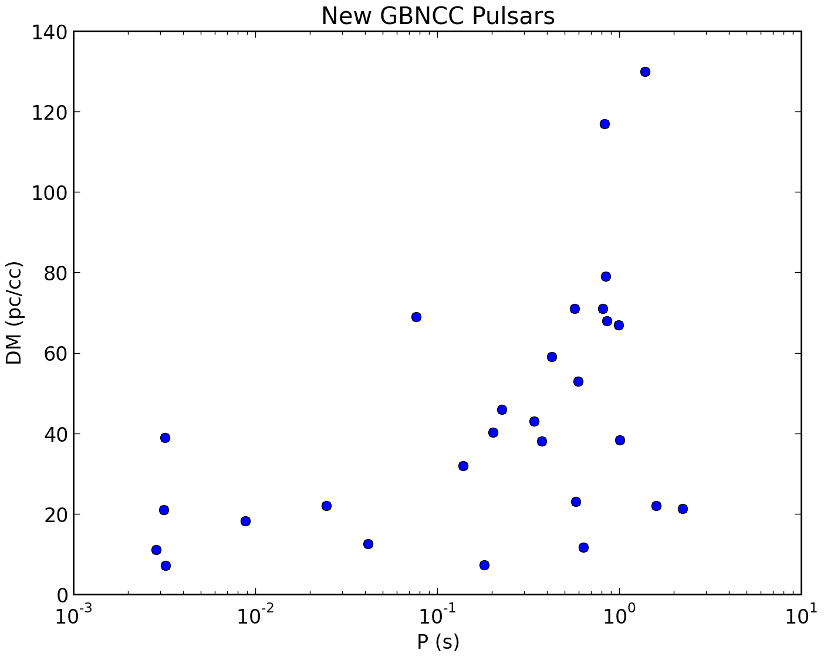

Slide 12
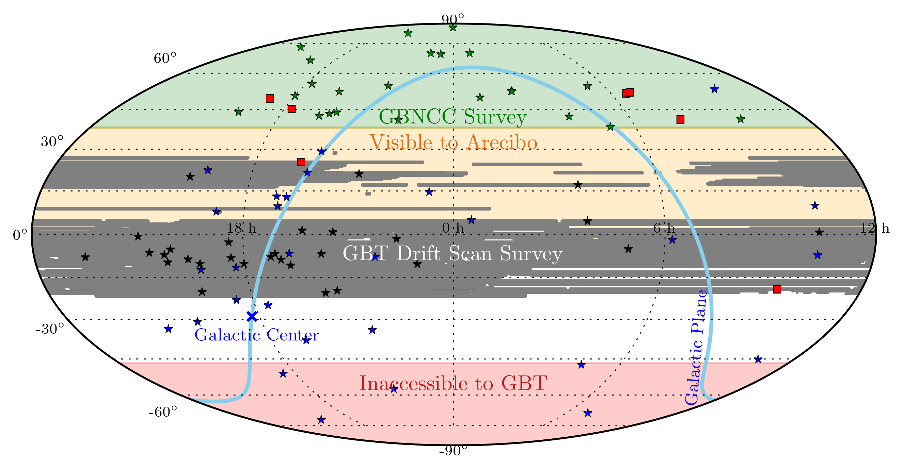

Slide 13
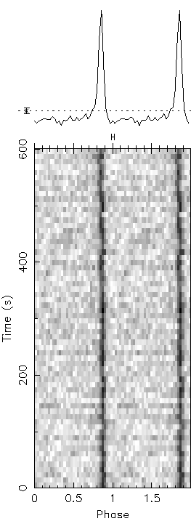
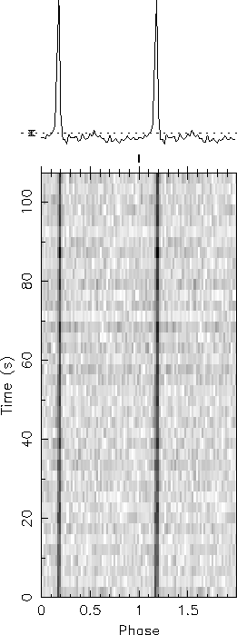
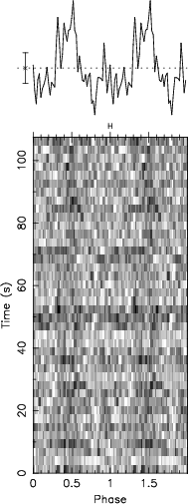
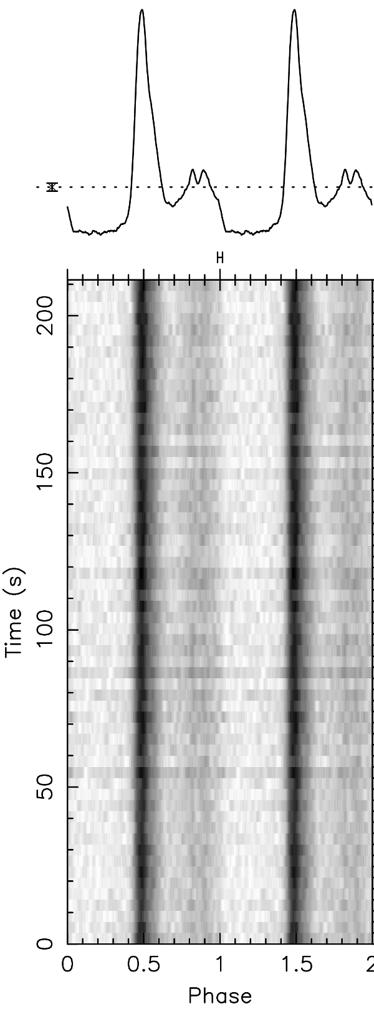
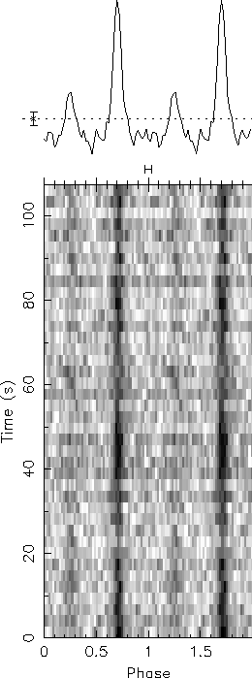
J0636+51
P = 2.86 ms
D = 480 pc
σTOA ~ 1 μs
J0645+51
P = 8.85 ms
D = 680 pc
σTOA < 1 μs
J0740+41
P = 3.14 ms
D = 700 pc
σTOA >10s μs
J1710+49
P = 3.22 ms
D = 660 pc
σTOA ~ 5 μs
J1816+45
P = 3.19 ms
D = 2.4 kpc
Black widow

Slide 14
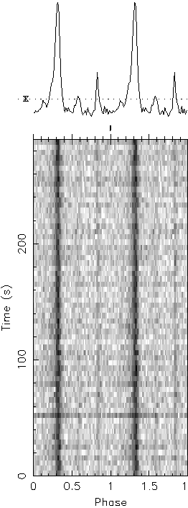
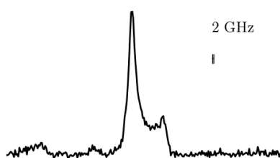
J1923+25
P = 8.85 ms
D = 1.6 kpc
σTOA ~ 6 μs @ 820 MHz
σTOA ~ 1 μs @ 2 GHz
J0931-19
P = 4.64
D = 1.8 kpc
σTOA ~ 3 μs

Slide 15
Looking ahead...
Stage II data taking is ongoing
  Will soon be able to process in near real time
Will be using Cyber SKA infrastructure to judge candidate pulsars
Several complimentary investigations of AI to automatically identify good candidates

Slide 16
Summary
The primary goal of the GBNCC survey is to find more PTA MSPs...success!
  5 MSPs discovered so far, with 1 already included in PTA timing
  2 potential PTA MSPs from the Drift Scan survey
These results are preliminary
  Data processing is proceeding rapidly
  Stage II data taking is underway
Look for even more pulsars, and hopefully more MSPs in the coming months

