Slide 1
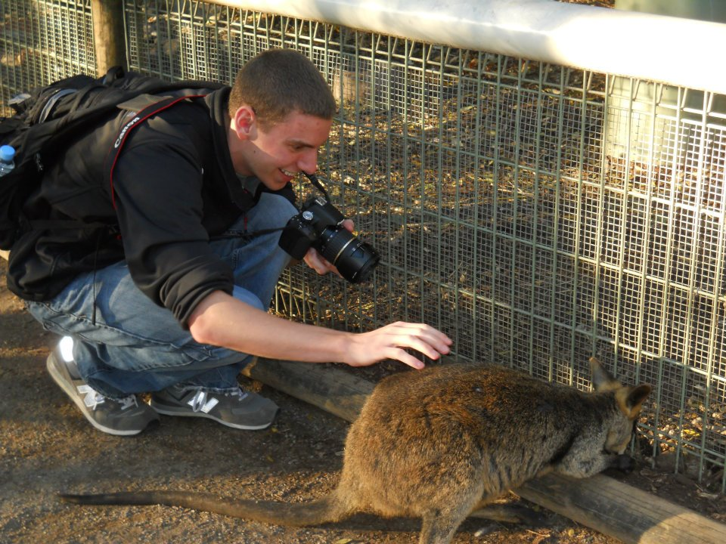
One scheme for Optimization of Pulsar Timing Arrays
Andrea Lommen, Sam Finn, Joe Simon, Ryan Anella, Brian Christy

Slide 2
Acknowledgments
The NANOGrav detection working group

Slide 3
Brief recap of Burt, Lommen & Finn (2011) results
Burt, Lommen and Finn (2011): spend MORE time on the best pulsars, and LESS time on the worst pulsars.
Analysis assumed
Ryan Anella’s analysis adds realistic noise floor, and optimization results under various conditions.
Notes:
In other words, I will show you actual distributions of times among pulsars for various circumstances.

Slide 4
This particular optimization optimizes for signal to noise. For use with a Bayesian detection algorithm for single sources.

Slide 5
Sum that up for all pulsars…

Slide 6
is the thing we get to jigger…
Notes:
So for each pulsar we can adjust these times until we get the optimize signal to noise, assuming we keep the total observing time constant

Slide 7
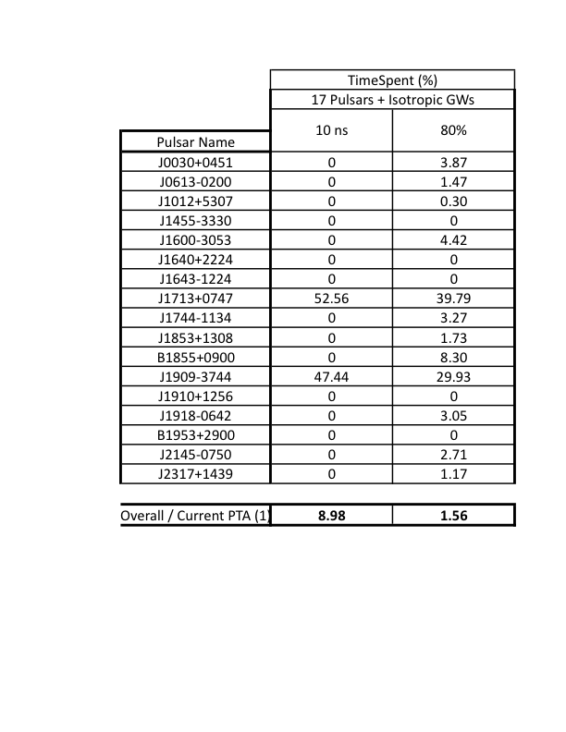
Results for Current NANOGrav Array
Notes:
3 different noises. Rms’s from demorest.
Describe noise floor.
Two messages – Spend your time on the best pulsars. And we need to know the noise floor to know which are the best pulsars.

Slide 8
Do we really expect the sources to be isotropically distributed?
Vikram Ravi: No.
Joe Simon: No.
Notes:
Joe has told you/will tell you about various important directions. Everything I’ve said about assumes that we are equally likely to detect GWs in every direction. It looks like we aren’t. How does this change?

Slide 9
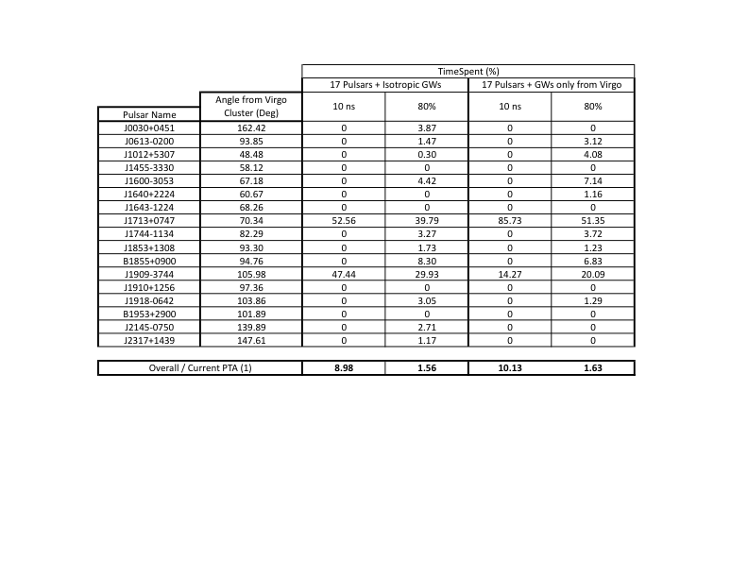
Optimize for a source toward virgo – how much does distribution change?
Notes:
. Not much. I think it favors 1713 more of 1909 because it’s closer (show graph of angle between pulsar and virgo)

Slide 10
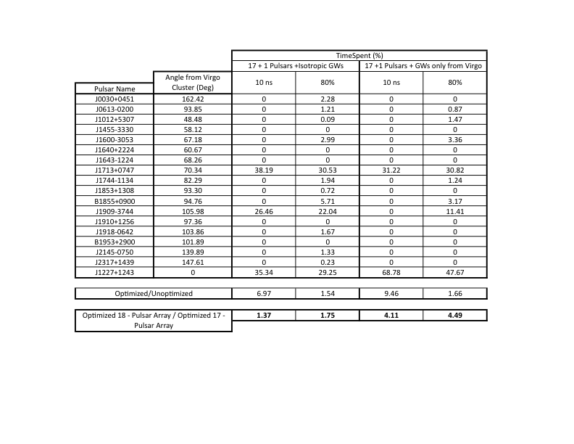
What if you add a pulsar in the direction of Virgo?
Notes:
How much sensitivity do you gain by adding a pulsar in the direction of virgo? If you add a random pulsar with the noise characteristics of 1713 at some random location of the sky, it increases the volume of the detectable sources by 1.2. But if you add that pulsar toward virgo and the source is toward virgo, you increase the volume by 10x – 10x more sources.

Slide 11
Conclusion
There are some pulsars we should be spending more time on, at the exclusion of others.
All experiments to characterize the noise in pulsars are absolutely worth it. They have the potential to completely change the way we observe.
Anisotropy of GW sources should be an ingredient in optimization schemes
We should consider a targeted search for new pulsars toward Virgo/Coma/Fornax.

