Slide 1


The International Pulsar Timing Array
R. N. Manchester
CSIRO Astronomy and Space Science Sydney Australia
Summary
What is the IPTA?
IPTA websites
Data sharing, projects, etc
The Future

Slide 2
What is the IPTA?
It’s an organisation that facilitates the holding of great meetings!
The IPTA is a consortium of consortia, namely existing PTAs from around the world
The aims of the IPTA are to facilitate collaboration between participating PTA groups and to promote progress toward PTA scientific goals
The IPTA has a Constitution which states these points and defines the rules under which it operates
There is a Steering Committee which sets policy guidelines for data sharing, publication of results etc. The current IPTASC is:
EPTA: Ben Stappers, Gilles Theureau
NANOGrav: Scott Ransom, Ingrid Stairs
PPTA: Dick Manchester (Chair), Willem van Straten
Andrea Lommen (Immediate past-Chair, non-voting)

Slide 3
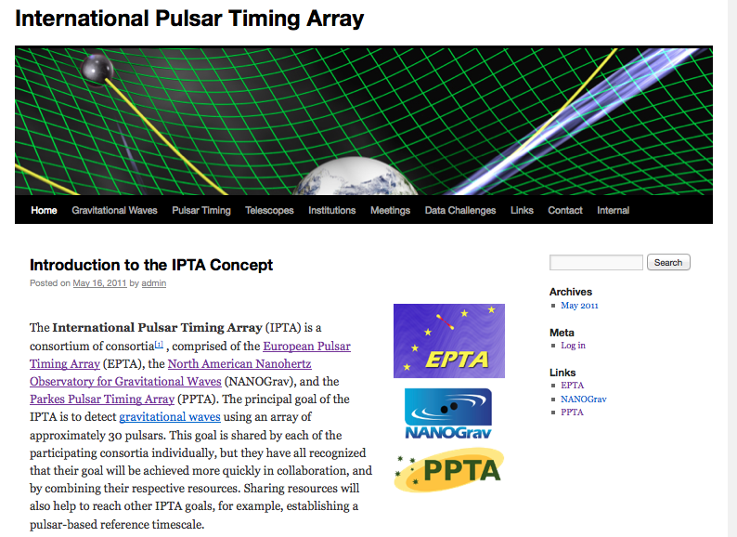
IPTA Website: www.ipta4gw.org
Public/Outreach site
Contains Data Challenge pages

Slide 4
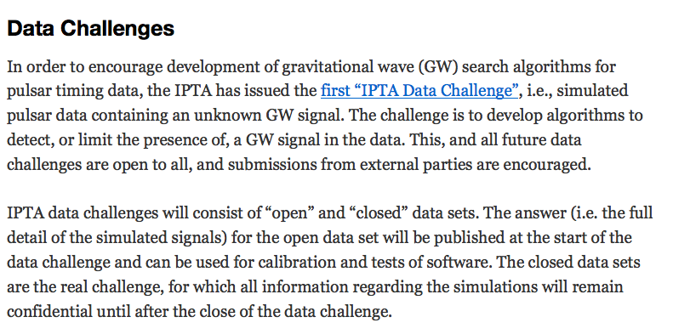
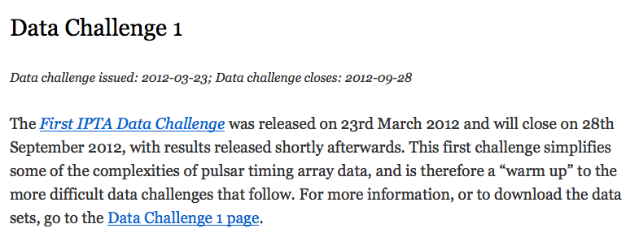

Slide 5
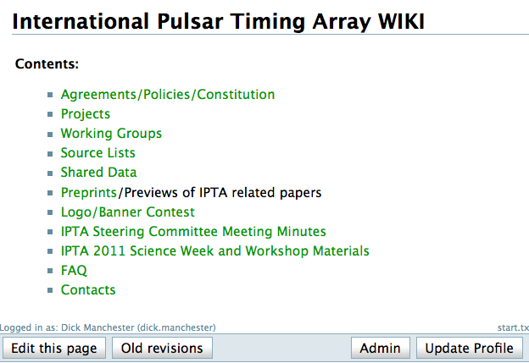
IPTA Wiki: www.ipta4gw/wiki
Main working area for IPTA business – accessible to members of participating PTAs
Contains pages for policy documents, shared data release, IPTA projects and preprints, Steering Committee Minutes, etc.
Requires approved “User” status to view (all) and edit (most) pages

Slide 6
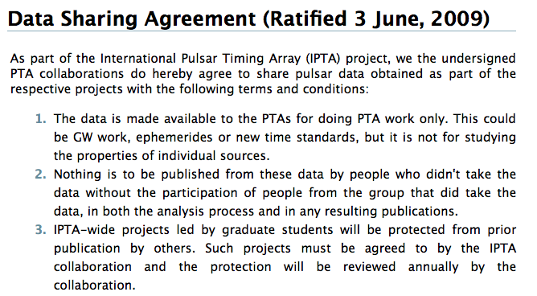
+ 5 more clauses

Slide 7
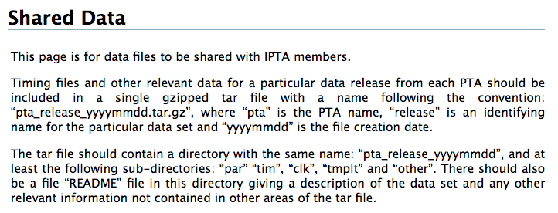
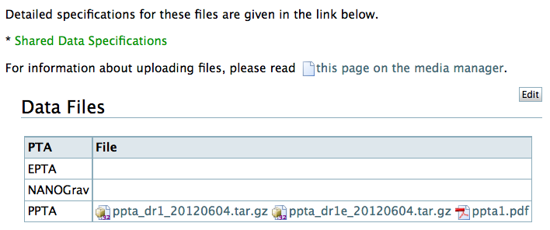
Shared Data Release

Slide 8
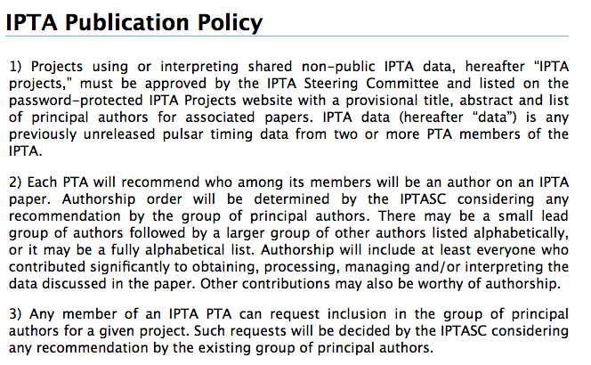
+ 6 more clauses

Slide 9

Page for submitted projects pending IPTASC approval soon
IPTA combined data sets
GW stochastic background limit
Future projections for GW detection
Characterising MSP timing noise
Etc, etc …..
Submit more projects!

Slide 10
Future Development
More shared ToA data
Access to “raw” shared data
New Projects (e.g. SKA 1 timing)
New Working Groups (e.g. Simulations group)
New Data Challenges
New PTAs
More ideas!

Slide 11
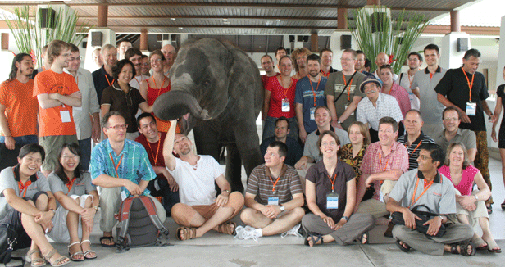
Future IPTA Meetings
2013: Organised by EPTA
  In Thailand, Sheraton Krabi Beach Resort, June17-28
2007 Pulsar Thai-ming Meeting
2014: Organised by NANOGrav
2015: Organised by PPTA, probably in South Africa
The IPTA is key to the future of pulsar science - be part of it!

Slide 12
The IPTA is key to the future of pulsar science - be part of it!

