Slide 1

Developing a pulsar timescale
George Hobbs
CSIRO Astronomy and Space Science
george.hobbs@csiro.au

Slide 2
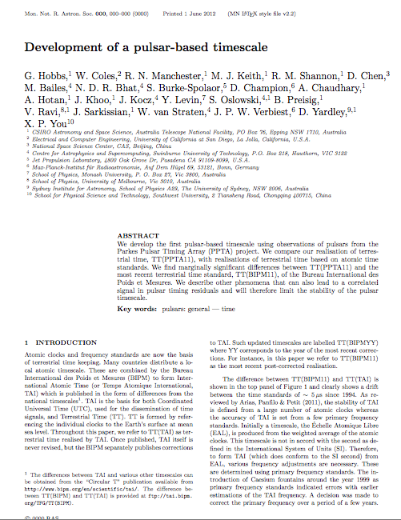
Thanks to …
Bill Coles (UCSD) for algorithmic development
Dick Manchester, Mike Keith, Ryan Shannon
Ding Chen (giving the initial impetus for the project)
All of PPTA team
Paper submitted to MNRAS (8th June 2012)
http://www.ipta4gw.org/wiki/doku.php?id=preprints

Slide 3
Summary
1) Have algorithm that can identify any time standard errors within a pulsar data set
2) Have applied the algorithm to the extended data release 1 from the Parkes Pulsar Timing Array.
3) Can use the pulsar observations to find errors in TT(TAI)
4) No highly significant errors found in TT(BIPM11)
…
5) Should get a huge boost in sensitivity with EPTA and NANOgrav data => IPTA project accepted by IPTASC (26/06/2012)

Slide 4
Purpose of talk
1) Why should the IPTA care about time standards
2) Describe the algorithm used
3) Highlight the current PPTA results
4) Show the improvement expected using IPTA data sets

Slide 5
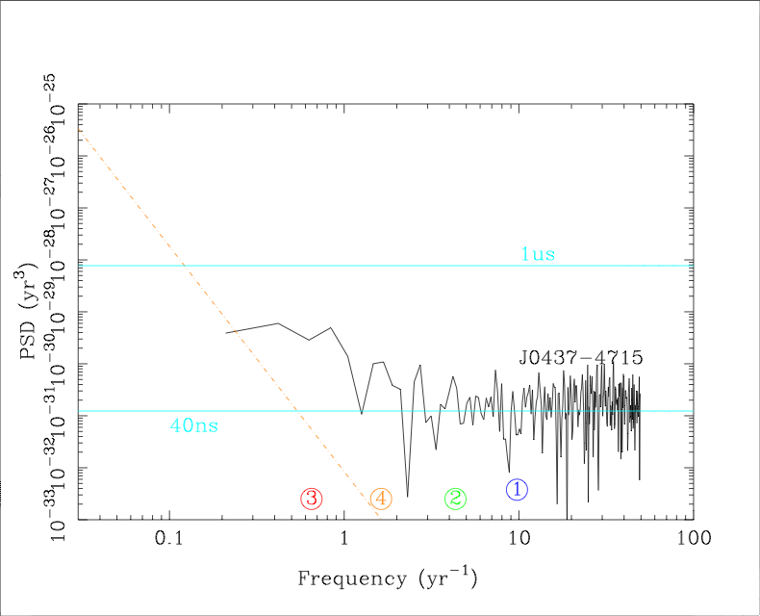
Why does the IPTA care?
Simulate GWB using tempo2
Actual PPTA PSR J0437-4715 observations
10⁻¹⁵ GW background

Slide 6
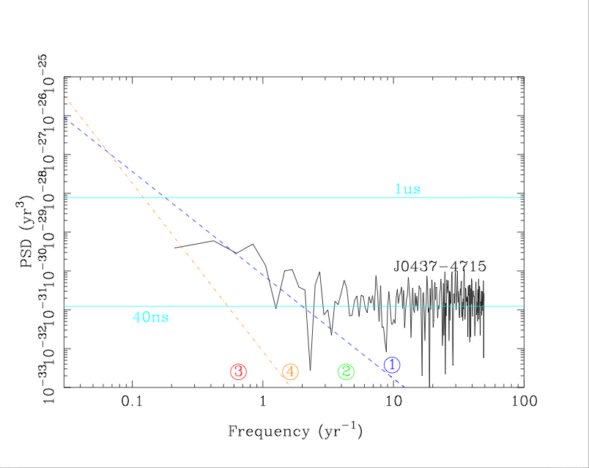
Why does the IPTA care?
Use prediction of expected signal caused by dispersion measure variations
Uncorrected DM variations

Slide 7
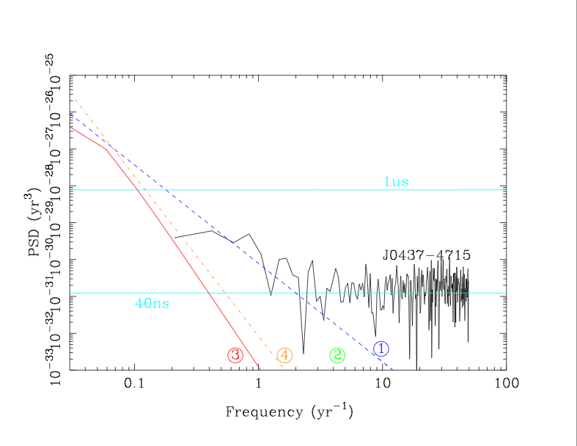
Why does the IPTA care?
Compare JPL ephemerides DE421 with DE414
Possible errors in solar system ephemeris

Slide 8
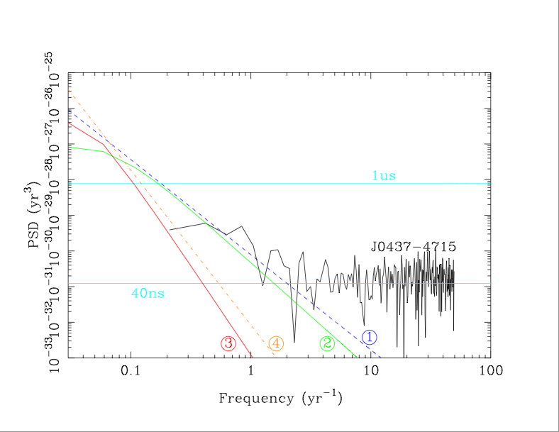
Why does the IPTA care?
Compare two realisations of terrestrial time TT(TAI) and TT(BIPM11)
Possible errors in timestandard

Slide 9
Terrestrial time, TT
Theoretical, ideal time standard (actual clocks can only approximate this time standard)
Most commonly used realisation is International Atomic Time (TAI) giving TT(TAI).
TAI is never revised once published => possible that errors become known, but will remain uncorrected
TT(BIPM12) is the current best realisation of terrestrial time
In this talk will consider using pulsars to obtain a realisation of terrestrial time TT(PPTA11) and compare to TT(TAI) and TT(BIPM12).

Slide 10
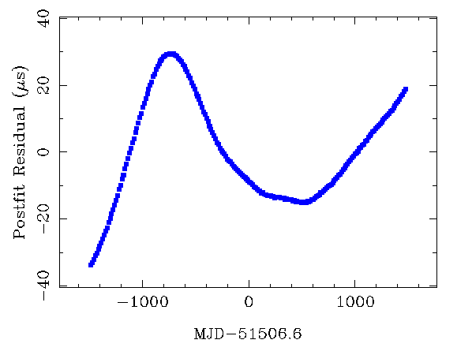
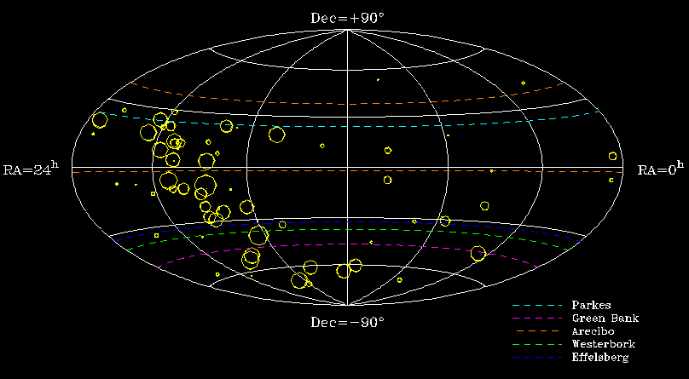
Terrestrial time standard irregularities will induce the same residuals in each pulsar
Monopolar signature
CSIRO. Gravitational wave detection
Notes:
10

Slide 11
It’s easy
All we need to do is to find the signal in the timing residuals that is the same for every pulsar.
That correlated signal corresponds to TT(PPTA11)-TT(TAI) and therefore errors in TT(TAI) can be identified

Slide 12
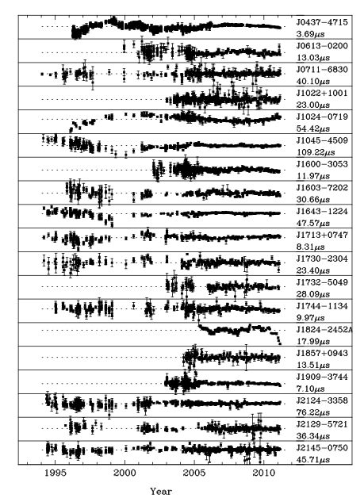
Why is it hard?
Because we have to use real data sets!

Slide 13
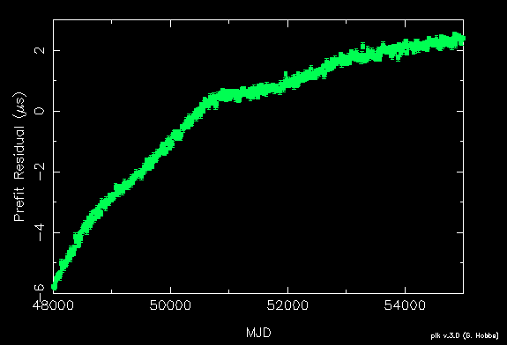
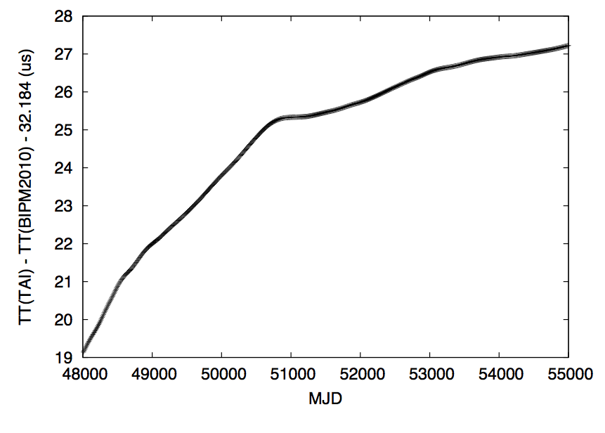
Why it is hard
Consider two pulsar data sets.

Slide 14
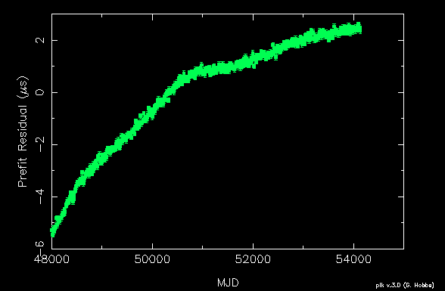
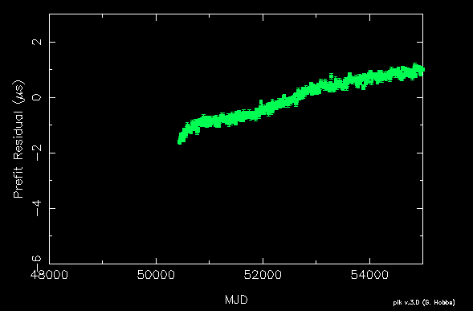
An example
Have different data spans

Slide 15
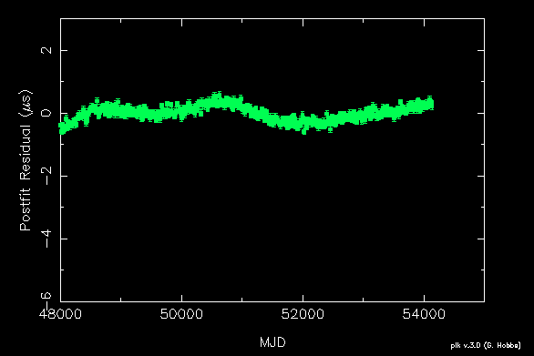
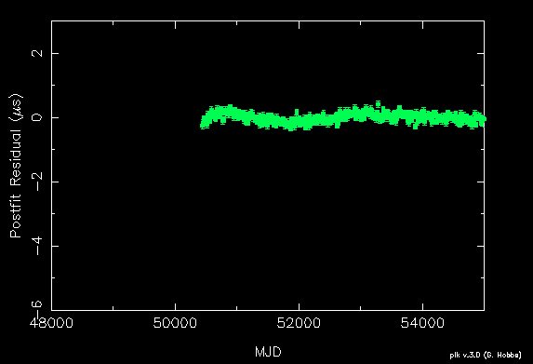
An example
Fit for the pulse frequency (F0) and its derivative (F1)

Slide 16
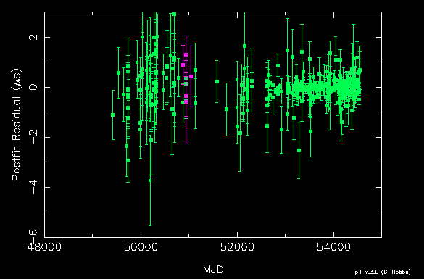
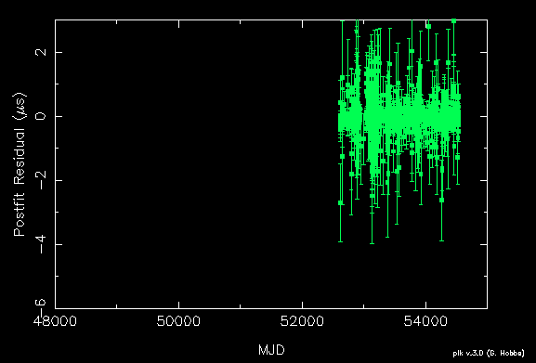
An example
Add in realistic amounts of white noise

Slide 17
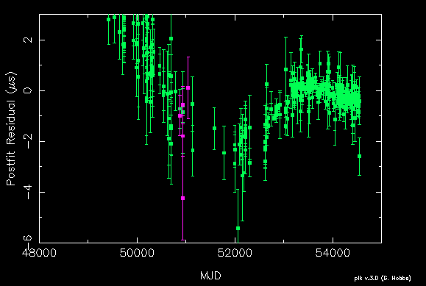
An example
Add in some unexplained timing irregularities

Slide 18
Important notes
We can never recover the linear and quadratic irregularities in a time standard
For data sets with different data spans, it is not possible to use a simple “weighted-average” method to determine the ensemble pulsar time standard.

Slide 19
Technique
Include a function, Δ_{c}(t), in the timing model that describes the clock errors.
Very similar to Mike/Bill’s “common mode” signal, but is now “common” to all pulsars
We define Δ_{c}(t) using a set of equally spaced samples with linear interpolation
Use tempo2 constrained fitting procedure to ensure that Δ_{c}(t) is not covariant with the pulsar’s pulse or astrometric terms
Use tempo2 Cholesky (generalised least-squares-fitting) procedure to account for timing noise
Use tempo2 global fitting procedures to fit for each pulsar’s pulse, astrometric and orbital parameters individually whilst globally fitting for Δ_{c}(t).

Slide 20
The dr1e data sets
See Dick’s talk
Each pulsar has a different data span
Data sampling is irregular with the most recent data being more uniform than earlier data
Very few observations exist around 2000
ToA uncertainties are variable
Timing noise is evident
RMS timing residuals vary widely

Slide 21
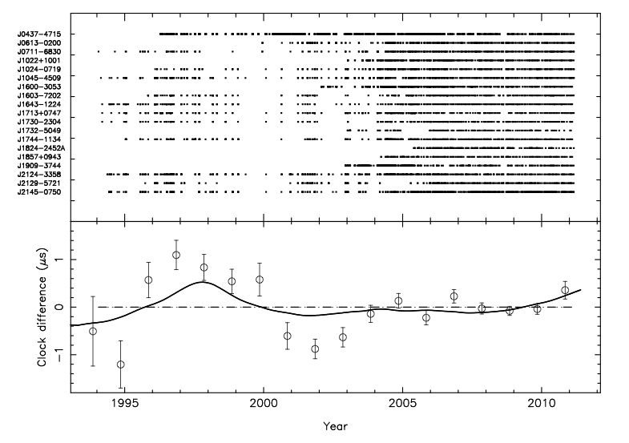
The result
The paper discusses lots of tests of the algorithm. Here we just show the result.
Sampling for different pulsars
Clock difference (us)
Year

Slide 22
Results/discussion in the paper
Lots of discussion on the error bars (being correlated) and the implications of the slight discrepancies with the expected value
---- No obvious error in TT(BIPM11) , but can recover errors in TT(TAI)
High precision pulsar timing experiments should not be using TT(TAI)
A GWB could not be causing a significant correlation in our residuals that mimics a clock error (yet)

Slide 23
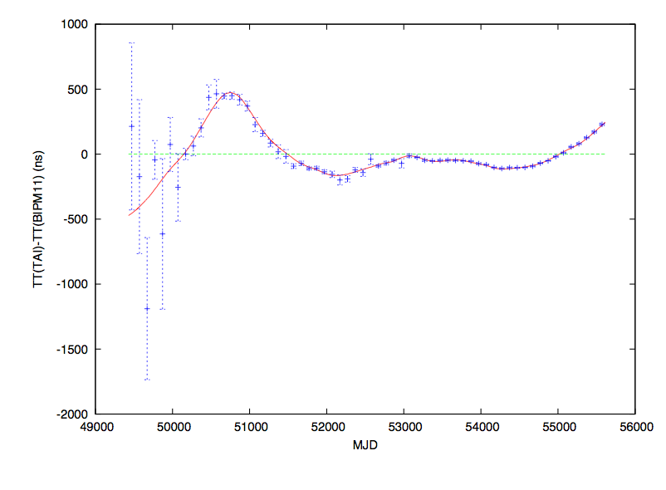
Adding in IPTA data
IPTA will provide data sets spanning ~20 years for a few pulsars and very high quality data sets for ~5 years on >30 pulsars.
[SIMULATED DATA]
Assume:
-Expected data sets
White data
No arbitrary jumps
…
Need early data sets!
1998

Slide 24
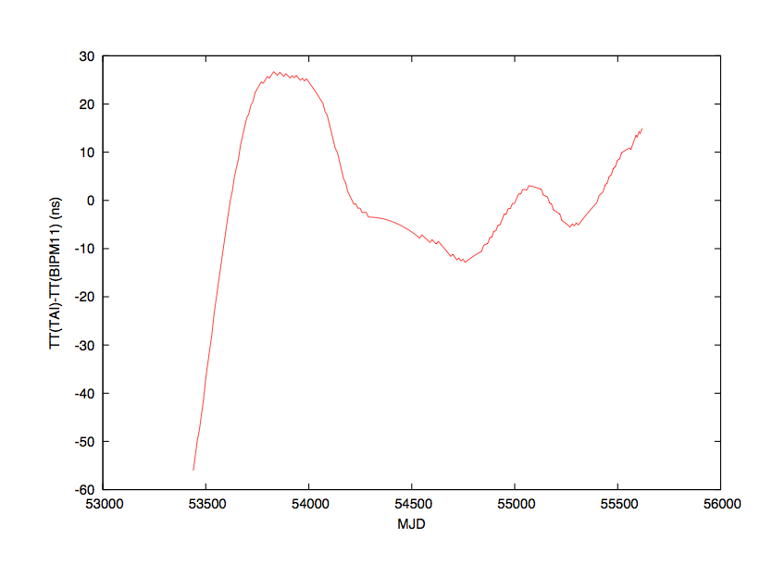
Most recent data
Clocks have significantly improved since the year 2000 … have the pulsars kept up?
100ns
Last 5 years

Slide 25
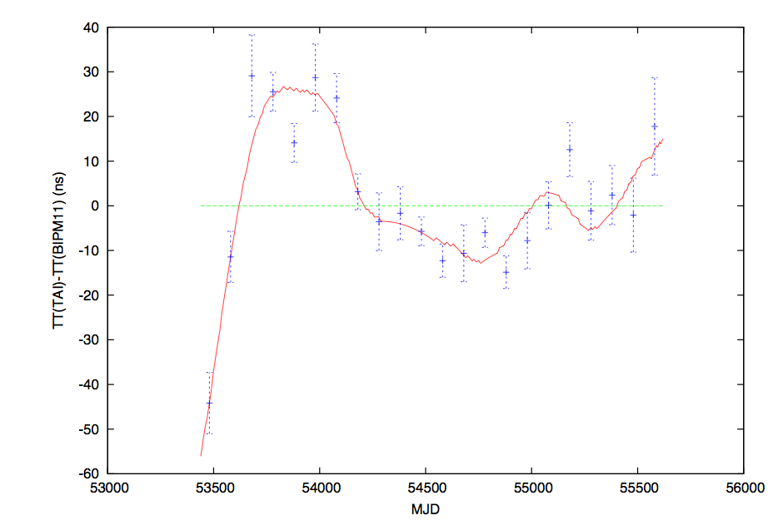
Expected result with combined PPTA + Demorest data
[Simulated data]

Slide 26
Conclusions
Pulsar observations can be used to develop a pulsar-based time standard
Algorithm implemented as a tempo2 plugin (“clock”)
(Takes ~2 minutes to run on the PPTA dr1e data set)
Paper using PPTA pulsars published. No major errors found in TT(BIPM11), but can recover errors in TT(TAI)
Ideal project for the IPTA – reasonably straightforward, exciting results and huge boost in sensitivity with IPTA data sets
IPTA project accepted – please talk with me if you have ideas/comments/suggestions … (can we compare algorithms? How do we combine the data sets? … do we need an ipta4clock.org website? …)
Advert: come and visit us sometime in Sydney – check out our “distinguished visitor program” for trips of 4 weeks -> 1 year!
(http://www.atnf.csiro.au/people/distinguished_visitors.html)

