Slide 1
Your Model Refresh
2023-07-06

Slide 2
YOUR MODEL
The term machine learning was first coined in the 1950s when Artificial Intelligence pioneer Arthur Samuel built the first self-learning system for playing checkers. He noticed that the more the system played, the better it performed. Fueled by advances in statistics and computer science, as well as better datasets and the growth of neural networks, machine learning has truly taken off in recent years. Today, whether you realize it or not, machine learning is everywhere ‒ automated translation, image recognition, voice search technology, self-driving cars, and beyond.

Slide 3
Data Summary
Unnamed: 0 | ORDERS | LINES | PCS | SKU | CITIES
30.0 | 30.0 | 30.0 | 30.0 | 30.0 | 30.0
14.5 | 1062.47 | 2040.97 | 2385.6 | 534.7 | 211.57
8.8 | 414.97 | 794.7 | 951.37 | 111.64 | 39.51
0.0 | 278.0 | 550.0 | 610.0 | 243.0 | 123.0
7.25 | 790.5 | 1557.0 | 1825.0 | 472.5 | 189.0
14.5 | 1022.0 | 1966.0 | 2334.5 | 540.0 | 207.5
21.75 | 1431.75 | 2698.5 | 3126.75 | 618.75 | 248.25
29.0 | 1921.0 | 3479.0 | 4188.0 | 694.0 | 279.0

Slide 4
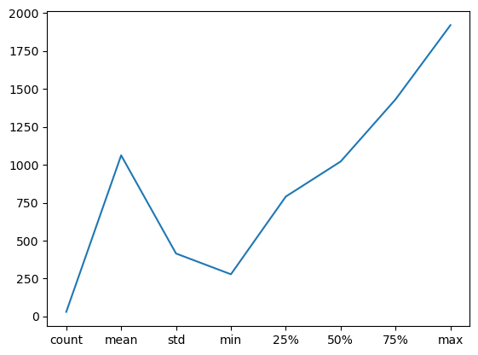
PDP Plot - ORDERS

Slide 5
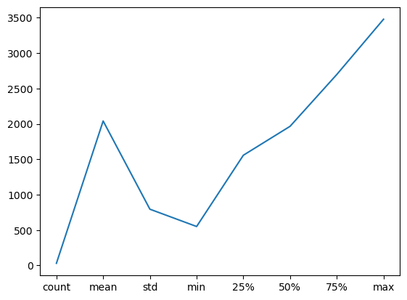
PDP Plot - LINES

Slide 6

PDP Plot - PCS

Slide 7
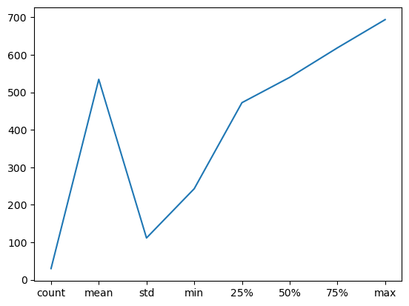
PDP Plot - SKU

Slide 8
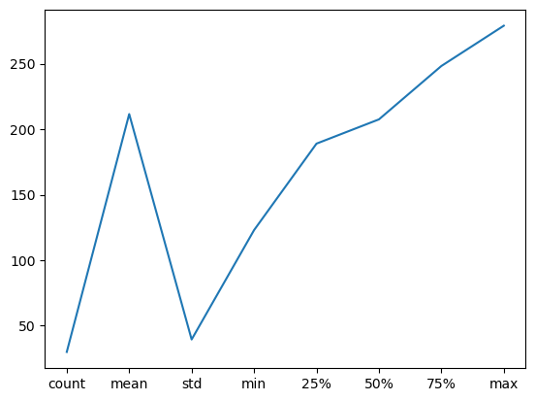
PDP Plot - CITIES

Slide 9
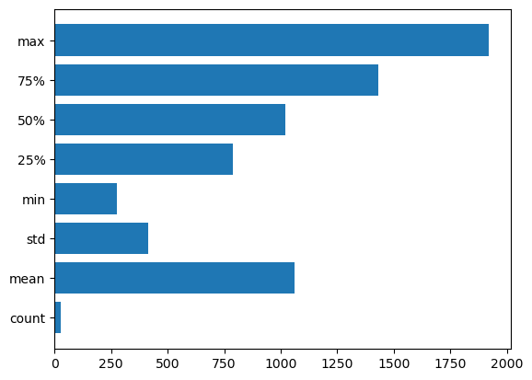
Feature Importance

