Slide 1


Slide 2
G-P Ls: What Are Your Habits?? And Linux to USE them…
RVA Linux Users Group
D.J. Davis, A+, CISSP
(ZeroRingDefender)
October 14, 2023
Version 1.0

Slide 3
This content was presented as… General-Purpose Languages: What Are Your Habits??
Defcon 31
BIC Village - Blacks in Cyber
D.J. Davis, A+, CISSP
(ZeroRingDefender)
August 12, 2023
Version 1.0

Slide 4
Objectives
How this presentation came about...
At DC30 I Listened to a *lot* of vulnerabilities in code. I sank in my chair with a defeated feeling of how all of us are so MESSED UP by the vulnerabilities... ... I wondered: Which Language SHOULD We Use ?????
Objectives:
Explore some vulnerabilities that can occur in languages (not OSes; not configuration)
Outline a few ways to create less buggy/vulnerable code
Review some popular G-P Ls, some real-world characteristics, and security vulnerability considerations
Examine ideas to help us choose our languages (Always have a current language!)
Provide a “Hello, World!” example, and information to start programming in these languages (to gen up a Linux laptop, see the Appendix online)

Slide 5

Prerequisites
Have looked at a program source code listing before
Basic knowledge of program variables
Awareness of Compiled programs vs Interpreted programs
With this said, in this presentation, I believe there is something meaningful for everyone
Disclaimer --
This presentation is not affiliated with my work. These are my own personal ideas. Feel free to choose and use selectively.

Slide 6
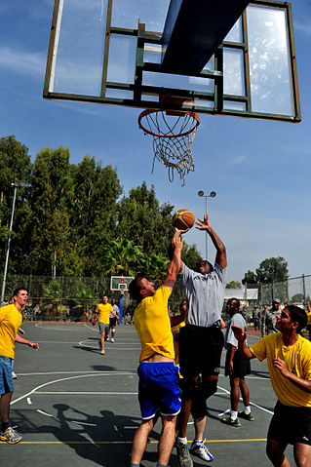
Our Game Plan … … …
Outline some General-Purpose Languages
Learn from some behaviors of legacy languages
Discuss 12 current G-P Ls and outline some of their behaviors
Outline some considerations in choosing our language
View the types of software vulnerabilities that can occur in languages
Consider some Recommendations from my Observations in Vulnerability Database
~~ Kindly defer questions to the end of the presentation
Nah. Let’s R-R-R-Rumble !! … …
We can debate. We will be polite. We must be brief because this slide deck is LONG … … …

Slide 7
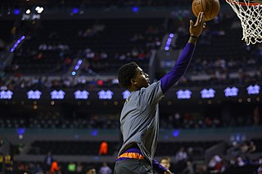

About D.J.
Background:
Ops, Dev, Mainframe Eng, Network Eng, WAN Design Eng, IT Integration, Sustaining Eng, Computer Security
Locale:
Live/work/play in Washington DC region
My humble beginnings… …
COBOL/CICS, EasyTrieve Plus, Business BASIC (Electronic Cash Register PC, police/dispatch Midrange)
Alma Mater:
Virginia Commonwealth University - Go Rams!!
BS Business, Info Sys; MS Business, Info Sys - IT Management

Slide 8
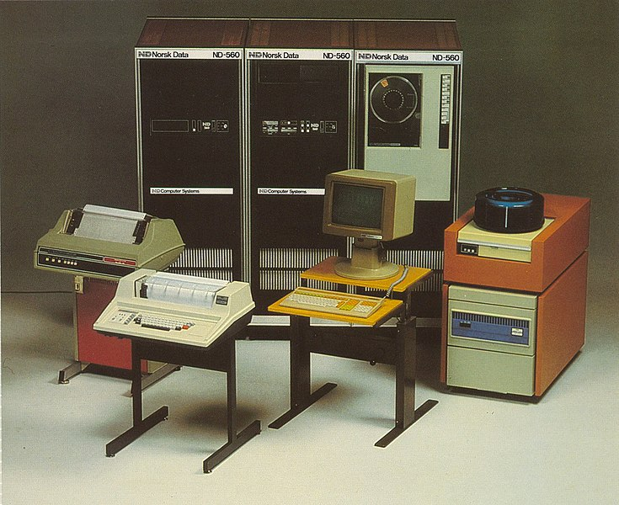
some Old-school LEGACY G-P Ls
Fortran - 1957 - First compiler. Math / science / engineering. First 3GL
Lisp - 1958 - First interpreter. Math, AI research. Second-oldest 3GL
ALGOL - 1958 - compiler. General computing. Father of several languages
COBOL - 1959 - compiler. Business record processing. IBM mainframes
BASIC - 1964 - interpreter. Teaching, PCs, Mid-range, home/commercial use
PL/1 - 1964 - compiler. Business (COBOL) and scientific (Fortran) use. IBM mainframes
APL - 1966 - interpreter. Math, finance, AI, image manipulation
Pascal - 1970 - compiler. Teaching, commercial use

Slide 9
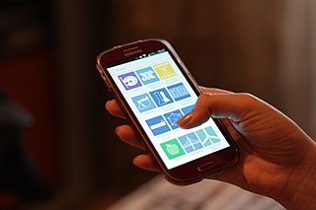
some CURRENT G-P Ls
C - 1972 - compiled
Objective-C - 1984 - compiled
C++ - 1985 - compiled
Perl - 1987 - interpreted
Python - 1991 - interpreted
JavaScript - 1995 - interpreted
PHP - 1995 - interpreted
Ruby - 1995 - interpreted
Java - 1995 - compiled to Java bytecode
C# - 2000 - compiled to .Net IL bytecode
Kotlin - 2011 - compiled to Java bytecode
Go - 2009 - compiled
Rust - 2010 - compiled
Swift - 2014 - compiled
Initial growth of the World Wide Web

Slide 10
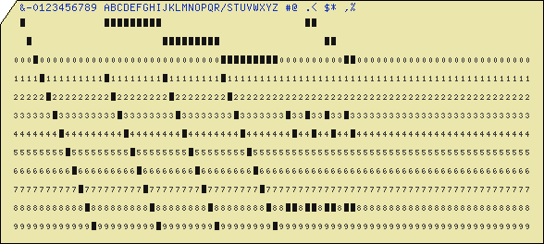
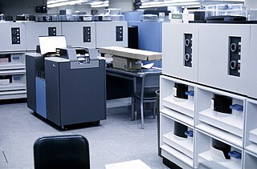
How We Started - LEGACY G-P Ls
Let's Go Old-school For 4 Minutes... ...
Note: Older languages are still available today and have evolved
Fortran is a popular language on supercomputers
Several legacy languages have OO versions
A language can be set up as both a compiler and an interpreter (e.g. APL, BASIC)

Slide 11
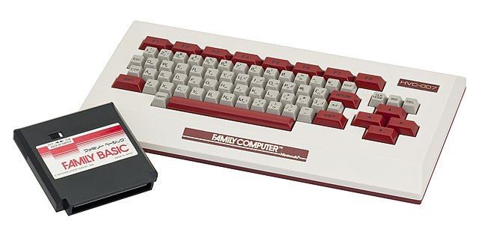
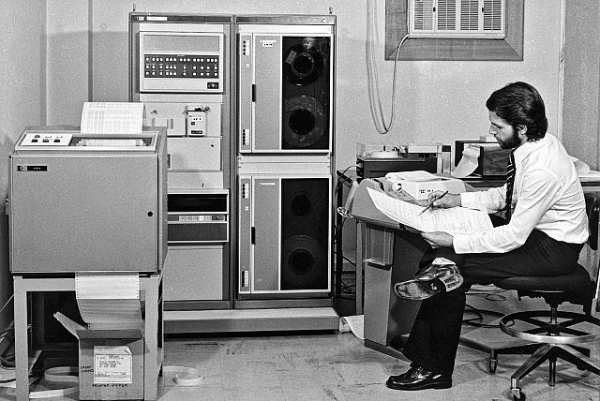
BASIC - 1964 - interpreted
In 1970s/80s versions, the interpreter also serves as a text editor
Upon entering a program line, the interpreter tokenizes keywords to save on memory space and increase program execution speed. Originally a teaching language; widely-used on PCs and mid-range systems
Program terminates on invalid I/O / div by zero / subscript overrun / invalid variable unless the language variant implemented error trapping
Historically, variable types are floating point numbers and strings
Input statement variable is a string; variable length limited to 255 chars (max string length)
Does not overrun variables
FUN FACT: BASIC was planned as a compiled language but memory footprint was too large; switched to interpreted language
10 REM a comment - HELLO.BAS
15 LET A = 5 : 'Multi-statement line; LET keyword is optional
16 B = 6
17 A$ = "" : 'String variable
20 PRINT "Hello, World!"
25 INPUT$ "Press ENTER to End Program ", A$
30 END
Licensed under Creative Commons Attribution 3.0 Unported license

Slide 12
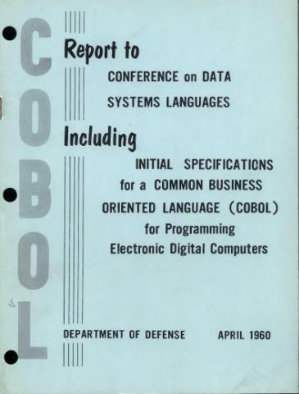
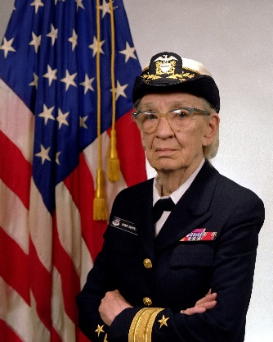
COBOL – 1959 - compiled
Primarily for business processing, file I/O. Very limited math support: + - * / ** ( )
Most often seen on IBM mainframes; most often used unit record I/O (fixed-length records)
Program abends (terminates) on invalid I/O / div by zero / invalid mem reference
Generally does not overrun variables (fixed-length variables; compiler/runtime checks)
000001* A COMMENT - HELLO.COB
000002 IDENTIFICATION DIVISION.
000003 PROGRAM-ID. HELLO.
...
ENVIRONMENT DIVISION.
DATA DIVISION.
WORKING-STORAGE SECTION.
01 WS-TEST-STRING.
03 WS-PART1 PIC X(16) VALUE "THIS IS A TEST. ".
03 WS-PART2 PIC S9(5)V99 VALUE 8.99 COMPUTATIONAL-3.
01 WS-INPUT-LINE PIC X(15) VALUE SPACES.
PROCEDURE DIVISION.
DISPLAY "HELLO, WORLD!".
ACCEPT WS-INPUT-LINE.
STOP RUN.
A major Contributor to COBOL
Rear Admiral Grace M. Hopper, USN

Slide 13
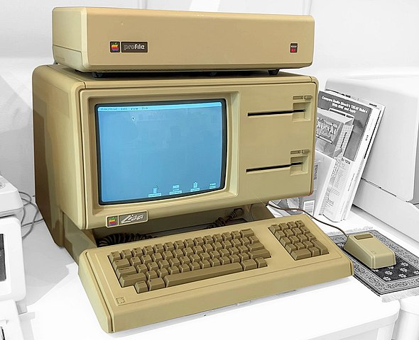
Pascal - 1970 - compiled
Based on ALGOL 60 (1960), Pascal was a breakaway project from an ALGOL rewrite
Originally regarded as a teaching language; moderate success until the popularity of C increased in academic and commercial settings
Structured language
Was used to write Apple Lisa OS and early Macintosh OS
In 1981 Brian Kernighan wrote a paper describing the notable deficiencies of Pascal as compared to C
// a comment - HELLO.PAS
program Hello ;
begin
var inputString: string;
writeln ('Hello, World!');
readln (inputString);
end.
The Apple Lisa OS is now available online for download at the Computer History Museum
Photo courtesy Timothy Colegrove
Licensed under the Creative Commons Attribution-Share Alike 4.0 International license

Slide 14
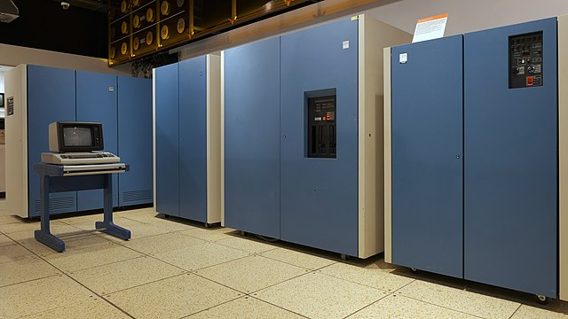
PL/1 - 1964 - compiled
Designed primarily by IBM
At the time, a large language for both I/O and math processing. Performs tasks handled by both Fortran and COBOL. IBM used PL/1 as a systems language
Program abends (terminates) on invalid I/O / div by zero / invalid memory reference
In general usage, it does not overrun (fixed-length) variables
“Modern features” (e.g. dynamic mem allocation, Pointers including pointer arithmetic, multitasking)
Notice the line: Procedure Options Main. Pl/1 had an influence on C
D.J.'s first language; much more compact than COBOL; shout-out to Dr. James Ames (VCU CS ret.)
/* A COMMENT - HELLO WORLD IN PL/1 */
HELLO: PROCEDURE OPTIONS (MAIN);
PUT SKIP DATA ('HELLO, WORLD!');
STOP;
END HELLO;

Slide 15
Some Themes from Legacy G-P Ls
Legacy programs might be less vulnerability-prone on legacy IBM mainframe due to unit record I/O, 80 / 96 character card input, fielded 3270 screens
BASIC interpreter limits/enforces input length and string variable length
Programs terminate on divide by zero, subscript out of bounds, I/O error, bad data, invalid mem reference
Legacy languages are generally case-INsensitive
Legacy languages evolved over time but not as quickly as today
Problems were more in the Bug category and less in the Vulnerability category because systems were less connected and more protected during input ( Every bug is *not* a vulnerability … … )
Without network connectivity / Internet / API Methods, input was from keyboard / disk / tape and did not need to be sanitized as much
Behaviors to note in legacy languages:
OS and Language controls were on effected program input and on Variables to prevent data overruns
Languages did not have memory Pointer variables, or they were used less often
Program execution stopped upon invalid references, out-of-bounds subscripts, data overruns, etc
Any APIs were accessible on the same system via programming; usually not remotely

Slide 16
Some language characteristics to observe …
Characteristics that are beneficial to observe ...
Minimum program size
Compiled or interpreted language
Compile speed, Execution speed
Semi-colon requirement as statement separators
Input handling, ease of input; risk of input (buffer overflow)
Can we overrun variables?
Behavior with unused variables -- Must every defined variable be used?
Concurrency -- Single-threaded vs concurrent processing
Error detection mechanisms
Variable types
Language is Case-sensitive / Case-insensitive - Perhaps ALL modern languages are Case-sensitive
void ourHumorForToday () {
bMorning = True ;
bAfternoon = False ;
bNoon = Maybe ;
}

Slide 17
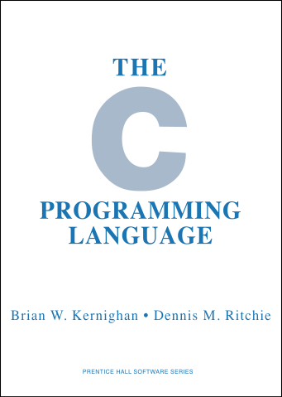

C - 1972 - compiled (#1 of 12)
C is a ubiquitous, omnipresent, mid-level, systems-oriented language
Produces the fastest code outside of Assembly
Compact, port-able, able to access HardWare (pointers, pointer manipulation, inline Assembly)
Gives power AND RESPONSIBILTY to programmer. NO BOUNDS CHECKING. Can overrun variables; C does not check length
Operating systems and most language compilers are written in C and/or C++
PL/1 influenced C
The C Library (libc / glibc) has similarities to Linux system calls
libc, when printing with buffered I/O, can run faster than handwritten Assembly that does not perform buffering
/* a comment - hello_c.c */ // also a comment
// compile with: gcc hello_c.c -o hello_c
#include <stdio.h>
int main ()
{
printf ("Hello, World! \n");
}

Slide 18
C’s behaviors (ref)
Compiled pgm size for Hello World: 24 kB
OO Model: None
Semi-colon requirements as stmt terminator: Required
Safer input into String objects; or routines that limit input: No
Concurrency (Single-threaded vs concurrent processing): Can start new threads via function calls
Program behavior on Divide by zero: Stop / Fatal error
Garbage Collector (for objects): No, N/A
Memory safe: No
Thread safe: No
DJ’s Difficulty Index: 6 out of 10
Language website: Search: C programming language
Frameworks: Kore, Vely, facil.io
Variable types: Integers (diff sizes, signed/unsigned), Floats, Char arrays, no booleans
Behavior with unused variables (must use every variable defined?): No
Can overrun variables: Yes
Error detection mechanism: None. Check the return value of a function call
Program behavior on Invalid File I/O: Continue
Pointer safe: No
Variable safe (overwrite, wrap-around, buff overruns): No
Goto statement: Yes
Release cycle: Several times per year for most compilers. glibc (GNU C library) every 6 months. C17 standard on June 2018. C23 due in 2024; draft is online

Slide 19
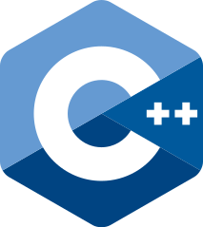
C++ - 1985 - compiled (#2 of 12)
Originally named C With Classes. Extended C with OO and numerous other features
Very complex language, Extensive standard library, Extensible framework with Standard Template Library (STL)
Most games and game engines are written in C++
Many modern-day language features appear to come from C++: Objects / Classes / Methods, Generics, Templates, Constructors, Lambdas, Namespaces, References, Semantics
Multiple ways to do a task in C++; Additionally, there is the C-style of programming. C++ should compile any C program
C++ techniques expand / extend with C++14, C++17, C++20. C++ appears to undergo extensive changes in new versions
In early years, language incompatibilities existed in different C++ implementations. C++98 received ISO standardization but Standard Template Library feature was incompatible with GNU and Microsoft compilers. Eventually Microsoft and GNU had to rewrite their compilers. Changes were made to Linux kernel (written in C) because C++ couldn't compile it
Linus Torvalds is not keen on having C++ code added to Linux kernel
// a comment - hello_c.cpp /* another comment - hello_c.cpp */
// compile with: g++ hello_cpp.cpp -o hello_cpp
#include <iostream>
using namespace std;
int main ()
{
cout << "Hello, World!" << endl;
}

Slide 20
C++’s behaviors (ref)
Compiled pgm size for Hello World: 25 kB
OO Model: Yes; requires developer to manage lifetime of objects
Semi-colon requirement as stmt terminator: Required
Safer input into String objects; or routines that limit input: Yes
Concurrency (Single-threaded vs concurrent processing): Can start new threads via function calls
Program behavior on Divide by zero: Stop / Fatal error
Garbage Collector (for objects): No
Memory safe: No
Thread safe: No
DJ’s Difficulty Index: 10 out of 10
Language website: isocpp.org
Frameworks: Boost, CLang, Qt, Wt
Variable types: Integers (diff sizes, signed/unsigned), Floats, Char, String object, Boolean
Behavior with unused variables (must use every variable defined?): No
Can overrun variables: Yes
Error detection mechanism: try/catch code block to detect error
Program behavior on Invalid File I/O: Continue
Pointer safe: No
Variable safe (overwrite, wrap-around, buff overruns): No
Goto statement: Yes
Release cycle: Several times per year for most compilers and for libc++ (C++ library). C++20 standard on December 2020. C++23 due TBD; draft is online

Slide 21

Python - 1991 - interpreted (#3 of 12)
Easier language that has taken the role of BASIC as a “first” language -- Widely used to learn programming
Used for applications, middleware, integration, data analytics, ML/AI
Popularity/flexibility comes from lots of core and 3rd-party libraries that are invoked with "import“ statement
Python interpreter has built-in debugger (pdb)
Python versions 2 and 3. Use version 3. Quick way to tell… v2: print “Hi” v3: print (“Hi”)
For new/changed program, interpreter stores translated byte-code in hidden subdirectory ( __pycache__ )
Indentation alignment rules can cause issues (one space too few/many and program does not run)
Oddness in the way its coded; some from PEP
Before a function is called, the interpreter must have already parsed the function. Generally, a line of code cannot call a function below it (but there is a caveat). Because of all this, the starting point of the program is generally at the BOTTOM of a source file
If a person gets access to a computer (esp. Linux) Python is more likely to be installed. Can’t run netcat? Type in your own!
#!/usr/bin/python3
# (on Linux the previous line specifies the interpreter)
# a comment - hello_py.py
# To run on Linux: ./hello_py.py
# To run on Windows and Linux: python3 hello_py.py
print ("Hello, World!")

Slide 22
Python’s behaviors (ref)
Compiled pgm size for Hello World: n/a
OO Model: Yes, optional
Semi-colon requirement as stmt terminator: No. Line break is stmt terminator
Safer input into String objects; or routines that limit input: Yes
Concurrency (Single-threaded vs concurrent processing): Std lib has Threading modules; Global Interpreter Lock allows concurrency but not multiprocessing
Program behavior on Divide by zero: Stopped by interpreter
Garbage Collector (for objects): Yes
Memory safe: Yes
Thread safe: Yes
DJ’s Difficulty Index: 3 out of 10
Language website: python.org
Frameworks: Django, Flask
Variable types: Number, String, Boolean, Object
Behavior with unused variables (must use every variable defined?): No
Can overrun variables: No
Error detection mechanism: try/except code block
Program behavior on Invalid File I/O: Continue
Pointer safe: Yes / n/a
Variable safe (overwrite, wrap-around, buff overruns): Yes
Goto statement: No
Release cycle: Minor release every October; Point releases every 2 months for duration of 18 months; some security fixes after this

Slide 23

JavaScript - 1995 - interpreted (#4 of 12)
Typically runs on client side by web browser to provide dynamic effects to a web page
Is usually tied closely to web browser for web pages; not standalone programs on the computer
Program can be embedded in HTML or called from HTML
Can be run from command line (and as backend program) with Node.js
To run in Linux: node program.js
// a comment - hello_js.js
/* another comment */
// JavaScript code is embedded in HTML file or called from HTML file
// run with: entering HTML file in a web browser
// file:///home/student/hello_js.html
document.write ("Hello, World!") ;
<html>
<body> <script type="text/javascript" src="hello_js.js"></script> </body>
</html>

Slide 24
JavaScript’s behaviors (ref)
Compiled pgm size for Hello World: n/a
OO Model: Yes, optional
Semi-colon requirement as stmt terminator: Required
Safer input into String objects; or routines that limit input: Yes
Concurrency (Single-threaded vs concurrent processing): Event Loop for asynchronous actions
Program behavior on Divide by zero: Stopped by interpreter
Garbage Collector (for objects): Yes
Memory safe: Yes
Thread safe: Yes
DJ’s Difficulty Index: 3 out of 10
Language website: ecma-international.org/publications-and-standards/standards/ecma-262/
Frameworks: NodeJS (js runtime env), jQuery, Web browsers, Angular, METEOR, Express, React
Variable types: Number, String, Boolean, Object
Behavior with unused variables (must use every variable defined?): No
Can overrun variables: No
Error detection mechanism: try/catch code block
Program behavior on Invalid File I/O: Continue
Pointer safe: Yes / n/a
Variable safe (overwrite, wrap-around, buff overruns): Yes
Goto statement: No, but keyword exists in language
Release cycle: ECMA-script yearly. Node.js every 6 months

Slide 25

PHP - 1995 - interpreted (#5 of 12)
General-purpose scripting language geared toward web development
Server-side of websites
On Linux, can be run from the command line
Program does not stop on error; keeps running
<?php
// a comment - hello_php.php # another comment
// To run on Linux: php hello_php.php
echo "Hello, World!";
?>

Slide 26
PHP’s behaviors (ref)
Compiled pgm size for Hello World: n/a
OO Model: Yes, optional
Semi-colon requirement as stmt terminator: Not used
Safer input into String objects; or routines that limit input: Yes
Concurrency (Single-threaded vs concurrent processing): With the “parallel” class that requires a build of PHP with ZTS (Zend Thread Safety)
Program behavior on Divide by zero: Continue running
Garbage Collector (for objects): Yes
Memory safe: Yes
Thread safe: Yes
DJ’s Difficulty Index: 2 out of 10
Language website: php.net
Frameworks: Web servers, Laravel, CodeIgniter, CakePHP, Symfony, Zend
Variable types: Number--Integer, Number-Float, String, Boolean, Object
Behavior with unused variables (must use every variable defined?): No
Can overrun variables: No
Error detection mechanism: try/catch code block
Program behavior on Invalid File I/O: Continue
Pointer safe: Yes / n/a
Variable safe (overwrite, wrap-around, buff overruns): Yes
Goto statement: Yes
Release cycle: Minor releases once per year around Nov/Dec. Point releases more often; perhaps one per month

Slide 27
Ruby - 1995 - Interpreted (#6 of 12)
Created from a desire for an object-oriented scripting language – not Perl or Python
Around 2005, popularity soared due to Ruby on Rails web framework written in Ruby
A focus on simplicity and productivity. Elegant syntax - natural to read; easy to write
Used primarily for Web development, Static website page generation, DevOps automation
Behind the scenes, everything is an object (like in Python)
Large standard library, especially for web stuff (YAML, JSON, XML, OpenSSL, etc )
On creating variables: start with lowercase creates Variable; uppercase creates Constant. Reassign Constant? Warns, continues
VARIETY of ways to perform terminal input/output but all of them are easy/straightforward
Ruby is not widely used to learn programming (first language) BUT it is free-form, quite forgiving, intuitive error messages
# a comment - hello_rb.rb # To run on Linux: ruby hello_rb.rb
puts "Hello, World!“
print “Type in your first name: “
name = gets # but normally we use gets.chomp to remove the carriage return char passed from the keyboard
print “Your name is “ + name + “\n”
print “Your name is #{name}”
apple = 5 ; pear = “A pear” ; apple = apple + 1
if apple == 6 then puts “HaHa” ; pear = 2 ; bic = “awesome” ; end
Ruby

Slide 28
Ruby’s behaviors (ref)
Compiled pgm size for Hello World: n/a
OO Model: Yes, optional
Semi-colon requirement as stmt terminator: Optional. Line break is stmt terminator but is also optional. Sometimes we can have multiple stmts on same line.
Safer input into String objects; or routines that limit input: Yes
Concurrency (Single-threaded vs concurrent processing): Native threads and fibers (lightweight)
Program behavior on Divide by zero: Stopped by interpreter
Garbage Collector (for objects): Yes
Memory safe: Yes
Thread safe: Yes
DJ’s Difficulty Index: 4 out of 10
Language website: ruby-lang.org
Frameworks: Ruby on Rails
Variable types: Number--Integer, Number—Float, String, Boolean
Behavior with unused variables (must use every variable defined?): No
Can overrun variables: No
Error detection mechanism: Exception handling
Program behavior on Invalid File I/O: Continue
Pointer safe: Yes / n/a
Variable safe (overwrite, wrap-around, buff overruns): Yes
Goto statement: No
Release cycle: 1+ times per year across 4 active release trains

Slide 29
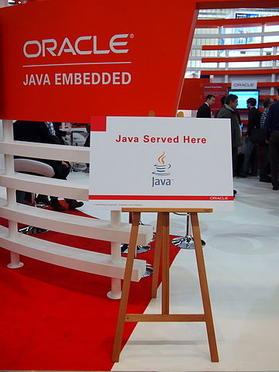
Java - 1995 - compiled to Java byte-code; run on Java virtual machine (#7 of 12)
Designed to be safer than C, easier OO model than C++, and the same program can run on multiple OS platforms
Compiled to Java byte-code; run on Java virtual machine (JVM)
A concept of the JVM: multi-platform code; write once, run anywhere (limitations apply such as OS filename formats, window icons)
Java is Object-Oriented. Java language reQUIRES OO from the get-go. OO is not optional in Java
Java syntax is known to be verbose
Keyboard input is possible but can be lengthy. To avoid variable overruns, some peeps write routines that include backspacing
Java is used frequently for the back-end of websites, and for business process logic
Java was the official language for Android app development until Kotlin became the preferred language in 2018
/*************************************************************************
* Multi-line comment
*************************************************************************/
// Single line comment
// compile with: javac hello_java.java
// This compiles to filename: hello_java.class
// run with: java hello_java
public class hello_java {
public static void main(String[] args) {
int orange = 5;
System.out.println("Hello, World!");
}
}

Slide 30
Java’s behaviors (ref)
Compiled pgm size for Hello World: less than 1 kB (427 bytes)
OO Model: Yes; mandatory
Semi-colon requirement as stmt terminator: Required
Safer input into String objects; or routines that limit input: Yes
Concurrency (Single-threaded vs concurrent processing): Can start new threads
Program behavior on Divide by zero: Stop / Fatal error
Garbage Collector (for objects): Yes
Memory safe: Yes
Thread safe: Yes
DJ’s Difficulty Index: 7 out of 10
Language website: oracle.com/java
Frameworks: Spring
Variable types: Integers (diff sizes, signed/unsigned), Floats, Char, Byte, String, Boolean
Behavior with unused variables (must use every variable defined?): No
Can overrun variables: No
Error detection mechanism: try/catch/finally block; try <resource> / catch block
Program behavior on Invalid File I/O: Continue
Pointer safe: Yes
Variable safe (overwrite, wrap-around, buff overruns): Yes
Goto statement: No, but keyword exists in language
Release cycle: Every March and September

Slide 31

Kotlin - 2011 - compiled to Java byte-code; run on Java virtual machine (#8 of 12)
Kotlin was designed as an easier alternative to Java that runs on the JVM
Kotlin compilation speed is slow... ... Execution speed is comparable to Java
Became the official language for Android in 2018
JVM-related names to compile and run might be tricky for a beginning user
// a comment - hello_kt.kt /* another comment */
// Compile with: kotlinc hello_kt.kt
// this ends as <name>.kt (must end in .kt)
// we compile to name: Hello_ktKt.class
// run with: java Hello_ktKt
// this is H<name>Kt (uppercase H, uppercase K, lowercase t)
fun main () {
println ("Hello, World!")
}

Slide 32
Kotlin’s behaviors (ref)
Compiled pgm size for Hello World: less than 1 kB (645 bytes)
OO Model: Yes, optional
Semi-colon requirement as stmt terminator: Optional. ; is NOT usually required
Safer input into String objects; or routines that limit input: Yes
Concurrency (Single-threaded vs concurrent processing): Coroutines (lightweight threads)
Program behavior on Divide by zero: Stop / Fatal error
Garbage Collector (for objects): Yes
Memory safe: Yes
Thread safe: Yes
DJ’s Difficulty Index: 5 out of 10
Language website: kotlinlang.org
Frameworks: Ktor, Kweb, Javalin, Spark , Spring Boot
Variable types: Integers (diff sizes, signed/unsigned), Floats, Char, Byte, String, Boolean (like Java; on JVM)
Behavior with unused variables (must use every variable defined?): No
Can overrun variables: No
Error detection mechanism: try/catch code block to detect error
Program behavior on Invalid File I/O: Continue
Pointer safe: Yes
Variable safe (overwrite, wrap-around, buff overruns): Yes
Goto statement: No
Release cycle: Minor release about every 6 months. Point releases can be quite frequent

Slide 33
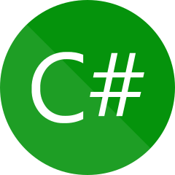
C# - 2000 - compiled (Microsoft Windows platform) (#9 of 12)
Somewhat of a Microsoft variant to Java
C# is currently quite popular as a language on the Microsoft Windows platform
Compiled to Intermediate Language (IL) in .exe file; run by Common Language Runtime with a Just-In-Time compiler
// a comment - hello_cs.cs
// compile with: csc hello_cs.cs --OR-- MS-Visual Studio
namespace HelloWorld
{
class Hello {
static void Main (string[] args)
{
System.Console.WriteLine ("Hello, World!");
}
}
}

Slide 34
C#’s behaviors (ref)
Compiled pgm size for Hello World: 4096 bytes standalone (Windows)
OO Model: Yes; optional but highly pushed
Semi-colon requirement as stmt terminator: Required
Safer input into String objects; or routines that limit input: Yes
Concurrency (Single-threaded vs concurrent processing): Thread and Task object classes
Program behavior on Divide by zero: Stop / Fatal error
Garbage Collector (for objects): Yes
Memory safe: Yes
Thread safe: Yes
DJ’s Difficulty Index: 7 out of 10
Language website: learn.microsoft.com/en-us/dotnet/csharp/
Frameworks: ASP.Net
Variable types: Integers (diff sizes, signed/unsigned), Floats, Char, String, Boolean
Behavior with unused variables (must use every variable defined?): No
Can overrun variables: No
Error detection mechanism: try/catch code block to detect error
Program behavior on Invalid File I/O: .Net throws exception
Pointer safe: Yes
Variable safe (overwrite, wrap-around, buff overruns): No
Goto statement: Yes
Release cycle: Visual Studio is released about twice per month

Slide 35

Go - 2009 - compiled (#10 of 12)
Developed by Google; used at Google -- their much-preferred alternative to C++
Core objectives are code safety and simplicity; minimalist approach. Minimum # of keywords. Only one way to perform a loop in Go
Requires program to be "production-ready" code
Opening brace MUST be on same line as function name
Compiler does not handle some arrangements of statements / blocks over multiple lines
Aborts compilation on Unused variables
Commenting out a section of code can be a “bear” because non-referenced variables abort the compilation
Native multitasking (Goroutines)
A Go program can require a lengthy list of import statements
Other languages have several loop structures (e.g. for, do/until, do/while), Go implements all or these with the “for” loop
Keyboard input is possible in Go, but this requires several “import” statements and a few lines of code
package main
// a comment - hello_go.go /* another comment - hello_go.go */
// compile with: go build hello_go.go
import "fmt"
func main () {
fmt.Println ("Hello, World!")
}

Slide 36
Go’s behaviors (ref)
Compiled pgm size for Hello World: 1.2 MB includes run-time by default
OO Model: OO-ish; not full OO model
Semi-colon requirement as stmt terminator: Optional
Safer input into String objects; or routines that limit input: Yes
Concurrency (Single-threaded vs concurrent processing): Native with Go-routines
Program behavior on Divide by zero: Stop / Fatal error
Garbage Collector (for objects): Yes
Memory safe: Yes
Thread safe: Yes
DJ’s Difficulty Index: 5 out of 10
Language website: go.dev
Frameworks: Goji, Gin, Beego, Echo, Buffalo, Gorilla
Variable types: Integers (diff sizes, signed/unsigned), Floats, String, Boolean
Behavior with unused variables (must use every variable defined?): Yes
Can overrun variables: No
Error detection mechanism: functions return err code in addition to value result
Program behavior on Invalid File I/O: Continue
Pointer safe: Yes
Variable safe (overwrite, wrap-around, buff overruns): No
Goto statement: Yes
Release cycle: Every 6 months in February and August

Slide 37

Rust - 2010 - compiled (#11 of 12)
Developed by Mozilla Inc. Used for Firefox and other projects
Chosen as alternative to C for use in the Linux kernel
Warns when variables are unused; opening brace can be on subsequent line
Feature-rich; significant learning curve
// a comment - hello_rs.rs
// Compile with rustc hello_rs.rs
fn main ()
{
println! ("Hello, World!");
}
Licensed under the Creative Commons Attribution-Share Alike 4.0 International license

Slide 38
Rust’s behaviors (ref)
Compiled pgm size for Hello World: 381 kB
OO Model: OO-ish; not full OO model https://doc.rust-lang.org/book/ch17-00-oop.html
Semi-colon requirement as stmt terminator: Required
Safer input into String objects; or routines that limit input: Yes
Concurrency (Single-threaded vs concurrent processing): Can start new threads via function calls
Program behavior on Divide by zero: Stop / Fatal error
Garbage Collector (for objects): No*. At compile time perform drop() at end of variable lifetime. Other options in std lib and in crates
Memory safe: Yes
Thread safe: Yes
DJ’s Difficulty Index: 8 out of 10
Language website: rust-lang.org
Frameworks: Actix, Rocket, Axum, warp
Variable types: Integers (diff sizes, signed/unsigned), Floats, Char, Boolean, String object
Behavior with unused variables (must use every variable defined?): No
Can overrun variables: No
Error detection mechanism: Result<T, E> for recoverable error; panic for unrecoverable error
Program behavior on Invalid File I/O: Continue
Pointer safe: Yes
Variable safe (overwrite, wrap-around, buff overruns): No
Goto statement: No
Release cycle: Stable release every 6 weeks

Slide 39

Swift - 2014 - compiled (#12 of 12)
Developed as a replacement for Apple’s older Objective C. Swift is used heavily on Apple platforms
On Apple platforms, Swift uses Objective C runtime library (interoperability). Different runtime library on non-Apple platforms
Extensive Object model and features
C-style language but several C-style constructs are changed/removed to reduced errors (see Wikipedia)
On creating variables… var keyword (optional) creates Variable but let keyword creates a Constant
Compiler nicely parses multi-line statements / code blocks with braces on different lines
Swift supports “Optionals” where a variable (var) might be nil and not have a value. Some functions REQUIRE a value and might need to be forced, e.g. with an (!) exclamation point. This can complicate things when you need a “var” and not a “let” (constant)
A code anomaly can generate several error or warning messages; not always identifying the actual problem or the parameter that is causing the problem. ‘Good times in knowing where to place / NOT place ! or omitting a : before an optional variable type
// a comment - hello_swift.swift
// compile with: swiftc hello_swift.swift -o helloswift
print ("Hello, World!")
var otherstring: String = “All kinds of stuff”
var response: String! = “ “
print (“Enter a string: “, terminator: “” )
response = readLine ()
print (response!) ; print (otherstring)
Licensed under the Apache License, Version 2.0 Copy of License: https://www.apache.org/licenses/LICENSE-2.0

Slide 40
Swift’s behaviors (ref)
Compiled pgm size for Hello World: 21 kB
OO Model: Yes
Semi-colon requirement as stmt terminator: Optional; can be used to place several stmts on one line
Safer input into String objects; or routines that limit input: Yes
Concurrency (Single-threaded vs concurrent processing): Built-in asynchronous and parallel code. Introduced in version 5.3
Program behavior on Divide by zero: Stop / Fatal error
Garbage Collector (for objects): Yes (Automatic Ref Count)
Memory safe: Yes
Thread safe: Yes
DJ’s Difficulty Index: 7 out of 10
Language website: swift.org
Frameworks: Cocoa, Cocoa Touch
Variable types: Integers (diff sizes, signed/unsigned), Floats, Character, String, Object, Boolean
Behavior with unused variables (must use every variable defined?): No (Swift prints a warning)
Can overrun variables: No
Error detection mechanism: do/catch code block; defer to ensure cleanup is run
Program behavior on Invalid File I/O: Continue
Pointer safe: Yes, generally (Ptrs are not exposed, by default)
Variable safe (overwrite, wrap-around, buff overruns): Yes
Goto statement: No
Release cycle: Minor releases about twice a year; Point releases between them

Slide 41

Julia - 2012 - interpreted by default (#13 of 12)
Work on the language was started in 2009 with the goal of producing a language that was free and fast. Dynamically typed
Features that are well-suited for numerical analysis and computational science. Data science & Visualization. ML
Also useful for systems programming, High-level Synthesis tool, hardware, FPGA, web programming
Programs can be compiled into binaries. Can be compiled into smaller binaries without the Runtime and garbage collector
Direct calling of C and Fortran libraries without “glue” code. Includes special (keyword) support for calling C language libraries. Can call C functions directly without wrappers or special APIs.
Can work with Python, R, Rust, C++, Java, Scala, SQL. Call Python with PythonCall.jl, PyCall.jl Call R with RCall.jl Call Java and Scala with JavaCall.jl
Speed of compiled Julia can approach C, but with the ease of use of a scripting language like Python
Does not allow a space between function name and parenthesis: println (“This does not work.”) ; println(“This works.”)
# a comment - hello_jl.jl
# Julia is interpreted; not compiled.
# To run on Linux: julia hello_jl.jl
println("Hello, World!")
print("Enter a line of text: ") ; line_in = readline()
println("You Entered: " * line_in)
# readline() Does not add newline (\n) to string. String concatenation is * char

Slide 42
Julia’s behaviors (ref)
Compiled pgm size for Hello World: n/a
OO Model: Yes; optional
Semi-colon requirement as stmt terminator: Optional; can be used to place several stmts on one line
Safer input into String objects; or routines that limit input: Yes
Concurrency (Single-threaded vs concurrent processing): Tasks, Coroutines (lightweight threads), Multi-threading, Channels
Program behavior on Divide by zero: Continue; INF value
Garbage Collector (for objects): Yes
Memory safe: Yes
Thread safe: Yes
DJ’s Difficulty Index: 6 out of 10
Language website: JuliaLang.org
Frameworks: Genie, JuMP, Bukdu, Merly
Variable types: Number (underlying Integers, Floats, Complex, Rational), String, Object
Behavior with unused variables (must use every variable defined?): No
Can overrun variables: No
Error detection mechanism: try/catch/finally
Program behavior on Invalid File I/O: Continue
Pointer safe: Yes, generally (Ptrs are not exposed, by default)
Variable safe (overwrite, wrap-around, buff overruns): Yes
Goto statement: No; but @label @goto macros
Release cycle: About 3 releases per year

Slide 43

Scala - 2004 - compiled to Java byte-code; run on Java virtual machine (#14 of 12)
Designed to be concise, and address criticisms of Java. Strong statically typed language. Supports object-oriented programming and functional programming
Modern and expansive language features somewhat similar/akin to Swift
Similar to Swift: On creating variables… var keyword creates Variable but val keyword creates a Constant
Some companies are using Scala for back-end processing or as a replacement for Java. Used for “Big Data Applications”
Can be used for mobile apps (Android), embedded devices (Raspberry Pi, IoT devices (sensors, UAVs)
A few business leaders mention Scala’s high learning curve and advise that they might not have chosen Scala if they were aware of this
/// a comment - hello_sc.sc
// Scala can be interpreted (REPL on-the-fly compiler) or compiled
// To run on Linux as interpreter: scala hello_sc.sc
// But to compile and run, compile with: scalac hello_sc.sc
// then run with: scala hello_sc
//Note: Executable file is hello_sc.class and is determined by object name
import scala.io.StdIn.readLine
object hello_sc {
def main (args : Array [String]) : Unit = {
var mydata = ""
println ("Hello, World!")
print ("Enter a line of data: ") ; mydata = readLine ()
println ("You entered: " + mydata)
}
}
/* readLine() does not add newline (\n) to string. String concatenation is + char */
This file is licensed under the Creative Commons Attribution 4.0 International license.

Slide 44
Scala’s behaviors (ref)
Compiled pgm size for Hello World: less than 1 kB (571 bytes)
OO Model: Yes; more or less mandatory
Semi-colon requirement as stmt terminator: Optional; can be used to place several stmts on one line
Safer input into String objects; or routines that limit input: Yes
Concurrency (Single-threaded vs concurrent processing): native Java threads; Scala Future that returns value after computation
Program behavior on Divide by zero: Stop / Fatal error
Garbage Collector (for objects): Yes
Memory safe: Yes
Thread safe: Yes
DJ’s Difficulty Index: 7 out of 10
Language website: scala-lang.org
Frameworks: Play, Chaos, Lift, BlueEyes, Slick
Variable types: Byte, Integers (diff sizes), Floats, String, Object, Boolean
Behavior with unused variables (must use every variable defined?): No
Can overrun variables: No
Error detection mechanism: try/catch/finally, Try/Success/Failure, Option/Some/None, Either/Left/Right
Program behavior on Invalid File I/O: Continue
Pointer safe: Yes, generally (Ptrs are not exposed, by default)
Variable safe (overwrite, wrap-around, buff overruns): Yes
Goto statement: No
Release cycle: Minor releases about twice a year; Point releases between them

Slide 45
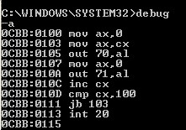
“Hello World!” in Assembly (Linux)
; a comment - hello_asm.asm
; To Assemble and Link 32-bit code in Linux with NASM:
; nasm -f elf hello_asm.asm (add -g for debug)
; ld -m elf_i386 hello_asm.o -o hello_asm
; To Assemble and Link 64-bit code in Linux with NASM:
; nasm -f elf64 hello_asm.asm (add -g for debug)
; ld hello_asm.o -o hello_asm
section .data
helloString db "Hello, world!",10,0 ; String, LF, ASCIIZ
len1 equ $ - helloString ; length of string (14)
section .text
global _start
_start:
; Write String to Stdout w Syscall
mov edx,len1 ; load string length
mov ecx,helloString ; load pointer to the string to write
mov ebx,1 ; load file handle (1 is stdout)
mov eax,4 ; load system call number (sys_write)
int 0x80 ; invoke Interrupt to call OS
;Exit Program
mov ebx,0 ; load exit code (0 = normal completion)
mov eax,1 ; load system call number (sys_exit)
int 0x80 ; invoke Interrupt to call OS
; note 32-bit hello_asm executable is 9076 bytes 64-bit is 9424 bytes Much of this is Linux exe format

Slide 46
Languages – Compile and Execution speeds
Language Compile speed Execution speed
C - Very fast the FASTEST
C++ - Fast Fast
Python - n/a Moderately Fast (but slower than PHP)
JavaScript - n/a Slow
PHP - n/a Fast (but slower than C, C++, Go, Rust. Very fast for an interpreter)
Ruby - n/a Moderate (*)
Java - Moderate Moderate
C# - Moderate Moderate
Kotlin - Slow Moderate (equivalent to Java)
Go - Moderate Fast (slightly slower than C++, Rust)
Rust - Moderate Fast (similar to C++, sometimes faster)
Swift - Moderate Fast (slightly slower than PHP)
(*) The Moderate execution speed languages are similar, given the natural variances in the test trials and their tendencies of time spent in user and system execution. They are also similar in wall-clock times

Slide 47
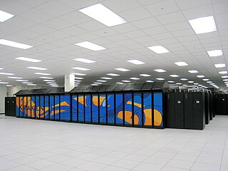
G-P L vs Systems Language vs Applications Language
G-P L - generic features that allows the same code on different platforms
Systems Language – to create systems software: OS, compilers, interpreters, assemblers, utilities
Some Systems programming languages…
Legacy systems languages:
Assembly, PL/1, Pascal
Current systems languages:
C, C++, Rust, Go, Swift
Some current Applications languages:
C++, Rust, Go, Swift, C#, Java, Kotlin, Python, JavaScript, PHP, Ruby, Perl
(compiled) (interpreted)

Slide 48
Languages Used to write Compilers, Interpreters
Language Written in Used for
C C and C++; orig New B OSes, Languages, glibc, embedded systems
C++ C and C++; orig C OSes, Games
Perl C "Glue"/integration language
Python C applications, middleware, integration, ML/AI
JavaScript C website client-side in browser
PHP C website server-side
Ruby C
Java Java (compiler), C (JRE); orig C and some C++ libs
applications, middleware, Android apps
C# C#; orig C and C++ MS-Windows applications
Kotlin Java and Kotlin; orig Java applications, Android apps
Go 88% Go, 6% Assembly; orig was C applications
Rust Rust; orig OCaml applications, Linux Kernel (OS)
Swift 50% C++, 5% C, 41% Swift (std lib) iPhone/iPad apps, MacOS applications

Slide 49
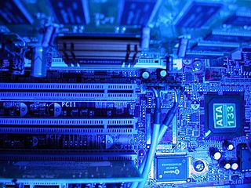
Languages Used to write OSes
OS Written in
Android - mostly C, then a layer of Java, apps in Java and Kotlin
iOS - C, C++, Objective C, Swift, Assembly
Linux - C, small amount of Assembly, now adding some Rust
MacOS - C, C++, Objective C, Swift, Assembly
Windows - C, C++, C#, Assembly
(Before C, most OSes and languages were written in Assembly)

Slide 50

Brief considerations in choosing your language
For certain tasks it is easy: JavaScript/frameworks for browser; PHP, Python, Java, Ruby for back-end
For other tasks the choice is more nuanced
Whether we can use or want to use Interpreted code, Compiled binary, or Compiled bytecode
3 Factors that Help in choosing language(s) to use:
Platform, OS
Languages used by a certain type of program or industry
Preference of language style, vulnerabilities, features
D.J.'s Picks:
(beginner) PHP from command line or Ruby; Kotlin or Python as a second or third language
(then) C
(followed by) Go or Rust
Some people say C needs to go away or C is going away...
D.J. believes C will be around for a long time: C is the base of OSes, glibc, and many languages

Slide 51
How does C-I-A manifest itself in code?
Let's review::
Confidentiality - Keep private information private (Disclosure)
Integrity - Data/program/function/Design is not changed (Alteration)
Availability - Data/program/system can be accessed and operated as designed (Destruction)
CIA inverse DAD
There are tensions among the C-I-A attributes
Example: A program keeps running (availability) with an I/O error or divide by zero but the results are incomplete or less accurate (integrity)
Example: A program is coded well to stop running on questionable input or program errors (integrity) but a minor issue prevents system processing from occurring (availability)
Example: The requirement of encryption (confidentiality) possesses a risk of changing data (integrity) or making data unavailable (availability)

Slide 52
Types of S/W Vulnerabilities in Languages (1)
Insufficient Input Validation
Overwriting a variable because Input String is too long
Input is appended to SQL/DB request and crafted field input modifies query
Input is appended to OS request and crafted field input modifies query
Result: Running unintended queries/commands. Directory traversal is a targeted example of this
Too large a value (e.g. number) can overflow into adjacent variable (integer overflow)
Too large/small/different a value can alter program logic in unintended/unchecked way
Unanticipated/unchecked error conditions can alter program logic in unintended/unchecked way
Unanticipated program stop OR continuation from an error conditions can alter program logic in unintended/unchecked way
Developer Misunderstands the behavior of statements, functions, frameworks, anything else... ... (logic, program errors)
Example: In C / C++ / Python, a logic error occurs if we use the exit statement without parentheses
Example: Python round function can truncate (round down) at .5 per the function’s Design
Addressing invalid memory - Pointer de-referencing to a null value
Resource exhaustion / memory leaks

Slide 53
Types of S/W Vulnerabilities in Languages (2)
Time of Check / Time of Use (TOC/TOU)
Example: At DC30 we saw the file substitution vulnerability with the Apple platform Zoom client Installer
Race conditions
Different or upgraded compiler/interpreter versions
Bugs in Assemblers, compilers, interpreters, linkers, Language libs, run-time
Examples:
Mismatch between NASM assembler and linker prevented 64-bit source code from displaying in gdb (GNU Debugger)
Assembly instruction to move 1 to rax 64-bit register ( mov rax, 1 ). Assembler inserts instruction to move 1 to eax 32-bit register: the lower half of rax
Processors have bugs. OSes code around them (Pentium FDIV, Meltdown, Spectre, Zenbleed, Speculative Store Bypass)
Bugs, vulnerabilities in libraries that you acquire; and in Frameworks
Example: Log4j, VM2 NodeJS JavaScript sandbox library
Intentional or Malicious changes by... ... Someone
Example: SolarWinds breach

Slide 54
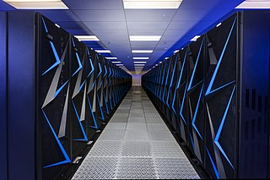
Recommendations from Observations in Vulnerability Databases
I Recommend good input validation, and edge case consideration during CODING and testing
Code and test for 7 edge cases:
Exact/max value (e.g. 25 characters in 25 length field)
Zero length entry
One character
Length +/- 1
and Length +/- 2
During application design and program design, identify the size/range limits of variables
For functions/subroutines, add comments to indicate the size/range constraints of variables
Until a developer is extremely familiar with a language, test every logic branch
Languages evolve. Changes in Statements/Keywords can break a program in the future. Review language release notes
Watch out for: Use of current keywords/functions, Future keywords
Frameworks can introduce vulnerabilities. IDEs can change/break an interpreted program’s behavior
Valgrind and profilers are great testing tools
Become familiar with using debuggers: gdb (GNU DeBugger), pdb (Python DeBugger), Visual Studio debugger
For Linux, AWS reduces Pointer abuse with their Gravaton processors. Compilers produce code to protect pointer operations
From a tough, yet beloved, Systems Analyst lady who became a Dev Manager and Department Director: I should be able to put my BUTT on the keyboard and the program not crash… … …

Slide 55
Counting things... Variations in the Ways Languages Process Loops
C, C++, C#, Java, JavaScript, Go, PHP
for (x = 1; x < 11; x++) print the number ; // counts to 10 D.J. prefers to use x <= 10 but this can generate more Assembly instructions
Python
for x in range (1, 10): # counts to 9
Ruby
for x in 1 .. 10; print the number ; end # counts to 10
for x in 1 … 10; print the number ; end # counts to 9
Kotlin
for (x in 1 .. 10) print the number // counts to 10
Rust
for x in 1 .. 10 { print the number } // counts to 9
for x in 1 ..= 10 { print the number } // counts to 10
Swift
for x in 1 ... 10 { print the number } // counts to 10
for x in 1 ..< 10 { print the number } // counts to 9
J | O | H | N | S | O | N | - | S | M | I | T | H | \0 | ??? | ???
4012 | 4013 | 4014 | 4015 | 4016 | 4017 | 4018 | 4019 | 4020 | 4021 | 4022 | 4023 | 4024 | 4025 | 4026 | 4027
0 | 1 | 2 | 3 | 4 | 5 | 6 | 7 | 8 | 9 | 10 | 11 | 12 | 13 | 14 | 15
1 | 2 | 3 | 4 | 5 | 6 | 7 | 8 | 9 | 10 | 11 | 12 | 13 | 14 | 15 | 16
Mem Addresses
Index
PTR
Subscript
There are numerous vulnerabilities in the CVE database that are caused by “counting” errors … …

Slide 56
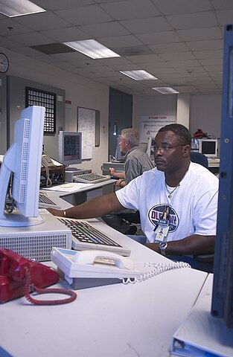
Traditional Resources for Vulnerability Prevention (1)
CVE Database by Mitre Corp - cve.mitre.org --transitioning-to--> www.cve.org
cve.org/ResourcesSupport/FAQs
Search - cve.mitre.org/cve/search_cve_list.html
NIST National Vulnerability Database
nvd.nist.gov/vuln/detail/CVE-yyyy-nnnnn
NIST Common Platform Enumeration (CPE)
https://nvd.nist.gov/products/cpe
CWE – Common Weakness Enumeration (in hardware and software)
cwe.mitre.org
Center for Internet Security (CIS)
CIS Controls, CIS Benchmarks, Hardened Images
https://www.cisecurity.org/

Slide 57
Traditional Resources for Vulnerability Prevention (2)
OWASP
Cheatsheat Series – Numerous languages, platforms, implementations, technologies,
vulnerabilities
https://cheatsheetseries.owasp.org/IndexProactiveControls.html
API Security Top 10 - 2023
https://owasp.org/www-project-api-security/

Slide 58

Conclusion
Sooo, which language SHOULD we use for less vulnerable code??
No Clear Winner. But … …
Newer languages (e.g. Kotlin, Swift, Go, Rust) provide some features that can reduce bugs in some cases
Objects / OO-ish behavior (they don’t overrun variables easily); Easier object handling (fewer mistakes); Efficient garbage collection (reduces resource exhaustion); Less dependence on pointers (reduces data errors, resource exhaustion, program crashes)
Interpreters offer these benefits, good input protection, good protection of variables but interpreters are less suited for systems work and high performance applications (like video games)
ALL languages have some desirable use-cases (even C for OSes and languages)
For ANY language we still need to exercise due care with the ideas that are presented here today
We have outlined a few ways to foster less buggy/vulnerable code
We have provided Examples to start programming in 12 languages

Slide 59

Remember: There is ALWAYS another … B ug … …
Thank you! D.J. Davis (ZeroRingDefender) ZeroRingD@gmail.com Twitter/X: @ZeroRingD
https://github.com/ipv3/DC31-BIC/
< Slide deck - Program examples - Set up, back up, restore Linux - GDB commands />
But we’re not done yet … … …
Let’s take a look at the Linux guides now… !

