Slide 1






Variational quantum eigensolver
Abhijit Chakraborty
Department of Physics and Astronomy, Middle Tennessee State University
Interstate quantum hackathon for beginners 2026
Scan me!

Slide 2

Logistics
Lecture recordings, slides, and notebooks are available on Github (public repository):
https://github.com/iq-hackathon/IQ-Hackathon-Fall-2026-Beginners
The materials will be uploaded after the lecture.
Challenges will be published on Thursday October 22, 2026.
You’re allowed to form a team of up to 5 people (look out for email with more instructions).
You’ll be given three tracks to choose from (three topics covered in today’s lecture):
    Variational quantum eigensolvers
    Quantum machine learning
    Quantum approximate optimization algorithm
Github QR code
Scan me!
More resources from IBM:
https://ibm.biz/IBMQFF26
VQE
MTSU
October 16, 2026
1

Slide 3
What is optimization?
Finding the best choice among many possible options.
Cost function
Variables
Constraints
The quantity you want to make as small or as large as possible, such as time, cost or energy.
The choices you are free to adjust in order to change the objective.
The rules a valid answer must follow, such as a budget or a size limit.
Everyday examples:
Minimize time
Maximize value
Getting to work
Grocery shopping
Pick the route and departure time that get you there fastest, within the tolls you are willing to pay.
Fill the cart with the most useful food while staying under your weekly budget.
VQE
MTSU
October 16, 2026
2
Notes:
Poll 1 here

Slide 4
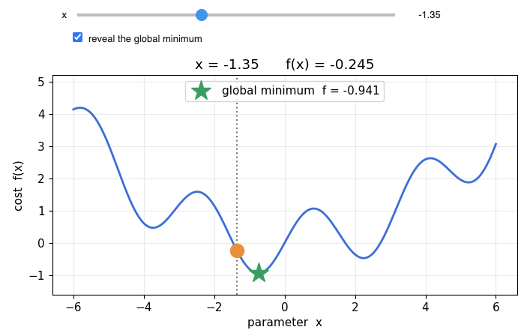

Mathematical formulation of optimization
A cost function with variables.
$$f\left(x\right)=0.1 x^{2}+sin\left(2x\right)$$
VQE
MTSU
October 16, 2026
3

Slide 5

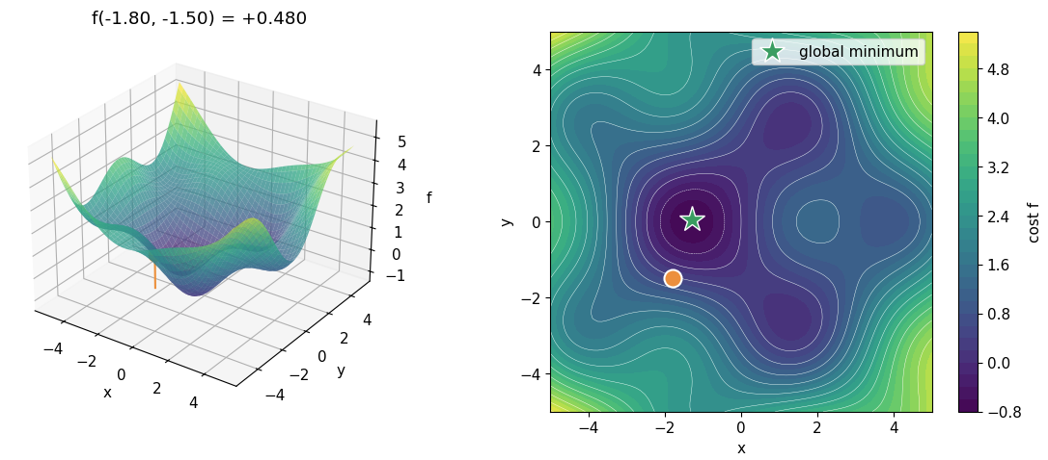

Optimization with two parameters
$$f\left(x,y\right)=0.1 {(x}^{2}+y^{2})+sin\left(x\right) cos⁡(y)$$
VQE
MTSU
October 16, 2026
4

Slide 6
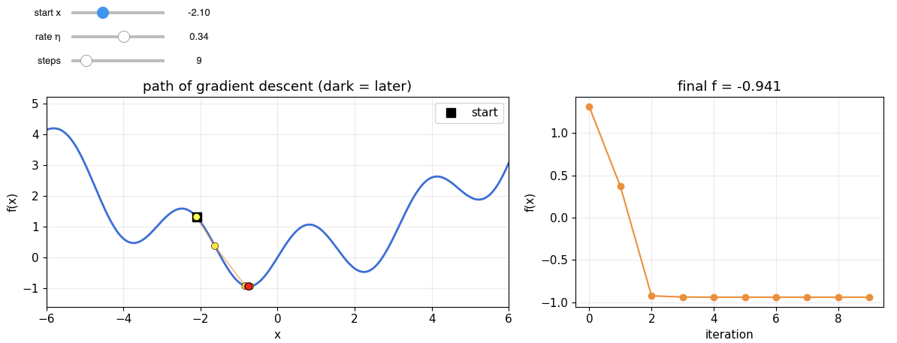

Optimization with multiple parameters
It’s very hard to visualize the cost function values (energy landscape) for multiple parameters. More than 3-d plot.
How can we find the optimal value (minimum) in these cases? → Optimization algorithms.
Gradient-based algorithms:
Move in the direction of maximum decrease of the cost function at each step.
$$x_{new}=x_{old}−η ∇f(x_{old})$$
Learning rate
Gradient
Gradient-based: Stochastic gradient descent, ADAM, BFGS etc.
Problem: Getting stuck in a local minima.
VQE
MTSU
October 16, 2026
5

Slide 7
Optimization with multiple parameters
Gradient-free algorithms
Some kind of grid-based search process.
Gradient-based: Nelder-Mead, COBYLA, SPSA etc.
Problem: Grid search, modifications of greedy-search.
Advantage: More possibility of avoiding local minima. Useful for quantum computers, less experimentally costly.
Q: Where does quantum come into all this?
VQE
MTSU
October 16, 2026
6
Notes:
Poll 2

Slide 8
Nature optimizes too: quantum systems settle into the lowest-energy state they can reach.
In quantum mechanics, many questions become: find the configuration that minimizes the energy of the system.

Slide 9
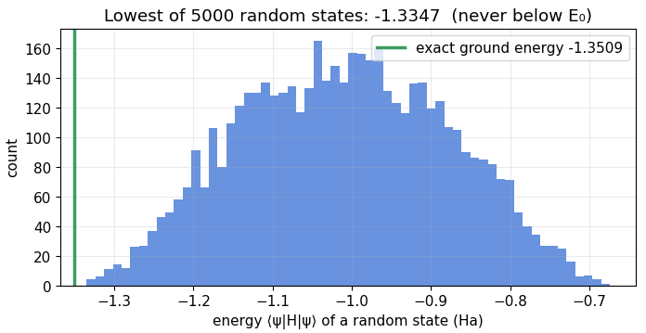
Example: Finding the ground state of a molecule
One of the crucial problems in quantum chemistry
Problem
What is optimized?
Why it is useful?
Given a molecule, which arrangement of its electrons has the lowest possible energy?
The parameters that define a molecular state wave function, until the energy of the state is as low as possible.
The ground-state energy and structure set bond lengths and energies, which guide material design.
Variational principle:
No trial state can give an energy below the true ground-state energy, so a lower energy is a better approximation.
VQE
MTSU
October 16, 2026
7

Slide 10
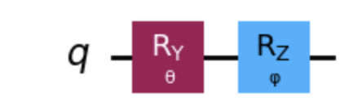
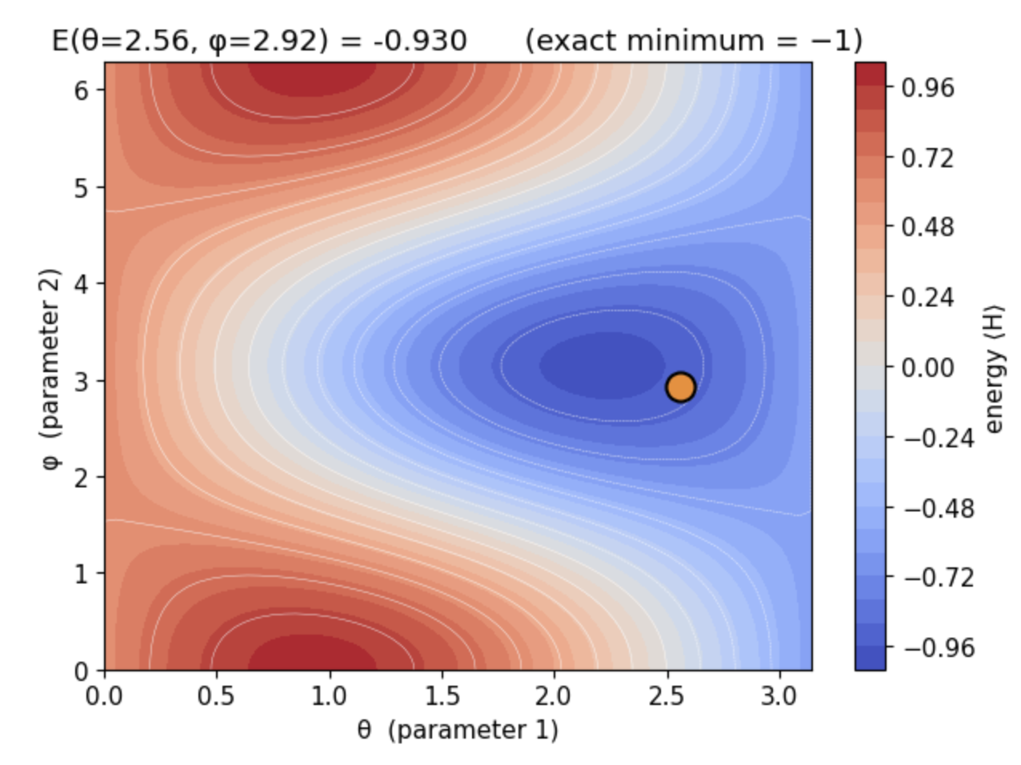
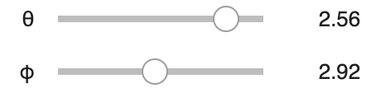


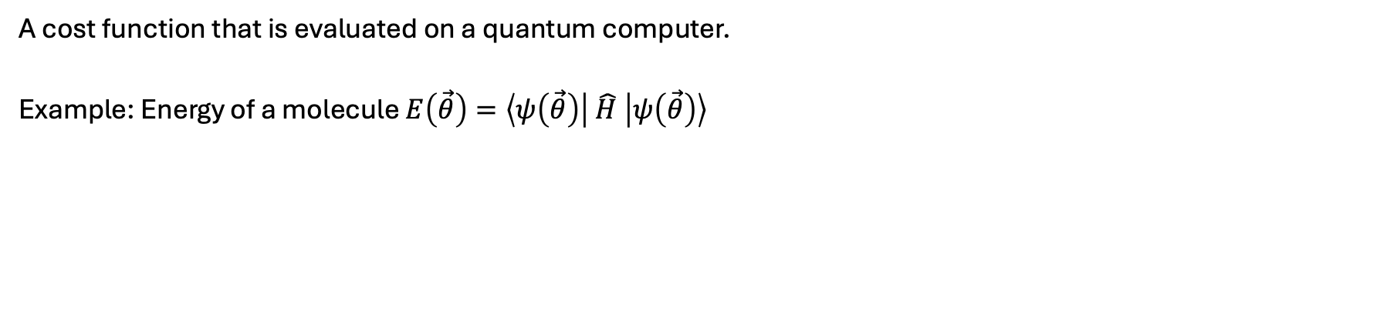





Quantum cost function
A cost function that is evaluated on a quantum computer.
Example: Energy of a molecule $E\left(\vec{θ}\right)=\left\langle ψ\left(\vec{θ}\right)\right| \hat{H} \left|ψ\left(\vec{θ}\right)\right\rangle$
Rotate knobs in the circuit to vary the parameters, measure energy until you reach minimum energy.
$$|0⟩$$
$$\left|ψ\left(\vec{θ}\right)\right\rangle$$
“Measure energy” on this state: $E\left(\vec{θ}\right)$
$$\vec{θ}=(θ,φ)$$
$$\hat{H}=0.6 \hat{Z}+0.8 \hat{X}$$
X =$\left(\begin{matrix}0 & 1 \\ 1 & 0\end{matrix}\right)$
Z = $\left(\begin{matrix}1 & 0 \\ 0 & −1\end{matrix}\right)$
VQE
MTSU
October 16, 2026
8
Notes:
Poll 3

Slide 11
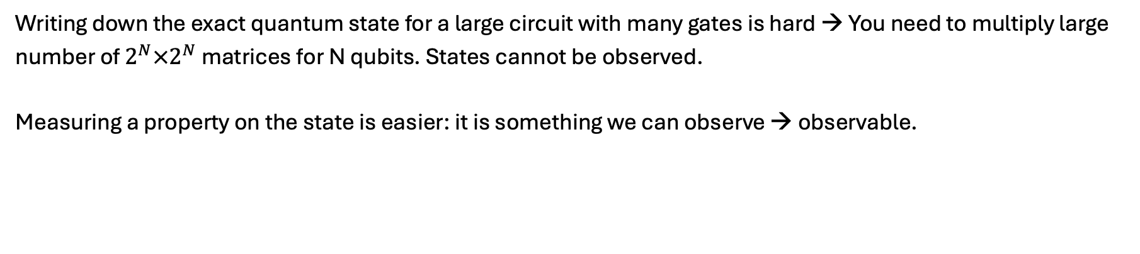
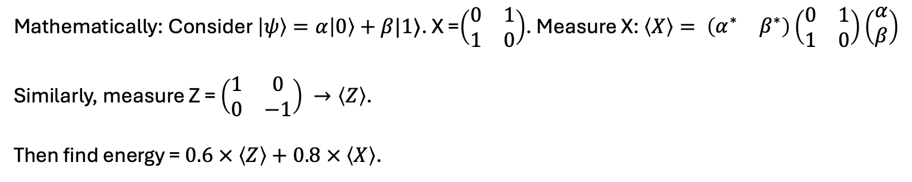


What does measuring energy means?
Writing down the exact quantum state for a large circuit with many gates is hard → You need to multiply large number of $2^{N}×2^{N}$ matrices for N qubits. States cannot be observed.
Measuring a property on the state is easier: it is something we can observe → observable.
$$\hat{H}=0.6 \hat{Z}+0.8 \hat{X}$$
$$|0⟩$$
Measure X, then measure Z. Calculate the energy.
Mathematically: Consider $\left|ψ\right\rangle =α\left|0\right\rangle +β|1⟩$. X =$\left(\begin{matrix}0 & 1 \\ 1 & 0\end{matrix}\right)$. Measure X: $\left\langle X\right\rangle = \left(\begin{matrix}α^{∗} & β^{∗}\end{matrix}\right)\left(\begin{matrix}0 & 1 \\ 1 & 0\end{matrix}\right)\left(\begin{aligned}α \\ β\end{aligned}\right)$
Similarly, measure Z = $\left(\begin{matrix}1 & 0 \\ 0 & −1\end{matrix}\right) →\left\langle Z\right\rangle$.
Then find energy = $0.6 × \left\langle Z\right\rangle +0.8 × \left\langle X\right\rangle$.
VQE
MTSU
October 16, 2026
9

Slide 12

What does measuring energy means in an experiment?
Measuring Z on different states:
STATE |0⟩
STATE |+⟩
$$|+⟩$$
|0⟩
M
|0⟩
H
M
|0⟩ is the +1 state of Z, so every shot gives bit 0.
H prepares |+⟩, which has no preferred Z outcome: a fair coin flip.
0
100%
1
0%
0
50%
⟨Z⟩ = P(0) − P(1) = 1.0 − 0.0 = +1
1
50%
⟨Z⟩ = P(0) − P(1) = 0.5 − 0.5 = 0
VQE
MTSU
October 16, 2026
10
Notes:
Poll 4

Slide 13


What does measuring energy means in an experiment?
Measuring X on different states:
$= \frac{1}{\sqrt{2}}\left(\left|+\right\rangle + | −\right\rangle )$
STATE |0⟩
STATE |+⟩
$$|+⟩$$
|0⟩
H
M
|0⟩
H
H
M
The H gate turns |0⟩ into |+⟩ before the bit is read: a fair coin flip.
The two H gates cancel, so the qubit is back in |0⟩ and the bit is always 0.
0
50%
0
100%
1
50%
1
0%
⟨X⟩ = P(0) − P(1) = 0.5 − 0.5 = 0
⟨X⟩ = P(0) − P(1) = 1.0 − 0.0 = +1
Prepares the state
Rotates the measurement basis
Measures the qubit (M)
VQE
MTSU
October 16, 2026
11

Slide 14
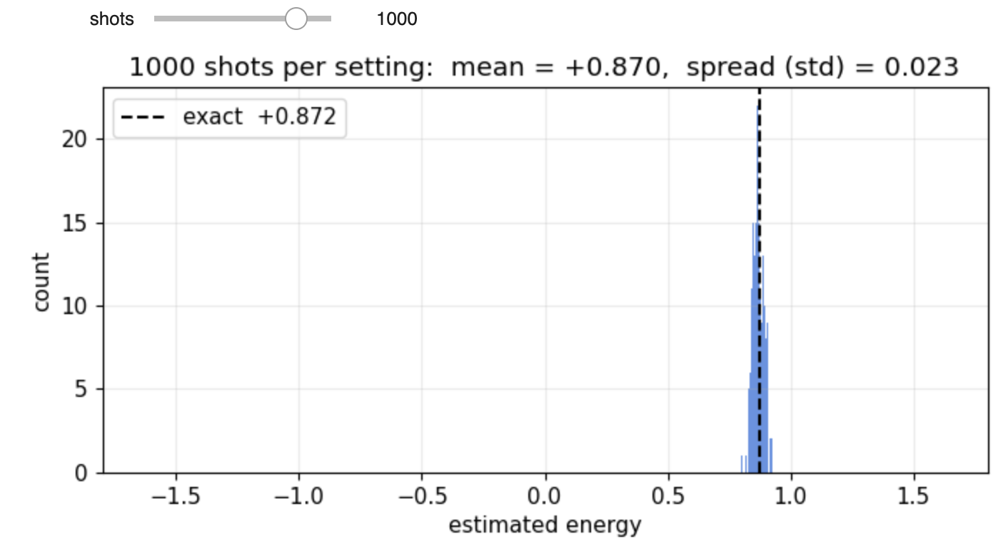
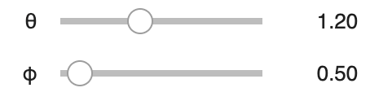

What does measuring energy means in an experiment?
$$|0⟩$$
H
M
⟨X⟩ = P(0) − P(1)
energy = $0.6 × \left\langle Z\right\rangle +0.8 × \left\langle X\right\rangle$
$$|0⟩$$
M
⟨Z⟩ = P(0) − P(1)
VQE
MTSU
October 16, 2026
12
Notes:
Poll 5

Slide 15

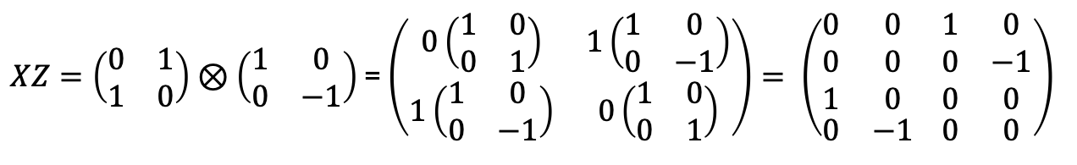
Measuring Pauli strings
Pauli strings (P) : XX, ZI, IZ, ZX,... etc.
$XZ=\left(\begin{matrix}0 & 1 \\ 1 & 0\end{matrix}\right)⊗\left(\begin{matrix}1 & 0 \\ 0 & −1\end{matrix}\right)$ = $\left(\begin{matrix}0\left(\begin{matrix}1 & 0 \\ 0 & 1\end{matrix}\right) & 1\left(\begin{matrix}1 & 0 \\ 0 & −1\end{matrix}\right) \\ 1\left(\begin{matrix}1 & 0 \\ 0 & −1\end{matrix}\right) & 0\left(\begin{matrix}1 & 0 \\ 0 & 1\end{matrix}\right)\end{matrix}\right)= \left(\begin{matrix}\begin{aligned}0 \\ 0 \\ 1\end{aligned} & \begin{aligned}0 \\ 0 \\ 0\end{aligned} \\ 0 & −1\end{matrix}\begin{matrix}\begin{aligned} 1 \\ 0 \\ 0\end{aligned} & \begin{aligned}0 \\ −1 \\ 0\end{aligned} \\ 0 & 0\end{matrix}\right)$
Measuring XX on a two-qubit state:
Bits | Prob. | XI | IX | XX
00 | 50% | +1 | +1 | +1
01 | 0% | +1 | −1 | −1
10 | 0% | −1 | +1 | −1
11 | 50% | −1 | −1 | +1
Avg |  | 0 | 0 | +1
CIRCUIT
|0⟩
H
H
M
$$+$$
H
M
|0⟩
If Pauli matrices commute: $P_{1}P_{2}=P_{2}P_{1}$, you can measure $P_{1}$ and $P_{2}$ together, otherwise you need separate measurement circuit → Heisenberg uncertainty principle.
VQE
MTSU
October 16, 2026
13

Slide 16
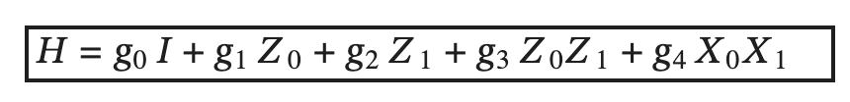
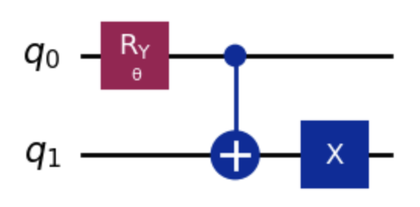
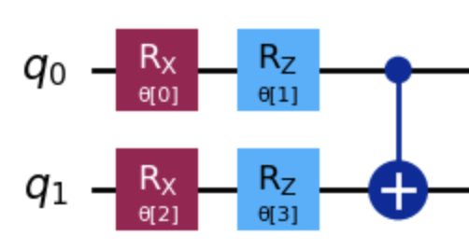
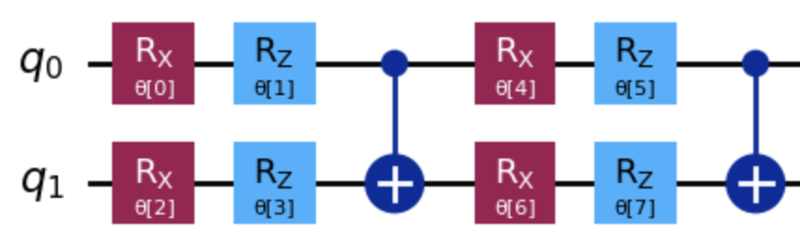
Variational quantum eigensolver for Hydrogen molecule
Build a parametrized circuit:
Define energy cost function: Qiskit can do this measurement for you. (estimator function in the notebook). Alternatively, create circuits for each Pauli string like shown before and measure.
Input: Circuit, parameters, shots.
output: Energy.
Use a classical optimizer to update the parameters: minimize(cost function, initial parameters, method). Different methods available in scipy.
Try different parametrized circuit: See if you can improve your ground state energy.
VQE
MTSU
October 16, 2026
14

Slide 17
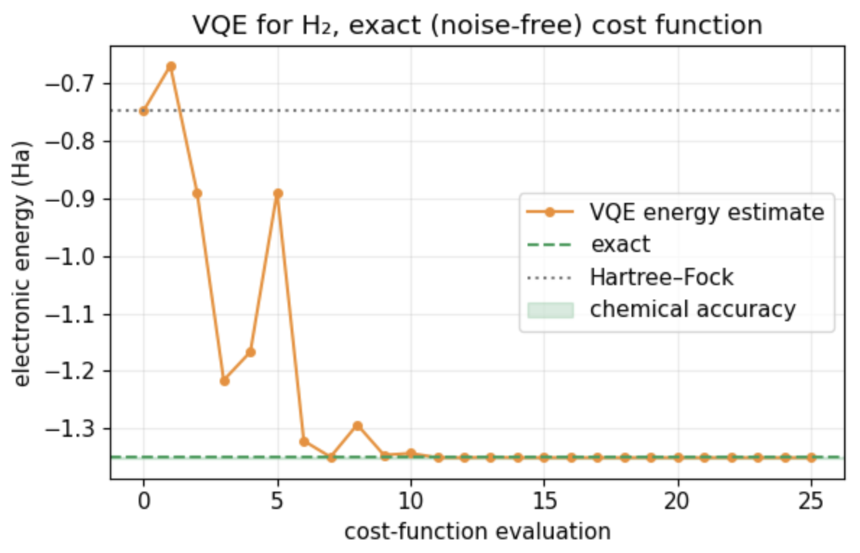
A typical VQE run
Circuit structure (# of parameters), initial state (Hartree Fock: no electron correlation)
VQE
MTSU
October 16, 2026
15

Slide 18
VQE: Summary
Build a parametrized circuit:
Define energy cost function: Qiskit can do this measurement for you. (estimator function in the notebook). Alternatively, create circuits for each Pauli string like shown before and measure.
Input: Circuit, parameters, shots.
output: Energy.
Use a classical optimizer to update the parameters: minimize(cost function, initial parameters, method). Different methods available in scipy.
Try different parametrized circuit: See if you can improve your ground state energy.
VQE
MTSU
October 16, 2026
14

