Slide 1

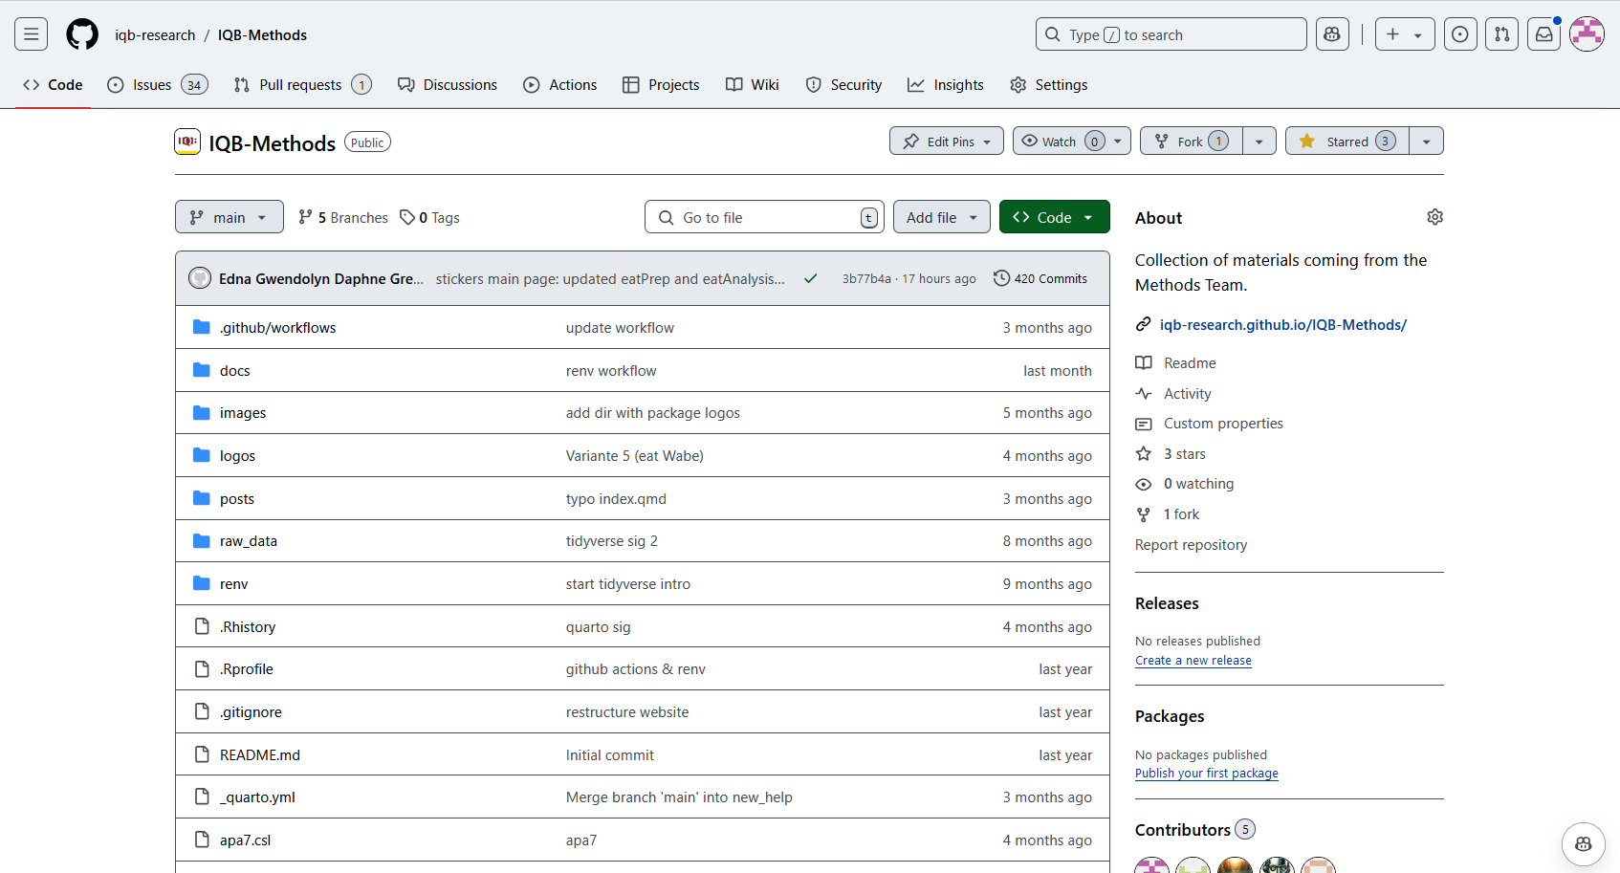


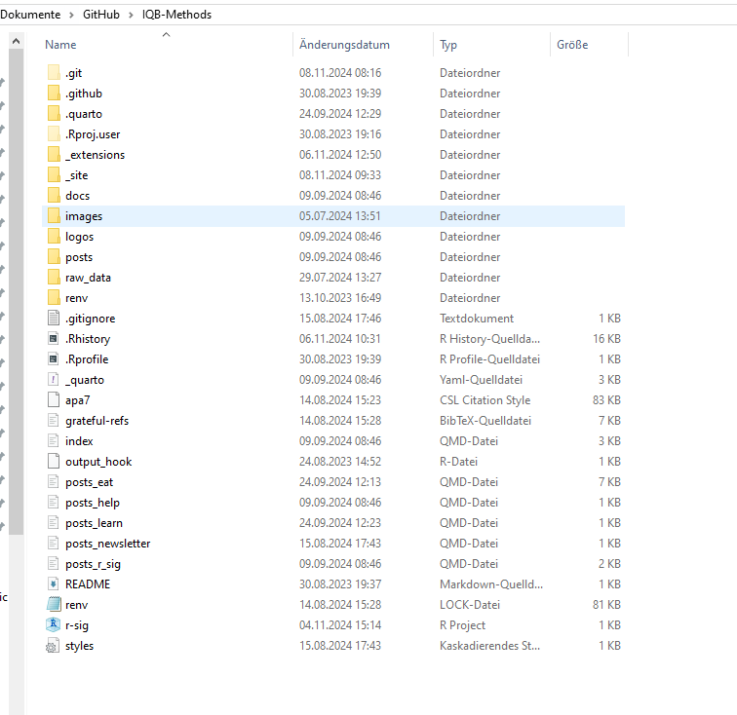
Push
Repository (online)
Git (lokal)
Clone
Stage/commit
Bearbeiten
Repository (lokal)
Repository (lokal)

Slide 2
Branch 2
Main/Master
Branch 1

Slide 3
Branch 2
Main/Master
Branch 1

