Slide 1

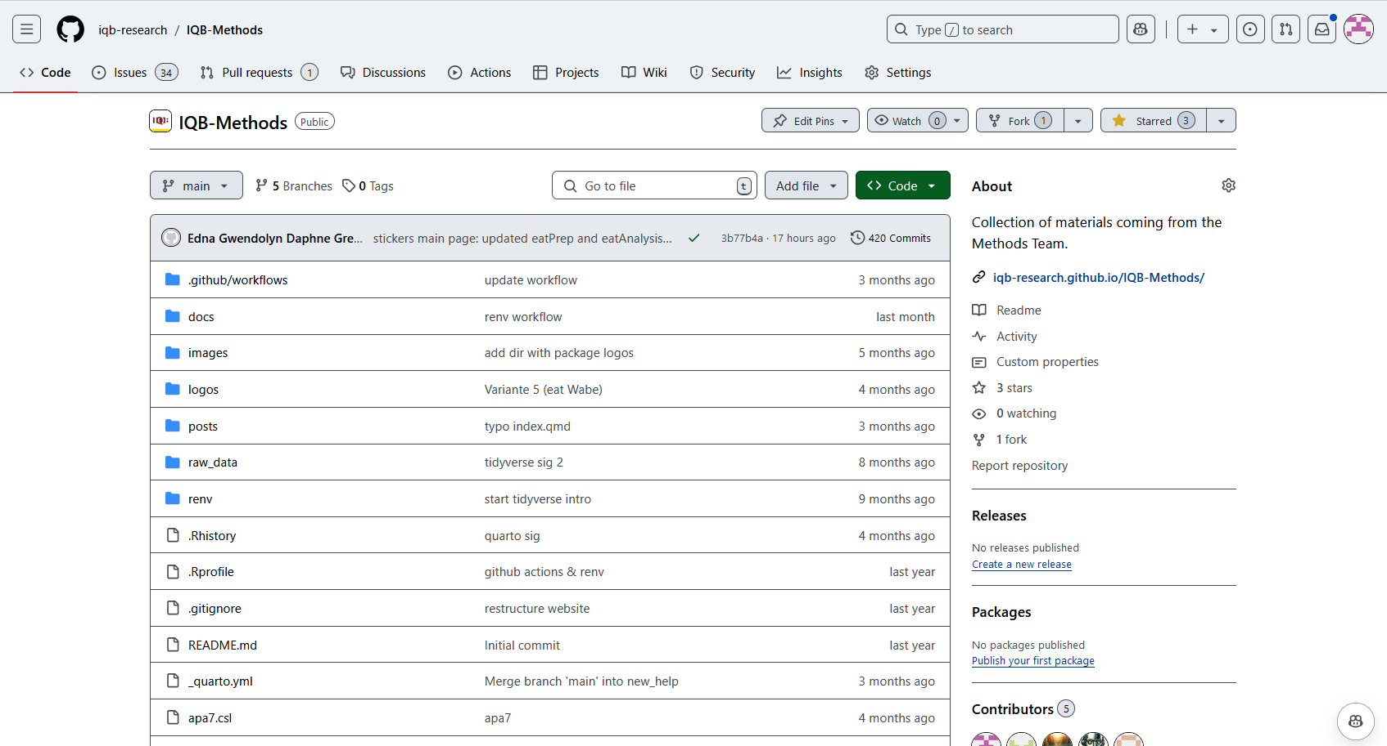

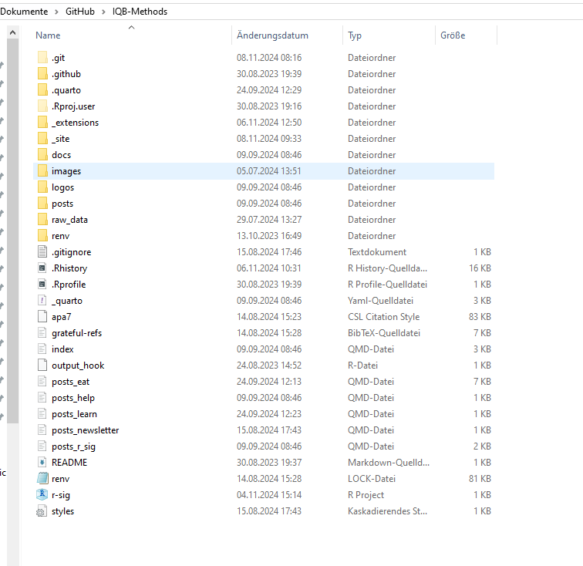
Push
Repository (online)
Git (lokal)
Pull
Stage/commit
Bearbeiten
Repository (lokal)
Repository (lokal)

Slide 2
Push
Repository (online)
Git (lokal)
Pull
Stage/commit
Bearbeiten
Repository (lokal)
Repository (lokal)

Slide 3
Push
Repository (online)
Git (lokal)
Pull
Stage/commit
Bearbeiten
Repository (lokal)
Repository (lokal)

Slide 4
Push
Repository (online)
Git (lokal)
Pull
Stage/commit
Bearbeiten
Repository (lokal)
Repository (lokal)

Slide 5
Push
Repository (online)
Git (lokal)
Pull
Stage/commit
Bearbeiten
Repository (lokal)
Repository (lokal)

Slide 6
Push
Repository (online)
Git (lokal)
Pull
Stage/commit
Bearbeiten
Repository (lokal)
Repository (lokal)

Slide 7
Branch 2
Main/Master
Branch 1

Slide 8
Branch 2
Main/Master
Branch 1

