Slide 1
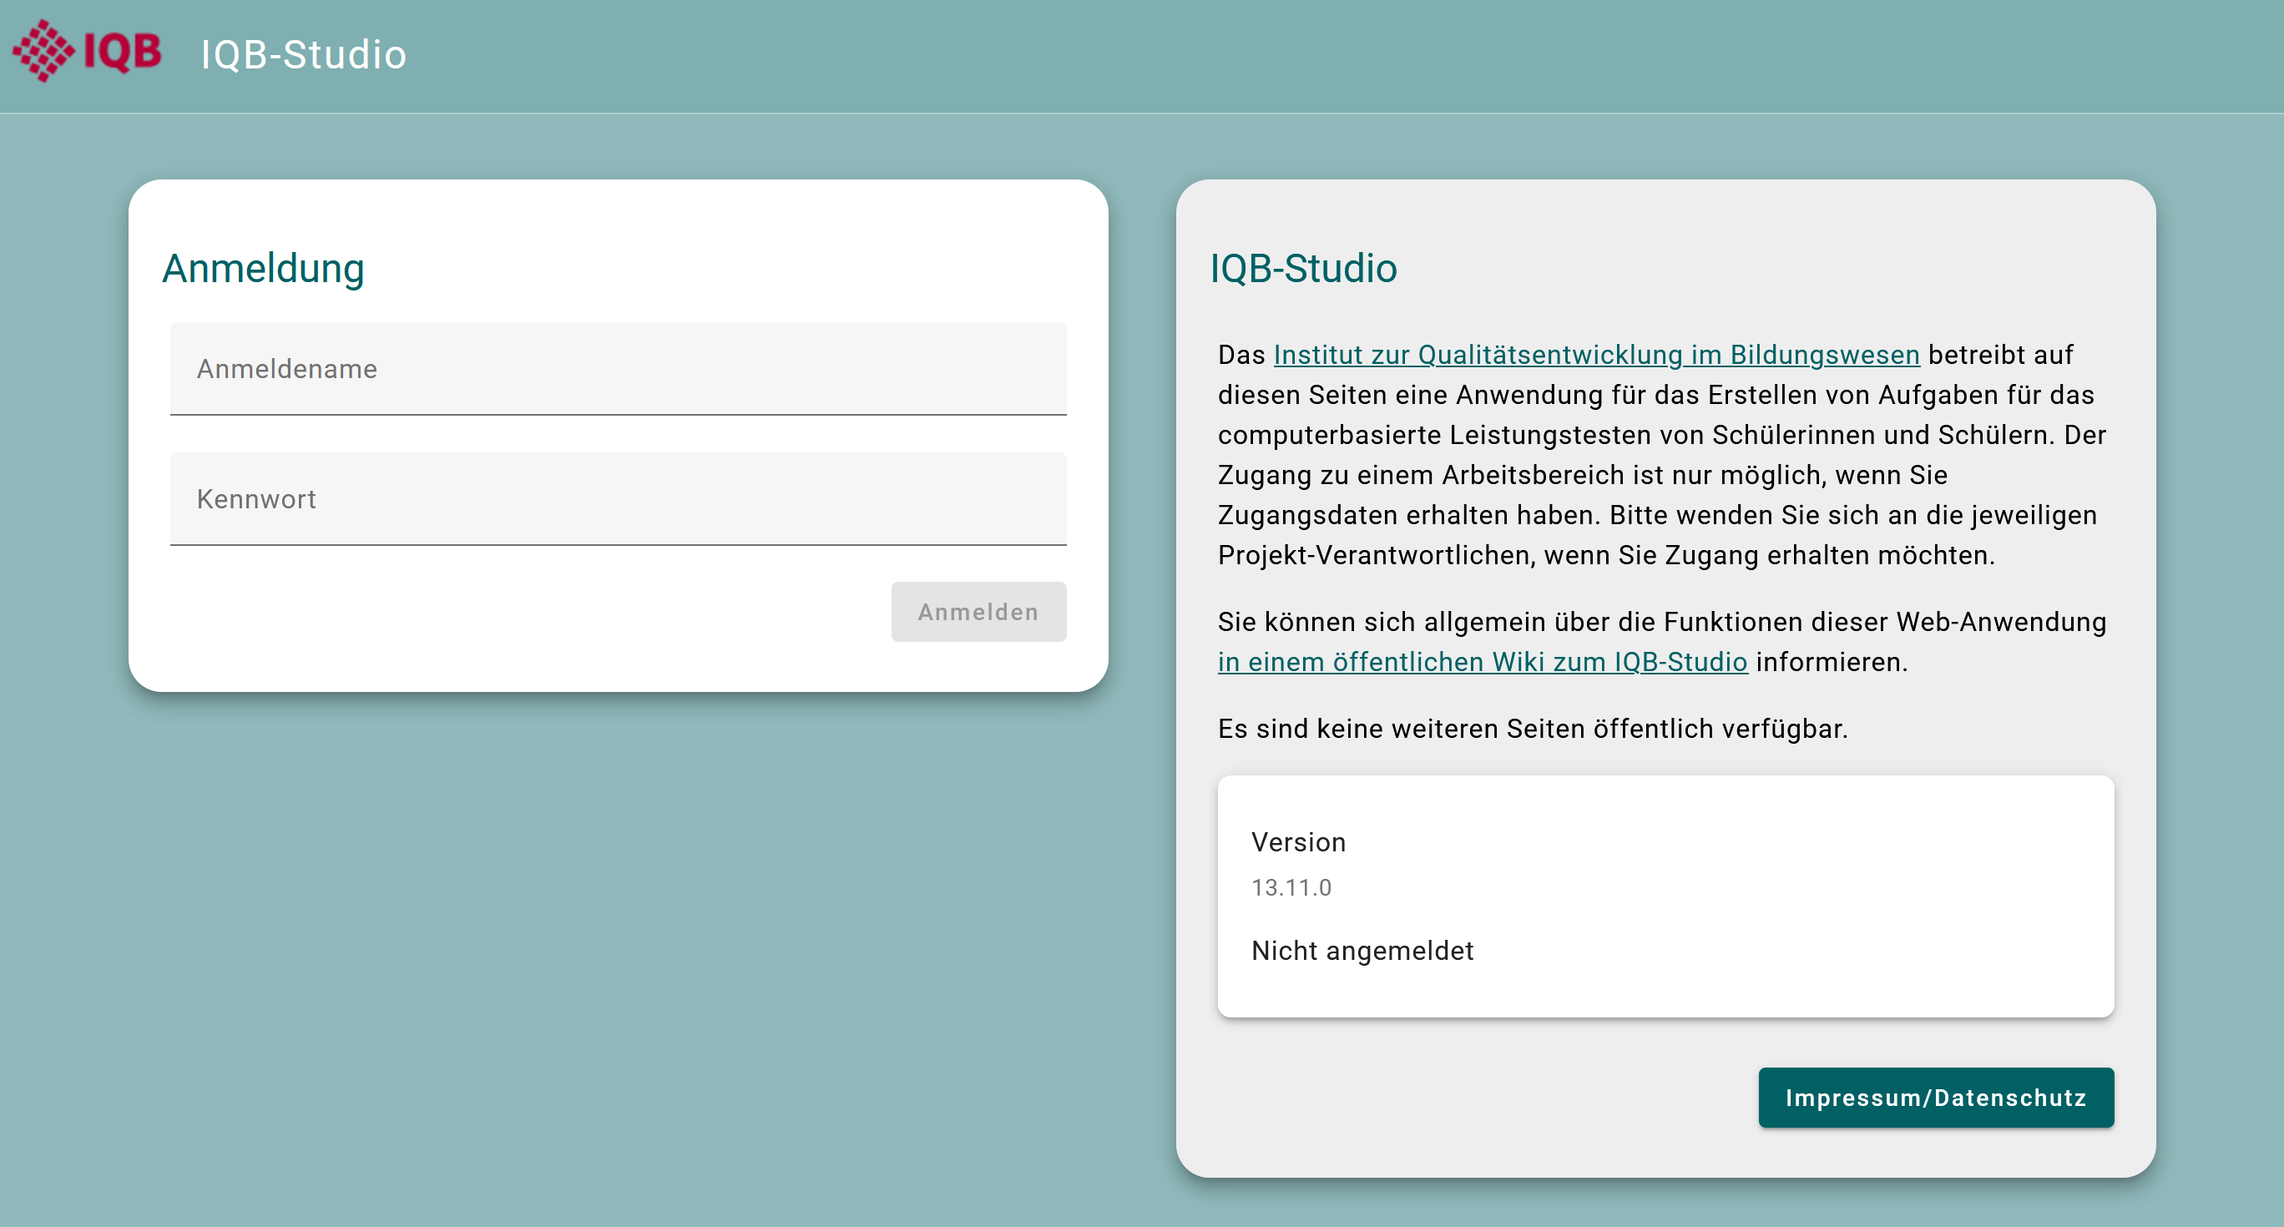
login_studio()
app_version

Slide 2
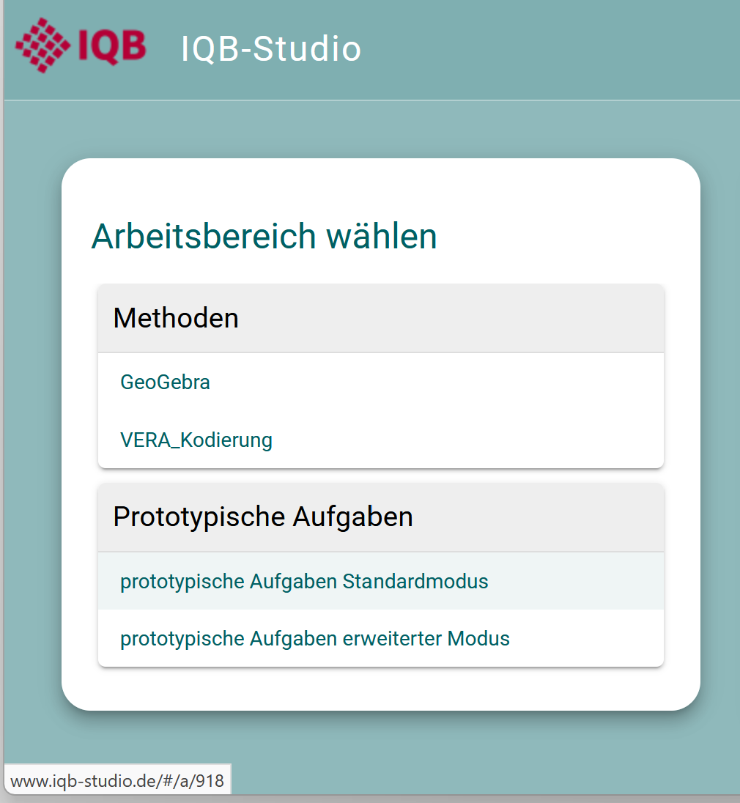
This is a workspace group.
This is a workspace.
access_workspace()
ws_id

Slide 3
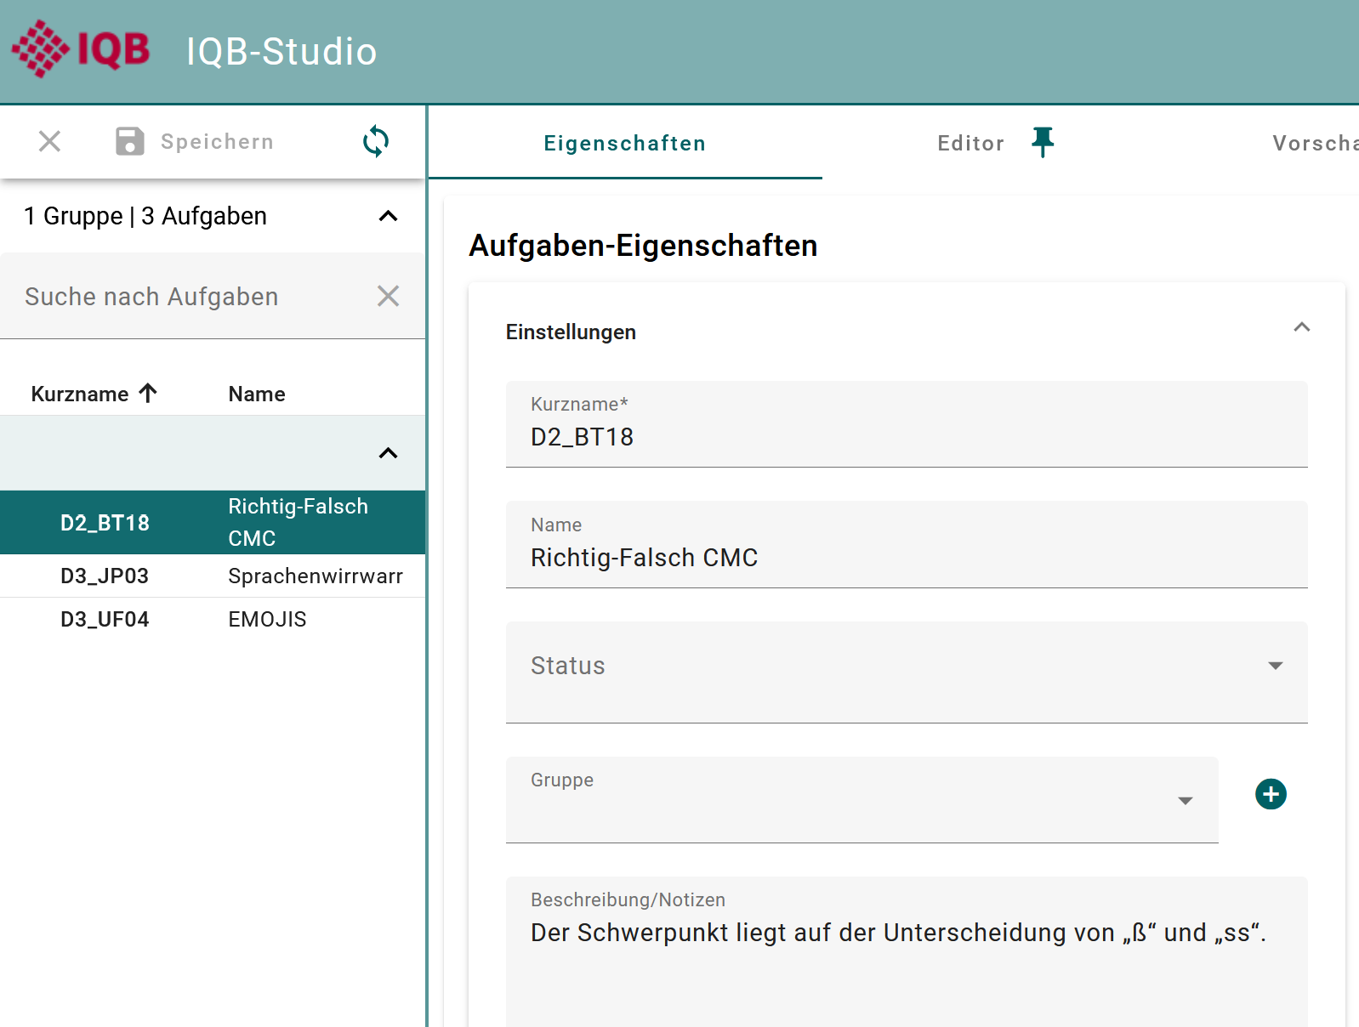

unit_id
unit_key
unit_label
state_id
group_name
description

Slide 4
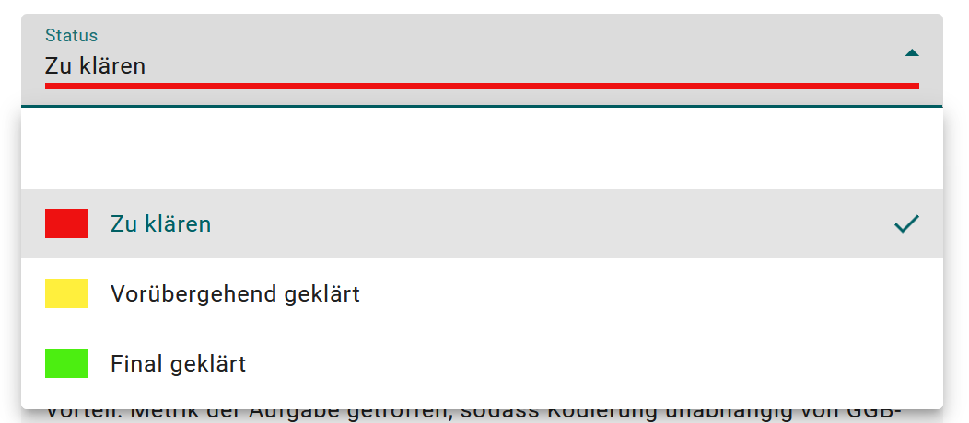
state_id
0
1
2
state_label
3
state_colour

Slide 5
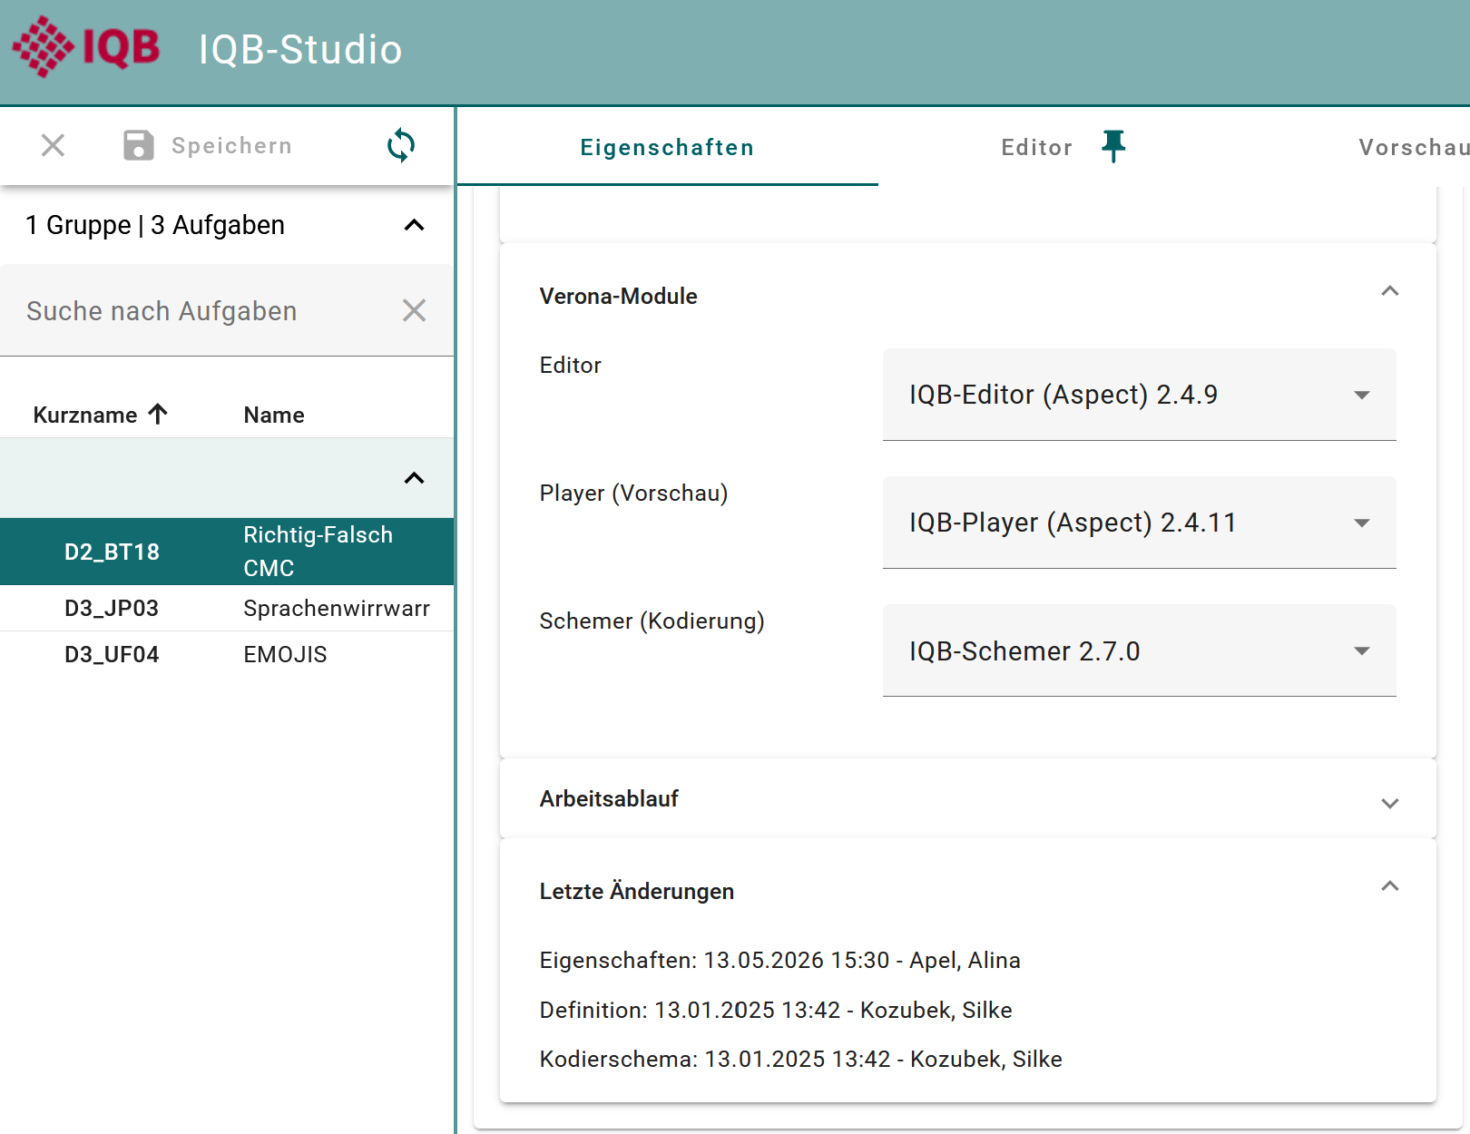

editor
player
schemer
last_change_metadata
last_change_definition
last_change_scheme

Slide 6
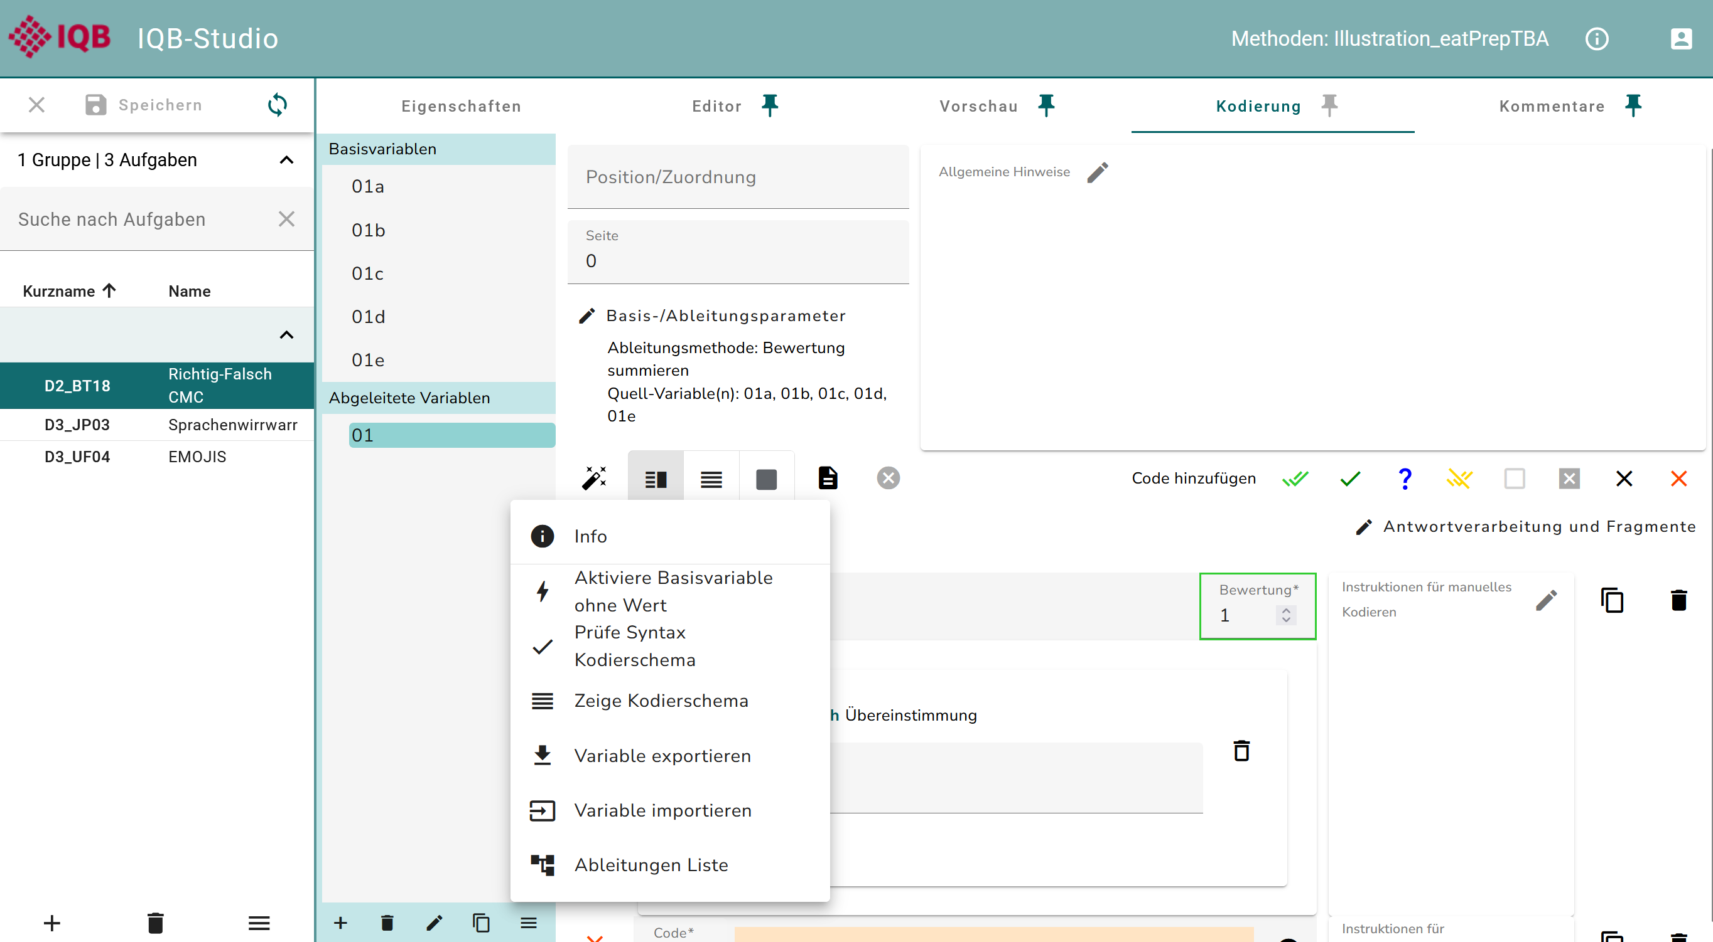
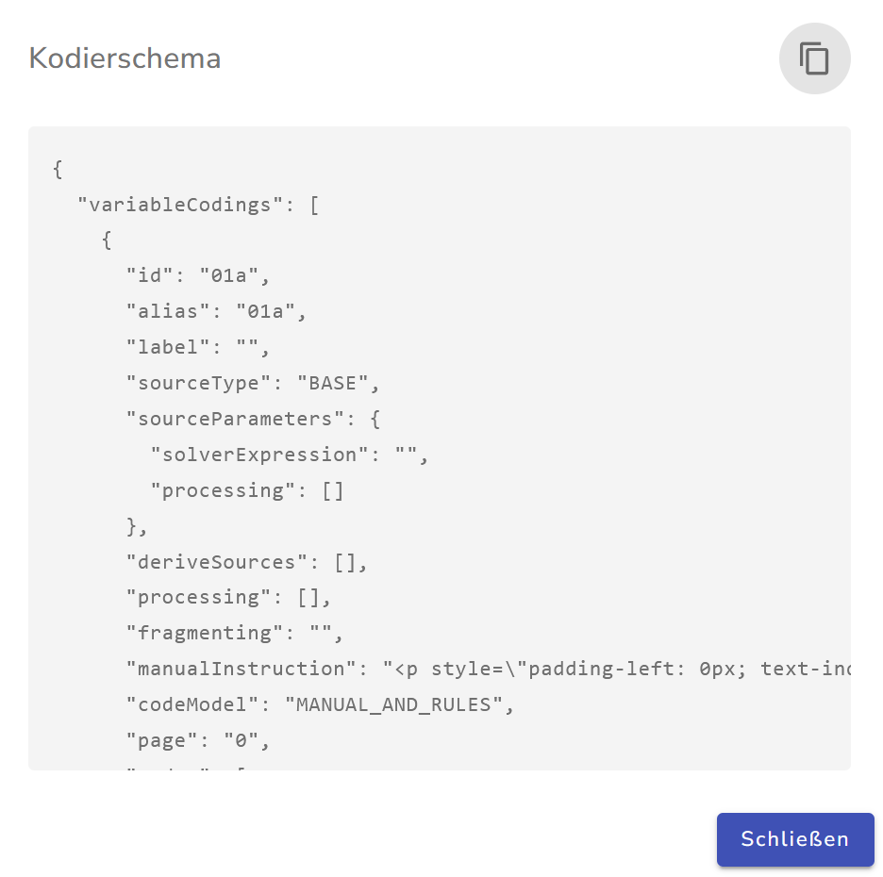
coding_scheme

Slide 7





HTTP Methods
Client
Server
Browser or R
GET
IQB Studio/Testcenter API
JSON
POST
HTTP
PUT
PATCH
DELETE

Slide 8
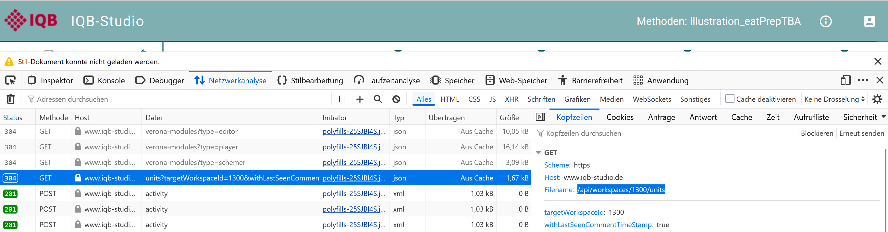
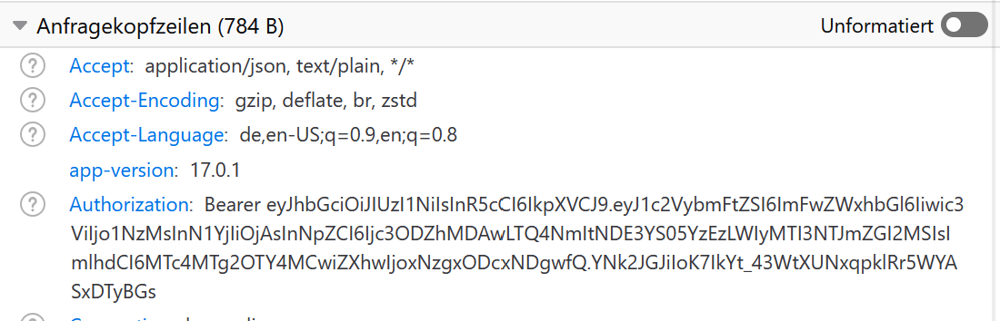
The browser asked the IQB Studio server for the unit list of workspace 1300.
This was a GET request.
This is the access token of the session.
Authorization

Slide 10
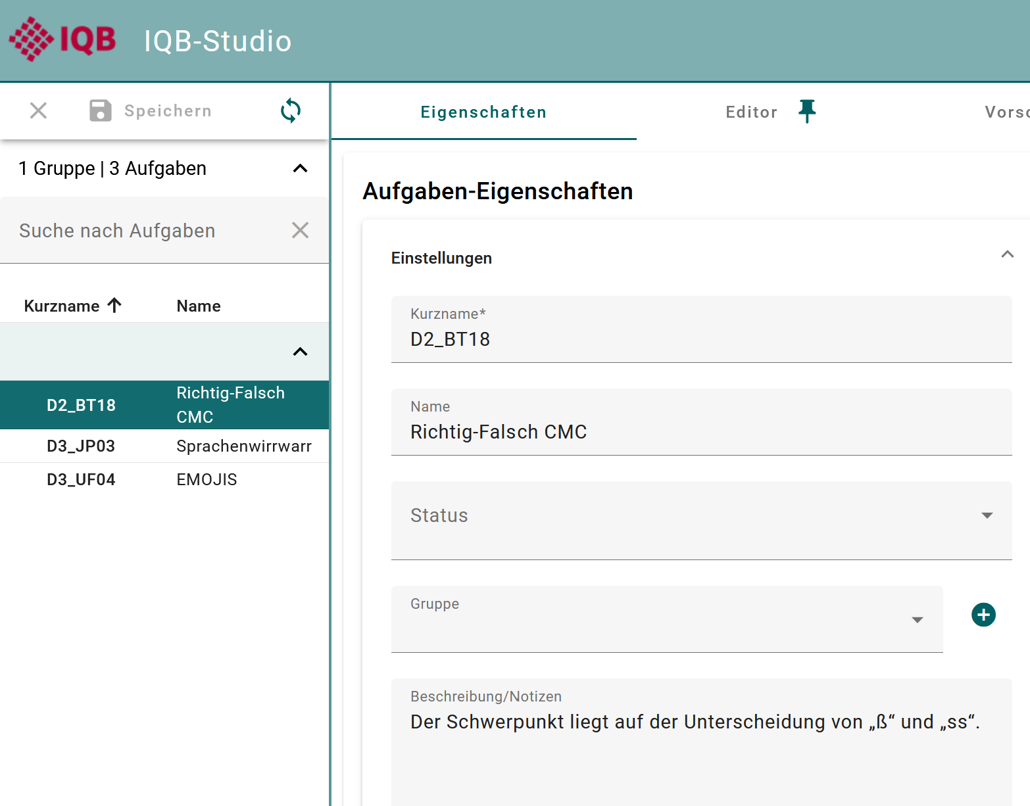
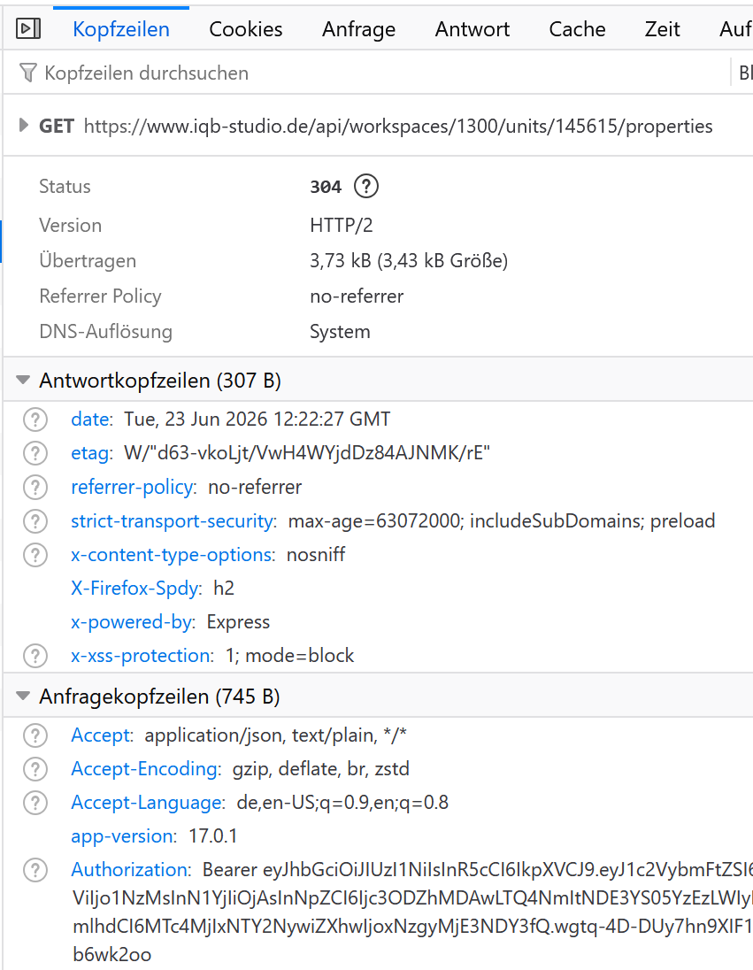
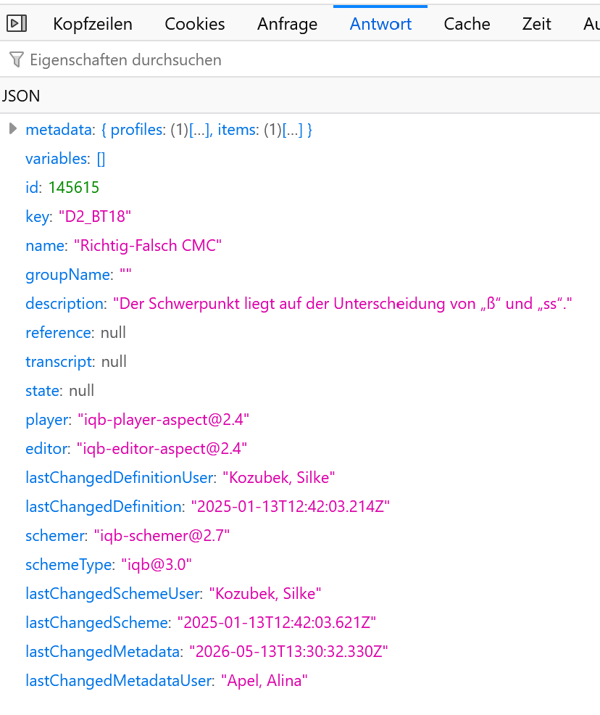
IQB-Studio:
Request:
Result:

Slide 11
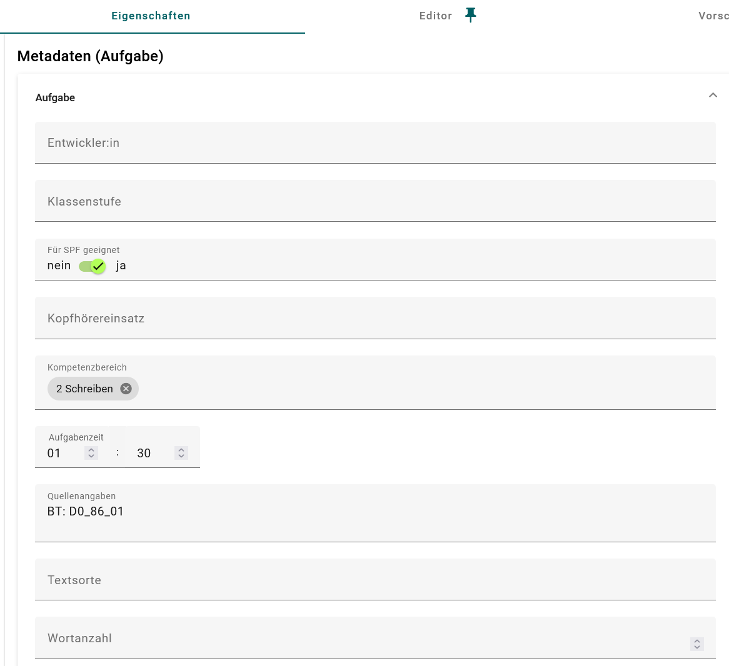

Slide 12
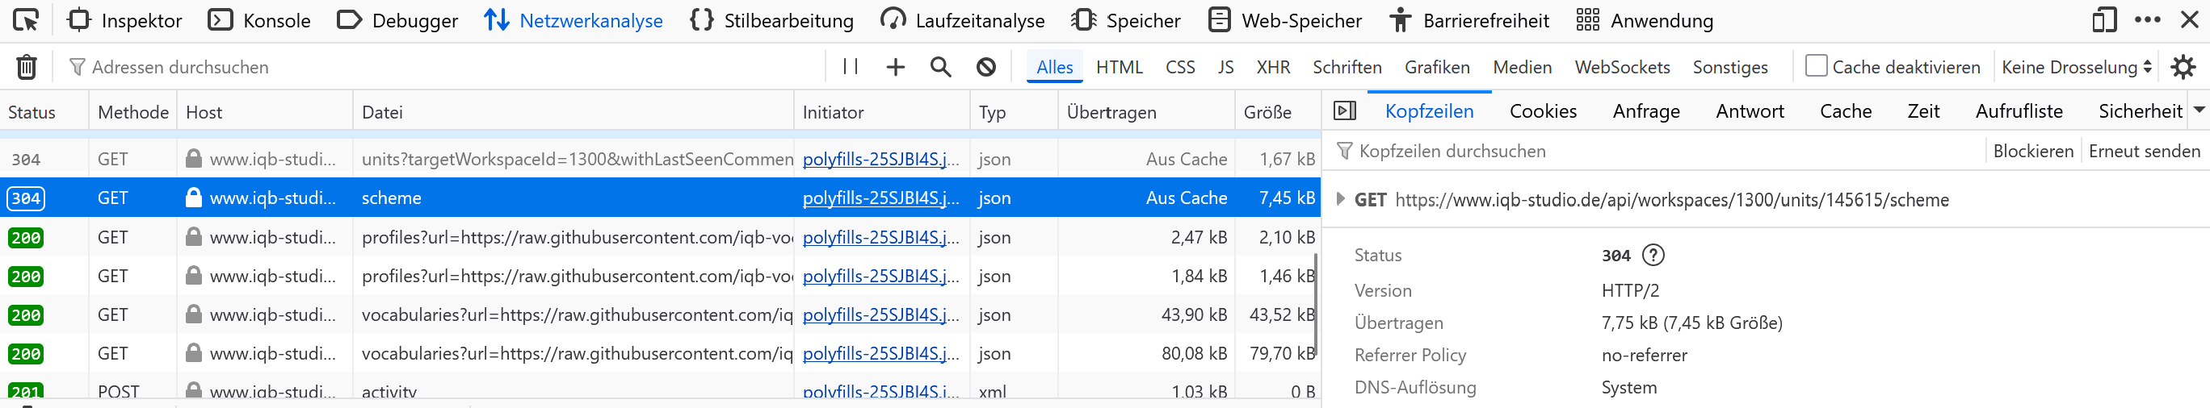

Slide 13
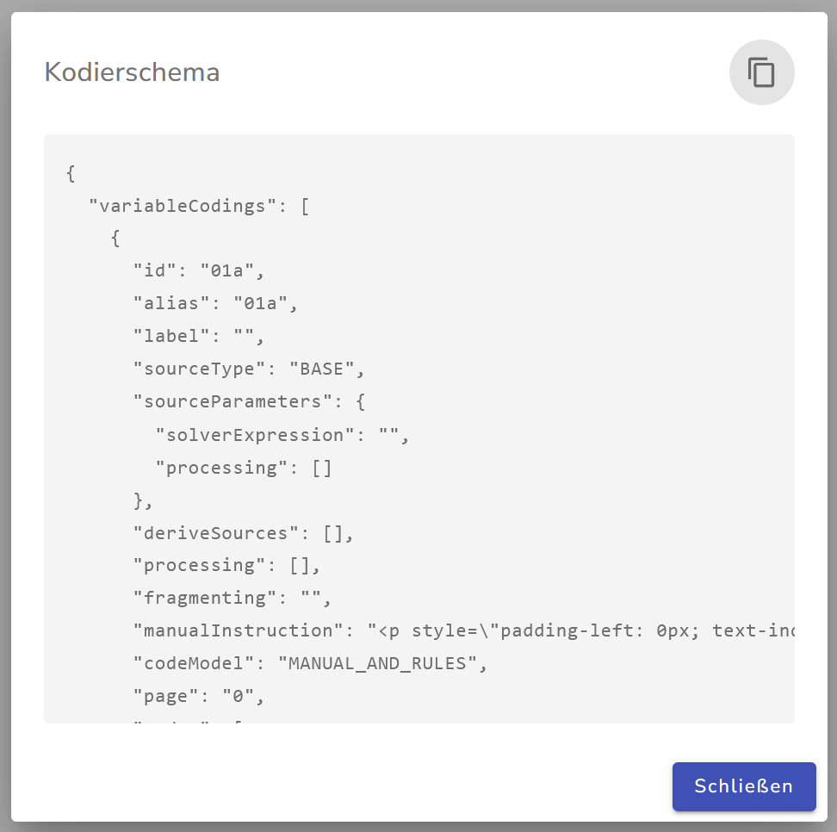

Slide 14
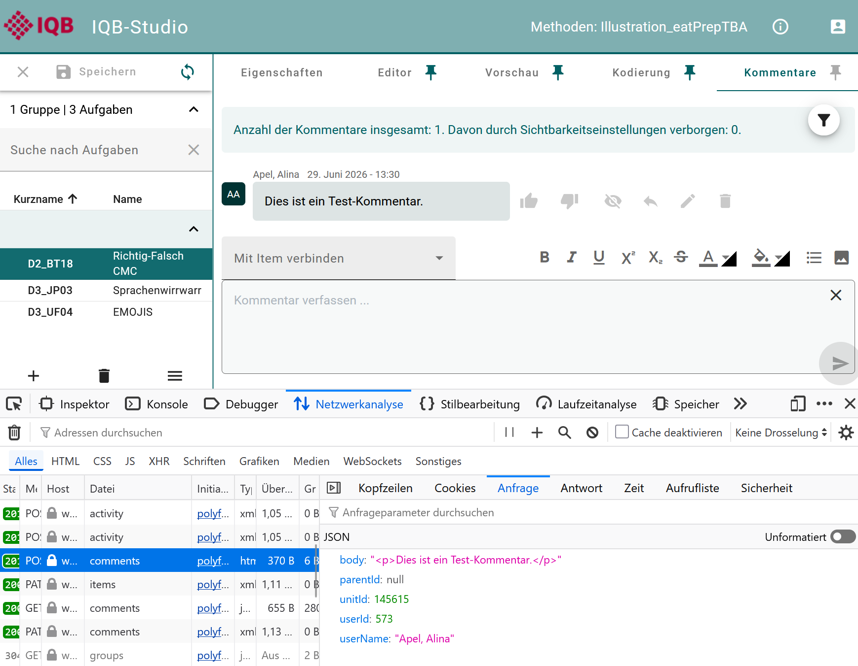
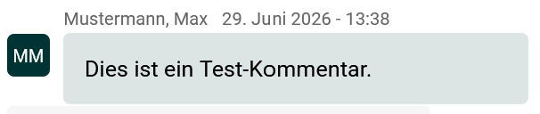
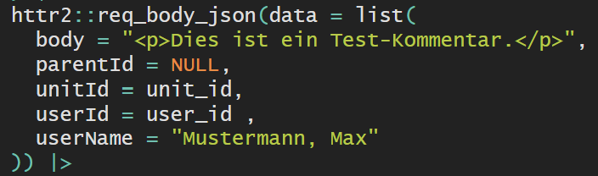

Slide 15
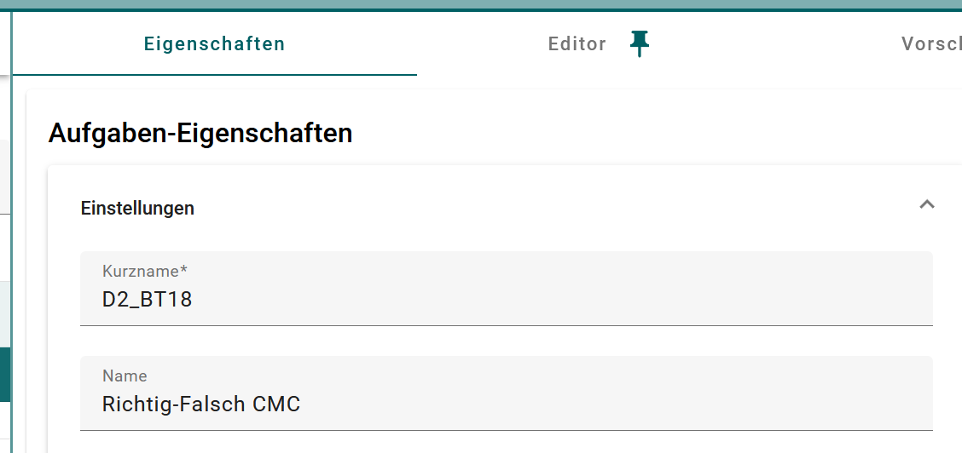
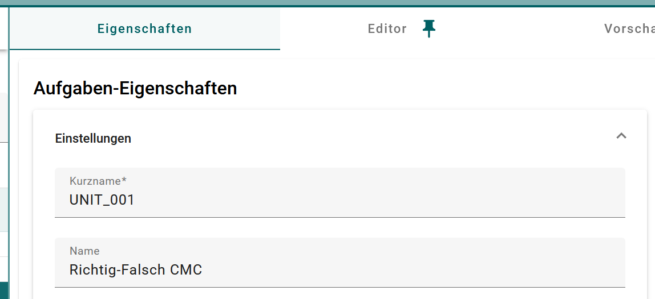

Slide 16
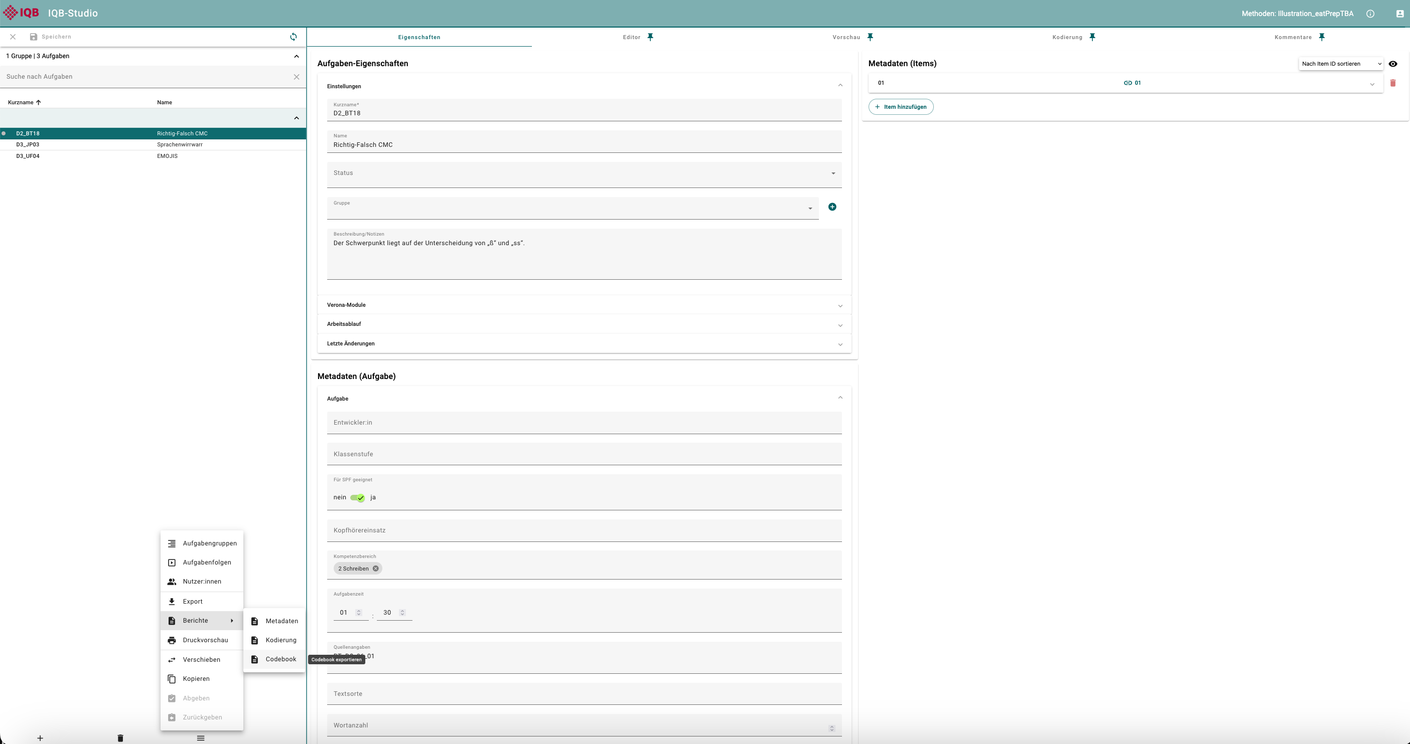
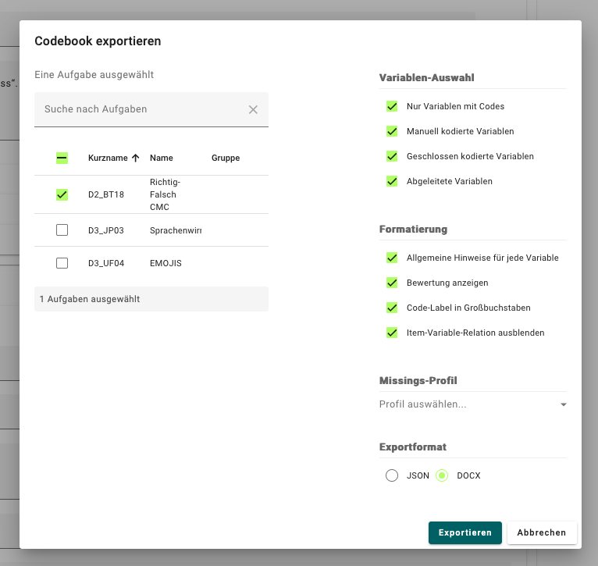
workspace
workspace
unit_keys
Codebook
Kodiermanual

Slide 17
only_coded
manual
closed
derived
unit_keys
general_instructions
show_score
code_label_to_upper
hide_item_var_relation
missings
missings_profile

Slide 18
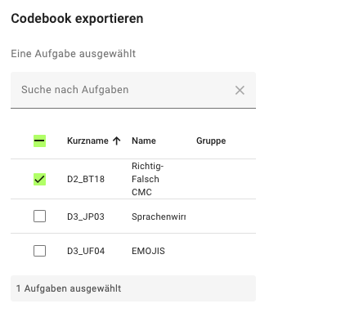
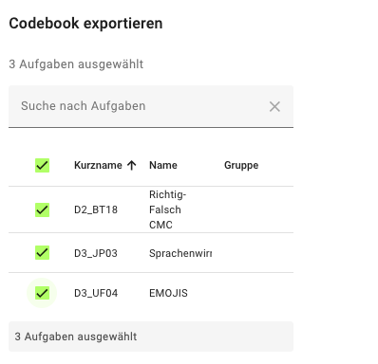

Slide 19
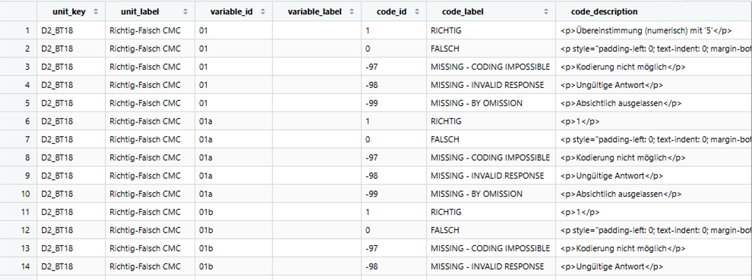

Slide 20
only_coded
manual
closed
derived
unit_keys
general_instructions
show_score
code_label_to_upper
hide_item_var_relation
format
missings
missings_profile

Slide 21
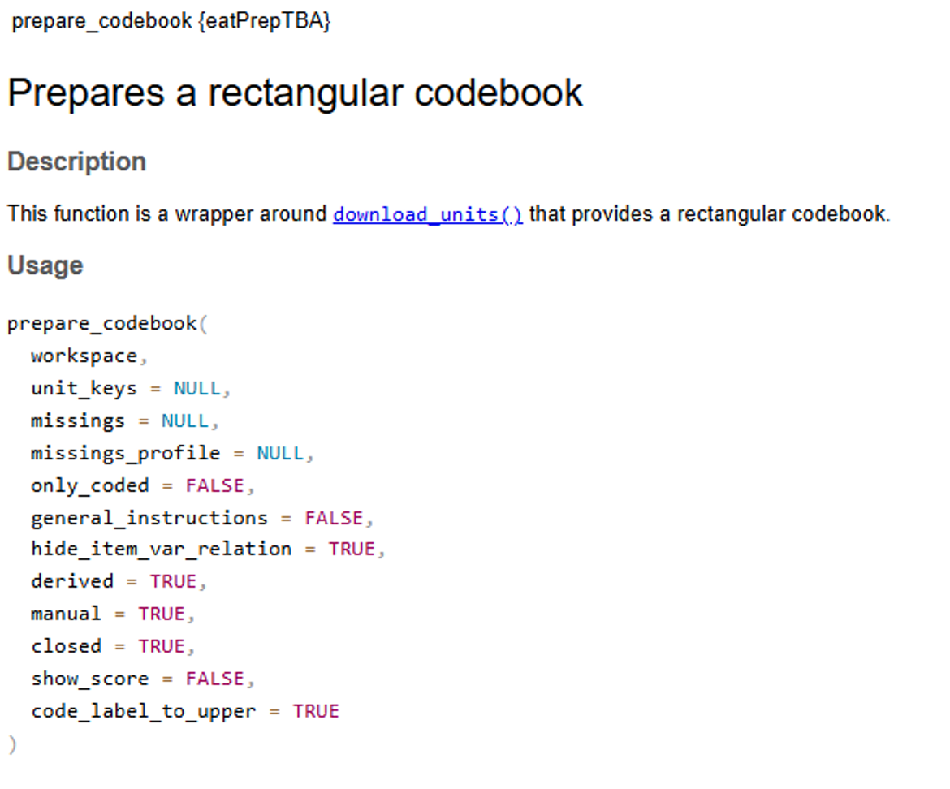
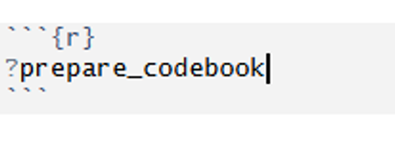
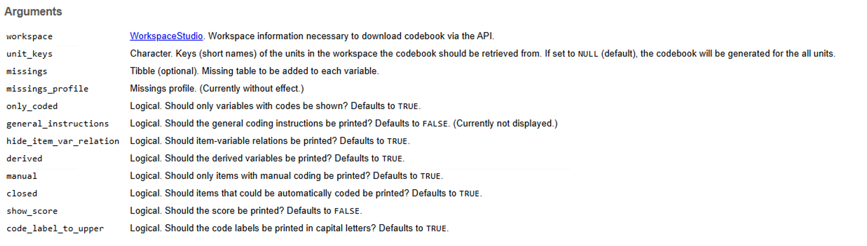

Slide 22
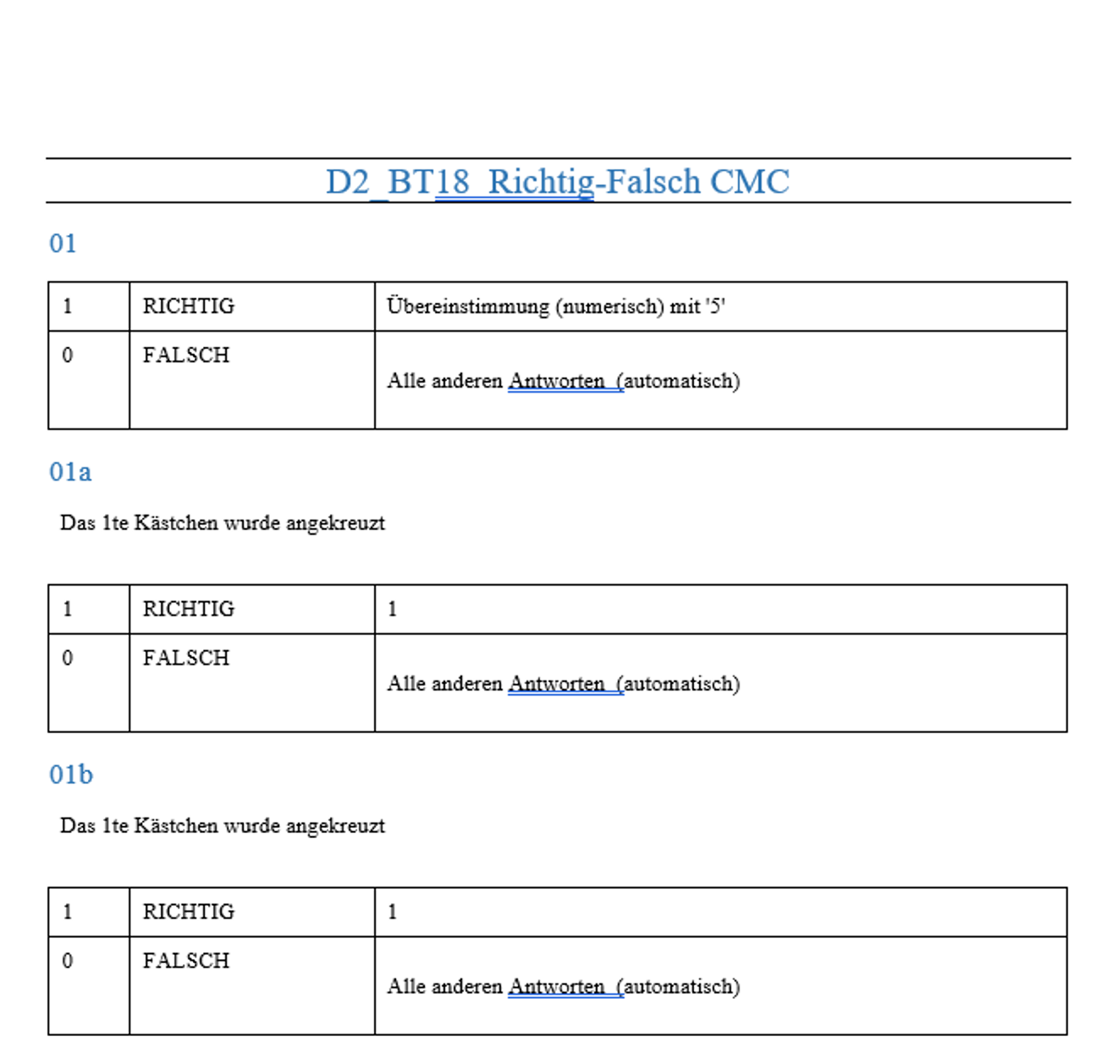
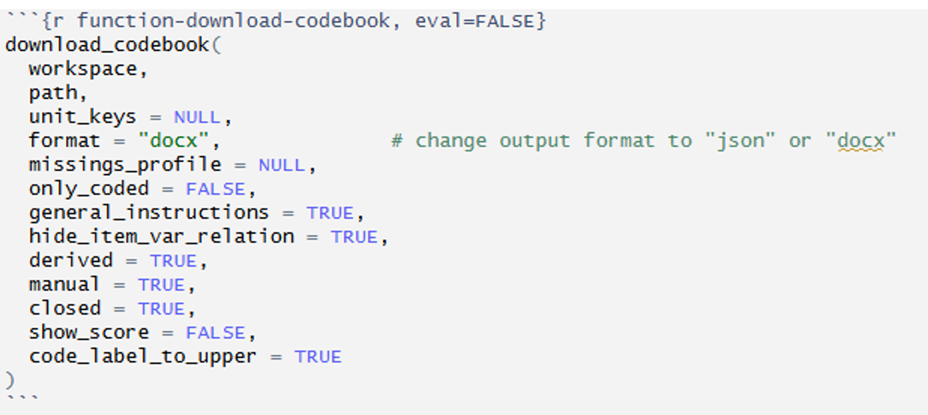
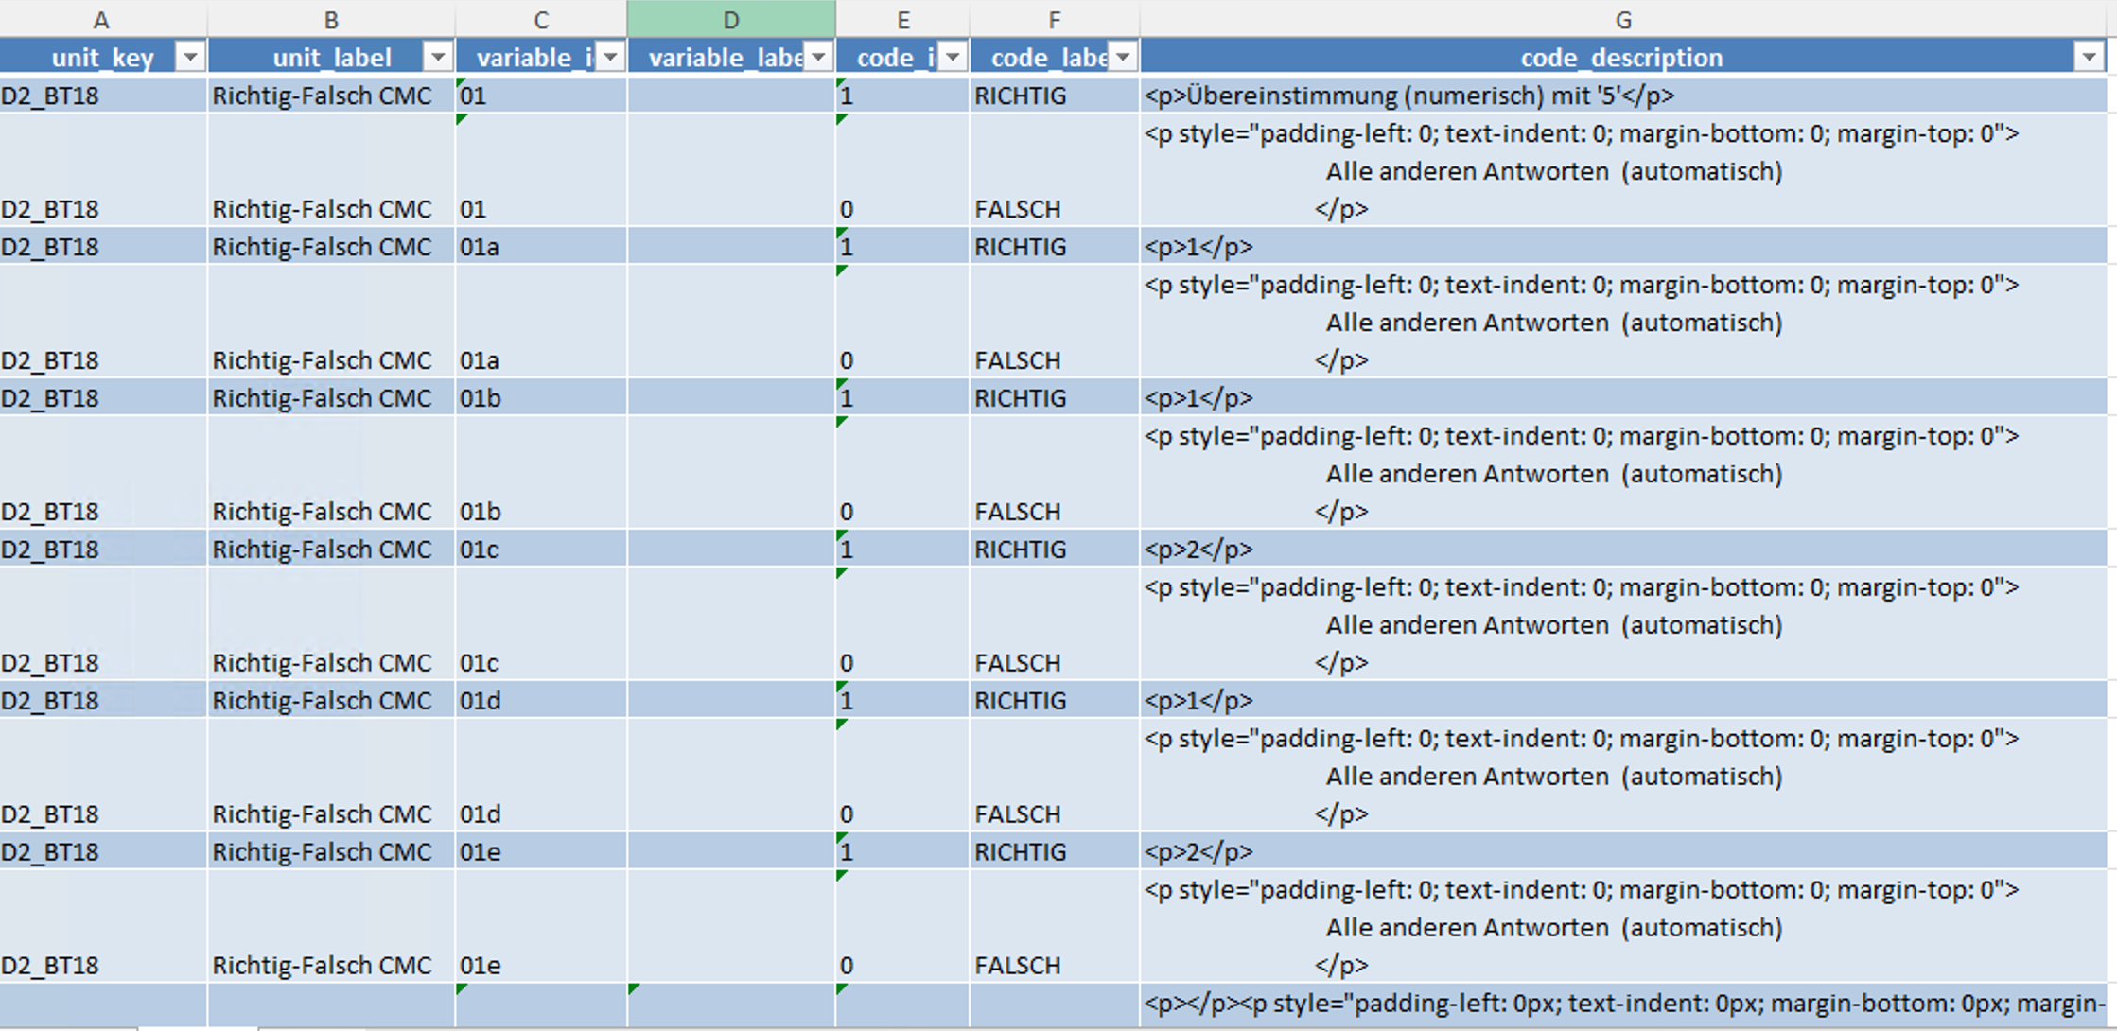
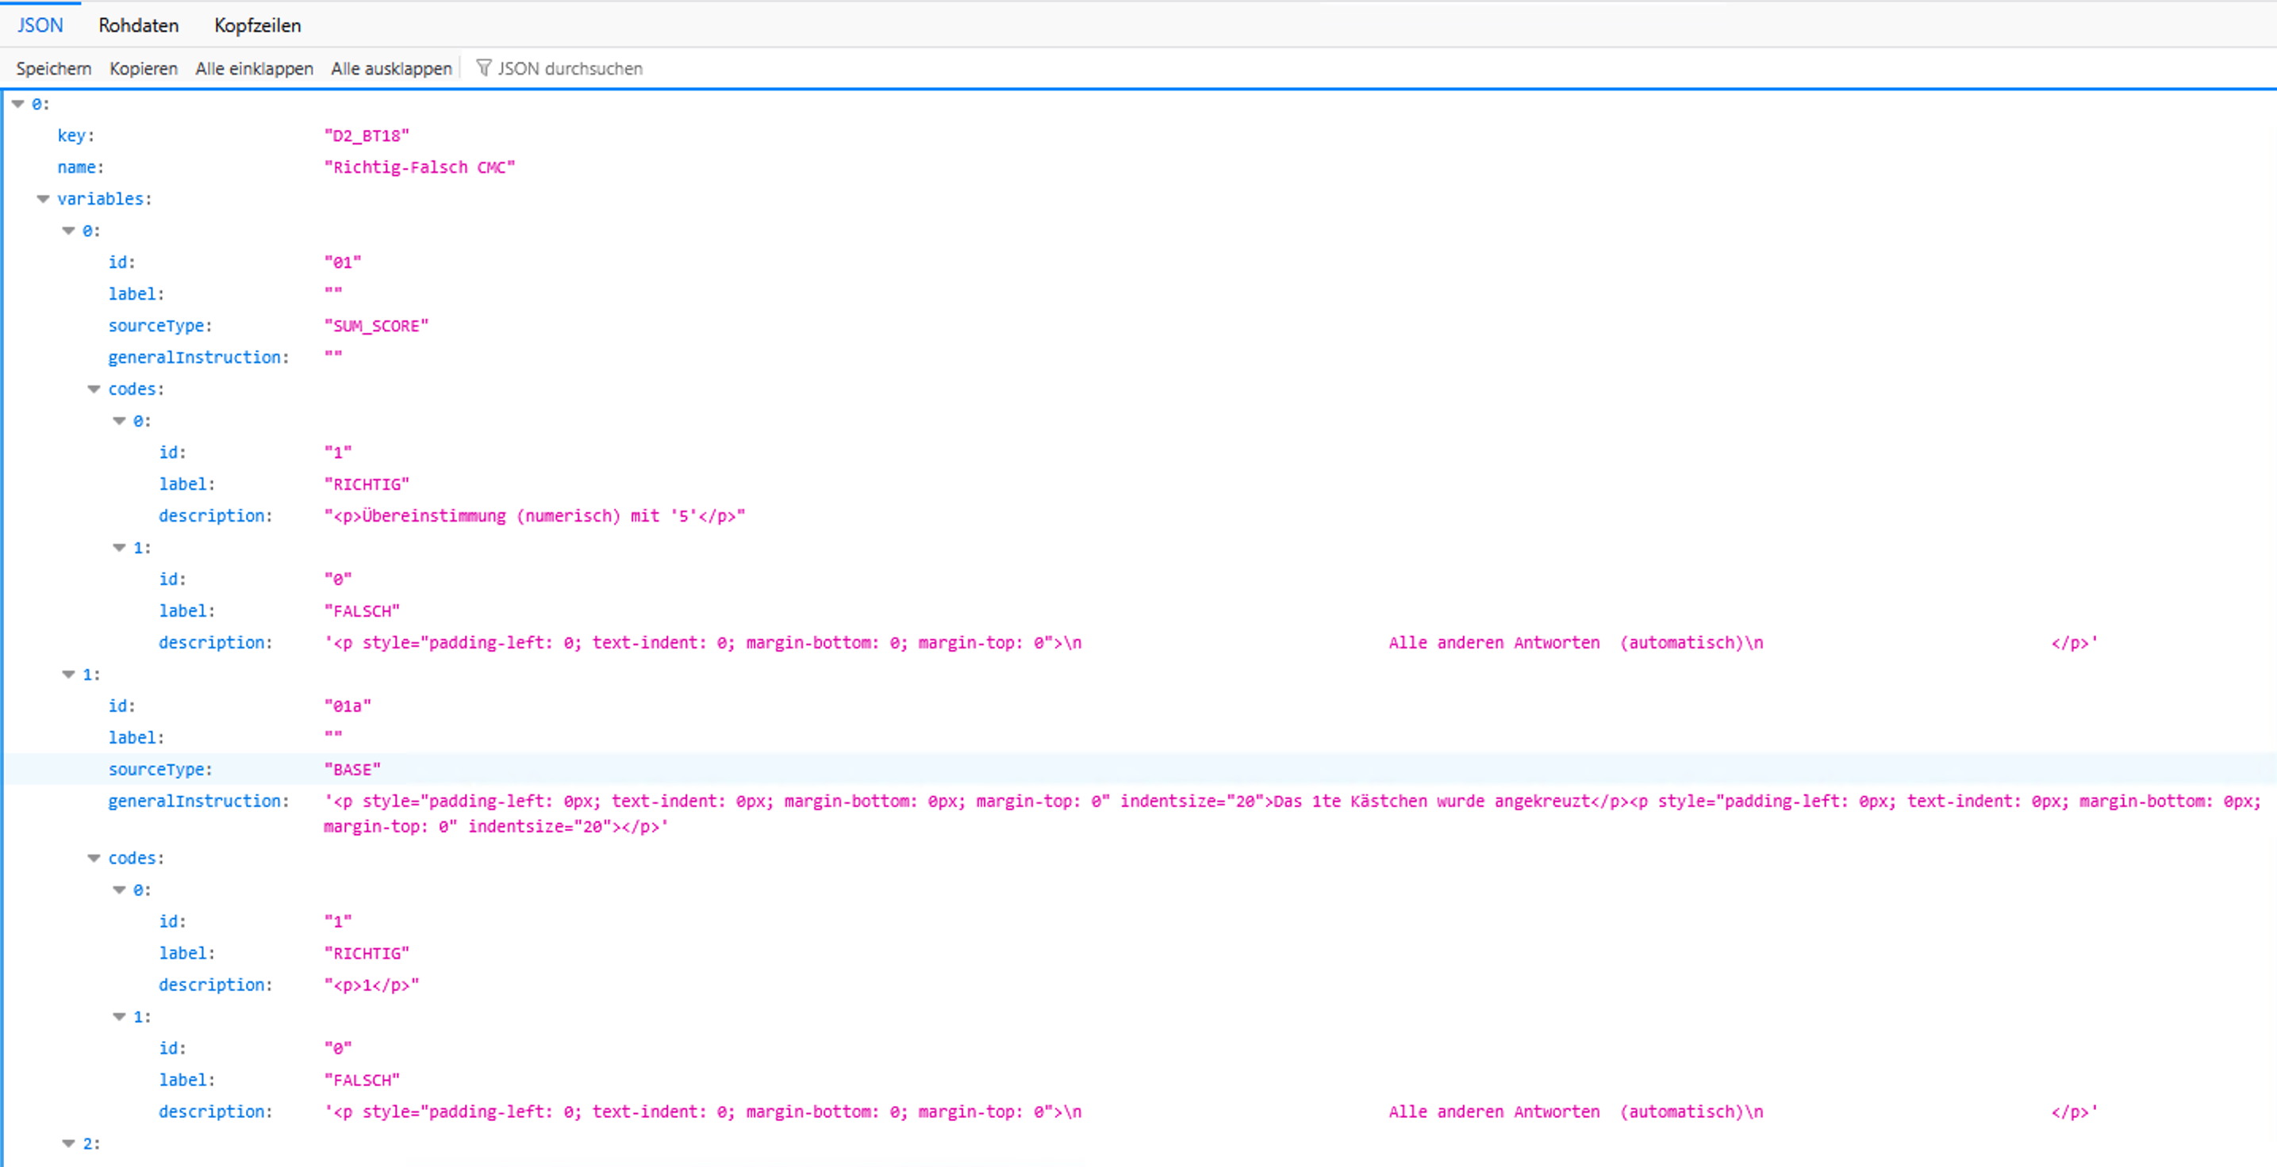
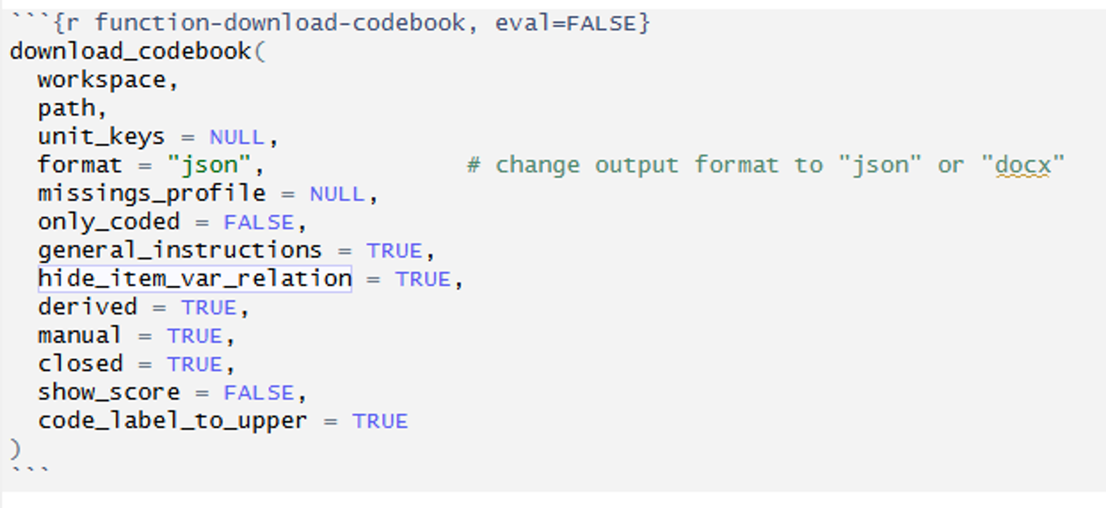
Kodiermanual
Codebook
with prepare_codebook()

