Slide 1
Presentation On
Development of Royal Electronics
An E-Commerce Platform
Supervised By
Mousumi Ahmed Mimi
Lecturer
Department of computer science and engineering
Prepared by
Jubayer Al Alam
ID: 17203068
Program: BCSE

Slide 2
Content
Project Overview
Process Model
Feasibility Study
Requirement Engineering
Project Estimation
Analysis and Design
Testing
Conclusion

Slide 3

Organization
Mistri Solutions is a full stack digital marketing agency in Bangladesh. Well known for their excellent services of web design, software development, mobile application, graphic and domain hosting field all over the world.

Slide 4
Project overview

Slide 5
Introduction
The project is about, The Daily Online shopping which is a web-based digital shopping system.
This system is designed for makes shopping easy and convenient for buyers and sellers.
The project is developed by the most demanding web programming language Node.js for backend and React.js for frontend.
The user-friendly interface and functionality help users and admin to manage the application easily

Slide 6
Objective
To provide a user-friendly interface.
To give an opportunity to open an account and buy product through online.
To give an opportunity to make payment via online.
To make the shopping system hassle-free and time-saving.
To helps sellers to sell their products anytime over online also on a holiday.

Slide 7
User type
Admin
Customer

Slide 8
Act of admin
Login
Add Product
Manage Product
Add Brand
Manage Brand
Add Category
Manage Category
Manage Order
Add new admin

Slide 9
Act of customer
Registration
Login
Search Product
Filter Product
View Product
Add to Cart
Manage Cart
Checkout
View Orders

Slide 10
Process Model

Slide 11
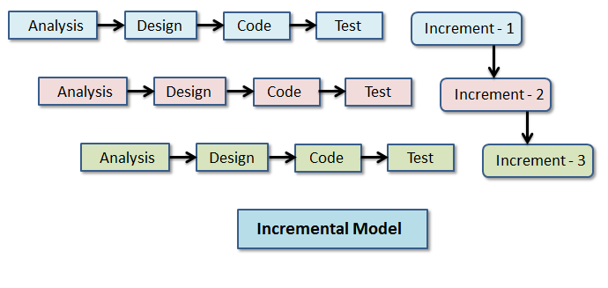
Incremental Process Model

Slide 12
Feasibility Study

Slide 13
Technical feasibility
This project is technically feasible because for making this project the required technology is available.
I have used Node.js, Express.js, React.js, CSS, and Bootstrap with Mongo DB database system.
And to run this project a simple configurable computer with some basic software like text editor, Node need to be installed.

Slide 14
Economical Feasibility
This project is economically feasible because the total personnel cost, time, software and hardware cost for making this project is less than the client budget which is much profitable.

Slide 15
Operational Feasibility
This project is operationally feasible because the actual or target user are able to use the project nicely.
To make the system more user friendly I have designed an attractive font-end using React.js, Html, CSS and Bootstrap.

Slide 16
Requirement Engineering

Slide 17
User & System Requirements(Admin)
Admin panel contains all options for managing the content of site.
Admin can see all available product with details and can manipulate them from Manage Product option in the Admin panel.
Admin can insert new product in the database from Add Product option in the Admin panel.
Admin can see all available product category with details and can update category from Manage category option in the Admin panel.
Admin can see all available product brand with details and can update brand from Manage brand option in the Admin panel.
Admin can see all order list with details and can update order status from Manage order option in the Admin panel.
Admin Can add new admin from add new admin option.

Slide 18
User & System Requirements(Customer)
User can see all products and also can check specific product details from home page as well as shopping page.
User can see filter products by category as well as by products Brands from shopping page.
User can search products by product name from shopping page.
User can add products to shopping cart and also can check all selected products added in cart.
User can proceed to checkout by creating account or login into system if already registered.
User can place order by providing shipping and payment information in checkout page.
User can see his/her all previous order list from Order page.

Slide 19
Functional Requirements
Add, update and delete Products.
Add, update and delete Categories.
Add, update and delete Brands.
Add and update Orders.
Visit all products.
Search products by name.
Filter products by category.
Filter products by brand.
View specific product details.
Add products to shopping cart.
Place order by login into the system.
Provide Shipping details.
Ensuring Payment by providing card information.
View all order list.

Slide 20
Non Functional Requirements
The system is very interactive
This system provides a well secure and trustable platform.
Easy tracking of records and updating can be done.
Backups for database should be available
Without providing valid information the form won’t submitted
Without filling up mandatory fields no form will be submitted.

Slide 21
Project Estimation

Slide 22
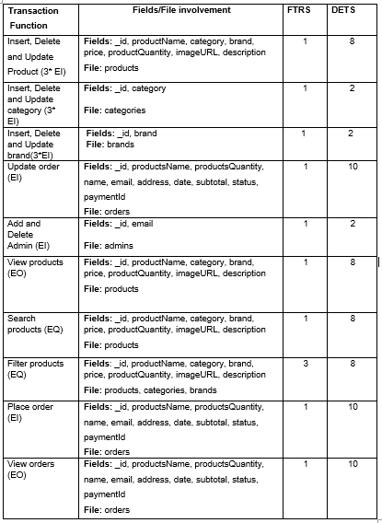
Identifying Complexity for Transaction Function

Slide 23
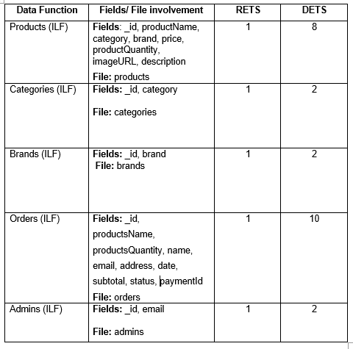
Identifying complexity for Data function

Slide 24
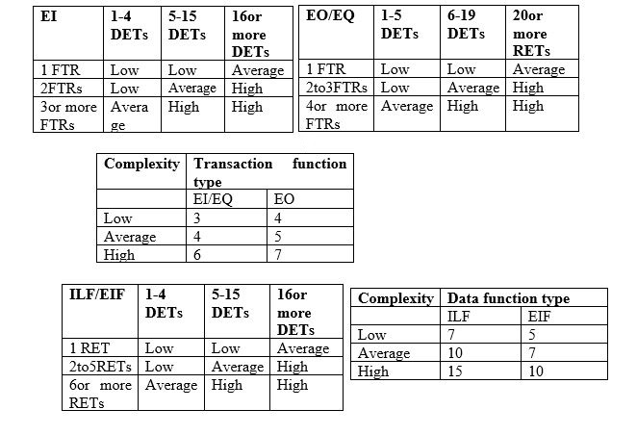
Complexity Weight Table

Slide 25
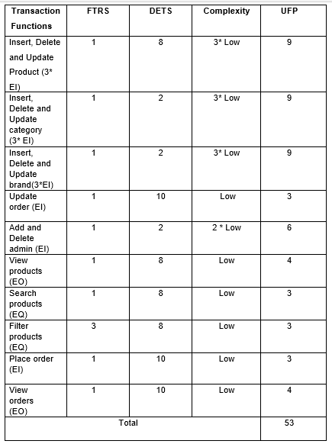
Unadjusted function point for transaction functions

Slide 26
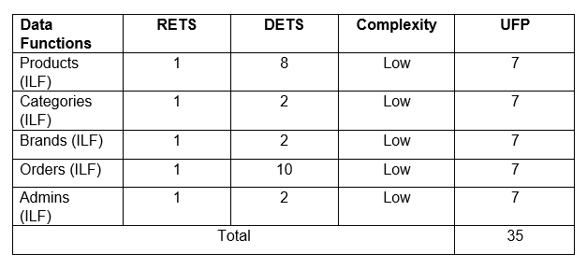
Unadjusted function point for Data functions

Slide 27
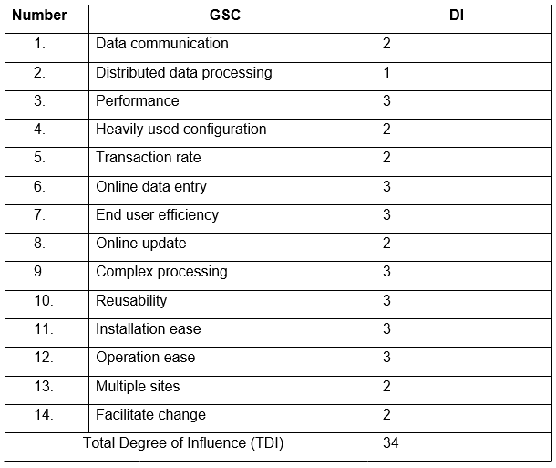
Complexity adjustment value

Slide 28
Calculation
UFP for Transection Function (TF) = 50
UFP for Data Function (DF) = 35
Total UFP = 53+35 = 88
Value Adjusted Factor (VAF)= (0.65 + (0.01 * TDI) = (0.65 + (0.01 *34) = 0.99
Adjusted Function Point (AFP) = UFP*VAF = 88 * 0.99
= 87.12 Efforts Calculation = AFP * Productivity
= 87.12 * 15.93
= 1387.82 person hours /7 = 198.26 person days / 30
= 6.61 person months/2 person = 3.31 months
= 3 month and 10 days approximately for 2 persons
Approximately 3 months and 10 days required for two persons to finish the project.

Slide 29
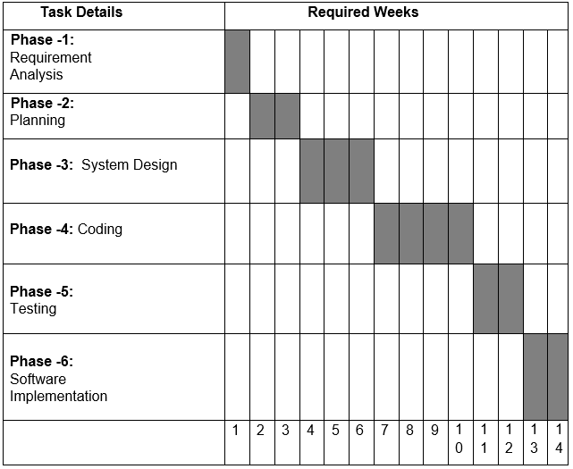
Project Scheduling Chart

Slide 30
Effort Base Estimation

Slide 31
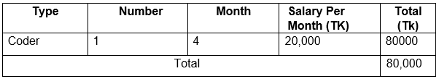
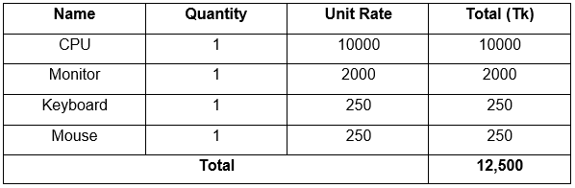
Cost Estimation
Personnel Cost:
Hardware Cost:

Slide 32
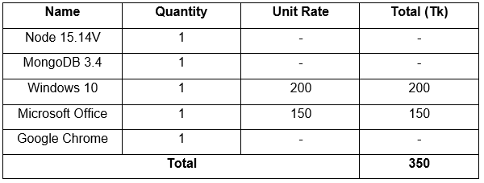
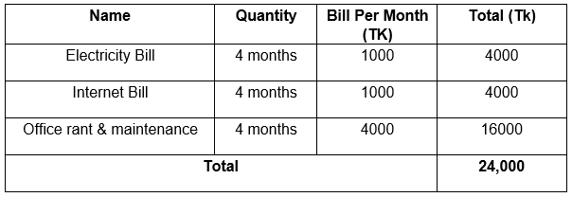
Cost Estimation
Software Cost:
Other Cost:
Total Cost: Personnel Cost + Hardware Cost + Software Cost + Other
= 80,000 + 12,500 + 350 + 24,000
= 116,850 Tk

Slide 33
Analysis & Design

Slide 34
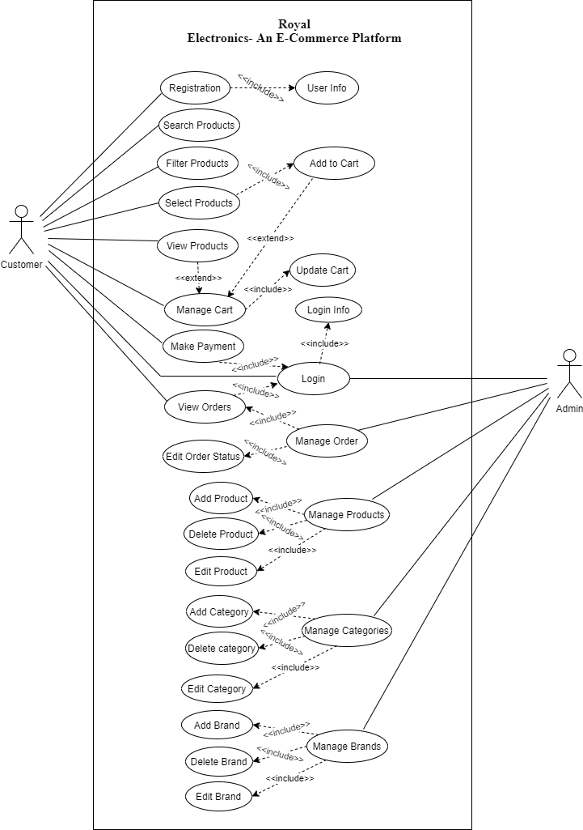
Use Case Diagram

Slide 35
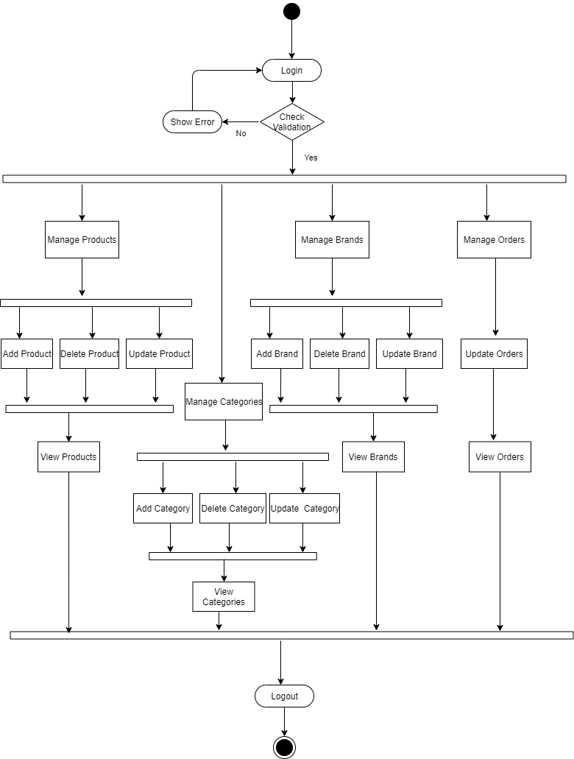
Activity Diagrams For Admin

Slide 36
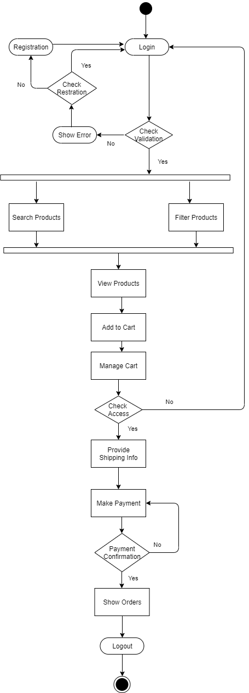
Activity Diagrams For Customer

Slide 37
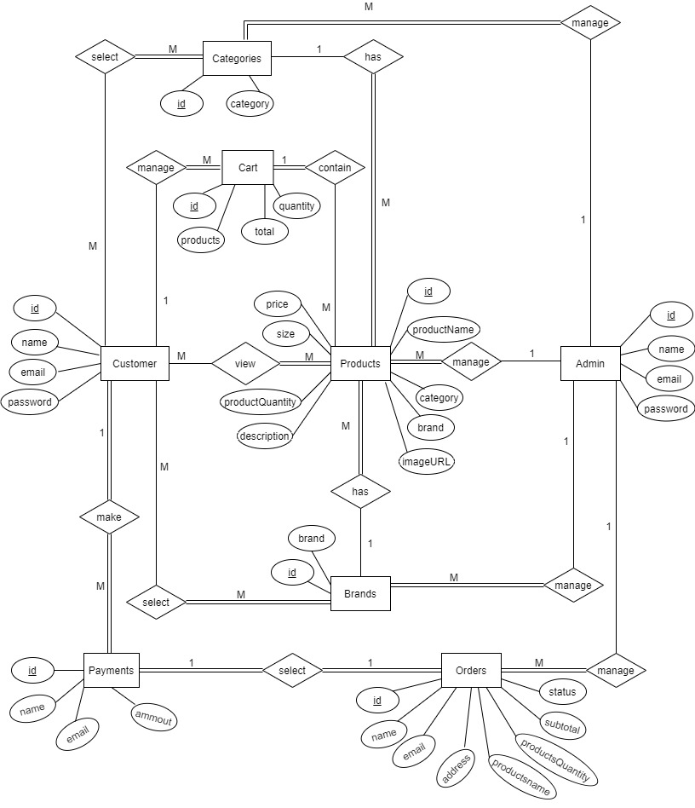
Entity Relationship Diagram (ERD)

Slide 38
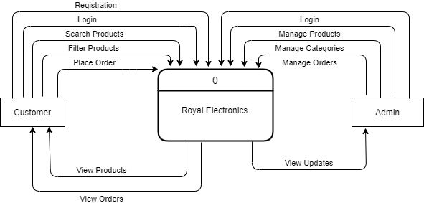
Context Level DFD

Slide 39
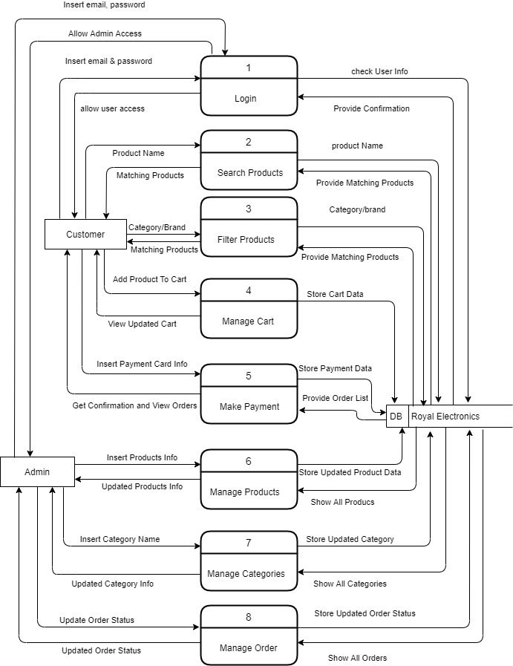
Level-1 DFD

Slide 40
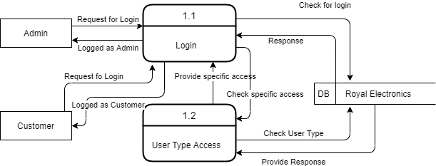
Level 2 DFD Of Process 1 (Login)

Slide 41
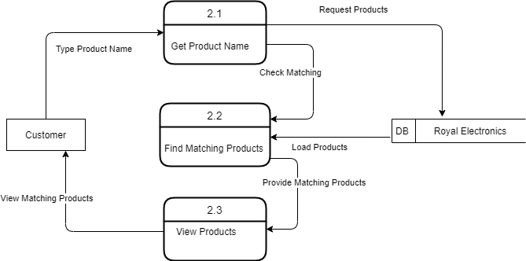
Level 2 DFD Of Process 2 (Search Products)

Slide 42

Level 2 DFD Of Process 3 (Filter Products)

Slide 43
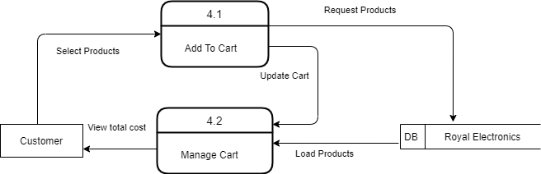
Level 2 DFD Of Process 4 (Manage Cart)

Slide 44
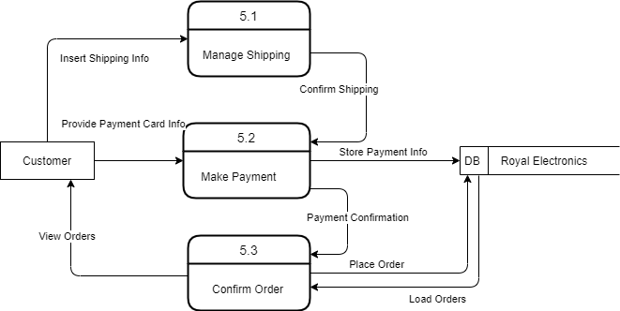
Level 2 DFD Of Process 5 (Make Payment)

Slide 45
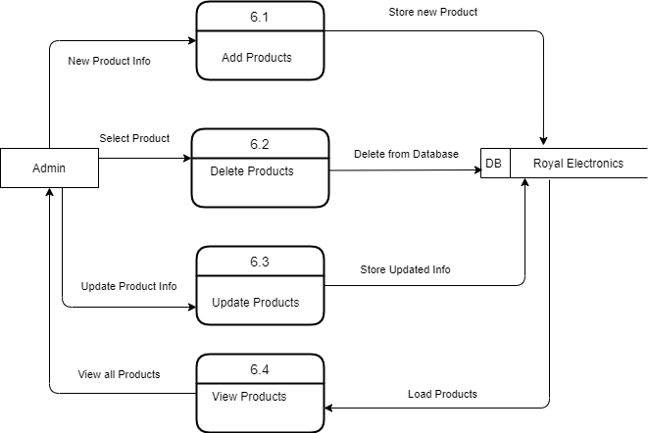
Level 2 DFD Of Process 6 (Manage Products)

Slide 46

Level 2 DFD Of Process 7 (Manage Categories)

Slide 47
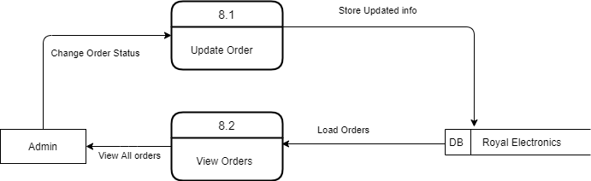
Level 2 DFD Of Process 8 (Manage Orders)

Slide 48
Project Demonstration

Slide 49
Testing

Slide 50
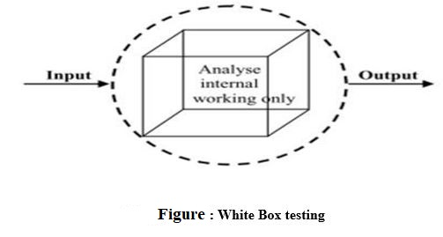
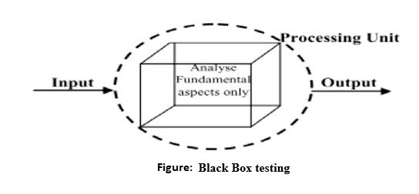
System Testing Methods

Slide 51
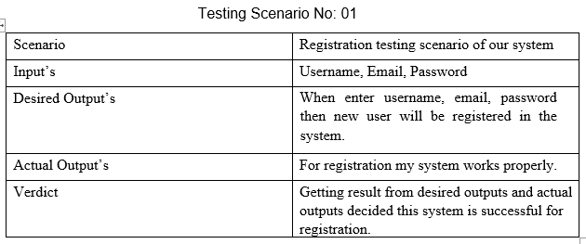
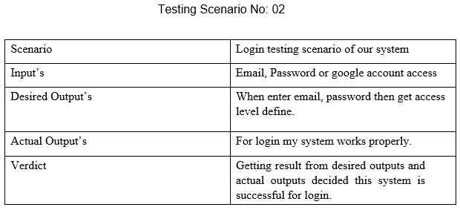
Testing Scenario

Slide 52
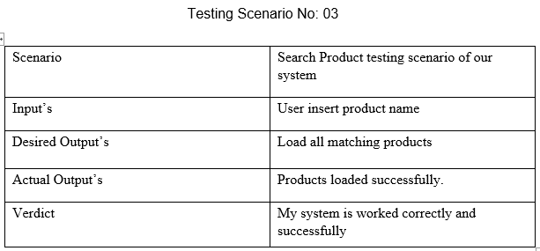
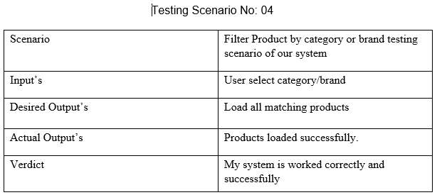
Testing Scenario

Slide 53
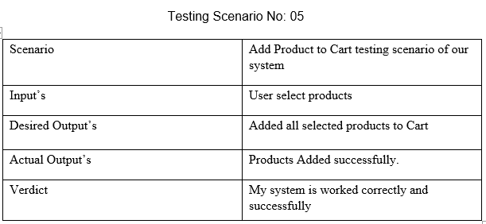
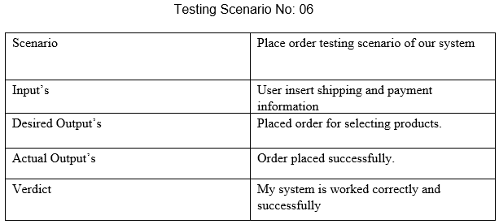
Testing Scenario

Slide 54
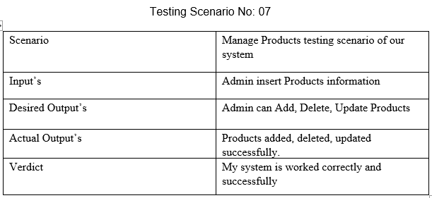
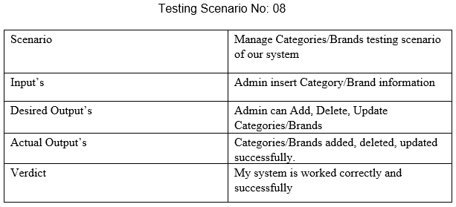
Testing Scenario

Slide 55
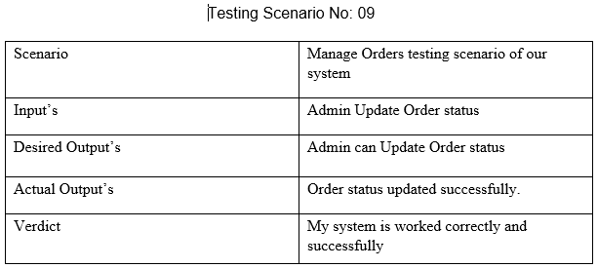
Testing Scenario

Slide 56
Conclusion

Slide 57
Conclusion
My project is only a humble venture to satisfy the needs in e-commerce system for general customer.
Several user-friendly coding has also adopted.
This package shall prove to be a powerful package in satisfying all the requirements of the client.
As nothing is perfect in the world so my system may have some issues those can be solve under maintenance in future.

Slide 58
Questions ??

Slide 59
Thanks

