Slide 1


Slide 2


Mengenal Teknologi Pengembangan Website

Slide 3
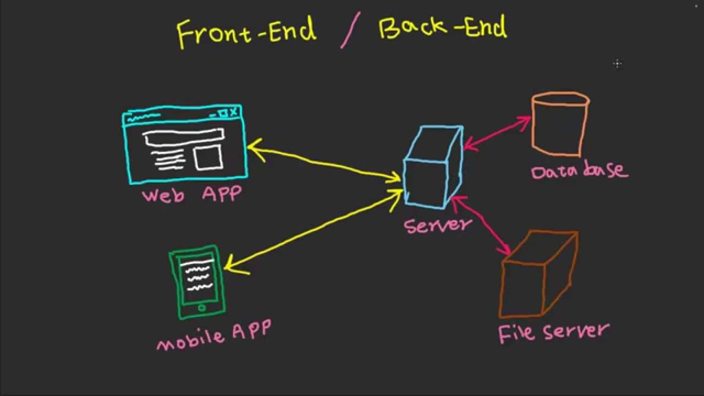
Web Development Technologies

Slide 4
Web Development Technologies
Front End
Back End
Database
HTML
CSS
JavaScript
PHP
Python
Ruby
Java
etc
MySQL
PostgreSQL
Oracle
etc

Slide 5


Kita akan mempelajari
HTML dan CSS

Slide 6








Website Development Tools
Text Editor
Browser
Browser Extention
Notepad
Sublime
Atom
Bracket
etc
Chrome
Firefox
Opera
Internet Explorer
etc
Inspect Element
Web Developer
etc

Slide 7

Berkenalan Dengan Struktur Website

Slide 8
Website Development Tools
Text Editor
Browser
Browser Extention
Notepad
Sublime
Atom
Bracket
etc
Chrome
Firefox
Opera
Internet Explorer
etc
Inspect Element
Web Developer
etc

Slide 9
Langkah – langkah membuat pemrograman website
Instalasi bracket ( http://brackets.io )
Mempelajari Heading, Link, Paragraph, List, Image, Video, Form, dan Table pada HTML
Mempelajari background-color, color, dan font-size pada CSS.

