Slide 1
Smart Home System

Slide 2
Contents
Problems
Solution = Smart Home
Choices For System Communication Used
Reasons of Choices
Diagrams – Use Case, Requirement
Implementation and Hardware

Slide 3
Problem Statement
Switches hard to access
Not energy and cost efficient
Careless or human mistakes – forgetfulness
Less convenient especially elder

Slide 4
Solution?
Smart Lamp
Smart Door lock
Smart Window
Smart heating and cooling system
All can be realised by having a smart home system

Slide 5
Implementation Of Smart Light

Slide 6
Choices For System Communication Used
Classic Bluetooth
Wifi
Zigbee
Bluetooth Low Energy (BLE)

Slide 7
Reasons Behind It: Why We Chose BLE?
Offers very low power consumption - battery life can be very long
Cheaper cost
Suitable range
Less Complex - does not need to exchange large amounts of data exchange

Slide 8
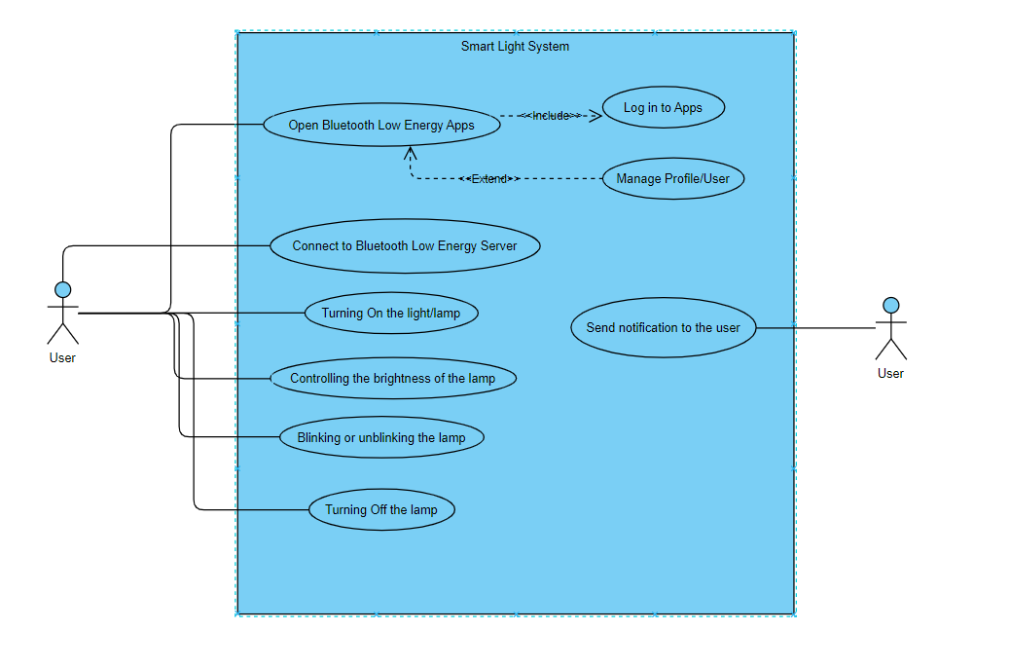
Use Case Diagram

Slide 9
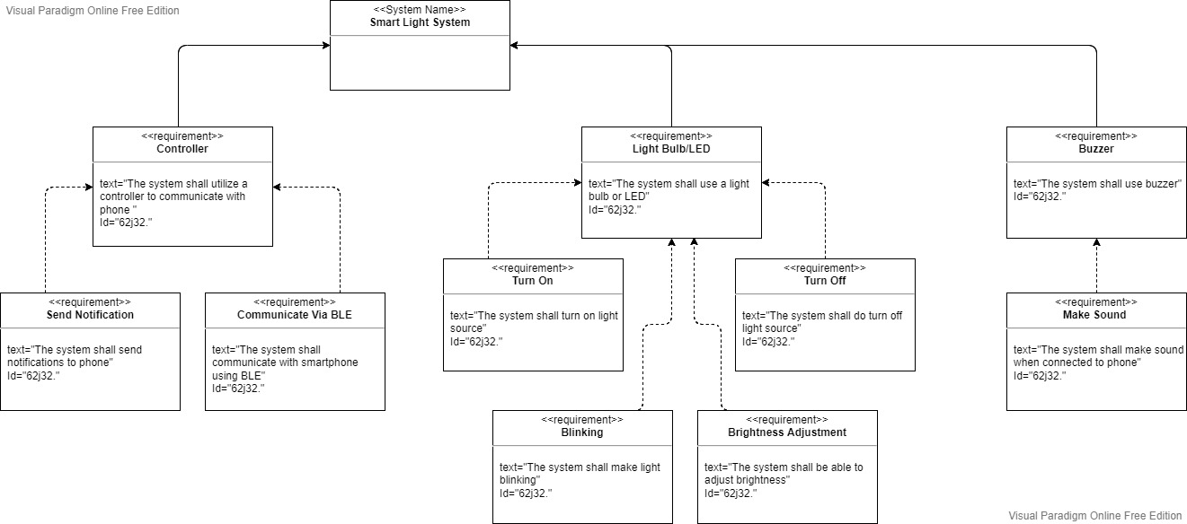
Requirement Diagram

Slide 10
Hardware Needed
ESP32
LED
Breadboard
Android Mobile Phone (App)
Male/Female Wires

Slide 11
THANK YOU FOR YOUR ATTENTION
ANY QUESTIONS?

