Slide 1
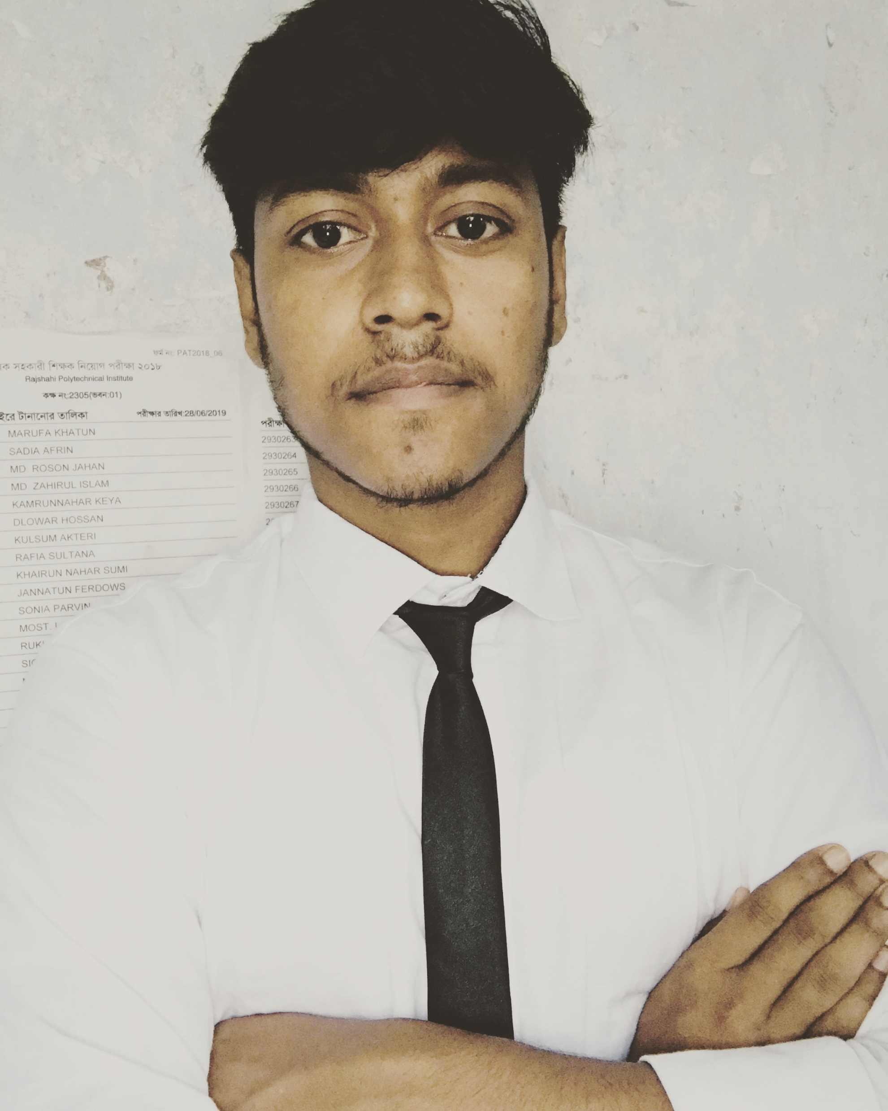












About me
ramin9927@gmail.com
+8801772-955 666
Naogaon, Bangladesh
facebook.com/R4Ruhul
twitter.com/Ruhulrocks
RUHUL AMIN
linkedin.com/in/r4ruhul
Android Developer
github.com/ramin9927
Professional Skills
stackoverflow.com/users/10220938/ruhul-amin
Education
Android
2019
Diploma
Java
Rajshahi Polytechnic Institute
GUI
Rajshahi
Diploma in computer engineering technology
Database
S S C
2016
Janakallyan Model High School
Personal Skills
Naogaon
Secondary school certificate in Science Group
Team Work
Experience
Creativity
Networking
2017
IMAX BD LTD
Leadership
Junior android developer
Rajshahi,Bangladesh
Hobbies
Certificates
Music
Photography
2018
MOBILE GAMES & APPLICATION DEVELOPMENT
BD ICT - DIVISION
Rajshahi,Bangladesh
Reading
03/2018 – 12/2018
Writing

