Slide 1
Entity - Attribute - Value (EAV) Data Model in Magento
@Pờ Đình Tâm

Slide 2
What is EAV
EAV can be thought of as “vertical” modeling instead of “horizontal” modeling of columns in a database table.
Instead of a table consisting of a number of columns, denoting attributes of a conceptual piece of data, the attributes are stored in one column of a separate table.

Slide 3
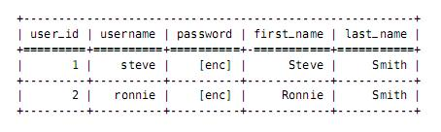
Traditional User Table
table: user_entity

Slide 4
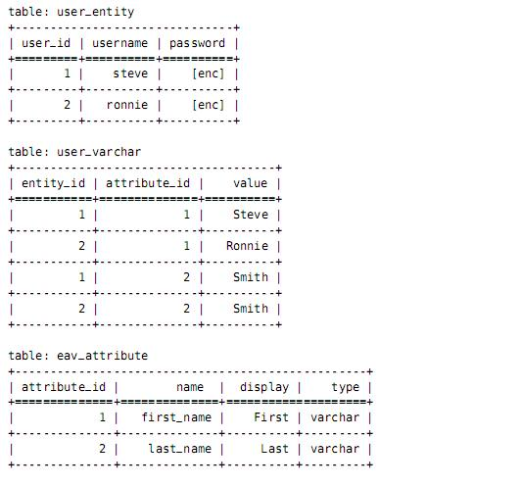
EAV Style Tables

Slide 5
Structure of an EAV table
The entity: Objects are entities (in Magento. Entities are: product, customer, order,…)
The attribute: object properties are attributes
The value: The value of the attribute

Slide 6
Update
SQL: UPDATE `eav_attribute` SET `attribute_id` = ?, `entity_type_id` = ?, `attribute_code` = ?, `attribute_model` = ?, `backend_model` = ?, `backend_type` = ?, `backend_table` = ?, `frontend_model` = ?, `frontend_input` = ?, `frontend_input_renderer` = ?, `frontend_label` = ?, `frontend_class` = ?, `source_model` = ?, `is_global` = ?, `is_visible` = ?, `is_required` = ?, `is_user_defined` = ?, `default_value` = ?, `is_searchable` = ?, `is_filterable` = ?, `is_comparable` = ?, `is_visible_on_front` = ?, `is_html_allowed_on_front` = ?, `is_unique` = ?, `is_used_for_price_rules` = ?, `is_filterable_in_search` = ?, `used_in_product_listing` = ?, `used_for_sort_by` = ?, `is_configurable` = ?, `apply_to` = ?, `position` = ?, `note` = ?, `is_visible_in_advanced_search` = ? WHERE (attribute_id='498')
BIND: Array
(
[0] => 498
[1] => 4
[2] => sp_test
[3] =>
[4] =>
[5] => varchar
[6] =>
[7] =>
[8] => text
[9] =>
[10] => sp test
[11] =>
[12] =>
[13] => 0
[14] => 1
[15] => 0
[16] => 1
[17] =>
[18] => 1
[19] => 0
[20] => 1
[21] => 0
[22] => 1
[23] => 0
[24] => 0
[25] => 0
[26] => 0
[27] => 0
[28] => 0
[29] =>
[30] => 0
[31] =>
[32] => 1
)

Slide 7
Delete
SQL: DELETE FROM `eav_attribute` WHERE (attribute_id='498')

Slide 8
Read
SQL:
SELECT COUNT(DISTINCT e.entity_id)
FROM `catalog_product_entity` AS `e`
INNER JOIN `catalog_category_product_index` AS `cat_index`
ON cat_index.product_id=e.entity_id
AND cat_index.store_id='1'
AND cat_index.visibility
IN(3, 4)
AND cat_index.category_id='2'
WHERE
(
e.entity_id in
(
SELECT `t1`.`entity_id` FROM `catalog_product_entity_varchar` AS `t1`
LEFT JOIN `catalog_product_entity_varchar` AS `t2`
ON t1.entity_id = t2.entity_id
AND t1.attribute_id = t2.attribute_id
AND t2.store_id='1'
WHERE (t1.store_id = 0)
AND (t1.attribute_id = 498)
AND (IFNULL(t2.value, t1.value) LIKE :attribute_498)
AND
(
t1.entity_id IN
(
SELECT `t1`.`entity_id` FROM `catalog_product_entity_int` AS `t1`
LEFT JOIN `catalog_product_entity_int` AS `t2`
ON t1.entity_id = t2.entity_id
AND t1.attribute_id = t2.attribute_id
AND t2.store_id='1'
WHERE (t1.store_id = 0)
AND (t1.attribute_id = 497)
AND (IFNULL(t2.value, t1.value) IN ('0', '1'))
AND
(
t1.entity_id IN
(
SELECT `t1`.`entity_id`
FROM `catalog_product_entity_int` AS `t1`
LEFT JOIN `catalog_product_entity_int` AS `t2`
ON t1.entity_id = t2.entity_id AND t1.attribute_id = t2.attribute_id
AND t2.store_id='1'
WHERE (t1.store_id = 0) AND (t1.attribute_id = 496) AND (IFNULL(t2.value, t1.value) IN ('0', '1'))
)
)
)
)
)
)
BIND: Array
(
[attribute_498] => %ten%
)

Slide 9
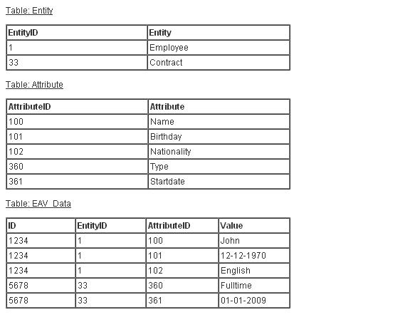
Read(2)

Slide 10
Read(3)
Relation database:
SELECT *
FROM Employee
WHERE Name = ‘John’
AND Nationality = ‘English

Slide 11
Read(4)
Self Join:
SELECT t1.ID as 'ID'
t1.Value AS ‘Name’,
t2.Value AS ‘Nationality’
t3.Value AS Birthday
FROM EAV_Data t1
LEFT JOIN EAV_Data t2
ON t1.ID = t2.ID
LEFT JOIN EAV_Data t3
ON t1.ID = t3.ID
WHERE t1.Attribute = ‘Name’
AND t1.Value = ‘John’
AND t2.Attribute = ‘Nationality’
AND t2.Value = ‘English’
AND t3.Attribute = ‘Birthday

Slide 12
Good
Provides a flexible mechanism to record the attributes associated with any entity.
This EAV design requires almost no consideration of the nature of the applicable hierarchical data and requires very little time to implement
The database schema does not change when the model changes

Slide 13
Bad
The EAV table doesn't provide a mechanism to create relationships between entities of different sub-types.
The EAV table does nothing to provide a grouping of related entity types.
The EAV table uses a VARCHAR column for all attribute values regardless if Dates, timestamps,
integers, numerics or booleans would be more appropriate
Inefficient queries. Where you would execute a simple query returning 20 columns from a single table, you end up with 20 self-joins, one for each column

Slide 14
Solution
Take a look at Magento Database Diagram

Slide 15
EAV table with Pivot (3)
Pivot
SELECT * FROM
(
SELECT ID
, [100] AS Name
, [101] AS Birthday
, [102] AS Nationality
FROM
(
SELECT ID, EntityID, AttributeID, Value
FROM EAV_Table
) p
PIVOT
(
MAX (Value)
FOR AttributeID IN ([100], [101], [102])
) AS pvt
)
WHERE Name = 'John'
AND Nationality = 'English'

Slide 16
When
Recommend from Amazon SimpleDB:
Principally utilize index and query functions rather than more complex relational database functions
Don’t want any administrative burden at all in managing their structured data
Want a service that scales automatically up or down in response to demand, without user intervention
Require the highest availability and can’t tolerate downtime for data backup or software maintenance

Slide 17
Thanks for your attention

