Slide 1


Lock Free Binary Search Trees
S.M. Iqbal Morshed
Fnu Tulha

Slide 2
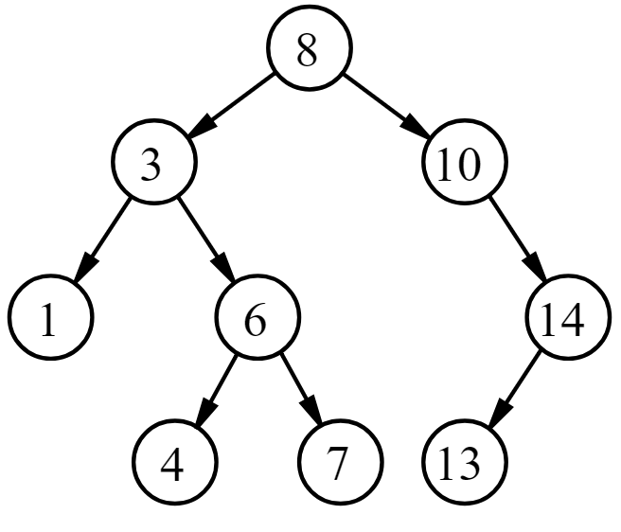
Binary Search tree
A Binary Search Tree contains keys that are taken from an ordered universe.
Build on the concept of binary search.

Slide 3
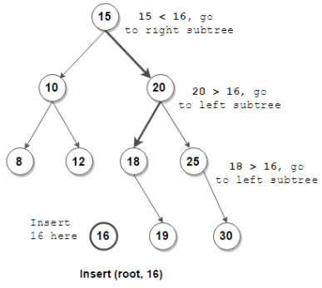
BST Insertion

Slide 4
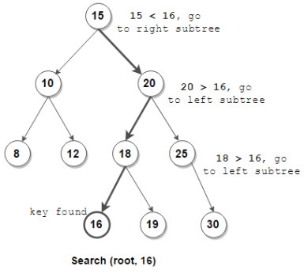
BST Search

Slide 5
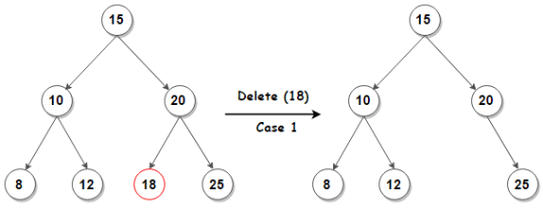
BST Deletion
Case 1
No Children

Slide 6
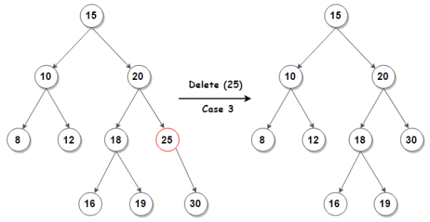
BST Deletion
Case 2
One Child

Slide 7
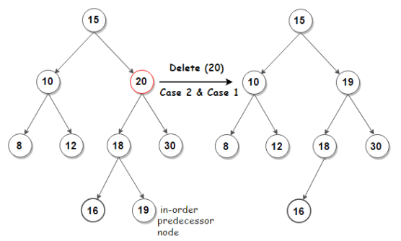
BST Deletion
Case 3
Two Children

Slide 8
Lock Free BST
Problems in concurrent BST
Multiple threads contend for deleting leaf node -> unsuccessful threads restart from the root.
Time Complexity: O(c*h(n))
where c = number of contending threads, h = height of tree for n nodes
“Contains” needs to be aware of concurrent remove of binary node.
Leads to invalid state otherwise.

Slide 9
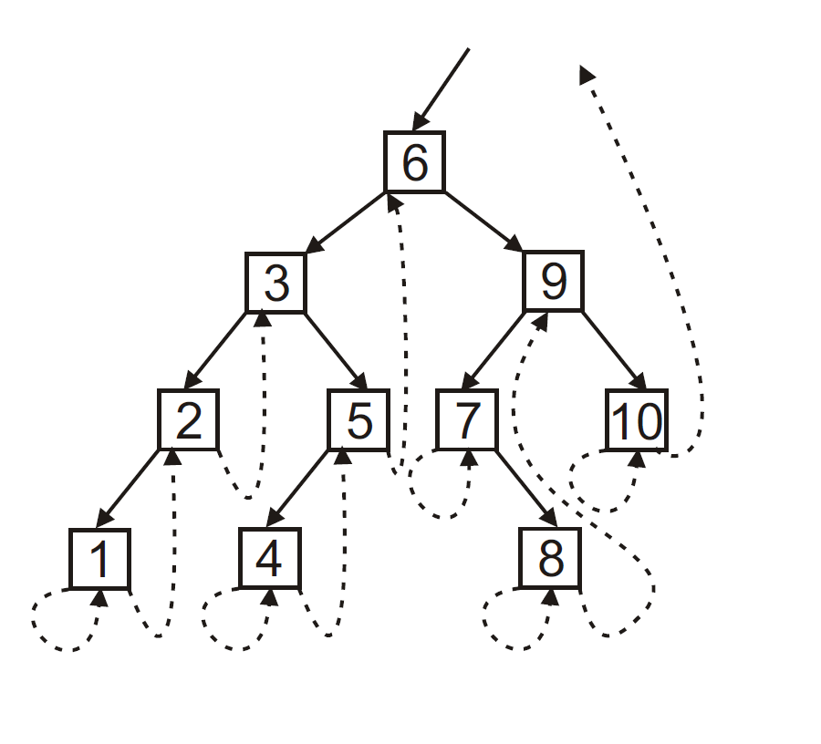
Threaded BST
Use of threaded links according to the approach in [3].
If leaf node, threaded link to itself and successor.
If unary node, threaded link to itself OR successor.
If binary node, an outgoing threaded link does not exist.

Slide 10
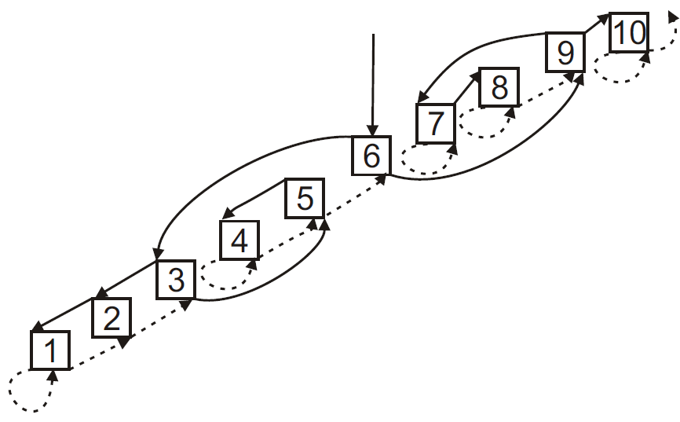
Why a Threaded BST?
Notes:
Benefits:
1.Helps If category 3 node has to be deleted. Gives us direct access to predecessor.
2. Helps concurrent contains. IN concurrent version, if a node is moved upwards, through threaded links we have access to that node.

Slide 11
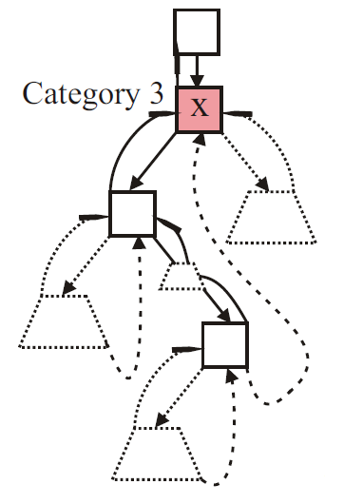
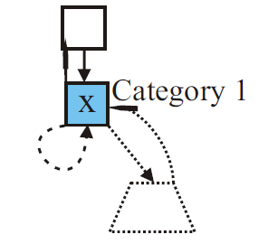
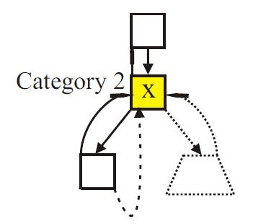
Other Features
An incoming threaded link is an order link.
Categories defined for the incoming order links at a node.
Notes:
An incoming threaded link is order link.

Slide 12
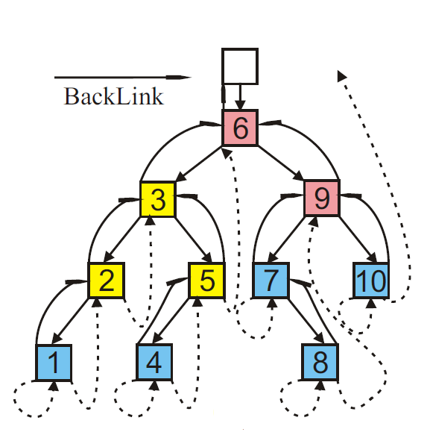
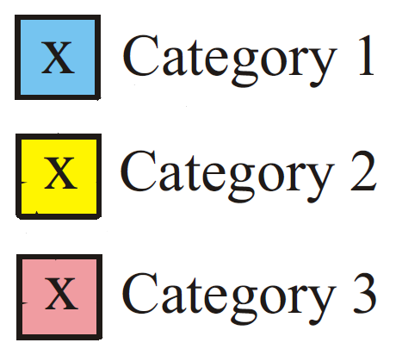
Updated BST
Backlinks from node to parent.
prev and succ obtained according to in order traversal.
Mark, Flag and Thread bit used for each link.
Each link of a node is represented by:
(Reference, flag, mark, thread)
Important: CAS takes this argument as well.
For example, (R, 0, 0, 1)

Slide 13
Set ADT
Supports add, contains and remove.
Add(k) -> Add node with key k to a BST.
Contains(k) -> return true if a node with key k is found.
Remove(k) -> remove node with key k.

Slide 14
Contains Operation
Contains can help marked nodes.
Condition: Starting from curr and prev, we traverse the BST:
While(true):
if k_curr == k:
return 2;
If(help):
help(marked)
else if link == leftThreaded:
stop; // since the key is not present
else if link==rightThreaded:
if k < k_next:
stop; since the key is not present
else:
continue;

Slide 15
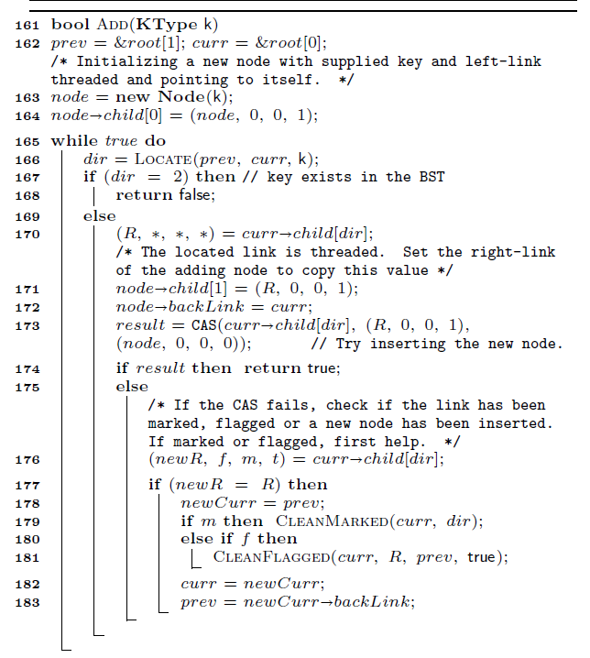
Add operation

Slide 16
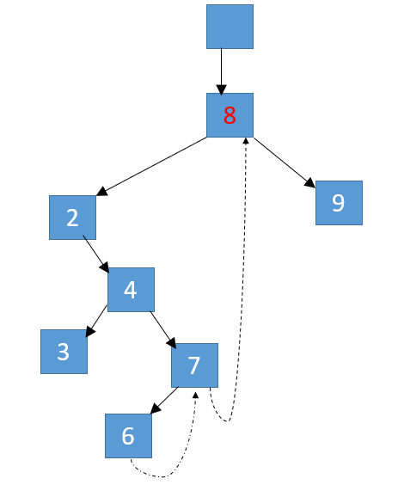
7 Steps of Remove operation
x
Node to be deleted
(delete node)
Step 1: Flag the incoming order link.
Order link
Predecessor node
Backlinks not shown
Fig: Removal of Category 3 node (Node 8)

Slide 17


7 Steps of Remove operation
x
Step 1: Flag the incoming order link.
1
Flag Mark Prelink

Slide 18
7 Steps of Remove operation
x
Step 1: Flag the incoming order link.
Step 2: Set the prelink
2
1
Flag Mark Prelink

Slide 19
7 Steps of Remove operation
x
3
Step 1: Flag the incoming order link.
Step 2: Set the prelink
Step 3: Mark the outgoing right link
2
1
Flag Mark Prelink

Slide 20
7 Steps of Remove operation
x
3
Step 1: Flag the incoming order link.
Step 2: Set the prelink
Step 3: Mark the outgoing right link
Step 4: Flag the parent-link of the predecessor
2
1
4
Flag Mark Prelink

Slide 21
7 Steps of Remove operation
x
5
3
Step 1: Flag the incoming order link.
Step 2: Set the prelink
Step 3: Mark the outgoing right link
Step 4: Flag the parent-link of the predecessor
Step 5: Flag the incoming parent link
2
1
4
Flag Mark Prelink

Slide 22
7 Steps of Remove operation
x
5
6
3
Step 1: Flag the incoming order link.
Step 2: Set the prelink
Step 3: Mark the outgoing right link
Step 4: Flag the parent-link of the predecessor
Step 5: Flag the incoming parent link
Step 6: Mark the outgoing left-link
2
1
4
Flag Mark Prelink

Slide 23
7 Steps of Remove operation
x
5
Step 1: Flag the incoming order link.
Step 2: Set the prelink
Step 3: Mark the outgoing right link
Step 4: Flag the parent-link of the predecessor
Step 5: Flag the incoming parent link
Step 6: Mark the outgoing left-link
Step 7: Mark the outgoing left link of the predecessor
6
3
2
1
4
7
Flag Mark Prelink

Slide 24
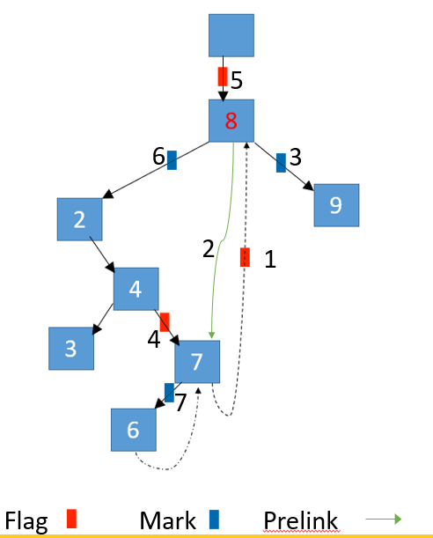
Pointer swapping
8
9
2
4
3
7
6

Slide 25
Pointer swapping
8
9
2
7
4
3
6

Slide 26
Why this orderly modification of links?
This is because, in this way concurrent operation can know in what stage a node is in.
And the helper function exactly knows what step should be taken to help the operation take step forward.

Slide 27
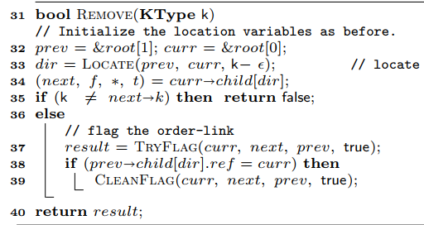
Remove operation
4 helper function is used to perform Remove() operation
TryFlag()
CleanFlag()
TryMark()
CleanMark()

Slide 28
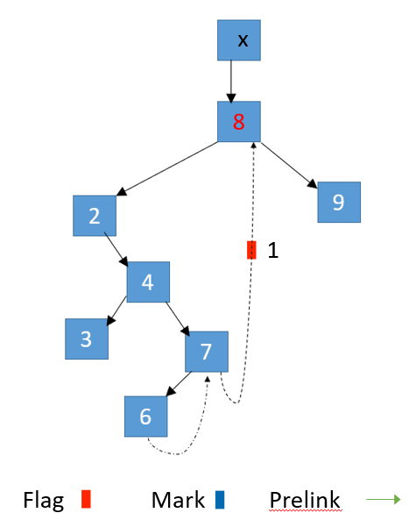
CleanFlag()
Helps to perform next step when a link is flagged
It identifies current state of the concurrent remove operation
Based on the state of flagged link

Slide 29
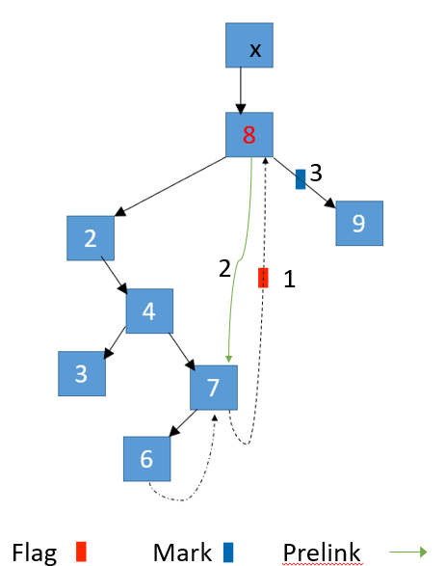
CleanFlag()
Link is threaded
Now in step 1
Perform step 2
Set the pre-link
Perform step 3
Mark the outgoing right-link
Then calls CleanMark() to perform next steps

Slide 30
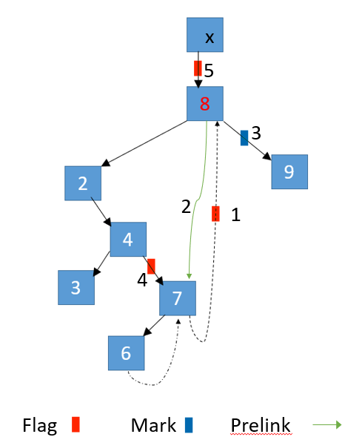
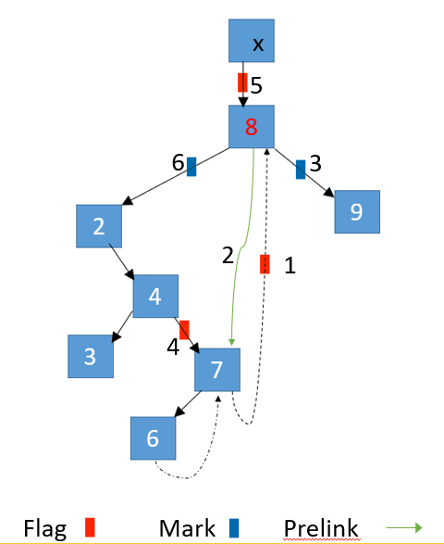

CleanFlag()
Link is not threaded
It is Parent link
Parent link of the predecessor node
In step 4
Performs step 5: Flag the incoming parent link
Parent link of the node to be deleted
In step 5
Performs step 6: Mark the outgoing left-link
CleanMark() is called to perform next steps

Slide 31
CleanFlag()
How CleanFlag() knows which parent link is flagged?
If the right child-link of the destination node is
threaded and flagged
Then, it is parent-link of the predecessor
marked
Then it is parent-link of the node to be deleted

Slide 32
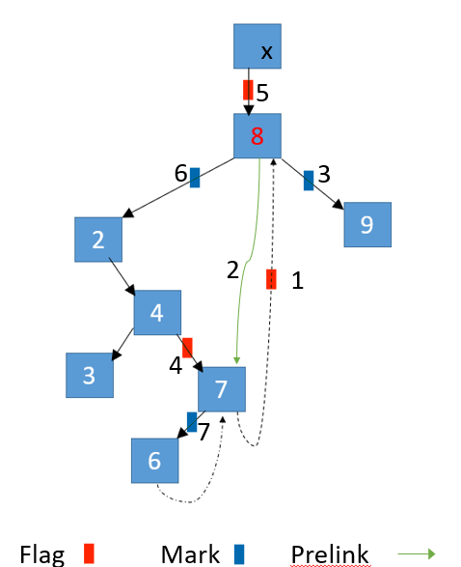
CleanMark()
Helps to perform next step when a link is marked
If right link is marked
In step 3, perform step 4 by calling CleanFlag()
If left link is marked
In step 6
Perform step 7: mark the outgoing left-link of the predecessor
If left link is marked and right-link is thread and flagged
In step 7
Time to perform pointer-swapping.

Slide 33
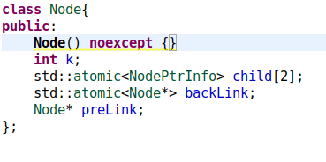
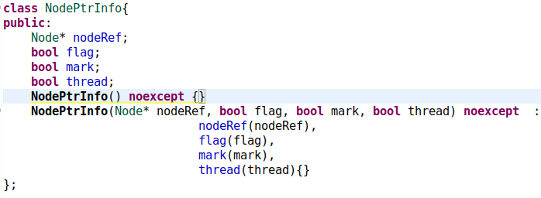
Our implementation
For this paper, there is no implementation available
This paper proposes the idea of bit stealing to store three bits (mark, flag and thread) for each pointer.
However, pointer address is architecture dependent.
So, bit stealing concept is not portable
We have created two different node class.
Node
NodePtrInfo
To store child link with 3 bits.

Slide 34
Correctness
Logically Removed Node
If right link is marked but a parent exists
Physically Removed Node
If no parent exists
Regular Node
All other nodes

Slide 35
Correctness
Locate returns true only for non physically removed node.
Add operation has to occur at unmarked and unflagged threaded link.
An unthreaded link cannot be marked and flagged i.e trymark, tryflag.
If a node is logically removed, eventually, it will be physically removed.

Slide 36
Linearizability
Add Operation
Failure: When a key k is already present.
Success: When link is not marked, flagged and no node has been inserted.
Contains Operation
Where the comparison between k_curr and k is performed.
Remove Operation
Success: where CAS for swapping flagged parent link(step V) is performed.
Failure:
If node is not located -> LP of unsuccessful LOCATE.
If node is located -> LP of concurrent remove that flags the order link.

Slide 37
Contributions over State-of-the-art
Use of backlinks to simplify complexity issue; each thread is a link away from the point of failure.
Leads to time complexity of O(h(n) + c); first algorithm with additive contention.

Slide 38
Challenges
Experimental evaluation not available
Next best thing?
Major bugs in the pseudocode.
e.g incorrect function calls, no declarations, incorrect variables used, typos, incorrect function parameters.

Slide 39
Conclusion
Exploit multiple link pointers for a node.
Challenging and complex to implement. Other approaches use simple ideas to achieve lock freedom.
Use of search path and store locally.
Remove operation quite expensive; up to 4 pointers need to be modified in the worst case.

Slide 40
References
Lock Free Binary Search Trees
https://arxiv.org/abs/1404.3272
BST Image
https://upload.wikimedia.org/wikipedia/commons/d/da/Binary_search_tree.svg
BST operations
https://www.techiedelight.com/deletion-from-bst/
https://www.techiedelight.com/search-given-key-in-bst/
https://www.techiedelight.com/insertion-in-bst/

