Slide 1
Merger: A Novel Algorithm for Constructing Short Genetic Element using Comparative Genome Assembly
S. M. Iqbal Morshed
Exam roll: 5001
Session: 2014-15
Supervisor:
Dr. Saifuddin Md. Tareeq

Slide 2
Contents
Introduction
Short Genetic Element
Comparative Genome Assembly
Methodology
Result and Discussion
Conclusion

Slide 3
Short Genetic Element
Short genetic element
Promoter
Initiates transcription of a particular gene
Enhancer
Increases the likelihood of transcription
Silencer
Stops transcription
Short gene sequence
Length varies.
Typically around 1000bp long

Slide 4
They may differ in biological functionality
But, same from computational perspective
From computational perspective
Genetic sequence of approximately 1000bp
Or, we can think as string of 1000 character.
Even though, all of these in our problem domain
We will focus more on Promoter
Promoter
Enhancer
Silencer

Slide 5
Short Genetic Element: Promoter
Promoter
Initiates transcription of a gene.
TF
Polymerase
DNA transcription
AGGTCGCCTGACGT
motif
motif
TSS
Promoter
Gene

Slide 6
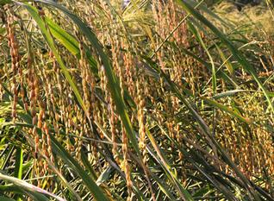

Importance of Promoter
Same gene is present
But, expression is different.
Why?
Difference in promoter
Pokkali rice
Nipponbare rice
Salt Tolerant
Salt Sensitive

Slide 7
How do we construct a Pokkali promoter?
Pokkali genome is not assembled.
We have
Pokkali raw data (i.e. fragmented data)
Nipponbare genome sequence
Can we construct Pokkali promoter sequence?

Slide 8
Problem Generalization
Given,
Raw data of a species.
Reference sequence of another variety.
Can we construct the genetic element?
Follow one of the genome assembly approach.

Slide 9

Genome assembly
How a genome is assembled?
Sequencer Machine
Read fragment (raw data)
Assembler Program
Contigs (i.e. long contiguos sequence)

Slide 10
Genome Assembly Approach
Genome Assembly Approach
De Novo Approach
Comparative assembly Approach
Combination of de novo and comparative

Slide 11
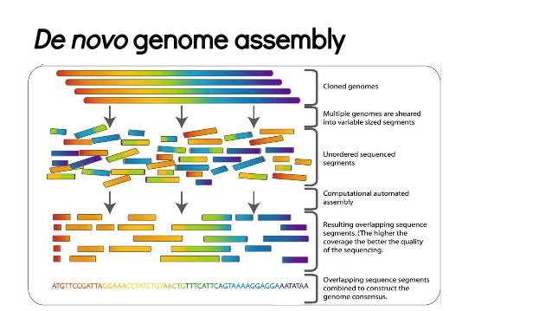
De novo appraoch

Slide 12
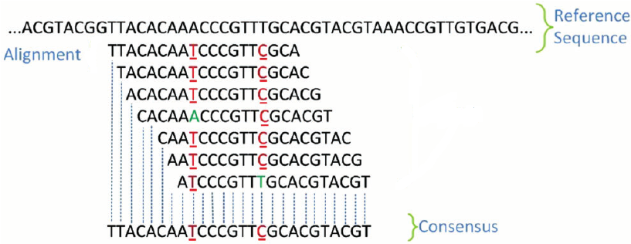
Comparative Genome Assembly
Reads (i.e. raw sequences) are aligned against reference

Slide 13
Combination of De-novo and comparative assembly
Aligns reads and contigs using comparative assembly
Extends cotings using de-novo assembly.
Example: AlignGraph

Slide 14
Our Approach
We chose ‘comparative genome assembly’ approach for constructing short genetic element.
It is faster
Suitable for short genetic element assembly
For the ability to prune unnecessary read

Slide 15
Whole Genome Assembly Vs. Short Genetic Element construction
Whole genome assembly
Aims to construct complete genome (billions of base pair long)
In reality, the construct thousands of contigs. (long contiguous sequence)
Focus to increase contig length
Short genetic element assembly
Aims to construct short genetic element (1000 bp long)
Focus on accuracy

Slide 16
Recap
We want to construct Short genetic element
Focus on promoter considering its importance
To construct a sequence there are several approach
we use comparative assembly approach.

Slide 17
Methodology
Steps to construct genetic element using comparative assembly
Align raw data to the reference
Alignment Grid Construction
Percentage of consensus base calculation
Assembly

Slide 19
1st Step: Aligning raw data to the reference Sequence
Global alignment
A | T | T | T | G | A | A | C | G | T | T | G | C | G | G | A | A | T | T | T | C | G | A | T | A | T | G | C | T | C
A | C | G | T | T | G | C
A | T | A | T | G | C | T
G | A | A | C | C | T | T
G | T | T | G | C | G | G
A | T | T | T | C | G | A
T | T | G | G | A | A | C

Slide 20
Alignment: Bowtie2
We perform alignment using Bowtie2 aligner
It performs local alignment.
Stores the alignment information in SAM file.
For each read alignement SAM file stores the first position, CIGAR value, complete sequence along with other information

Slide 21
Alignment Grid Construction
Bowtie 2: Local alignment
A | C | A | G | T | A | A | G | A | C | T | A | A | C | A | G | C | T | T | A | A | T | G | T | G
T | T | G
G | T | A | A
C | T
G | A | C | T
A | C
G | A | T
Left Clip
Insertion
Right Clip
T | T | G | G | T | A | A | C | T | G | A | C | T | A | C | G | A | T

Slide 22
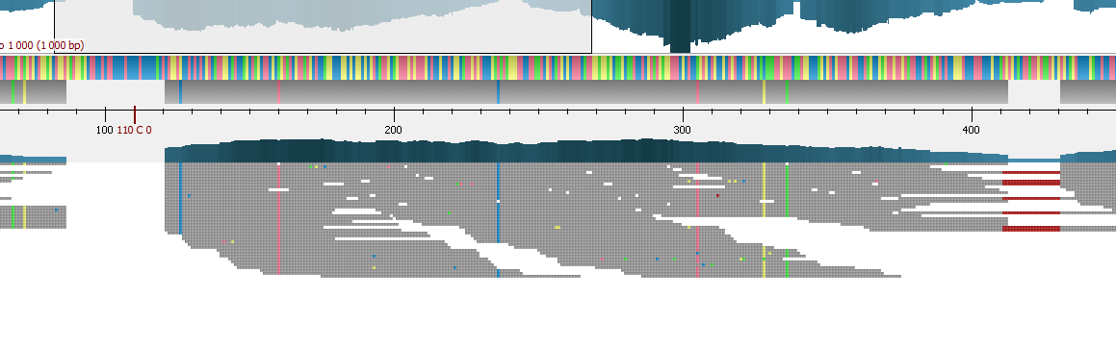
Alignment
Fig: Graphical Representation using UGENE

Slide 23
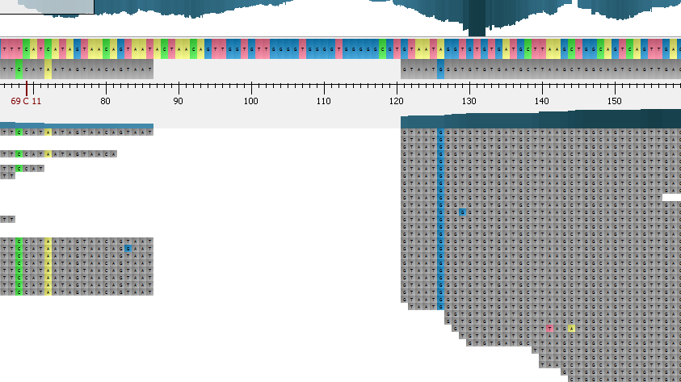
Problems After Alignment
Reference
sequence
Alignment of reads
Of target sequence
Clipping due to local alignment
Fig: Alignment against Os08g44850 gene of O. Sativa ssp. Japonica

Slide 24
Cause of the Problem: Clipping
A | C | A | G | T | A | A | G | A | C | T | A | A | C | A | G | C | T | T | A | A | T | G | T | G
A | C | A | G | T | A | A
T | G | T | G
C | A | G
T | A | A | T | G | T | G
A | C | A | G | T | A | A
T | G
A | C | A | G
T | A | A | T | G | T | G
A | C | A | G | T | A | A
T | G | T
A | G
T | A | A | T | G | T | G

Slide 25
How can we construct correct sequence from this?

Slide 26
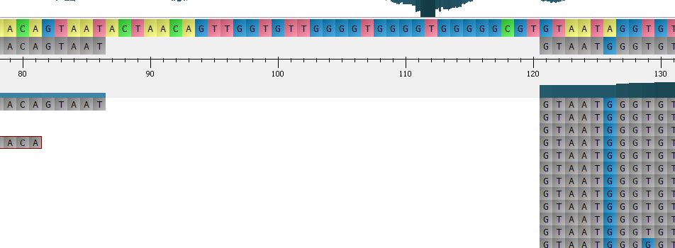
Or is there overlap?
. | . | A | C | A | G | T | A | A | T
G | T | A | A | T | G | G | G | . | .
Can we simply join the two part to construct correct sequence?

Slide 27
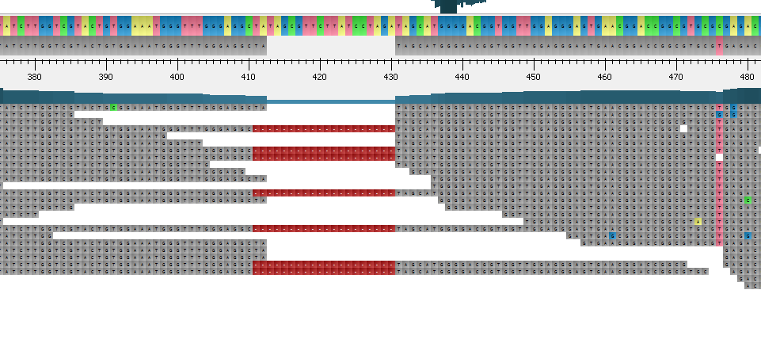
Clipping occurred in colum 412
Deletion started from column 410

Slide 28
Alignment Grid Construction
A | C | A | G | T | A | A | G | A | C | T | A | A | C | A | G | C | T | T | A | A | T | G | T | G
T | T | G
G | T | A | A
C | T
G | A | C | T
A | C
G | A | T
Left Clip
Insertion
Right Clip
T | T | G | G | T | A | A | C | T | G | A | C | T | A | C | G | A | T

Slide 29
Alignment Grid Construction
A | C | A | G | T | A | A | G | A | C | T | A | A | C | A | G | C | T | T | A | A | T | G | T | G
G | T | A | A
G | A | C | T
A | C
T | T | G
C | T
G | A | T
Left Clip
Insertion
Right Clip
G T A A G A C T
D
A C

Slide 30
Alignment Grid Construction
A | C | A | G | T | A | A | G | A | C | T | A | A | C | A | G | C | T | T | A | C | T | G | T | G
G | T | A | A
G | A | C | T
A | C
T | T | G
C | T
T | G | C
Left Clip
Insertion
Right Clip
 |  |  |  |  |  |  |  |  |  |  |  |  |  |  |  |  |  |  | A | C | T | G
A | C | A | G | T | A | A | G | A | C | C | D | A | C |  |  |  |  |  | A | C | T | G
A | C | A | G | T | A | A | G | A | C | T | D | A | C |  |  |  |  |  | A | C | T | G
A | C | A | G | T | A | A | G | A | C | T | D | A | C |  |  |  |  |  | A | C | T | G
A | C | A | T | T | C | A | G | A | C | T | D | A | C |  |  |  |  |  | A | T | T | G
A | C | A | G | T | A | A | G | A | C | T | D | A | C |  |  |  |  |  | A | C | T | G
G T A A G A C T
D
A C

Slide 31
Why storing in the Alignement Grid important?
Helps to restore the original sequence.
Helps to identify the position of
Insertion
Deletion
Clipping

Slide 32
Step 3: Percentage Calculation
A | C | A | G | T | A | A | G | A | C | T | A | A | C | A | G | C | T | T | A | C | T | G
Column
1 | 2 | 3 | 4 | 5 | 6 | 7 | 8 | 9 | 10 | 11 | 12 | 13 | 14 | 15 | 16 | 17 | 18 | 19 | 20 | 21 | 22 | 23
Alignment
Grid
 |  |  | G | T | A | A | G | A | C | T | D | A | C |  |  |  |  |  | A | C | T | G
A | C | A | G | T | A | A | G | A | C | C | D | A | C |  |  |  |  |  | A | C | T | G
A | C | A | G | T | A | A | G | A | C | T | D | A | C |  |  |  |  |  | A | C | T | G
A | C | A | G | T | A | A | G | A | C | T | D | A | C |  |  |  |  |  | A | C | T | G
A | C | A | T | T | C | A | G | A | C | T | D | A | C |  |  |  |  |  | A | T | T | G
A | C | A | G | T | A | A | G | A | C | T | D | A | C |  |  |  |  |  | A | C | T | G
Cons. Base
100 | 100 | 83 | 83 | 100 | 83 | 100 | 100 | 100 | 100 | 83 | 100 | 100 | 100 | 0 | 0 | 0 | 0 | 0 | 100 | 83 | 100 | 100
0 | 0 | 0 | 0 | 0 | 0 | 0 | 100 | 0 | 0 | 0 | 0 | 0 | 0 | 0 | 0 | 0 | 0 | 0 | 0 | 0 | 0 | 0
0 | 0 | 17 | 0 | 0 | 0 | 0 | 0 | 0 | 0 | 0 | 0 | 0 | 0 | 100 | 0 | 0 | 0 | 100 | 0 | 0 | 0 | 0
Insertion
Clipping

Slide 33
Step 4: Assembly: Algorithm
We assemble column by column
If insertion percentage is greater than base threshold,
then we insert the insertion string to the assembly
If consensus base percentage is greater than base threshold
We add the consensus base to the assembly.
Otherwise
We merge two column

Slide 34
Step 4: Assembly
A | C | A | G | T | A | A | G | A | C | T | A | A | C | A | G | C | T | T | A | C | T | G
 |  |  | G | T | A | A | G | A | C | T | D | A | C |  |  |  |  |  | A | C | T | G
A | C | A | G | T | A | A | G | A | C | C | D | A | C |  |  |  |  |  | A | C | T | G
A | C | A | G | T | A | A | G | A | C | T | D | A | C |  |  |  |  |  | A | C | T | G
A | C | A | G | T | A | A | G | A | C | T | D | A | C |  |  |  |  |  | A | C | T | G
A | C | A | T | T | C | A | G | A | C | T | D | A | C |  |  |  |  |  | A | T | T | G
A | C | A | G | T | A | A | G | A | C | T | D | A | C |  |  |  |  |  | A | C | T | G
Cons. Base
100 | 100 | 83 | 83 | 100 | 83 | 100 | 100 | 100 | 100 | 83 | 100 | 100 | 100 | 0 | 0 | 0 | 0 | 0 | 100 | 83 | 100 | 100
0 | 0 | 0 | 0 | 0 | 0 | 0 | 100 | 0 | 0 | 0 | 0 | 0 | 0 | 0 | 0 | 0 | 0 | 0 | 0 | 0 | 0 | 0
0 | 0 | 17 | 0 | 0 | 0 | 0 | 0 | 0 | 0 | 0 | 0 | 0 | 0 | 100 | 0 | 0 | 0 | 100 | 0 | 0 | 0 | 0
Insertion
Clipping
Assembly:
A
C
A
G
T
A
A
C T
G
A
C
T
D
A
C
Base threshold = 80

Slide 35
 |  |  | G | T | A | A | G | A | C | T | D | A | C |  |  |  |  |  | A | C | T | G
A | C | A | G | T | A | A | G | A | C | C | D | A | C |  |  |  |  |  | A | C | T | G
A | C | A | G | T | A | A | G | A | C | T | D | A | C |  |  |  |  |  | A | C | T | G
A | C | A | G | T | A | A | G | A | C | T | D | A | C |  |  |  |  |  | A | C | T | G
A | C | A | T | T | C | A | G | A | C | T | D | A | C |  |  |  |  |  | A | T | T | G
A | C | A | G | T | A | A | G | A | C | T | D | A | C |  |  |  |  |  | A | C | T | G
Alignment
Grid
Left Point
Right Point
Left Array
Right Array
T | A | A | A | C | G | A | C | T | A | C | T | G | C
T | A | A | A | C | G | A | C | C | A | C | T | G
T | A | A | A | C | G | A | C | T | A | C | T | G | C
T | A | A | A | C | G | A | C | T | A | C | T | G | C
T | C | A | A | C | G | A | C | T | A | C | T | G
T | A | A | A | C | G | A | C | T | A | C | T | G
A | C | T | A | C | T | G | C | C | T | C | G | C
 | C | T | A | C | T | G | C | C | T | C | G | C
 | C | T | A | C | T | G | C | C | T | C | G | C
A | C | T | A | C | T | G | C | C | T | C | G | C
 |  | T | A | T | T | G | C | C | T | C | G | C
A | C | T | A | C | T | G | C | C | T | C | G | C
Left Array and Right array stores the read in original order

Slide 36
Merging
T | A | A | A | C | G | A | C | T | A | C | T | G | C
T | A | A | A | C | G | A | C | C | A | C | T | G
T | A | A | A | C | G | A | C | T | A | C | T | G | C
T | A | A | A | C | G | A | C | T | A | C | T | G | C
T | C | A | A | C | G | A | C | T | A | C | T | G
T | A | A | A | C | G | A | C | T | A | C | T | G
A | C | T | A | C | T | G | C | C | T | C | G | C
 | C | T | A | C | T | G | C | C | T | C | G | C
 | C | T | A | C | T | G | C | C | T | C | G | C
A | C | T | A | C | T | G | C | C | T | C | G | C
 |  | T | A | T | T | G | C | C | T | C | G | C
A | C | T | A | C | T | G | C | C | T | C | G | C

Slide 37
Step 4: Assembly
A | C | A | G | T | A | A | G | A | C | T | A | A | C | A | G | C | T | T | A | C | T | G
 |  |  | G | T | A | A | G | A | C | T | D | A | C |  |  |  |  |  | A | C | T | G
A | C | A | G | T | A | A | G | A | C | C | D | A | C |  |  |  |  |  | A | C | T | G
A | C | A | G | T | A | A | G | A | C | T | D | A | C |  |  |  |  |  | A | C | T | G
A | C | A | G | T | A | A | G | A | C | T | D | A | C |  |  |  |  |  | A | C | T | G
A | C | A | T | T | C | A | G | A | C | T | D | A | C |  |  |  |  |  | A | T | T | G
A | C | A | G | T | A | A | G | A | C | T | D | A | C |  |  |  |  |  | A | C | T | G
Cons. Base
100 | 100 | 83 | 83 | 100 | 83 | 100 | 100 | 100 | 100 | 83 | 100 | 100 | 100 | 0 | 0 | 0 | 0 | 0 | 100 | 83 | 100 | 100
0 | 0 | 0 | 0 | 0 | 0 | 0 | 100 | 0 | 0 | 0 | 0 | 0 | 0 | 0 | 0 | 0 | 0 | 0 | 0 | 0 | 0 | 0
0 | 0 | 17 | 0 | 0 | 0 | 0 | 0 | 0 | 0 | 0 | 0 | 0 | 0 | 100 | 0 | 0 | 0 | 100 | 0 | 0 | 0 | 0
Insertion
Clipping
Assembly:
A
C
A
G
T
A
A
C T
G
A
C
T
D
A
C
T
G

Slide 38
Step 4: Assembly
A | C | A | G | T | A | A | G | A | C | T | A | A | C | A | G | C | T | T | A | C | T | G
 |  |  | G | T | A | A | G | A | C | T | D | A | C |  |  |  |  |  | A | C | T | G
A | C | A | G | T | A | A | G | A | C | C | D | A | C |  |  |  |  |  | A | C | T | G
A | C | A | G | T | A | A | G | A | C | T | D | A | C |  |  |  |  |  | A | C | T | G
A | C | A | G | T | A | A | G | A | C | T | D | A | C |  |  |  |  |  | A | C | T | G
A | C | A | T | T | C | A | G | A | C | T | D | A | C |  |  |  |  |  | A | T | T | G
A | C | A | G | T | A | A | G | A | C | T | D | A | C |  |  |  |  |  | A | C | T | G
Cons. Base
100 | 100 | 83 | 83 | 100 | 83 | 100 | 100 | 100 | 100 | 83 | 100 | 100 | 100 | 0 | 0 | 0 | 0 | 0 | 100 | 83 | 100 | 100
0 | 0 | 0 | 0 | 0 | 0 | 0 | 100 | 0 | 0 | 0 | 0 | 0 | 0 | 0 | 0 | 0 | 0 | 0 | 0 | 0 | 0 | 0
0 | 0 | 17 | 0 | 0 | 0 | 0 | 0 | 0 | 0 | 0 | 0 | 0 | 0 | 100 | 0 | 0 | 0 | 100 | 0 | 0 | 0 | 0
Insertion
Clipping
Assembly:
A
C
A
G
T
A
A
C T
G
A
C
T
D
A
C
T
G

Slide 39
Merging is done based on a Distance suggestion.
If any contiguous read is found between left merge point and right merge point then the number of bases contained in that read, between the two point is considered as distance.
If many such read is found, then the Distance suggestion with the highest frequency is taken.
If no suggestion is found. Then the Distance is considered 0.
If the merging based on suggestion fails,
It is shrank 10 columns gradually to find high percentage consensus.
If shrink merging fails then it expanded 10 columns to find high percentage consensus.

Slide 40
Complexity
Best case complexity O(N)
N is the length of the Reference Sequence
Worst case complexity O(C*N)
C is the total how many times we do shrinking and expanding
So, complexity is O(N)

Slide 41
Result and Discussion
Data collection
Pokkali raw data (i.e. collection of reads sequence)
3 salt inducible Nipponbare promoter
Os08g44850
Os01g02160 (Hkt 1;5)
Os02g02170 (High affinity Nitrate transporter)
We used Nipponbare promoter as reference sequence.
For each reference sequence corresponding Pokkali promoter sequence was constructed

Slide 42
Result
We finally constructed
3 Pokkali promoter sequence
Os08g44850
Os01g20160
Os02g20170

Slide 43
Result: Validation
We need to validate that our constructed Promoter sequence is the actual one.
To validate we collected 2 original Pokkali promoter from literature for
Os08g44850 gene
Os02g20160 gene
For the Os02g20170 we compared with O. Sativa Indica RS Bio-226 found in NCBI database.

Slide 44
Result: Identity
We aligned our constructed sequence with biochemically produced original sequence
Using BLAST alignment tool
Assembled Promoter (Pokkali) | Comparison Sequence | Indentity | Gaps | E value
Os08g44850 | Os08g44850 | 97% | 2% | 0.0
Os02g20160 | Os02g20160 | 99% | 0% | 0.0
Os02g20170 | O. Sativa Indica RP Bio-226 | 98% | 0% | 0.0

Slide 45
Result: observation
examined the reasons for little (1% to 3% ) dissimilarity.
Found that this is due to Copy Number Variation (CNV) between the two compared sequence.
Not because of the weakness of our algorithm.

Slide 46
Copy Number Variation
It is a phenomenon in which
Section of a genome is repeated
And the number of repeat varies between individuals
Person 1
A | T | A | G | C | - | - | - | A | C | T | A | C | T | G | G | C | A | G | T
Person 2
A | T | A | G | C | A | C | T | A | C | T | A | C | T | G | G | C | A | G | T

Slide 47
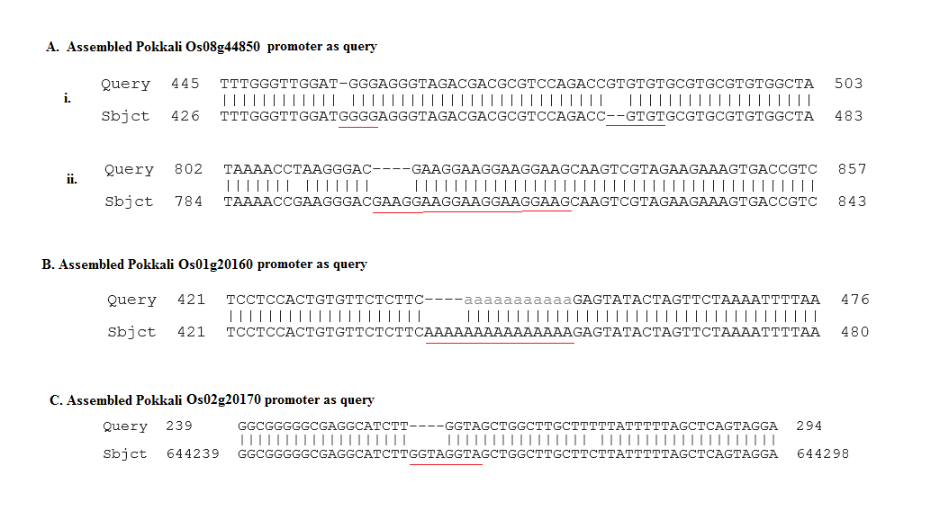

Slide 48
Result: Validation
We further validated our assembled sequence with promoter prediction software NNPP
Promoter (Pokkali Constructed) | NNPP (Predicted Promoter Position, Score)
Os08g44850 | 177-227(0.74); 54-594 (0.72) ;689-739 (0.65)
Os01g20160 | 244-294 (0.97);651-701 (0.71) ;673-723 (0.63) ;835-885(0.62) ;886-936(1.0)
Os02g20170 | 201-251(0.71) ;213-263 (0.63) ;563-613 (0.68) ;875-925 (0.77); 928-978 (0.96)

Slide 49
Time cost
Also, our assembly program is very efficient in terms of time cost.
Complexity is linear
Assembled Seq. | Time (second)
Os08g44850 | 0.8
Os01g20160 | 0.7
Os02g02170 | 0.8

Slide 50
Conclusion
We proposed a novel algorithm Merger
We assembled sequence with high accuracy
Our algorithm is highly efficient in terms of time cost

Slide 51
Thank you

