Slide 1

Log Management System
Simple spring boot project to add the log details of employees

Slide 2
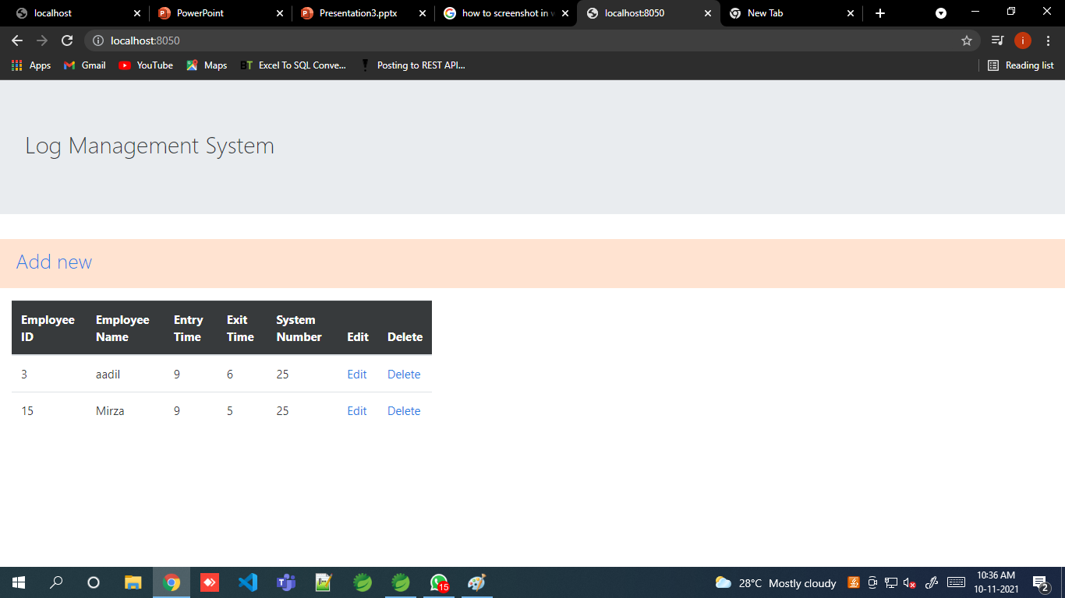
1
2
3

Slide 3
Landing page
The Second slide shows the landing page of the webapp
It mainly display these things :
The heading line "Log management System"- Used jumbotron class in bootstrap for this
Add new button
A table which shows the data of an employee which is stored in the database
Edit and delete button

Slide 4
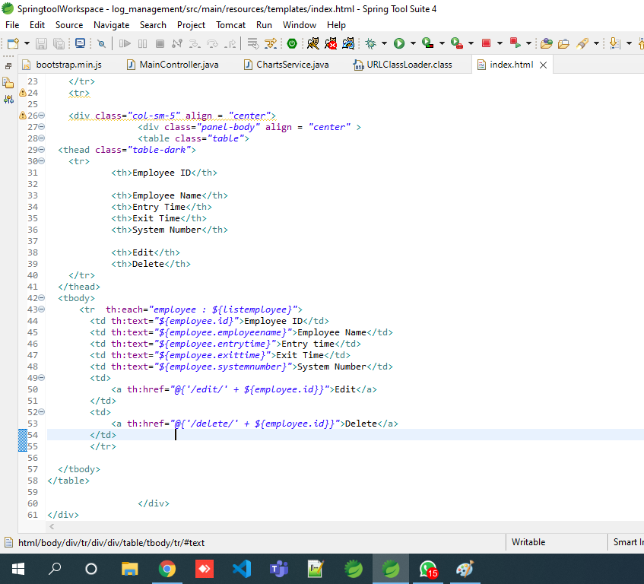
Table data

Slide 5


Add new button
Index.html file
Controller class

Slide 6
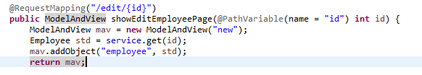

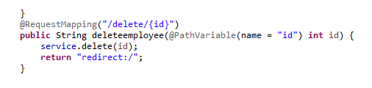
Edit and delete button

Slide 7
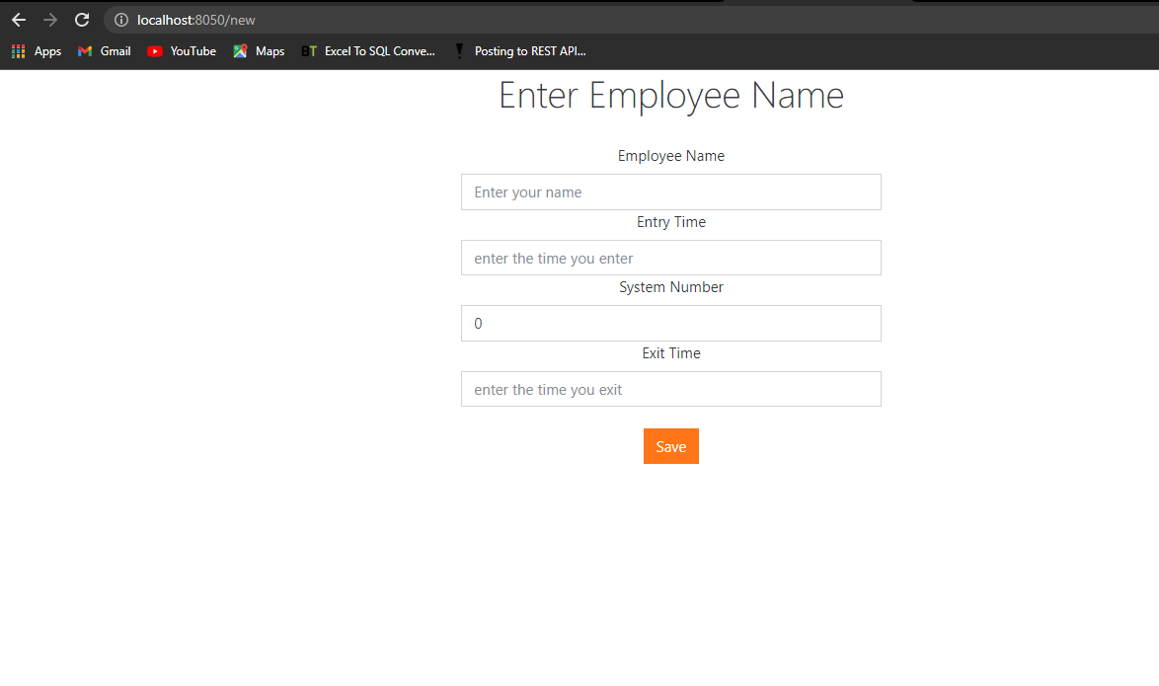
To add new employee details

