Slide 1
Ardros python node
/cmd_vel processing details
Ubuntu Notebook
ROS core
BEFORE:
Telop Node
|
/cmd_vel
|
Ardros Node
Arduino.py
\___
Serial
Port
Arduino
Maple
Sabertooth
2X12
In RC Servo
mode
M1
M2
NOW:
Ubuntu 14.04
Chromebook
Edison
roslibjoy.js
roslib –>
|
/cmd_vel
|
Joystick
|
USB
Ethernet
ROS core
IP:9090
|
rosbridge_websocket
|
rosbridge_server
|
/cmd_vel
|
edros Node
edison.py
\____________
USB
Kangaroo
Motion
Controller
M1
Xbox 360
Game Pad
Serial
Port
Sabertooth
2X12
M2

Slide 2
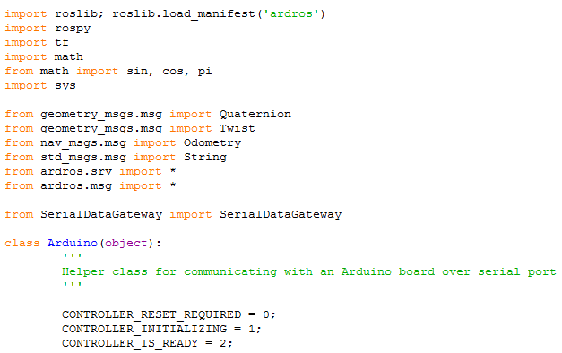

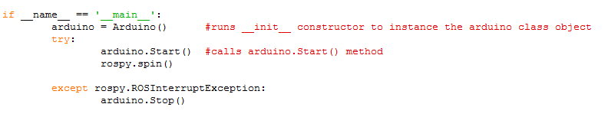
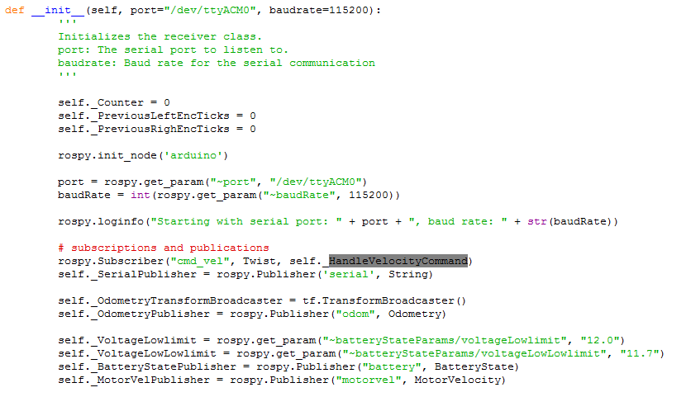
drh-r108\ros\ardros\nodes\ arduino.py
Python Node
drh-r108\ros\ardros\launch\ardros_standalone.launch
(1) Launch file starts arduino.py
ROS Node name __/
(2) _init_ & Start() run
For edison <--> kangaroo connection the serial port
Will need to be changed
2.2 < port & baudRate read from
info\ardros.yaml
|
ROS package name
2.3 < subscribes to cmd_vel
& installs callback handler
_HandleVelocityCommand() to
process /cmd_vel messages

Slide 3
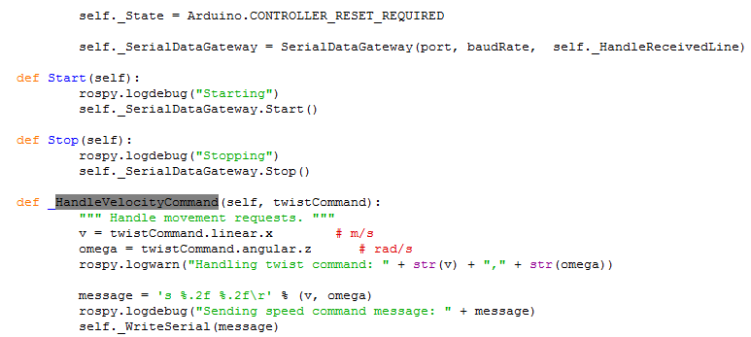
2.1 .Start() > SerialDataGateway.Start()
2.4 ea /cmd_vel message gets processed here
In ardros, the 'arduino' node subscribes to the /cmd_vel
Topic, it inputs /cmd_vel and outputs 's CV CAV\r'
message to arduino serial port
For edison <--> sabertooth connection
This code needs to be changed to translate
Ros twist messages into kagaroo serial message

Slide 4
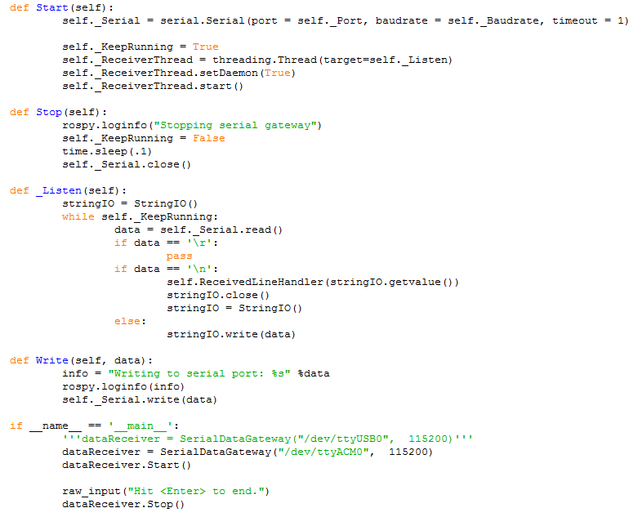
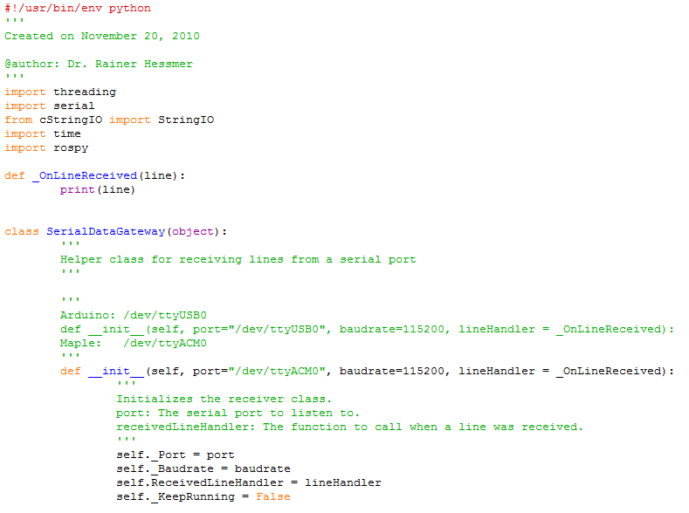
SerialDataGateWay.py

