Slide 1
Dimension Engineering
Kangaroo x2 Motion Controller

Slide 2
Kangaroo x2 Motion Controller I/F
ed.Start()
  Initialize Kangaroo serial session … mimic what u do by hand now:
    $

Slide 3
Kangaroo Simplified Serial
------ Start Experiment -----------------------------------------------------------
C:\Users\iadean\Documents\2015\SWDEV\Intel-Edison\software\pc-python-scripts> python 7-3-pcpyserial.py
Insert "exit" to leave the application. BKM, startup sequence that seems to work all the time
16:27:18>> d,start \ 1. Issue start commands 2x
16:27:21>> d,start
16:27:25>> t,start >
16:27:29>> d,s0 1.1 Issue s0 command 1x
16:27:39>> t,s0 /
16:27:42>> d,s128 2. then start issuing drive/turn cmds as rqd drive fwd@s128 lines/sec both wheels turn=
16:27:51>> t,s64 Note1 : in mixed mode, the command persist till turn while driving fwd, L whl turns slower
explictly canceled. L R whl turns faster
16:28:01>> t,s0 cancels turn,previous drive cmd persists still driving fwd @ s128 both whls turn=
16:28:06>> t,s-64 turn while driving fwd, L whl turns faster
R R whl turns slower
16:28:16>> t,s0 cancels turn,previous drive cmd persists still driving fwd @ s128 both whls turn=
16:28:23>> d,s0 cancels last drive cmd all stop
17:02:29>> t,s128 turn CCW Both whls turn= L whl rev dir
L R whl fwd dir
17:02:50>> t,s0
17:05:08>> t,s-128 turn CC Both whls turn= L whl fwd dir
R R whl rev dir
17:05:39>> t,s0
18:22:58>> 1,getp In mixed-mode, you can't read each wheel encoder, kangaroo just ignores the command
18:24:18>> 2,getp and doesn't respond to it with anything
18:24:22>> d, getp In mixed-mode, it seems to keep track of total avg fwd/rev movement in terms of encoder counts
18:26:47>> D,P14 have no idea what the units are ? defaults to lines ?
18:26:47>> t, getp total avg rotational movements in terms of encoder counts
18:26:53>> T,P-87 have no idea what the units are, ? default to lines ?
17:06:50>> exit < just to exit the app

Slide 4
Motor Control and Encoder Feedback Check
---- motor controls and encoder interfaces ----
term2: $ sudo ./edspi52 <- monitor encoder counters WORKS!
term1: $ sudo python 7-4a-edpyserial.py <- drive motors WORKS!
term1: 7-4a-edpyserial.py
iqdean@ubilinux:~/motors$ sudo python 7-4a-edpyserial.py
[sudo] password for iqdean:
Opening Uart(0): /dev/ttyMFD1
Enter your commands below.
Insert "exit" to leave the application.
23:10:19>> d, start
23:10:26>> d,start
23:10:33>> t,start
23:10:39>> t,start
23:10:43>> d, s0
23:10:52>> t, s0
23:11:13>> d, getp
23:11:26>> D,P0
23:11:26>> t, getp
23:11:33>> T,P0
23:11:33>> d, s256
23:11:41>> d, s0
23:11:46>> d, s-256
23:11:58>> d, s0
23:12:05>> t, s256
23:12:13>> t, s0
23:12:22>> t, s-256
23:12:38>> t, s0
23:12:49>> exit
term2: edspi52.c
mraa version: v0.8.1-21-g5cf54fd
uart(0): /dev/ttyMFD1
Set cs[X Y Z] = 1
Xcs WR_MDR0: 88
Xcs RD_MDR0: 3
Xcs WR_MDR1: 90
Xcs RD_MDR0: 0
Ycs WR_MDR0: 88
Ycs RD_MDR0: 3
Ycs WR_MDR1: 90
Ycs RD_MDR0: 0
Zcs WR_MDR0: 88
Zcs RD_MDR0: 3
Zcs WR_MDR1: 90
Zcs RD_MDR0: 0
X axis count FFFFFC3D 743
Y axis count FFFFEEA5 689
Z axis count 0 674

Slide 5
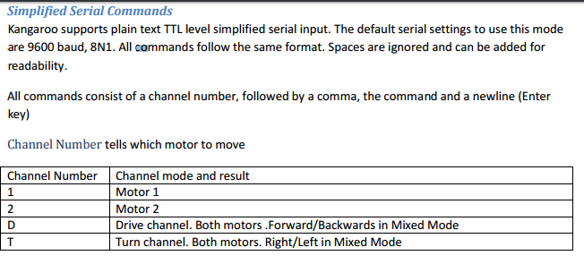
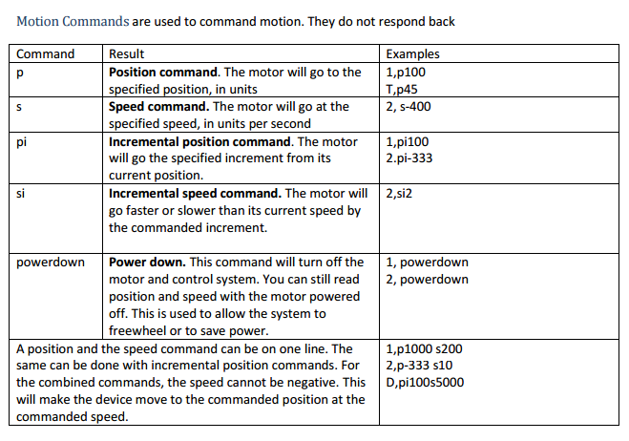
Dimension Engineering
Kangaroo x2 Motion Controller

Slide 6
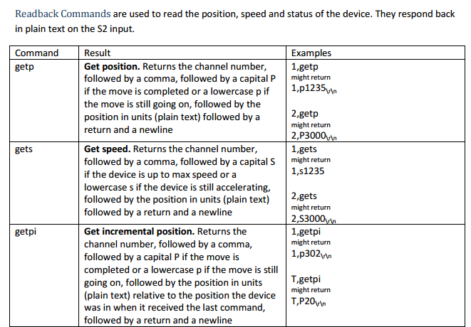
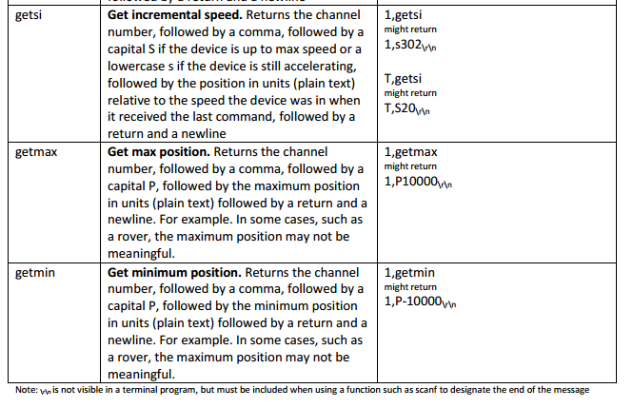
Dimension Engineering
Kangaroo x2 Motion Controller

Slide 7
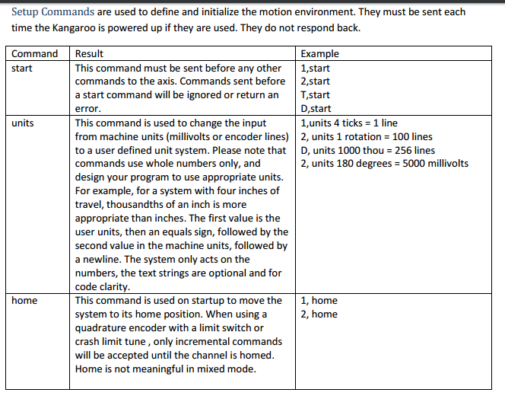
Dimension Engineering
Kangaroo x2 Motion Controller

Slide 8
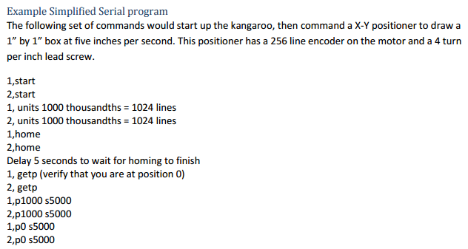
Dimension Engineering
Kangaroo x2 Motion Controller

Slide 9
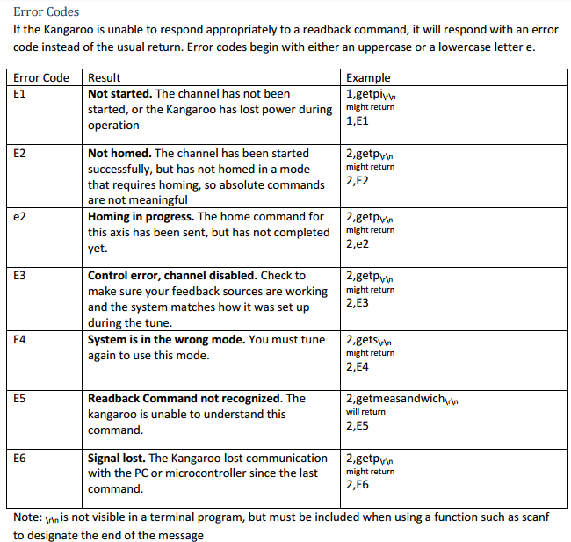
Dimension Engineering
Kangaroo x2 Motion Controller

