Slide 1
12-clean-shutdown-via-pwrbtn
7-29-2016

Slide 2
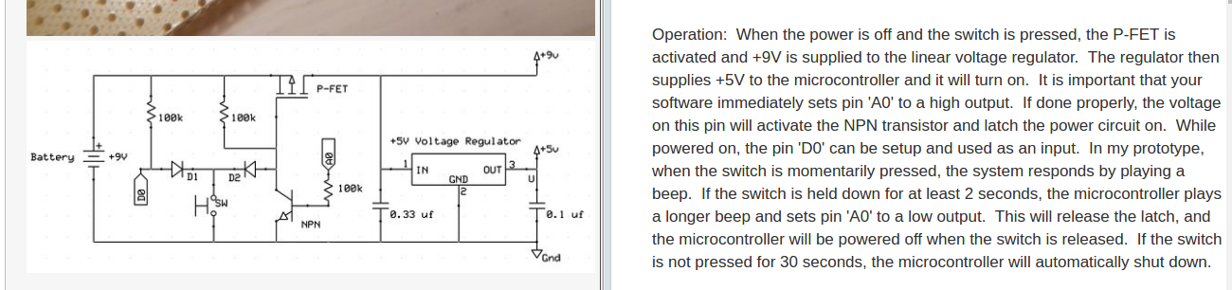
Soft Latching Power Switches

Slide 3


Slide 4

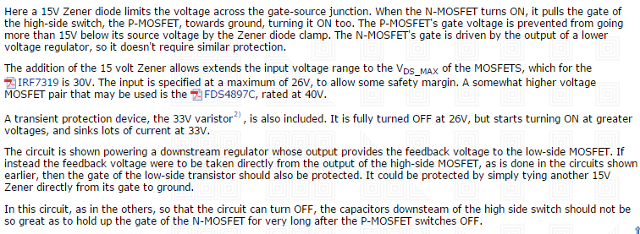

Slide 5
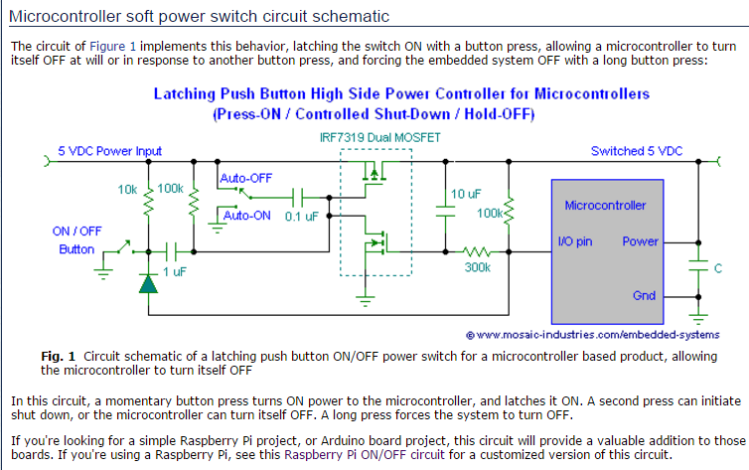

Slide 6
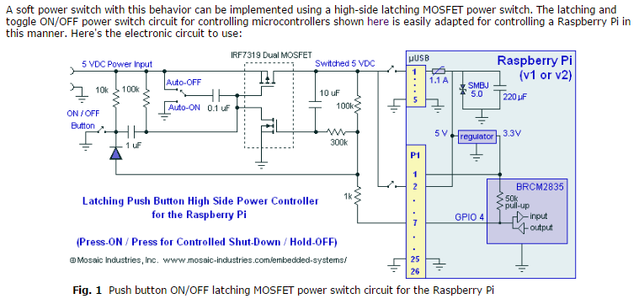

Slide 7
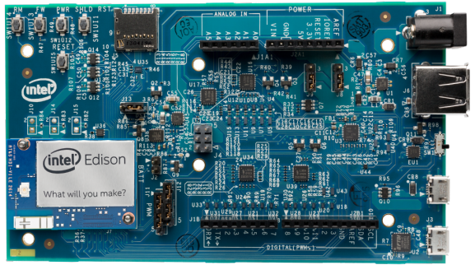
13 12 11 10 9 8 7 6 5 4 3 2 1 0
AIO 0 1 2 3 4 5
GPIO 14 15 16 17 18 19
REF:
C:\u1404\intel-edison\10-3-Edison-Hardware-Refs\Edison-Arduino-Board-GPIO-Mux-Tables
Edison Arduino GPIO Mux.pptx

Slide 8
Edison Arduino Board GPIO Pin Usage Tracker
Digital Headers
J281
10 I2C SCL
9 I2C SDA
8 AREF
7 GND
6 IO13 --- SCK_GPIO \ Bit-Banged SPI Bus using fast memory mapped io
5 IO12 --- MISO_GPIO > Robogia encoder shied
4 IO11 --- MOSI_GPIO /
3 _IO10 -x- cut robogia shield pin (on bottom) & jmp to IO6 (on top)
2 / IO9 –-- csZ
1 | IO8 –-- csY
J181 |
8 | IO7 <<<< breaks Wifi, DO NOT USE
7 \_IO6 --- csX
6 IO5
5 IO4
4 IO3
3 IO2
2 IO1 → Uart(0) TxD \ Serial Interface to Kanagroo X2 MC
1 IO0 ← Uart(0) RxD /
Analog Header
6 IO19 – A5
5 IO18 – A4
4 IO17 – A3
3 IO16 – A2
2 IO15 – A1 >OUT pwroff at end of shutdown
1 IO14 – A0 <IN pwroff btn: /etc/rc.local -> shutdown_ed.py -> isr > $ shutdown –h now
AIO pins are treated as 0-5 in mraa_aio_init() but as 14-19 for everything else.
> Therefore use mraa_gpio_init(14) to use A0 as a GPIO

Slide 9
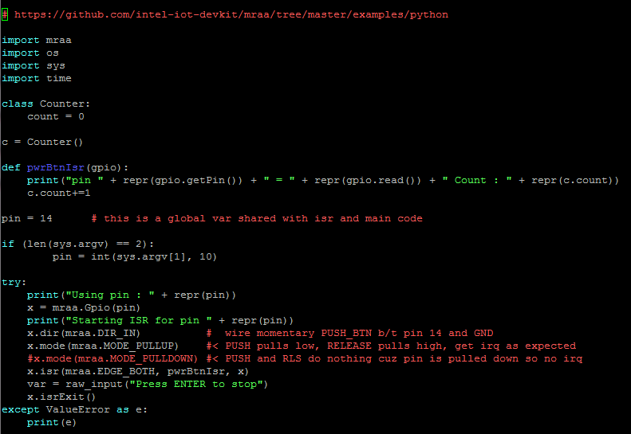
button_isr.py
Libmraa based programs don’t work unless you run them with sudo permissions!!
iqdean@ubilinux:~/mraa_test$ python button_isr.py
Using pin : 14
Invalid GPIO pin specified
iqdean@ubilinux:~/mraa_test$ python button_isr.py 2
Using pin : 2
Invalid GPIO pin specified
iqdean@ubilinux:~/mraa_test$ python button_isr.py 3
Using pin : 3
Invalid GPIO pin specified
iqdean@ubilinux:~/mraa_test$ python button_isr.py 4
Using pin : 4
Invalid GPIO pin specified
iqdean@ubilinux:~/mraa_test $ sudo python button_isr.py
Using pin : 14
Starting ISR for pin 14
Press ENTER to stop
pin 14 = 0 Count : 0
pin 14 = 1 Count : 1
pin 14 = 0 Count : 2
pin 14 = 1 Count : 3
pin 14 = 0 Count : 4
pin 14 = 1 Count : 5
pin 14 = 0 Count : 6
pin 14 = 0 Count : 7
This confirms gpio pins can be pulled up and pulled down on the edison arduino board!!

Slide 10
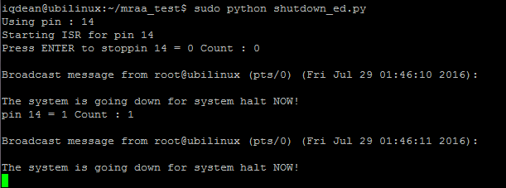
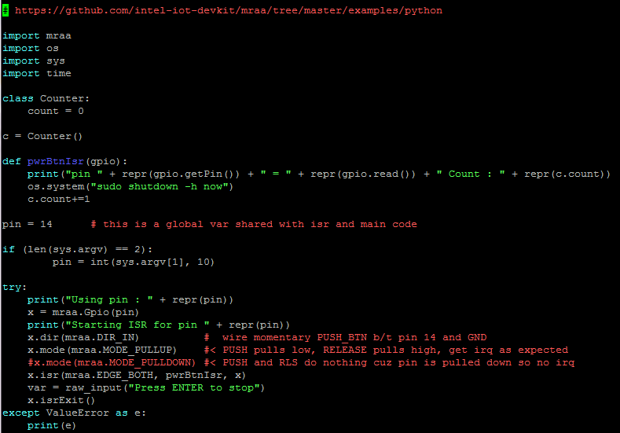
shutdown_ed.py
Push Button Once to trigger shutdown of the system using
$ shut shutdown –h now

Slide 11
Run shutdown_ed.py in the background a root without sudo
iqdean@ubilinux:~/mraa_test$ sudo passwd root < root passwd is not set on debian ubilinux so set one
Enter new UNIX password: csolinux
Retype new UNIX password:
passwd: password updated successfully
iqdean@ubilinux:~/mraa_test$ su root < & then $ su root works
Password:
root@ubilinux:/home/iqdean/mraa_test#
root@ubilinux:/home/iqdean# python /home/iqdean/mraa_test/shutdown_ed.py & < now root can run *.py w/o sudo
[1] 2023
root@ubilinux:/home/iqdean# Using pin : 14
Starting ISR for pin 14
root@ubilinux:/home/iqdean# ps ax | grep shutdown
2023 pts/0 Rl 0:24 python /home/iqdean/mraa_test/shutdown_ed.py
2026 pts/0 S+ 0:00 grep shutdown
root@ubilinux:/home/iqdean#
Broadcast message from root@ubilinux (pts/0) (Fri Jul 29 07:09:55 2016): < & when you push the button
The system is going down for system halt NOW! < the isr handler initiates shutdown
Broadcast message from root@ubilinux (pts/0) (Fri Jul 29 07:09:56 2016):
The system is going down for system halt NOW!

Slide 12
Update /etc/rc.local to install power_button ISR handler on each boot
$ cat /etc/rc.local
# By default this script does nothing.
echo 1 >/sys/devices/virtual/misc/watchdog/disable
#/sbin/first-install.sh
bluetooth_rfkill_event >/dev/null 2>&1 &
rfkill unblock bluetooth
bluetoothd &
python /home/iqdean/mraa_test/shutdown_ed.py & < Hmm, adding script to /etc/rc.local isn’t launching it ???
exit 0
iqdean@ubilinux:~/mraa_test$ ps ax | grep shutdown < no shutdown_ed.py running in the background via /etc/rc.local ????
2260 pts/0 S+ 0:00 grep shutdown

Slide 13
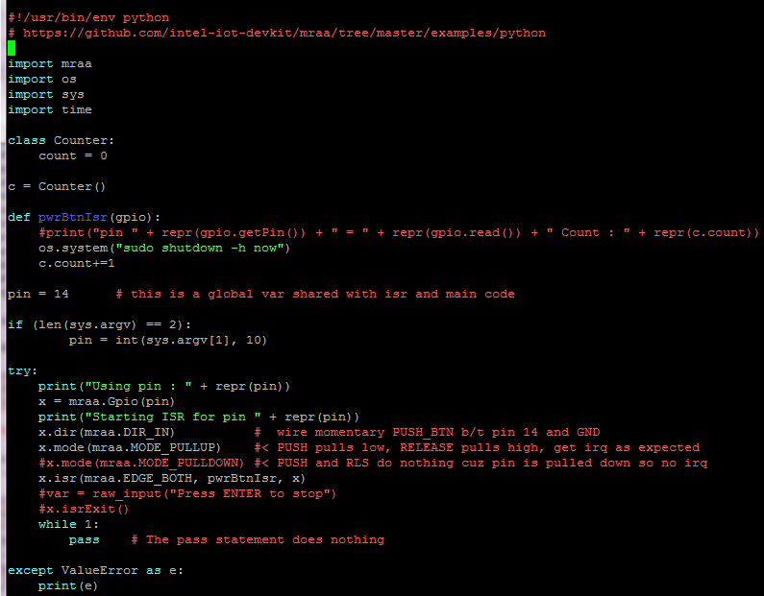
Get python script that monitors pwrBtn to start at boot and run in the background
1) #!/usr/bin/python >>>> #!/usr/bin/env python
iqdean@ubilinux:~/mraa_test$ cat /etc/rc.local
#!/bin/sh -e
#
# rc.local
#
# This script is executed at the end of each multiuser runlevel.
# Make sure that the script will "exit 0" on success or any other
# value on error.
#
# In order to enable or disable this script just change the execution
# bits.
#
# By default this script does nothing.
echo 1 >/sys/devices/virtual/misc/watchdog/disable
#/sbin/first-install.sh
bluetooth_rfkill_event >/dev/null 2>&1 &
rfkill unblock bluetooth
bluetoothd &
/home/iqdean/mraa_test/shutdown_ed.py & (2)
exit 0
--------------------
iqdean@ubilinux:~/mraa_test$ sudo /etc/rc.local (3)
iqdean@ubilinux:~/mraa_test$ D-Bus setup failed: Name already in use
Using pin : 14
Starting ISR for pin 14
---------------------
iqdean@ubilinux:~/mraa_test$ ps ax |grep shutdown
2044 pts/0 Rl 0:28 python /home/iqdean/mraa_test/shutdown_ed.py
2054 pts/0 S+ 0:00 grep shutdown
----- 4) push button & system shutdown happens ------
Broadcast message from root@ubilinux (Fri Jul 29 22:55:48 2016):
The system is going down for system halt NOW!
< 3.1 manually running /etc/rc.local starts python in background
5) REBOOT ??? Shutdown_ed.py NOT RUNNING IN THE BACKGROUND??
iqdean@ubilinux:~$ ps ax | grep blue
1941 ? S 0:00 bluetooth_rfkill_event
1943 ? S 0:00 bluetoothd
2027 pts/0 S+ 0:00 grep blue
iqdean@ubilinux:~$ ps ax | grep shutdown
2029 pts/0 S+ 0:00 grep shutdown

Slide 14
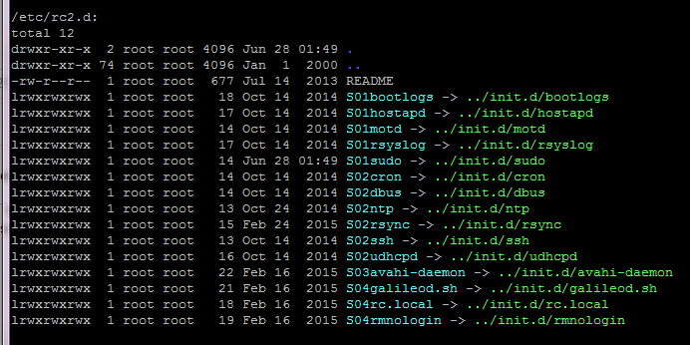
Python script won’t start at boot, but it starts fine if I run /etc/rc.local manually ??
iqdean@ubilinux:~$ runlevel
N 2
Twiddle with /etc/rc.local
Full path
Pipe to /dev/null
Sleep 5
>> Still same results, won’t start on boot
!!WTF!!!
# By default this script does nothing.
echo 1 >/sys/devices/virtual/misc/watchdog/disable
#/sbin/first-install.sh
bluetooth_rfkill_event >/dev/null 2>&1 &
rfkill unblock bluetooth
bluetoothd &
/usr/bin/python /home/iqdean/mraa_test/shutdown_ed.py >/dev/null 2>&1 &
sleep 5
exit 0
iqdean@ubilinux:~$ ps ax | grep blue
1942 ? S 0:00 bluetooth_rfkill_event
1946 ? S 0:00 bluetoothd
2043 pts/0 S+ 0:00 grep blue
iqdean@ubilinux:~$ sudo /etc/rc.local
iqdean@ubilinux:~$ D-Bus setup failed: Name already in use
iqdean@ubilinux:~$ ps ax | grep shutdown
2051 pts/0 Rl 0:11 /usr/bin/python /home/iqdean/mraa_test/shutdown_ed.py
2061 pts/0 S+ 0:00 grep shutdown
All the other crap starts fine??

Slide 15
FINAL SOLUTION TO LAUNCH A PYTHON script at boot Power Button Handler to monitor GPIO via ISR and initiate orderly shutdown when button is pressed
(1) /etc/rc.local << /etc/rc.local is a shell script (#!/bin/sh –e at the beginning of file)
iqdean@ubilinux:~$ cat /etc/rc.local
#!/bin/sh -e
#
# rc.local
#
# By default this script does nothing.
echo 1 >/sys/devices/virtual/misc/watchdog/disable
#/sbin/first-install.sh
bluetooth_rfkill_event >/dev/null 2>&1 &
rfkill unblock bluetooth
bluetoothd &
export PYTHONPATH=/usr/local/lib/python2.7/site-packages; nohup /usr/bin/python /home/iqdean/mraa_test/shutdown_ed.py >/dev/null 2>&1 &
exit 0
Shutdown / Cold boot
ubilinux login: iqdean
Password:
Last login: Fri Jul 29 23:54:06 UTC 2016 on ttyMFD2
…
iqdean@ubilinux:~$ ps ax | grep shut
1943 ? Rl 0:34 /usr/bin/python /home/iqdean/mraa_test/shutdown_ed.py
2016 ttyMFD2 S+ 0:00 grep shut
iqdean@ubilinux:~$
nohup is a POSIX command to ignore the HUP (hangup) signal by default. on unix, all programs get hangup signal when you close the terminal. With python, the scripts that you started in a terminal will die when you close the terminal. Nohup enables the script to run in background
Therefore >/dev/null 2>&1 is redirect the output of your program to /dev/null. Include both the Standard Error and Standard Out
iqdean@ubilinux:~$ ls /usr/local/lib/python2.7/site-packages/
mraa.py mraa.pyc _mraa.so
TO START A PYTHON SCRIPT from /etc/rc.local, you have to specify the PYTHONPATH so it can find all it’s dependent libraries:
Finally, it starts on boot!!

Slide 16
Final Solution: (2) shutdown_ed.py – python script to monitor power button connected to GPIO by installing a ISR that detects button presses and runs $ sudo shutdown –h now

Slide 17
Final Solution: (3) pushing the button (with shutdown_ed.py script running in the background) – results in orderly shutdown, including “unmounting local file systems”
iqdean@ubilinux:~$
Broadcast message from root@ubilinux (Sat Jul 30 01:00:47 2016):
The system is going down for system halt NOW!
INIT: S/▒▒▒-▒▒
▒W▒▒▒▒WK▒jԤ▒(▒*▒▒▒U▒▒▒▒▒▒▒ɽ▒▒▒͕́▒▒▒▒▒I5▒▒▒▒▒▒▒5jR▒[info] Using makefile-style concurrent boot in runlevel 0.
Stopping very small Busybox based DHCP server: Stopped /usr/sbin/udhcpd (pid 1795).
udhcpd.
Stopping galileod
start-stop-daemon: warning: failed to kill 1937: No such process
sketch.elf: no process found
[ ok ] Stopping Avahi mDNS/DNS-SD Daemon: avahi-daemon.
[ ok ] Asking all remaining processes to terminate...done.
[ ok ] All processes ended within 1 seconds...done.
[ ok ] Stopping enhanced syslogd: rsyslogd.
[....] Deconfiguring network interfaces...Internet Systems Consortium DHCP Client 4.2.2
Copyright 2004-2011 Internet Systems Consortium.
All rights reserved.
For info, please visit https://www.isc.org/software/dhcp/
Listening on LPF/wlan0/78:4b:87:a6:98:77
Sending on LPF/wlan0/78:4b:87:a6:98:77
Sending on Socket/fallback
DHCPRELEASE on wlan0 to 10.0.0.1 port 67
done.
[info] Saving the system clock.
hwclock: select() to /dev/rtc0 to wait for clock tick timed out: Success
[info] Hardware Clock updated to Sat Jul 30 01:00:54 UTC 2016.
[ ok ] Unmounting temporary filesystems...done.
[ ok ] Deactivating swap...done.
[ ok ] Unmounting local filesystems...done.
[info] Will now halt.

Slide 18
Recap
=== SO, IN THEORY, WE COULD
1. build soft-latching powerswitch circuit board done
push button to turn on and push button to turn off
led indicating power state: on, powering_down, off
1 input to allow ecu to turn pwr off
1 output to signal ecu of pwr btn press
2. write python script to monitor pwrbtn input press shutdown_ed.py done
and run $ shutdown -h now
2.1 hook system startup scripts to start shutdown_ed.py /etc/rc.local done < this is a shell script
on each boot
3. hook the system shutdown scripts to switch off the power
AFTER the filesystem has been cleanly unmounted
3.1 write a libmraa program the toggles the power switch off pwroff.py < done & works
3.2 modify /etc/init.d/halt to run pwroff.py BEFORE the halt command /etc/init.d/halt < this is a shell script
Analog
Header
2 IO15 – A1 >OUT pwrdown via system halt script
1 IO14 – A0 <IN pwroff btn: /etc/rc.local -> shutdown_ed.py -> isr > $ shutdown –h now

Slide 19
Houston, we have a problem:
OFF > Push PWRBTN > power on > ON
ON > push pwrbtn > isr > pwroff.py > $shutdown –h now > triggers system shutdown scripts > /etc/init.d/halt > shutdown_ed.py > switches pwr
unmounts file systems including sysfs so theres no sysfs
so libmraa becomes useless
& cant toggle any gpios
so softpower latch stays ON
SCREW IT, this is taking way too long:
WORKAROUND:
Flip Main Power switch ON to PowerON
To power off
$ sudo shutdown –h now
Wait for edision shutdown scripts to unmount filesys & powers down the edison 3.3v rail (but 5v remains on as long as there is Vin)
Green LED on edison turns off
Flip Main Power switch OFF to power down edison Vin, which powers down 5v rails

