Slide 1
Lead-lag Compensation
Tang Qi,
M-B5-5515-2

Slide 2
content
Lead Compensation
Design Lead Compensation
Procedure
Example
Lag Compensation
Design Lead Compensation
Procedure
Example
Conclusion

Slide 3
Objective
Like other methods, ( PID, Root Locus,…), is to make poles and zeros to be at desired location for certain systems.
By selecting appropriate pole & zero locations, the system properties can be influenced to meet particular design requirements.
Lead compensator causes a relatively phase lead in system;
Lag compensator causes a relatively phase lag in system;

Slide 4
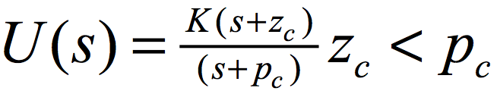
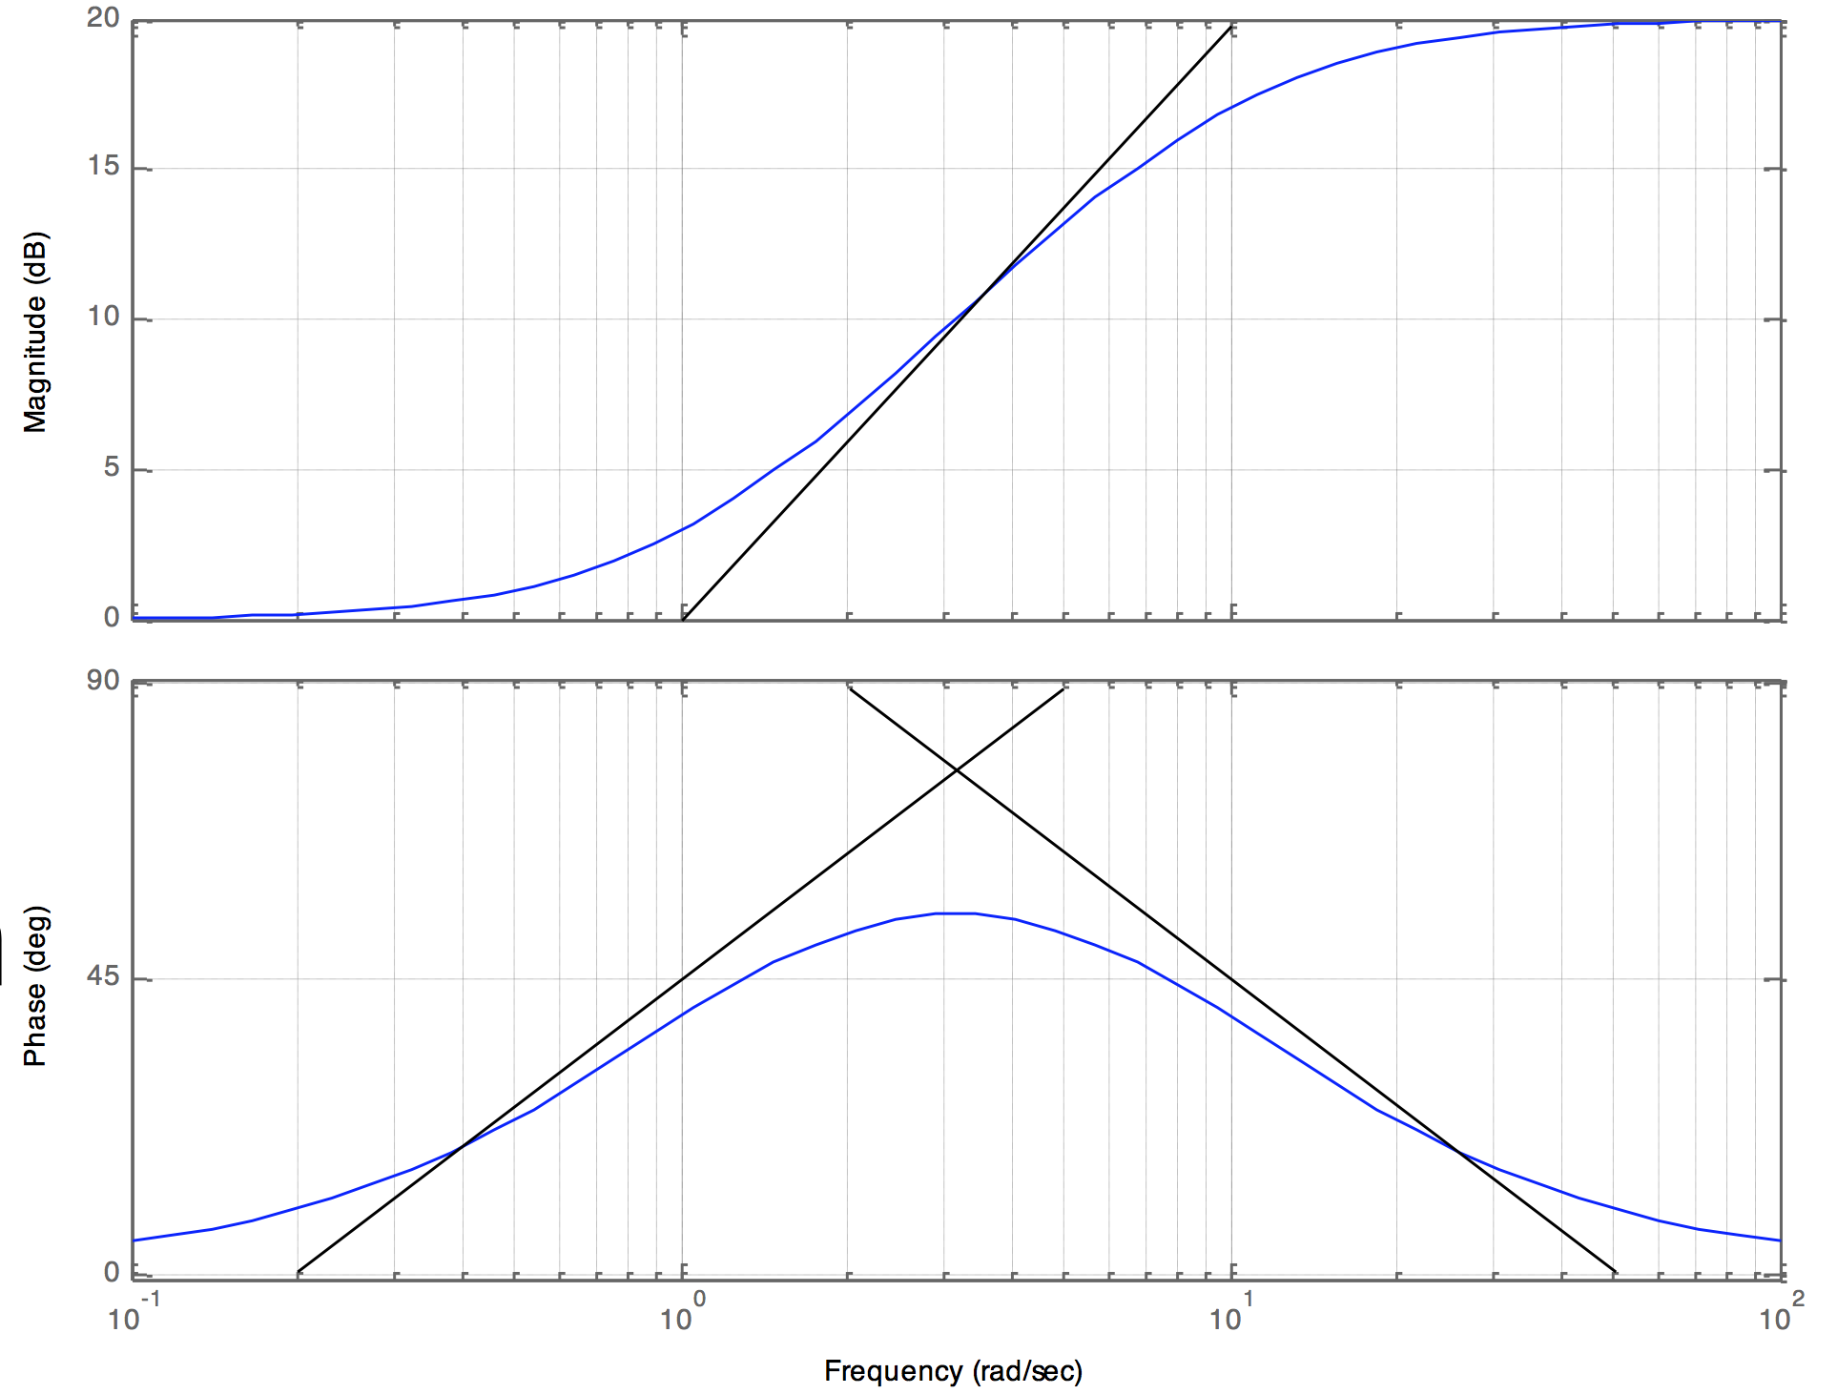
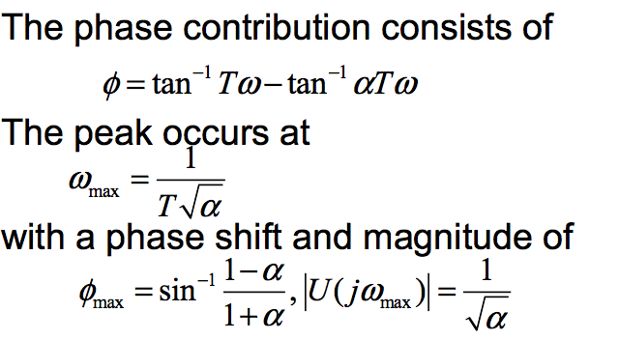
lead compensation
A higher order pole yields the lead compensator, imparts a phase lead :
Frequency of phase increase designed to meet a particular PM requirement;
High frequency magnitude is now limited;
It can change damping ratio by PM;

Slide 5
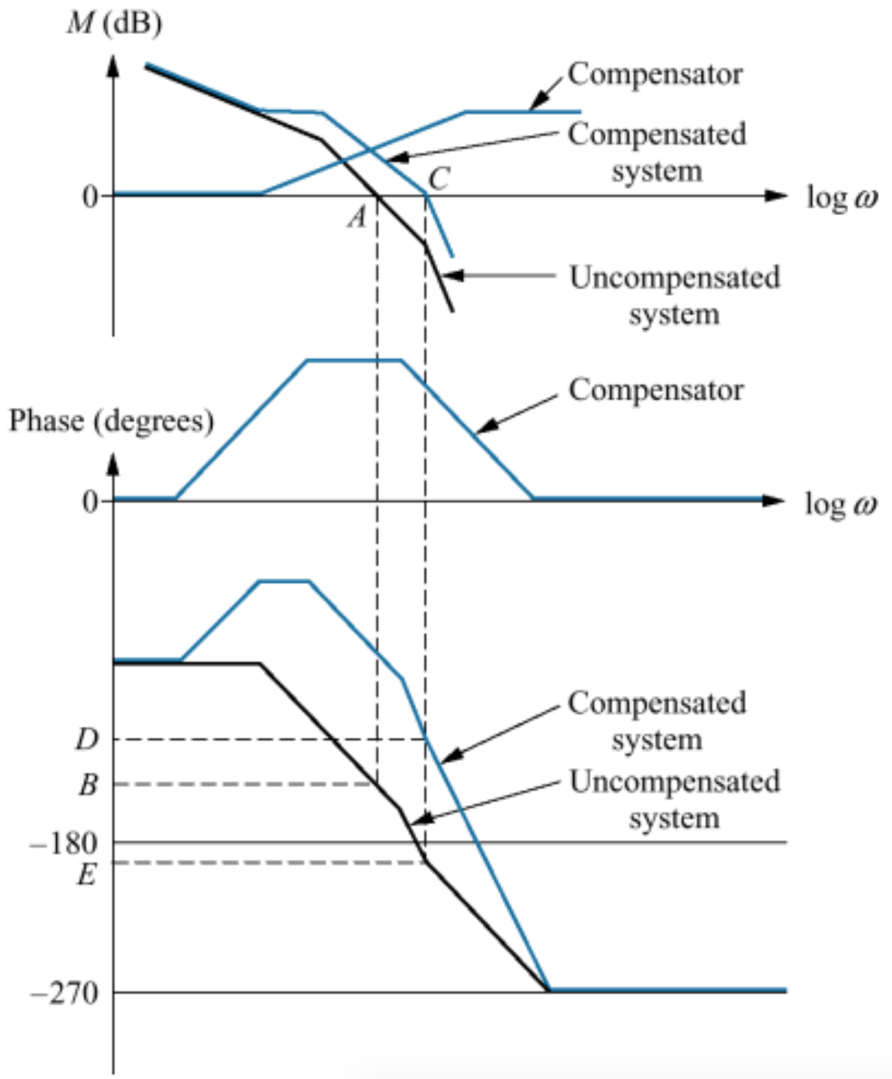
Bode plot of the system before and after lead compensation

Slide 6
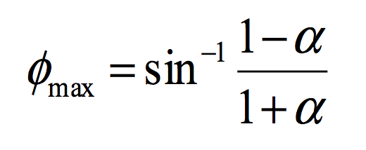
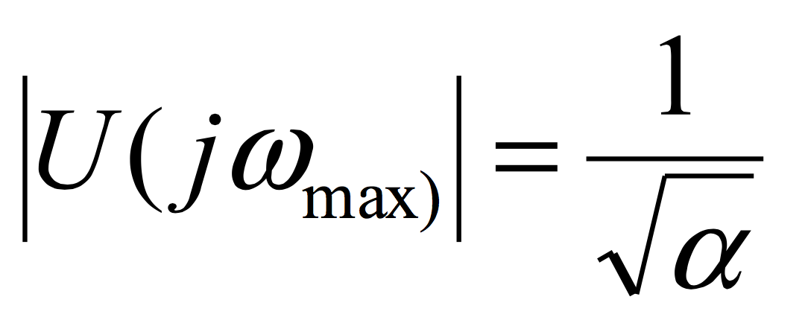
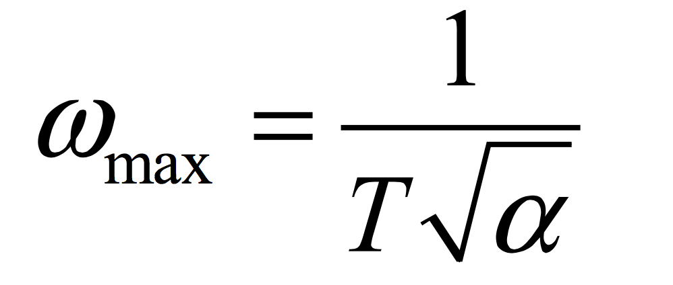
Design lead compensation --Procedure
Find K to satisfy Ess or bandwidth requirements ;
Evaluate PM of uncompensated system using K;
Find required phase lead to meet the damping requirements；
Determine the value of α to yield the required increase in phase；
5. Determine the new crossover frequency；
6. Determine the value of T such that ωmax lies at the α
new crossover frequency；
7. Check and simulate to be sure that the system meets the specifications.

Slide 7
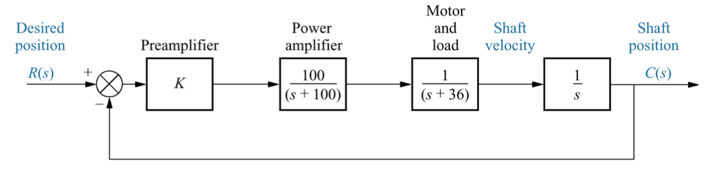
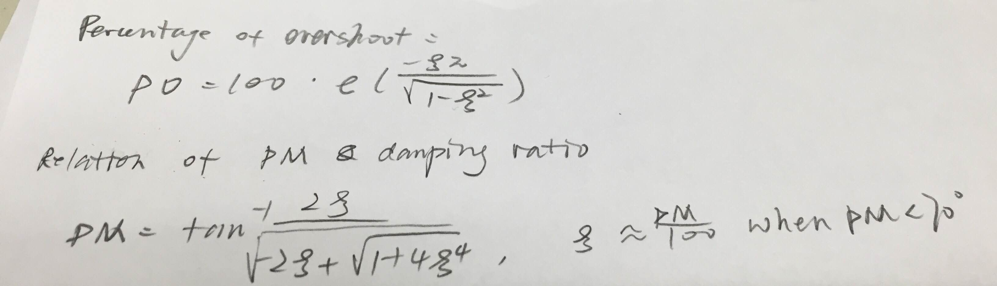
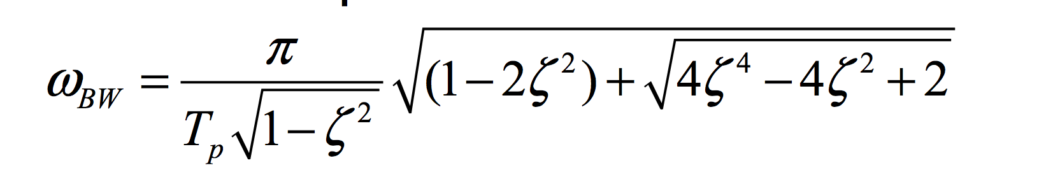
Design lead compensation --Example
Requirements：
20% overshoot;
Kv=40;
Peak time: 0.1s;
Procedure:
ζ=0.456 (as overshoot 20%), PM=48.1°；
Closed loop bandwidth is 46.6 rad*s^-1;
Kv = 40 = lim sG(s) = K100/3600 => K=1440 ;
From Bode plot, for a gain of 1440, PM =34°;
Use lead compensator to raise PM;

Slide 8
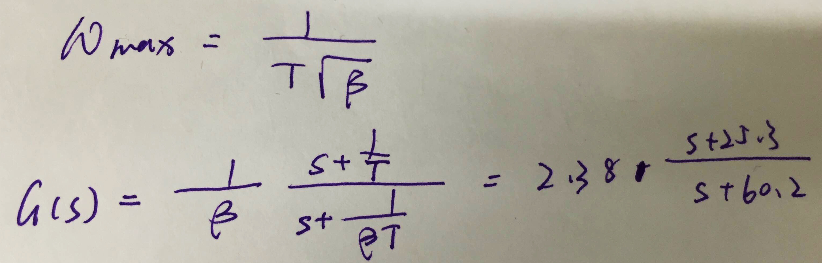
Design lead compensation --Example
6. To compensate for the lower uncompensated system’s phase angle, assume the correction factor to be 10°.
Phase shift:
Φmax =48.1° – (34° – 10°) = 24.1°;
As Φmax = sin^-1((1-α)/(1+α)), α=0.42. lead compensator magnitude is
|U(jw)|=1/(sqr(α))=3.77 dB;
Frequency at -3.77dB is :ωmax=39rad/s，
which is the new PM frequency.
9. The break frequencies can be found at
1/T= 25.3 and 1/βT =60.2;
The compensator is
U (s) = 2.38 *(s + 25.3)/( s+60.2);

Slide 9
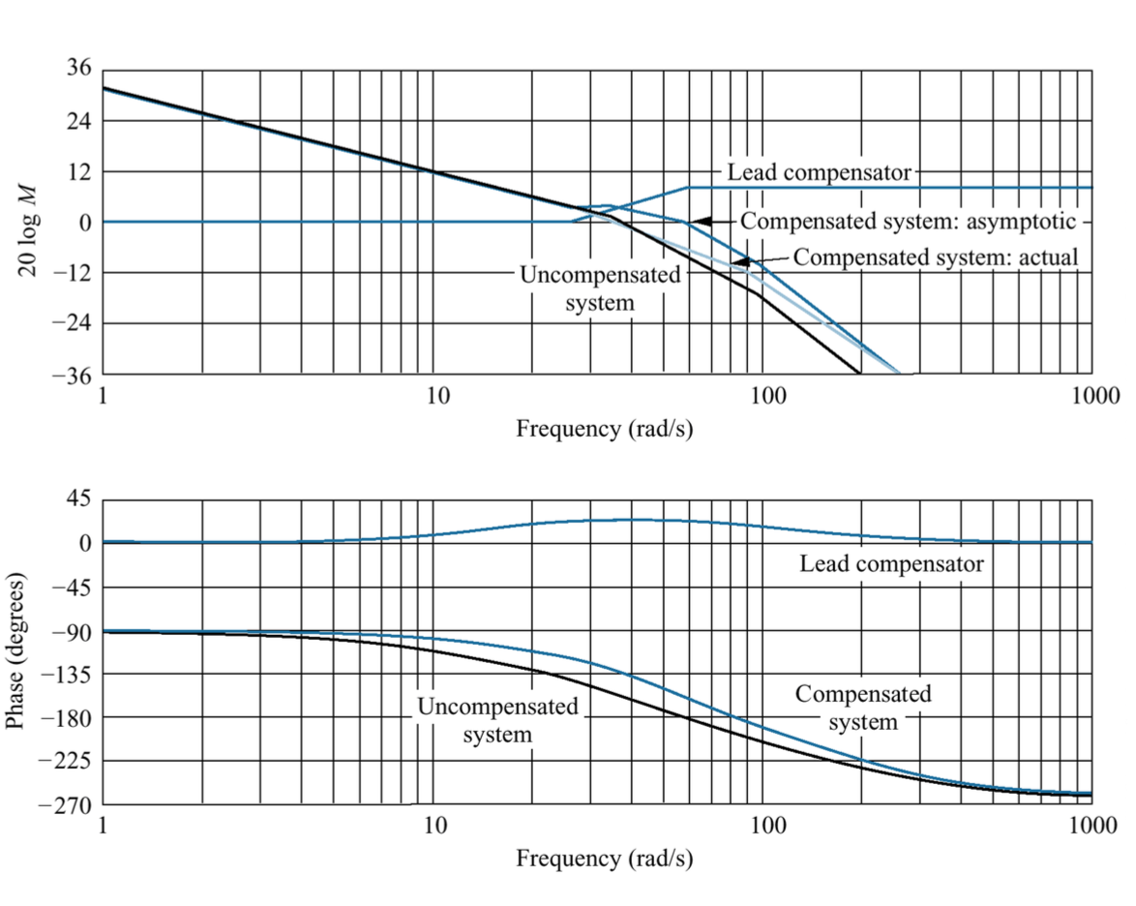
Design lead compensation --Example
Bode plot of systems before and after lead compensation

Slide 10
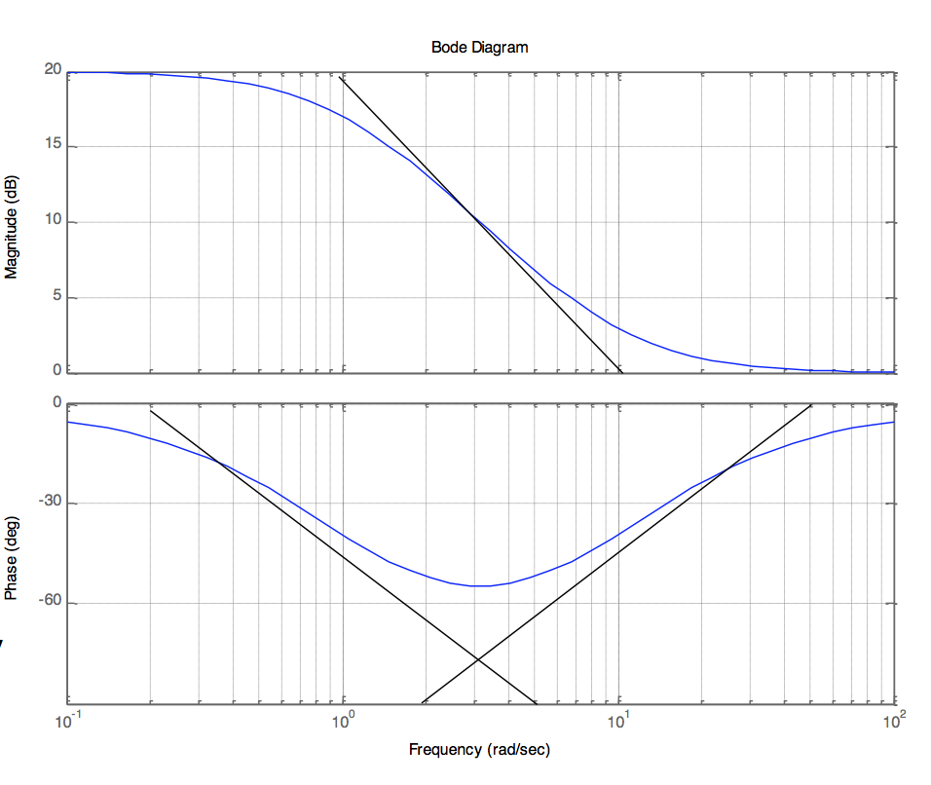
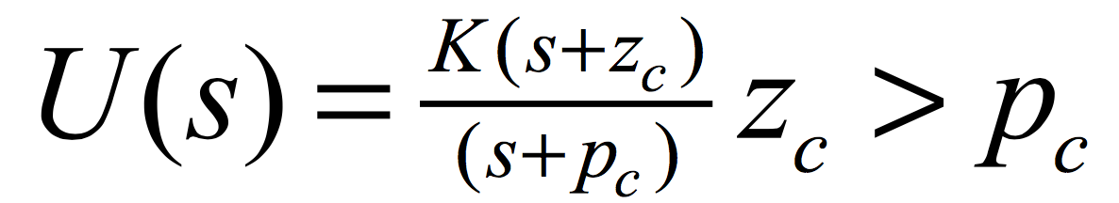
Lag compensation
Lag compensation causes a phase lag
Raise the gain at low frequencies (without affecting the stability of the system).
Setting K for PM, design lag network to raise the low freq. gain w/o affecting system stability.

Slide 11
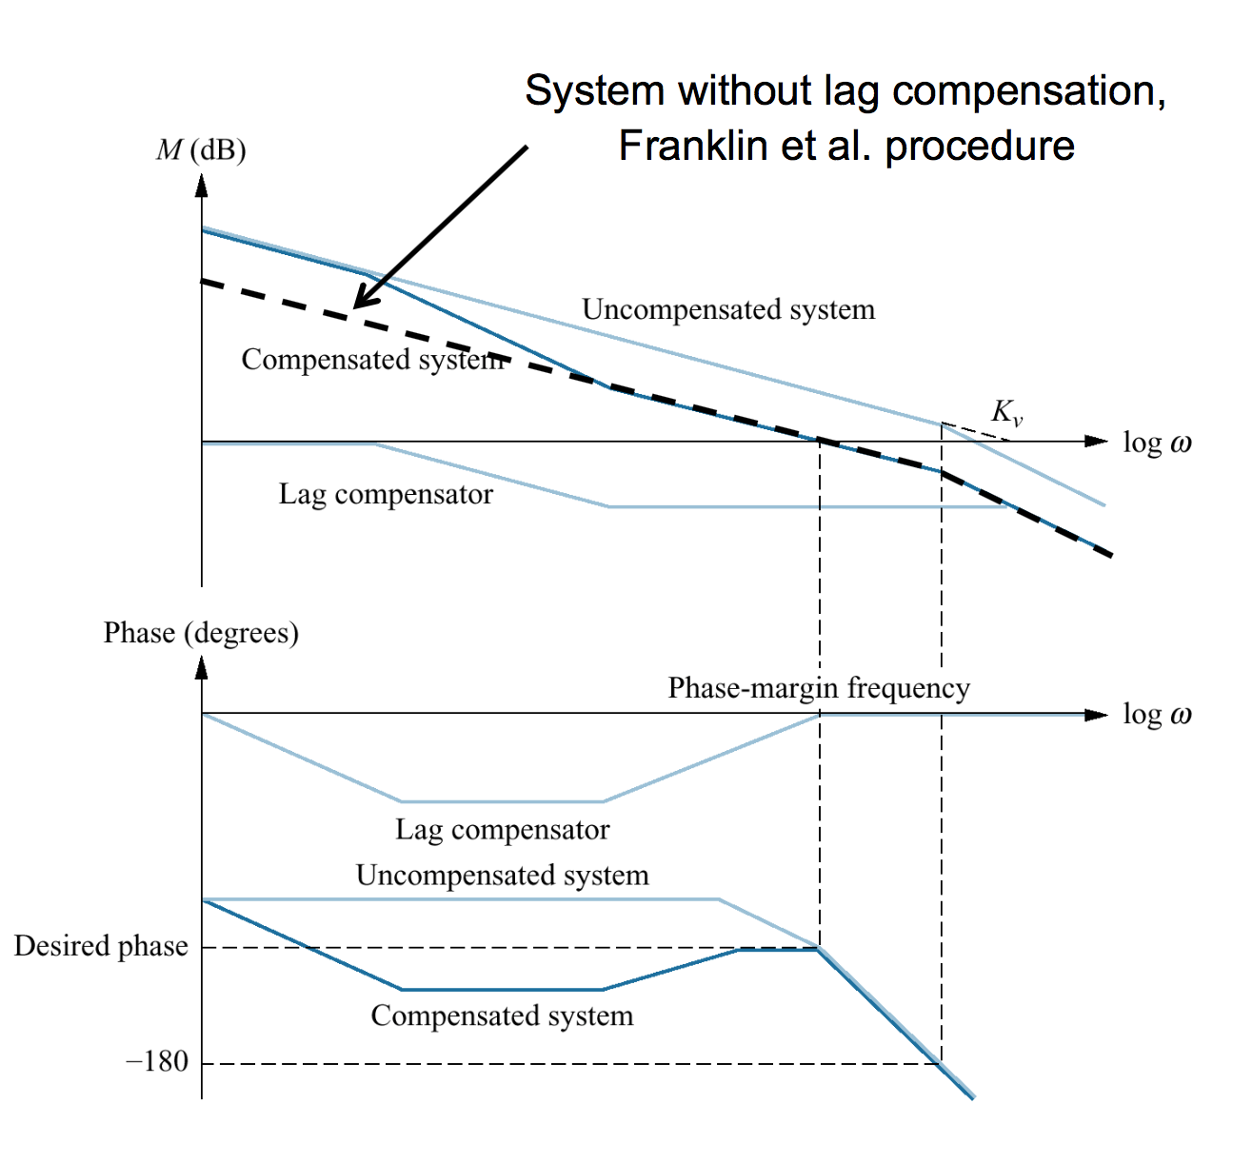
Bode plot of system before & after lag compensation

Slide 12
Design lag compensation --Procedure
Find open loop gain K to satisfy PM specification without compensation;
Draw Bode plot and evaluate low frequency gain;
Determine α to meet the low-frequency gain error requirement;
Choose the corner frequency ω=1/T (the zero) to be one octave to one decade below the new crossover frequency;
5. Evaluate the second corner frequency (the pole)ω=1/αT;
6. Simulate to evaluate the design and iterate as required;

Slide 13
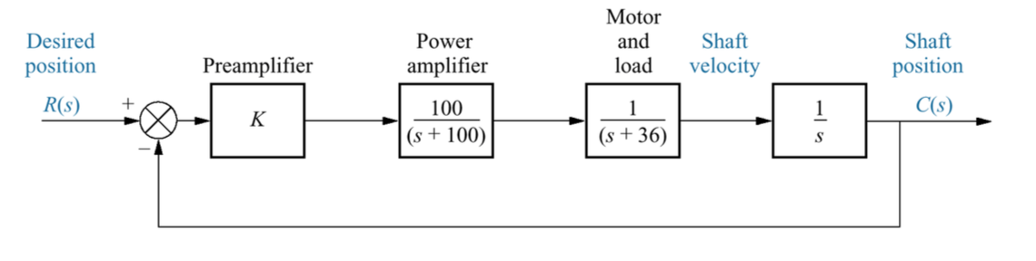
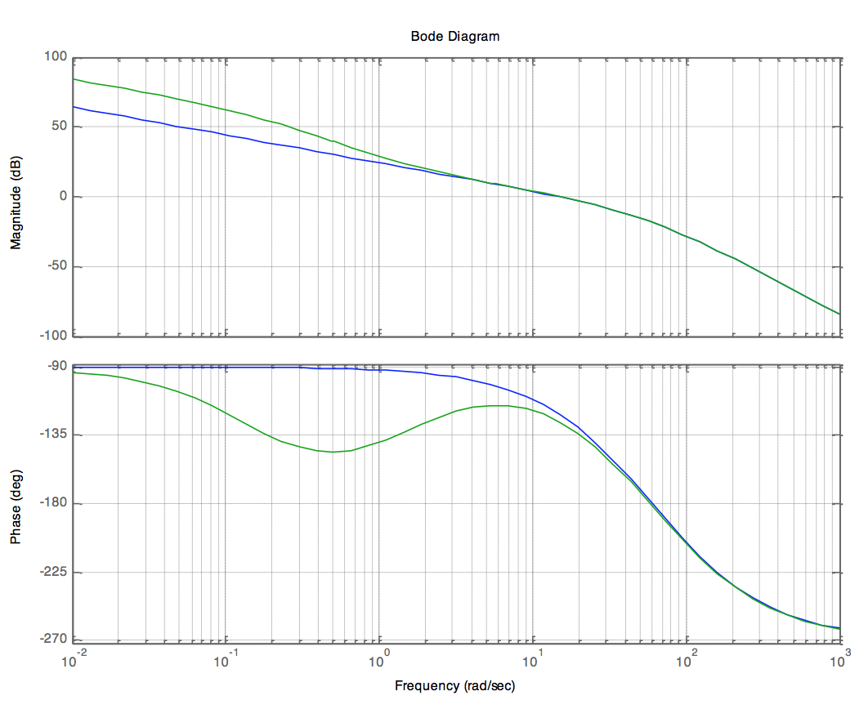
Design lag compensation --Example
Requirements：
A ten fold improvement
in Ess;
Overshoot is 9.5% at K=583.9 with a PM of of 59.2 ° at 14.8 rad/s ;
Design:
Kv = lim sG(s) = K100/3600=16.22;
2. Raise the low frequency magnitude by 10 (20 dB) without affecting PM;
3. Bode plot with K = 583.9, set zero at one decade location, 1.48 rad/s, lower than PM frequency;
U (s)= (s+1.483)/(s+0.1483)= 10 *( 0.674s+1)/ (6.74s+1)

Slide 14
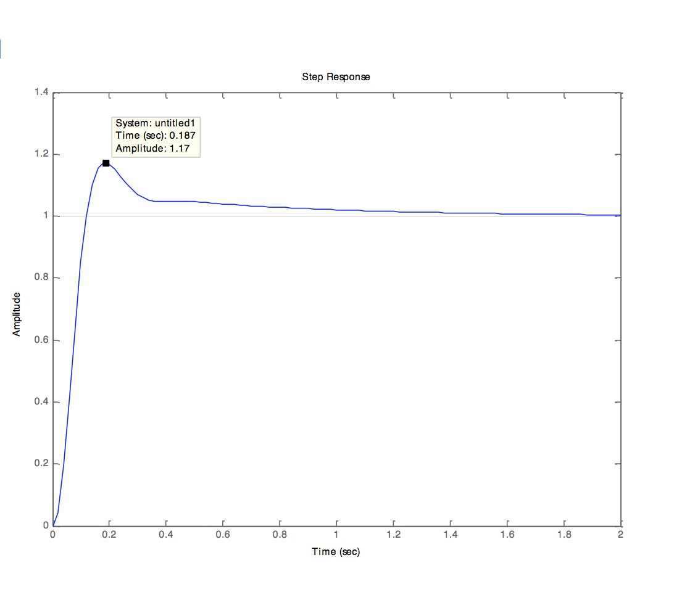
Design lead compensation --Example
The resulting system has a low frequency gain Kv of 162.2;
The overshoot is slightly higher than the desired;

Slide 15
Conclusion
1. Three design parameters to trade off in designing Lead- lag compensation:
– Crossover frequency ωc which determines bandwidth, rise time and settling time
– Phase margin which determines the damping coefficient and hence overshoot
– Low frequency gain which determines steady state error characteristics
2. Choosing appropriate pole and zero locations to influence system to meet design requirements.

Slide 16
Thank you!

