Slide 1
Aircraft War with Kinect Sensor
Zhen ZHAO
Any questions and advices are welcome, email me today at zhen.now@gmail.com
Date: April 11, 2016

Slide 2
Outline
“Aircraft War” game
Solution Overview
Key Ideas & Techniques
Source Code
Run the demo

Slide 3
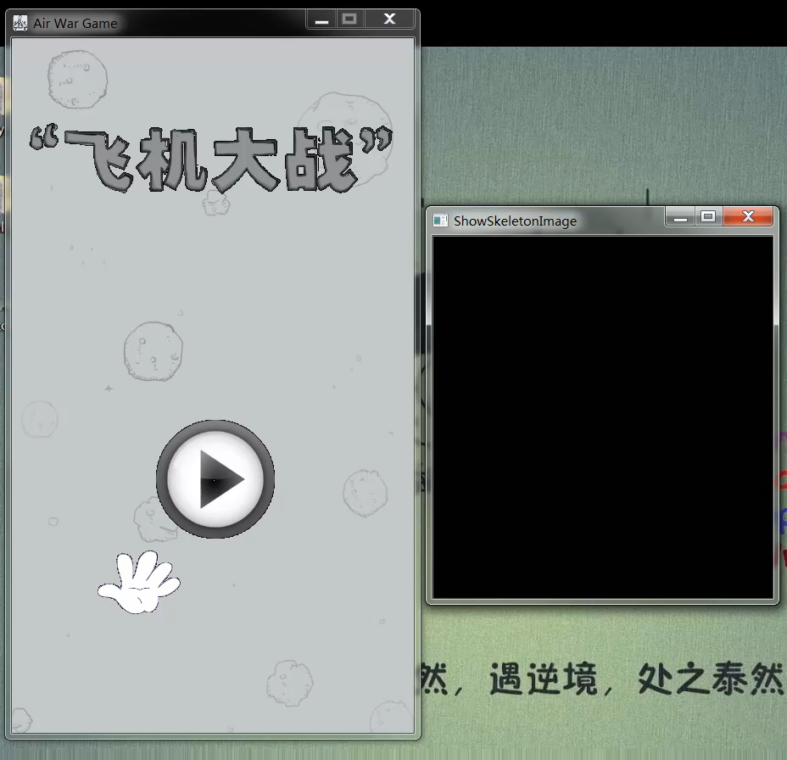
“Aircraft War” Game
Show/hide Skeleton Window
Virtual Switch
Hero Controlling
Up, down
Left, right
Give up
Kill all (ultimate)
Object Collision
From my YouTube Channel: https://youtu.be/G7fK6GrSmB4

Slide 4
Solution
Platform: Windows OS.
UI : Win32 API
Gesture Recognition
Static Movement:
Skeleton data from Kinect
Vector Angles in 3D space
Dynamic Movement:
multiple “static”
Timer

Slide 5
Solution
Game Render:
GDI double buffering for gaming view
OpenCV for Skeleton view
SDK/Libraries:
Kinect for windows SDK v1.8
MCI libraries for background music
STL, Win API
Programming Language: C++ (11)

Slide 6
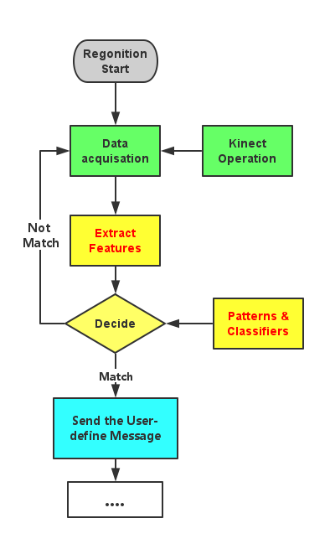
Solution
Two major coding jobs
Game design
Game Object
UI render
Message Processing
Gesture recognition
Kinect-related design
Feature(Angle) design --- Classifiers
User-defined Message --- Actions
Other jobs:
user score recording, play music, enemy generation

Slide 7
Key Ideas & Techniques
Game Design
Kinect Operations
Gesture Recognition
Motion Recognition
Player Information

Slide 8
Key Part 1: Game design
Game State
GS_MENU, GS_PLAYING, GS_RESULT
UI & UI Render
Create Window, Update Drawing
Message Processing
Message Loop, Receiving and process the WM_KEYDOWN, WM_LEFTBUTTONXXX, WM_CLOSE.
Keyboard & mouse Events.

Slide 9
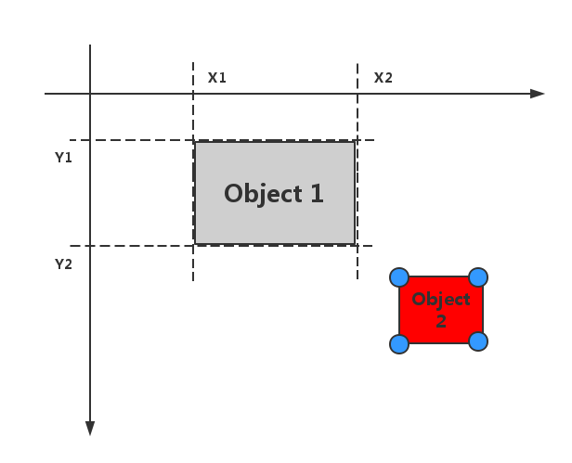
Key Part 1: Game design
Collision Detection
2-Dimension
User:
UE(user experience)
Designer/Developer:
Art Design (video, image, sound)
Game Scripts (story)
Performance (memory, Multithread)
Algorithm (drawing, light, AI (path finding, Behavior Tree…))
Physical Property (Collision Detection, Gravity effect)

Slide 10
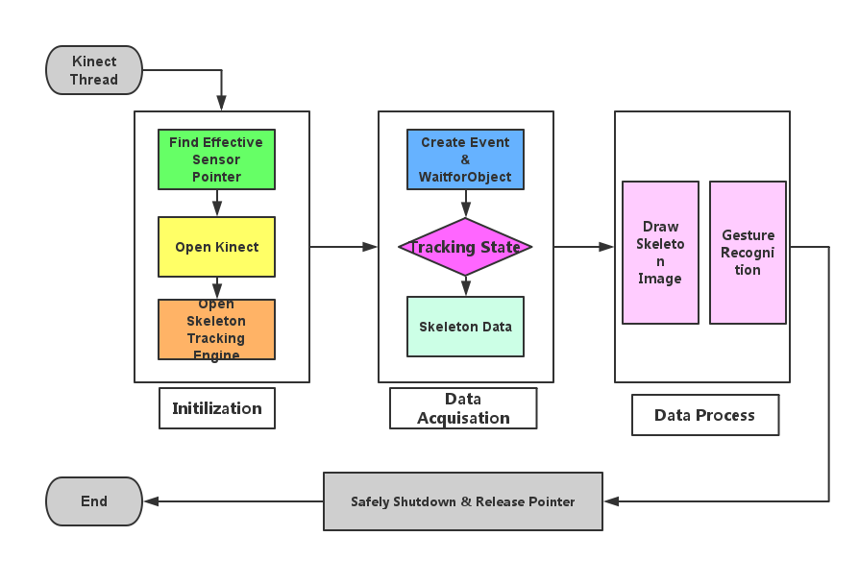
Key Part 2: Kinect Operation

Slide 11
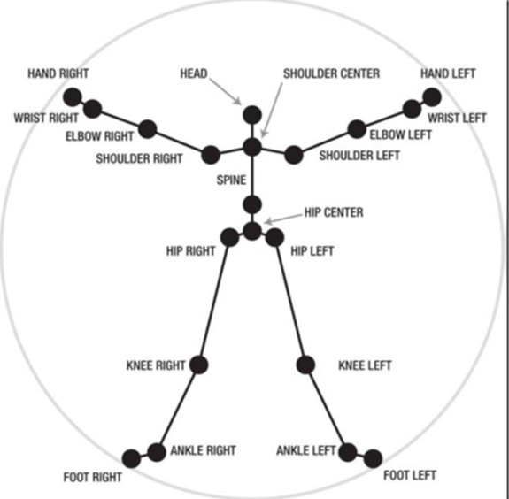
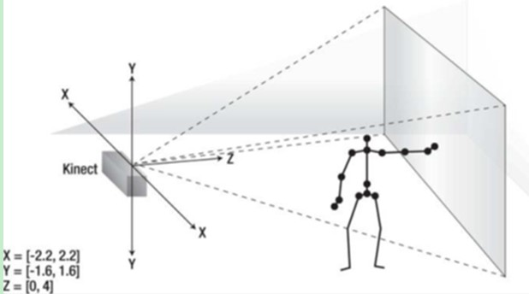
Key Part 3: Gesture Recognition
y
.
x
z

Slide 12
Key Part 3:Gesture Recognition
Features(Angles)
Tolerance Errors
Left
Right
Angle 1: <vec1, X> (10,20)
2
4
Angle 2: <vec2, X> (10,20)
1
3
Angle 3: <vec3, X> (10,20)
Angle 4: <vec4, X> (10,20)
Angle 5: <vec1, Z> (10,20)
Angle 6: <vec2, Z> (10,20)
Angle 7: <vec3, Z> (10,20)
Angle 8: <vec4, Z> (10,20)

Slide 13
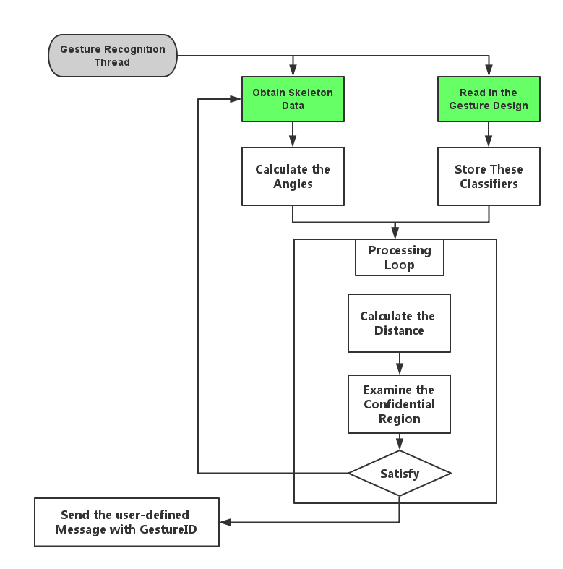
Key Part 3:Gesture Recognition
More Advanced Techs
DTW
HMM
LPP
TDNN

Slide 14
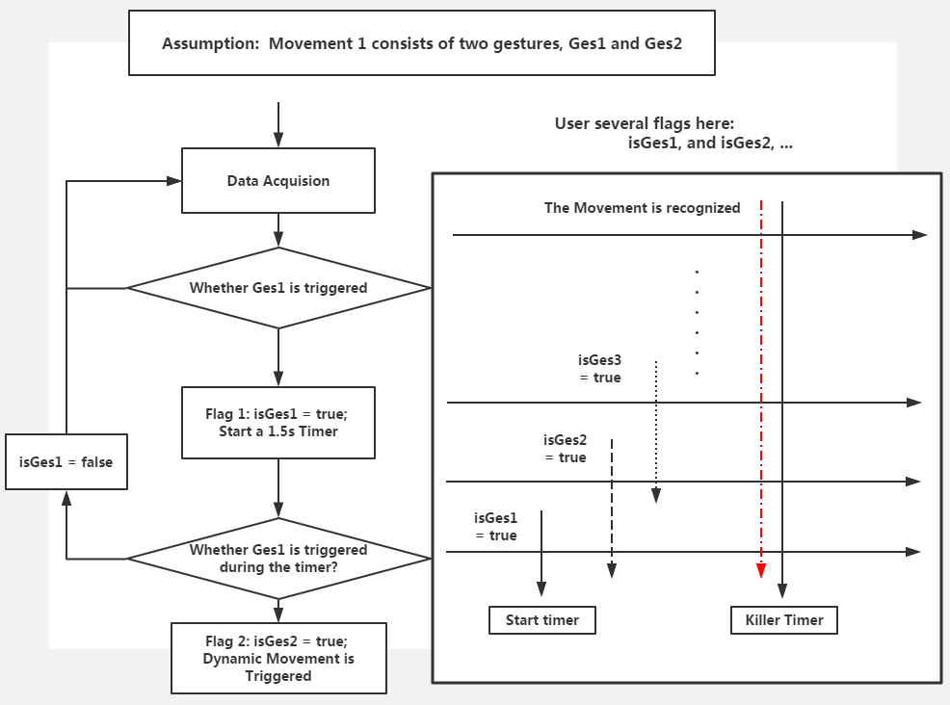
Key Part 4: Motion Recognition
Video = multiple picture (changing fast)
Dynamic Movement = several static gestures during a short time
2

Slide 15
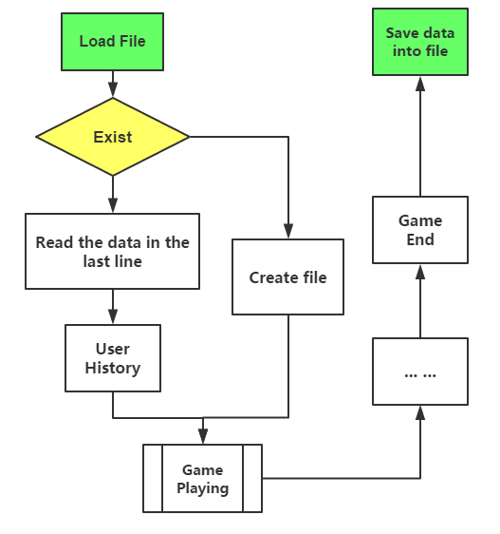
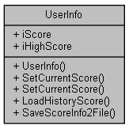
Key Part 5: Player Information
Server
Local data storage
Structured way: lightweight Database (Sqlite), XML
Unstructured way: plain-text files

Slide 16
Source Code
UML Diagram
(9 diagram: sequence, class, use case, activity … )
Class Diagram (Doxygen)
Source Code in VS2010

Slide 17
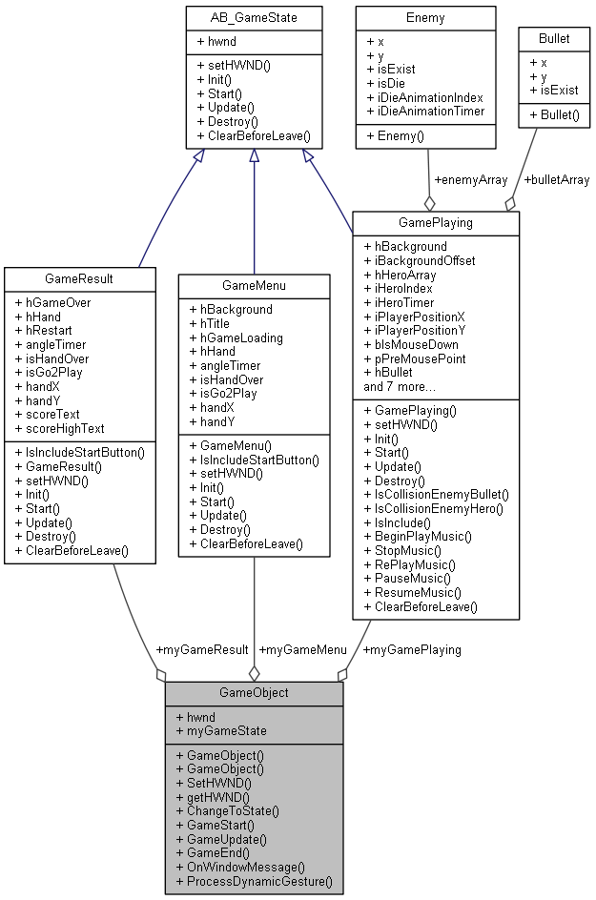
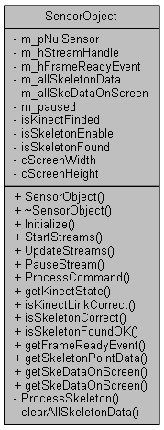
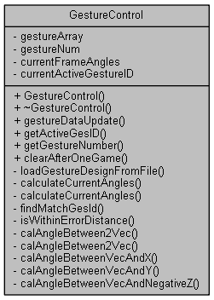
Class Diagram
Link To Code Analysis
Link To Visual Studio

Slide 18
Run & Test the Demo
Q&A

