Slide 1


Legal Landmines in Employment Screening
The information presented by Inquirehire is not intended to be legal advice.
Inquirehire recommends that you consult with legal counsel before making any decisions related to the information presented.
Alan Kinsey

Slide 2







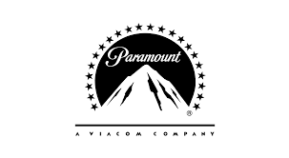
What do these companies have in common?

Slide 3
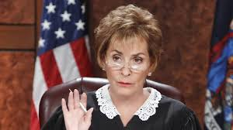
Hint: They weren’t on a Judge Judy episode

Slide 4
Faced federal class actions under the FCRA

Slide 5
Legal Landmines in Employment Screening
FCRA (Fair Credit Reporting Act) Basics
A federal law enacted in 1970 to regulate consumer reporting agencies (CRAs), that collect and compile consumer information into reports used by others. It also applies to users of reports, such as employers.
The FCRA includes hyper-technical requirements and ambiguous guidance. These factors can lead to unintentional, but serious violations.

Slide 6
Legal Landmines in Employment Screening
FCRA (Fair Credit Reporting Act) Basics
Applicants must be notified about the report beforehand, this is known as disclosure.
Applicants must authorize the background check in writing and must understand what they are authorizing
If the employer takes action based on the report they must notify the applicant in two separate steps and make certain disclosures

Slide 7
Legal Landmines in Employment Screening
Why is FCRA litigation increasing?
“Willful” violation can lead to damages of $100 to $1,000 for every consumer impacted
Substantial discovery efforts lead to large attorney fees and court costs which can be recovered
Potential punitive damages can also be awarded for reckless disregard of statutory duty

Slide 8
Legal Landmines in Employment Screening
Additional Incentives:
No requirement in an FCRA lawsuit to demonstrate that any consumer is actually harmed
A simple and careless error is enough to lose an FCRA lawsuit

Slide 9
Legal Landmines in Employment Screening
4 High Potential Targets for Plaintiffs
Repetitive Procedures – disclosure and authorization
Black and White Violations – easiest route to class action
Actual harm has occurred – wrongfully denied employment
Blood in the Water – situations where other lawsuits have been successful

Slide 10
Legal Landmines in Employment Screening
Greatest Risk for Litigation
Black and White Error
+ Actual Harm
+ Prior Class Action Success

Slide 11
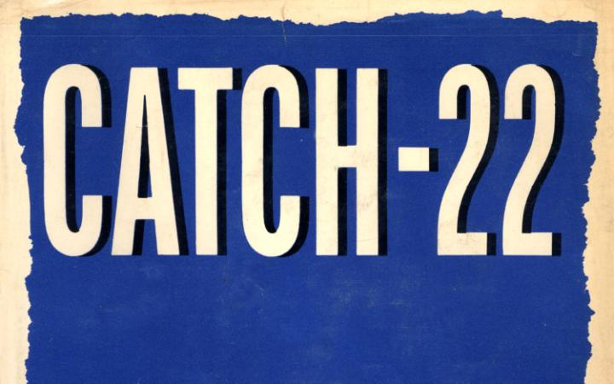
Legal Landmines in Employment Screening
Don’t perform background checks – violate compliance regulations and face a potentially serious hiring mistake and negligent hiring lawsuit
Screen incorrectly and face the risk of costly litigation and potential class action lawsuits

Slide 12

Legal Landmines in Employment Screening
The only clear path is to perform employment screening, and take all appropriate and necessary steps to ensure full legal compliance.

Slide 13

Legal Landmines in Employment Screening
Today’s Agenda:
Top 9 errors employers make that lead to FCRA litigation
Avoiding Discrimination Charges

Slide 14

Legal Landmines in Employment Screening
Employer fails to provide a stand-alone disclosure to job applicants
Clear and conspicuous disclosure – in a document that consists solely of the disclosure.
Cannot be part of the job application or any other application document.

Slide 15

Legal Landmines in Employment Screening
Employer fails to obtain a proper written authorization from job applicants
Applicant’s written authorization must be received BEFORE the background check is conducted.
A class action lawsuit alleged that New England Motor Freight ran 7,000 background checks on applicants without written authorization. Settlement: $875,000.

Slide 16

Legal Landmines in Employment Screening
Liability releases are prohibited
Including a liability release violates the stand-alone requirement.
Employers can be sued on the grounds that the liability release itself is a violation of the FCRA

Slide 17

Legal Landmines in Employment Screening
Pre-Adverse Action Failures
Failure to provide adequate, notification, a copy of the report, and the summary of rights.
Not providing sufficient time for the applicant to review the report and respond.
Dollar General was sued for only allowing candidates 1 day to respond.

Slide 18

Legal Landmines in Employment Screening
Adverse Action Notification Failure:
Not providing the applicant with an adequate notice of the adverse action decision.
CRA information, right to a free copy for 60 days, and the right to dispute the findings in the report.
GEICO has been sued for not providing legal Adverse Action Notification.

Slide 19

Legal Landmines in Employment Screening
Failure to Update Forms
Outdated summary of rights, disclosure, authorization, or adverse action notifications.
K-Mart settled a class action lawsuit for $3 million for using an outdated summary of rights.

Slide 20

Legal Landmines in Employment Screening
Disqualification is not Job Related
Adverse Action decision should be based on an individualized assessment of the applicants record, job history, and efforts at rehabilitation.
Disqualifying records should be clearly job-relevant and the employer must show a clear business necessity to deny employment.

Slide 21

Legal Landmines in Employment Screening
Failure to Follow State Law
The FCRA requires employers follow federal and state laws
Some states restrict the use of certain criminal records. Employers should follow the law of the state holding the criminal record.

Slide 22

Legal Landmines in Employment Screening
Lawsuit for Staffing Firm Actions
Amazon was sued based on FCRA violations of their staffing vendor
NLRB has expanded the definition of “joint employer”

Slide 23
Legal Landmines in Employment Screening
Avoiding Discrimination Charges:
Review the background check report and evaluate any records for job relevance and consistency with business necessity.
If records are determined to meet that criteria, conduct the Pre-Adverse Action step and allow the candidate “reasonable”(5 – 8 days) to review the report and dispute the findings.
No Adverse Action decision is made yet, and your company communications (especially email) should be very clear on this point.

Slide 24
Legal Landmines in Employment Screening
Avoiding Discrimination Charges:
Conduct an individualized assessment that should include the following considerations:
Circumstances of the offense or conduct
The number of offense(s)
Age at the time of the offense(s)
Employment history before and after the offense(s)
Rehabilitation and/or education efforts
Employment or character references
Whether the candidate is bonded or bondable

Slide 25
Legal Landmines in Employment Screening
Avoiding Discrimination Charges:
Proceed with the Adverse Action decision and notification process when:
The records are deemed job relevant and consistent with business necessity
The individualized assessment does not change the fundamentals of job relevance and business consistency

Slide 26
Legal Landmines in Employment Screening
Other Tips for Avoiding Discrimination Charges:
Do utilize a background check protocol that is job relevant and consistent with business necessity.
Do not utilize a pass/fail chart or table.
If a consumer challenges something on the report, do not make a decision on that consumer until the dispute is resolved.

Slide 27
Legal Landmines in Employment Screening
Certification of Permissible Purpose:
Consumer Reporting Agencies are changing procedures to require affirmation of permissible purpose for every background check ordered.
Can be affirmed electronically at order placement, or CRA will require pager version with manually placed orders.

Slide 28
Legal Landmines in Employment Screening
Summary:
Class actions for FCRA violation have increased sharply since 2014.
Employers are advised to review their screening practices with a knowledgeable screening partner or FCRA familiar attorney.

Slide 29
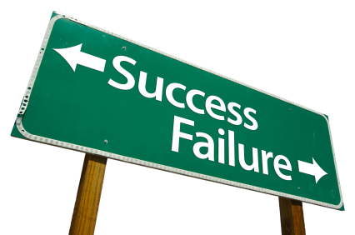
Questions?
Alan Kinsey
Vice President
Inquirehire
www.inquirehire.com
Office: 563-323-5922
Toll Free: 800-494-5922
akinsey@inquirehire.com

