Slide 1


Recruiting and Hiring Top Talent
Alan Kinsey
akinsey@inquirehire.com
800-494-5922

Slide 2
Recruiting and Hiring Top Talent
Our Agenda:
The Opportunity
The Challenges
Best Practices
Quantitative Improvements

Slide 3
Recruiting and Hiring Top Talent
71% of people in the labor force say they are actively looking or open to a new job.
Source: Harris Poll (Base=Employed or not employed but looking, n=2,293)

Slide 4
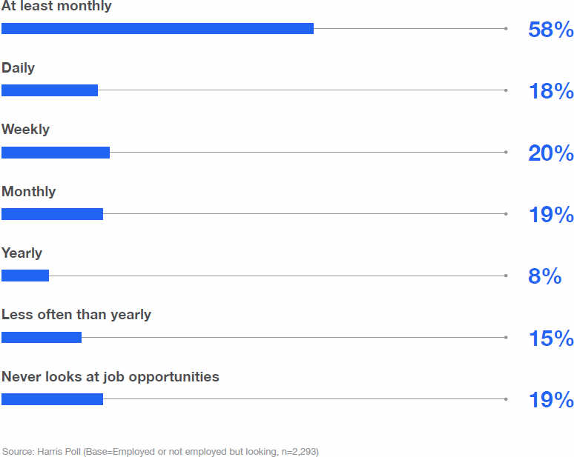
Recruiting and Hiring Top Talent

Slide 5
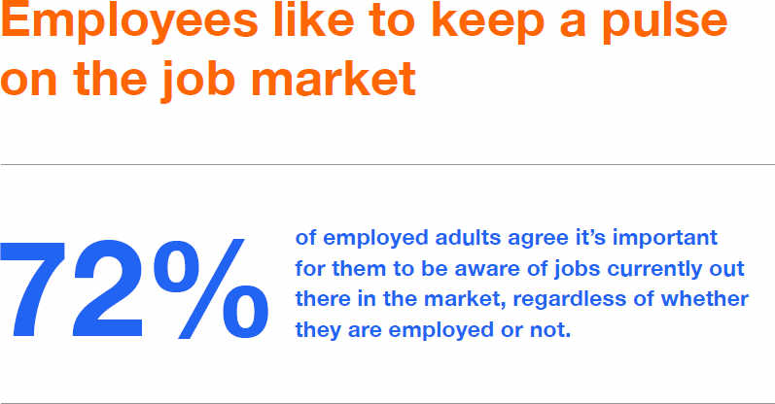
Recruiting and Hiring Top Talent

Slide 6
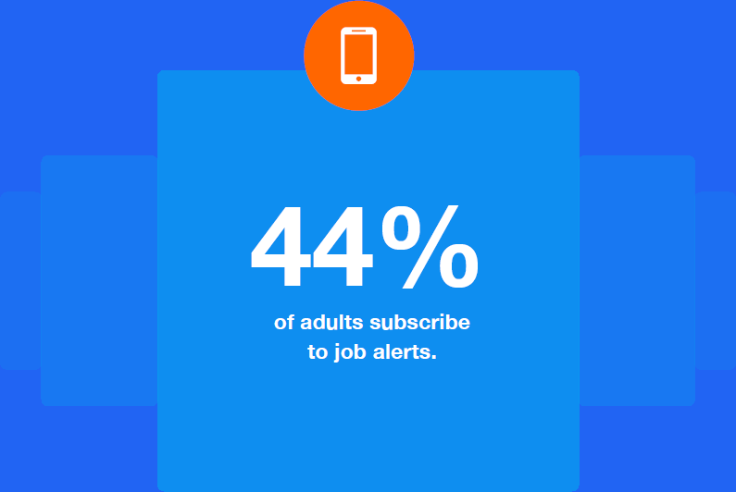
Recruiting and Hiring Top Talent
Source: Harris Poll (Base=Employed or not employed but looking, Some college or less education, n=1,701; College degree or more education, n=981)

Slide 7
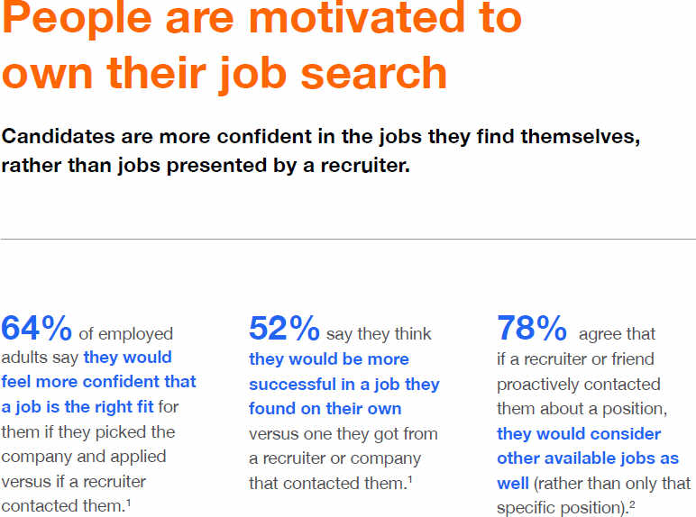
Recruiting and Hiring Top Talent
1. Source: Harris Poll (Base=Employed, n=1,997)
2. Source: Harris Poll (Base=Employed or not employed but looking, n=2,293)

Slide 8
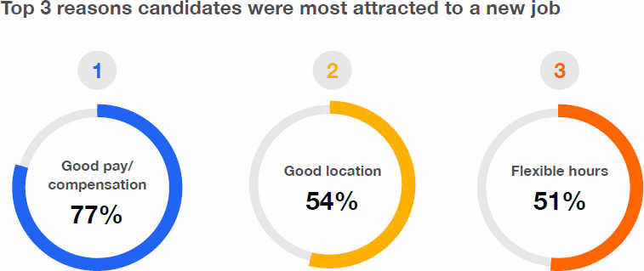
Recruiting and Hiring Top Talent
Source: Harris Poll (Base=Employed or not employed but looking, n= 2,293)

Slide 9
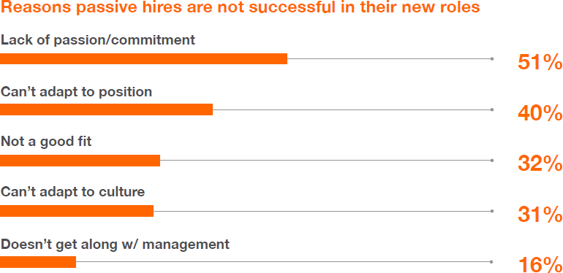
Recruiting and Hiring Top Talent
Source: The Polling Company

Slide 10
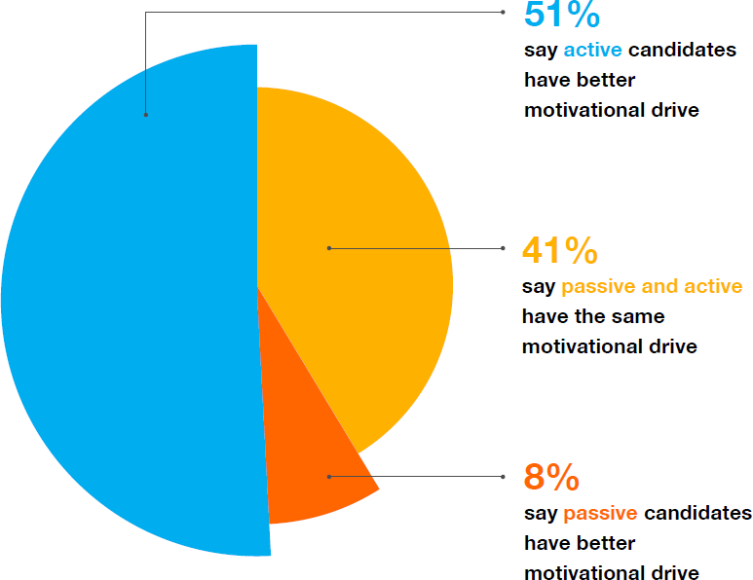
Recruiting and Hiring Top Talent
Source: The Polling Company (Base: n=1,000)

Slide 11

Recruiting and Hiring Top Talent

Slide 12
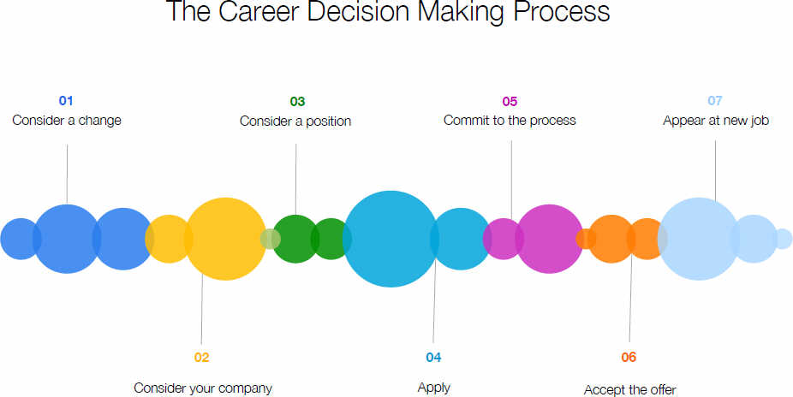
Recruiting and Hiring Top Talent

Slide 13

Recruiting and Hiring Top Talent
Considering a career change
Stressful event
Cost/Benefits analysis
Candidates tend to over-estimate costs
Candidates tend to under-estimate benefits

Slide 14
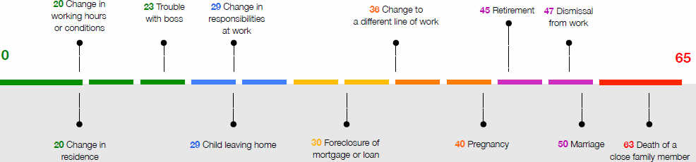
Recruiting and Hiring Top Talent

Slide 15
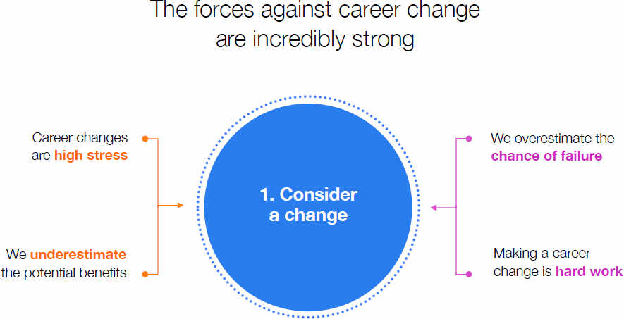
Recruiting and Hiring Top Talent

Slide 16

Recruiting and Hiring Top Talent

Slide 17

Recruiting and Hiring Top Talent
Factors considered when evaluating an opportunity
Pay and compensation
Location
Flexibility
Benefits
Work environment
Reputation
Family fit
Advancement potential
Mission/vision alignment

Slide 18

Recruiting and Hiring Top Talent
What is your hiring process like?
Simple, clear, and easy?
Mobile enabled?
How much time does it take?
What is your employment brand identity?

Slide 19
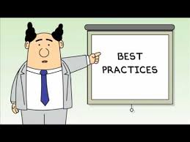
Recruiting and Hiring Top Talent

Slide 20
Recruiting and Hiring Top Talent
Best Practice 1 – Manage Costs Wisely
Free inbound – website career page, employee and customer referrals, free job boards, social media
Paid inbound – paid job sites
Outbound – paid recruiters, search consultants, and head hunters

Slide 21
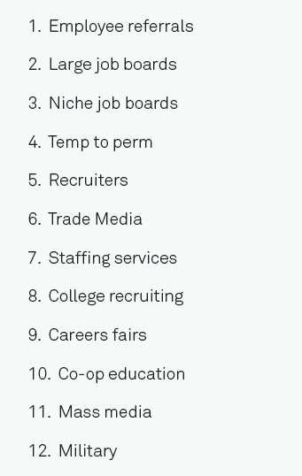
Recruiting and Hiring Top Talent
According to major employer surveys, employee referrals are the best source for new hire quality.

Slide 22
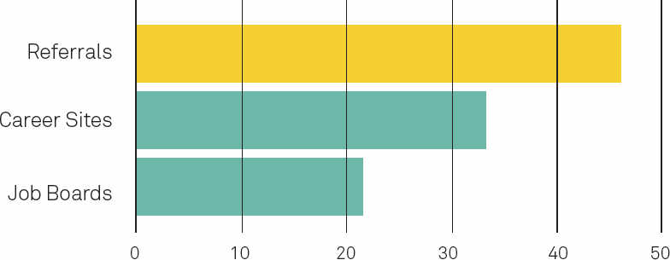
Recruiting and Hiring Top Talent
Referrals are #1 for employee retention after two years.

Slide 23
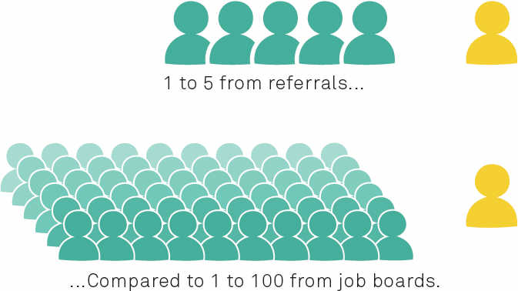
Recruiting and Hiring Top Talent
Hiring from referrals is more efficient than hiring from other sources.

Slide 24
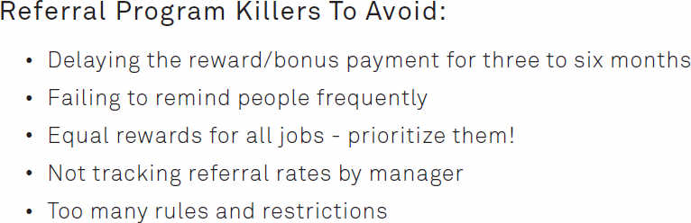
Recruiting and Hiring Top Talent

Slide 25
Recruiting and Hiring Top Talent
Best Practice 2 – Shape Your Candidate Pipeline
Job Titles - should be clear and understandable
Job Descriptions – should be 1 paragraph, use words that appeal to candidates that subscribe to job alerts
Career Site – apply online and mobile friendly

Slide 26
Recruiting and Hiring Top Talent
Best Practice 3 – Build a Good Employment Brand
Candidates are accustomed to making decisions based on online reviews; hotels, movies, etc.
80% of candidates consult company reviews
50% of candidates say company reputation is a significant factor in their decision

Slide 27

Recruiting and Hiring Top Talent

Slide 28
Recruiting and Hiring Top Talent
A brand is a proprietary, visual, emotional, rational, and cultural image that is associated with a company or product.

Slide 29
Recruiting and Hiring Top Talent
Ideally your brand . . .
is credible and compelling
links the brand with workplace attributes
uniquely differentiates (positively)
is authentic and aligned with your organization’s culture and values
speaks directly to recruits and employees

Slide 30
Recruiting and Hiring Top Talent
4 Questions Your Brand Must Answer:
Why should I work here?
What is the value proposition? What do I get in exchange for my labor?
What will my job be like?
What will my future be like?

Slide 31
Recruiting and Hiring Top Talent
3 Big Mistakes to Avoid:
Not establishing differentiation
Changing too much and too often
Not aligning promise with delivery

Slide 32
Recruiting and Hiring Top Talent
Best Practice 4 – Optimize the Inbound Candidate Experience
Frequently Asked Questions – address the risk/reward assessment they are making
Applicant Tracking Software – should be online and mobile enabled – no paper documents
Candidate Feedback – ask new hires about the application and interview experience

Slide 33
Recruiting and Hiring Top Talent
Best Practice 5 – Build a Recruiting Technology Platform
Career Site – this is your branding opportunity
Application Process – online, simple, mobile-friendly
Candidate Screening – don’t overlook key risk factors
Candidate Management – communicating effectively through the process
Talent Performance Analytics – determine the best sources of candidates for retention, job performance, upward mobility

Slide 34
Recruiting and Hiring Top Talent
Significant Quantitative Improvements
Cost per Hire – reduced reliance on paid sources
Reduce the Number of Applicants Required to Fill a Position – increase efficiency for all including applicants
Increased Access to Desired Candidates – a good employment brand will open many doors
Reduce Time to Hire – become a hero in your organization

Slide 35
Recruiting and Hiring Top Talent
Summary of Key Points:
A substantial % of employees are open to a new opportunity, but candidates want to manage their own job search.
Employers must adopt a marketing approach that addresses key applicant questions and makes the application process online, simple, and mobile-friendly.
If done well, employers can save both time and money while improving their hiring quality.

Slide 36

Recruiting and Hiring Top Talent
Alan Kinsey
akinsey@inquirehire.com
800-494-5922
The information presented by Inquirehire is not intended to be legal advice. Inquirehire recommends that you consult with legal counsel before making any decisions related to the information presented.

