Slide 1
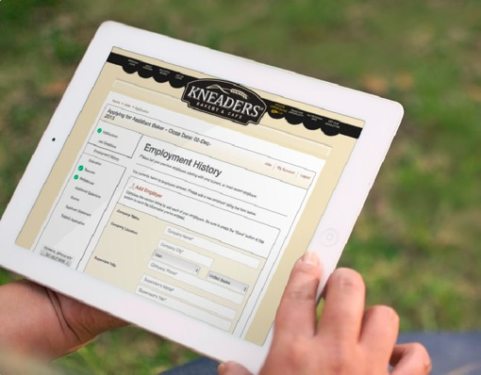

ApplicantList Applicant Tracking System

Slide 2
Who is Inquirehire?
We are a national provider of systems and services that help employers optimize talent decisions. We’ve been in operation since 1996.
We’re based in Davenport, IA, and we work with more than 2,000 employers in 49 states.
Our services include background screening, aptitude assessments, professional references, drug testing, and applicant tracking systems.

Slide 3
Who is Inquirehire?
We work with 200 banking organizations in 12 different states.
We are accredited by the National Association of Professional Background Screeners.
More than 70% of our new clients are referrals because of our reputation for outstanding customer service.

Slide 4

ApplicantList Applicant Tracking System
Solution Overview:
Cloud-based SaaS solution – no software to buy, load, or maintain.
No internal IT resources/support is required.
Mobile Optimized.
OFCCP compliant.

Slide 5
ApplicantList Applicant Tracking System
Key Strategic Benefits:
Improves employment brand image
Establishes/maintains consistency of process
Reduces time to hire
Improves hiring decision quality
Improves the hiring process for applicants

Slide 6
ApplicantList Applicant Tracking System
Key Cost Savings:
Reduces internal labor costs
Reduces employment advertising costs
Reduces paper and paper storage costs
Reduces mailing costs

Slide 7
Top Standard Features
Free 30 Day Trial Period
Free Implementation and Training
Fully Branded Career Site + Internal Job Board
Job Alerts and Social Following
Custom External Application and/or Custom Internal Application
Race, Gender, and Veteran Status Tracking
Unlimited Job Screening Questions
Question Scoring, Weighting and Auto Disqualification
Unlimited HR and Manager Logins
Push to Free Job Aggregators and Paid Job Boards
Social Media Integration
Default Email Templates and Unlimited Custom Templates
Standard Report Library, Custom Report Builder, Traffic Analytics
Auto Assigned Application Statuses

Slide 8

Advertise
Getting the word out about your job openings can be tricky and tedious but it doesn’t have to be with an applicant tracking system.
Having one place to write your job listings, push to job boards in a single click, recruit with social media channels, and leverage employee referrals is a snap.
Attracting candidates has never been so easy.

Slide 9
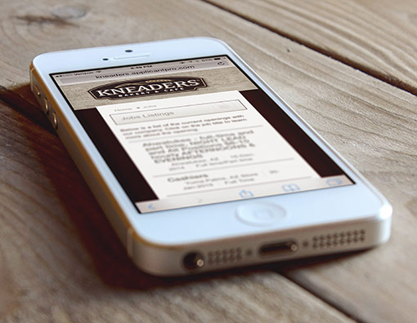
Convert
A candidate found your job! Now what? Getting the word out is only part of the process. Getting them to apply is the next step.
ApplicantList helps you see conversions through slick branded career sites that are mobile optimized, online applications, and job alerts for passive applicants.

Slide 10

Screen
With ApplicantList, screening your applicant pool couldn’t be easier.
Customize your job questions at time of application including auto-disqualify questions and weighted questions.

Slide 11

Select
Now that you have a smaller, more qualified group of applicants, it is time to get to work selecting.
We give you unlimited manager logins so collaborating is a snap. Our simple 5 star rating system and notes area keeps everyone on the same page.
Tracking candidates through each hiring stage and tracking disposition codes make compliance easy.

Slide 12
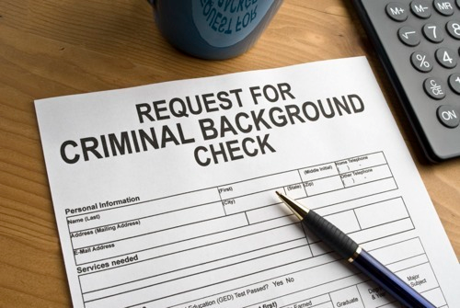
Background Check
When it is time to background check the finalist, ApplicantList is fully integrated with the Inquirehire background screening system.

Slide 13
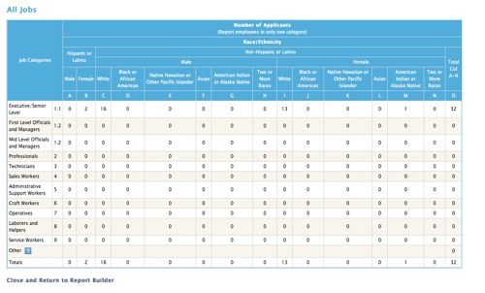
Reporting
Knowledge is power. Backing that knowledge up is powerful. Be more informed and improve your hiring process by pulling reports that track visitor and source traffic, application abandon rates, and time-to-fill. You can also pull EEO and OFCCP reports and applicant logs in a few clicks. Use these reports to become a strategic HR professional.

Slide 14

Communicate
With so many players involved in hiring, communication can be tough, especially when the process is a manual one.
We help you with offer letters, rejection letters, confirmation emails, and automated job alerts.
With ApplicantList, distribution of candidates to hiring managers is easy and encourages collaboration and more informed hiring decisions.

Slide 15

Wondering about an ApplicantList Demo? Here are a few answers that can help you take the next step:
How long is the demonstration? Generally our demos are between 30 – 45 minutes. We are happy to take as long as you need though.
How are demos conducted? We’ll use a screen share and phone call to show you our powerful hiring software in action. We work really hard to have this be a discussion driven by you and tailored to your needs so it is a good use of your time.
When will I see pricing? Just email us at solutionsupport@inquirehire.com, provide your organization’s current headcount, and we will provide you with pricing. Then, if you are interested, we will schedule the system demo.
What happens after the demonstration? That’s up to you. Once we complete our live demo, we can get your 30-day free trial started. This takes 48 hours or less to set up and then you can post a real job to real job boards and generate real applicants.
Optimize Every Talent Decision

